Slide 1

Modeling and Forecasting Implications of Driverless Cars
Joan Walker
UC Berkeley
@ Workshop on
ATB Impacts and TDM Implications of Driverless Cars
TRB 2014

Slide 2
Determining the modeling implications
What’s different? On both supply and demand
What can be captured within existing models?
  Analogs of existing modes
  Existing attributes (value or preference)
  Existing decisions
What structural changes are necessary?
  New attributes, modes, choice sets, decisions
  Disruptive/Transformative (major behavioral shifts)

Slide 3
Levels of automation (NHTSA)
No-Automation (Level 0): Driver is in complete and sole control
Function-specific Automation (Level 1): Automation of one or more specific control functions (e.g., automatic braking)
Combined Function Automation (Level 2): Automation of at least two primary control functions working together (e.g., adaptive cruise control with lane centering).
Limited Self-Driving Automation (Level 3): Automation enables driver to cede full control of all safety-critical functions under certain conditions. Driver is expected to be available.
Full Self-Driving Automation (Level 4): The vehicle is designed to perform all safety-critical driving functions for an entire trip. This includes both occupied and unoccupied vehicles.

Slide 4
What’s different?
Supply
  Capacity, Safety, Reliability
Demand
  Level 3 (driver in the loop)
    Safety, Reduce driver burden (Stress/fatigue), Conjoint activities, Cost savings via fuel and insurance
  Level 4 (driverless)
    Parking; Fetching; Refueling/Charging;
    Mobility for young, old, disabled
    Control/Robot anxiety
  Impacts both Public and Private ownership models
Notes:
NHTSA

Slide 5
Changing Car Modes
Notes:
How to capture differences in these modes? How does utility change with automation. Challenge? How do we model? NEW: modes are changing in a way that are not reflected in existing attributes. ASCs may be changing. Time and cost may be changing. Other benefits.

Slide 6
Example of Modifying Utilities
Gucwa (2014) preliminary results
  MTC Travel Model One
  Scenarios
    Pervasive adoption of Level 3 in 2030
    3 levels of capacity improvement: 0, 10%, 100%
    4 levels of time quality improvement via β_{time}:
    current β_{time}, 70% current, 50% current, 0
  2030 Forecast
    4-8% increase in VMT for moderate scenarios
    15% increase in VMT for most extreme scenario

Slide 7
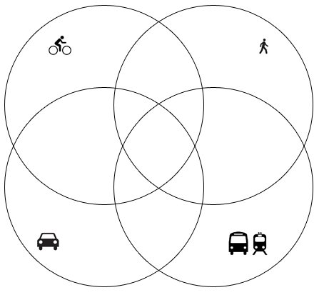
Latent Modality Styles
MOVING FROM
Trip/Tour-based Mode Choice
→ Lifestyle-based Mode Choice
Modality Styles
Defined as: lifestyles built around particular travel modes
Latent modal preferences
Choice set
Taste heterogeneity
Vij and Walker (2013)

Slide 8
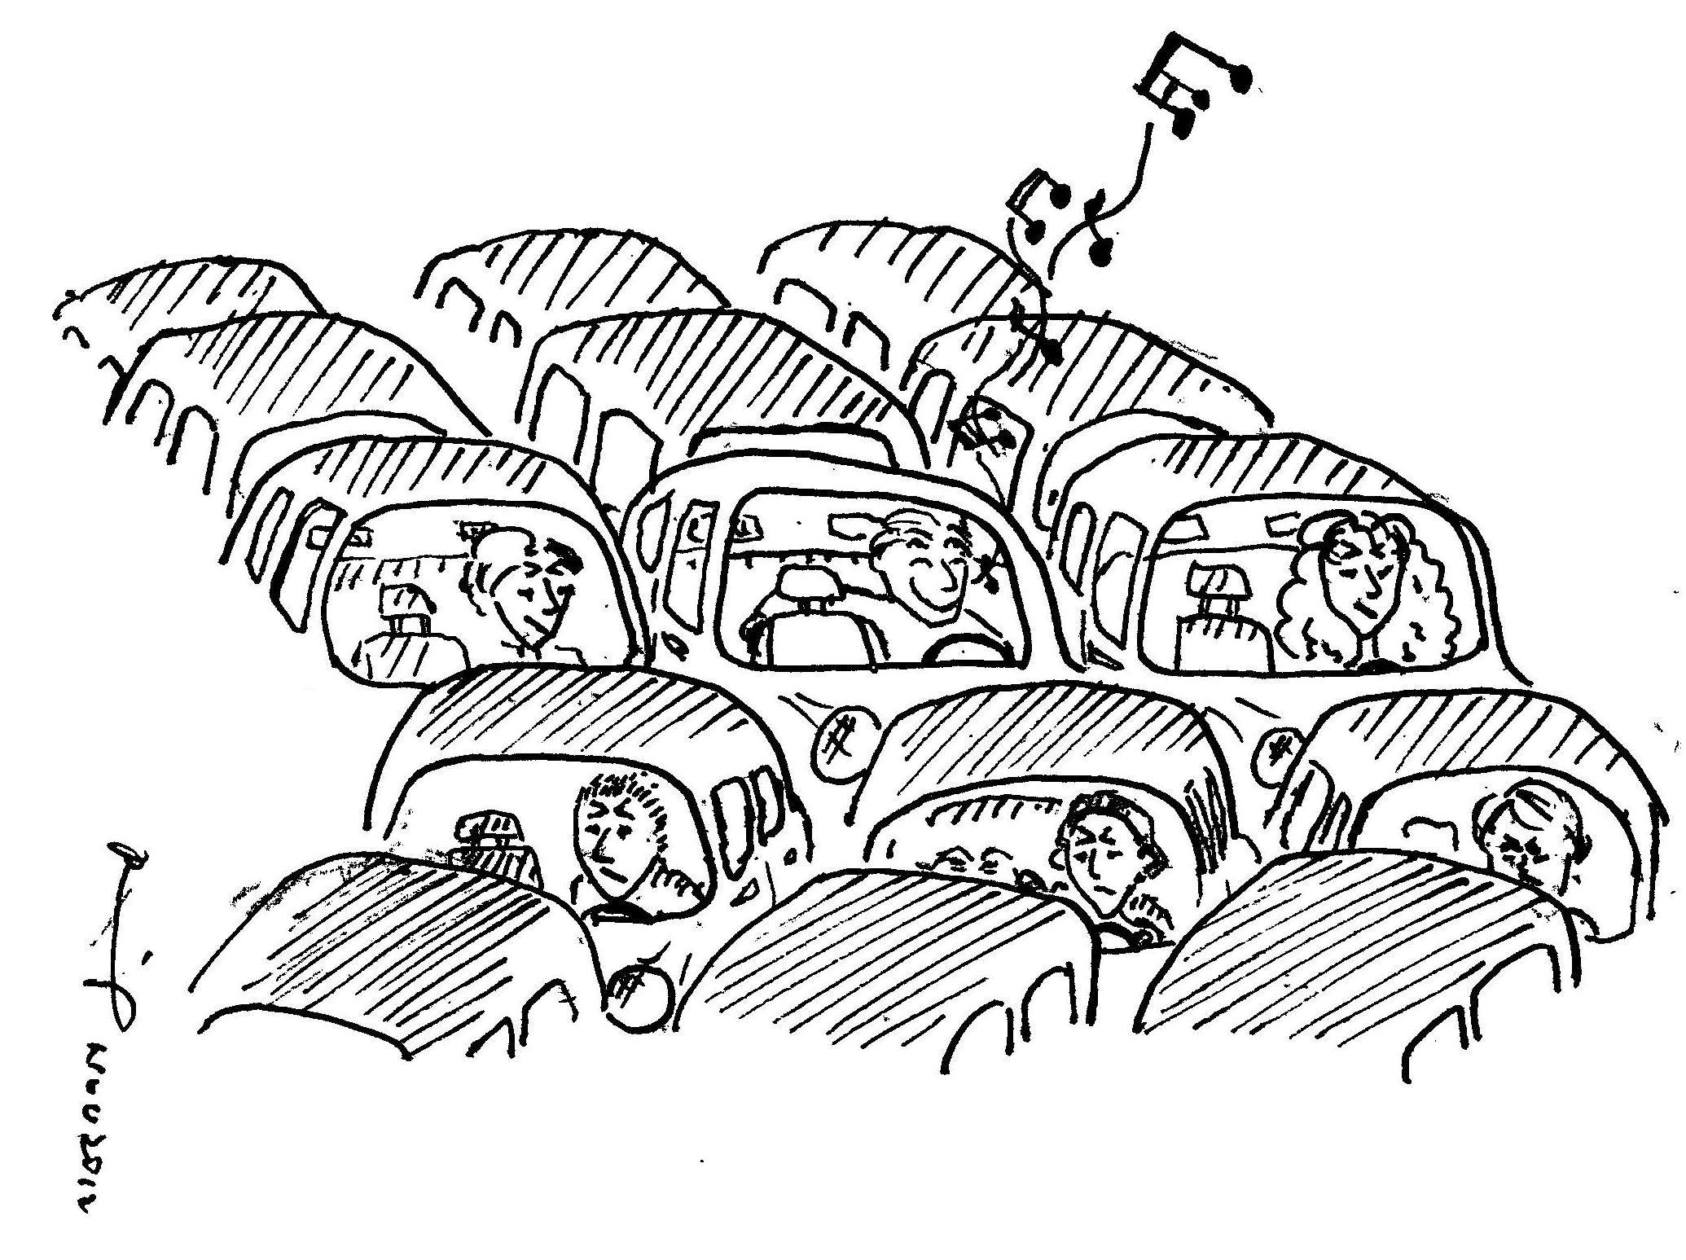
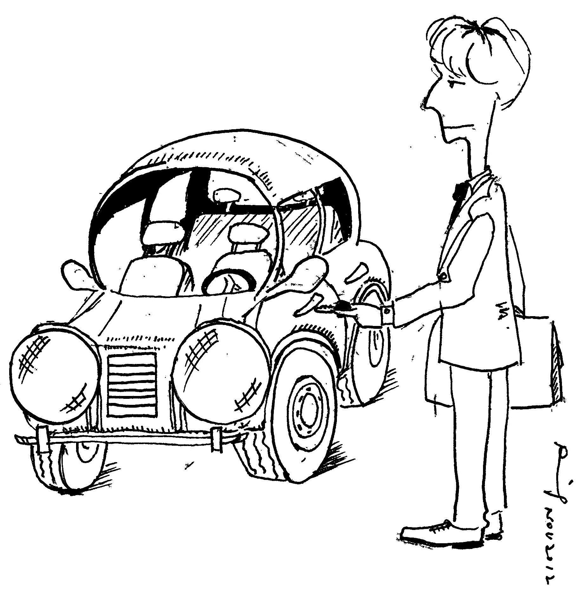
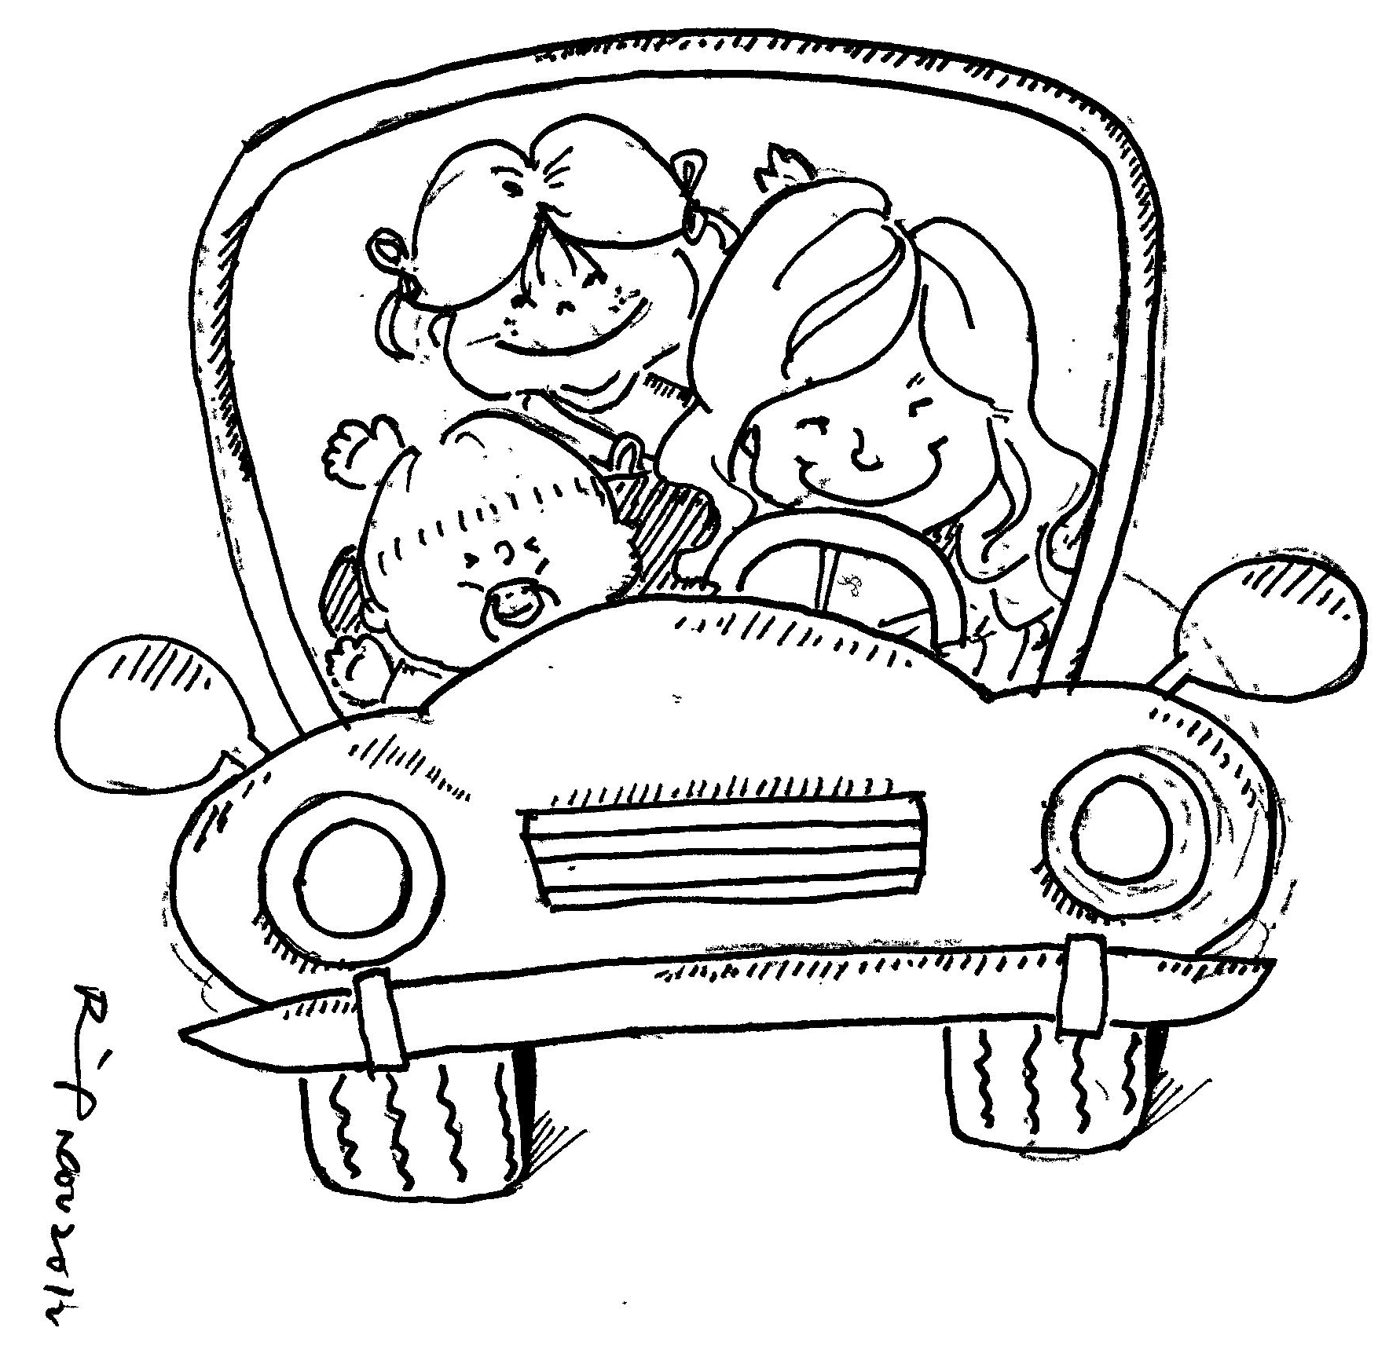
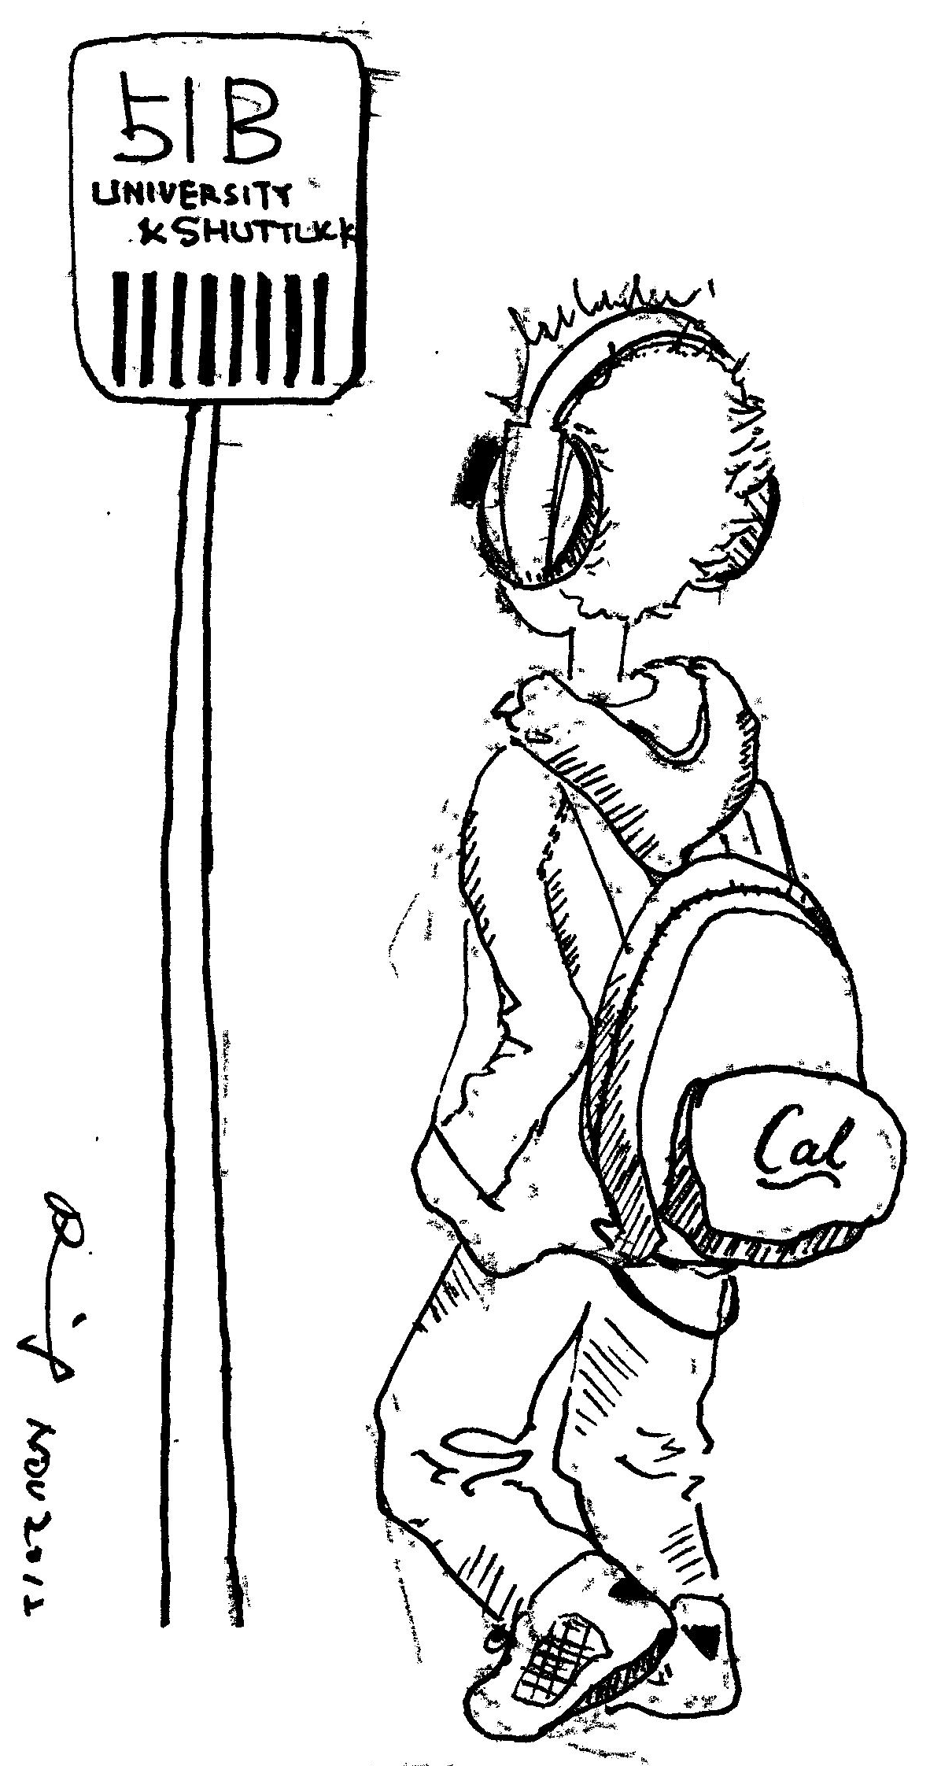
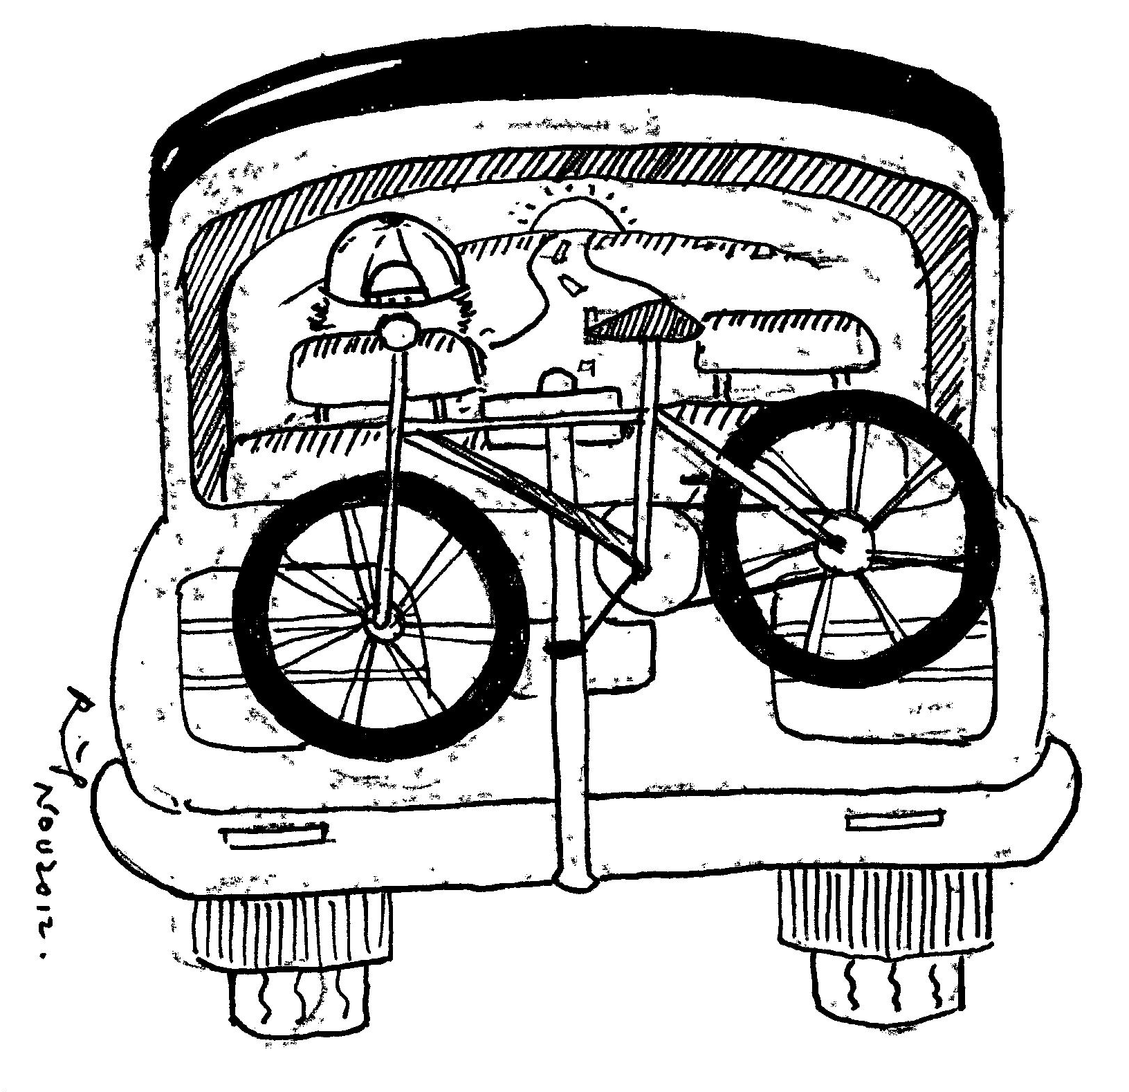
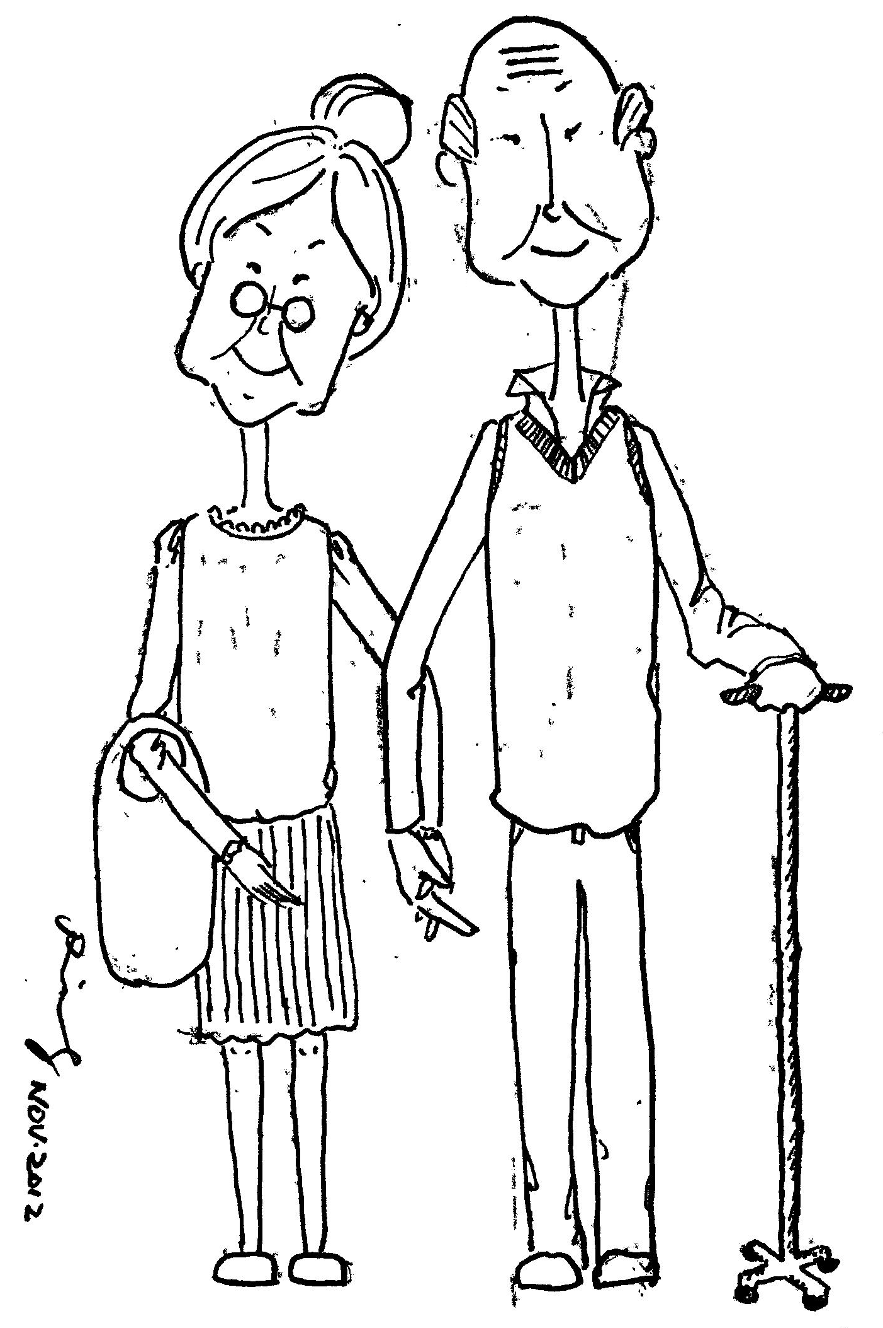
1. Inveterate Drivers
2. Car Commuters
3. Moms in Cars
(Vij, 2014)
4. Transit Takers
5. Multimodals
6. Empty Nesters

Slide 9
Research Questions
Need to model all modes in base case
How to quantify the effect of automation on choice behavior
  How do the utilities of the different modes change?
  Level 3: Safety, Driver burden, Conjoint activities
Level 4
  Substitution between private and public ownership
  Utility: driver effect, self-parking, 0 access carshare, focus on conjoint, robot anxiety
  Choice sets: Availability for young/elderly/disabled
  Choice dimensions: Sending kids, refueling, parking
  More fundamental behavioral shifts?
Adoption dynamics; policy interventions/implications
Notes:
Real experiments as opposed to stated preferences

Slide 10
Changing Modes 2

