Slide 1
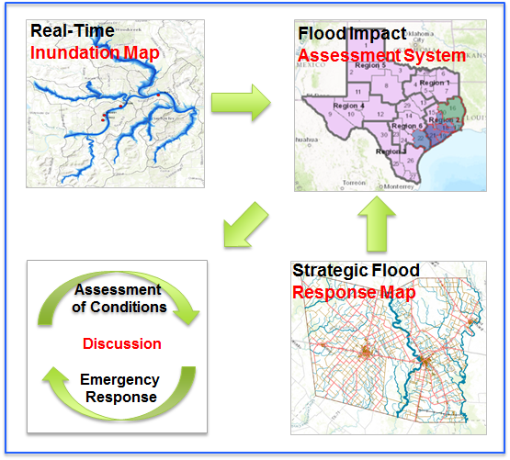
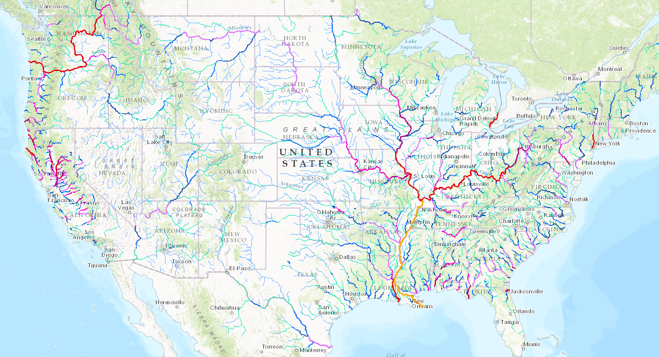
Texas Flood Response System
David Maidment, Harry Evans, David Arctur, Xing Zheng
University of Texas at Austin
Dean Djokic, ESRI; and Matt Ables, Kisters North America
Presentation for West Gulf River Forecast System, 3 March 2017
Acknowledgments: Yan Liu, University of Illinois; David Tarboton, Utah State University;
Texas Division of Emergency Management; City of Austin, National Weather Service, NCAR,
National Science Foundation, Colleagues and students at UT Austin.

Slide 2
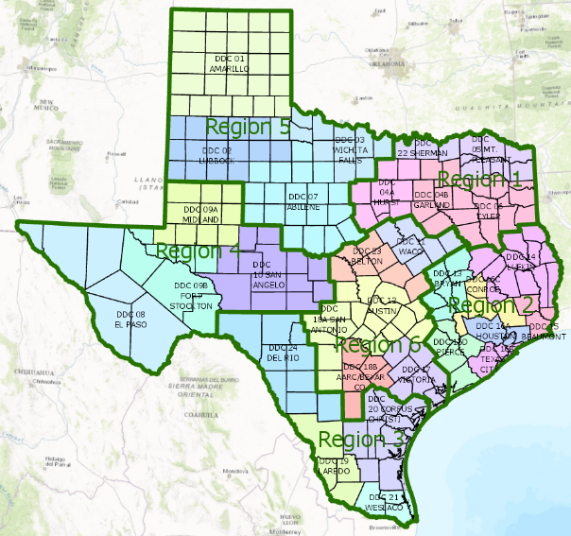
Information Flow During a Flood Emergency
West Gulf River
Forecast Center
Weather and
Flood Forecasting
State Operations Center
Flood Impacts
Assessment of
Conditions
TDEM Area coordinators
Disaster District coordinators
County emergency managers
Communications
Cycle
Emergency
Response

Slide 3
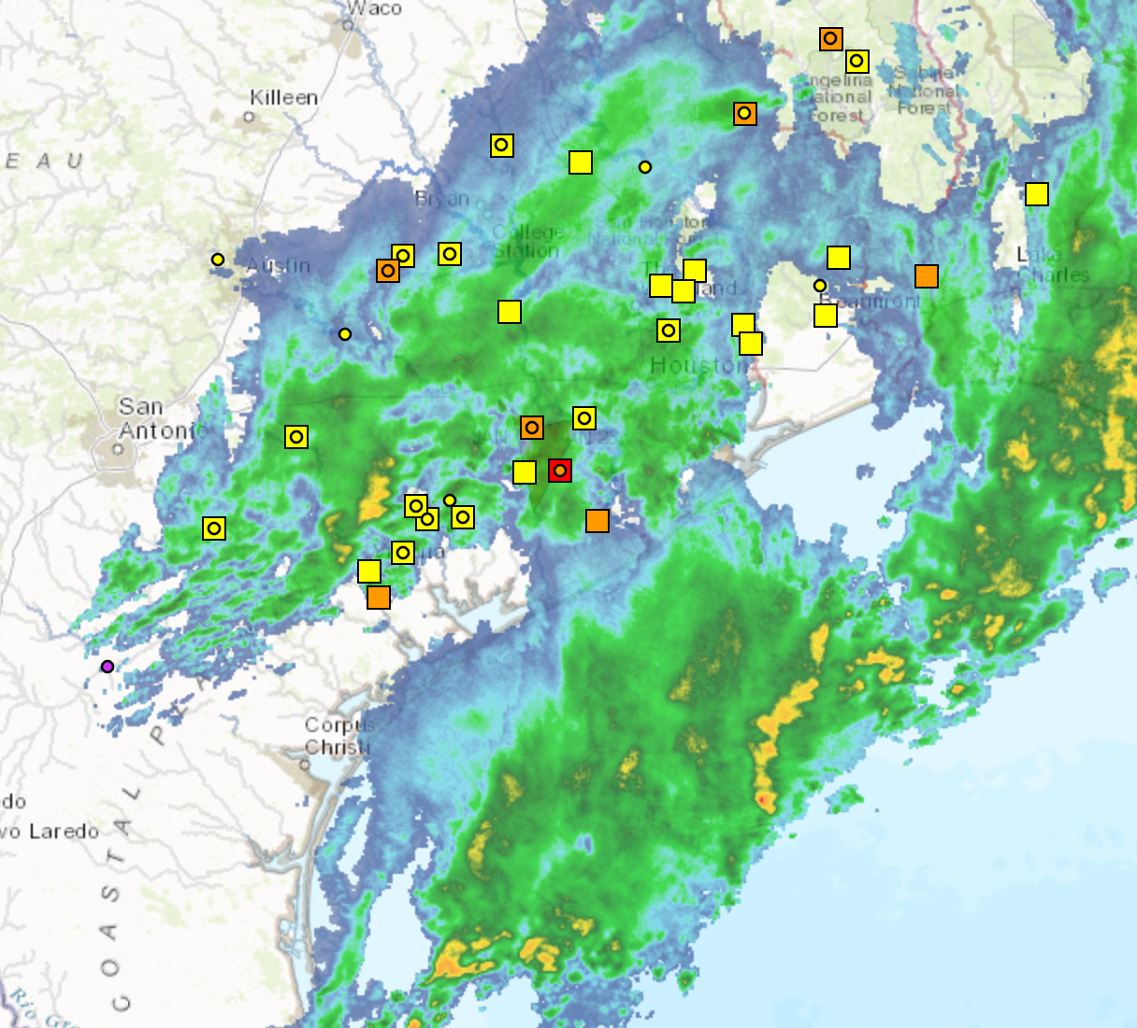
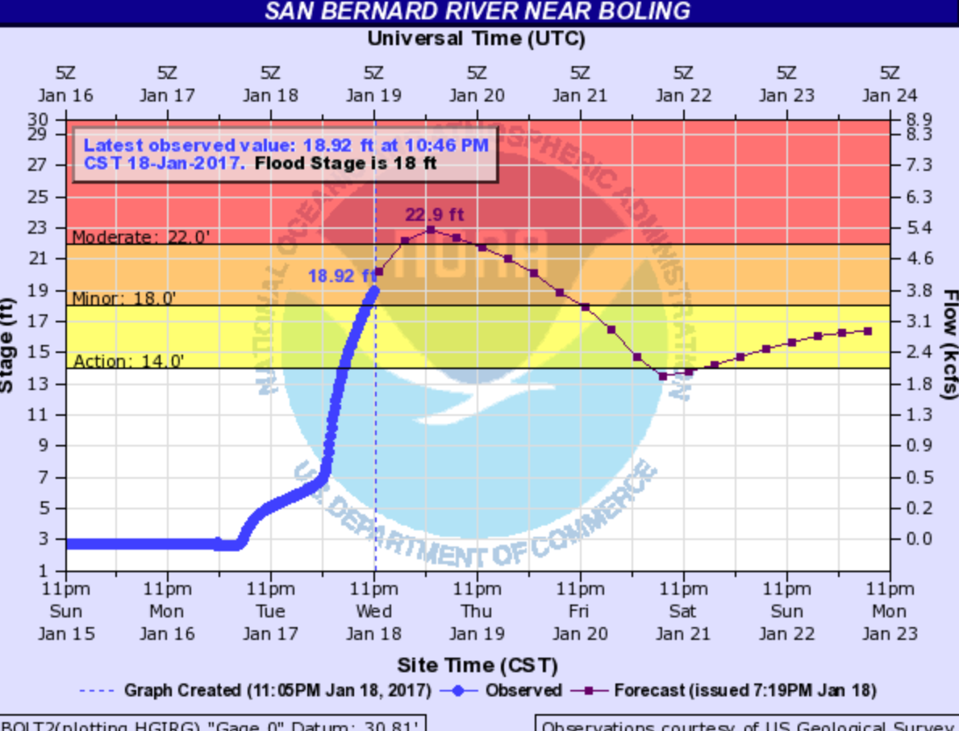
Current Information Flow
Rain maps
State
Operations
Center
Hydrographs
at forecast points
Flood Impacts
Assessment of
Conditions
Communications
cycle
Verbal
Discussion
Emergency
Response
TDEM Area coordinators
Disaster District coordinators
County emergency managers

Slide 4
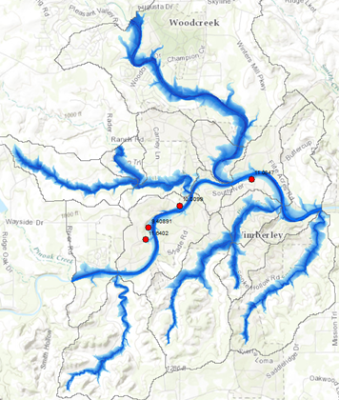
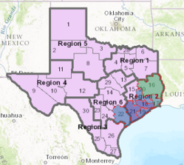
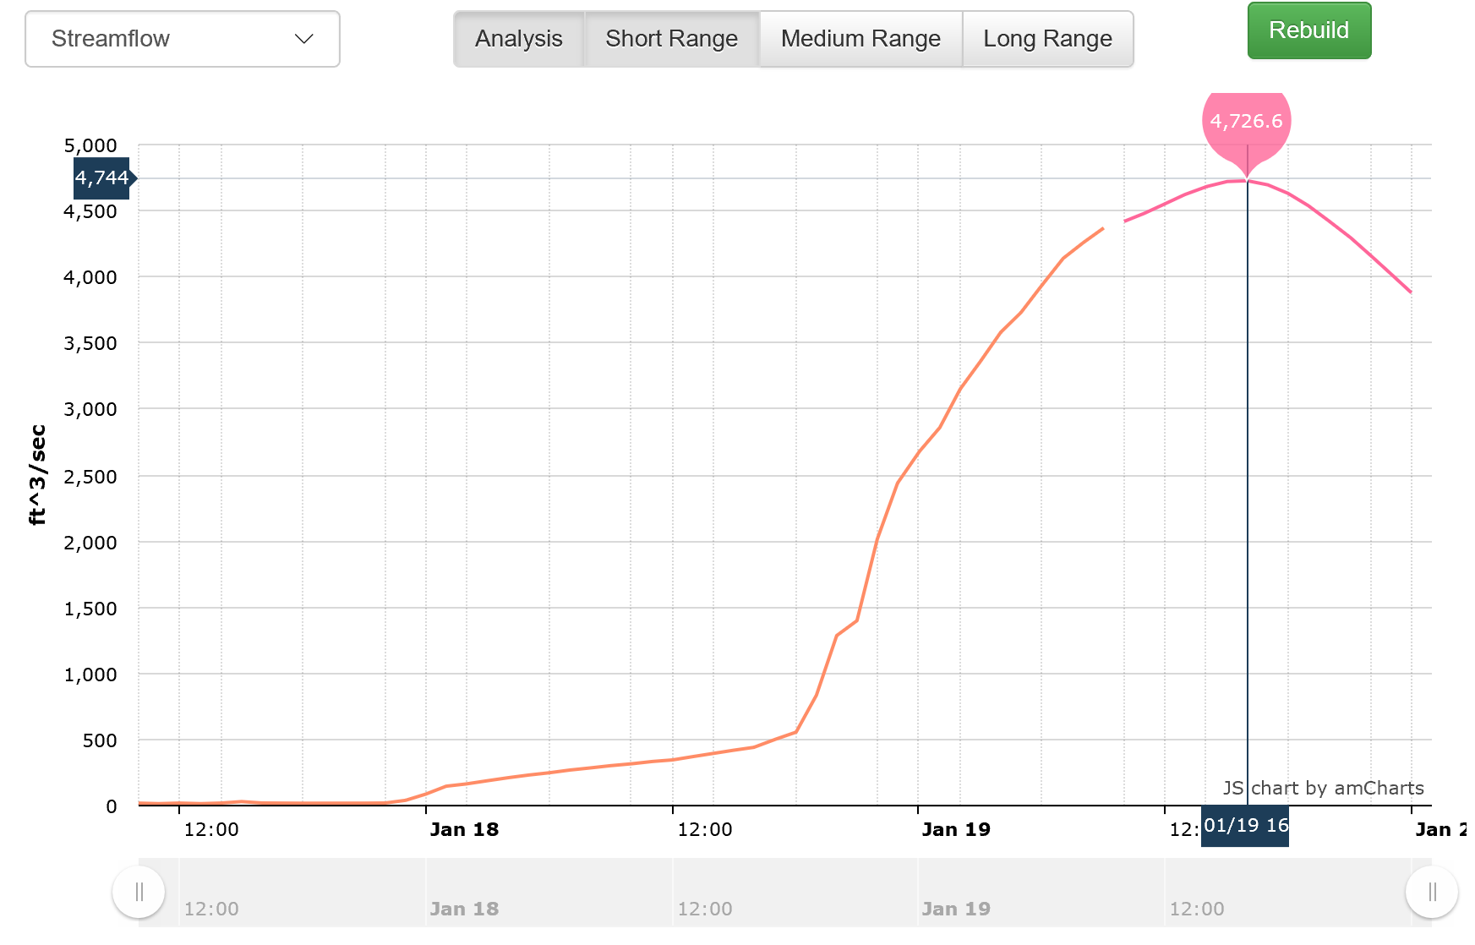
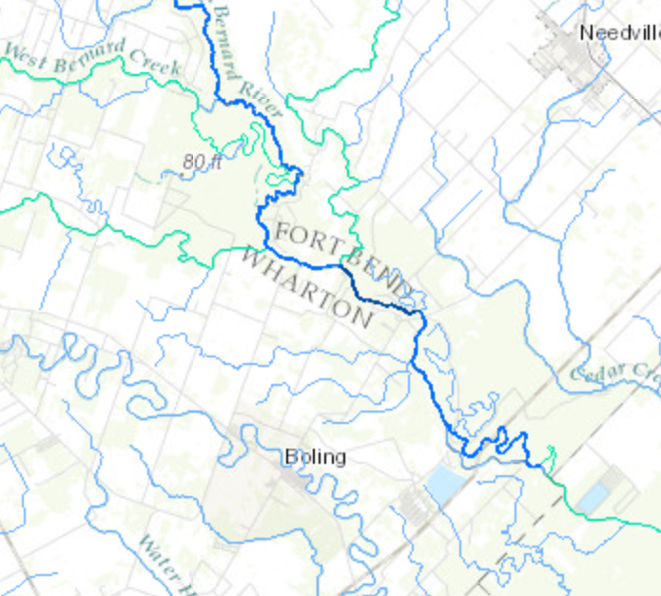
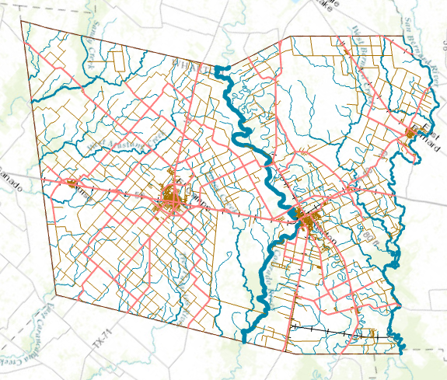
Future Information Flow
Real-Time
Inundation Map
Flood Impact
Assessment System
Rain maps
Hydrographs
from National
Water Model
Metrics
ESRI-Kisters Service
State Operations Center
Assessment
of Conditions
Strategic Flood
Response Map
Discussion
Emergency
Response
Reporting impacts:
TDEM Area Coordinators
Disaster District Coordinators
County Emergency Management Coordinators

Slide 5
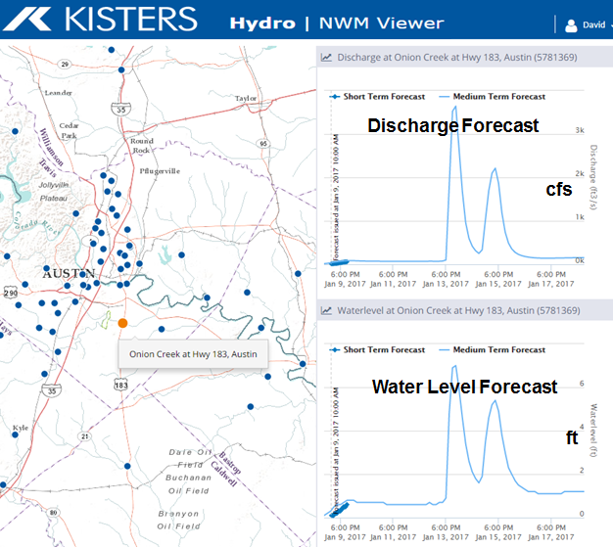
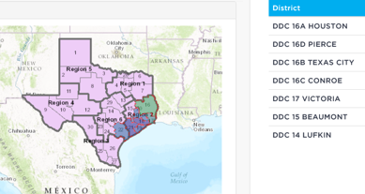
Automated workflow for short term and medium term forecasts
National Water Model discharge forecasts
Conversion of discharge to depth using rating curves
Summary of Impacts for Disaster Districts
Inundation mapping and local impact assessment
ESRI

Slide 6
Proposed Approach
Texas Flood Response System
Real-Time
Inundation Map
Flood Impact
Assessment System
Three key elements:
Strategic Flood Response Map
Real-Time Inundation Map
Flood Impact Assessment System
Assessment
of Conditions
Strategic Flood
Response Map
Discussion
Emergency
Response

Slide 7
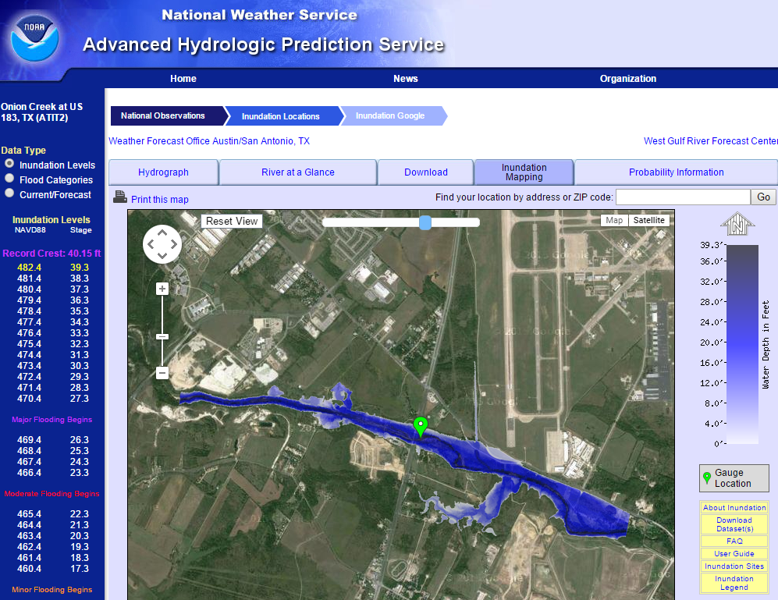
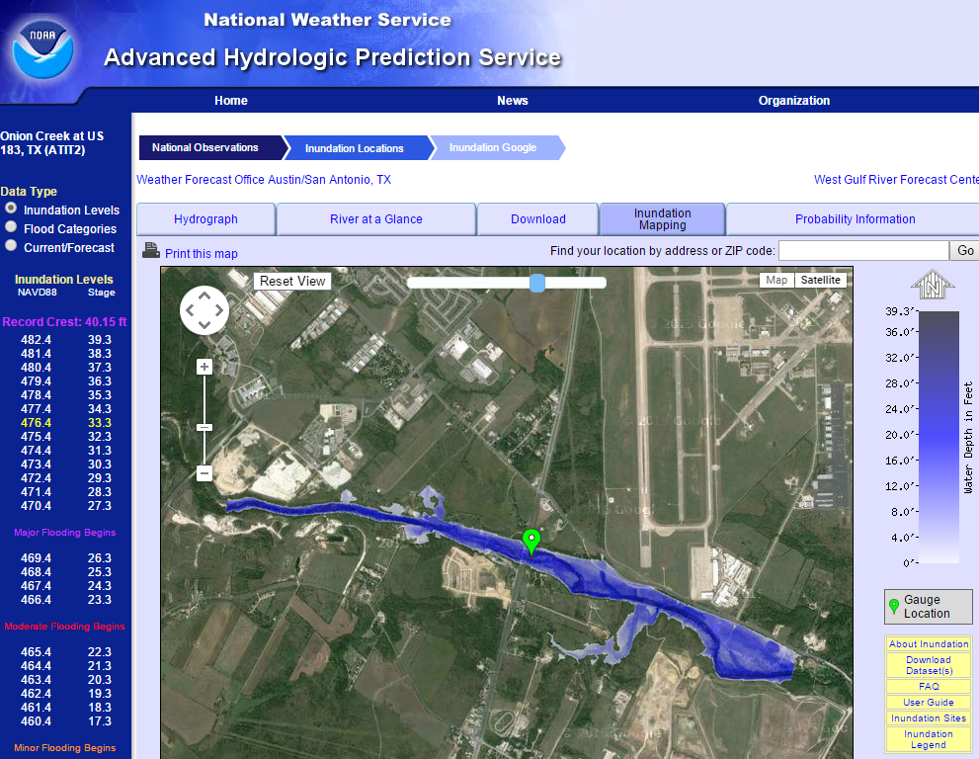
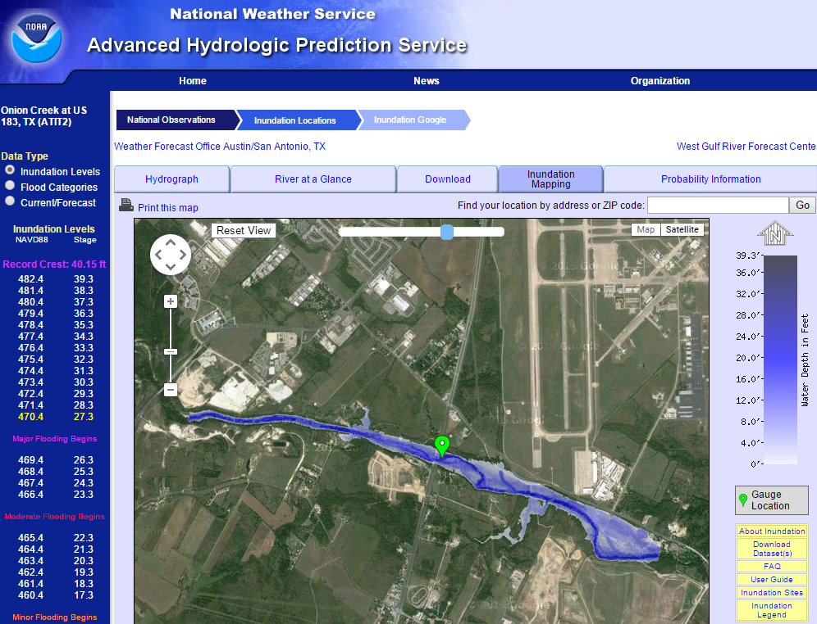
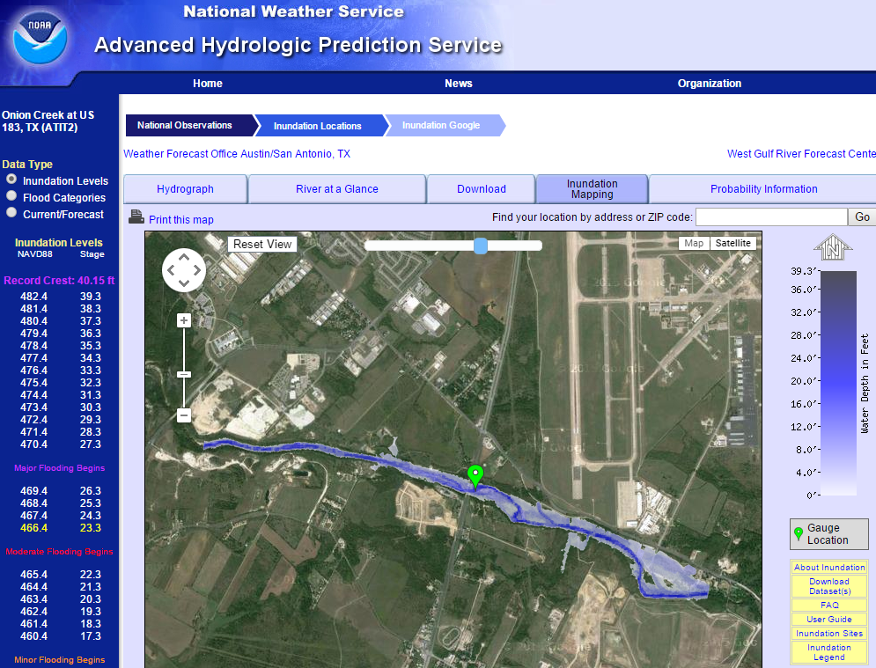
Real-Time Flood Inundation Mapping Onion Creek at Highway 183
http://water.weather.gov/ahps2/inundation/inundation_google.php?gage=atit2

Slide 8
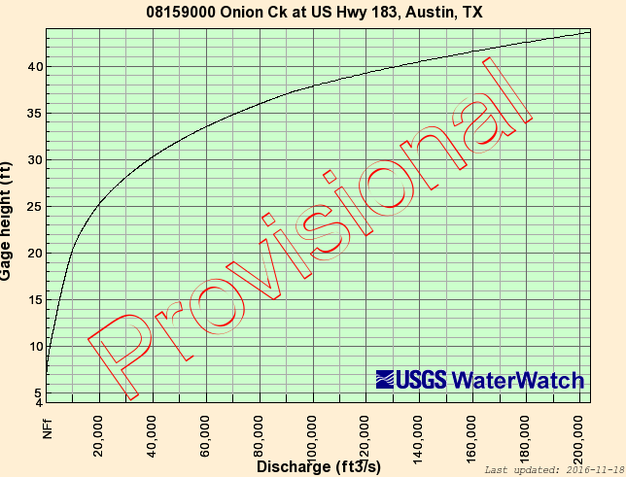
USGS Rating Curve at a Stream Gage
Onion Creek at Highway 183
Measure
Water Level
Determine Discharge

Slide 9
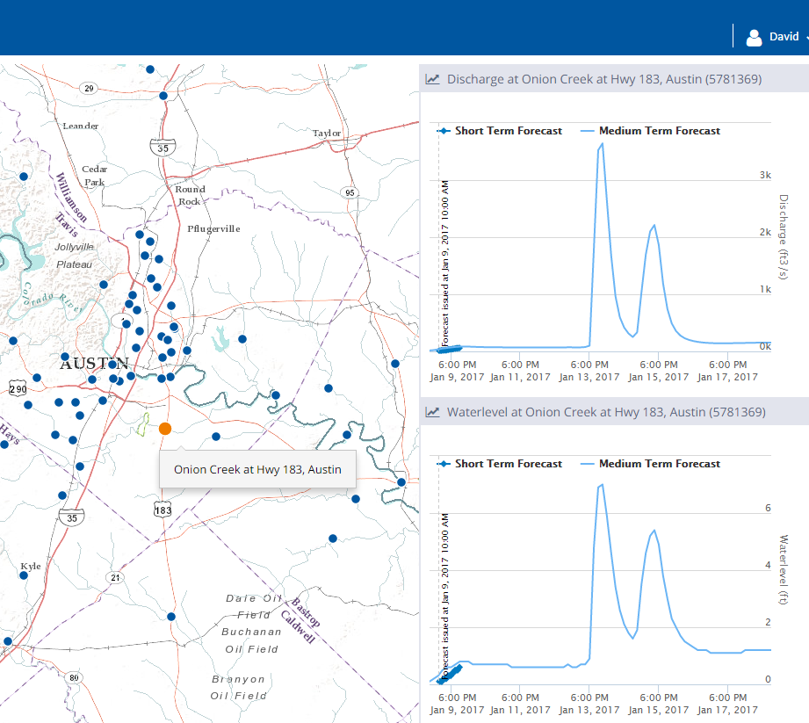
Real Time Charts for Discharge and Depth for all of Texas
Discharge Forecast
cfs
Water Level Forecast
ft

Slide 10
Method for Determining Flood Risk: Height Above Nearest Drainage (HAND)
Flooding occurs when Water Depth is greater than HAND
Address Point
Flood
HAND
Normal

Slide 11
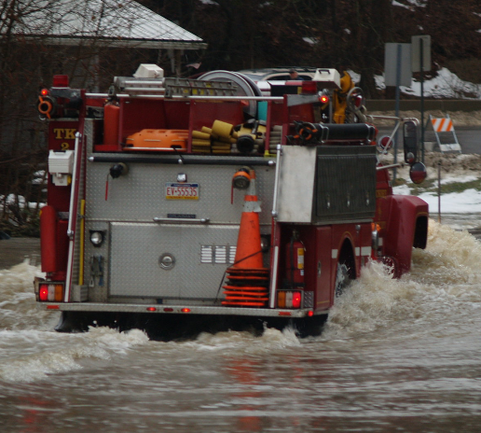
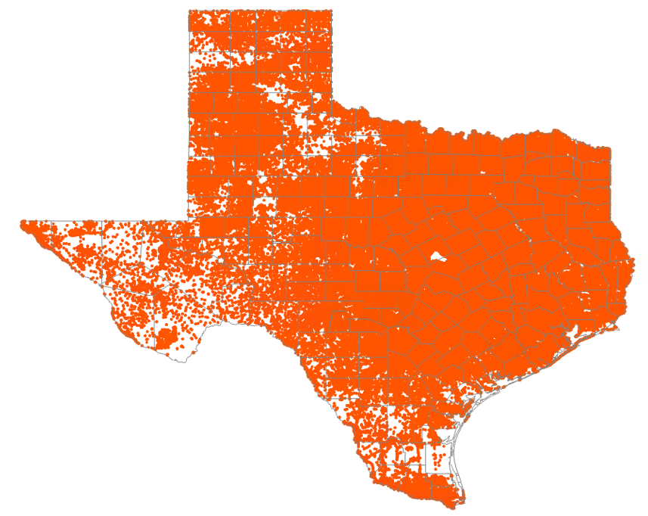
Texas Address Points
8.7 million points
Used for dispatching emergency
response vehicles in 911 systems

Slide 12
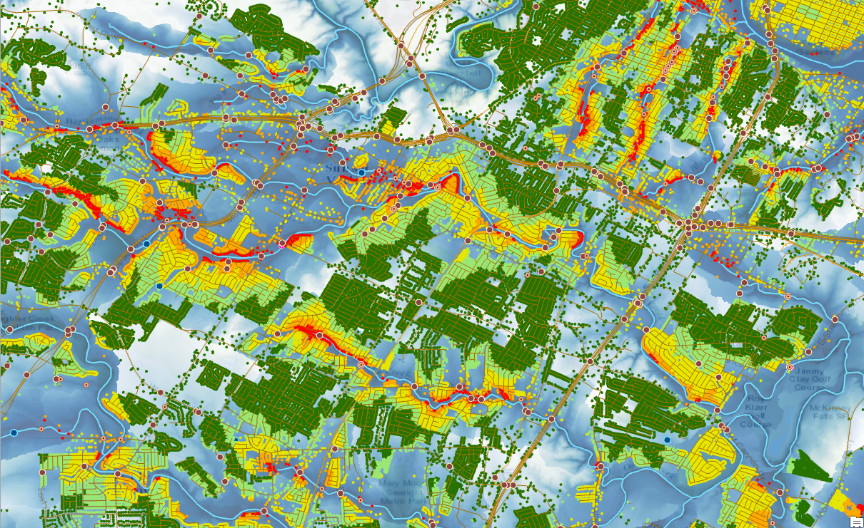
Address points attributed with HAND using LIDAR Austin, Texas: A data rich community

Slide 13
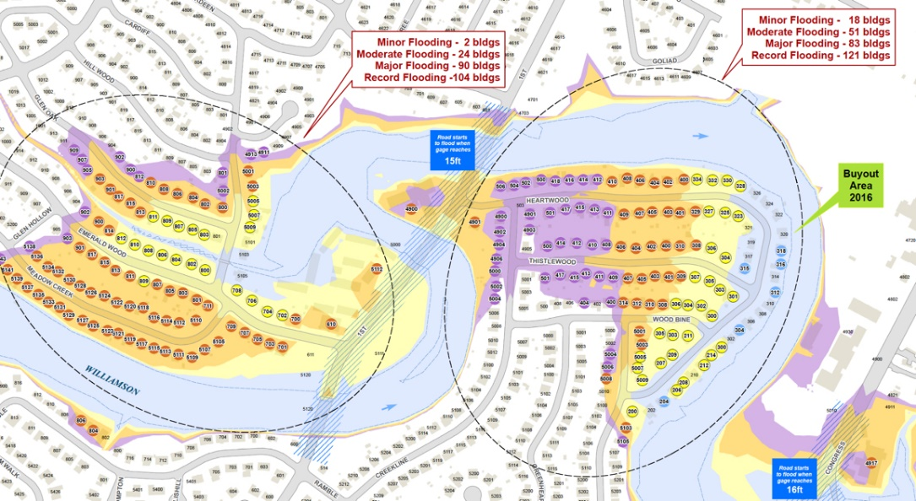
Detailed engineering modeling on creeks Austin, Texas: A data rich community

Slide 14
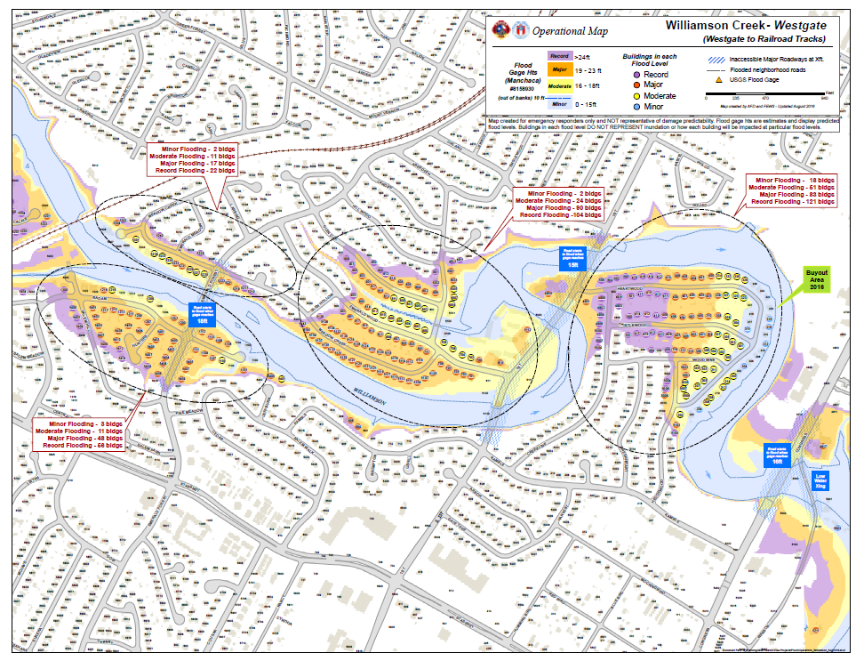
Collaboration between Austin Fire Dept and Flood Early Warning System
Flood operational maps for 21 Austin creeks
Tested in six table top exercises over last 2 years
Now deployed in fire trucks in paper and pdf format

Slide 15
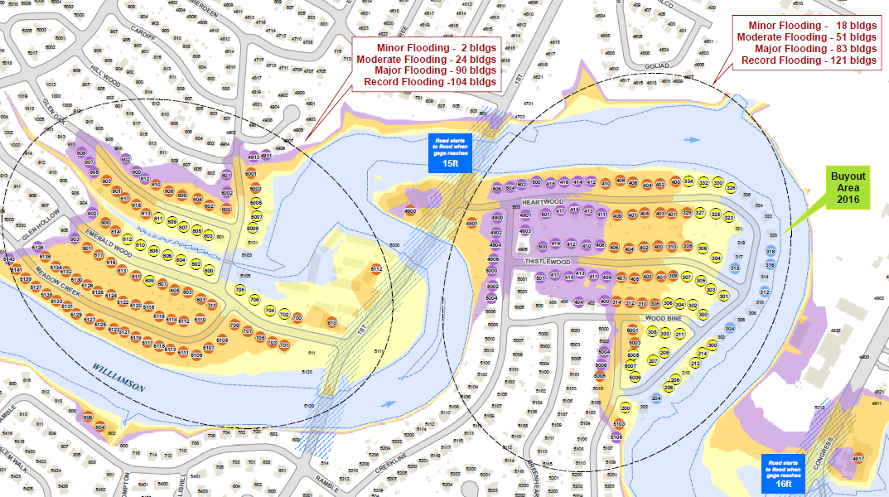
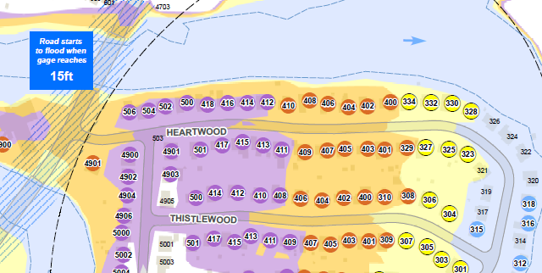
Flood Operational Maps
Potentially flooded
neighborhoods
Flood depth in houses
3ft
6” – 3 ft
< 6”

Slide 16
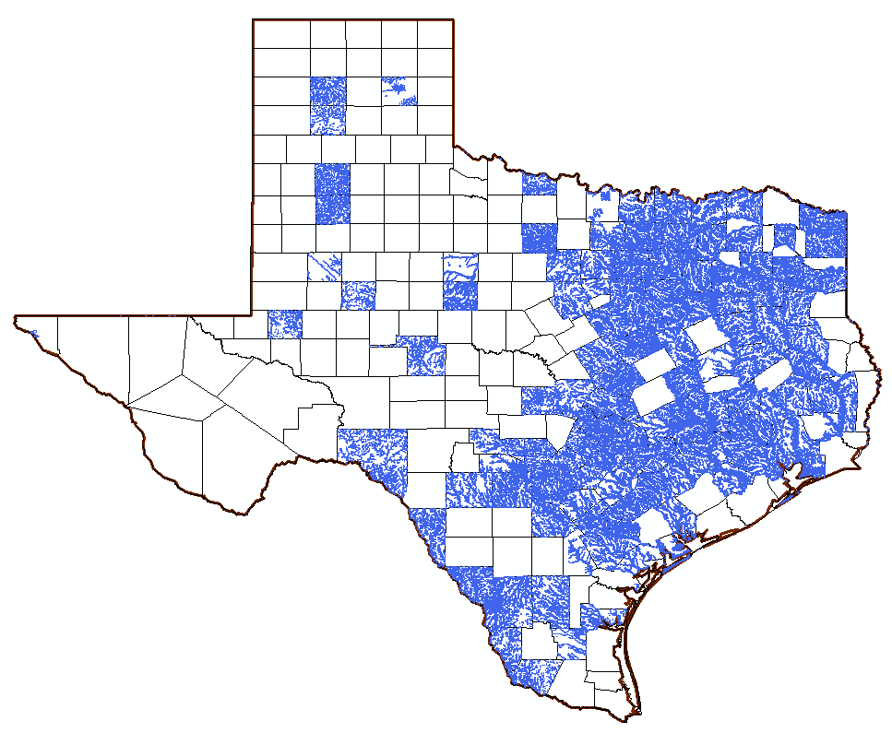
FEMA National Flood Hazard Layer in Texas (~ 120 counties)
Large areas of Texas
lack flood information
Wharton County

Slide 17
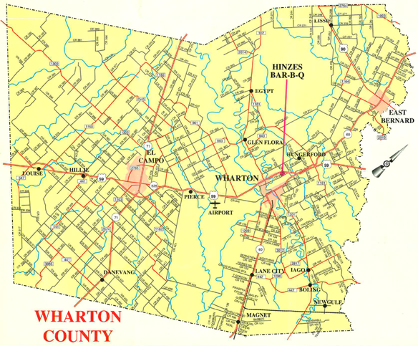
Paper Map of Wharton County

Slide 18
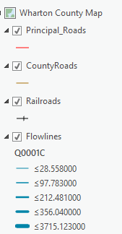
Strategic Flood Base Map for Wharton County
Prepared using standard Texas GIS data

Slide 19
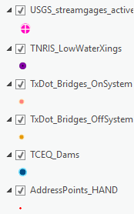
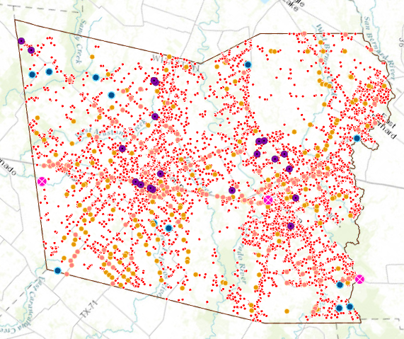
Potentially Impacted Features in Wharton County
(3)
(21)
(176)
(189)
(12)
(20,342)
Add Selected Features to the Base Map with the help of:
County Emergency Management Coordinator
TDEM Disaster District Coordinator

Slide 20
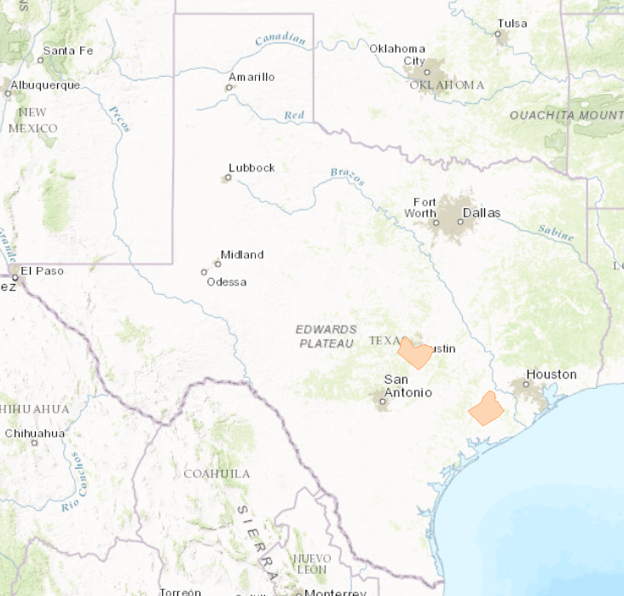
Common Operating Picture for each County
Summarize information for
urban counties
Prepare information for
rural counties
Travis
Wharton
… Buildings
Identify neighborhoods at risk from flooding
using FEMA flood maps and interaction
with county Emergency Management Coordinator

Slide 21
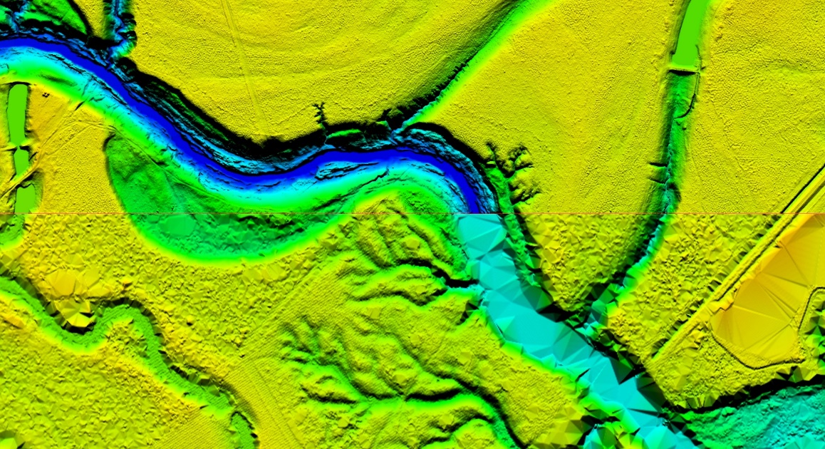
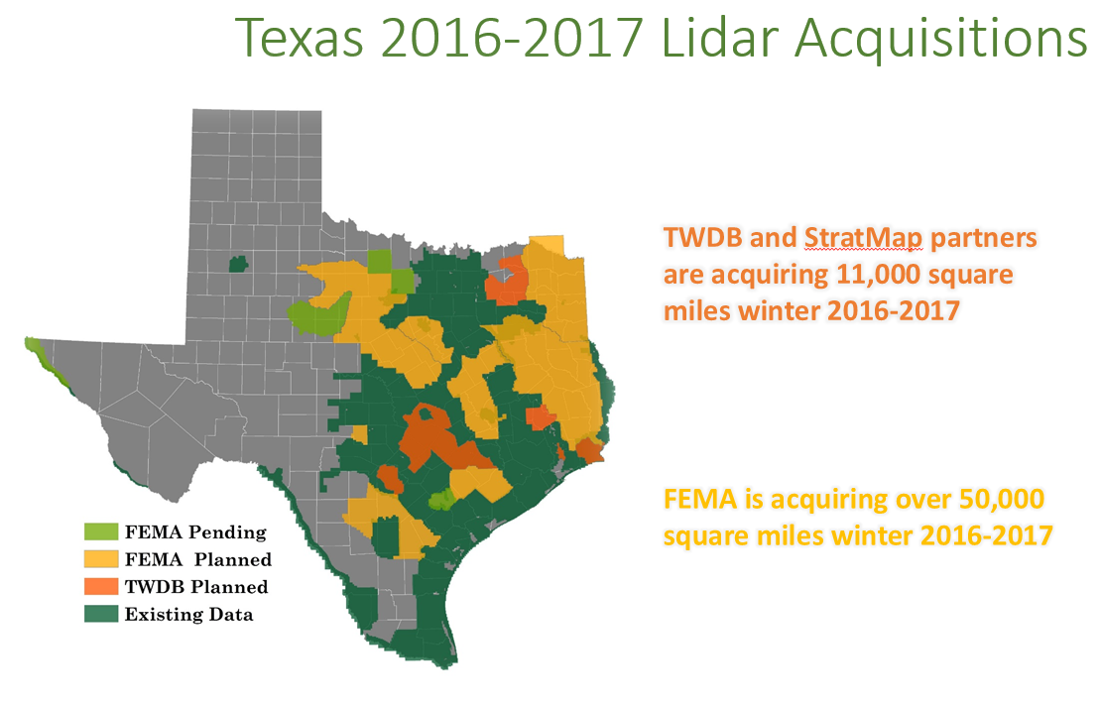
LIDAR Terrain Mapping
4 points per square meter
0.5 points per square meter
Wharton County
Source of Images: Joey Thomas, TNRIS

Slide 22
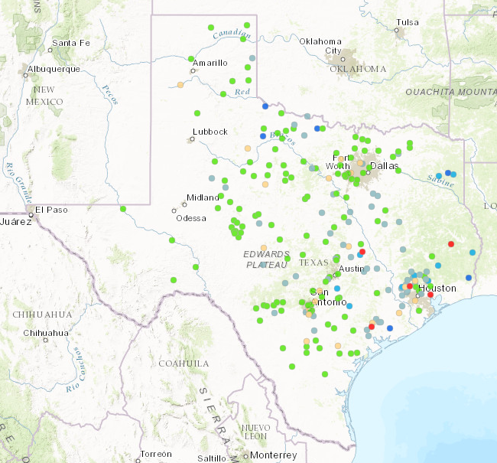
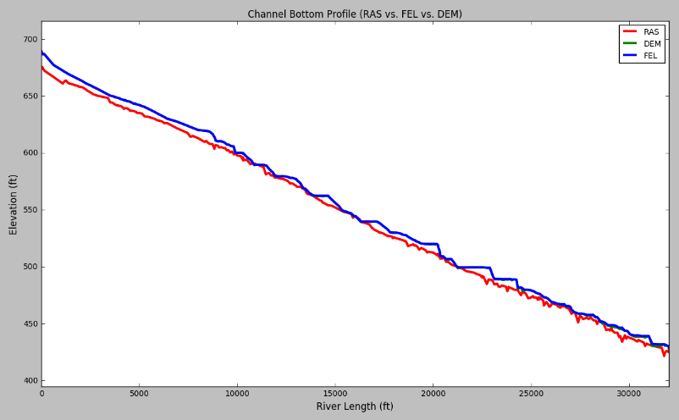
River Toolbox – Integrity Checking and Database Adjustment
Minimum channel elevation – adjustment to get to bottom of the channel
Channel hydraulic properties – comparison with HEC-RAS geometries
Reach rating curves – comparison with USGS ratings
Inundation mapping extent – compare with FEMA flood maps
Checking water depth – Compare to USGS measurements in Kisters NWM viewer

Slide 23
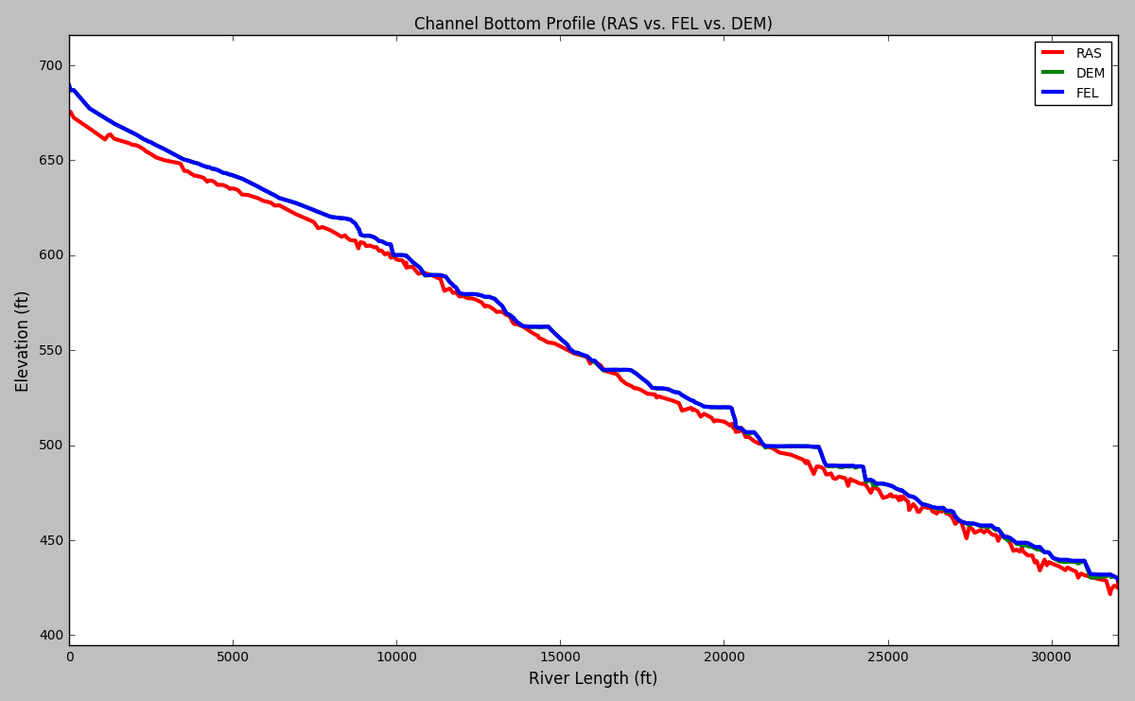
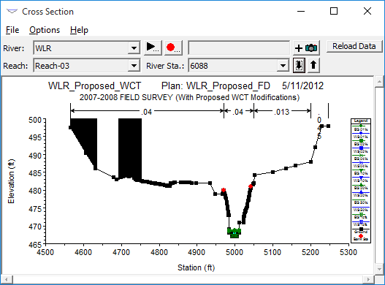
HEC-RAS Minimum Channel Elevation vs NED Waller Creek, Austin, Texas
DEM is 4.8 ft above HEC-RAS on average
DEM is 1.89 ft above HEC-RAS at this cross-section

Slide 24
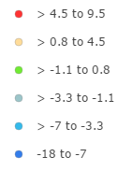
Error in Depth Predictions at USGS Gage Sites
Depth Error (ft)
(weekly average)
Average Depth Error = - 0.7 ft
Depth Error = Water Depth from Synthetic Rating Curve – Gage Water Depth (USGS)
Gage Water Depth (USGS) = Observed Gage Height – Gage Height of Zero Flow

Slide 25
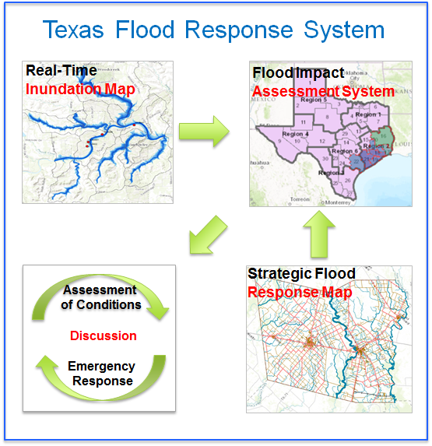
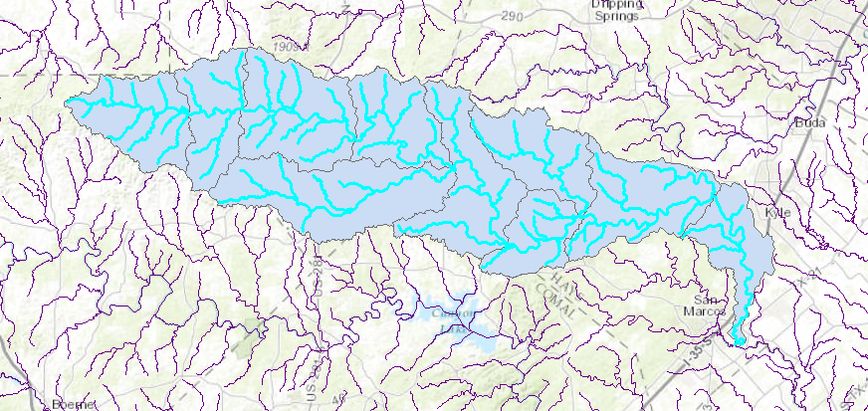
March 28 Exercise
Introduction
Exercise 1: Building a strategic flood response map
Exercise 2: Inundation mapping and impact assessment
Conclusion and recommendations
May 2015 flood in Blanco basin

Slide 26
Questions for WGRFC
Do you want to be involved in the March 28 exercise?
Guidance on how to translate NWM forecasts to maps?
Participate in integrity checking the TFRS?
Suggestions and recommendations for us?

