Slide 1
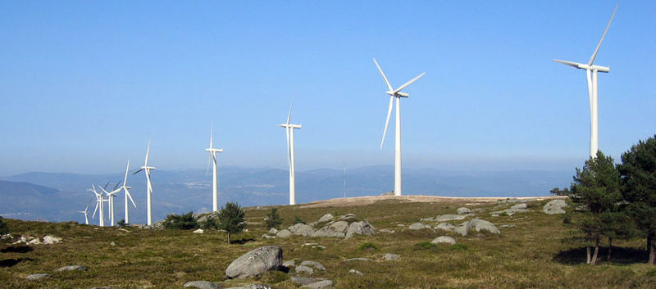
Estimating the Optimal Location of a New Wind Farm
based on Geospatial Information System Data
Dec.6 2007
Chungwook Sim

Slide 2
How does a Wind Turbine Works?
Generating the Power
- Inside the wind turbine
(retrieved from http://green.nationalgeographic.com)
Blades
Low-speed shaft, Gear box, High-speed shaft
Generator

Slide 3
General Sketch of the Project
- Numerical Weather Prediction model
“meso-scale”, “micro-scale”
- Wind Shear Profile
“atmospheric stability”, “roughness”
- Wind Speed at Hub height
- Annual Power prediction

Slide 4
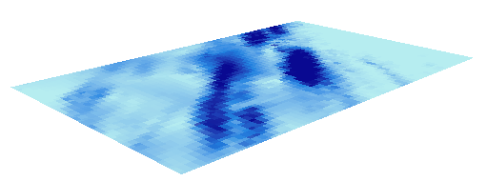
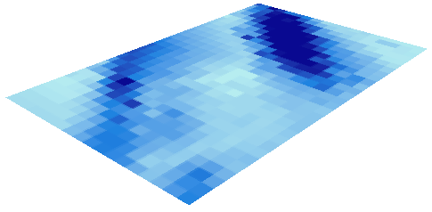
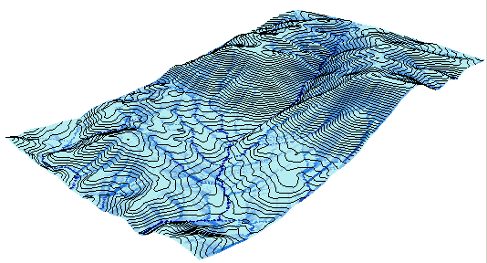
Objective of the Project
- Understand the stability influential factors of a wind shear profile
“Richardson Number”,
“Monin-Obukhov Length”
- Use GIS to integrate various layers
“Multi-dimensional tools”,
“Spatial-analyst tools”

Slide 5
Physical Concepts of Boundary-Layer Flow
- Navier-Stokes and Continuity Equation of the atmosphere
- Reynolds-Averaged Equations and the Turbulent Momentum Flux
- Wind Speed

Slide 6
- Mixing Length, Friction velocity, roughness length
Logarithmic Wind Shear Profile

Slide 7
- Richardson Number and Monin-Obukhov Length
Thermal Stratification on the Wind Shear Profile
*** CORRECTION of the Logarithmic Profile
Potential Temperature
Richardson Number
- Monin-Obukhov Length

Slide 8
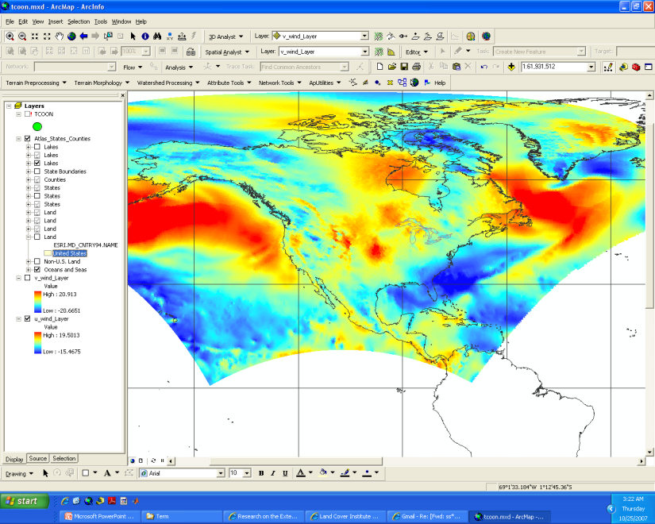
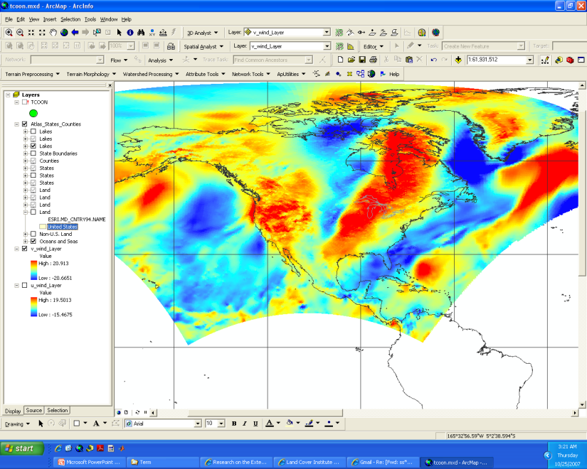
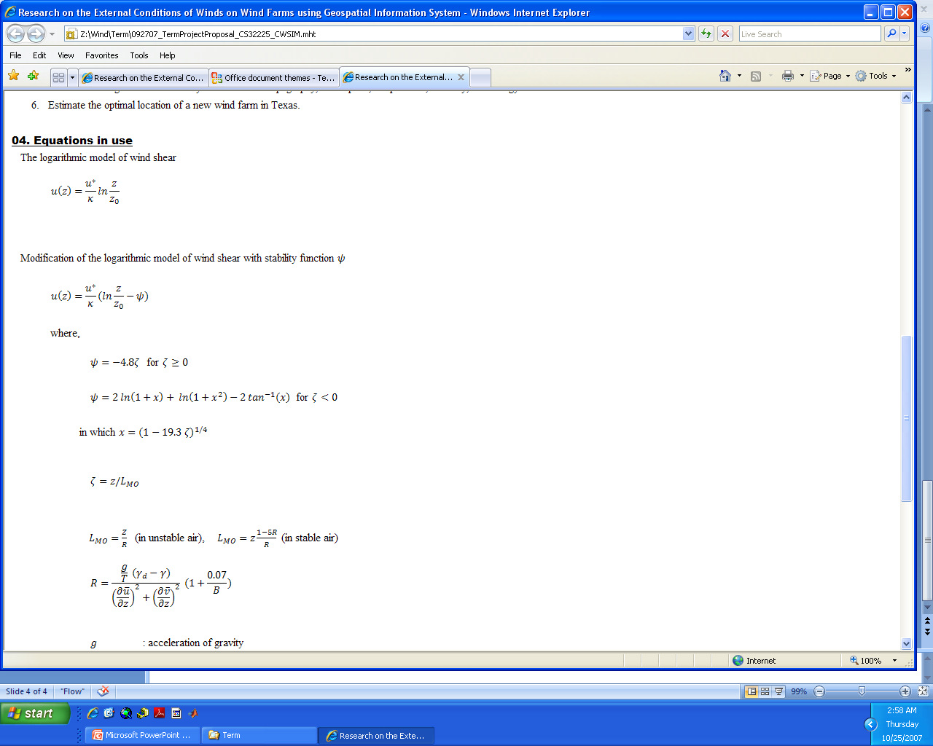
Data Collection
Format of the data (NetCDF)
a) Choose various locations with different terrain conditions in Texas.
>> http://ned.usgs.gov//
>> http://www.geographynetwork.com/
b) Investigate and collect data of the topography and other stability conditions
that can affect the wind power production.
c) Collect climate data of wind speed from NOAA online.
>> http://cdo.ncdc.noaa.gov/CDO/cdo
d) Collect the data of demography or energy consumption to determine
the energy demand of each location.
>>http://landcover.usgs.gov/classes.php
Data Catalog of National Centers for Enviornmental Prediction (NCEP)
NARR (North American Regional Reanalysis) dataset
>> http://nomads.ncdc.noaa.gov:8085/thredds/catalog/narr/
- The operational model: Eta model
- Resolution: 32 km grid
- Data available: 1979 to current
- Directories: 3 hourly climatologies, daily, monthly

Slide 9
Data Verification- Comparison with TCOON Measurements

Slide 10
NARR v.s. TCOON Measurements

Slide 11
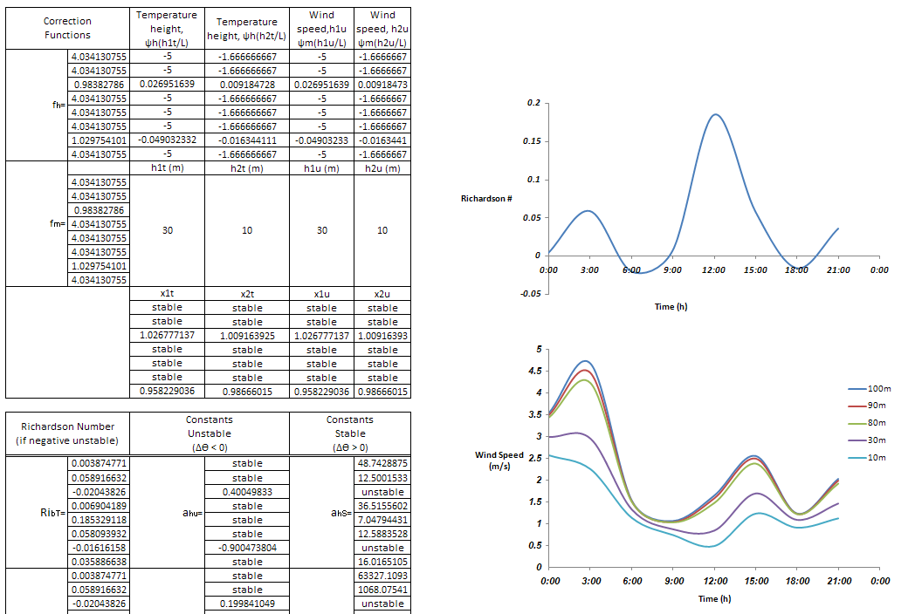
Spreadsheet of Wind Shear Profile Correction

Slide 12
Spreadsheet of Wind Shear Profile Correction

Slide 13
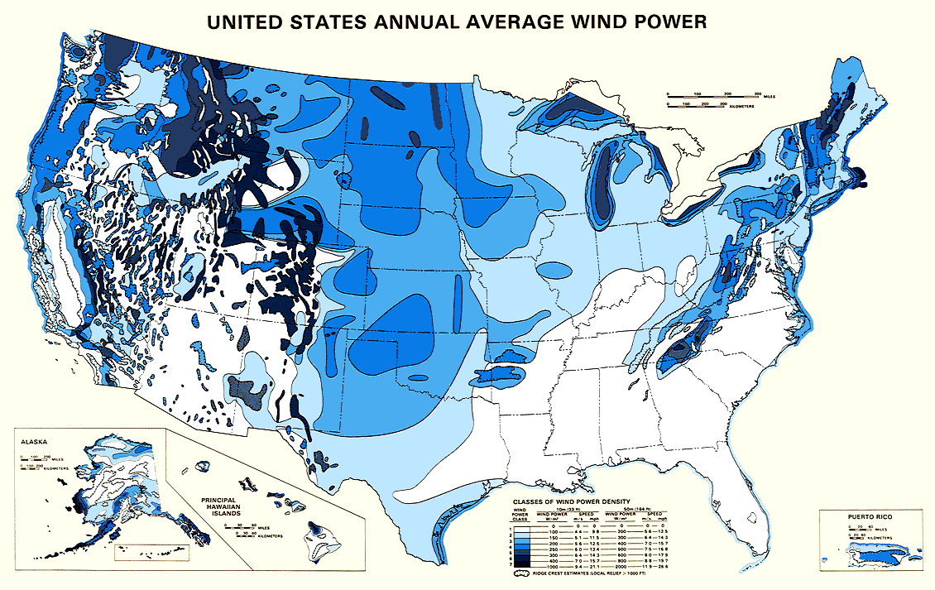
Wind Power of US

Slide 14
Conditions at the Great Plain- Richardson Number

Slide 15
Conclusions and Future Work
- GIS is useful in integrating a great number of variables
“Map Algebra” with scripts!
- NARR data catalog is useful in estimating climate related topics
“verification required near surface”
- Annual Power prediction v.s. Demand of Power?
“accuracy in wind speed at hub-height”

Slide 16
Questions?

