Slide 1
Salinity gradients in the Mission-Aransas National Estuarine Research Reserve
Kimberly Bittler

Slide 2
Salinity
Freshwater ~0
Estuary
Brackish
Saltwater ~35

Slide 3
Mission-Aransas NERR

Slide 4
Questions
On what temporal scale does salinity vary?
On what spatial scale does salinity vary?
Coupled models?

Slide 5
Temporal Variability in Salinity

Slide 6
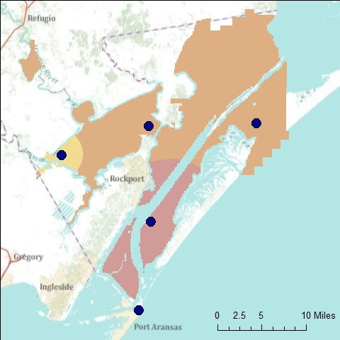
Salinity
(ppt)

Slide 7
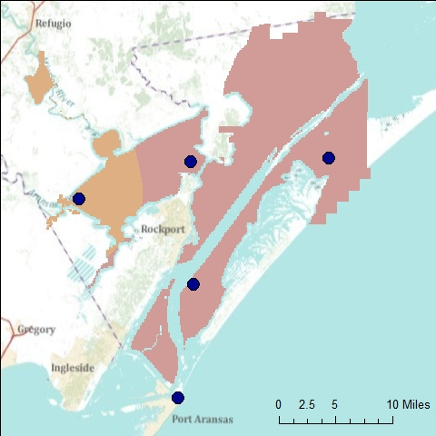
Salinity
(ppt)

Slide 8
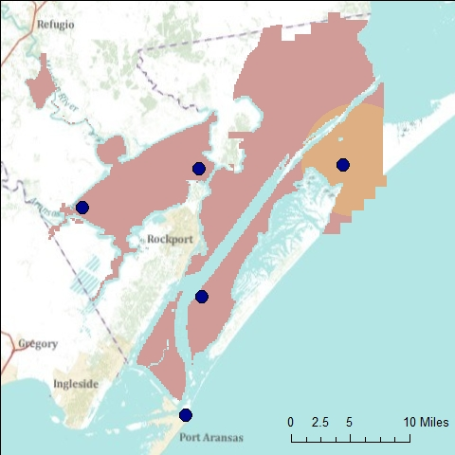
Salinity
(ppt)

Slide 9
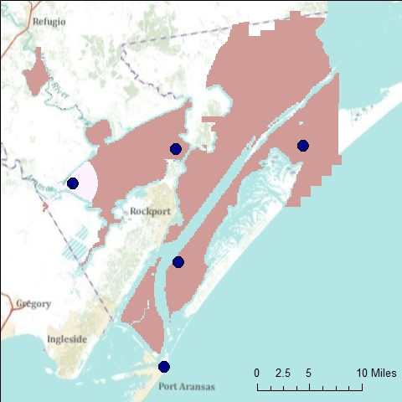
Salinity
(ppt)

Slide 10
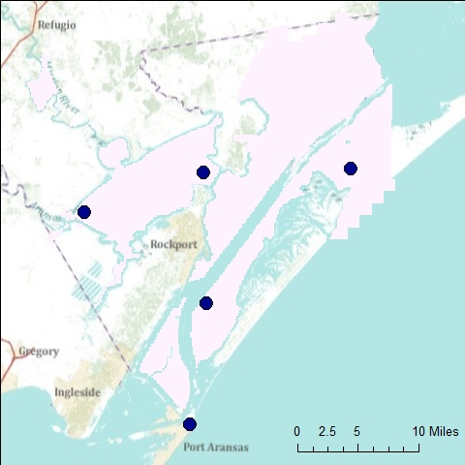
Salinity
(ppt)

Slide 11
Salinity
(ppt)
Nov. 2009

Slide 12
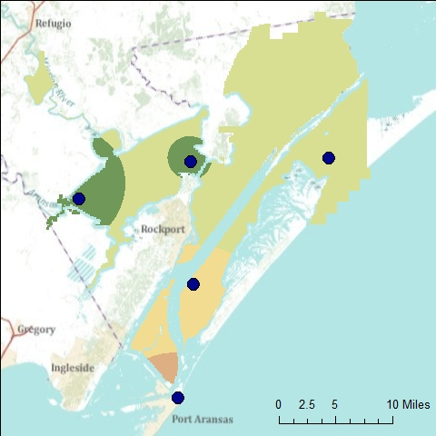
Salinity
(ppt)
Dec. 2009

Slide 13
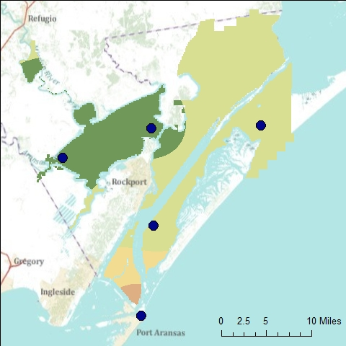
Salinity
(ppt)
Jan. 2010

Slide 14
Spatial Variation

Slide 15
Spatial Variation

Slide 16
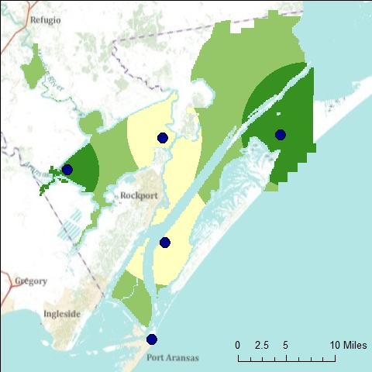
Salinity Range
(ppt)
March 2008

Slide 17
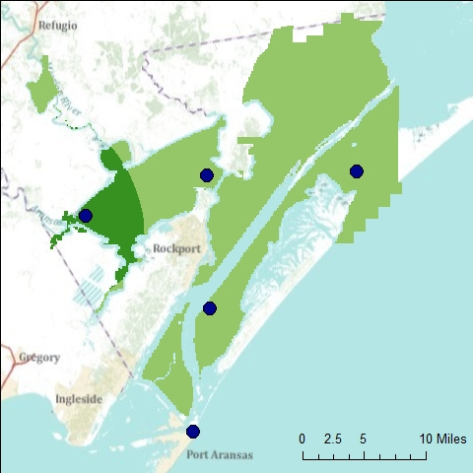
Salinity Range
(ppt)
Oct. 2009

Slide 18
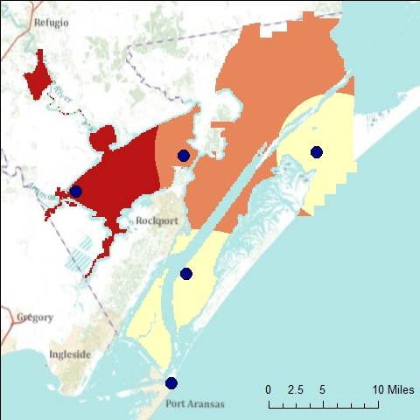
Salinity Range
(ppt)
Nov. 2009

Slide 19
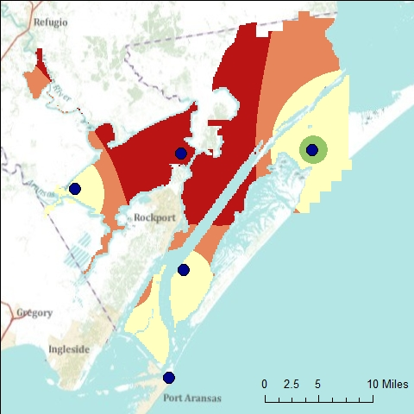
Salinity Range
(ppt)
Dec. 2009

Slide 20
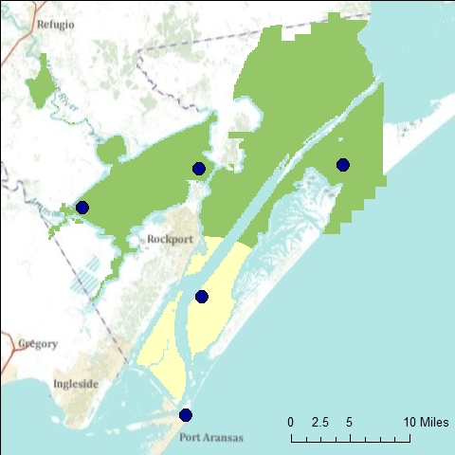
Salinity Range
(ppt)
Jan. 2010

Slide 21
Summary
Temporal variation present in salinity
Tidal at some sites
Event-driven
Short and long-term
Spatial variation present between NERR sites
Investigate if finer spatial variation exists

Slide 22
References
http://cdmo.baruch.sc.edu/
http://www.utmsi.utexas.edu/
http://midgewater.twdb.state.tx.us/tceq/soap/wateroneflow.wsdl
http://midgewater.twdb.state.tx.us/tpwd/soap/wateroneflow.wsdl
Thanks to Dr. Maidment and Fernando Salas

