Slide 1
A GIS-based comparison of pre- and post-lignite strip mine waters
A Progress Report by
L. Joy Mercier
on Tuesday, November 22, 2011
*Luminant reclaimed land near Monticello Mine (Luminant, May 2011)

Slide 2
Questions to Answer
What is lignite, and why do we care?
Where is the lignite in Texas?
Where are the lignite mines in Texas?
What are the hydrologic and hydrogeologic impacts of lignite surface (strip) mining?
How can we use GIS to better understand the complex spatial and temporal relationships between mining and reclamation and changes in water quality or behavior?
Notes:
Topics to be addressed in this presentation. The last question will begin to be addressed as I discuss previous questions with the help of ArcGIS generated images.

Slide 3
Methods
Library, Internet, and Online Database Research:
What is lignite, and who cares about lignite anyways?
Research + GIS Mapping:
Where is the lignite in Texas?
Where are the lignite mines in Texas?
What are the hydrologic and hydrogeologic impacts of lignite surface (strip) mining?
Analysis Using GIS Tools:
How can we use GIS to better understand the complex spatial and temporal relationships between mining and reclamation and changes in water quality or behavior?
Notes:
Topics to be addressed in this presentation. The last question will begin to be addressed as I discuss previous questions with the help of ArcGIS generated images.

Slide 4
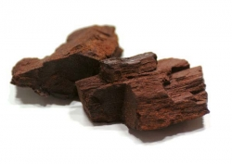
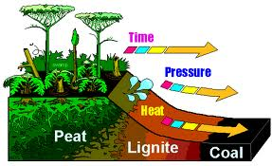
What is lignite?
Above: Lignite Coal
(Photo by: Center for Applied Energy Research, University of Kentucky)
Notes:
Lignite = “brown coal”
Lowest grade coal: low (46-60%) fixed-carbon content, low heating value, high content of volatile matter, high moisture content
Can often distinguish some individual bits of plant material in lignite deposit
Spontaneous combustion, mine mouth power plants

Slide 5
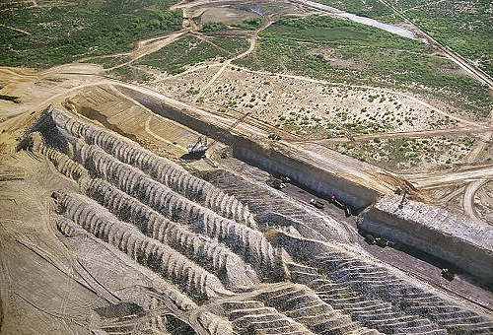
Who cares about lignite?
Lignite strip mine north of Laredo in Webb County, TX (photo by AirPhoto, Image #16387, taken on 4/29/1997)
Notes:
*Large amount of near-surface (20-200 ft depth) deposits (there are also deep basin deposits)
*Estimated 8,600 to 11,100 million tons
*In 1991, lignite generated 20% of the electricity for Texas

Slide 6
Where are the lignite mines in Texas?
Notes:
“Coal Mining Locations” map from the Railroad Commission of Texas: Surface Mining and Reclamation Division
Published August 2011
The NW line of yellow corresponds to the outcropping Wilcox Group (esp. the Calvert Bluff Formation). The SE line of yellow corresponds to the

Slide 7
Where is the lignite in Texas?
Notes:
“Coal Mining Locations” map from the Railroad Commission of Texas: Surface Mining and Reclamation Division
Published August 2011
Most near-surface lignite is associated with the Calvert Bluff Formation of the Wilcox Group. The CBF outcrops are mapped here in red.
Note that the outcrop of the CBF (approximates location of near-surface lignite) lies within the recharge zone for the Carrizo-Wilcox aquifer, a prolific aquifer and a sole-source of drinking water for many Texans.

Slide 8
Where are the lignite mines in Texas?
Notes:
This is the same map as the one shown on the previous slide, but now I have added the locations of most of the lignite surface mines (digitalized points of all the mines depicted in the Railroad Commission map)

Slide 9
What are the hydrologic and hydrogeologic impacts of lignite surface (strip) mining?

Slide 10
Exploring “mining impact” questions via research methods:
Dewatering and rerouting surface water
Changes from reducing to oxidizing conditions in the de-saturated overburden
Changes in overburden permeability and hydraulic gradients
Changes in water quality parameters
Notes:
*It’s a big deal if surface mining activities change water availability by decreasing the surface/ground water quantity or harming water quality: 60 counties rely on the Carrizo-Wilcox aquifer for municipal drinking-water
*

Slide 11
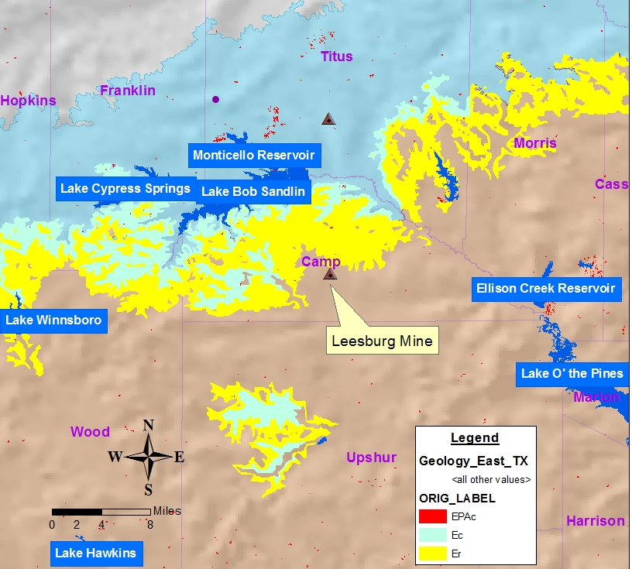
Exploring the “mining impacts” questions via GIS methods:
Notes:
To combat the feeling of being completely overwhelmed by all of the data and ArcGIS capabiltiies, I thought that I would focus on 1 or 2 mine locations.
Leesburg Mine: Perfectly situated to test the working hypothesis that outcropping Reklaw and Carrizo units cause a natural deterioration in water quality perameters similar or identical to changes from elsewhere induced by oxidizing the overburden
Problem: I found out that the mine is not yet being actively produced!

Slide 12
Exploring the “mining impacts” questions via GIS methods: Future Research!!
Notes:
*Let’s return to the original plan outlined in my project proposal
*Get location and years of operation where information is missing
*If necessary, use satelletie imagery to estimate the extent of each mine
*Use the JOIN relationship to add mine data from spreadsheet to shapefile and associated attribute table
*Color code the mines by years active (using the Symbology property)
Add stream gauging sites with sufficient surface water quality measurements to geodatabase/map
Add well sites with sufficient groundwater quality measurements to map

Slide 13
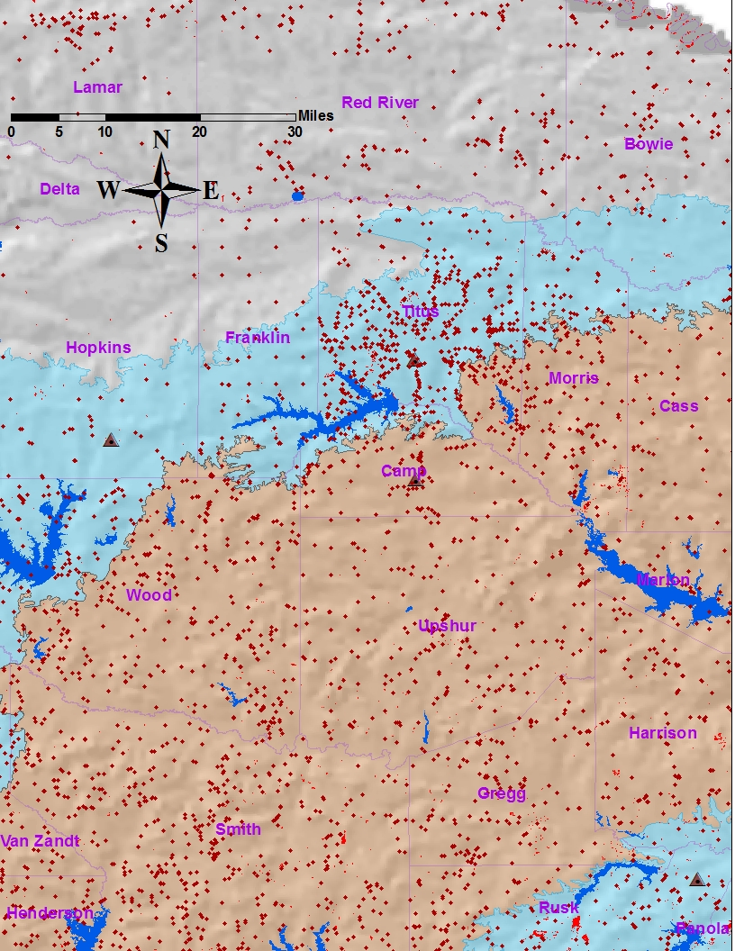
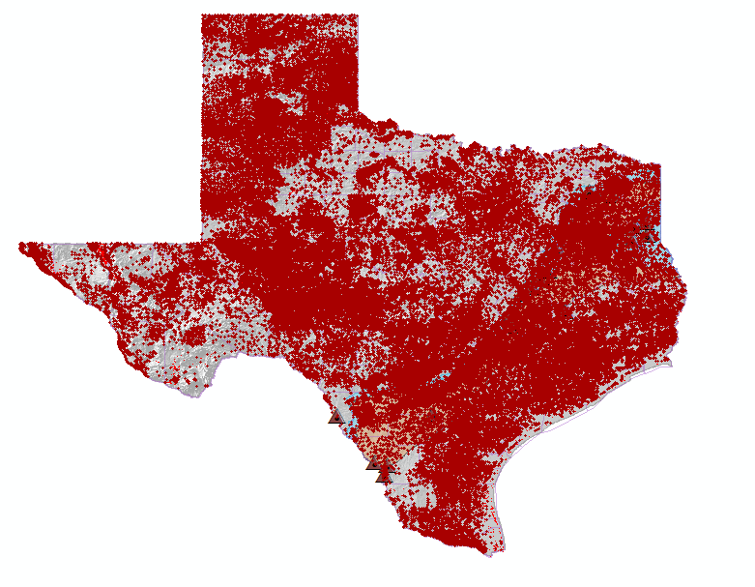
Notes:
*Stop re-inventing the wheel and utilize the ArcGIS Hydro tools to organize and analyze data!

Slide 14
How can we use GIS to better understand the complex spatial and temporal relationships between mining and reclamation and changes in water quality or behavior?
Also future research!!!

Slide 15
More about future work: ArcGIS Tools
No time to sleep! No time to eat (turkey)! Do more analyses!
… Because there is always more that you can do in ArcGIS!

Slide 16
More about Lignite Mining in Texas:
Cagle, M.F., 2007, Temporal and spatial sulfate variability in groundwater at a lignite mine, northeast Texas [M.S. thesis]: Austin, University of Texas at Austin, 269 p.
Espey, Huston, and Associates, Inc., 1983, Impacts of Lignite Development in Texas: An Environmental Primer: Prepared for Texas Energy and Natural Resources Advisory Council, TENRAC/EDF-091, 89 p.
Kaiser, Ayers Jr., & LaBrie, 1980, Lignite Resources in Texas: Bureau of Economic Geology, University of Texas at Austin, and Texas Energy and natural Resources Advisory Council, 55 p.
Surface Mining and Reclamation Division, 1991, Information and Statistical Facts on Coal and Uranium Mining in Texas: Railroad Commission of Texas, 63 p.
Venburg, L.C., 1983, Monitoring the effect of surface mining operations on the hydrologic regime: Ground Water Monitoring Review, v.3, pp.86-91.

Slide 17
Questions?

