Slide 1
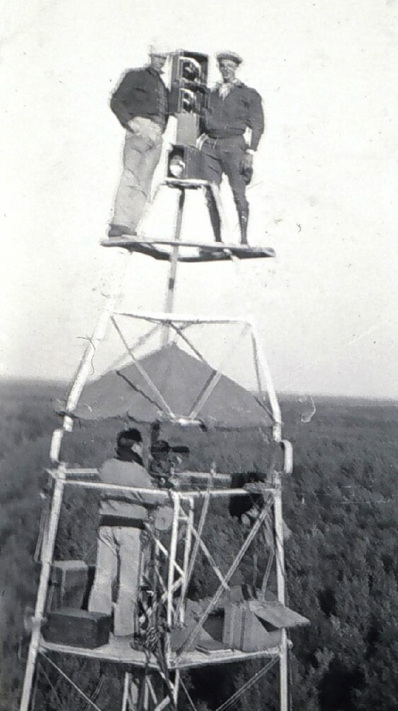
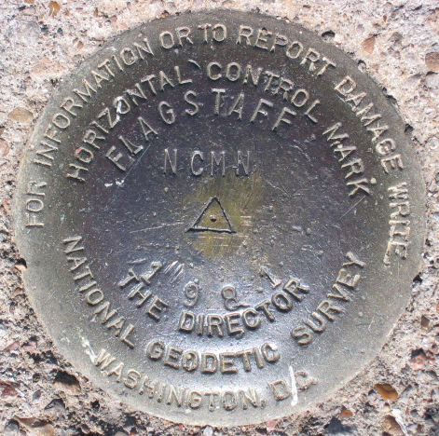
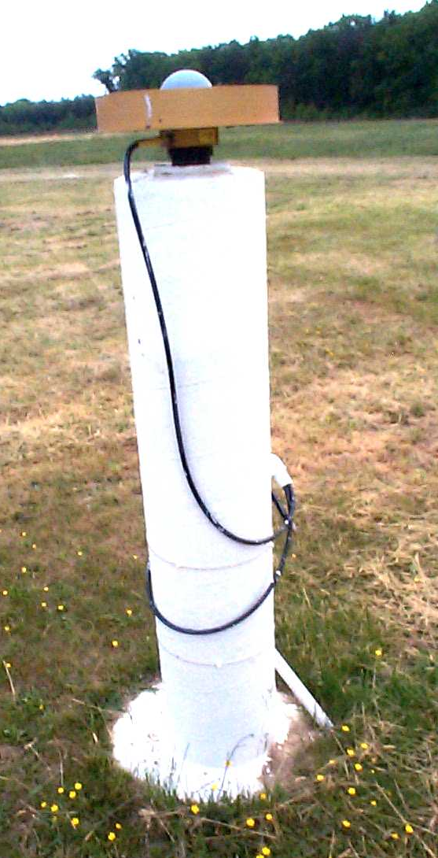
Revolution in Earth Measurement
Some images and slides from Michael Dennis, National Geodetic Survey and Lewis Lapine, South Carolina Geodetic Survey
Traditional Surveying uses benchmarks as reference points
Global Positioning uses fixed GPS receivers as reference points (Continuously Operating Reference System, CORS)

Slide 2
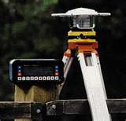
Differential GPS
Differential GPS uses the time sequence of observed errors at fixed locations to adjust simultaneous measurements at mobile receivers
A location measurement accurate to 1 cm horizontally and 2cm vertically is now possible in 3 minutes with a mobile receiver
More accurate measurements if the instrument is left in place longer

Slide 3
This leads to adjustments in locations of the national network of survey benchmarks
Survey Benchmark
{Latitude (φ), Longitude (λ), Elevation (z)}

Slide 4
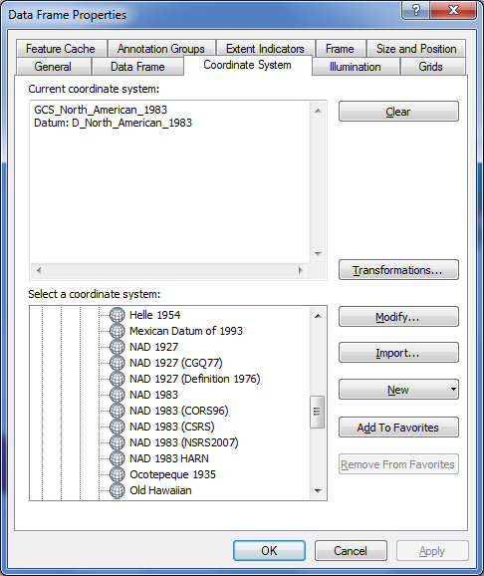
Adjustments of the NAD83 Datum
Slightly different (φ, λ) for benchmarks
Continuously Operating Reference System
Canadian Spatial Reference System
National Spatial Reference System
High Accuracy Reference Network

Slide 5
THE GEOID AND TWO ELLIPSOIDS
CLARKE 1866 (NAD27)
GRS80-WGS84
(NAD83)
Earth Mass
Center
Approximately
236 meters
GEOID

Slide 6
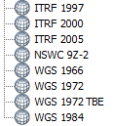
WGS 84 and NAD 83
North American Datum of 1983 (NAD 83) (Civilian Datum of US)
International Terrestrial Reference Frame (ITRF) includes updates to WGS-84 (~ 2 cm)
Earth Mass
Center
2.2 m (3-D)
dX,dY,dZ
World Geodetic System of 1984 (WGS 84) is reference frame for Global Positioning Systems
GEOID

Slide 7
High Accuracy Reference Network
Continuously Operating Reference System
http://www.ngs.noaa.gov/faq.shtml
Slide: Lewis Lapine

Slide 8
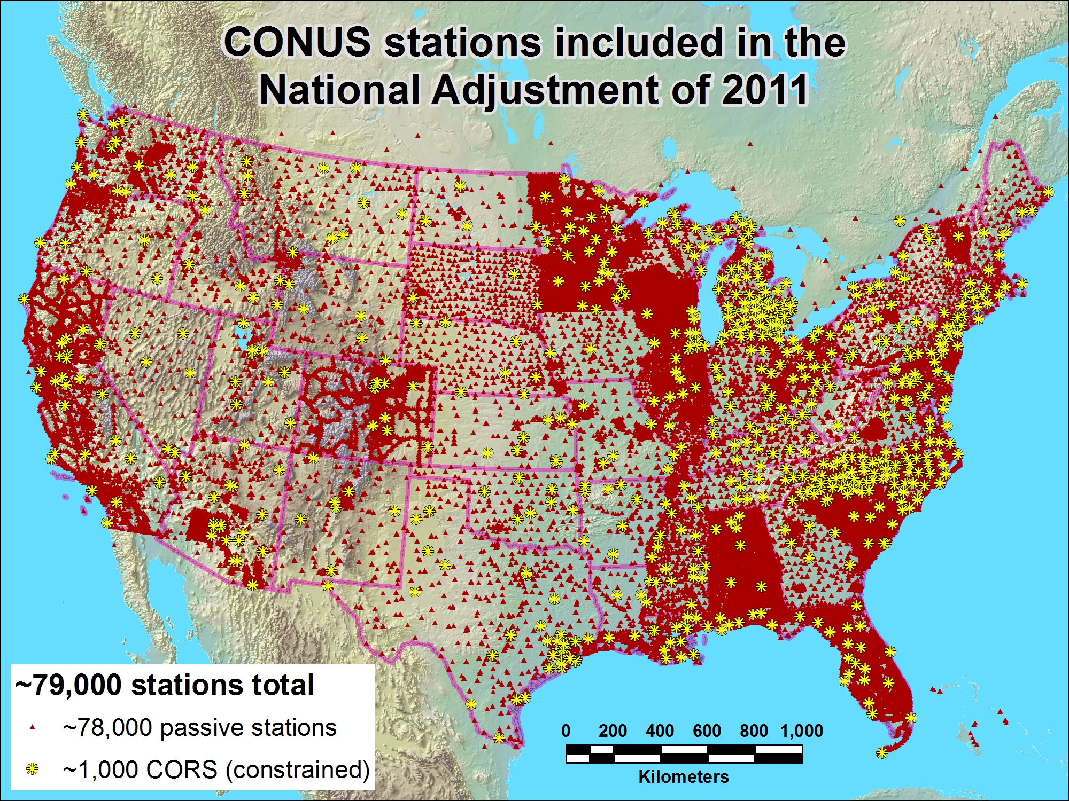

Slide 9
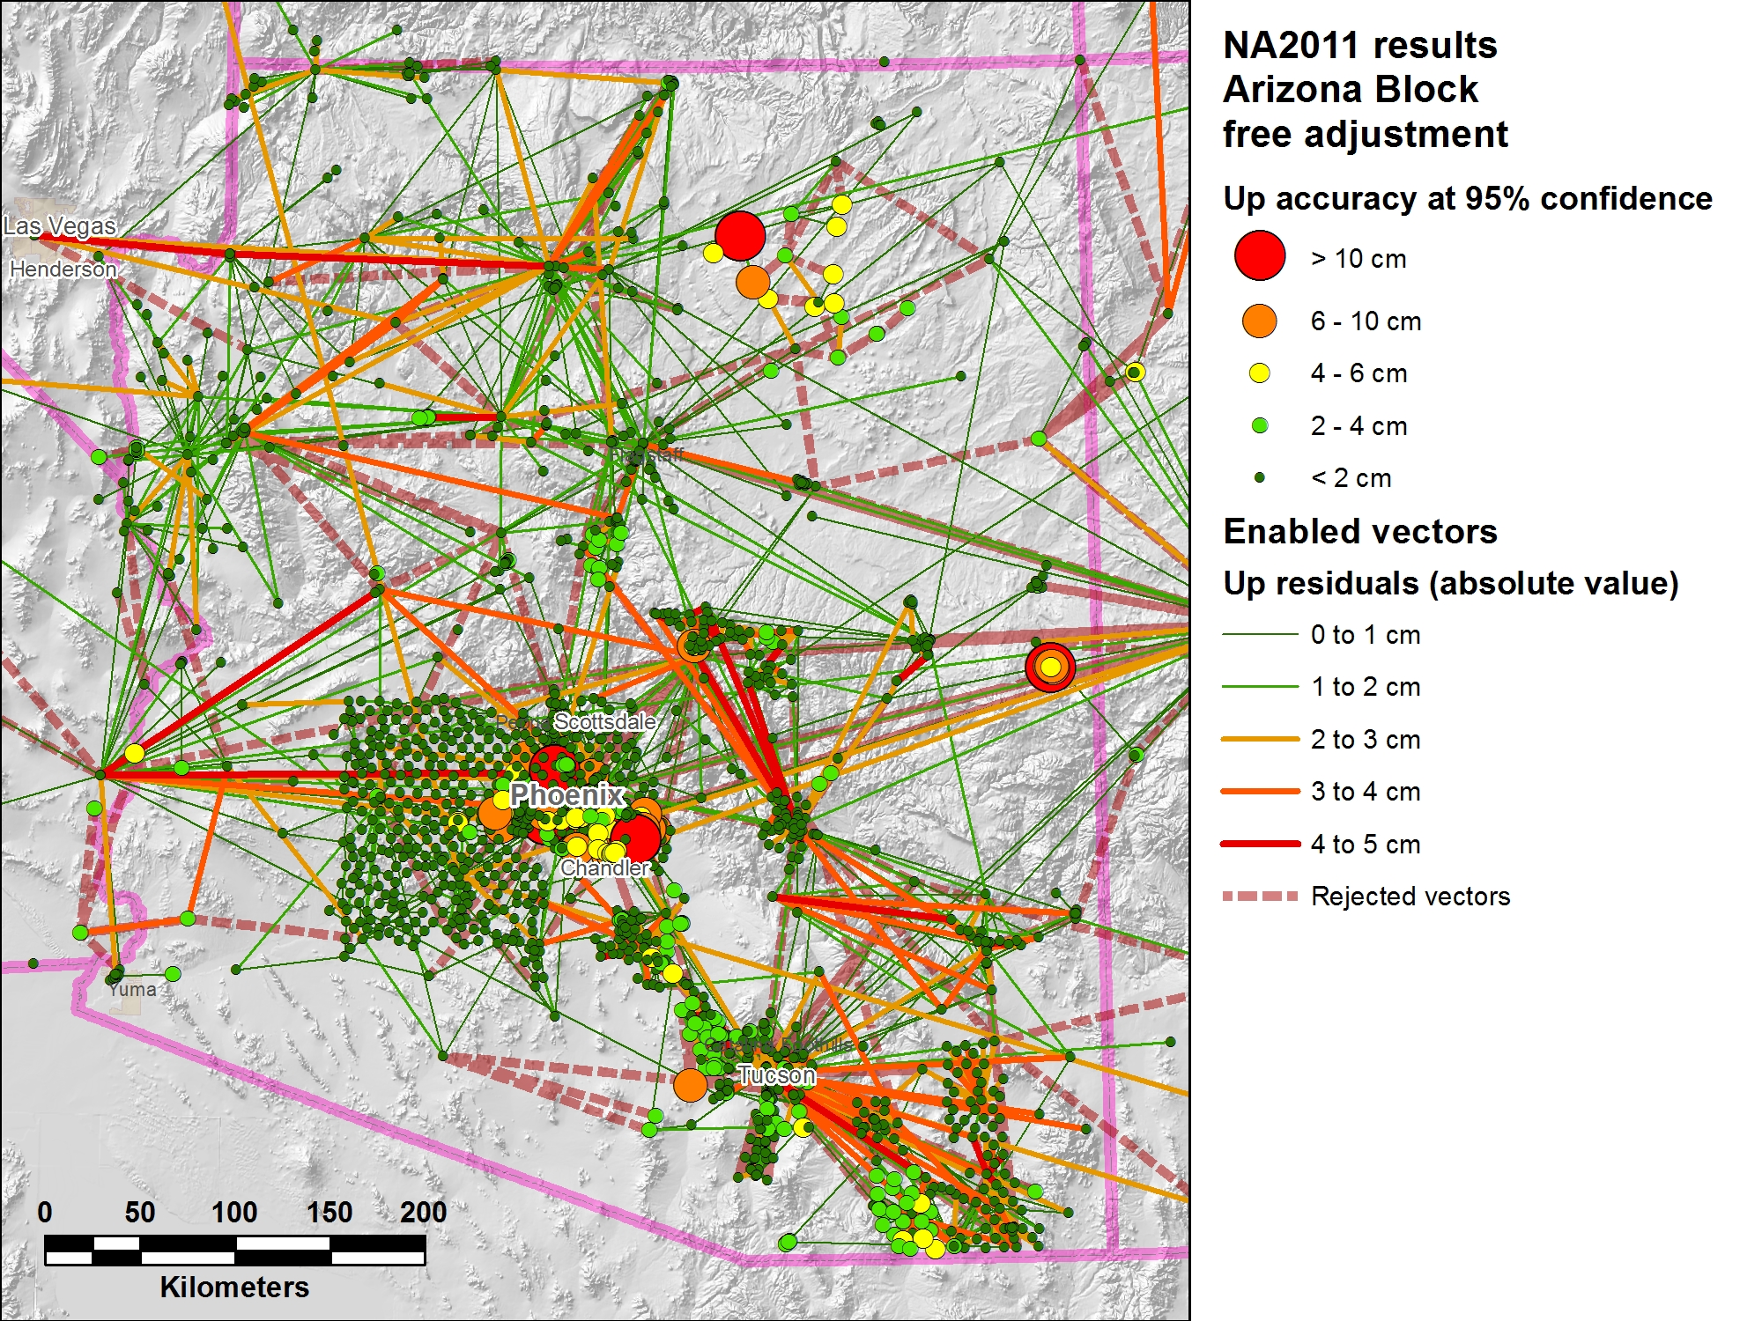
Adjustment using Triangulation of Reference Locations of Various Accuracies

Slide 10
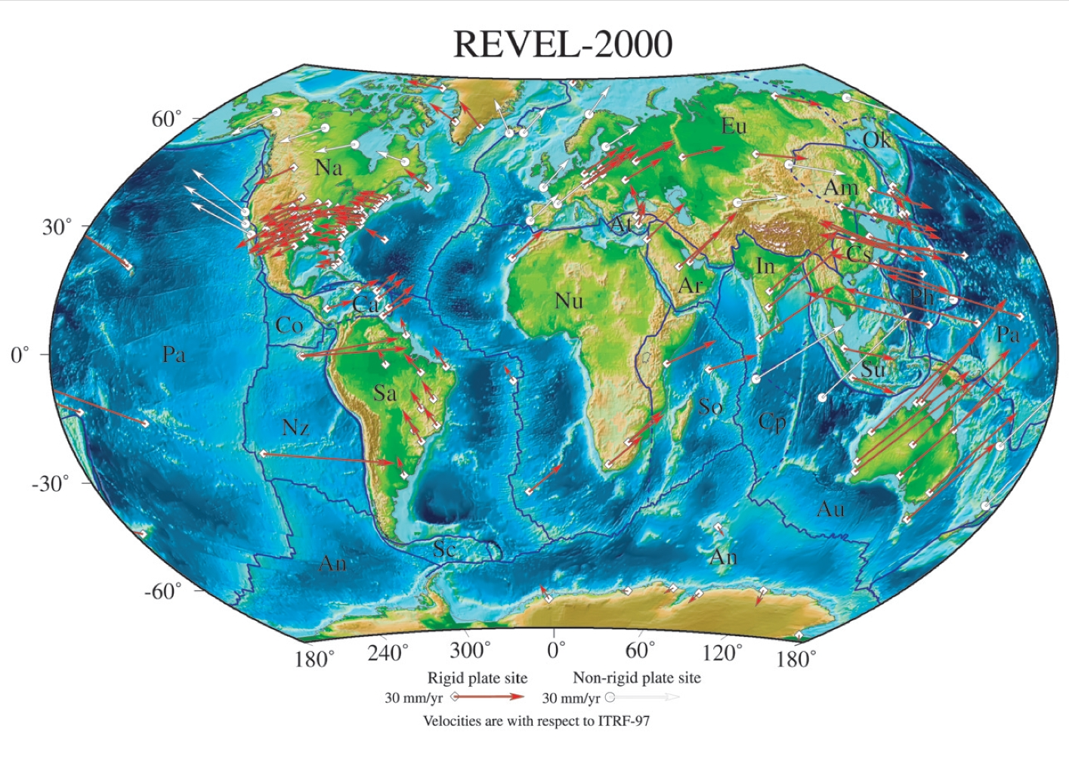
Tectonic Motions
This has to take Tectonic Motions into account
From Sella et al., 2002

Slide 11
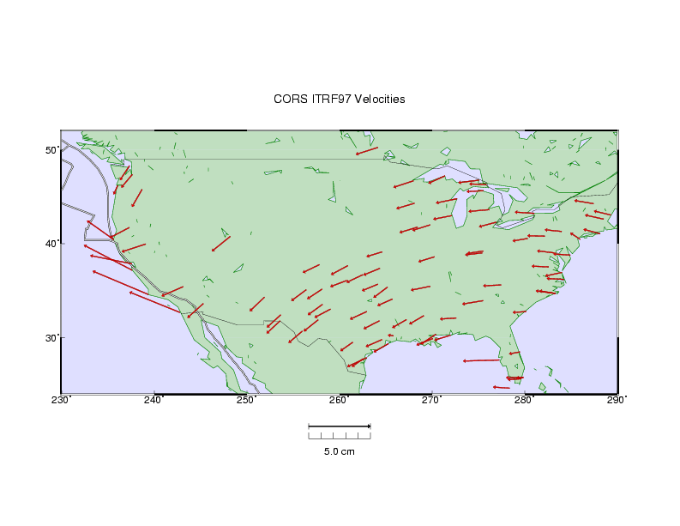
HORIZONTAL TECTONIC MOTIONS
Motion in cm/year
North American Plate
Pacific Plate
When is California not in North America …
…. when its on the Pacific Plate!

Slide 12
What’s in a name?
That which we call a datum By any other name would smell as sweet…
NAD 83(2011) epoch 2010.00
“2011” is datum tag → year adjustment complete
“2010.00” is “epoch date” (January 1, 2010)
Date associated with coordinates of control station
Frame fixed to North American tectonic plate
Includes California, Alaska, Puerto Rico, and US Virgin Islands
NAD 83(PA11) epoch 2010.00
Frame fixed to Pacific tectonic plate (Hawaii and American Samoa)
NAD 83(MA11) epoch 2010.00
Frame fixed to Mariana tectonic plate (Guam and CNMI)
The latest datum adjustments are referenced to location on a particular tectonic plate

