Slide 1
Stormwater Management in Chicago waterways: Basement Flooding and its prevention
Prepared by: Kyungmin Kim

Slide 2
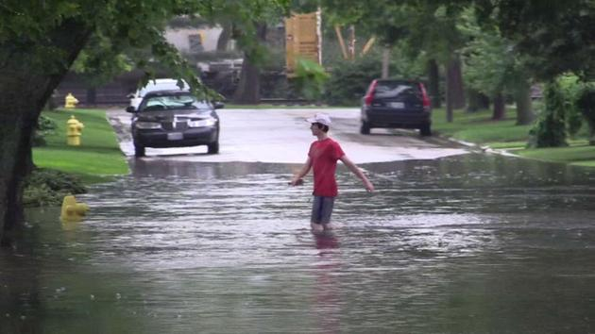
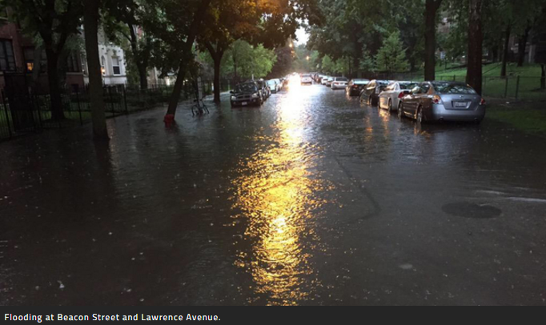
Project Area
Notes:
You may see or experience similar pictures of situation during the previous presentation or last month’s Halloween Flood.
It is always happening in Chicago during spring and early summer.
Pic1 :Heavy rain flooded streets in Elmhurst, Ill. on Monday.
Pic 2: Flooding at Bacon street and Lawrence Avenue

Slide 3
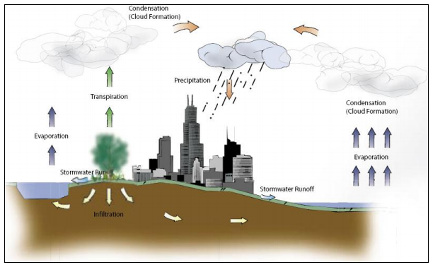
Project Area
Stormwater runoff
Stormwater runoff
Flooding
 | Net |  |  |  | Tree Cover Change |  | Impervious cover Change |  | Annualized net
 | Absolute Change |  | Relative Change |  |  |  |  |  | Absolute Changge |  | Relative Change
 | Tree | Imp | Tree | Imp | ha/yr | m^2/cap/yd | ha/yd | m^2/cap/yd | Tree | Imp | Tree | Imp
Chicago(2005-2009) | -0.5 | 0 | -2.7 | 0 | -70 | 0.02 | 0 | 0 | -0.13 | 0 | -0.69 | 0
20 City Ave. | -1.5 | 1.3 | -5 | 3.7 |  | -3 |  | 2.1 | -0.37 | 0.3 | -1.29 | 0.82
18 City Ave. | -1.1 | 1.4 | -3.8 | 3.9 |  | -0.19 |  | 2.2 | -0.27 | 0.31 | -0.9 | 0.87
Percent net and annualized net absolute and relative tree and impervious cover change in 20 U.S. cities (D.J. Nowak, E.J. Greenfield / Urban Forestry & Urban Greening 11 (2012) 21–30)

Slide 4
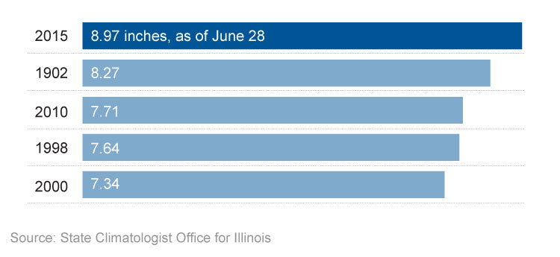
Project Area
Wettest June on record in Illinois
http://www.chicagotribune.com/news/ct-you-thought-right-june-breaking-rainfall-records-20150629-htmlstory.html
Notes:
The situation is getting problematic. This year, June, it was the wettest month during last 120 years.
The heavy June rain is part of a larger trend of wetness in the region over past decades
Rainfall in Illinois this month pushed over 8.97 inches, making this the wettest June since record keeping began in 1895, according to state climatologist Jim Angel. Before the record-setting weather this month, the wettest June on record was in 1902, when 8.27 inches fell.
http://www.chicagotribune.com/news/ct-you-thought-right-june-breaking-rainfall-records-20150629-htmlstory.html

Slide 5
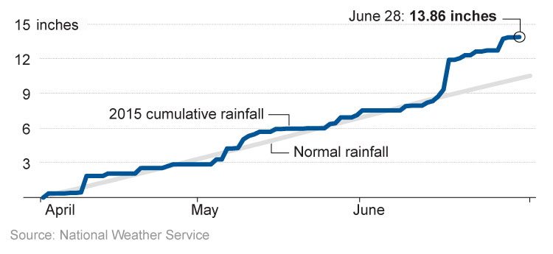
Project Area
Chicago Rainfall: 2015 vs. normal (cumulative by day)
http://www.chicagotribune.com/news/ct-you-thought-right-june-breaking-rainfall-records-20150629-htmlstory.html
Notes:
The heavy June rain is part of a larger trend of wetness in the region over past decades, Angel said.
"We are definitely in a period of altogether wetter conditions in the last 30 or 40 years," he said. "It's been overall wetter conditions than really any decade in the first half of the 20th century."
Chicago has also seen abnormal rain patterns this month, recording the 16th wettest June on the books, with 6.33 inches, according to National Weather Service meteorologist Mike Bardou. Chicago's wettest June was recorded in 1892, when the city got 10.58 inches of rain.
http://www.chicagotribune.com/news/ct-you-thought-right-june-breaking-rainfall-records-20150629-htmlstory.html

Slide 6
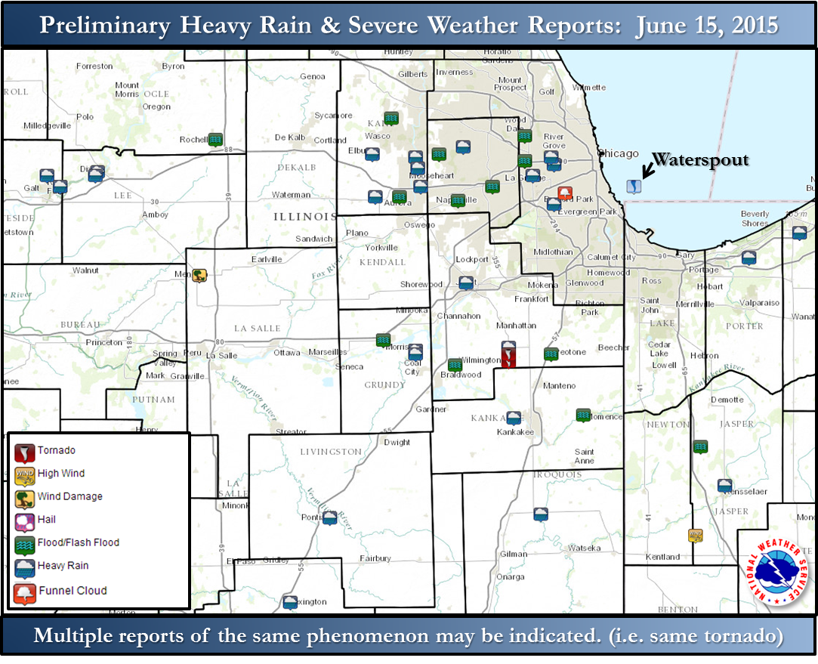
Project Area
Notes:
Chicago Flooding map in June 15, 2015
This is the Chicago Flooding map in this wettest month. Marked as GREEN squares illustrated where it was suffered from flood as you saw in previous slide.
However, Flooding in Chicago is not the recent problem. People who are in my area (Water resource management) designed huge and huge and deep and deep tunnel under the Chicago Area.

Slide 7
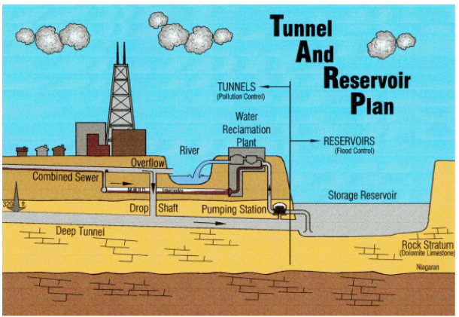
What is TARP?
Reservoir | Completion | Capacity (Gallon) | Flood damage reduction ($)
O’Hare | 1998 | 350 million | 250 million
McCook | 2017 | 10 billion | 114 million
Thornton | 2015 | 11 billion | 40 million
Notes:
So, TARP is an abbreviation of Tunnel and Reservoir Plan.
It is a series of deep, large diameter tunnel and big reservoir.
TARP was adopted by the Metropolitan Water Reclamation District of Greater Chicago (MWRDGC) in 1972 to solve the combined sewer overflow (CSO) pollution and flooding problems in Chicago area.
Reservoirs are located at the downstream ends of the tunnel to provide additional storage capacity for CSOs. And there are 3 tunnels which is Thornton, McCook and O’Hare Reservoir.

Slide 8
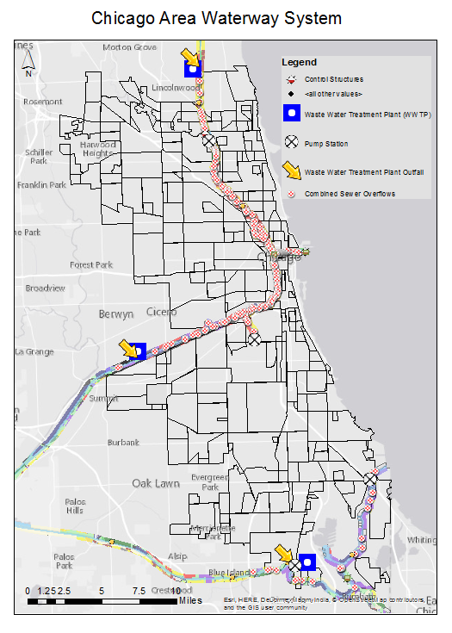
Project Area
Notes:
Chicago Flooding map in June 15, 2015
This is the Chicago Flooding map in this wettest month. Marked as GREEN squares illustrated where it was suffered from flood as you saw in previous slide.
However, Flooding in Chicago is not the recent problem. People who are in my area (Water resource management) designed huge and huge and deep and deep tunnel under the Chicago Area.

Slide 9
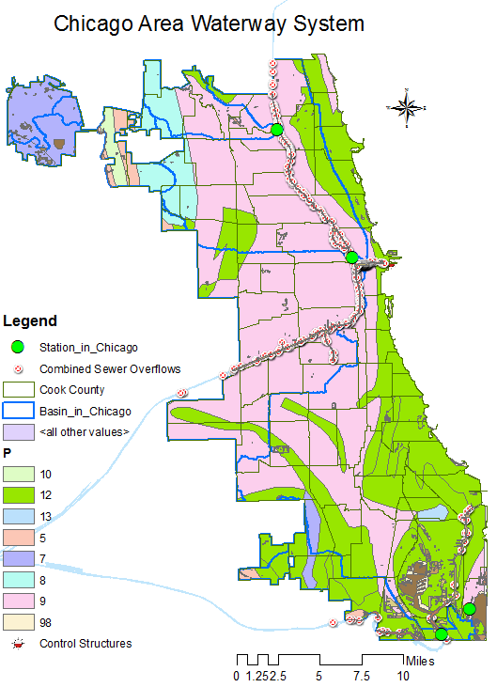
Future work
Only 4 Stations in this big city of Chicago?
 | Soil | Area(m^2) | %
10 | Sandy Clay | 581822780 | 3.339
12 | Clay | 1087259600 | 6.24
13 | Organic Materials | 2034917892 | 11.679
7 | Sandy Clay loam | 5218452024 | 29.95
8 | Silty clay loam | 705480450 | 4.049
9 | Clay loam | 4309253252 | 24.731
5 | Silt | 806876796 | 4.631
Notes:
0 - No data 1 - Sand 2 - Loamy sand 3 - Sandy loam 4 - Silt loam 5 - Silt 6 - Loam 7 - Sandy clay loam 8 - Silty clay loam 9 - Clay loam 10 - Sandy clay 11 - Silty clay 12 - Clay 13 - Organic materials 14 - Water 15 - Bedrock 16 - Other

Slide 10
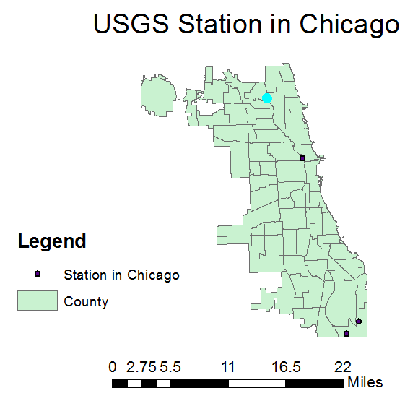
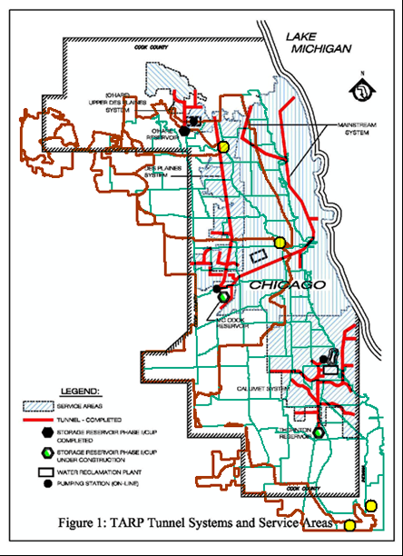
My Question: Is TARP working?
O’Hare Reservoir
USGS 05536105
NB CHICAGO RIVER AT ALBANY AVENUE AT CHICAGO, IL
USGS 05536118
N.B. Chicago River at Grand Ave at Chicago, IL
LAKE MICHIGAN
McCook Reservoir
Floodwater discharges to lake
USGS 04092500 Wolf Lake at Chicago, IL
Thornton Reservoir
USGS 05536358
CALUMET R BLW OBRIEN LOCK AND DAM AT CHICAGO, IL
Notes:
There are 4 USGS gage station in Cook County as know as Chicago. The right side of the map is Lake Michigan.
There are 3 reservoir and they are correlated with each stations

Slide 11
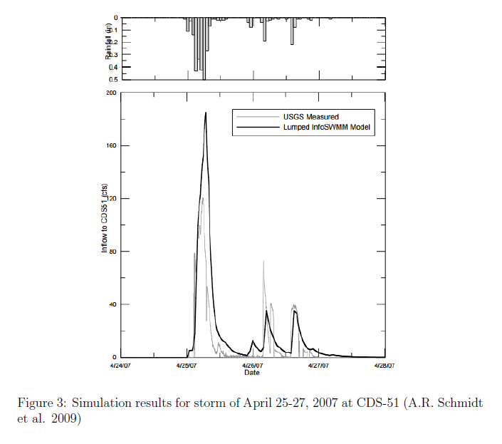
Comparison: Simulated vs. Measured

Slide 12
Future work
More simulation to compare the inflow data measured
from USGS and simulated from InfoSWMM
search for out flow data to estimate how much outflow
TARP system captured to prevent flooding in Chicago area
Visualize a flood map before/after the TARP project

Slide 13
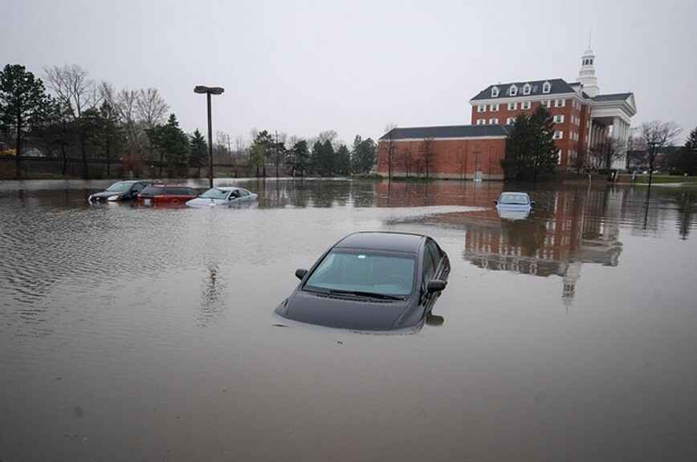
Question and more idea
Chicago Flood 2013

