Slide 1
Drinking Water Violations in Low Income Communities
GISWR 2017
Chinelo Agbim

Slide 2
Outline
Motivation
Purpose
Safe Drinking Water Act Policy Overview
Data Sets
Maps/Results
Looking Forward/Future

Slide 3
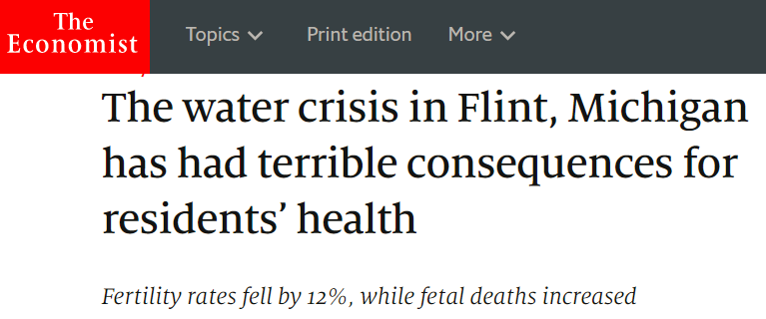
Motivation: Growing Spotlight of Aging Water Infrastructure

Slide 4
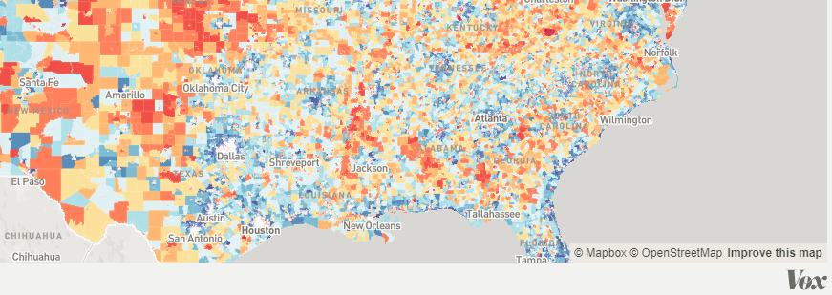
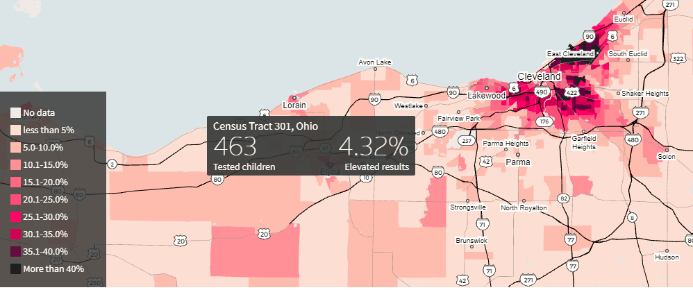
Drinking Water Contamination has Been Mapped A Lot But Not with Wealth
Natural Resource Defense Council
Vox
Reuters

Slide 5
Safe Drinking Water Act and Enforcement
Lead and Copper Rule
Other Violations:
Maximum Contaminant Level (MCL) vs. Maximum Contaminant Level Goal (MCLG)
Sampling Protocol
Issues with Sampling and Reporting
EPA does not have Flint POTW listed as a lead MCLG violation
Roughly 90% of drinking water violations only have informal actions

Slide 6
Purpose: Map Correlation Between Drinking Water Violations and Wealth
Number of in Facilities Each County with:
(1) At least One General Drinking Water Violations: Data for Past 3 Years (both small and large water systems)
(2) At least One Lead & Copper Violations: Data for Past 5 years
Texas and California used because they have similar:
Percent of Poverty
High Population
Opposing Standards on Environmental Regulation
Why Poverty and Not Income?
Poverty has a Nationwide Standard

Slide 7
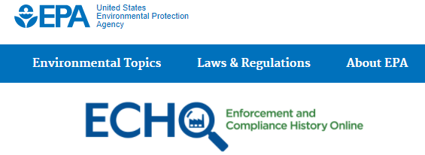
Data Sets Used
Census Bureau-Poverty by County
US.gov- shapefiles for Counties
EPA: ECHO-Water Facility EPA Compliance Website by Address

Slide 8
Map of Poverty and Water Violations

Slide 9
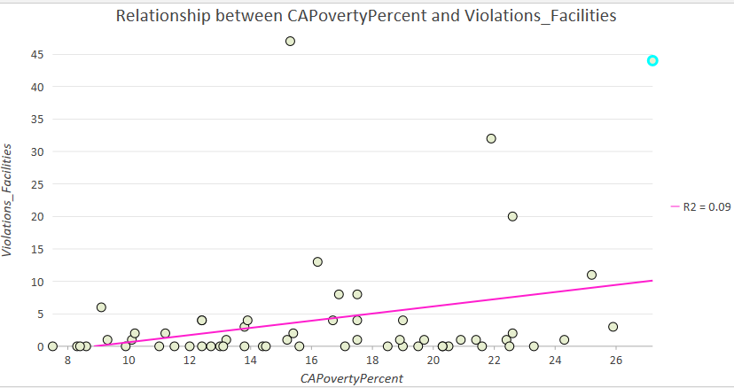
CA Poverty and Water Violations

Slide 10
Map of Poverty and Water Violations

Slide 11
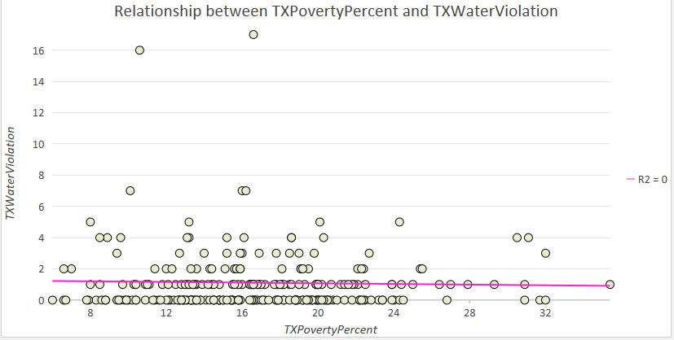
TX Poverty and Water Violations

Slide 12
Map of Poverty and Lead & Copper Violations

Slide 13
Map of Poverty and Lead & Copper Violations

Slide 14
Future Work
Create a map of number of:
Number of people served by these systems in each county
Poverty in each county
Create plot of correlation between poverty and Lead and Copper Rule Violations
Report will elaborate on formal and informal enforcement actions in report

