Slide 1
CE 384N GIS in water resources Flooding in Houston during Hurricane Harvey
Yun Liu (Lorraine)
11/27/2018

Slide 2
Outline
Background
Data
Methods
Results

Slide 3
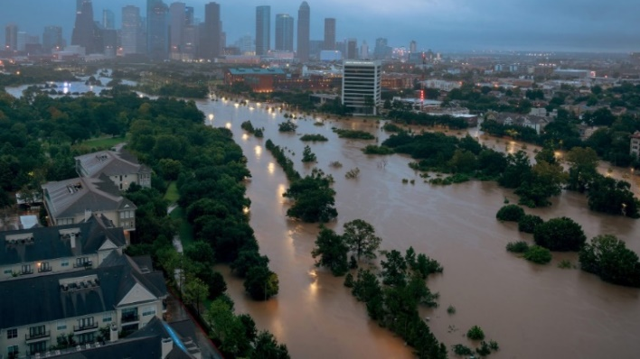
background
Hurricane Harvey of 2017 formed catastrophic rainfall-triggered flooding in the Houston metropolitan area and Southeast Texas.
In a four-day period, many areas received more than 40 inches of rain.
The resulting floods inundated hundreds of thousands of homes, which displaced more than 30,000 people.

Slide 4
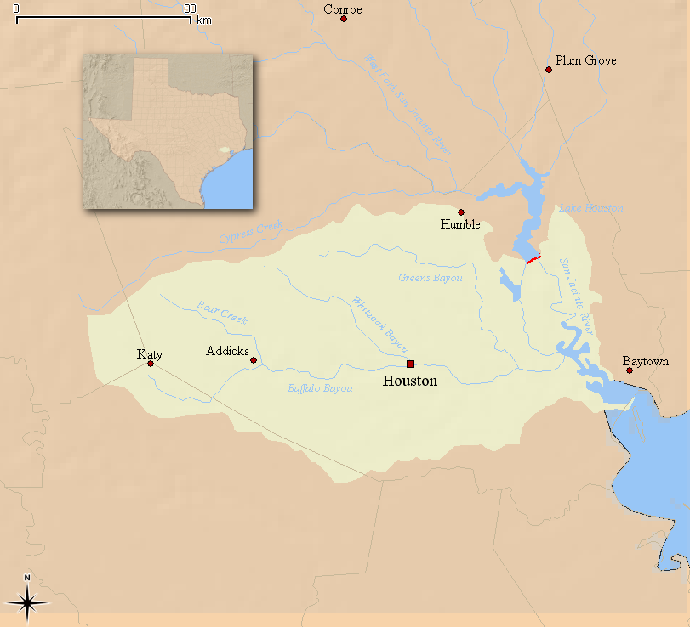
background
The Buffalo Bayou watershed is primarily located in west-central Harris County with a small portion crossing into Fort Bend County.
Nearly 80 percent of the Watershed is urbanized yielding a high percentage of impervious land area. Problems associated with this level of urbanization include flooding, poor water quality etc.
Based on the 2010 U.S. Census, the estimated population of the Buffalo Bayou watershed is 444,602.

Slide 5
data
DEM
-USGS 1/3 arc-second DEM
Hydrology Data
-NHD PLus V2 (Flowlines, Watersheds, Catchments)
Water-level Data
-USGS
-NOAA
Boundary (Developed from NHD Plus Sub-watersheds)

Slide 6
Methods
Interpolation
The Interpolation tools create a continuous (or prediction) surface from sampled point values. Kriging is a geostatistical method of interpolation. It is based on statistical models that include autocorrelation.

Slide 7
Methods
Using raster calculator tool and set the condition as "Buffalo DEM"-"Water Surface "<0 and did the raster calculation. The output provided a raster file with values of 1 where the elevation is lower than water surface and 0 everywhere else.

Slide 8
Methods
Using raster calculator tool and set the condition as "Buffalo DEM"-"Water Surface "<0 and did the raster calculation. The output provided a raster file with values of 1 where the elevation is lower than water surface and 0 everywhere else.

Slide 10
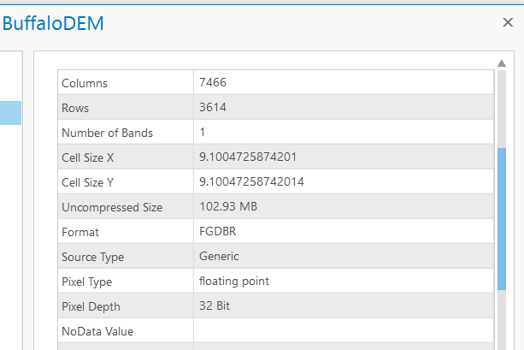
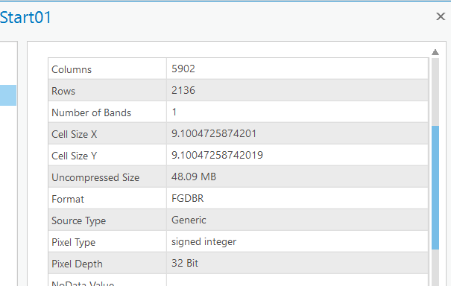
Methods
HAND
Just as we learnt in Exercise 5, but I encountered some problems with the dimensions of my Start.tif, which lead to a failure when doing flow accumulation.

Slide 11
Methods
GeoFlood
GeoFlood is a method designed for mapping real-time inundation extents using high-resolution terrain inputs at low computational cost. It couples the effective Height Above Nearest Drainage (HAND) method and GeoNet, a channel extraction method designed for high-resolution lidar-derived terrain data.
Easy to use and does not charge for using.
Once finished for the first
time, could generate
real-time flood map easily
with NWM forecast data.
Poor fault-tolerance.

Slide 12
Future Work
HAND
-Find out how to develop Start.tif with correct dimensions and finish the mapping.
GeoFlood
-Convert the water-level data from USGS gages into required format, plug into the model and develop the inundation map.
-Compare the difference between maps developed from different methods and real map

Slide 13
acknowledgement
David R. Maidment
Xing Zheng

Slide 14
Questions?

Slide 15
Thanks!

