Slide 1
Science is the key to improving our fresh water
David R. Maidment
Center for Water and Environment
University of Texas at Austin
Presented to Local Government New Zealand Freshwater 2017 Conference
Wellington, New Zealand | 30 May 2105
Acknowledgements: US National Weather Service, US academic colleagues and students,
Open Geospatial Consortium, Horizons Regional Council, NIWA.

Slide 2
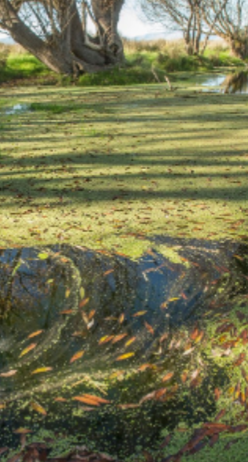
Four water problems to be solved
Flood
Drought
Water Pollution
Ecological Degradation
Notes:
There are four basic problems to be solved in natural water systems:
Flooding – how to characterize and mitigate floods
Droughts – how to assess water availability and define water supply
Dirty water – how to assess water quality assessment and calculate Total Maximum Daily Load estimates
Environmental Issues – how to ensure that there is enough water quantity and quality to support aquatic life?

Slide 3
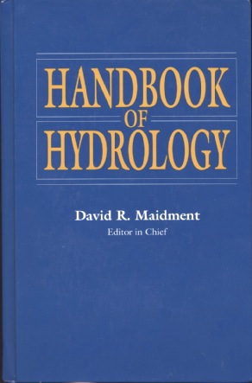
How is new knowledge discovered?
After completing a Handbook of Hydrology, I asked myself the question: how is new knowledge discovered in hydrology?
Deduction from existing knowledge
By deduction from existing knowledge
By experiment in a laboratory
By observation of the natural environment
Experiment in a laboratory
Observation of the natural environment
Notes:
After completing a Handbook of Hydrology, I asked myself the question: how is new knowledge discovered in hydrology?
<Click> to show answers
By deduction from existing knowledge
By experiment in a laboratory
By observation of the natural environment

Slide 4
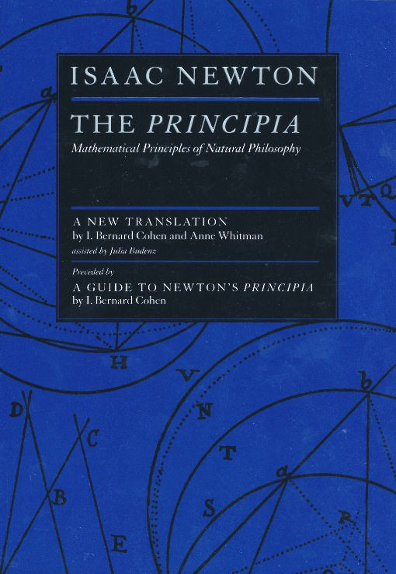
Deduction – Isaac Newton
“The ancients divided mechanics into two parts; the rational, which proceeds accurately by demonstration; and the practical.
It occurs that mechanics is so distinguished from geometry, that what is perfectly accurate is called geometrical, what is less so, is called mechanical. Yet the errors do not come from the art but from those who practice the art.
In this sense rational mechanics will be the science of motions resulting from any forces whatsoever, and of the forces required to produce any motions, accurately proposed and demonstrated.”
Isaac Newton
Trinity College, Cambridge
8 May, 1686

Slide 5
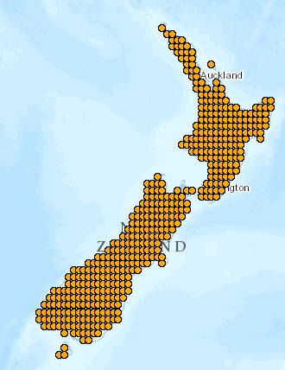
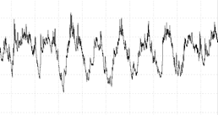
Computer Modeling as Deduction
Deduction is the classical path of mathematical physics:
Given a set of axioms
Then by a logical process
Derive a new principle or equation
Processes varying in
space and time
Computer Modeling is a modern equivalent that says:
Given a set of input data
Then using an algorithm
Derive a computational result
Space
Time

Slide 6
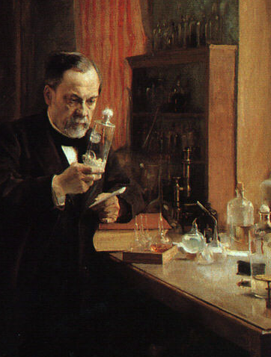
Experiment – Louis Pasteur
Experiment is the classical path of laboratory science – a simplified view of the natural world is replicated under controlled conditions
Pasteur showed that microorganisms cause disease and discovered vaccination
a foundation of scientific medicine
Laboratory experiments are more for microscale than the macroscale
hard to conduct at the global scale
Experiment – a simplified view of the natural world is replicated under controlled conditions
Pasteur showed that microorganisms cause disease and discovered vaccination
a foundation of scientific medicine
Laboratory experiments are more for microscale than the macroscale
Important for water chemistry and microbiology
Notes:
Experiment is the classical path of laboratory science – a simplified view of the natural world is replicated under controlled conditions
Pasteur showed that microorganisms cause disease and discovered vaccination
a foundation of scientific medicine
Laboratory experiments are more for microscale than the macroscale
hard to conduct at the global scale

Slide 7
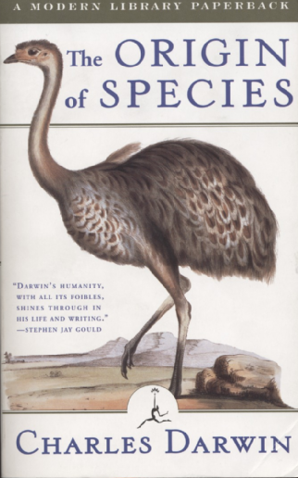
Observation – Charles Darwin
“When on board H.M.S. Beagle, as naturalist, I was much struck with certain facts in the distribution of the inhabitants of South America, and in the geological relations of the present to the past inhabitants of that continent. These facts seemed to me to throw some light on the origin of species -- that mystery of mysteries, as it has been called by one of our greatest philosophers. On my return home, it occurred to me, in 1837, that something might perhaps be made out on this question by patiently accumulating and reflecting on all sorts of facts which could possibly have any bearing on it.
I can here give only the general conclusions at which I have arrived, with a few facts in illustration, but which, I hope, in most cases will suffice.”
Published 24 November,1859
Most accessible book of great
scientific imagination ever written

Slide 8
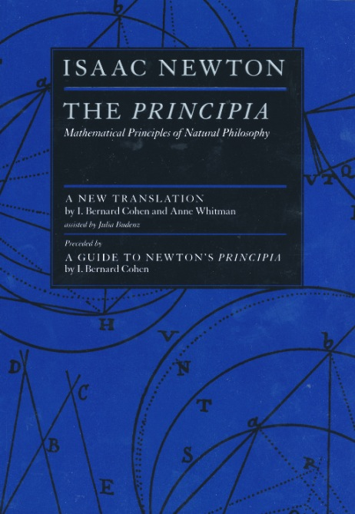
Integrating Modeling and Observations
Deduction
Observation
National
Water Model
Precise
but Sparse
Comprehensive
but Approximate

