Slide 1
Questions concerning the Halloween Flood in Onion Creek
Presentation by David R. Maidment Center for Research in Water Resources University of Texas at Austin
Public Safety Commission City of Austin 7 July 2014

Slide 2
David R. Maidment
On the faculty of the University of Texas at Austin since 1981 in the Civil, Architectural and Environmental Engineering Department
Teach hydrology, hydraulics and geographic information systems in water resources
Chair of National Academy of Science Reviews of FEMA Floodplain Mapping in 2007 and 2009, and presently on the National Academies Committee on Flood Insurance Affordability
Chair of the National Academies Mapping Sciences Committee

Slide 3
Three Questions Posed by the City of Austin
Unique characteristics of the Onion Creek watershed and to compare and contrast the Halloween flood with previous floods in that watershed
Impervious cover and its effect on the flood waters that day
Future risk, particularly in light of continued rapid urban growth in this part of central Texas

Slide 4
Three Questions
Unique characteristics of the Onion Creek watershed and to compare and contrast the Halloween flood with previous floods in that watershed
Impervious cover and its effect on the flood waters that day
Future risk, particularly in light of continued rapid urban growth in this part of central Texas

Slide 5
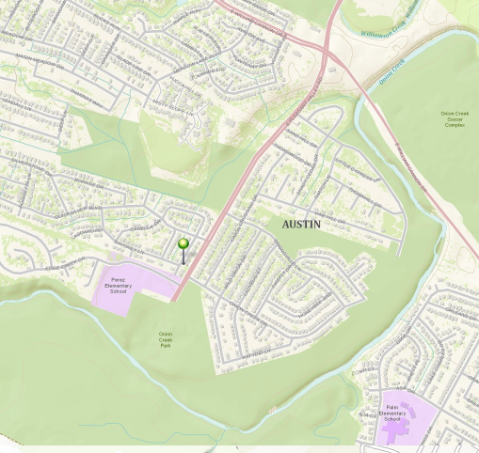
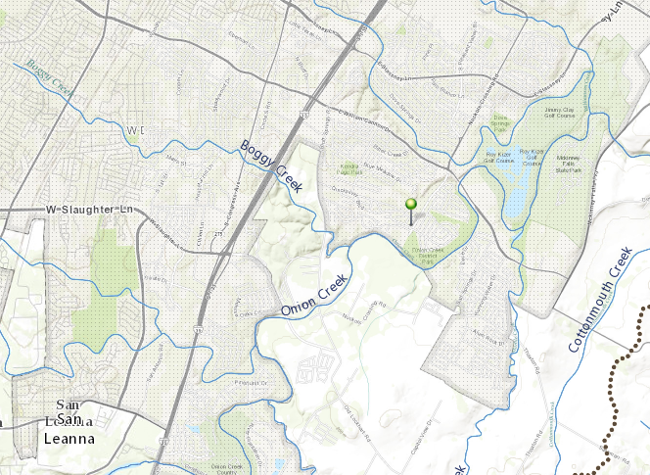
Onion Creek Flooding, 30-31 October 2013
IH-35
William Cannon Dr
A flooded home location

Slide 6
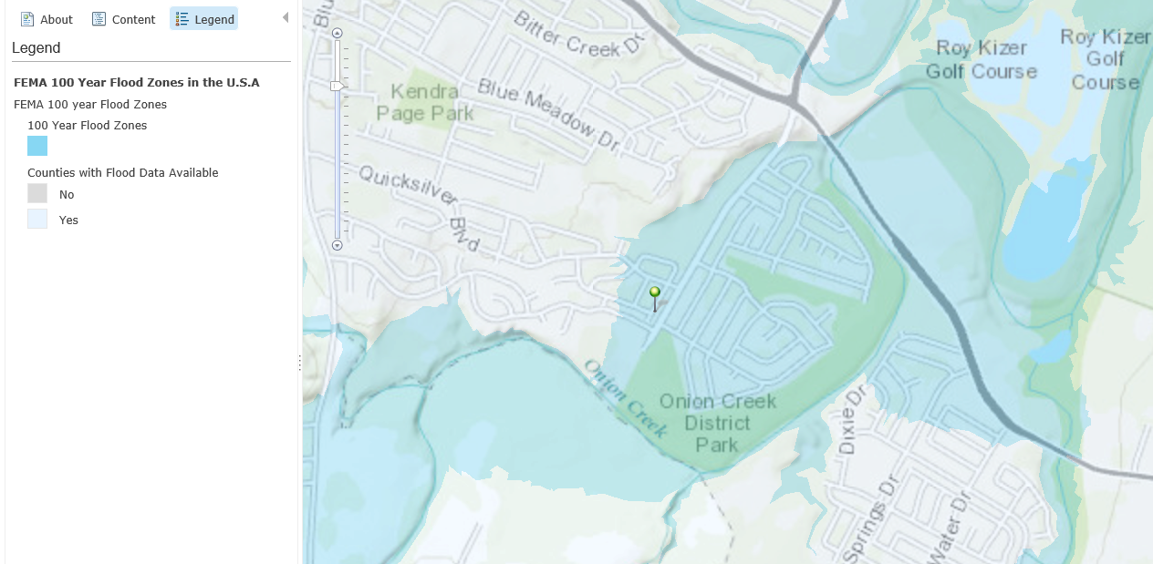
FEMA Flood Hazard Zone

Slide 7
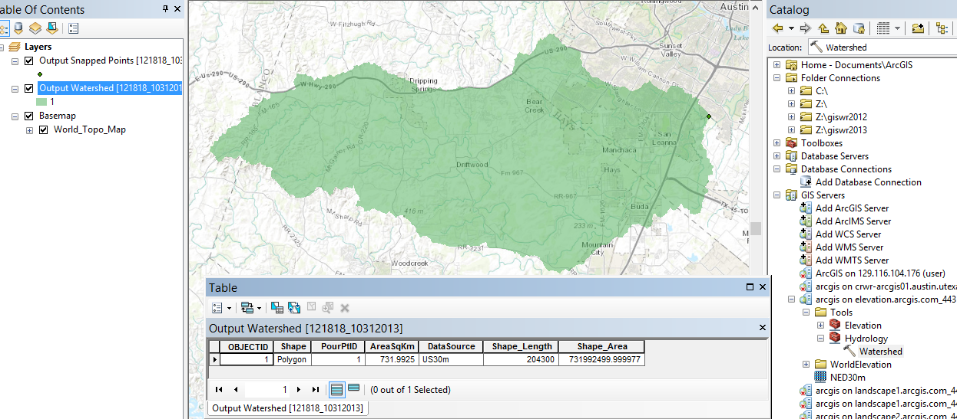
Drainage Area above Home
Drainage area = 732 km², or 282 miles²
Watershed delineation using ESRI Watershed Delineation Services

Slide 8
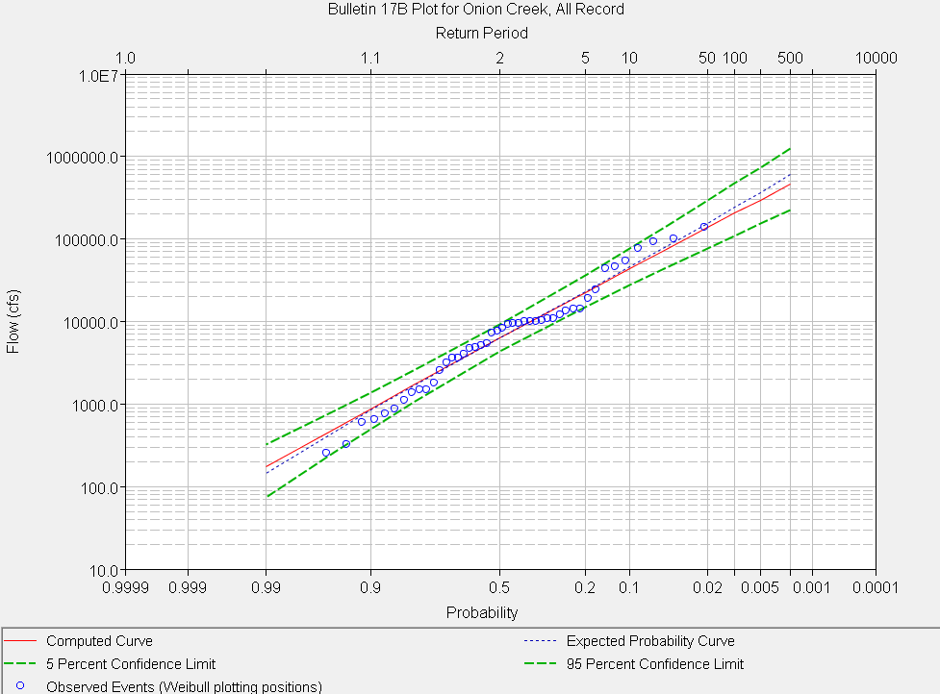
Frequency Analysis of Halloween Flood
Return Period (Years)
Halloween Flood (135,000 cfs)
Discharge (cfs)

Slide 9
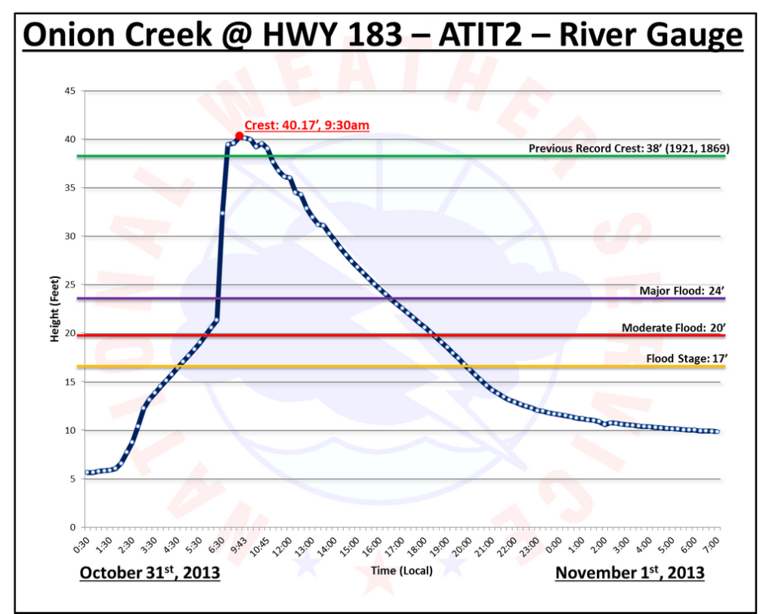
Flood Water Elevations
Halloween Flood
Hurricane Storm Surge on Gulf Coast
16 ft above major flood stage
16 ft of storm surge ~ Cat 3 hurricane

Slide 10
Responses to Question One
Unique characteristics of the Onion Creek watershed and to compare and contrast the Halloween flood with previous floods in that watershed
Onion Creek has a huge watershed equivalent in area to the entire City of Austin
The area flooded during the Halloween flood is within the 100-year floodplain defined by FEMA
The magnitude of the observed flood is within the range that could have been anticipated from past flood events. It is not “off the charts”
The flood peak stage was about 16 ft above “major flood stage” ~ Category 3 hurricane storm surge on the Gulf Coast

Slide 11
Three Questions
Unique characteristics of the Onion Creek watershed and to compare and contrast the Halloween flood with previous floods in that watershed
Impervious cover and its effect on the flood waters that day
Future risk, particularly in light of continued rapid urban growth in this part of central Texas

Slide 12
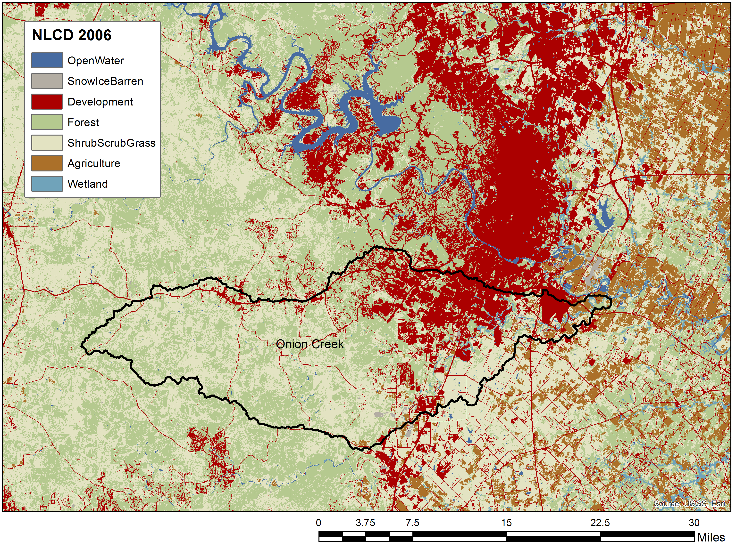
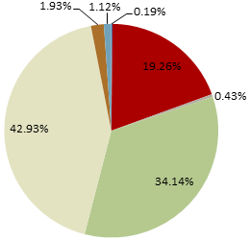
Land Cover in the Onion Creek Watershed (2006)
4% Other
19% Developed
43% Shrub,
Grass
34% Forest

Slide 13
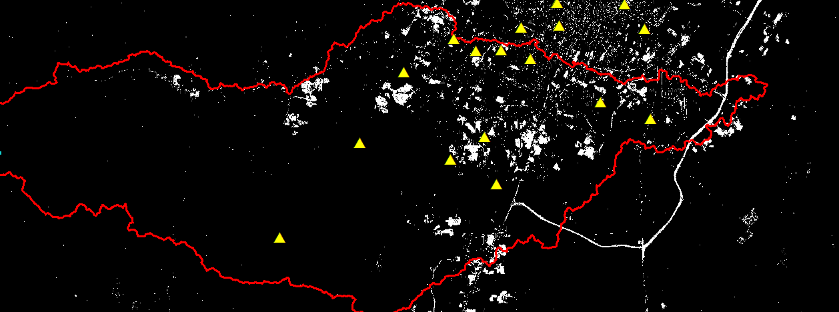
From NLCD – Change in Impervious Cover from 2001 to 2011

Slide 14
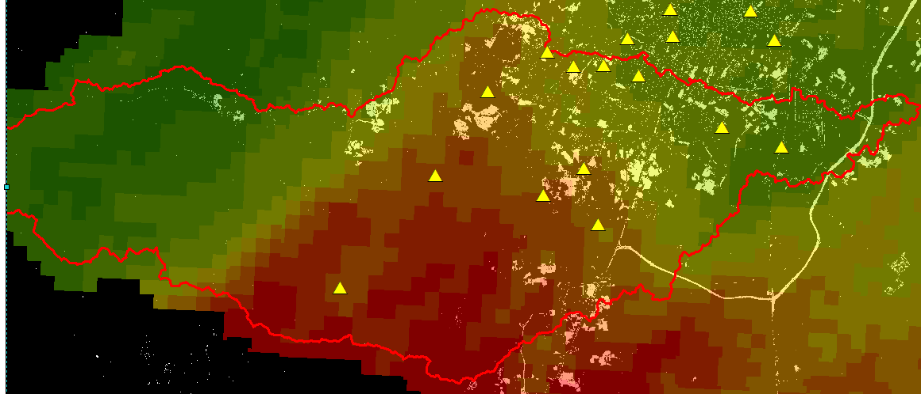
Change in Impervious Cover from 2001 – 2011 with Halloween Rainfall

Slide 15
Upper Onion Creek Future Conditions Study (City of Austin)
Hays County Master Plan
% impervious cover increased to 15% in each subbasin unless already greater than 15%, then left unmodified
Average increase in design flow at Twin Creeks gage
25-year flow increases from 47,300 to 50,200 cfs
100-year flow increases from 87,600 to 89,300 cfs
Evaluation of Increased Development in Buda Area
% impervious cover within Buda ETJ increased to 47%
Less than 0.5% incremental increase in flow over master plan
Note: Hays County master plan design flows are lower than the effective FEMA flows. For details please refer to City of Austin Watershed Protection Department
Notes:
There were two steps in the evaluation of future conditions in the upper Onion watershed.
As part of the Hays County study, Halff Associates (with input from Hays County staff) projected a 2040 development condition for the watershed. In order to represent this condition they a) increased impervious cover for all subbasins in the model to a minimum of 15% (equivalent to low density residential land use) and b) adjusted Snyder lag times based on an assumption of a minimum level of “urbanization” (a measure of the extent of improvement expected in the drainage system associated with land use).
The City took this analysis one step farther. We increased the projected level of development within the ETJ of the City of Buda to levels equivalent to the fully developed condition assumed for adjacent City of Austin watersheds (South Boggy Creek and a portion of Slaughter Creek). These levels exceed those assumed by Halff Associates in the Hays County study. We did this for both the existing and 2040 condition models from the Hays County study.
There are a number of residents that were impacted by the flood that have voiced the opinion that development in and around Buda has had a significant impact on the amount of flow generated by the upper watershed. The Hays County study considered increased development throughout the entire watershed. The City’s effort looked more specifically at development in the Buda area.
The Hays County study 2040 projection scenario produced a 6.28% increase in the 25-year event and a 1.93% increase in the 100-year event. The 2040 projection with the City’s assumptions for denser development in the Buda area produced increases of 6.40% and 1.97% in the 25-year and 100-year event respectively. For this modeling, the impervious percentage in the upper watershed was increased from an area-weighted average of 11.9% to 17.7%. The change in flow due to the assumptions for denser development in the Buda area resulted in a less than 0.5% increase over both existing and projected 2040 conditions (area-weighted average of 19.8% for the upper watershed, 47% within the Buda ETJ).
The more conservative assumptions used in the effective FEMA and City of Austin regulatory models (from FEMA Map Modernization study that became effective in 2008) produced an increase from 95,180 cfs to 108,058 cfs (13.53%). For this modeling, the impervious percentage in the upper watershed was increased from an area-weighted average of 11% to 43%.

Slide 16
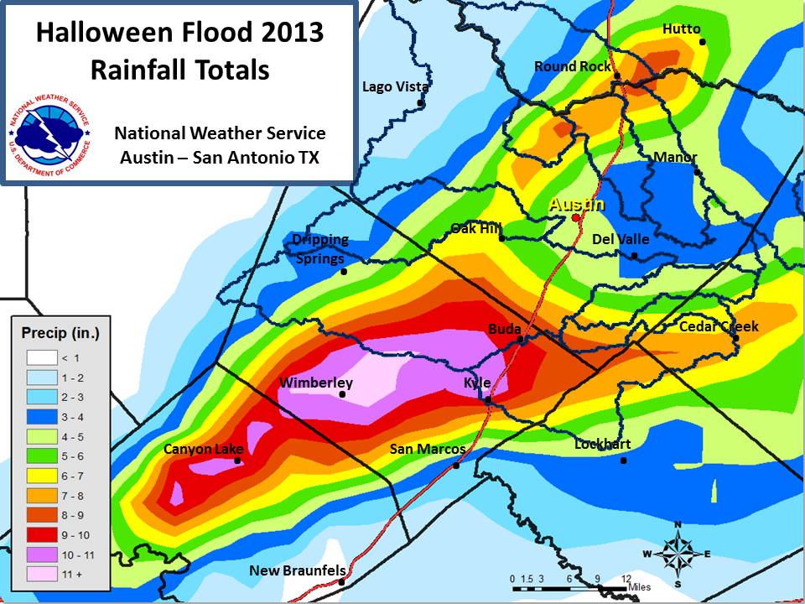
Actual Rainfall Totals
Onion Creek watershed

Slide 17
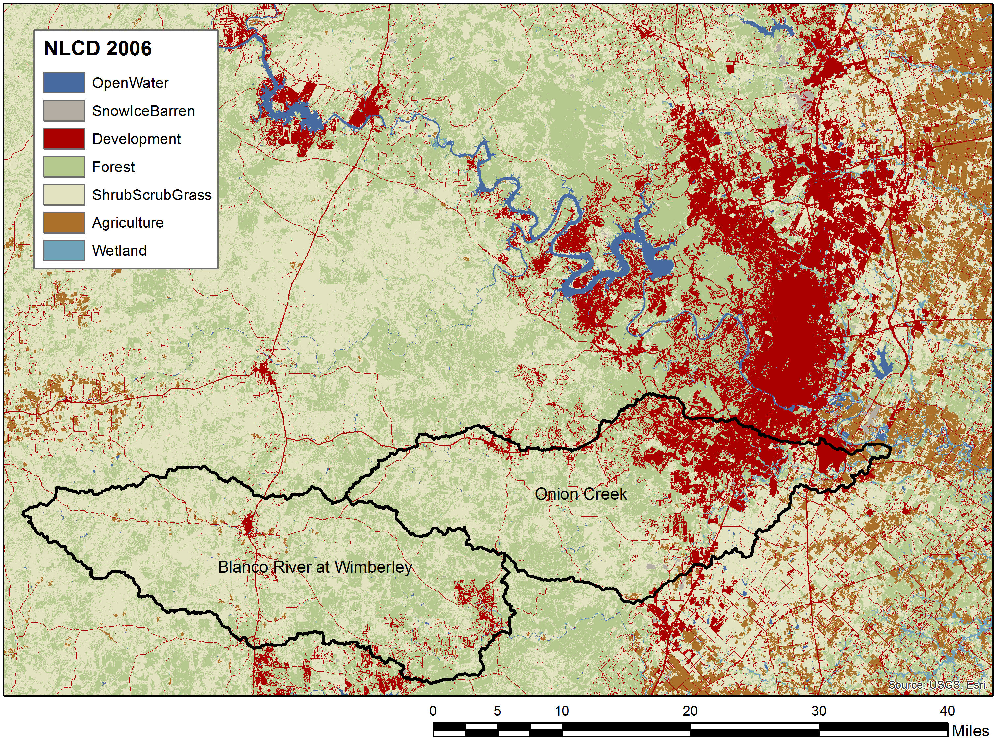
Onion Creek and the Blanco River

Slide 18
Responses to Question Two
Impervious cover and its effect on the flood waters that day
Onion Creek is about 20% developed, concentrated in the lower end of the watershed
In Halloween Flood, the major rainfall was over the rural part of Onion Creek not the urbanized part
Urbanization did not have a major effect on the Halloween flood but could do so in future storms if rainfall were centered on the lower part of the watershed

Slide 19
Three Questions
Unique characteristics of the Onion Creek watershed and to compare and contrast the Halloween flood with previous floods in that watershed
Impervious cover and its effect on the flood waters that day
Future risk, particularly in light of continued rapid urban growth in this part of central Texas

Slide 20
Anne Castle, Asst Secretary for Water and Science, Dept of Interior
“Today we have unprecedented opportunities to use science and technology to create a better understanding of one of our most precious resources – water”
“I am committed to working with you to do that”
New Open Water Data Initiative
Chair

Slide 21
National Water Center
Opened by National Weather Service at the University of Alabama in Tuscaloosa in May 2014
Will synthesize work of present 13 regional River Forecast Centers
Like National Hurricane Center
Offers new opportunities to integrate national and local efforts for flood forecasting

Slide 22
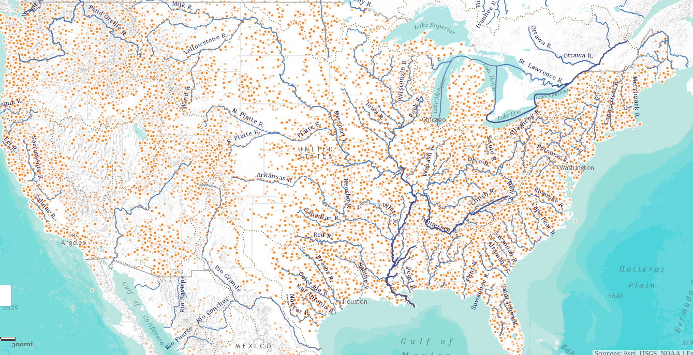
National Water Data Infrastructure
David R. Maidment,
University of Texas at Austin
NWS National Water Center Opening
Tuscaloosa, Alabama
13 May 2014
Complete presentation: http://www.caee.utexas.edu/prof/maidment/meetings/NWSTuscaloosa/NWDITuscaloosa.pptx

Slide 23
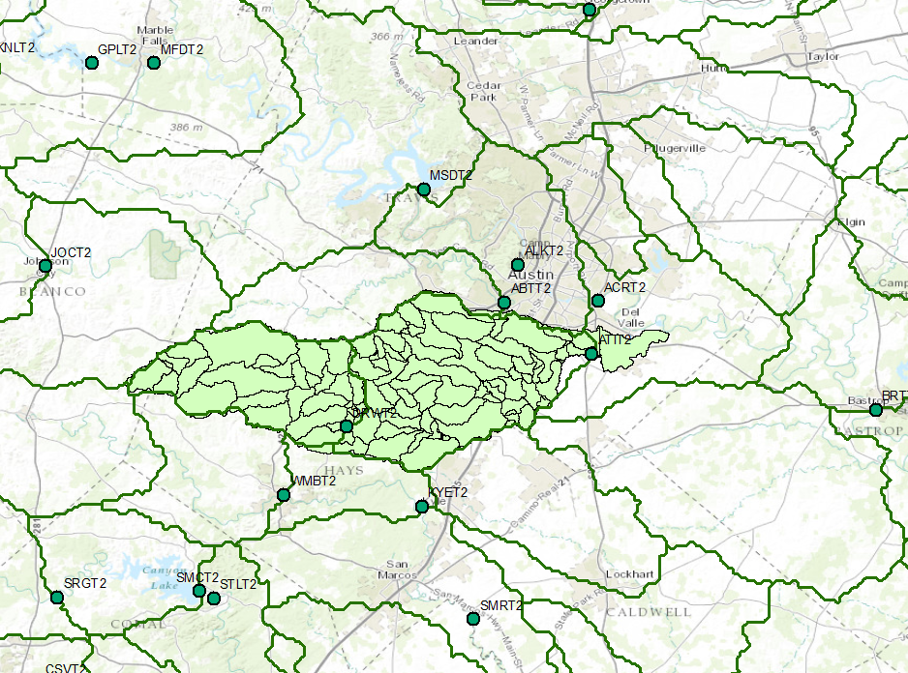
National and Local Flood Modeling
City of Austin
NWS River Forecast Center

Slide 24
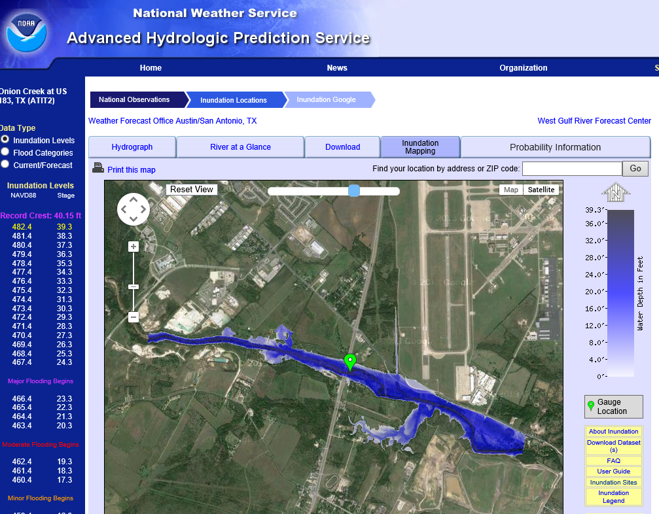
Real-Time Flood Inundation Mapping on Onion Creek (USGS/NWS)
Gage at Highway 183
http://water.weather.gov/ahps2/inundation/inundation_google.php?gage=atit2

Slide 25
FEMA Flood Hazard Zone

Slide 26
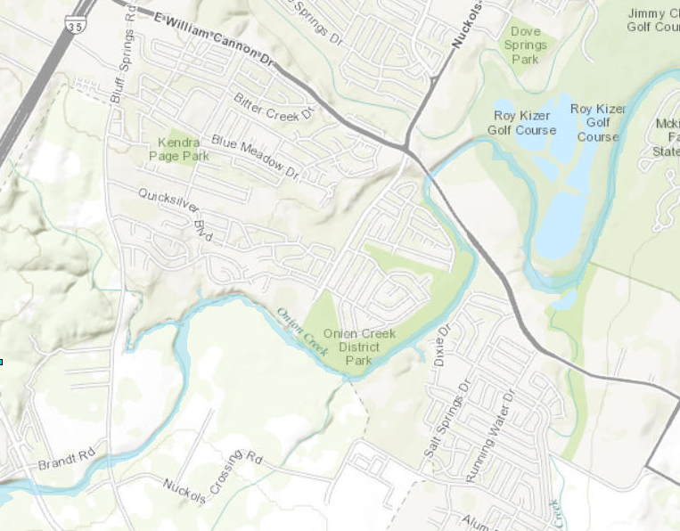
17’ AHPS Flood Warning Stage

Slide 27
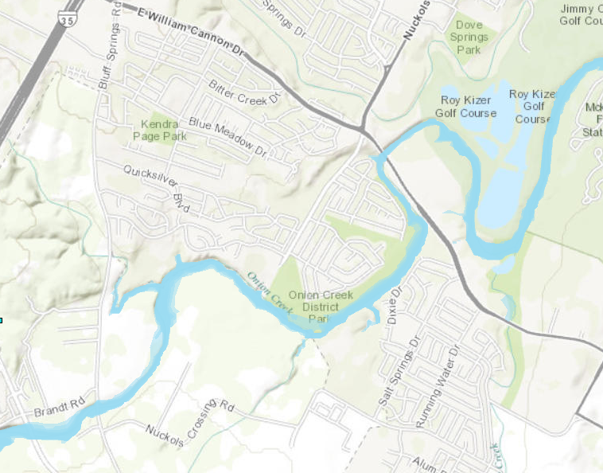
21’ NWS issues Flood Warning for Onion Creek (issued at 02:44)

Slide 28
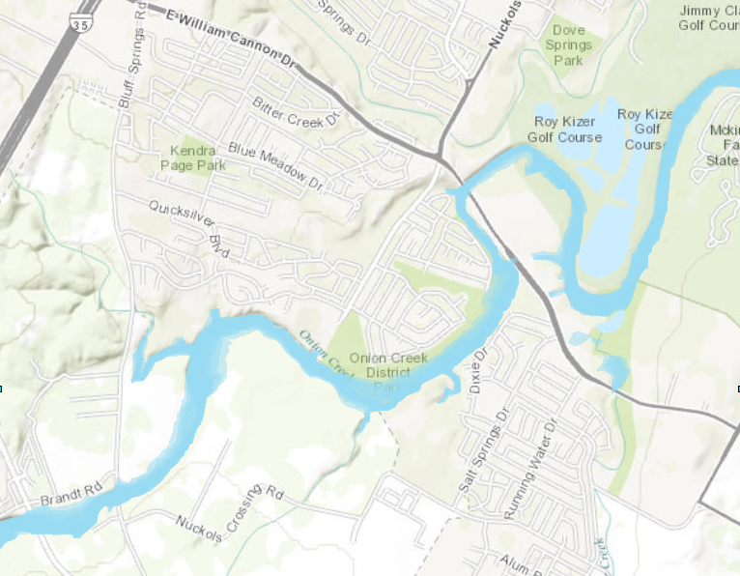
25’ NWS issues Flood Warning for Onion Creek at 03:40 – gauge will rise to 25.9’

Slide 29
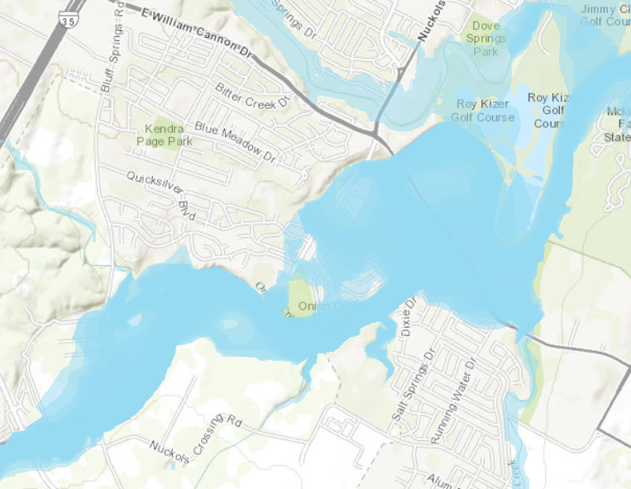
41’ -- At 10:07 – peak of USGS gauge – 40.97’

Slide 30
Inundation Mapping
Flood emergency response is tied to the extent of inundation
Prepare flood response plan using a “library of inundation maps”
1 ft level increments on all major streams
During flood events make probabilistic projections of what flood stage will be reached
Work with National Weather Service through National Water Center to create an improved real-time flood data, modeling and inundation mapping procedure

Slide 31
Responses to Question Three
Future risk, particularly in light of continued rapid urban growth in this part of central Texas
Flooding is a regional phenomenon
More detailed modeling of flooding at NWS is feasible through National Water Center
Flood inundation mapping is the key interface between hydrology and flood emergency response planning
Propose Austin and Halloween Flood as a case study for the National Water Center

