Slide 1
Broader Applications
Data Hubs, Interoperability, and Floods – Klaus Kisters

Slide 2
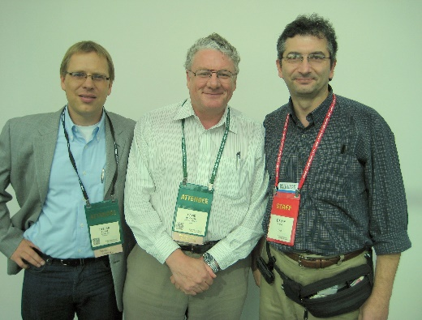
Timeline
Working together since 2006
14th of April 2006 AWRA conference, CUASHI
CUASHI’s WaterOneFlow did evolve to WaterML and SOS
1998-2014: WaterML, which has become the global standard information model for observational data by OGC.
2012: Concepts bringing data together in one place was used to create the central Texas data hub for Flood warning
2016/2017: Concepts were used to build the “National Water Model Portal” for Texas which was tested during hurricane Harvey and copied to support the east coast with following hurricanes
Notes:
14th of April 2006 Dean Djokic and myself met at the AWRA conference. Couple weeks later we are introduced to Dr. David Maidment who invited us to the GIS Hydro conference.
9th August 2006 David Maidment introduced us to CUAHSI which was the starting point for a closer collaboration.
CUASHI’s WaterOneFlow did evolve to WaterML and SOS
WaterML, which has become the global standard information model for observational data by OGC.
Later this standards were implemented in KiWIS (Web Interoperability suite), which allows organizations to easily access data from a wide range of different date providers (eg USGS, NOA, HYDSTRA/WISKI users etc.). This enables organizations to get quickly a full picture of a situation based on data from all available sources.
2012: Using this concepts bringing data together in one place was used to create the central Texas data hub for Floodwarning
2016/2017: Concepts were used to build the National Water Model Portal for Texas which was tested during hurricane Harvey and copied to support the east coast with following hurricanes
Beginning of November 2006 David Maidment has been to Australia, visiting CSIRO presenting the CUAHSI vision. Later some of his concepts were adopted for the national archive in Australia by BOM.

Slide 3
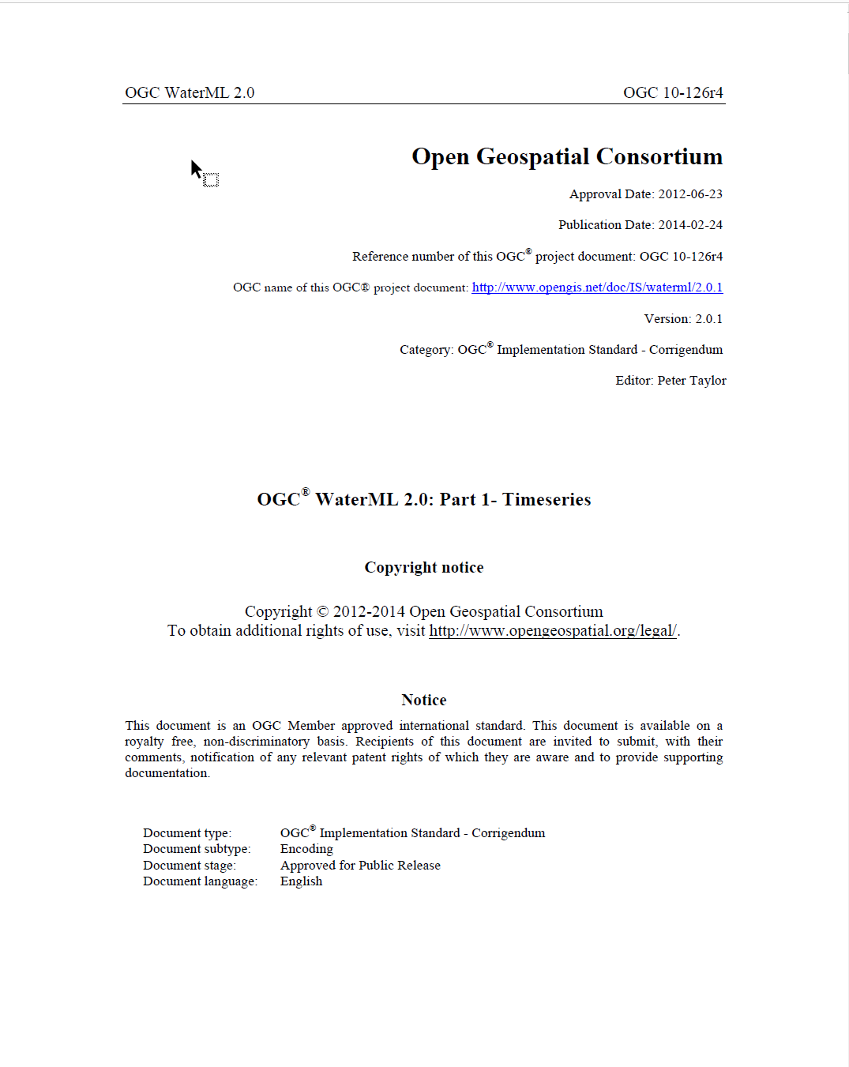
Standardization WaterML2.0
Worldwide standard information model for observational water data by OGC.
Global team for the specification phase.
Implementation into KiWIS software, which allows organizations to easily access data from a wide range of different data providers (eg USGS, NOA, Hydstra /WISKI users etc.).
This enables organizations to get quickly a full picture of a situation based on data from all available sources.
OGC® WaterML 2.0:
Part 1- Timeseries
Maidment Symposium – 12th May 2022 – Klaus Kisters

Slide 4
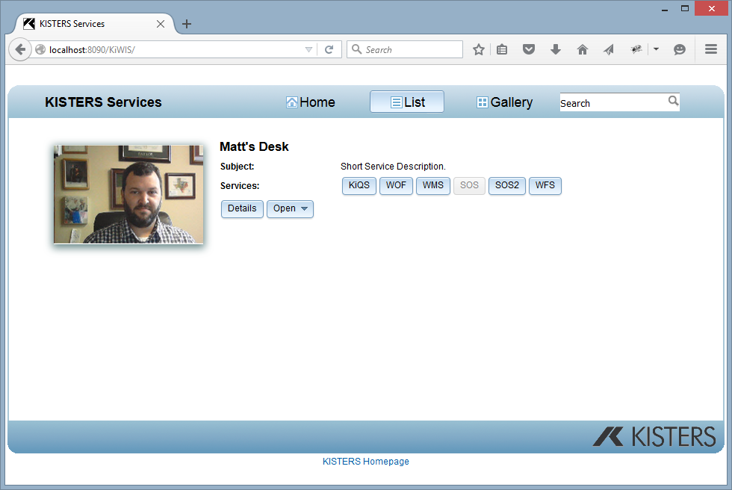
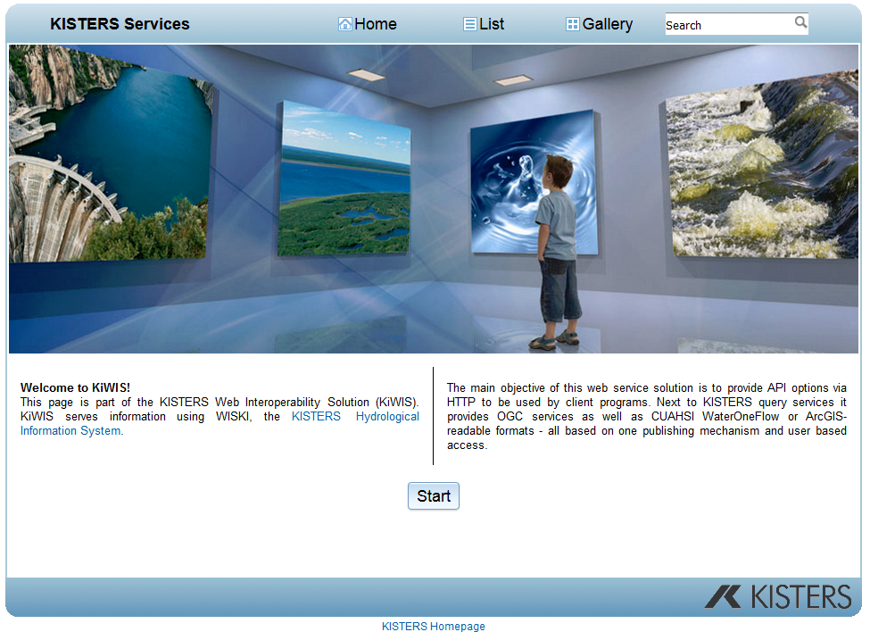
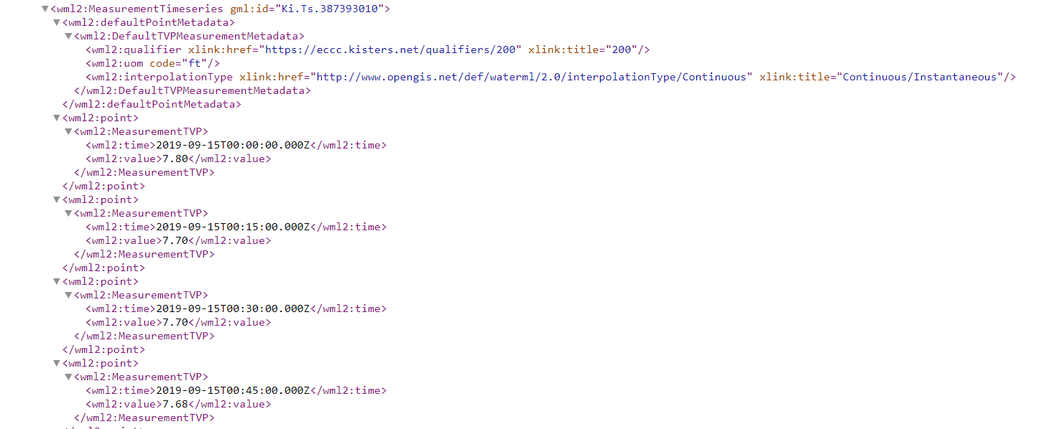
What is KiWIS?
Web Interoperability Solution
KiQS: Query Service
Includes help file
WOF: Water One Flow – CUAHSI
WMS: Web Mapping Service
SOS(2): Sensor Observation Service
WFS: Web Feature Service
Maidment Symposium – 12th May 2022 – Klaus Kisters
Notes:
KiWIS: Was created in response to the CUASHI inititive.
KISTERS created KiWIS to support WaterOneFlow, WaterML and SOS and others.
Later KiWIS has continued to grow in features and functionality.

Slide 5
World Water Online
The Datahub concept using KiWIS
KiQS: Query Service
Includes help file
WOF: Water One Flow – CUAHSI
WMS: Web Mapping Service
SOS(2): Sensor Observation Service
WFS: Web Feature Service

Slide 6
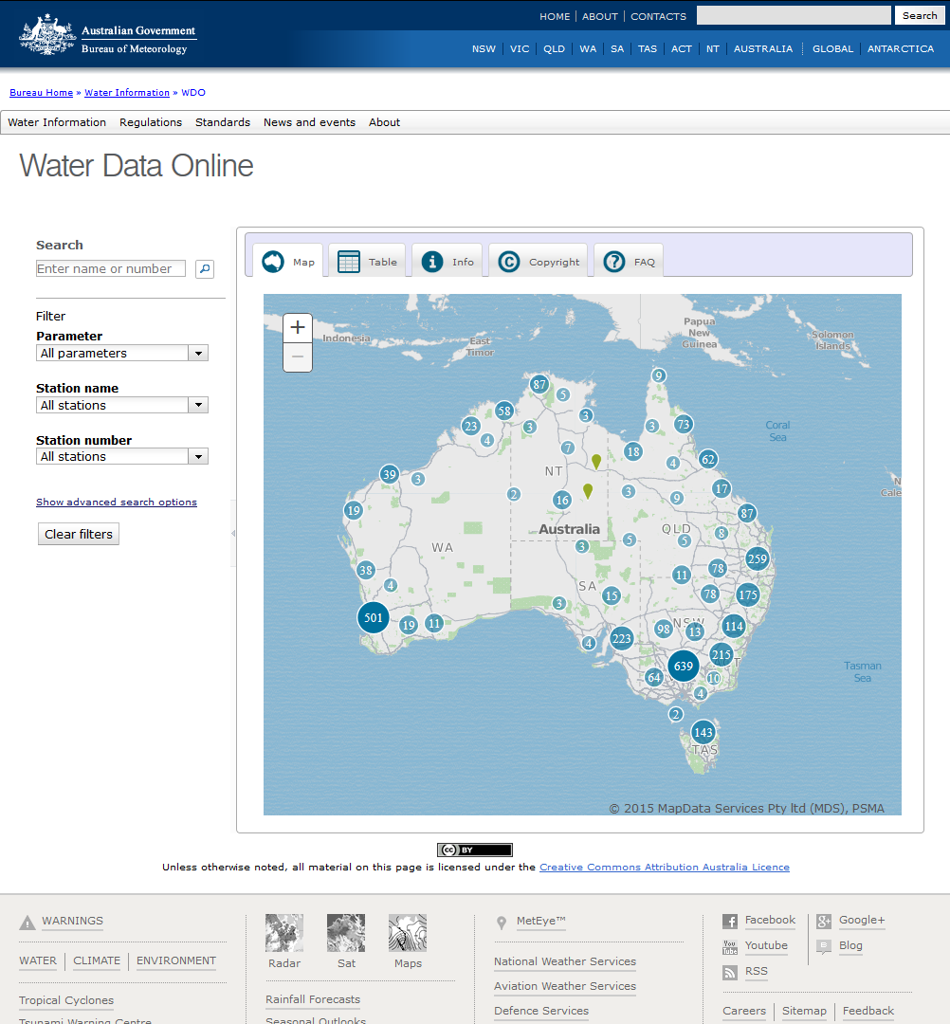
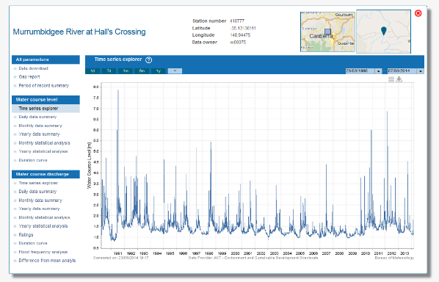
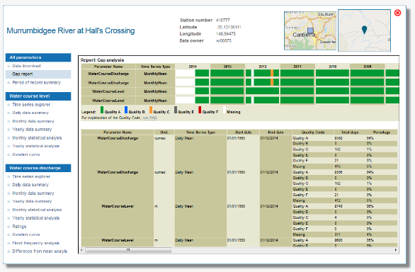
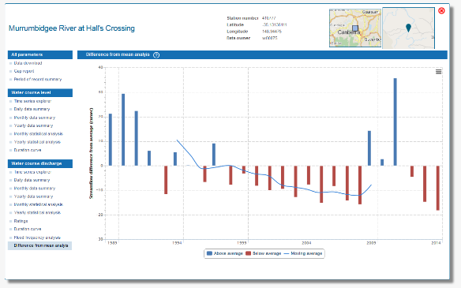
Examples around the world
Australian Water Resource Information System: Addressing water scarcity for a sensible continent
Fact Sheet
Water Data Online is a solution to centrally manage Australia’s Water Resources in time of climate change
Central solution to manage demands and expectations for the water consuming industries and related stakeholders
Data from more than 260 data providers are integrated into a central access point at BOM
Producing the core data products to inform Australia about the current water conditions
Enabling the Geo-Fabric integration of in-situ data

Slide 7
Notes:
2:07min
In the last year we also turned on the first Australian web based Water Archive solution. The system starts with several thousands of station and will increase to up to 20.000 stations. We cluster the points in the map for better navigation. Each station has in individual station widget with several web-based report types.
The solution is designed for archived information providing (and not flood warning).

Slide 8
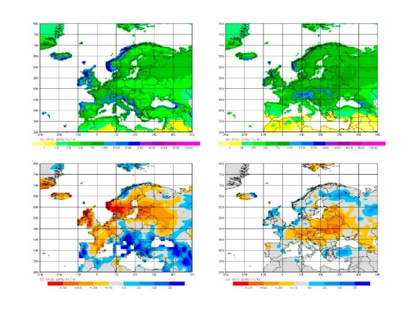
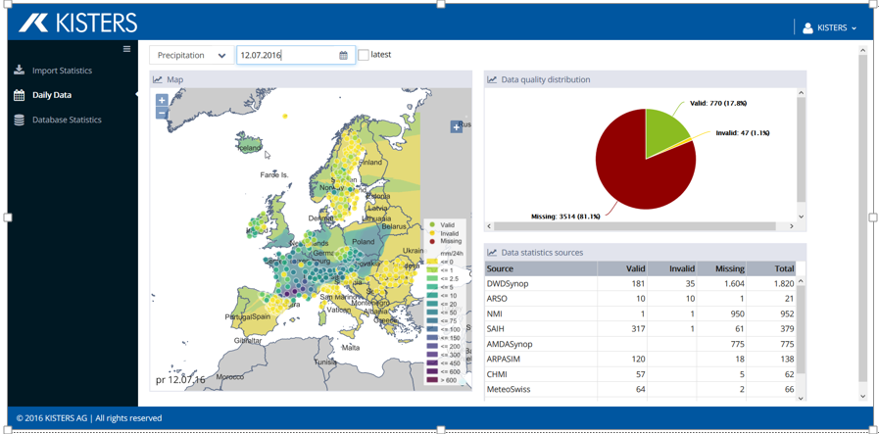
Examples around the world
European Flood Awareness System: Collection and validation of meteorolgogical data for Europe
Fact Sheet
EFAS MDCC: meteorological data collection and validation for the European Flood Awareness System
Management of 16 different data provider of the European member states
Collecting data for more than 60,000 meteorological stations (historic and real time)
Real time spatial temporal validation and delivery of gridded precipitation, wind speed and air temperature data product to the computational center (every 6 hours)
Regular anomaly reporting

Slide 9
Examples around the world
WaterInfo.be: Central Flood and Drought information portal for 1.6 Million people in Flanders
Fact Sheet
WaterInfo.be is an operational flood and drought portal for Flanders, Belgium
Connecting two authorities to a common information portal (HIC&VMM)
15.000 short term forecasts, 3500 long term forecasts
About 500,000 Imports per day; 4 Million calculation requests
Surface Water, Tidal Stations, artificial forecast points @ critical infrastructure nodes
1,000 professional users
1.6 Million Public users per hour

Slide 10
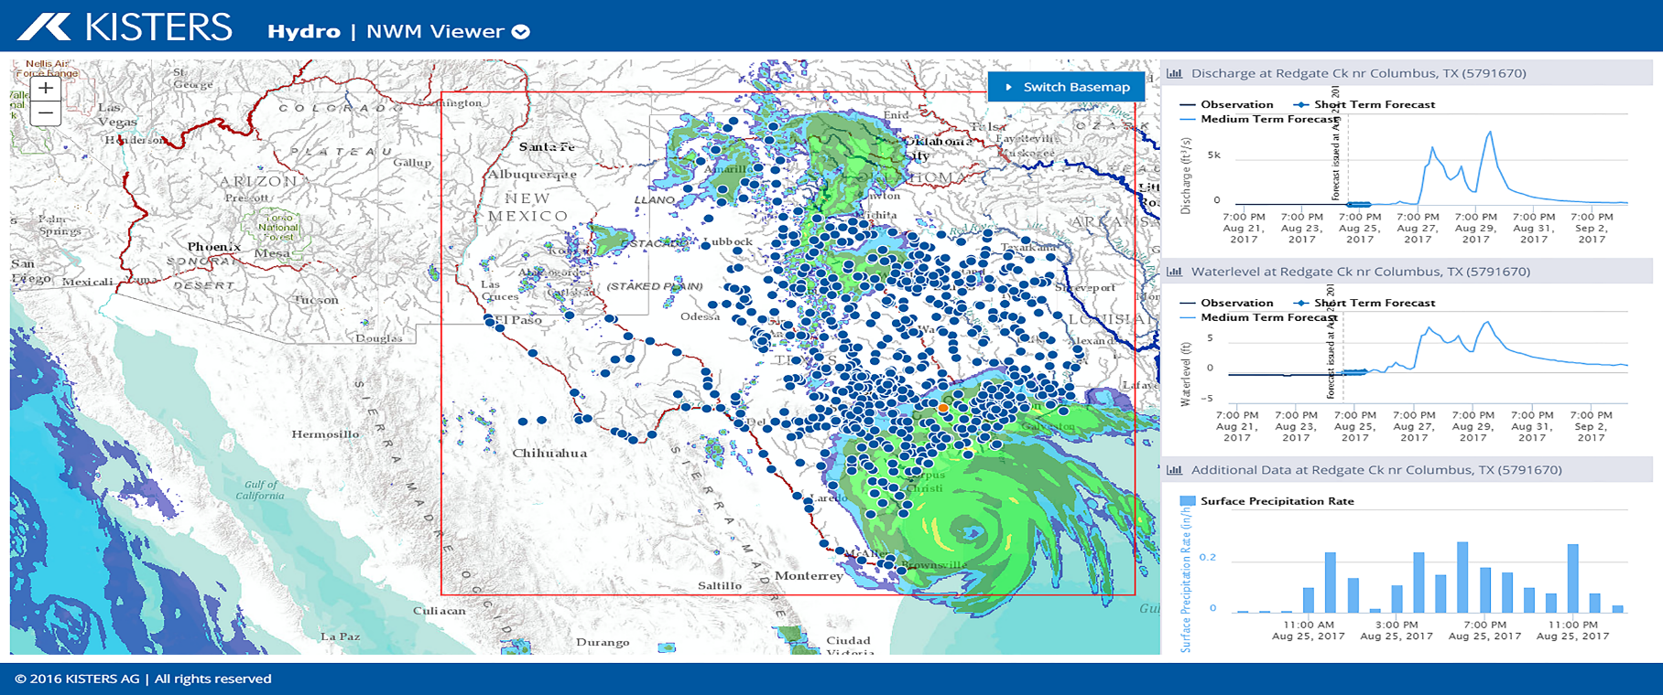
Examples around the world
National Water Model Portal: Combines real time gauge data, weather forecasts & hydrological models
Fact Sheet
Multiple Data Sources: NOAA NWS Office of Water Prediction – standard flood forecast model – National Water Model (NWM) short- and long-term forecasts Third-party stream gauges – U.S. Geological Survey – National Weather Service – Lower Colorado River Authority – City of Austin – Harris County Flood Control District
102,000 stream reaches in Texas alone includes NWM variables of precip, wind, soil moisture, etc.
Collaborative with Esri, University of Texas, Texas Dept. of Emergency Mgmt.

Slide 11
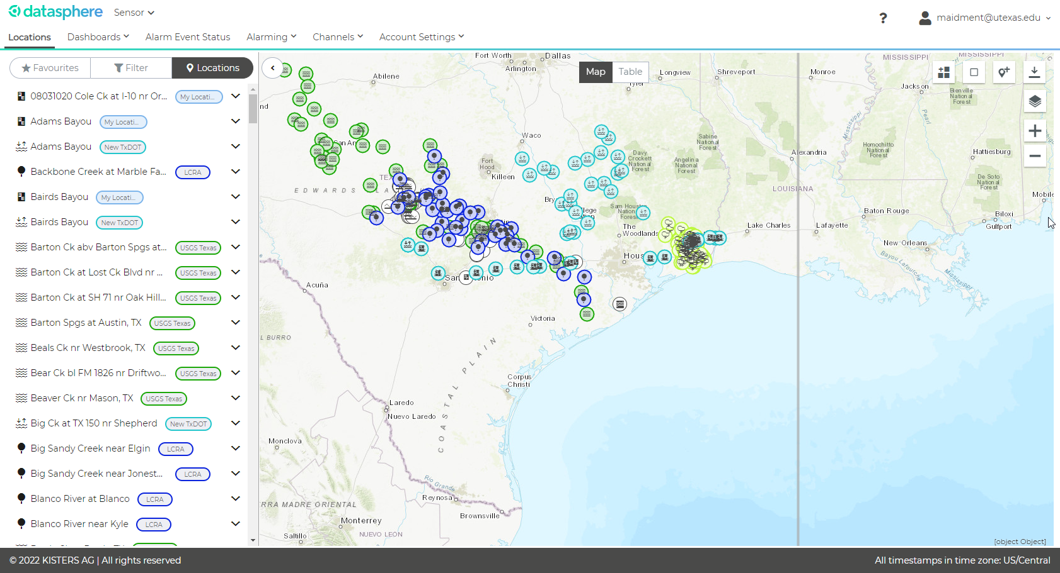
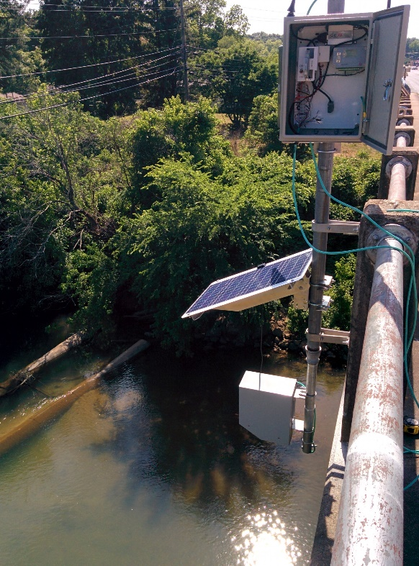
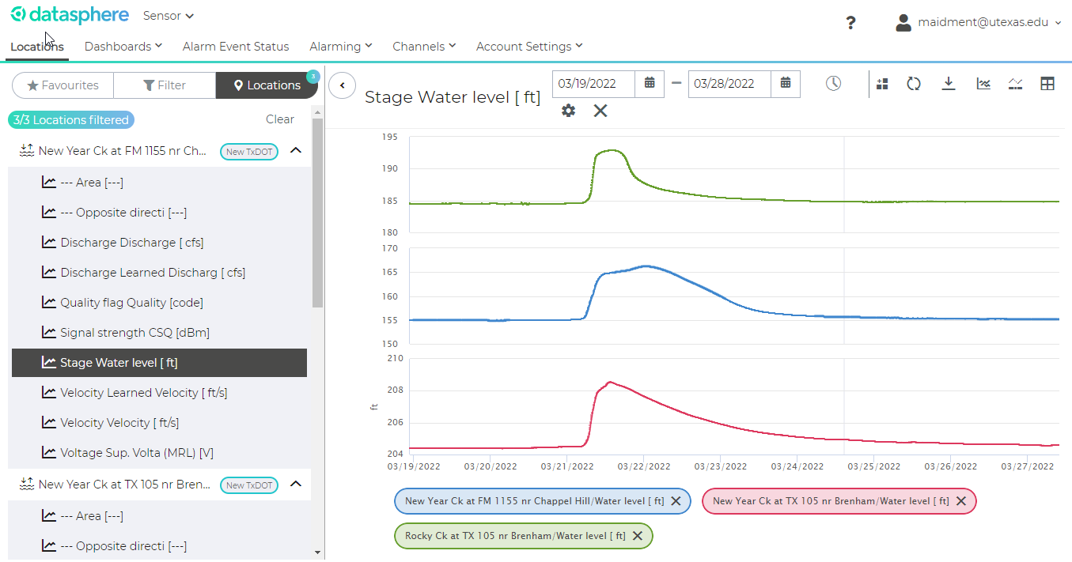
Examples around the world
Texas Department of transportation
Datasphere
Time series management in the cloud
Interactive Map and Graphing
Web Services and APIs

Slide 12
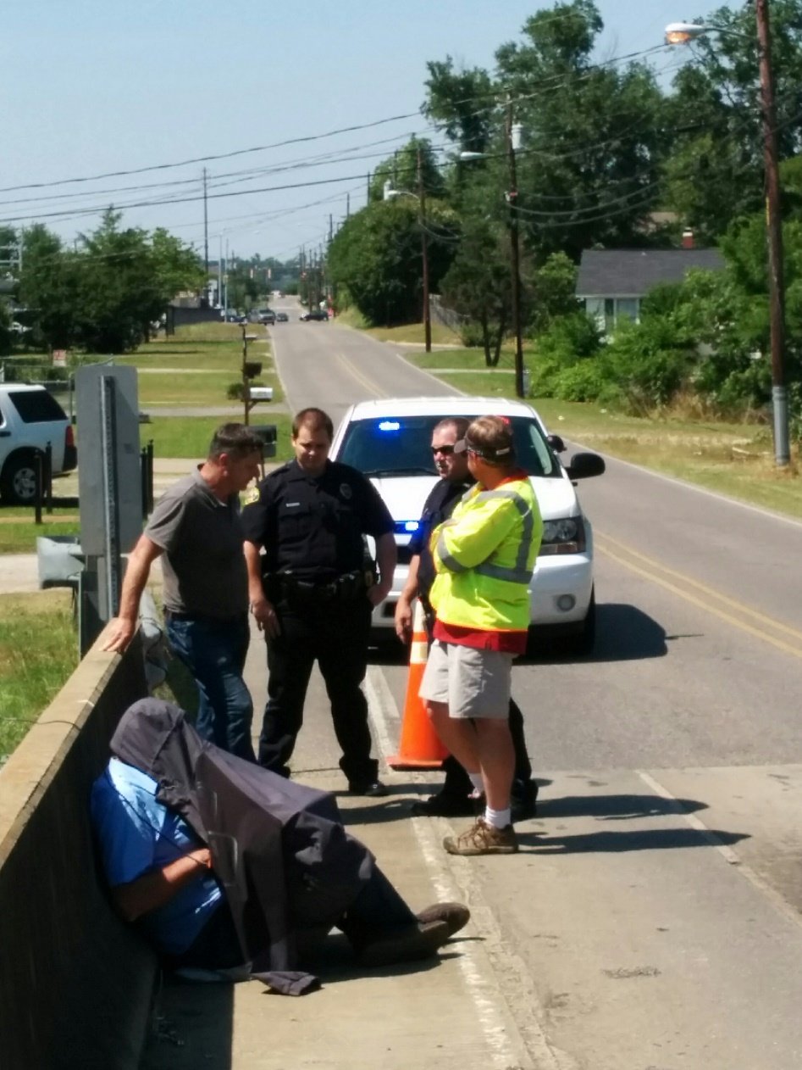
Examples around the world – the fun part
Datasphere
Time series management in the cloud
Interactive Map and Graphing
Web Services and APIs

Slide 13
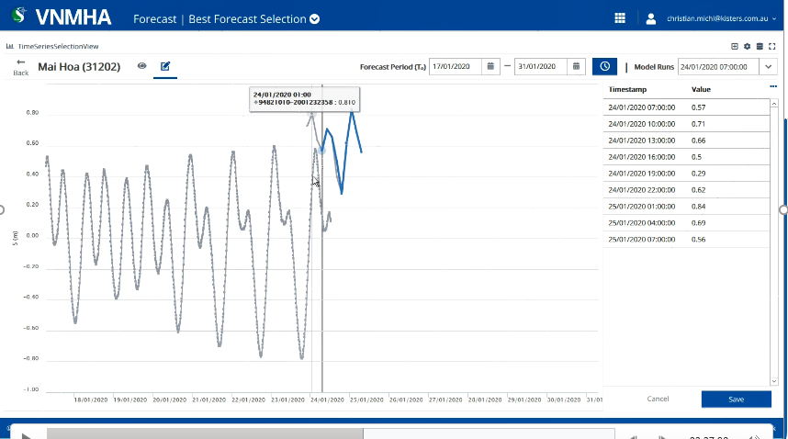
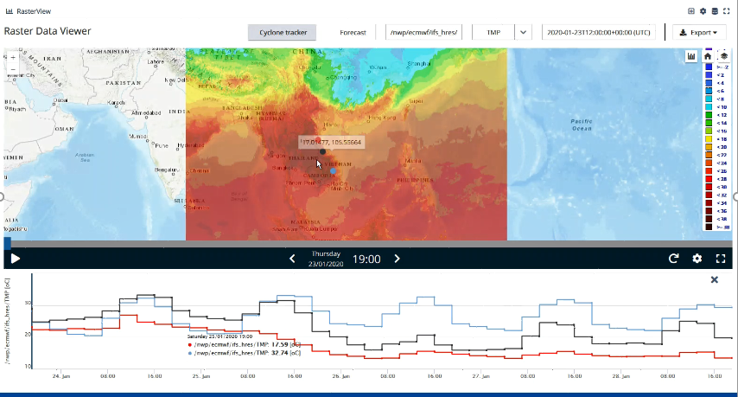
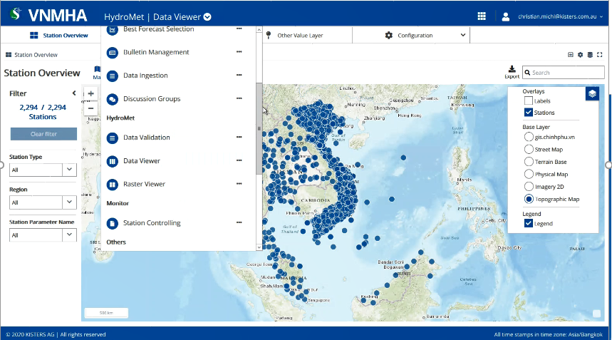
Examples around the world
Implementation of a National Flood Forecast System for the Republic of Vietnam
Fact Sheet
Strengthen the national Meteorological and Hydrological Service
Better operative forecast (off shore and Inland) for flood forecast and typhoon tracking
Central data hub for scalar and gridded data (observation and forecast)
Integration of hydrological and hydrodynamic models
Training and capacity building
Project implementation 2 years
World bank Project

Slide 14
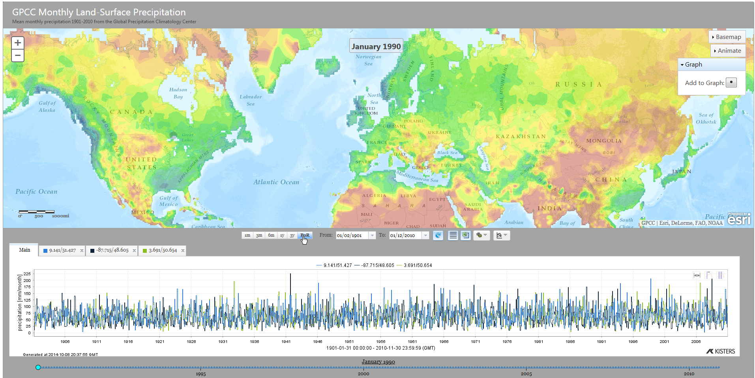
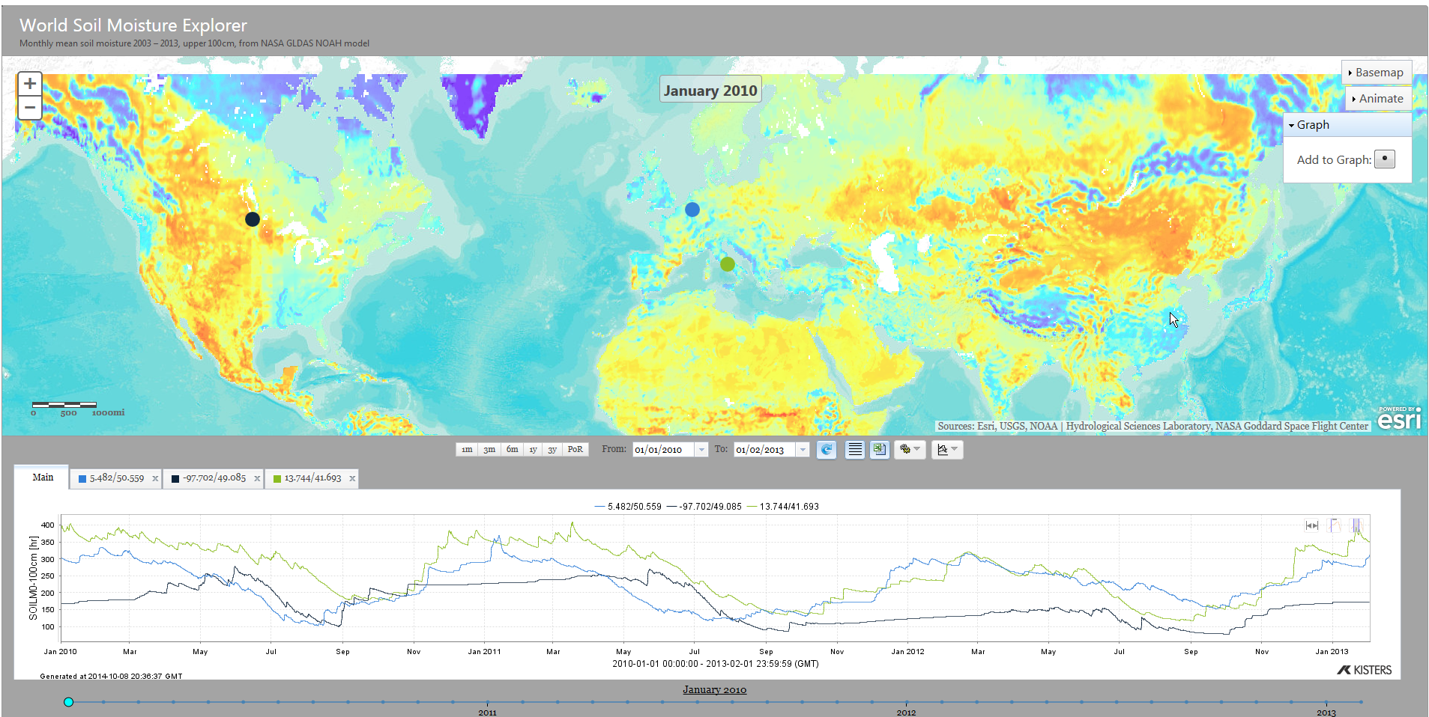
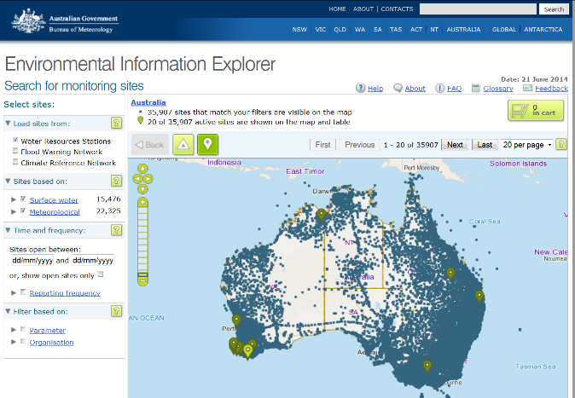
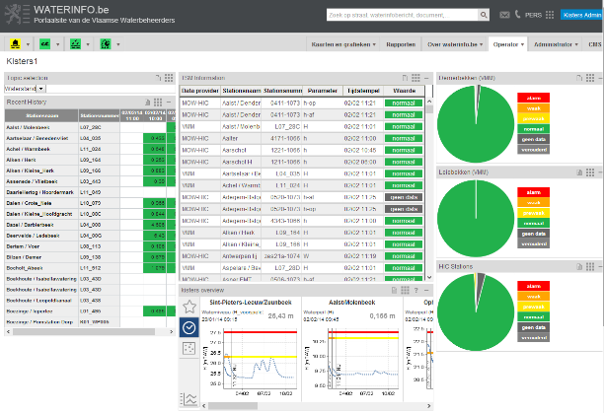
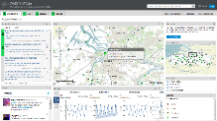
Hubs and portals

Slide 15
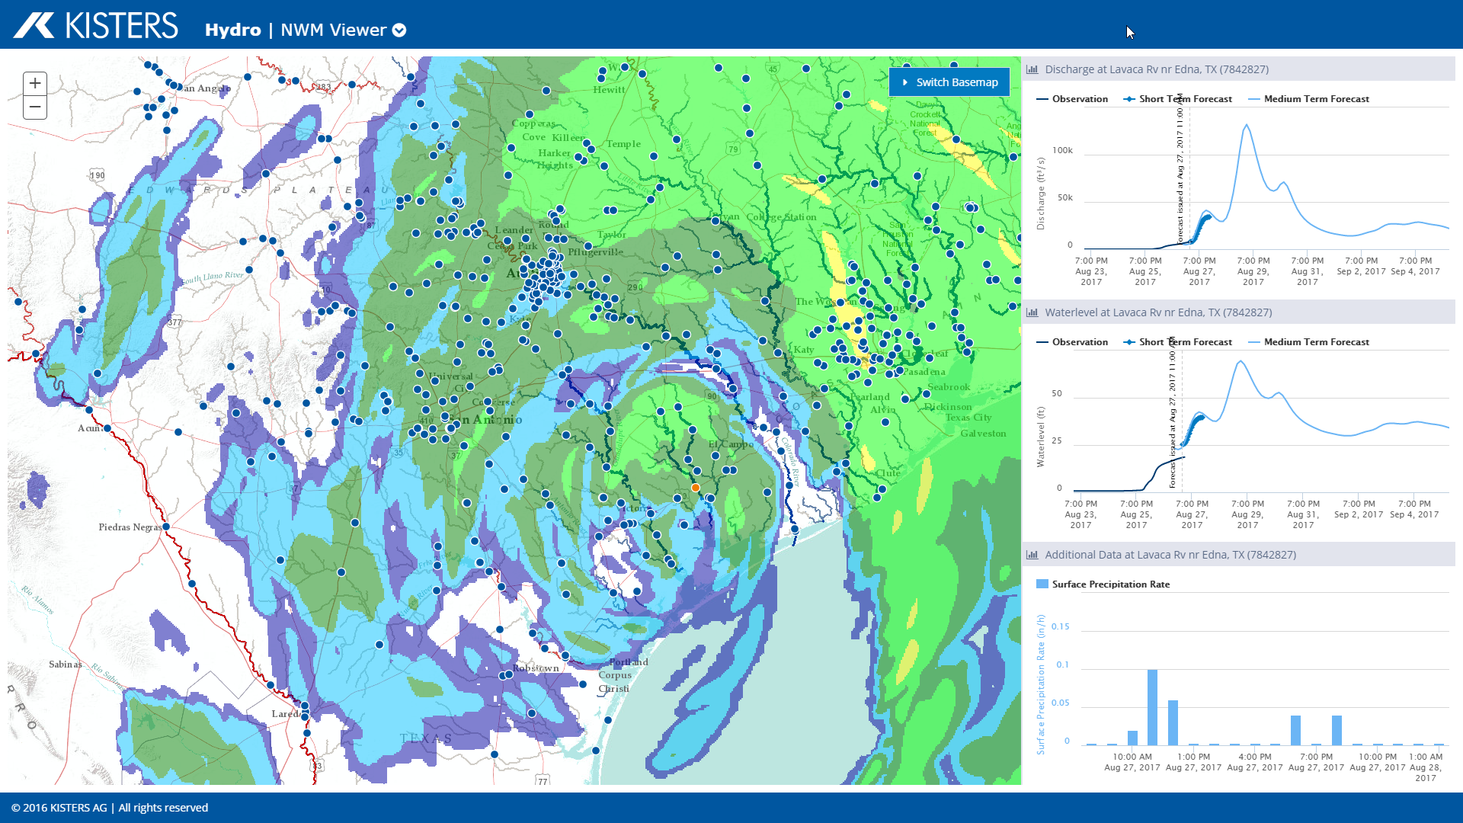
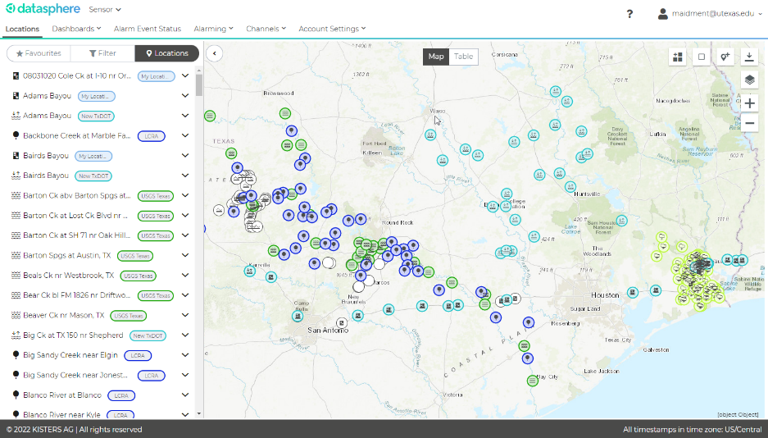
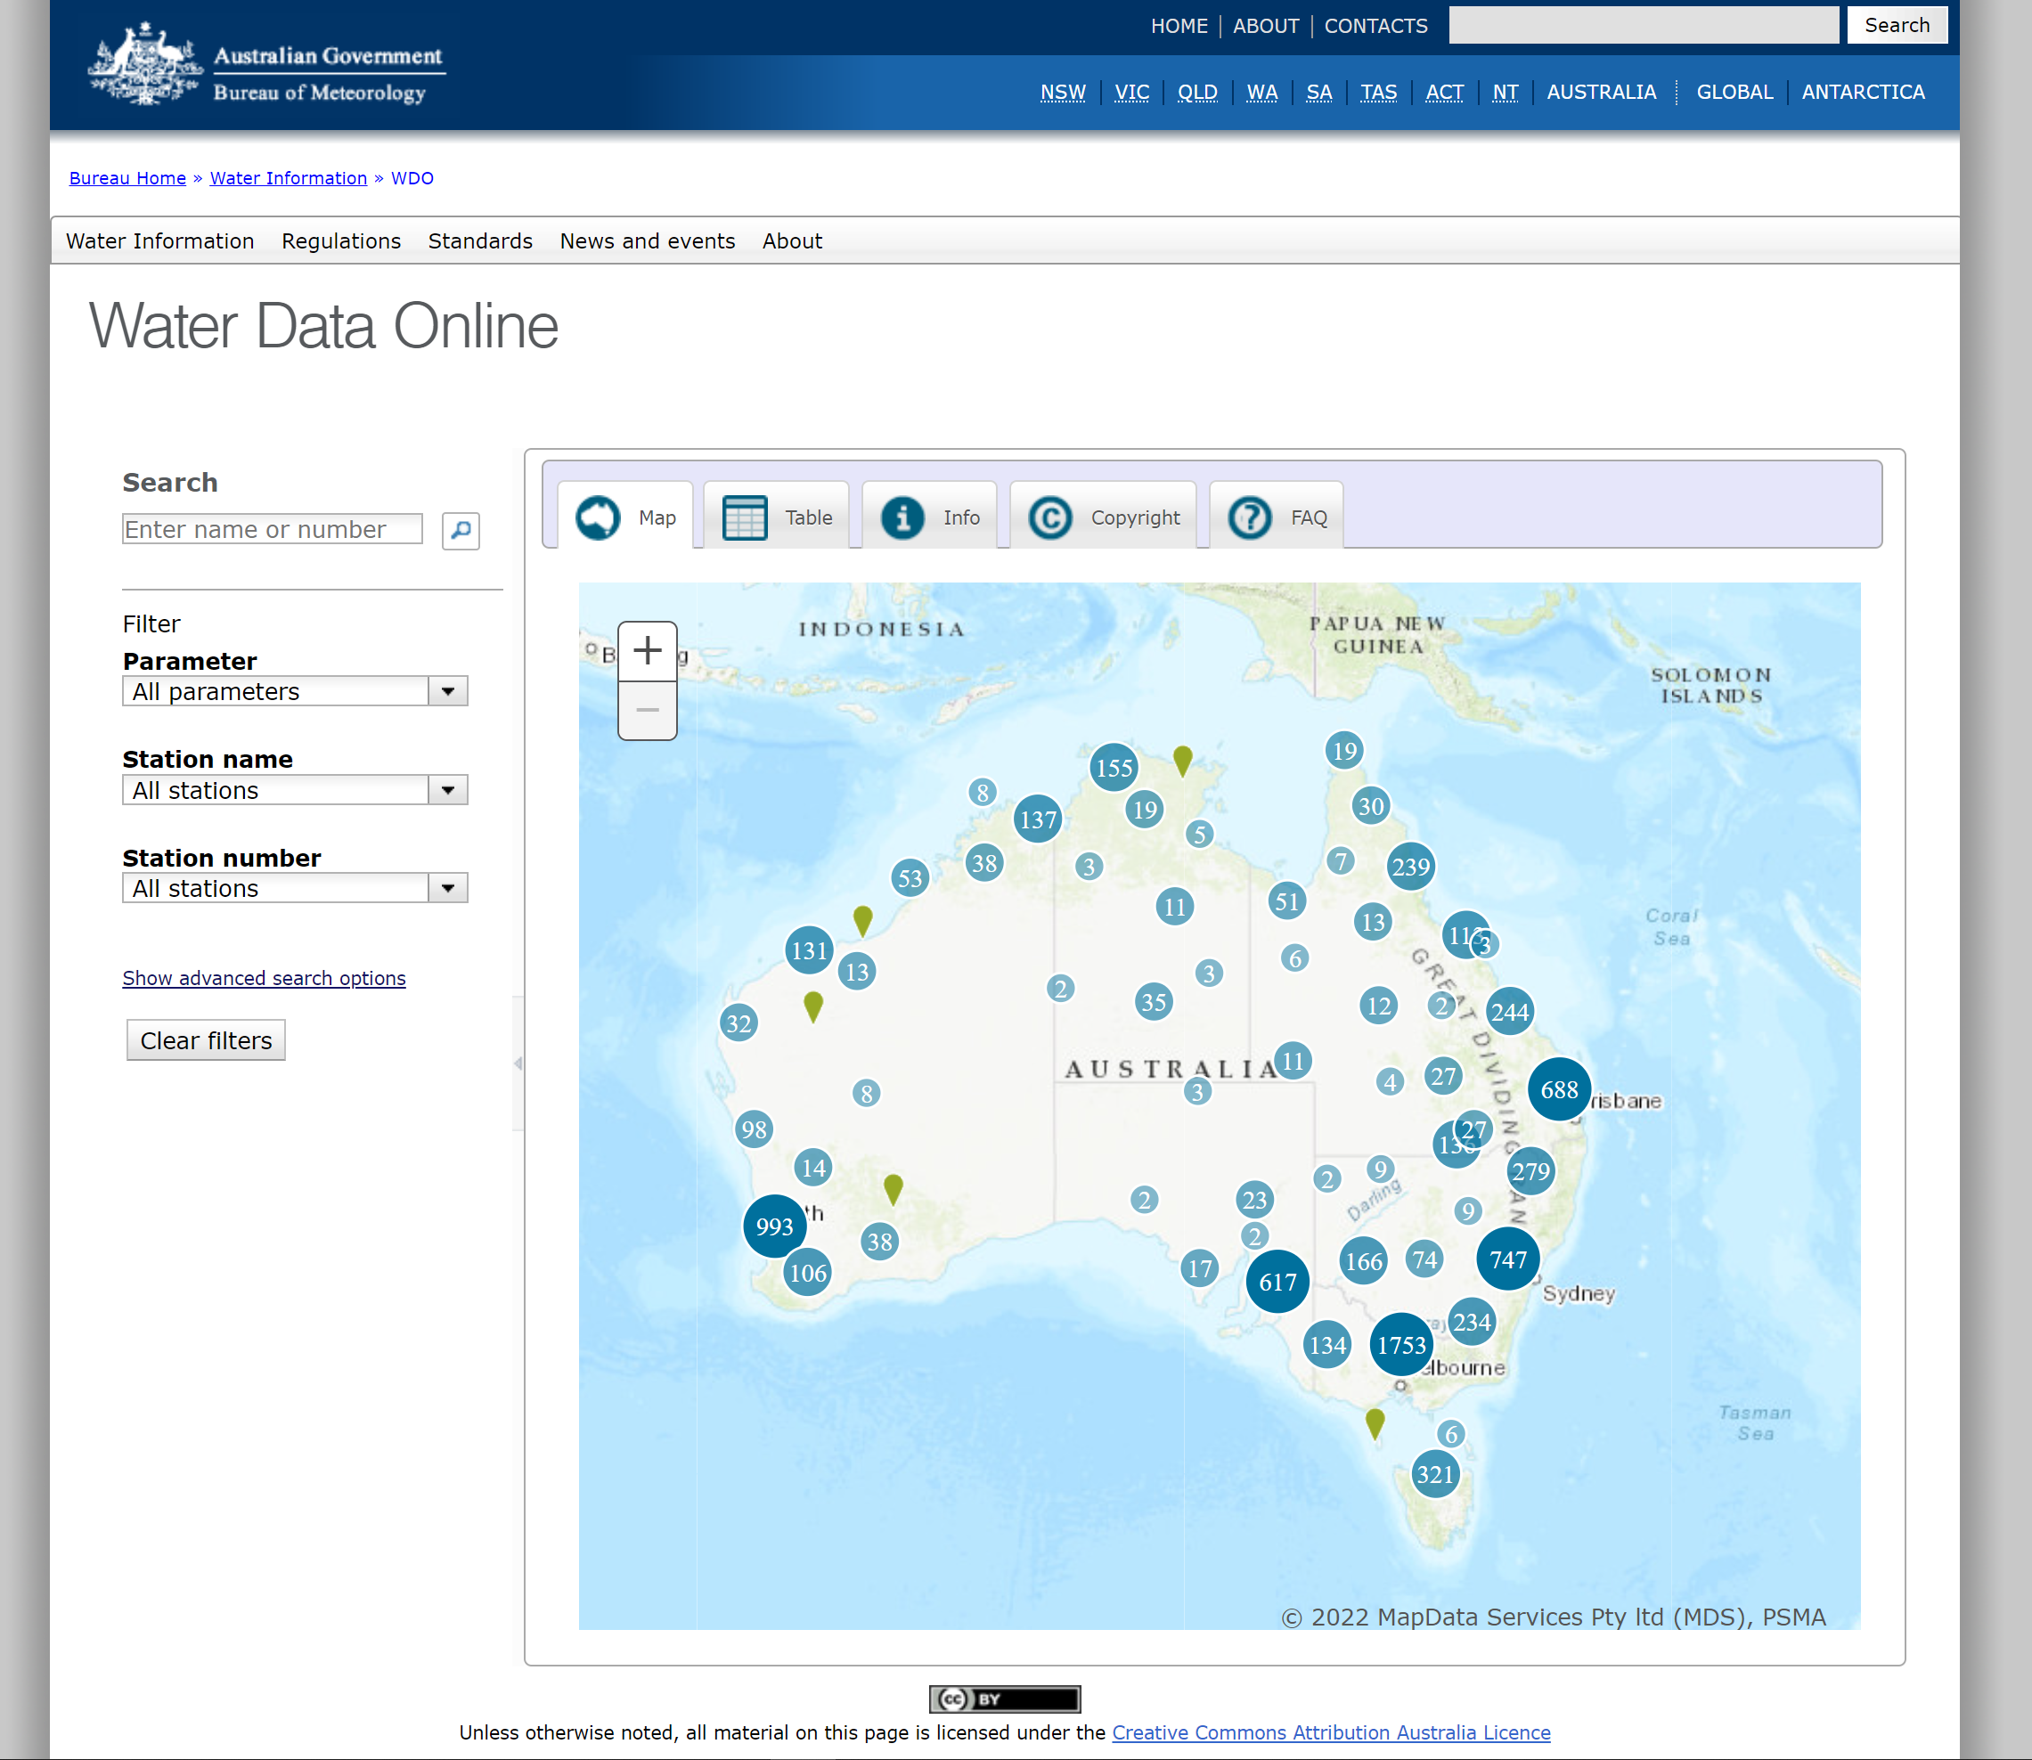
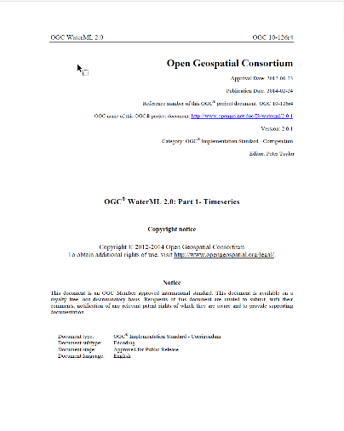
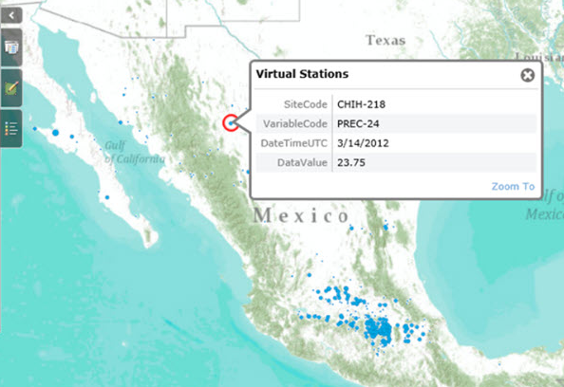
Thank You – the joint Journee will go on
to modeling & mapping
from hardware installation
to hydrologic web applications
OGC® WaterML 2.0:
Part 1- Timeseries
Maidment Symposium – 12th May 2022 – Klaus Kisters
Notes:
I would like to take the opportunity to thank you for the outstanding cooperation.
We were allowed to cooperate with you in important projects for the international water industry. The cooperation has always been very constructive and cooperative. Sometimes you threw so many balls that it was hard to catch them all. But with your dedicated, humble and inspiring attitude you kept everybody motivated and on track.

Slide 16
Thank you!

