Slide 1
National DEM-based Hydro
Alan Rea
Senior Advisor for Hydrography Science and Applications
National Geospatial Program
May 12, 2022

Slide 2
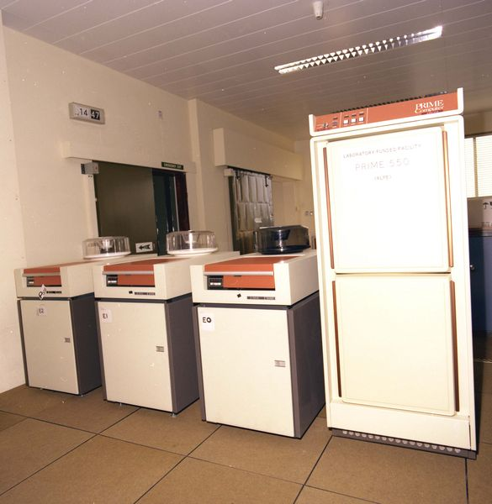
“The Good Old Days”
Computing in 1987 – 89
PR1ME minicomputer
1 MB RAM
1 MIPS
Two 300 MB hard drives
Resources shared with ~50 people
State of the art!

Slide 3
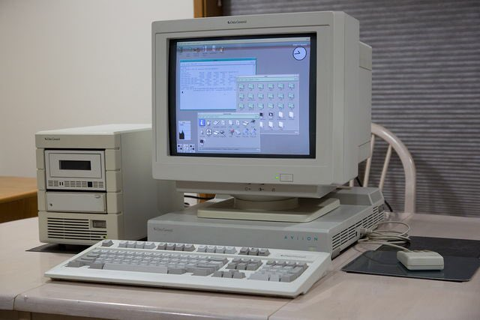
The Mid 1990’s
When I first met Dr. Maidment
Data General DG/UX systems
Equivalent to i386 PC
ArcInfo Rev 6 added Grid (raster processing)
DEMs were starting to become usable with readily available SW/HW
DEM availability was spotty

Slide 4
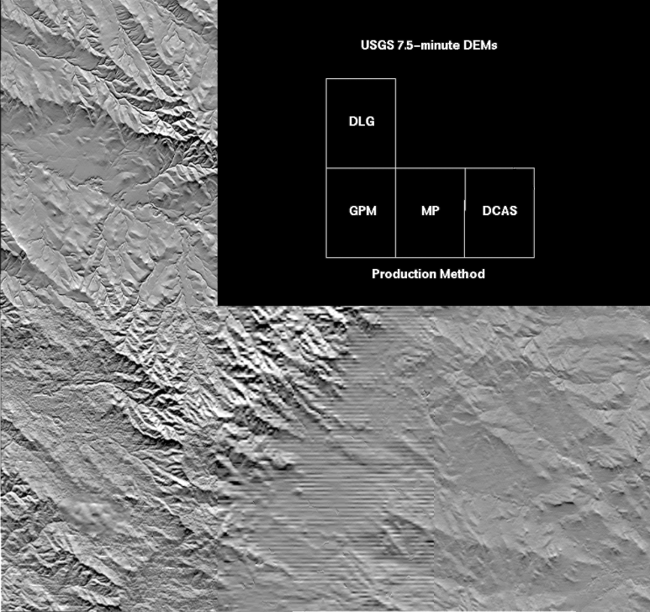
DEM Quality Issues
DEMs in the mid-1990s had a lot of quality issues
DLG-to-Grid were the best
Manual Profiled were some of the worst
Nationally consistent
3DHP Data

Slide 5
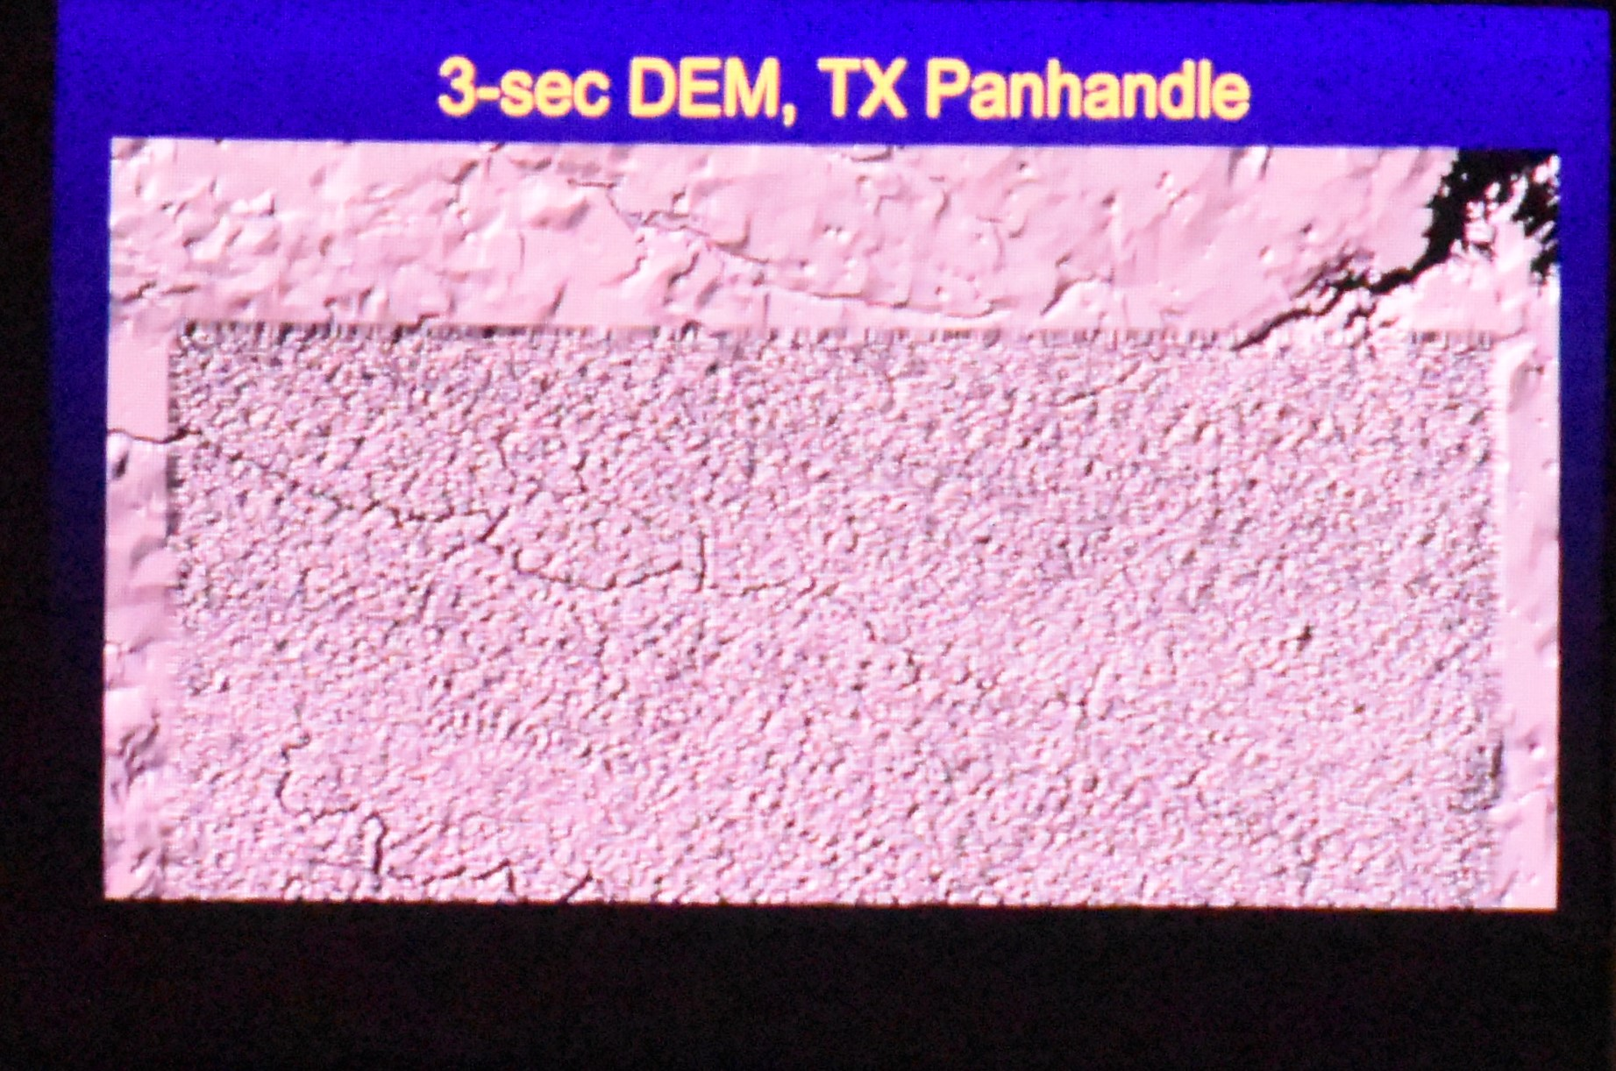
DEM Quality Issues
DEMs in the mid-1990s had a lot of quality issues
DLG-to-Grid were the best
Manual Profiled were some of the worst
The 3-arc-second (~90-m DTED) and 2-arc-second (~60-m) were done differently, and had their own serious quality issues
Nationally consistent
3DHP Data

Slide 6
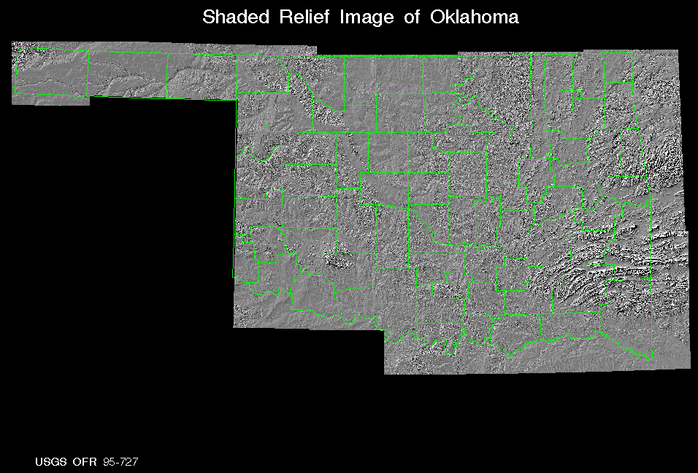
Oklahoma 60-m DEM
Created using 1:100K Contours and Streams with ANUDEM software
Included flowdirection, flowaccumulation
This was quite a processing challenge!
USGS Open-File Report 95-727
Nationally consistent
3DHP Data

Slide 7
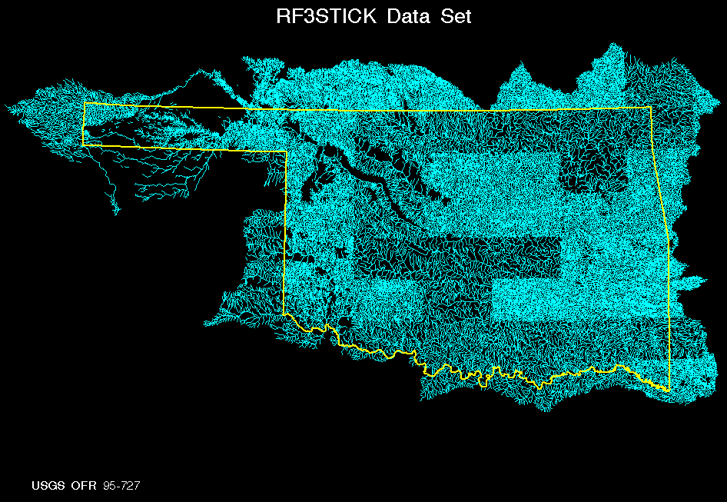
Oklahoma 60-m DEM
These were the streams used to create the DEM
This was before NHD existed
Nationally consistent
3DHP Data

Slide 8
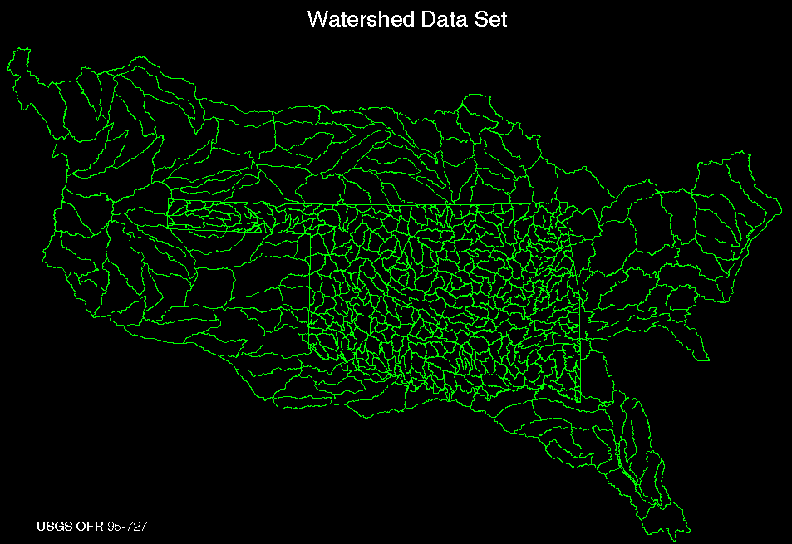
Oklahoma 60-m DEM
Used the 60-m DEM to delineate Watersheds (now known as HUC-10s) for Oklahoma
Polygons merged with HUC-8 polygons outside of OK
Could be used to delineate watersheds from any point—if you had GIS software and know-how!
Nationally consistent
3DHP Data

Slide 9
Perspectives from the Mid 1990’s
Good data is great, but users need tools
Software is hard to maintain with project-based funding
A community was starting to form around GIS for Water Resources—led by David Maidment and AWRA
NHD was being developed
NED was being developed
CD-ROM was the medium of choice for data publication

Slide 10
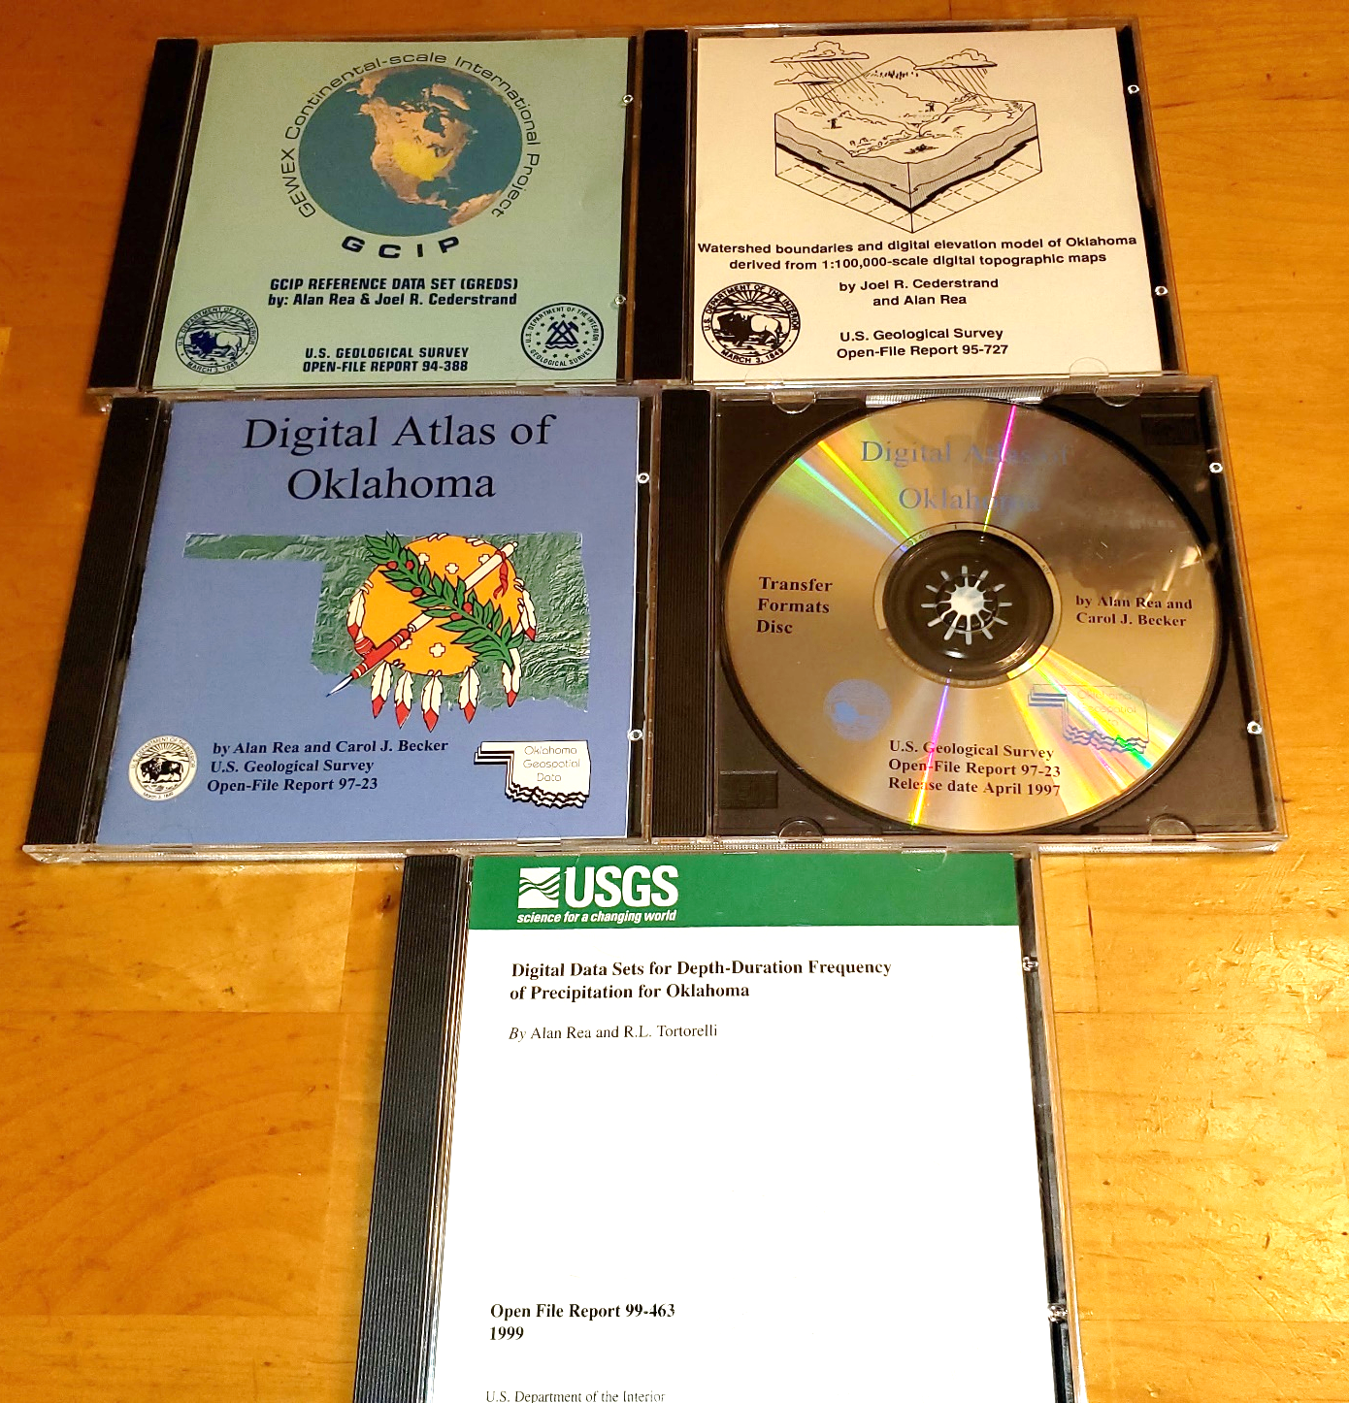
Data format longevity
CD-ROMs published in 1994-99
File formats:
  Text files
  FGDC Metadata in text files
  Vector data – DLG and dBASE, ARC/INFO Coverages, e00
  Raster data – BIL, ARC/INFO Grid
  Graphics: GIF, .PS
Software
  FORTRAN, C code
  Windows 3 .exe
  ArcView 1 (Windows 3)
No Shapefiles or PDFs
Nationally consistent
3DHP Data

Slide 11
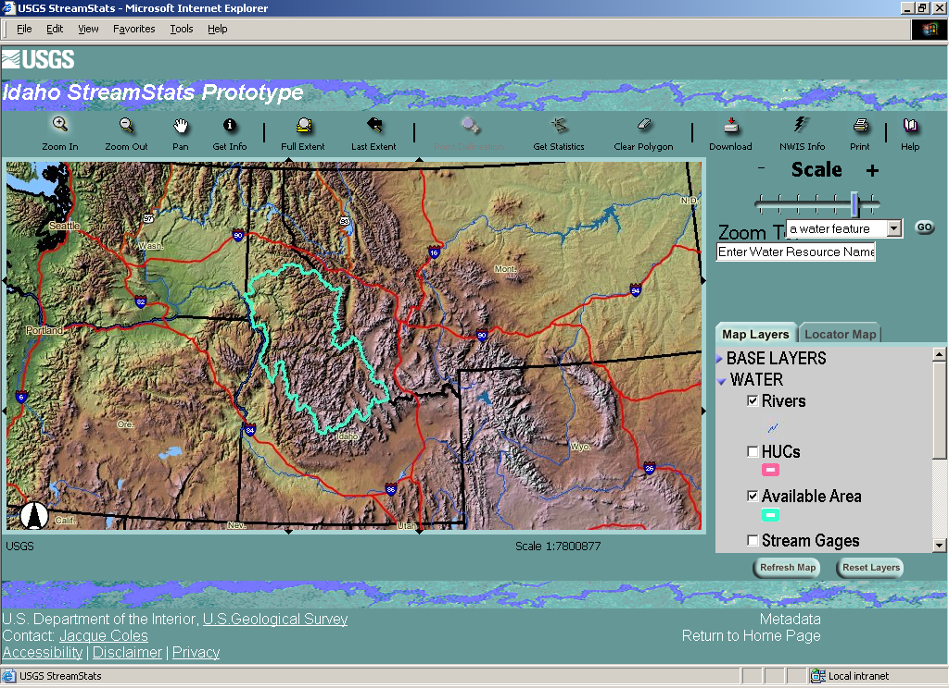
The Early 2000’s
Consortium for GIS in Water Resources
Several December meetings in Austin (ice storm, Bush v. Gore, raster-vector “wars”)
Teams formed for NHDPlus and StreamStats
Web-based tools and services
NED and NHD established and continuously updating to higher resolution

Slide 12
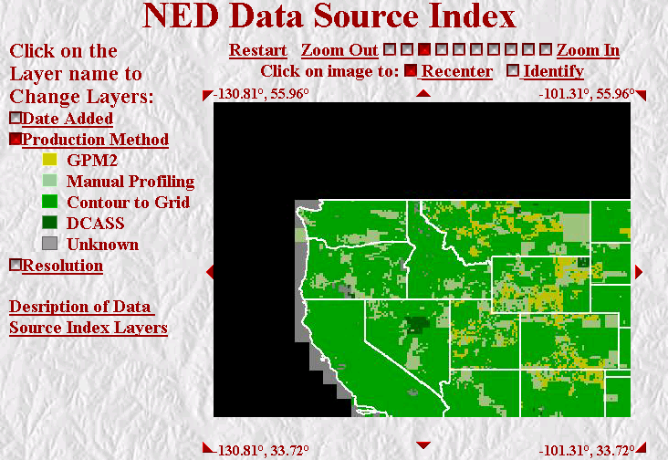
National Datasets—NED and NHD
Basic concepts evolved
Logically seamless datasets that cover the nation and edge-match
Spatial metadata describing data quality/sources/methods
NHDPlus and StreamStats sought to combine the best of raster and vector worlds (DEMs and NHD)

Slide 13
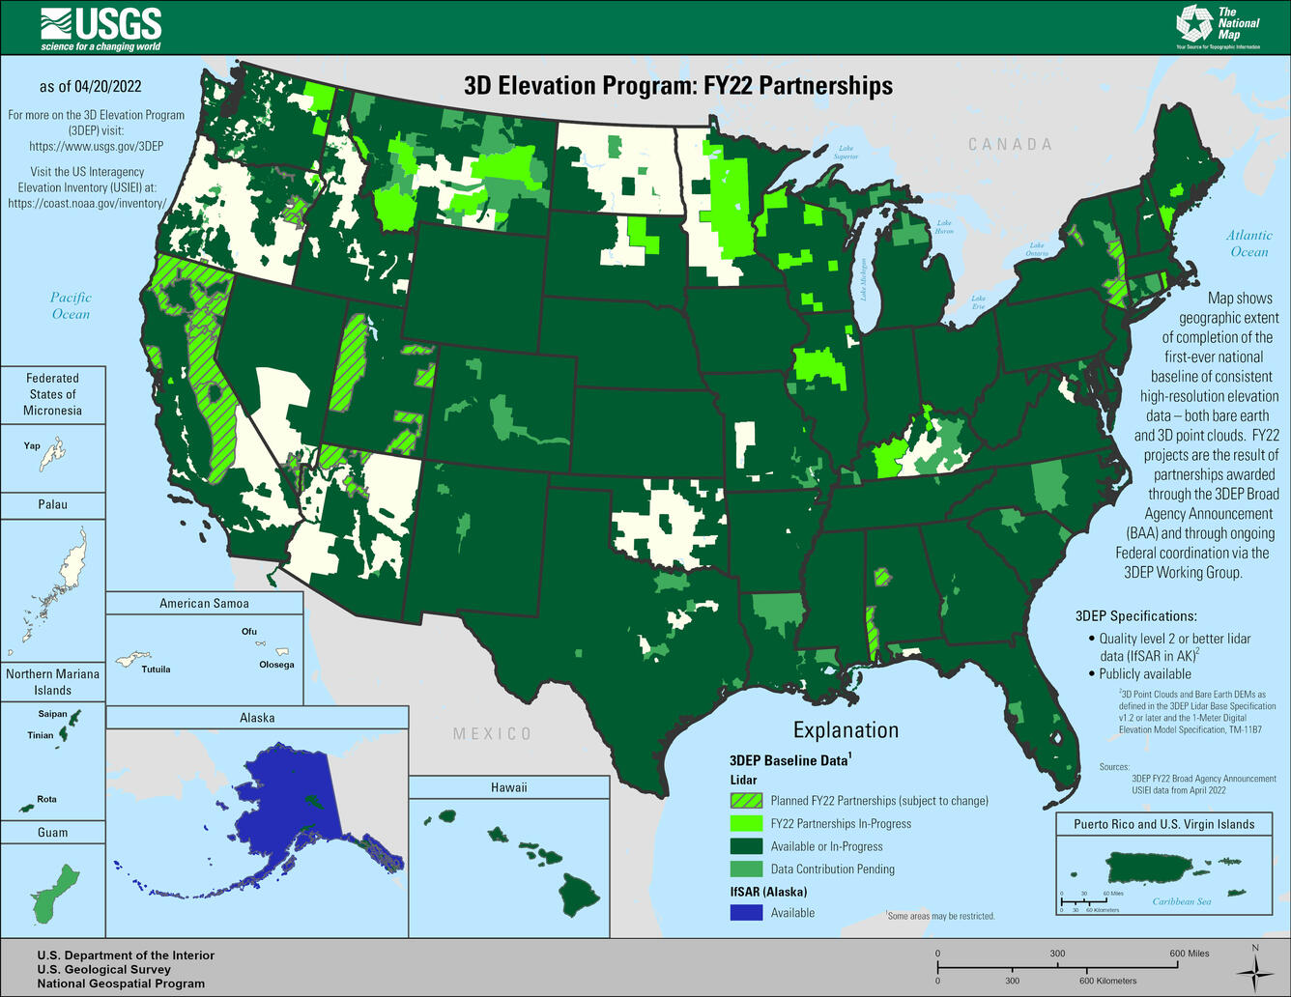
The 2010’s
Consolidating National Datasets and Building Partnerships
3D Elevation Program replaced NED
  Building partnerships
  Specifications and acquisition
NHDPlus High Resolution
  Beta done for CONUS, HI/PR, territories
  Alaska begun, a long-term project

Slide 14
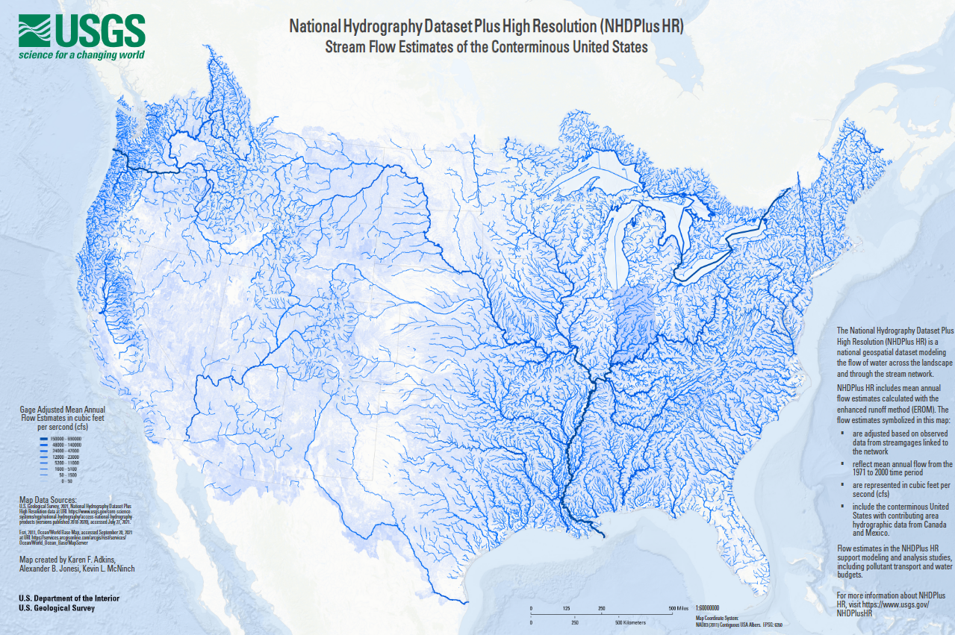
NHDPlus High Resolution
Adds catchment areas, flow rasters, many more attributes to NHD
NHDPlus HR Beta finished except Alaska
Mean annual streamflow estimates on (nearly) every flowline
Nationally consistent
3DHP Data

Slide 15
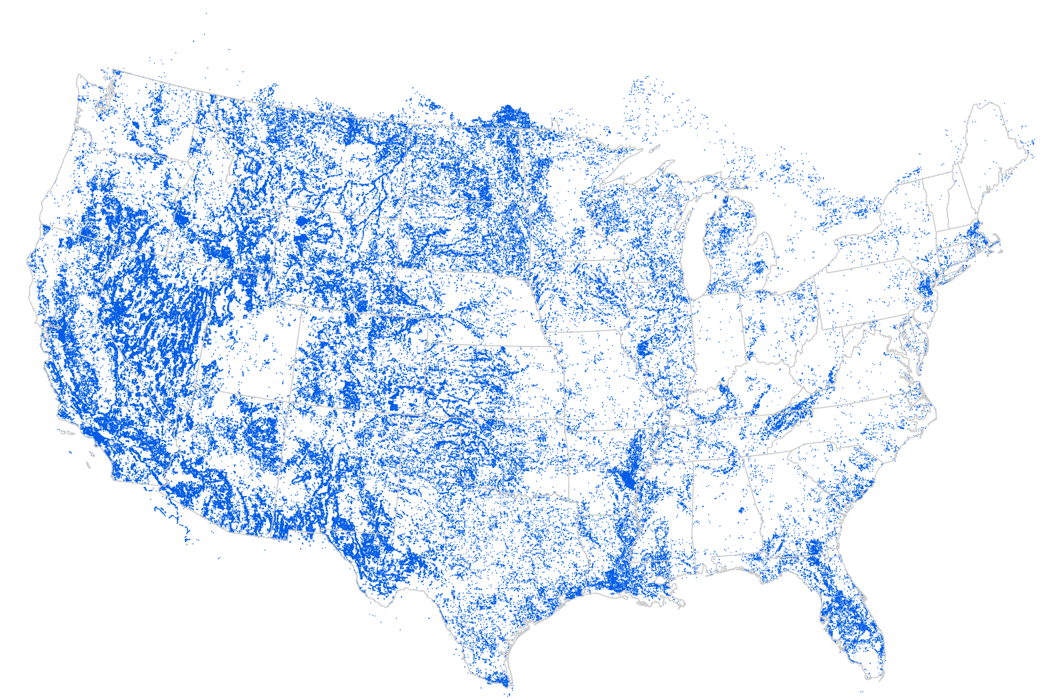
NHDPlus HR Beta—Some Caveats
NHD began as a cartographic product
There is a lot of disconnected network
The map at right shows network ends in NHDPlus HR Beta
The vast majority are small networks, but with some exceptions
EPA is leading an effort to connect as many of these as reasonably possible in an automated process
Nationally consistent
3DHP Data
Notes:
There are over 250,000 network ends in the 3/06/2021 candidate version of NHDPlus HR Beta National Release 1.

Slide 16
Nationally consistent
3DHP Data

Slide 17
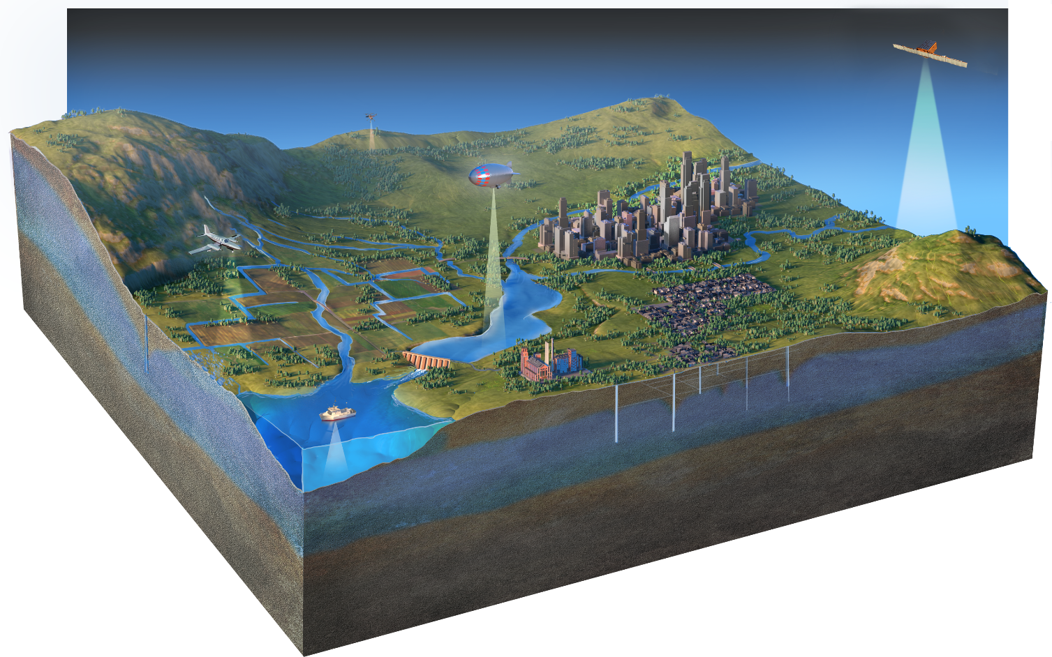
The Future—3D National Topography Model
Inland Bathymetry and Elevation-derived Hydrography
Next Gen 3DEP to include inland bathymetry in a single topobathymetric surface
New 3D Hydrography Program

Slide 18

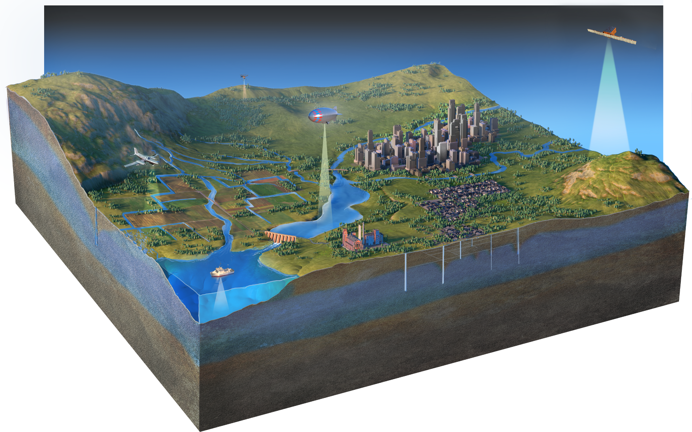
z
18
3DNTM: Supports the Nation’s Critical Applications
Topography is defined by elevation and hydrography; elevation shapes hydrography, and hydrography shapes elevation. To support a broad range of applications, the 3D National Topography Model integrates USGS elevation and hydrography datasets to model the Nation's topography in 3D.
3D Nation vision of a continuous data surface from the depths of the oceans to the peaks of the mountains
Provides universal sharing of water information as the geospatial foundation for the Internet of Water
Provides foundational data to critical initiatives
  FEMA Future of Flood Risk Data and Risk Rating 2.0
  The National Water Model
  The Clean Water Act
  National Landslides Preparedness Act
Enables new and emerging applications
  Multiple vintages enable change detection
  Water-related applications move from the neighborhood to the street-level in accuracy
Underpins a broad range of applications including flood risk management, hazards response and mitigation, infrastructure management, climate change science, and more
Notes:
The 3D National Topography Model, or 3DNTM, is designed to deliver the terrestrial component of the 3D Nation vision by integrating national elevation and hydrography datasets to model the Nation’s topography in 3D.
3DNTM is based on extensive requirements and benefits documentation to maximize its return on investment to a broad range of business uses.
It will provide foundational data to critical initiatives including FEMA Risk Rating 2.0, the National Water Model, the Clean Water Act, and the National Landslides Preparedness Act.
3DNTM will provide universal discovery and sharing of water information as the geospatial foundation for the Internet of Water.
With multiple new vintages of data coverage and increased accuracy, the 3DNTM will enable new and emerging applications.

Slide 19
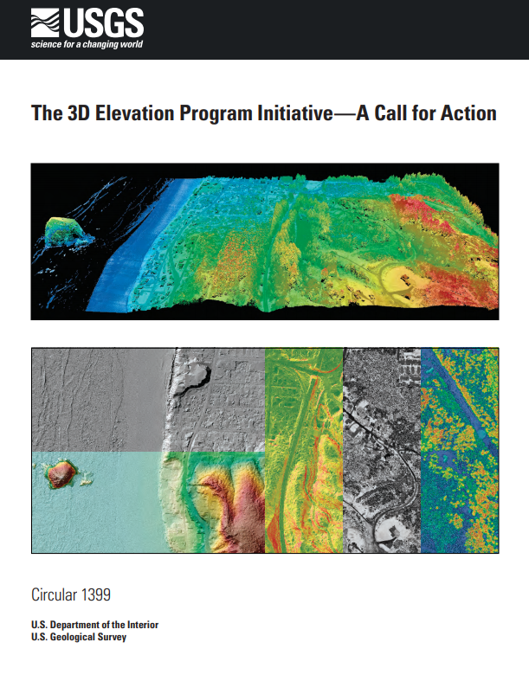





3DNTM Development Tracks
19
Topography is defined by elevation and hydrography; elevation shapes hydrography, and hydrography shapes elevation. To support a broad range of applications, the 3D National Topography Model integrates USGS elevation and hydrography datasets to model the Nation's topography in 3D.
Complete nationwide elevation and hydrography baseline datasets
3DNTM Call for Action Part 1:
3D Hydrography Program
3DNTM Call for Action Part 2:
Next Gen 3DEP
Pilot integration of hydrography and elevation
Design and implement next generation of integrated data
3DHP data derived from elevation
Connections to groundwater and engineered hydrography
3DHP Infostructure
Elevation data collected at new quality levels and frequencies
Integration with inland bathymetry
Research and develop
3D data model
Notes:
We are focusing now particularly on developing the next generation of our hydrography and elevation programs, and working towards program plans much like the 3DEP Call for Action report that laid out the goals, milestones, and roles for the program.

Slide 20
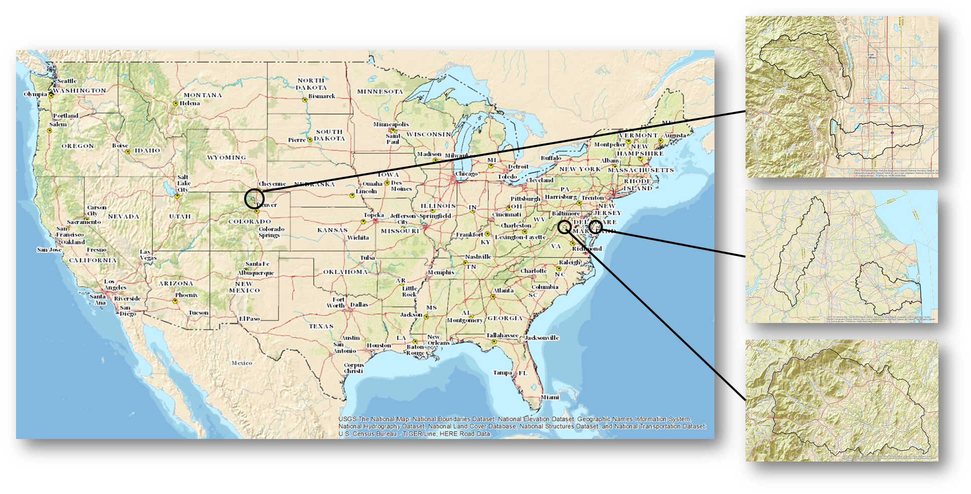
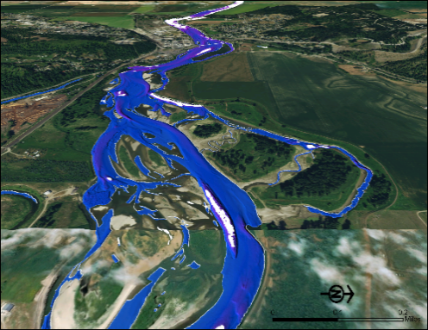
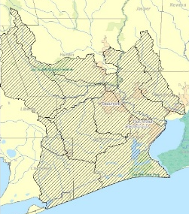
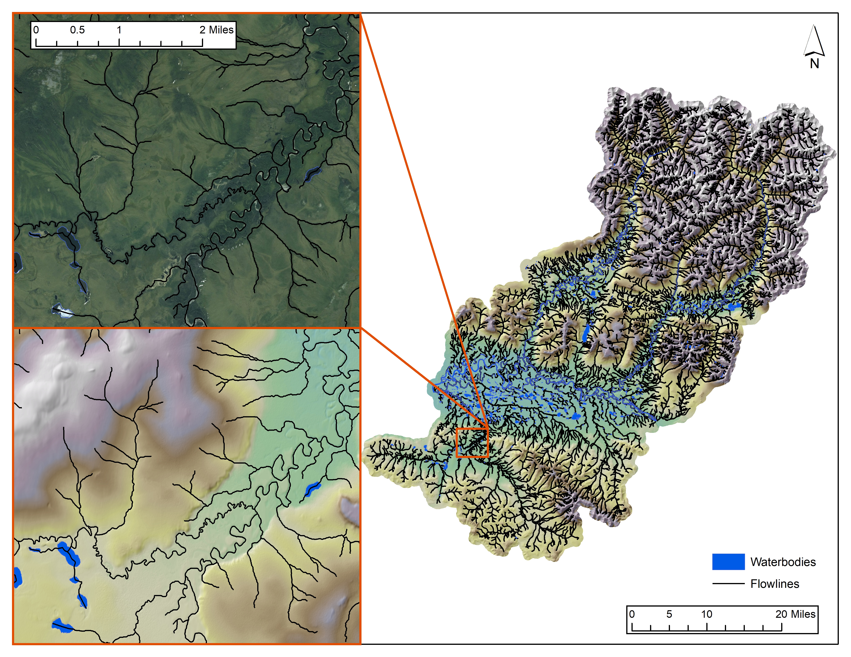
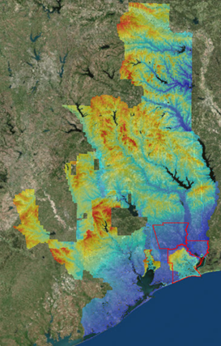
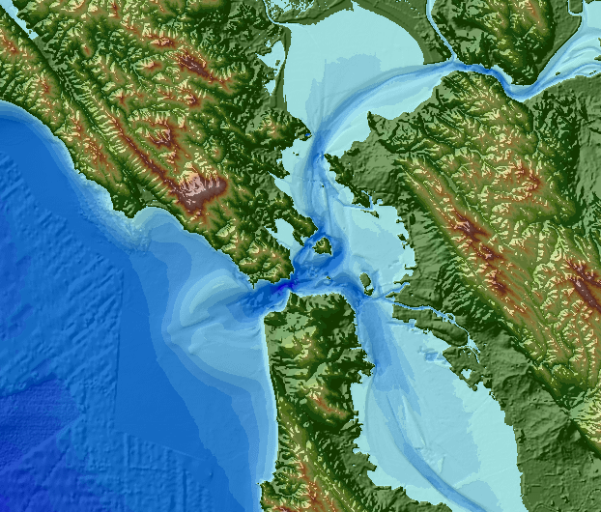
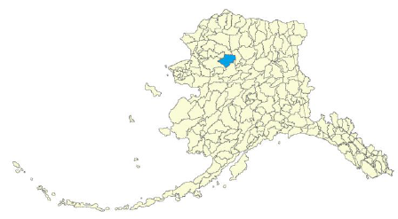
Test processes to work toward operational approach
Pilot integration of hydrography and elevation
Inland Bathymetry - Extend the 3DEP elevation surface under waterbodies to replace estimated flow volume with volume calculated from the mapped surface
River | State | Status | Data Availability
Elwha | WA | Acquired in 2015 | Published on TNM
Kootenai | ID | Acquired in 2017 | Published on TNM
Klamath | CA | Acquired in 2018 | Published on TNM
McKenzie | OR | Acquired in 2021 | Processing in progress
Niobrara | NE | Acquired in 2020 | Published on TNM
Nisqually | WA | Acquired in 2020 | Published on TNM
Potomac 1 | WV/VA/ MD | Acquired in 2019 | Will be published on TNM in FY22
Potomac 2 | WV/MD | Acquired in 2021 | Processing in progress
Upper Colorado | CO | Acquired in 2020 | Published on TNM
SE TX Pilot | TX | Use existing bathy data to produce topobathy model | Will be published in April 2022
2017 Pilots: 5 areas across the US
2021 Pilot: SE TX
Bathymetric lidar
2020 Pilots: Kobuk River Basin, AK
Integrated topobathy
model
Derive hydrography with Z-values from lidar to move from the neighborhood to the street-level in accuracy of features
Notes:
Now I am moving on to the second development track, piloting integration of hydrography and elevation.
This is an important transitional step as we look to the future and test key areas of data integration to plan towards operational approaches.
One area of piloting highlighted on the left is on extending the elevation surface under waterbodies with inland bathymetry, wo we’ll start to build that continuous elevation surface of 3DNTM and the 3D Nation.
We are also using the pilots to help develop processes to operationalize inland bathy including data validation and publishing, defining data collection considerations, and integrating multiple inland bathymetry data sources into integrated topobathy models.
The map on the left shows the inland bathymetry projects we’ve conducted in the last few years to test different conditions.
Another critical area of elevation and hydrography piloting is deriving hydrography with z-values form lidar, highlighted on the right.
We have been piloting approaches with our Geospatial Products and Services mapping firm partners in several locations in the US and are now focusing on Alaska.
The Southeast Texas pilot includes both deriving hydrography from lidar and producing an integrated topobathy model – so in that case we are blending both together as a more holistic 3DNTM pilot. We look forward to sharing the results of that work in the future.
Goals of Hydrography Pilots Overall
Build inspection procedures and assess specifications
Understand costs and any issues with contracting
Still working to zero in on costs
5 Areas across the U.S.
First NHD pilots
Covered 5 areas with different environments
Lessons learned applied to specifications
Alaska Pilots - Kobuk River Basin
3DEP 5m IfSAR as elevation base to update NHD and WBD
Alaska pilots helped develop the foundation for data acquisition and inspection processes at USGS
Southeast Texas Pilot - Near Houston
Updating the NHD and WBD using 3DEP QL2 lidar 1m DEMs
Part of a larger 3DNTM pilot and interagency project to create a seamless terrain model above and below water
Important for improving hydrologic and hydraulic networks and inform decision making on flood prediction and response

Slide 21
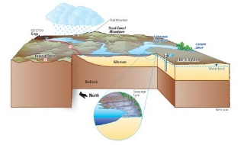
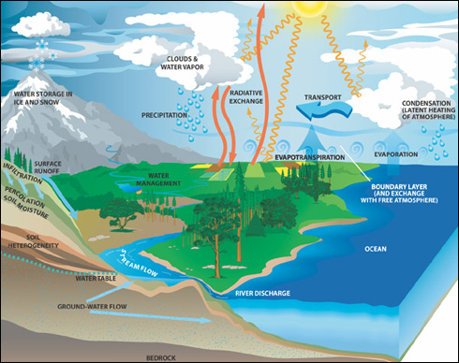
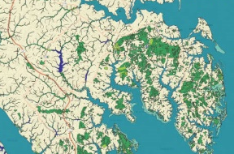
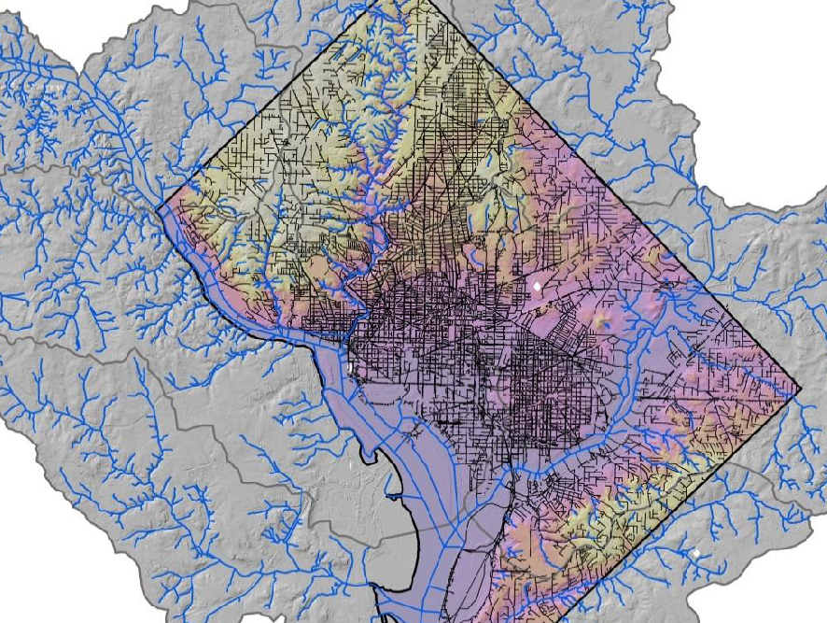
3D Hydrography Program Data Enhancements
Enabling better accounting of the hydrologic cycle
More detailed and precise data
Adding connections to groundwater
Align with and National Wetlands Inventory
  Working with FWS to understand how to improve mapping across these data sets
Including engineered hydrologic systems
  Storm water systems in midsized to larger cities
  Need more research into the appropriate level of storm system mapping
Estimated to provide more than $1 billion in benefits every year when fully implemented (Hydrography Requirements and Benefits Study, 2016)

Slide 22
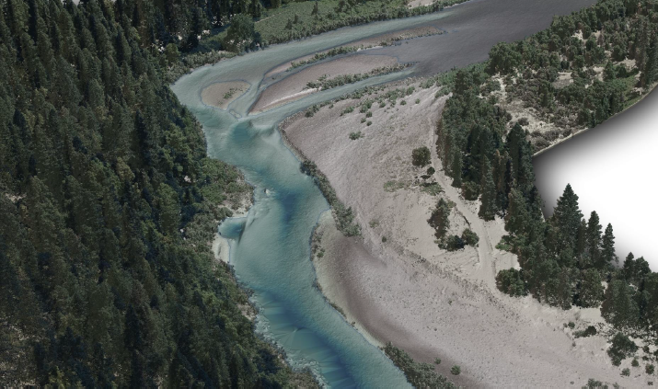
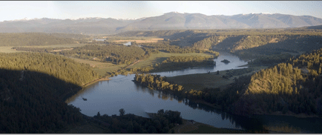
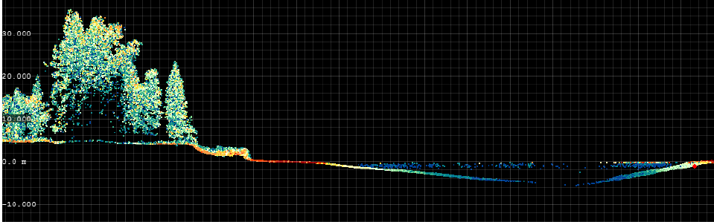
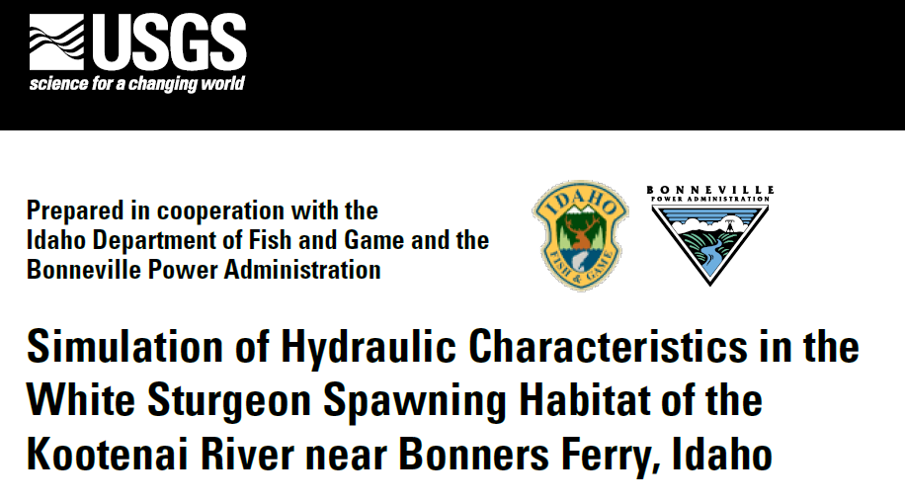
Inland Bathymetry
Commercial bathymetric lidar sensors are available for mapping both coastal and inland bathymetry
Collections will help inform future specifications and topo-bathy lidar collection criteria
Bathymetric lidar surveys completed by lidar contractors on the Kootenai River in ID in 2017, Klamath River (CA) in 2018, survey of the Potomac River (MD/WV) in 2019, Niobrara River (NE) in 2020, and Upper Colorado River survey in 2020
USGS and partners can acquire bathymetric lidar using the USGS GPSC contract
USGS scientists collected field data during lidar surveys for assessing instrument performance and data quality
  Image courtesy of Quantum Spatial International
Notes:
The goal of the pilot study is to test the viability of commercially contracting topobathymetric lidar surveys through our GPSC contract, and to begin to develop recommendations on defining collection parameters (for example, related to river stage, river bottom type, albedo, water turbidity and depth. This will help ensure that when we collect topobathy lidar data, the data coverage and quality meets the expectations of 3DEP and the science community. In general, we also want to increase the base of knowledge on this emerging technology within NGP.

Slide 23
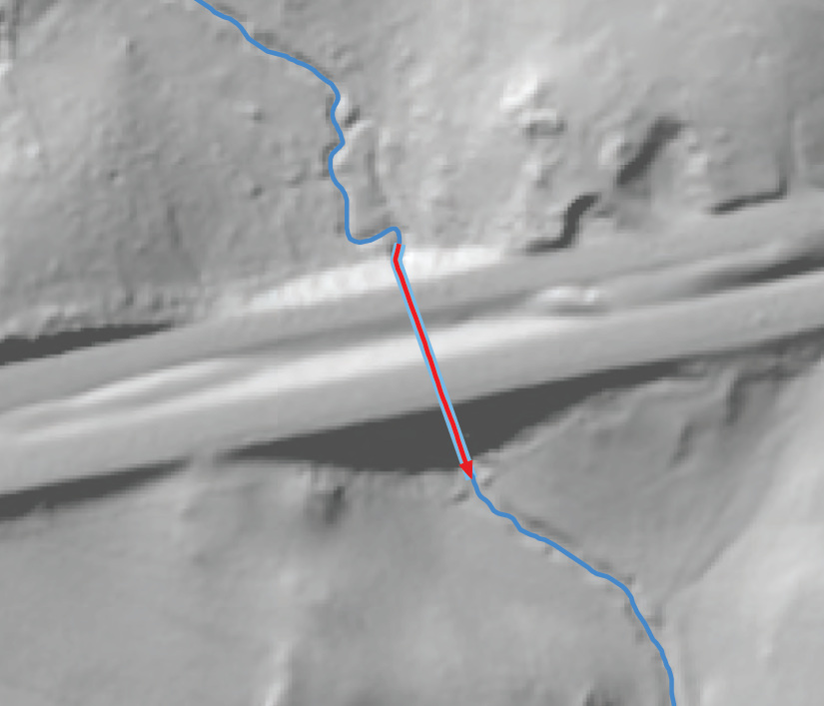
Constructed – Culvert features
3DHP will include culverts and other features needed to enforce proper drainage
For a surface to be suitable to model the flow of water, areas within a bare-earth digital elevation model (DEM) that create a blockage to flow through the surface must be removed.
The most common surface features that block flow across a DEM are roads or railroads.
Finding the location of culverts and small bridges within a surface beneath transportation corridors or other features is a critical step in hydro-enforcement.
Notes:
One thing we have to deal with, though, is where streams pass under things like this road embankment. Our specifications require these situations to be identified as culverts so we can use the culverts in drainage enforcement. If this isn’t done, it can cause a lot of problems, as any of you who have processed lidar data are well aware. The EDH data will have all these situations identified.

Slide 24
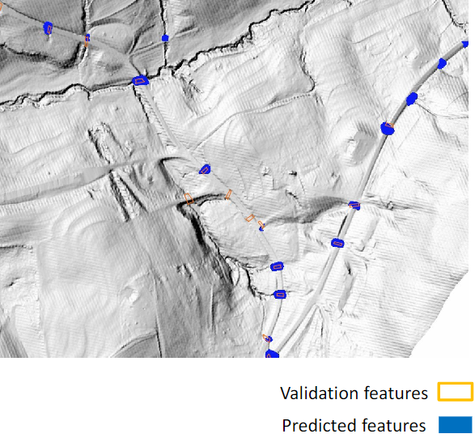
3DHP Research
Using AI on HPC to lower costs and increase automation
Data model research – linked open data, learning from Canadian and Australian data models, simplicity is a major goal
Bridging from current data to future data – can we identify common tie points/segments?
Building data pipelines – flow updates through automated processes
Generalization and multi-scale data products

Slide 25
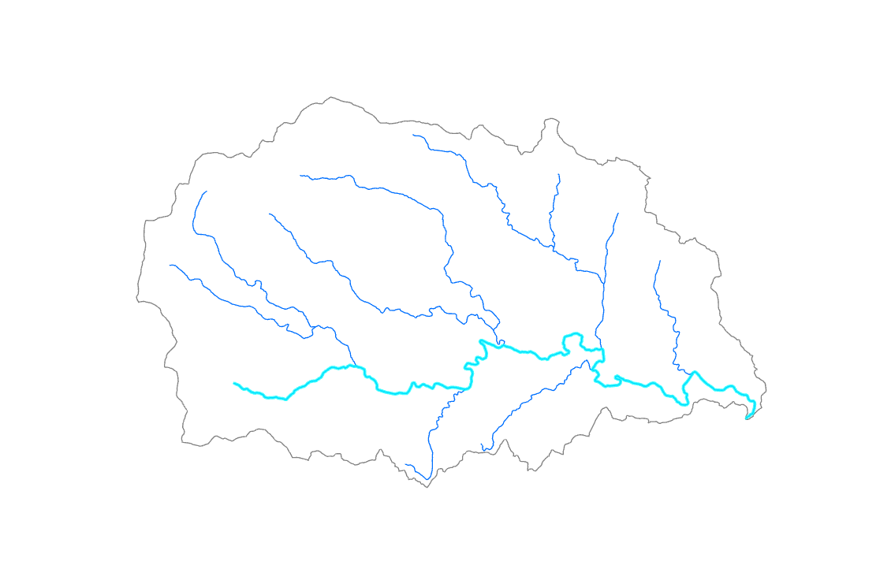
Thornton River
Original NHD 1:100,000-scale stream network
Notes:
And here is the NHDPlus Medium Resolution with that same main path identified. Being able to represent the same logical features with representations at different levels of detail is really important. With EDH data we will be able to do this consistently by building the networks at really high resolution, and then generalizing the networks and the features as needed for different applications.

Slide 26
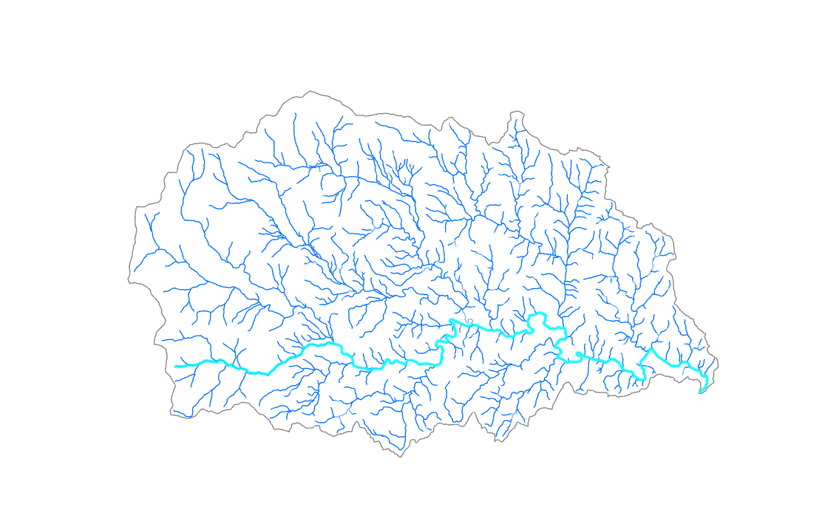
Thornton River
Current NHD 1:24,000 stream network
Notes:
This shows the current NHDPlus HR for the same basin, with the same main path identified.

Slide 27
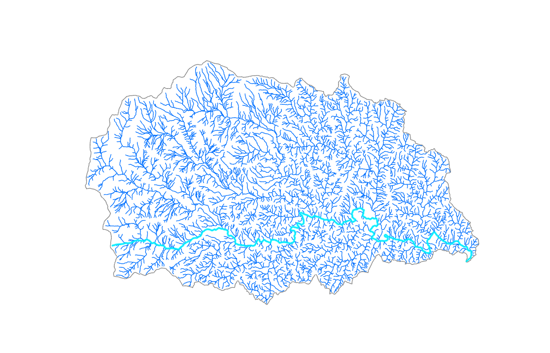
Thornton River
Pilot lidar-derived hydrography
Notes:
We also want to be sure that the network holds together and can be used for many different purposes. So here we have some EDH data that was developed in a pilot study basin, and we’ve used the NHDPlus attributes to identify the main path

Slide 28
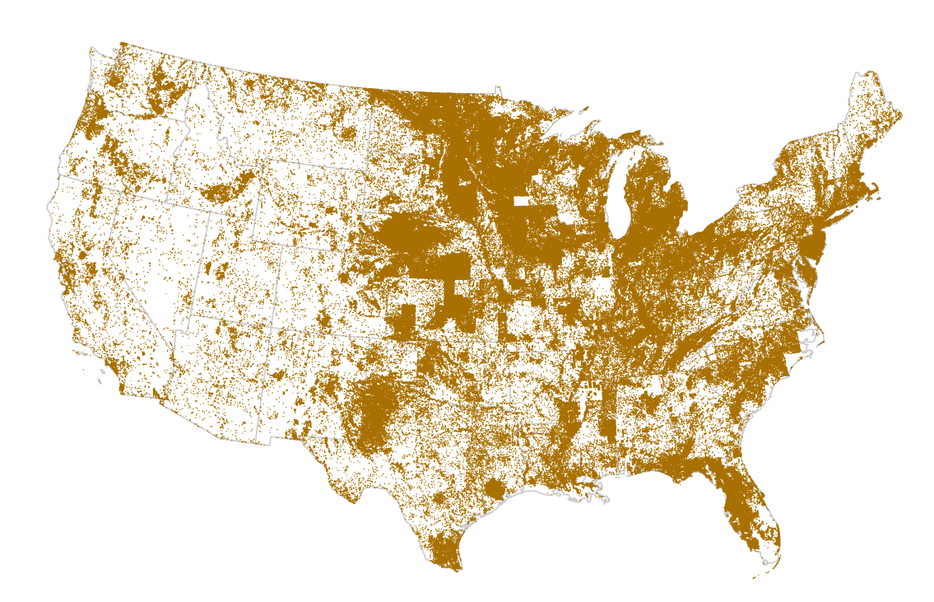
Landscape Depressions
The 1:24,000-scale topo maps show about 1.8 million depression contours in CONUS
Lidar will show lots more small depressions
Automated tools can find them, but: Which are connected to storm drains, and which will store water?
Nationally consistent
3DHP Data
Notes:
There are over 250,000 network ends in the 3/06/2021 candidate version of NHDPlus HR Beta National Release 1.

Slide 29
1989 – 2021 Computing Comparison
 | 1989 PR1ME 750 | 2021 Laptop | Multiple
CPU | 1 MIPS | 5080 MIPS | 5080
RAM | 1 MB | 32 GB | 32,000
Disk drive | 300 MB | 2 TB | 6667
$/MB disk storage | $47/MB | $.0002 | 1/531,100 (in 1989 $)
“Big” Data | 90-m DEM | 1-m DEM | 8100

Slide 30
Perspectives
It’s the community, stupid!
Lots of applications don’t need 1-m DEMs or hydrography with 2-m horizontal accuracy
All applications need the water to be flowing in the right place and in the right direction – best accuracy can be achieved with detailed data
3DNTM/3DHP is a very bold, ambitious vision – best opportunity to get significant funding to improve hydrography
USGS can’t do it alone, it will take partnerships and participation from the whole community
NOW is the time to get our specifications right—Please help!
Undreamed-of applications will come from this

Slide 31
Words of Wisdom/Experience
Repeatable workflows—replaceable datasets
Build the best data possible, generalize from that
It’s a Community—Not a Club!
Perseverance.

Slide 32
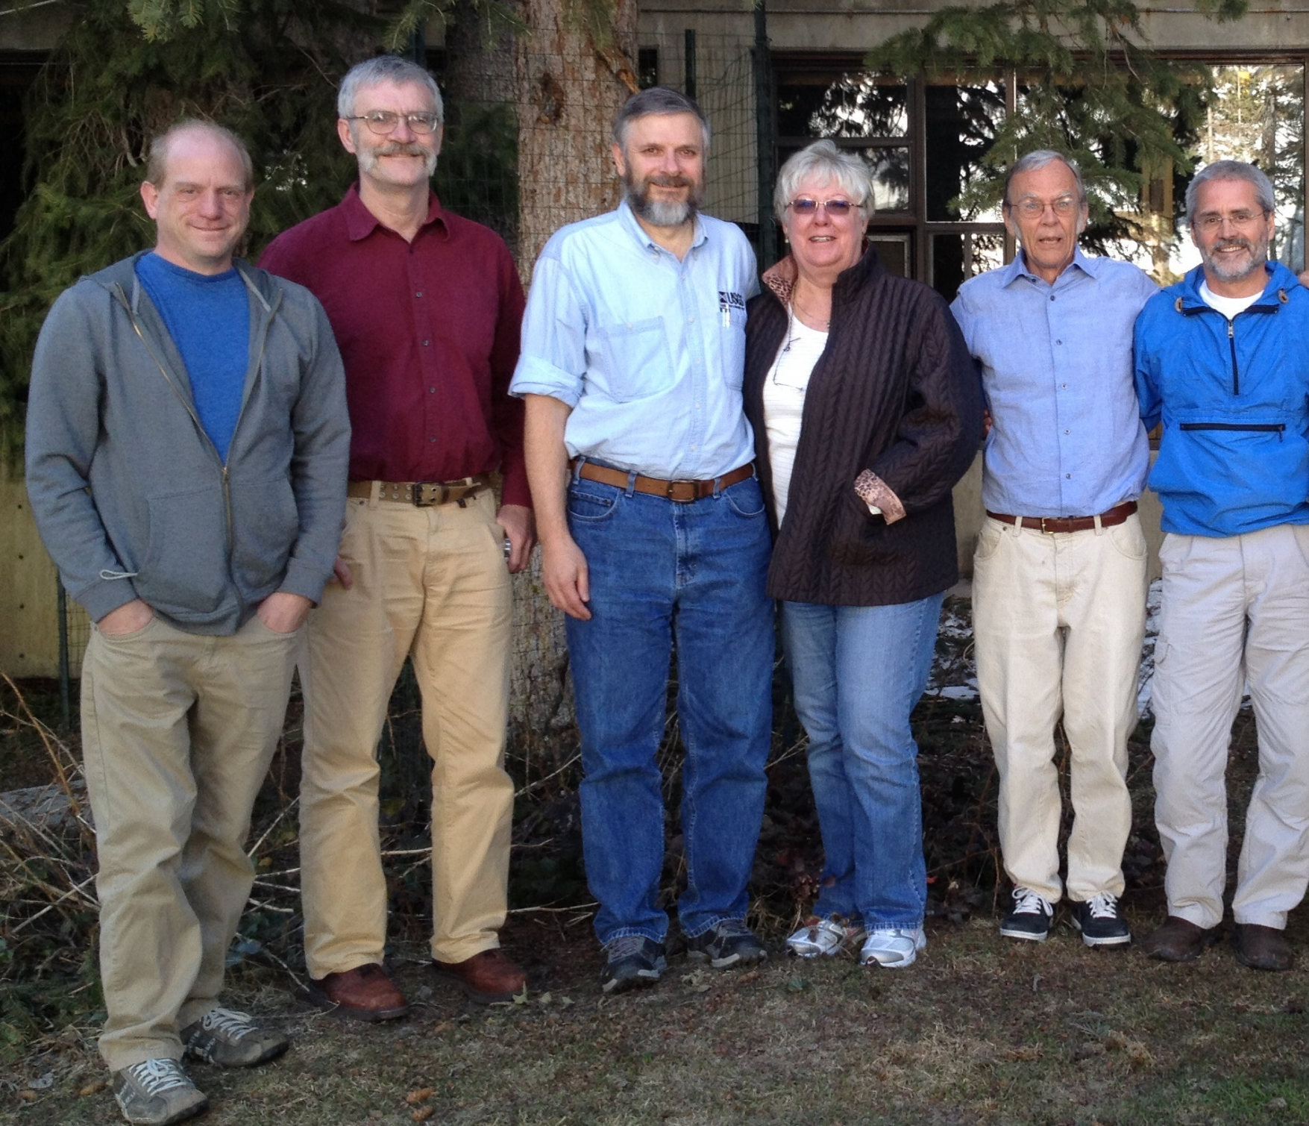
The NHDPlus Team (V1 & 2)
Nationally consistent
3DHP Data

Slide 33
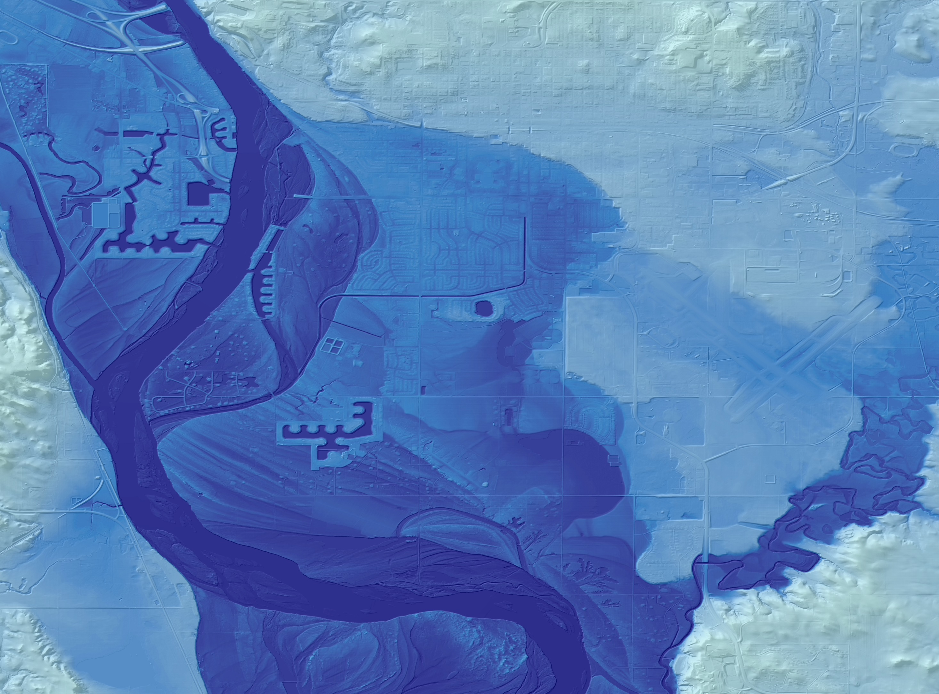
THANK YOU!
Alan Rea
USGS National Geospatial Program
ahrea@usgs.gov
usgs.gov/NHD
Bismarck, ND
3D Elevation Program (3DEP) data

