Slide 1
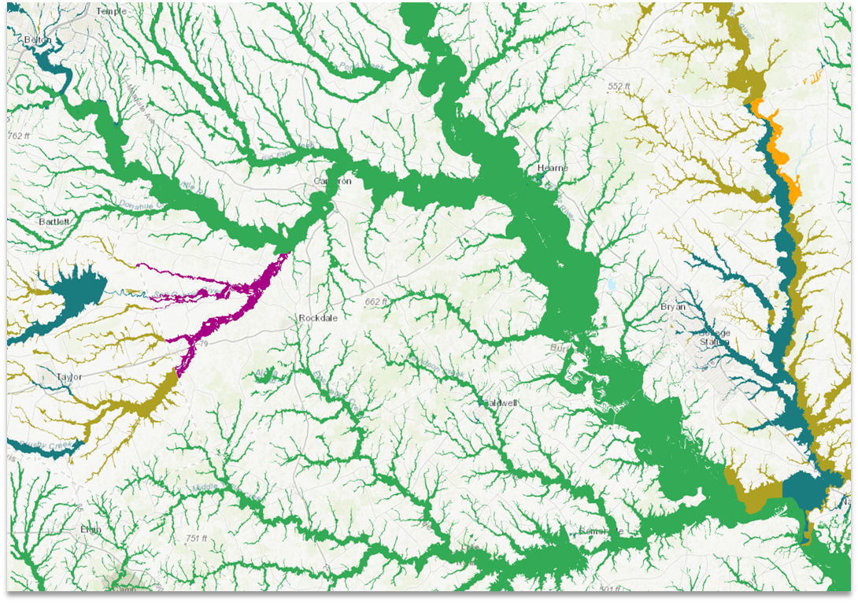
The Flood Quilt and other TWDB Flood Initiatives
Saul A. Nuccitelli, PE, CFM
May 12, 2022
Notes:
So yes, we really are calling an important aspect of our flood work, “The Flood Quilt”, and I’ll touch on that and several other initiatives at TWDB

Slide 2
2019 - Senate Bills 7 & 8
Mapping - Base Level Engineering (BLE)
  2024 – approximate flood mapping complete for all of Texas
Planning - Develop statewide flood plan
  January 2023 – 1st regional flood plans due
  September 2024 – 1st statewide flood plan due
Mitigation – State Flood Mitigation Funding
  Flood Infrastructure Fund (FIF), >$790M
  Texas Infrastructure Resiliency Fund (TIRF), >$680M
Notes:
Texas is no stranger to floods, and in the wake of several consecutive years of extreme floods (2015 Memorial Day, 2016 Tax Day, and 2017 Harvey),
In 2019 Texas passed a series of laws to improve our efforts against flood risk and damage statewide. These laws were centered on 3 principles – mapping, planning, mitigation.
First need improved mapping. NFHL covers only about 50% of the land area of TX, so many areas have no maps at all. Texas recently completed statewide LiDAR so focused efforts on approximate mapping (with LiDAR) statewide, no watershed unstudied.
Second, we developed a brand new statewide flood planning process with target dates for 2023 regional plans and 2024 statewide plan.
Finally, Mitigation – Almost $1.5B to support mitigation efforts with several programs. Goal is that new mapping and planning would support future mitigation, but also knew of immediate needs that could begin right now.
As a practical effect on our state agency, we increased from maybe 10 folks focused on flood activities to well over 50 folks in a couple years to manage these new programs.
Have time only to touch on the first two. But, we have tons of info on our website if you want to learn more.

Slide 3
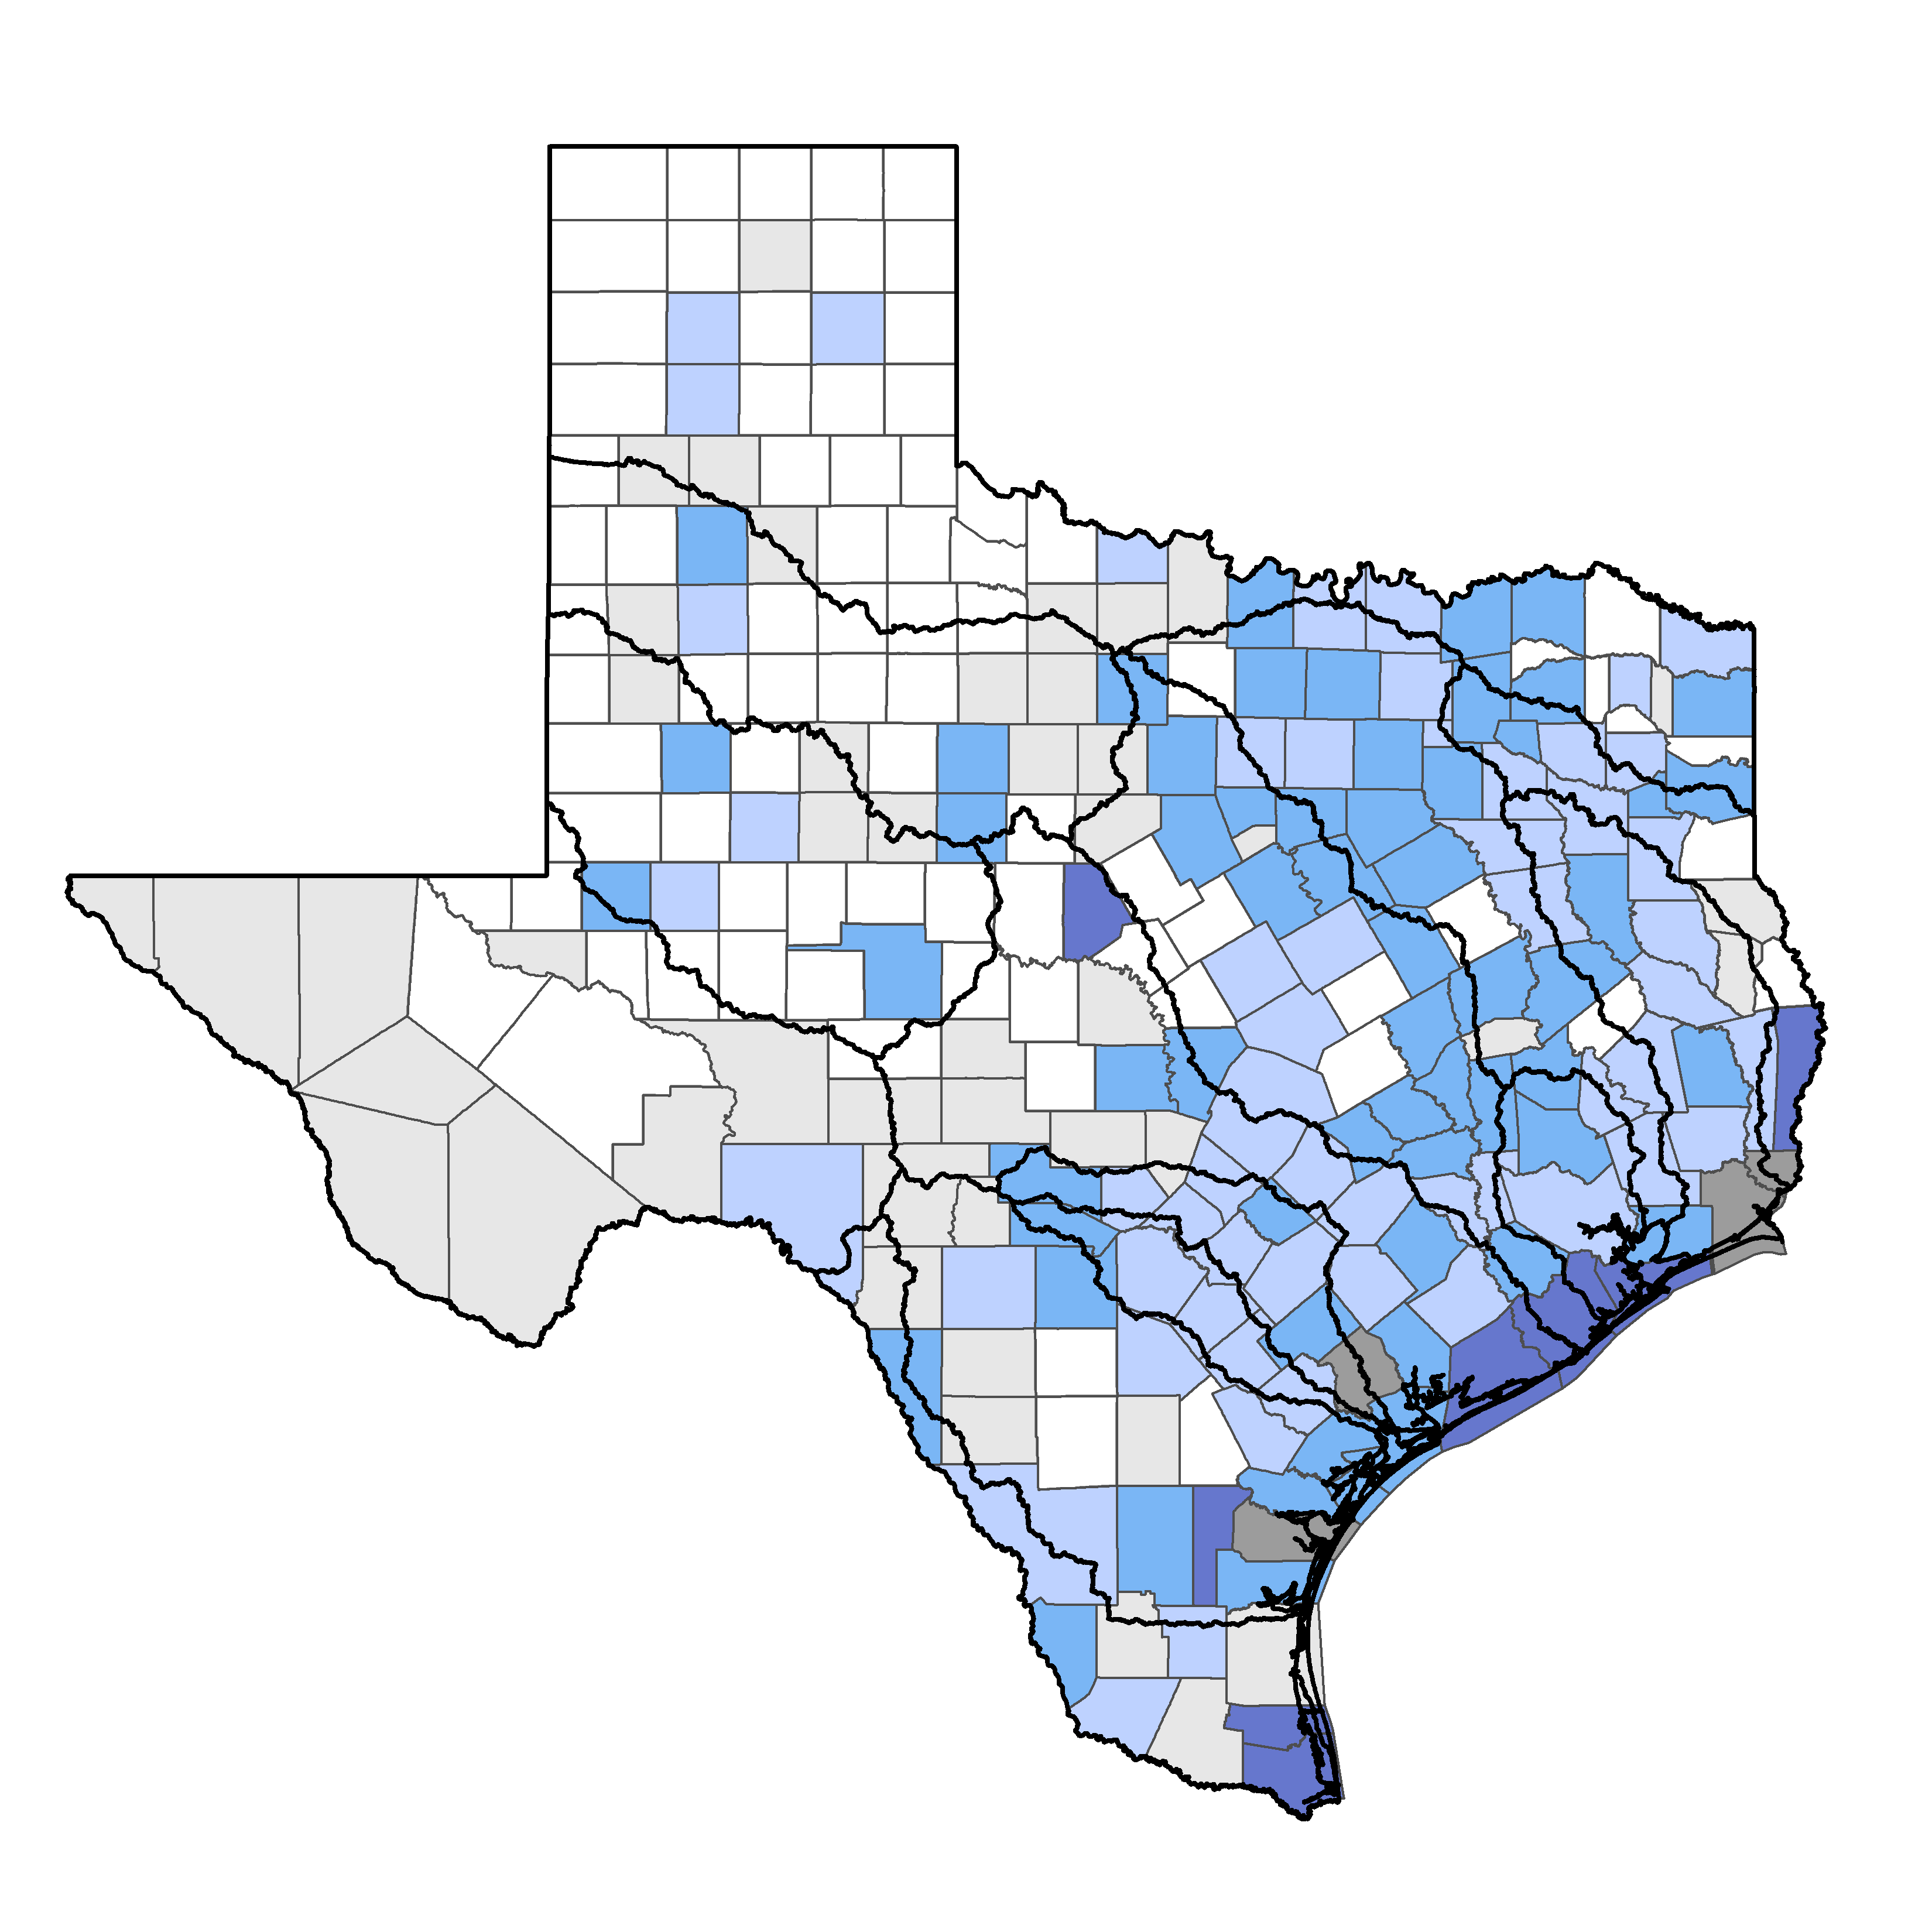
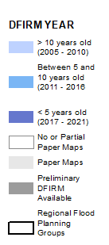
Initial Flood Risk Data Availability
Notes:
This is a snapshot of where the state is on digital data available from FEMA.
We have 254 counties, about half of those have FEMA digital data the rest are unmapped or have only paper maps.
Of the counties with DFIRM: 57 >10 yrs. Old, 60 between 5&10, 8 are 5 years old or less.
Also important to highlight those DFIRM map ages reflect just when the map was converted digitally, but NOT the date of the modeling/mapping info, which is very often much older.

Slide 4
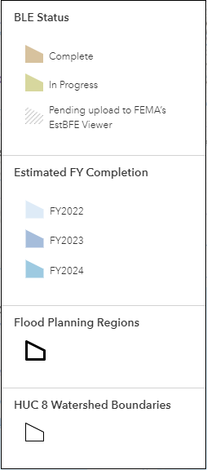
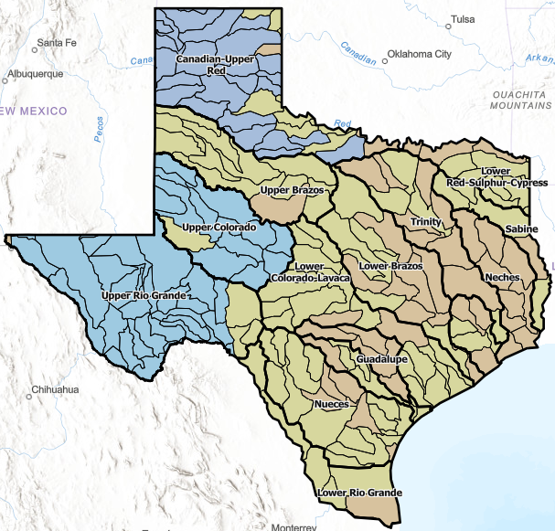
Base Level Engineering (BLE) Status
https://www.twdb.texas.gov/flood/mapping/ble-status-viewer.html
Notes:
So, couple years back we launched a statewide effort to develop BLE mapping (in coordination with FEMA’s efforts).
Brown reflects completed
Yellowish/tan reflects in progress
Varying shades of blue shades is the planned FY start data
208 HUC-8s in TX
39 complete
92 underway
77 left to go

Slide 5
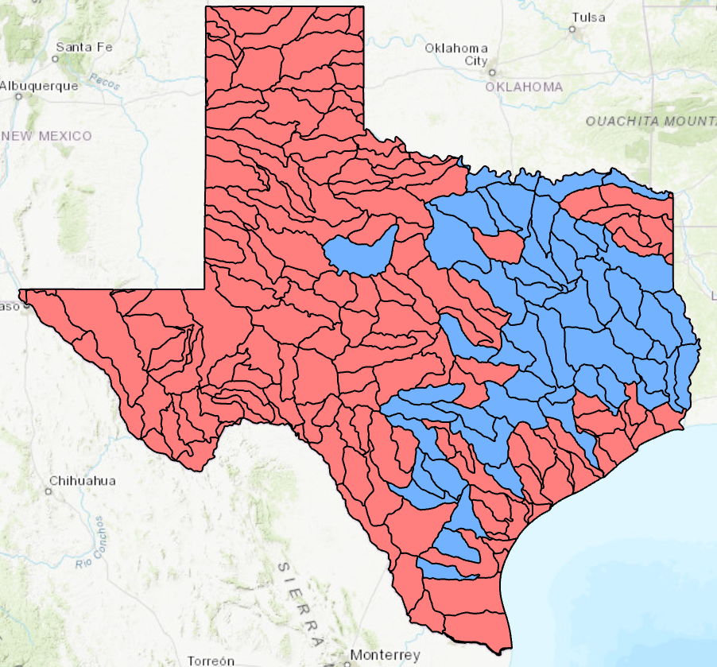
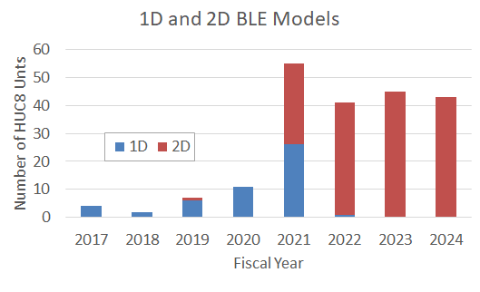
Completion Time Profile of 1D and 2D Models
Notes:
This slide, I’m shamelessly ‘borrowing’ from Prof. Maidment where he mapped out from our data which modeling efforts were performed for BLE (1D/2D) by year.
As you can see, nearly all initial BLE efforts were 1D and now we’ve moved to a full conversion over to 2D modeling (prompted in large part due to the improved ease of use of HEC-RAS for 2D modeling and improvements in computing capacity)
In the future, we’ll move into a maintenance mode and eventually convert them all to 2D

Slide 6
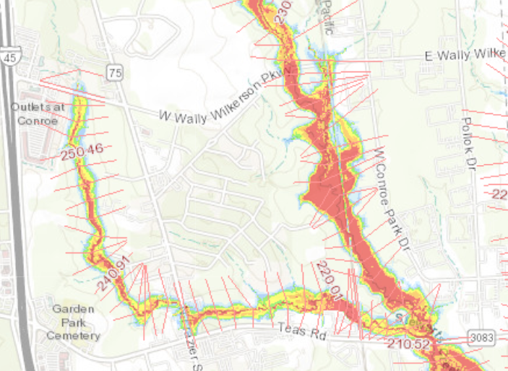
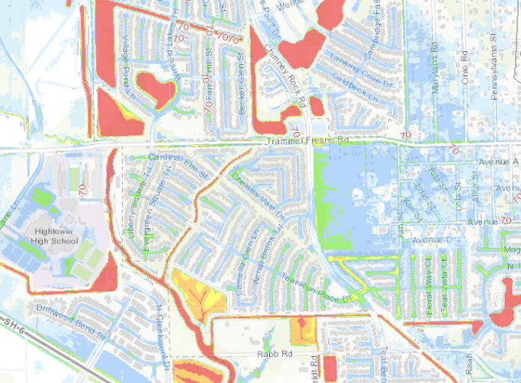
BLE Modeling Approach
1D BLE:
  Riverine Flood Risk
2D BLE:
  Riverine and Localized Flood Risk
Notes:
These images are for different areas, but helpful to understand how 1D and 2D flood mapping varies and how you get a much better sense of the localized/overland (or pluvial) flood risk.
1D cross sections limit where flooding will be modeled/shown
2D we’re literally dropping rain on a terrain grid and letting the water flow/accumulate where the terrain is low
Certainly has implications for what we all ‘think’ the floodplain should be, and we could have a whole different discussion on that
Suffice to say, even though we could, we’re not mapping all parking lots puddles and have some removal algorithms for very shallow or small area flooding.

Slide 7
BLE – Potential Uses
  Advisory Flood Data
    Support Planning, Emergency Management, Research, other efforts
  Support Local Regulatory Efforts
    BFE estimates, adopted as ‘local’ regulatory floodplain
  Develop detailed studies using BLE as a start
    GLO Regional Flood Planning Studies
    Drainage Master Plans
    TxDOT Projects
  Develop Flood Forecast Modeling
Notes:
Because we are serving up both models/maps easily online, there are many potential uses
TWDB’s initial focus was to support statewide flood planning, but many other uses
GLO, TxDOT, and others can leverage the BLE work for more detailed studies.
Prof. Maidment has been leading an effort to see how we can best leverage BLE for flood forecast modeling

Slide 8
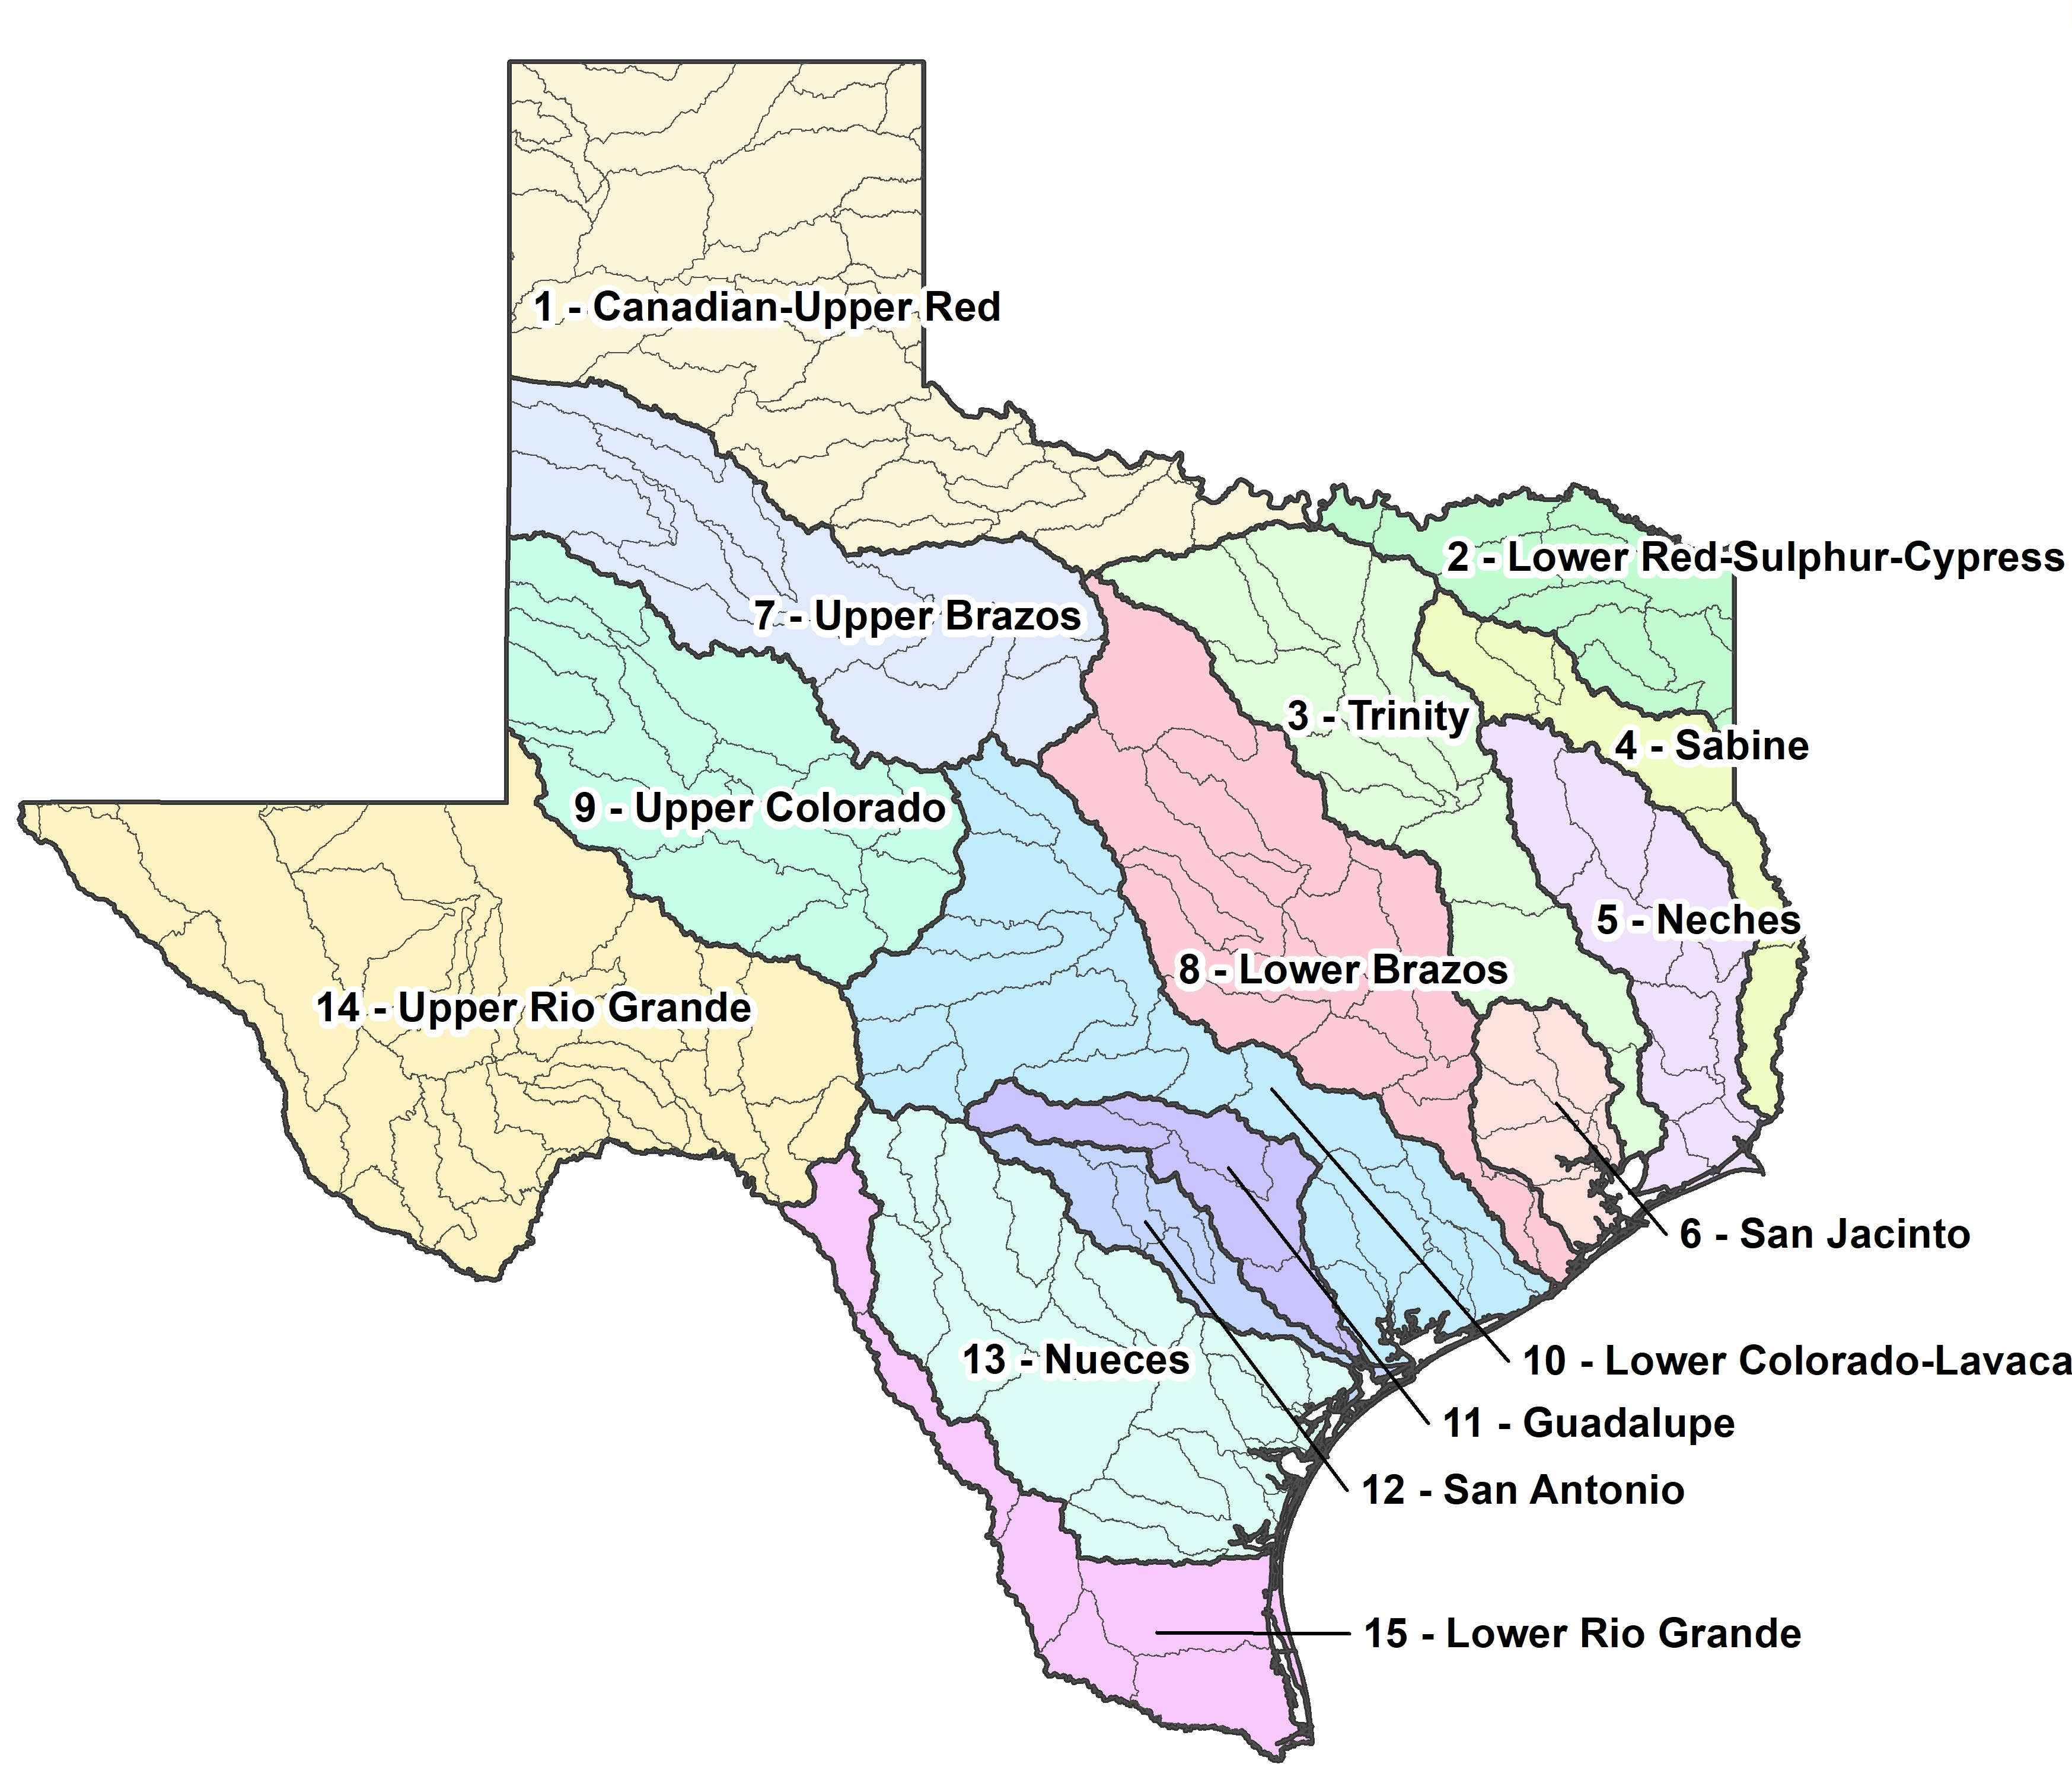
Flood Planning
First of its kind statewide flood plan
Bottom-up approach to planning
Watershed-based regions
Volunteer RFPG members representing different interest categories
Transparent process with public input
Find your RFPG Information, Meeting Schedules & Important Documents here:
https://www.twdb.texas.gov/flood/planning/index.asp
Notes:
Meanwhile with all that mapping effort, we also have a very large concurrent effort of flood planning going on. 15 Regions, 15 RFPGs volunteers, 15 consulting teams, over 320 meetings held to date over past 1.5yrs.
New process, built off TWDB’s existing approach to water supply planning, somewhat figuring things out as we go, but it's been very well received so far.

Slide 9
Key Tasks of the RFPGs
Gather and analyze data
Identify existing and future flood risks
Evaluate floodplain management practices
Recommend evaluations, strategies, and projects to reduce flood risks
Develop a regional flood plan by Jan 2023
Flood Hazard Analysis
Determines location, magnitude, and frequency of flooding
Flood Exposure Analysis
Identifies who and what might be harmed within the region
Flood Risk
Vulnerability Analysis
Susceptibility, critical facilities, resilience
Notes:
RFPGs have a lot to do, but in summary – focus on 1) identifying flood hazards, 2) who/what is exposed to those hazards, and 3) how are they vulnerable
But we had a problem. We knew that most of our BLE wouldn’t be complete in time for when RFPGs needed it

Slide 10
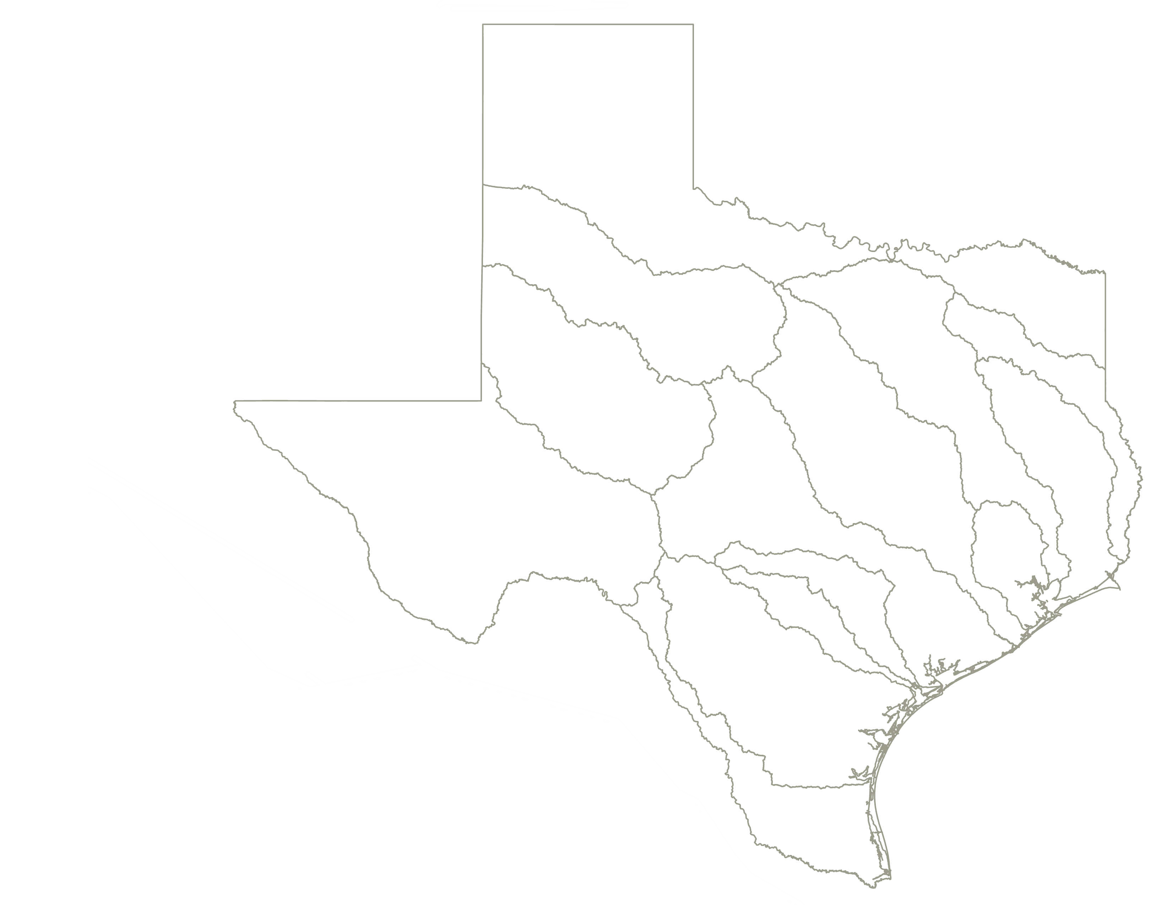
Flood Planning Regions
Regional Flood Planning Groups
Notes:
Since we didn’t have a single/composite data set to use, we decided to ‘quilt’ together the data we did have

Slide 11
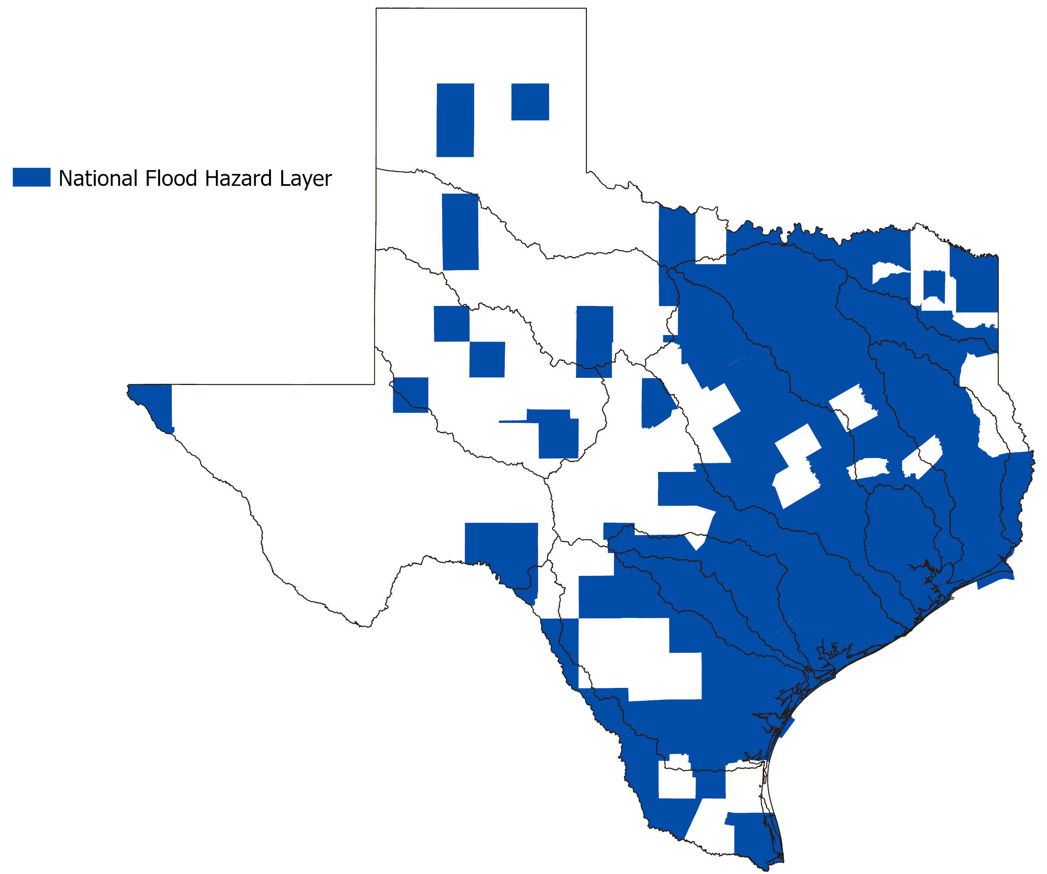
Flood Data Coverage
Notes:
First, Here’s the extent of what FEMA has downloadable on the map service center. This includes the effective, pending, and preliminary maps
While it covers most of the eastern half of Texas and the state’s large metro areas. It does not cover all of TX and very little of W TX.

Slide 12
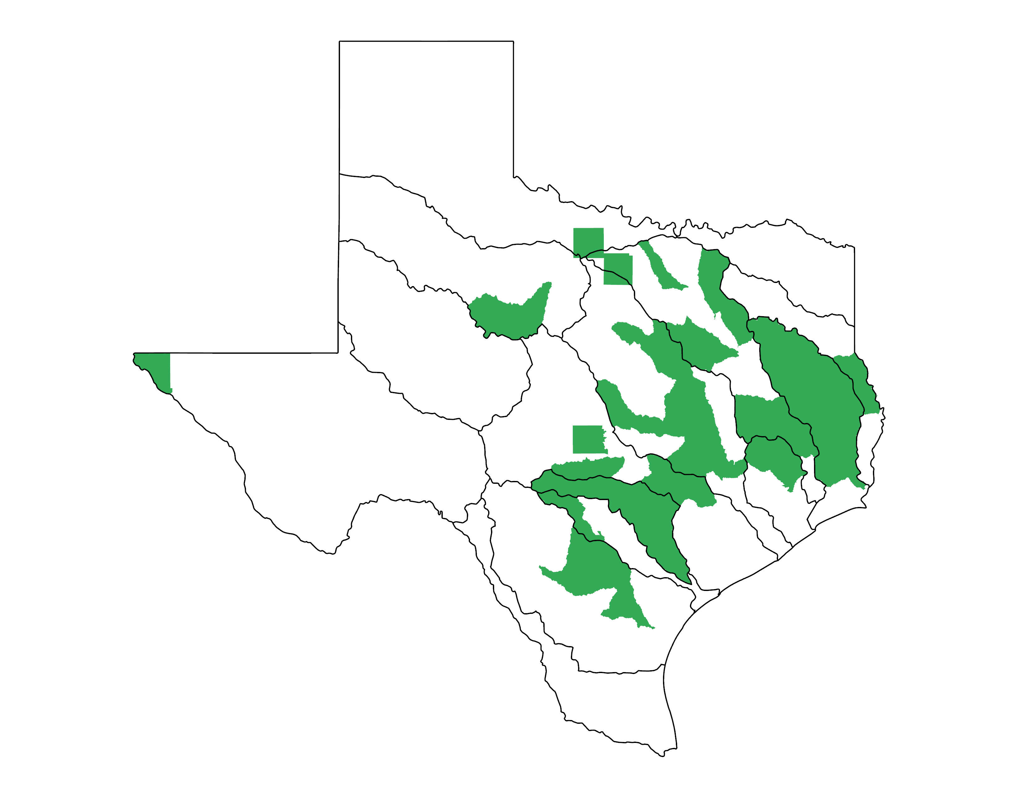
Flood Data Coverage
Base Level Engineering (BLE)
Notes:
Next up, here’s completed BLE coverage.
This is not the most current view, more watersheds completed than what’s shown, but this is what was available to RFPGs in 2021.
By 2024, we’ll have 100% coverage

Slide 13
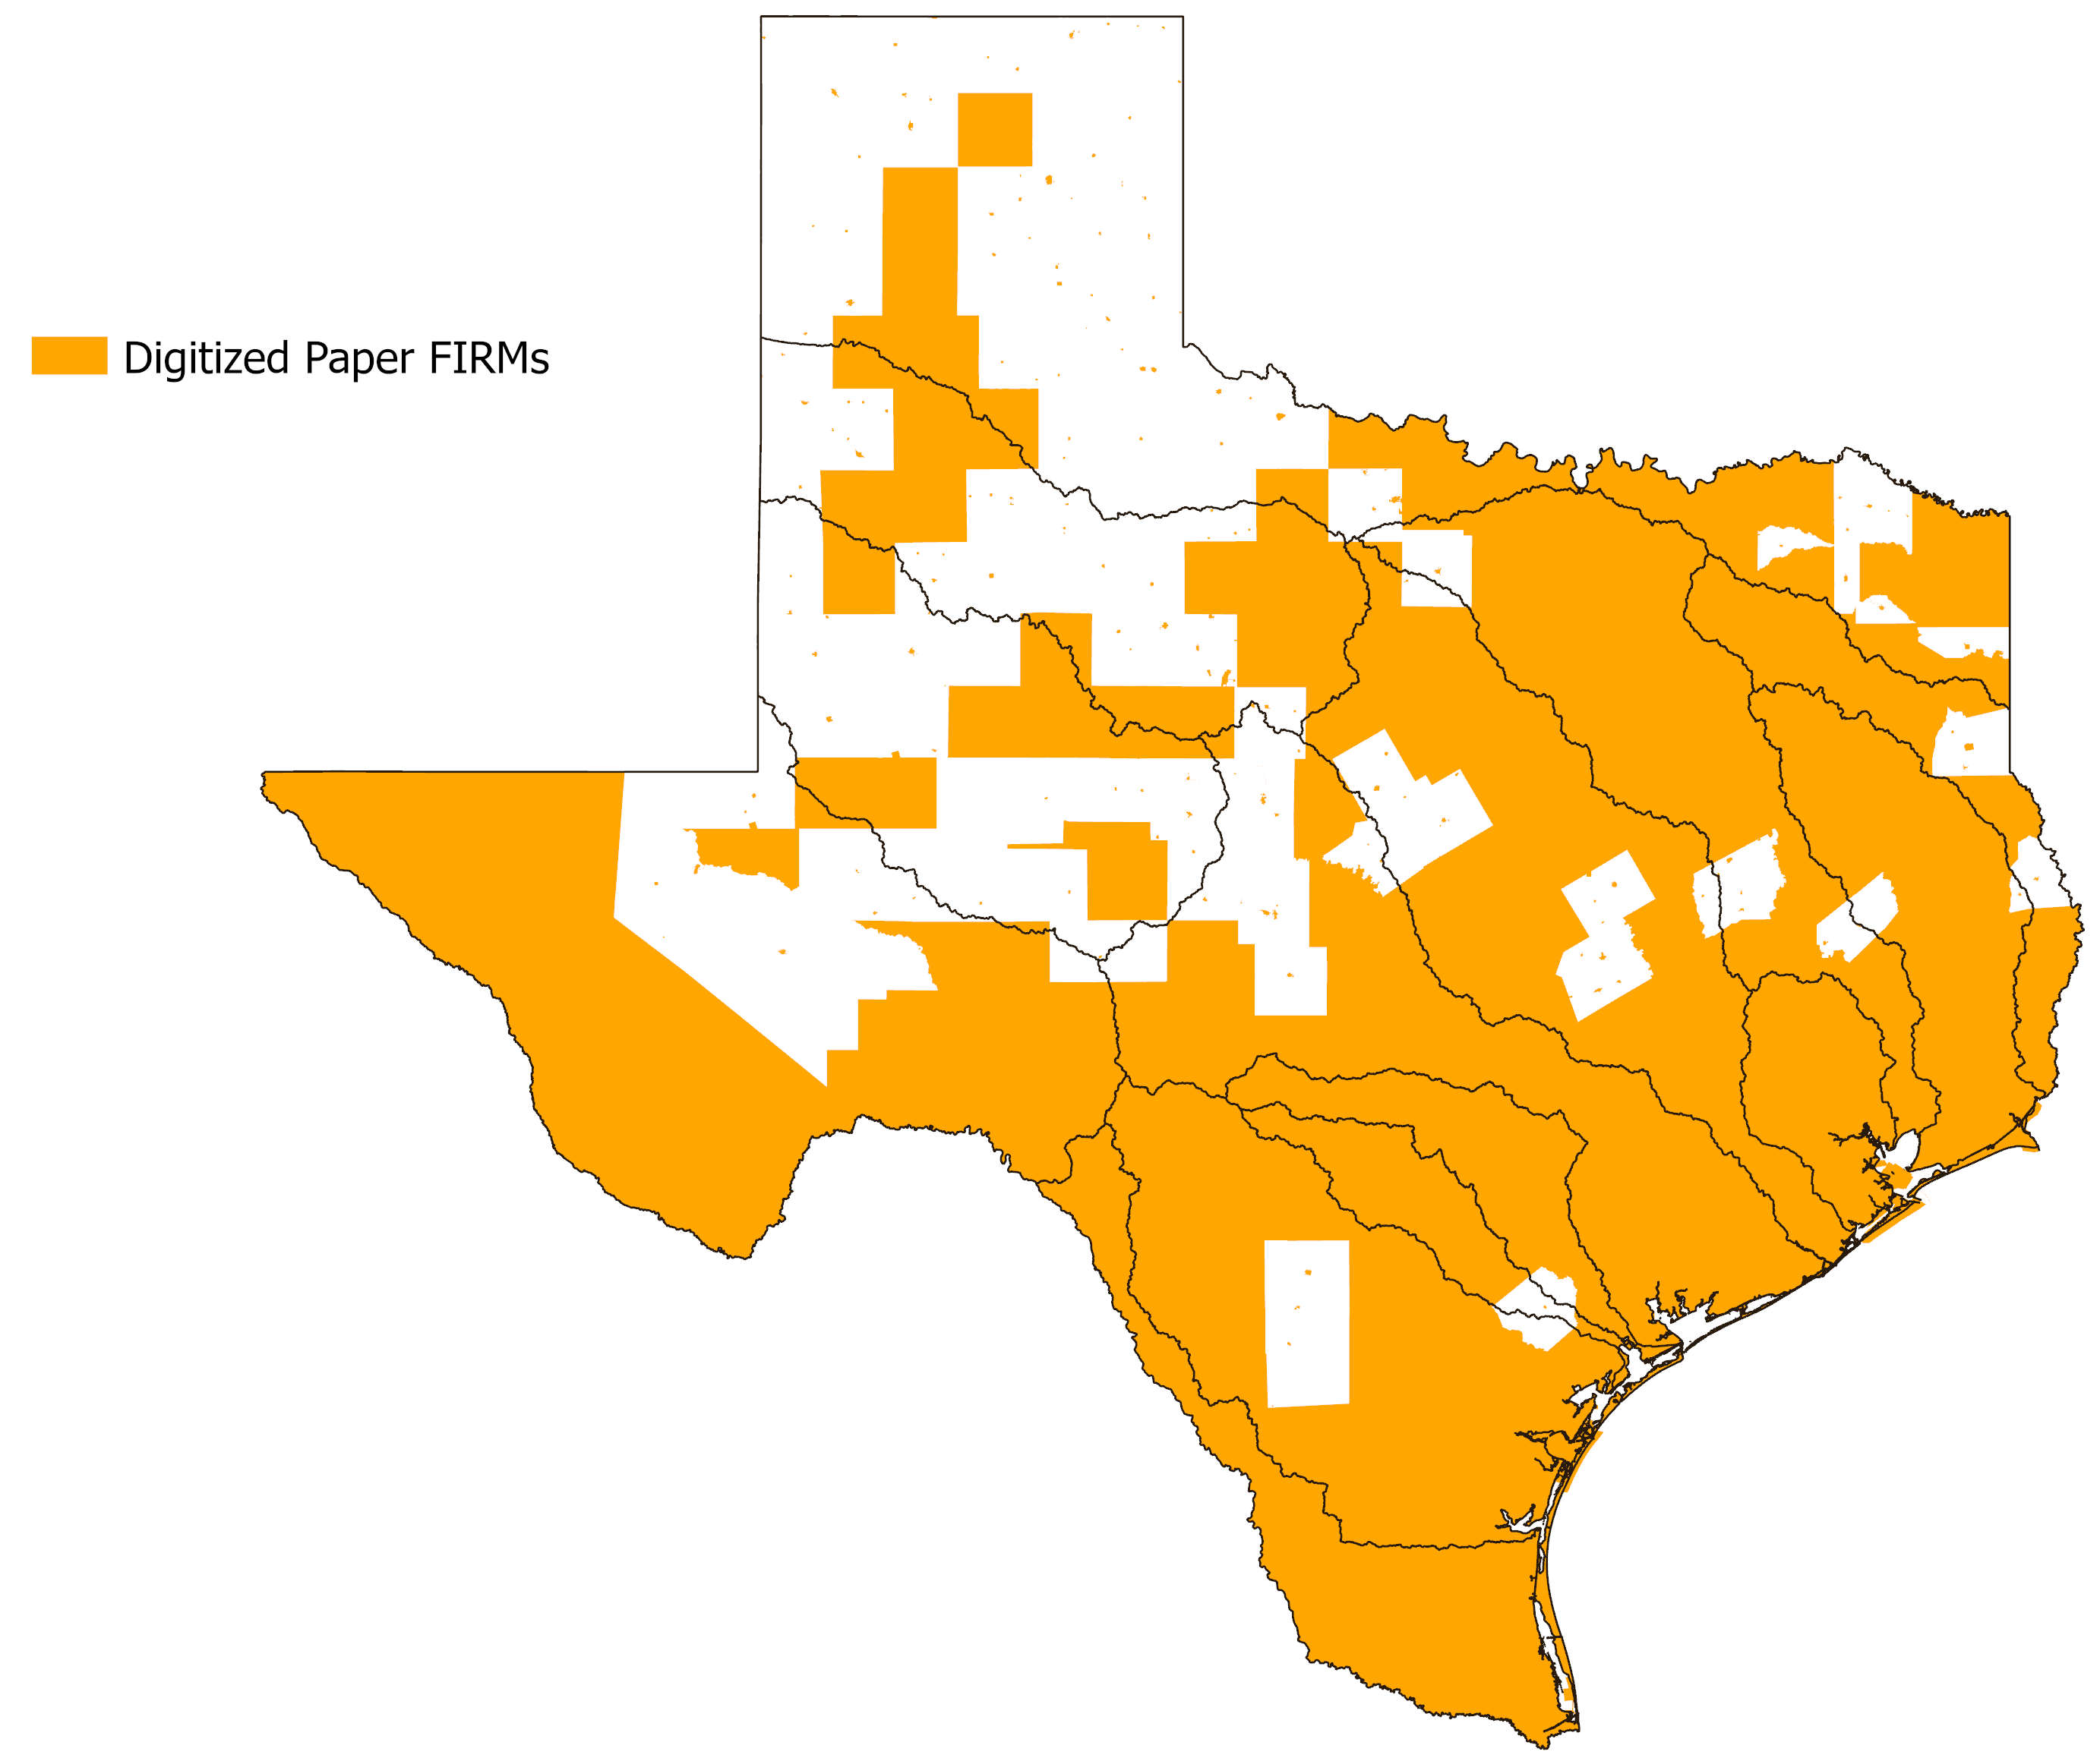
Flood Data Coverage
Notes:
Third - the digitized paper maps.
This FEMA effective data is not available on the NFHL, but is available as ‘pdf’ on the MSC. We have a digitized coverage of this data that we used.
Important to notice the little orange specs on the map - cities that have FIRM data inside counties with no map data.

Slide 14
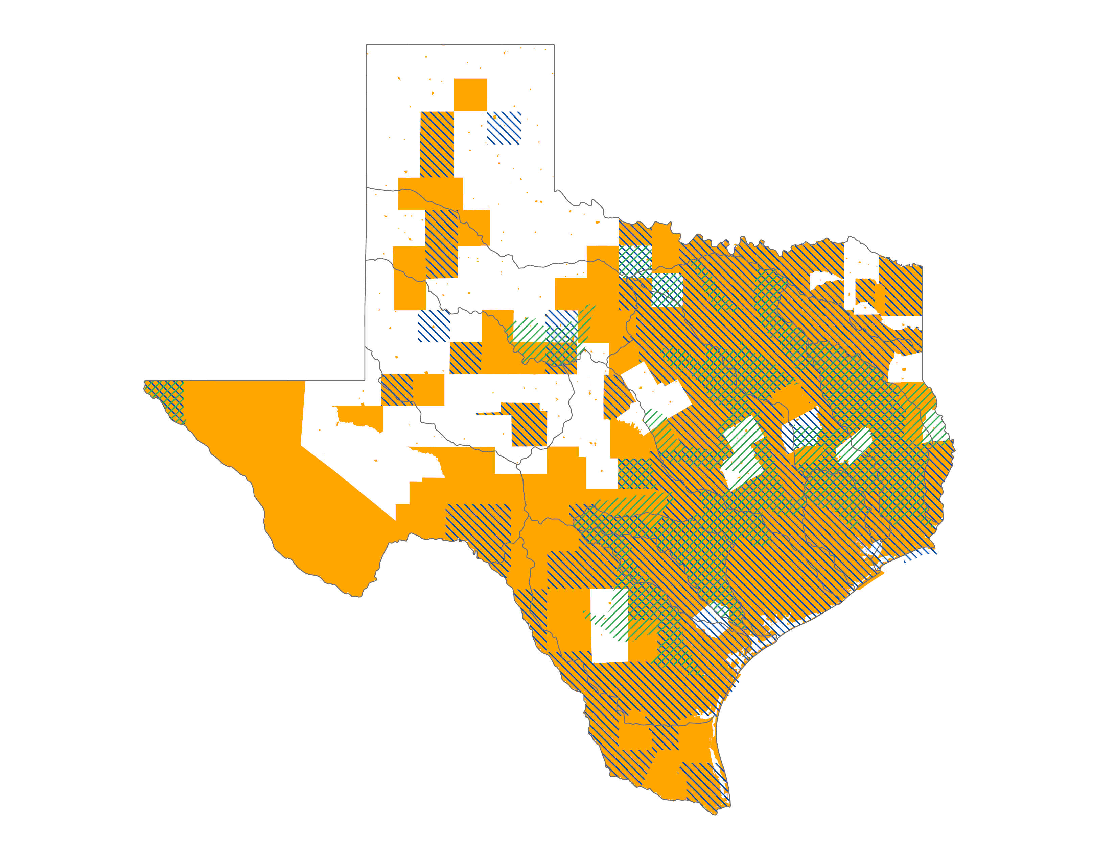
Flood Data Coverage
NFHL Availability
BLE
Digitized Paper FIRMs
Notes:
Here are the availability layers for those three data sources.
As you can see even when these 3 sources are combined, there is still white space (or gaps) with no data.
So, that left us with our next “problem”. Incomplete coverage. Particularly, in rural areas.
Nationally, FEMA has mapped 90% of the population. But in Texas that still left us with large gaps in the state. We needed to support our rural planning regions with reasonably accurate data and produce complete coverage in a few months versus years…

Slide 15
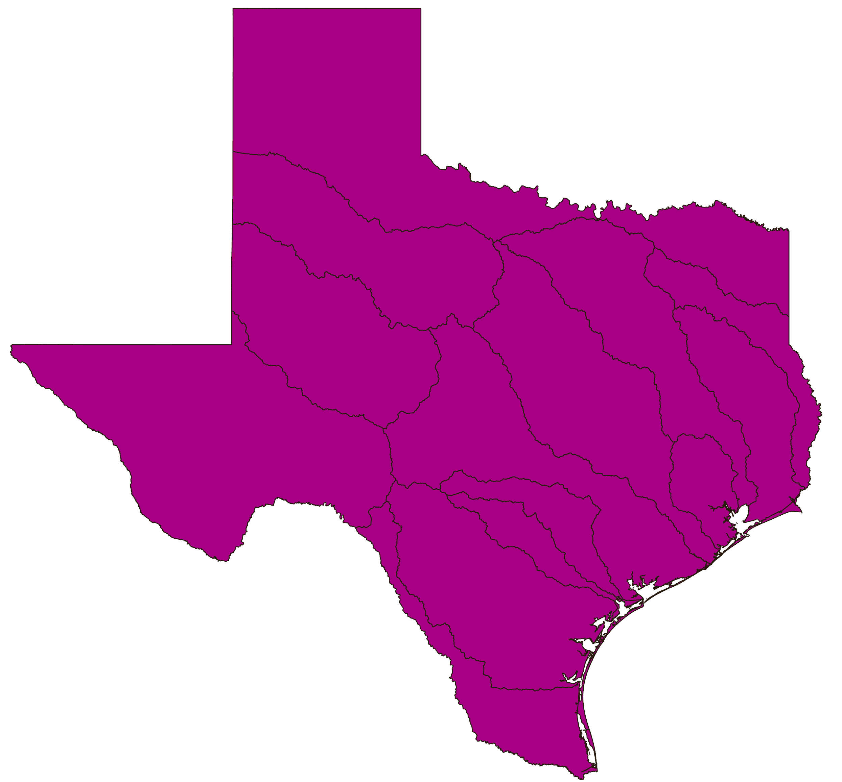
Flood Data Coverage
Cursory Floodplain
Notes:
Well, credit goes to Prof. Maidment in first introducing us to Paul Bates from UK Bristol and a group out of the UK, called Fathom was producing data that would meet our needs.
You might be familiar with their product, Flood Factor, that is now on sites like Redfin and realtor.com
We worked with Fathom, who is a collaborator with First Street Foundation to fill in that remaining white space with our data.
We settled on calling this dataset the cursory floodplain, because we already have the approximate floodplain. We wanted to make it clear that the data generated by this model was not as not as robust as other layers in the quilt.
Our cursory floodplain generated by Fathom provided sharper resolution than their national scale data, because LiDAR is available for the entire state so they were able to use the TX LiDAR data in the model.
The layer created used 30-meter modeling, 3 meter mapping
We were able to get a statewide model for less than the cost of BLE for one HUC 8 and it only took a few months. The future of floodplain mapping is changing rapidly towards increased efficiencies.

Slide 16
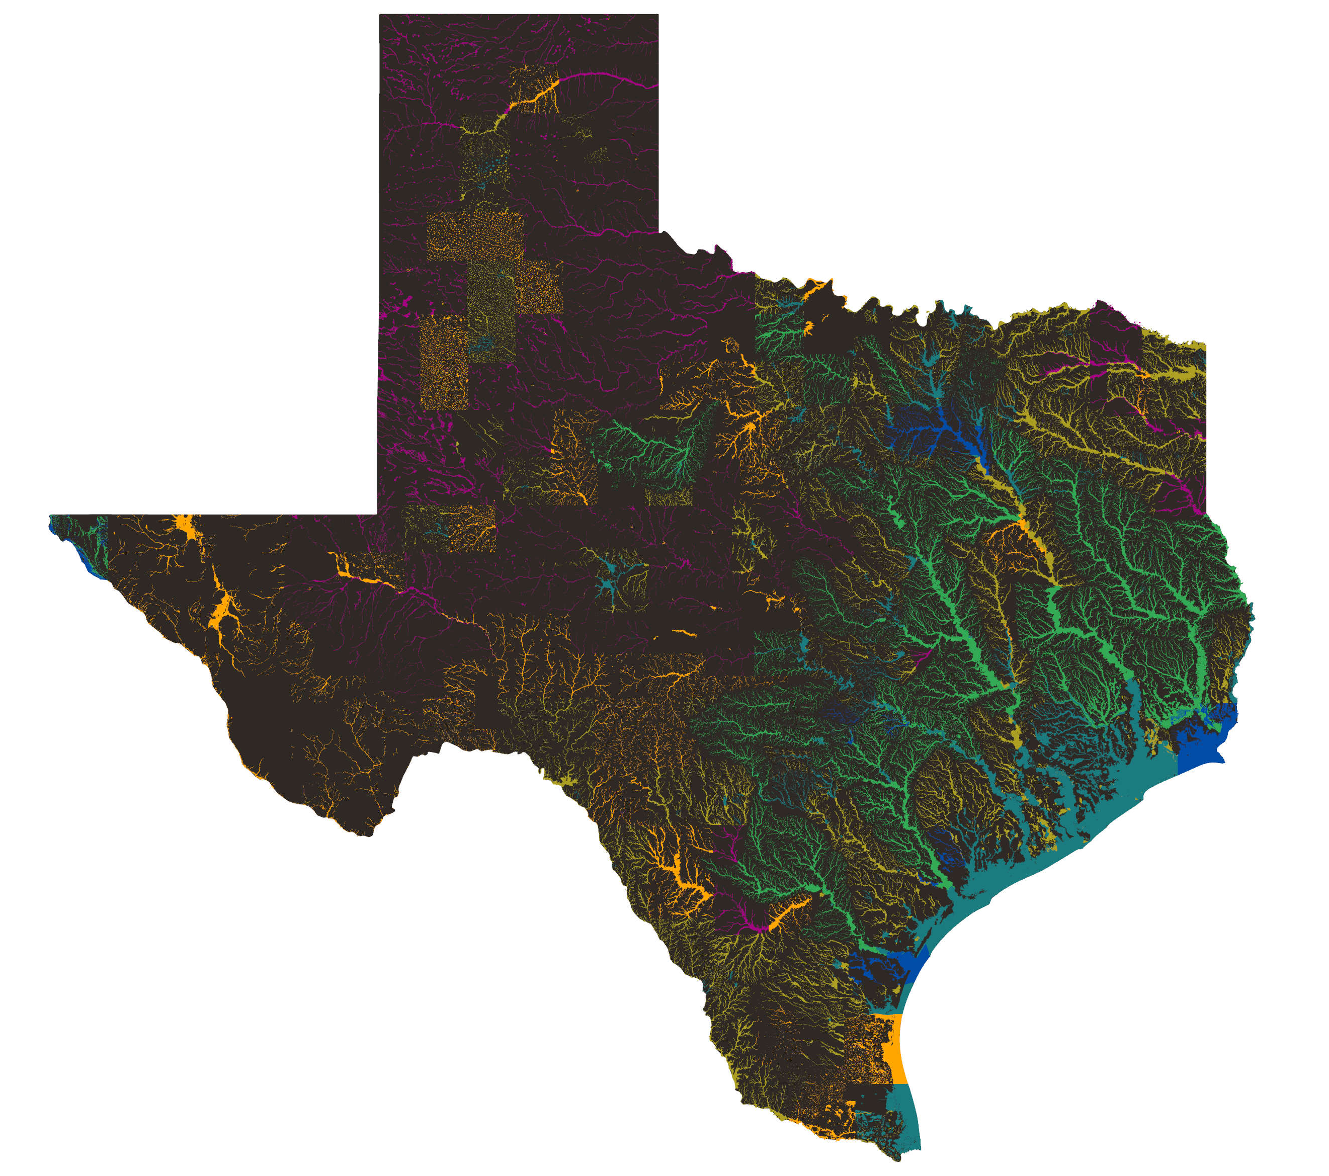
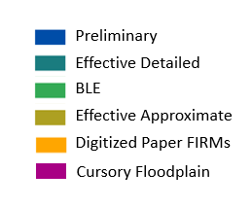
Flood Planning Data Quilt
Notes:
Here is the final statewide floodplain “Quilt” with all of the layers stitched together according to an initial prioritization we developed
We tried to roughly establish which layer was likely to be ‘best available’ over another layer.
But, RFPGs can adjust those prioritization layers as they desire. For example, if they think their 2019 BLE data is better than their 2005 “detailed” studies, they can just swap the priority.
Reminder this data is being used for planning purposes, not to be confused with regulatory floodplain data which has stricter controls on how you can adjust it.

Slide 17
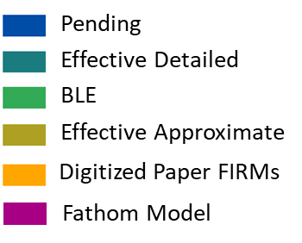
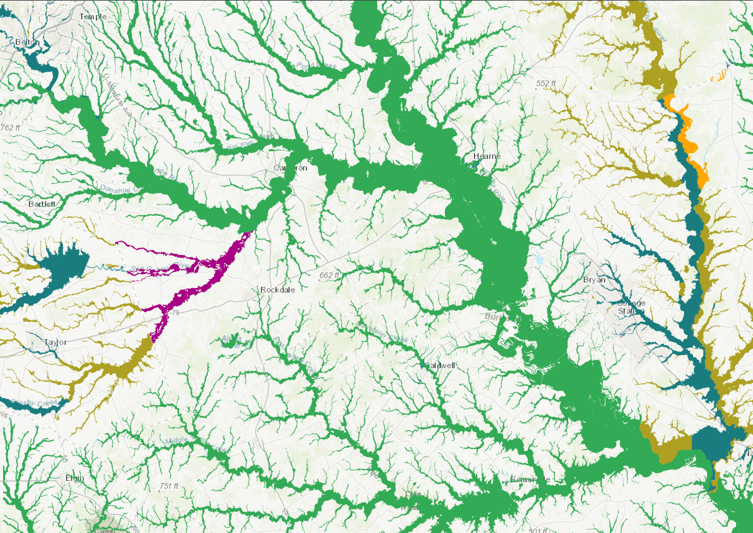
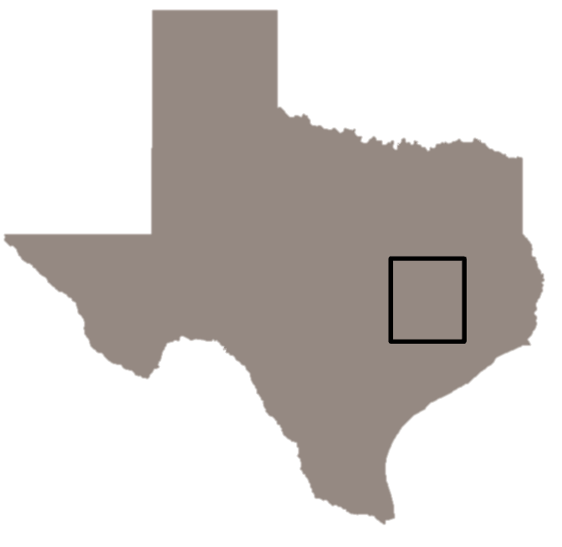
Taking a Closer Look
Notes:
Here’s one zoomed in view of the floodplains around Bryan/College Station.
Note, the Navasota River with all the different colors. You can see 3 different colors (data sets) all on the same river, why? This river splits Brazos County and Madison County and those two counties had maps developed at different times, resulting in different study efforts of different quality. Part of Milam County (top left) was recently mapped as part of the BLE effort. Some areas were not mapped yet and so the fathom model is used.

Slide 18
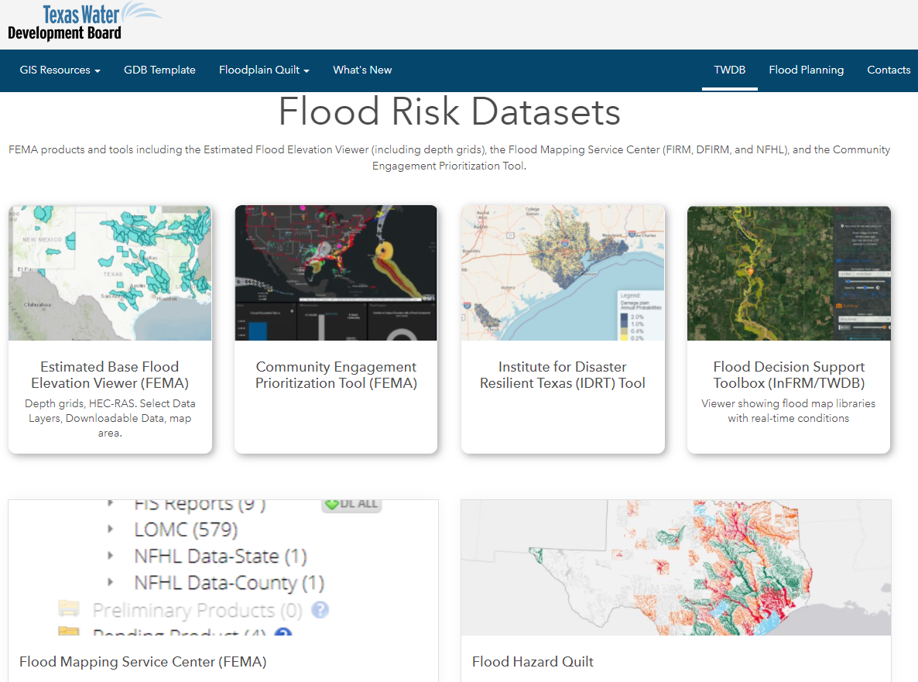
Flood Quilt is Online
Notes:
Flood quilt online on our flood planning data hub
Last year I was bragging about how we had statewide LiDAR topo publicly available, this year I get to brag about how we have 100% complete statewide flood risk data available through the quilt (and by 2024 with BLE data where you can download each model as well).
For those of you that have been in the flood mapping industry, just think about that for a sec. How complicated it used to be to develop data, much less statewide data.
Its certainly not exaggerating to say Prof. Maidment has been an integral part of how this all developed in both TX and across the US.

Slide 19
Flood Mitigation Assistance
FEMA Flood Mitigation Assistance (FMA) Grants
FMA Funding for Texas Communities
FY | Federal Share ($M) | Local Share ($M) | Total Project Cost ($M)
2015 | 17.5 | 0.1 | 17.6
2016 | 33.4 | 1.5 | 34.9
2017 | 48.5 | 4.9 | 53.4
2018 | 29.5 | 3.0 | 32.5
2019 | 47.2 | 3.5 | 50.7
2020 | 63.6 | 10.2 | 73.8
Total | 239.7 | 23.2 | 262.9
Flood Reduction Planning and drainage Projects
Building Elevation
Property Acquisition
Notes:
Finally, while I’m not going to touch on state flood funding, I would be remiss if I didn’t mention FEMA’s FMA program managed by TWDB
FMA has 3 main project types shown here. Perhaps building elevations is most popular in TX.
Table shows how federal and local shares combine for total project costs. Each row represents usually 10-15 communities and their associated projects.
Key point of this table shows really strong cost leverage for this program. One of the best for flooding.
In FY20, obtained nearly 1/3 of available federal funding ($200M), good/bad, LA got even more. Friendly competition for highest past few years.
Note funds are ALL pass through for state. State has one contract per year with FEMA, then manages the subcontracts with various communities. Those communities then have sub-subcontracts with elevation contractors, engineers, and other professionals.
In summary, FMA is one of the best leveraged federal funding programs out there and we have a strong history dating back to 1998 with this program.

Slide 20
Application Period for FY 2022
Anticipated triple funding over past years
Grants.gov
FEMAGO.gov
Anticipated Start: 10/01/2022
Community Deadline: 11/2022
Applications Deadline: 1/2023
Nationally Competitive
NOFO 8/2022
Notes:
The main point to highlight is with the new Infrastructure Investment and Jobs (IIJA) Act, FMA is getting a huge infusion of federal funds, resulting in triple the prior year funding levels (~$160M to ~$500M+ per year ongoing for at least 5yrs, I think)
Because its nationally competitive, it doesn’t automatically mean Texas gets 3x the money. We need 3x the applicants to get a chance of 3x the awards. Hence me asking you all to spread the word. And those of you from other states, please ignore this.
Notice of Funding Opportunity announcement is usually Aug each year
Communities need to submit to TWDB by late Nov/early Dec
TWDB needs to submit to FEMA by Jan 2023.
Not too early to start considering what sort of projects each community may want to apply for.
For you consultants out there, even grant application development (aka- efforts now helping communities) may be reimbursed by the grant, if awarded.

Slide 21
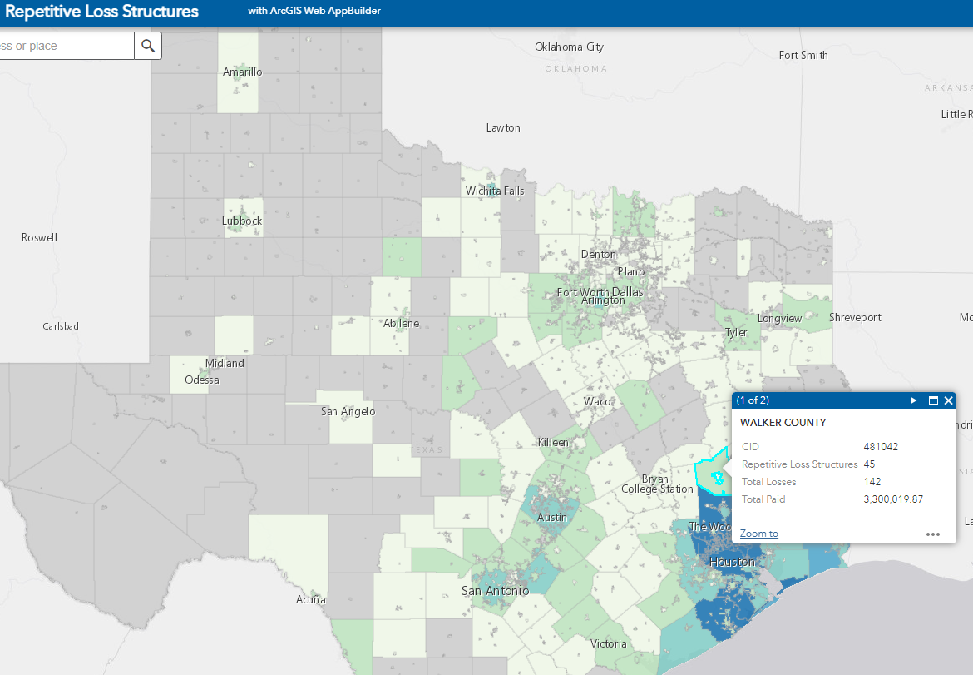
Repetitive Loss Viewer
https://www.twdb.texas.gov/flood/grant/index.asp
Notes:
FMA gets best funding leverage with SRL and RL properties (100/0, 90/10) and it can be a pain to figure out how many a community has and whether its worth considering FMA grants. We tried to make that a little easier for communities by recently putting up this web viewer that shows # rep loss structures, # losses, total amount paid out to get a sense of the magnitude of prior claims/payouts.
This site doesn’t have detail of each address, but gives you a sense of where demand is highest, so those community officials can then quickly assess if they want to spend more time pursuing mitigation activities for their community.

Slide 22
Questions?
Saul Nuccitelli, PE, CFM
Director, Flood Science & Community Assistance
saul.nuccitelli@twdb.texas.gov
Notes:
That’s it. Happy to take any questions you have.

Slide 23
Community Assistance Program
(CAP)
  Promote and maintain enrollment in the NFIP/CRS
    Roughly 1,260 NFIP participating communities
  Provide technical assistance
    Floodplain management regulations, permitting, general inquiries
  Provide training
    https://www.twdb.texas.gov/flood/workshop/index.asp
  Assist with local and federal coordination
    Community Assistance Visits
  Assist with disaster preparation and recovery
    Substantial Damage assessments
Notes:
Go over ordinances, regulations, permitting process, and map updates. Even with homeowners and business owners.
Trainings virtually and in-person, most of them count for continuing education credits for certified floodplain managers and professional engineers
Floodplain Mgmt 101 is a 2 day online webinar and is a great introduction.
We also have trainings on:
Elevation Certificates
Base Level Engineering
Substantial Damage/Substantial Improvement
Conduct Community Assistance Visits (CAVs) – longer process where we review permits, going back a few years, and tour the floodplain areas for structural compliance
We can also review how a community does their Substantial Damage assessments, which
are important for building back better, meeting current codes, and retrofitting older homes

Slide 24
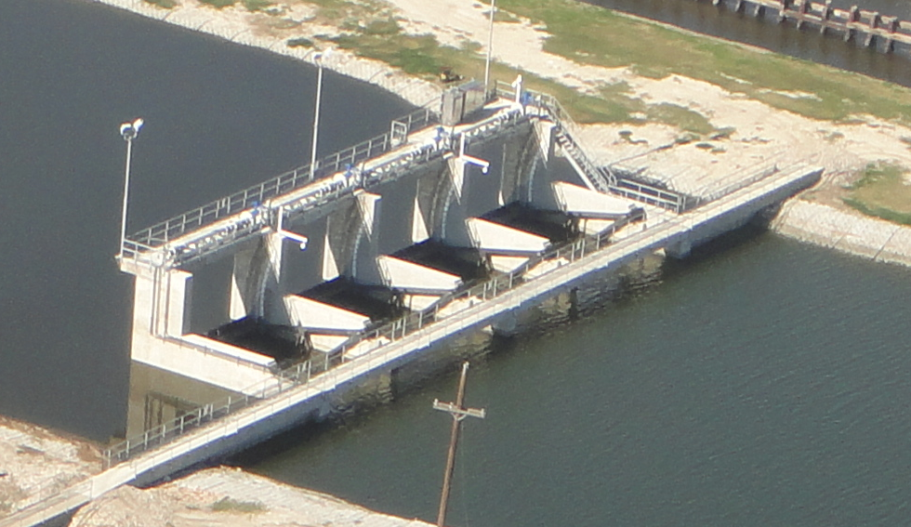
Flood Mitigation Assistance Grants
FMA Planning Grants (75%/25%): develop/update Flood Hazard component of the Multi-Hazard Mitigation Plan.
FMA Project Grants (75%/25%, can be 90/10 or 100%): focus on mitigation for repetitive and severe repetitive loss properties, including:
  Acquisition of structures and property
  Demolition, relocation, elevation, and/or retrofitting of structures
  Dry floodproofing of non-residential or historic structures
  Minor localized flood control and drainage projects
Notes:
$87 Million awarded since 2008
Jurisdictions that Apply must have a FEMA approved Hazard Mitigation Plan
And the Properties being mitigated must be insured thru the NFIP

Slide 25
Other Financial Assistance at TWDB
FIF: Flood Infrastructure Fund
SWIFT: State Water Implementation Fund for Texas
Dfund: Texas Water Development Fund
EDAP: Economically Distressed Areas Program
DWSRF: Drinking Water State Revolving Fund
CWSRF: Clean Water State Revolving Fund
RWAF: Rural Water Assistance Fund
Agricultural Water Conservation Grant and Loan Programs
Groundwater District Loan Program
Notes:
Texas Water Development Fund (DFund)
The DFund is a streamlined state loan program that provides financing for various types of infrastructure projects.
Flood mitigation & control are eligible, along with water & wastewater projects
This program enables the TWDB to fund projects with multiple purposes (e.g., water and wastewater) in one loan.
Planning, design, acquisition, and construction of projects
Clean Water State Revolving Fund (CWSRF)
low-cost financing for a wide range of wastewater, stormwater, pollution control projects. Recycling/reuse of water, wetland restoration, and disaster relief after declared flood-related disasters
Recent streamlining of the program provides year-round funding, as long as the project is listed in the CW Intended Use Plan
Planning, design, acquisition, and construction

