Slide 1
DEPLOYMENT OF LOW COST SENSORS (LCS) IN SOUTHEAST TEXAS
Department of Civil and Environmental Engineering
Lamar University, Beaumont, TX
Nicholas Brake, Ph.D. Liv Haselbach, Ph.D. Mubarak Adesina Hossein Hariri Asli

Slide 2
Project Overview
Objective: Deploy and manage 75 IoT flood sensors in SE Texas.
Sensor Manufacturer: Intellisense Systems, Inc. – Torrance, CA
Client: U.S Department of Homeland Security (DHS), Science and Technology Directorate (S&T)
Custodian: The Southeast Texas Flood Control District.
Southeast Texas received 75 sensors
73 sensors have been installed and reporting

Slide 3
Project Stakeholders
Lamar University
Southeast Texas Flood Control District
Texas Division of Emergency Management
Department of Homeland Security Science and Technology Directorate
Government Agencies
City of Beaumont
Sabine River Authority
Lower Neches Valley Authority
Drainage District 6
Drainage District 7
Chambers County
Hardin County
Jasper County Emergency Management
Jefferson County (Precincts 1 – 4)
Newton County Emergency Management
Orange County Drainage District
Texas Park and Wildlife
Private
ExxonMobil Refinery
Enterprise Chemical Plant

Slide 4
Overview of Sensing System
Image Reference: DHS S&T Sensors and Platforms Technology Center
Notes:
The flood sensor is designed to remotely monitor water bodies, critical infrastructures and provide advance warnings during flooding events. The sensors communicate via cellular LTE or Iridium to satellite to a designated data center/server which then notifies registered first responders and the public during flooding events.

Slide 5
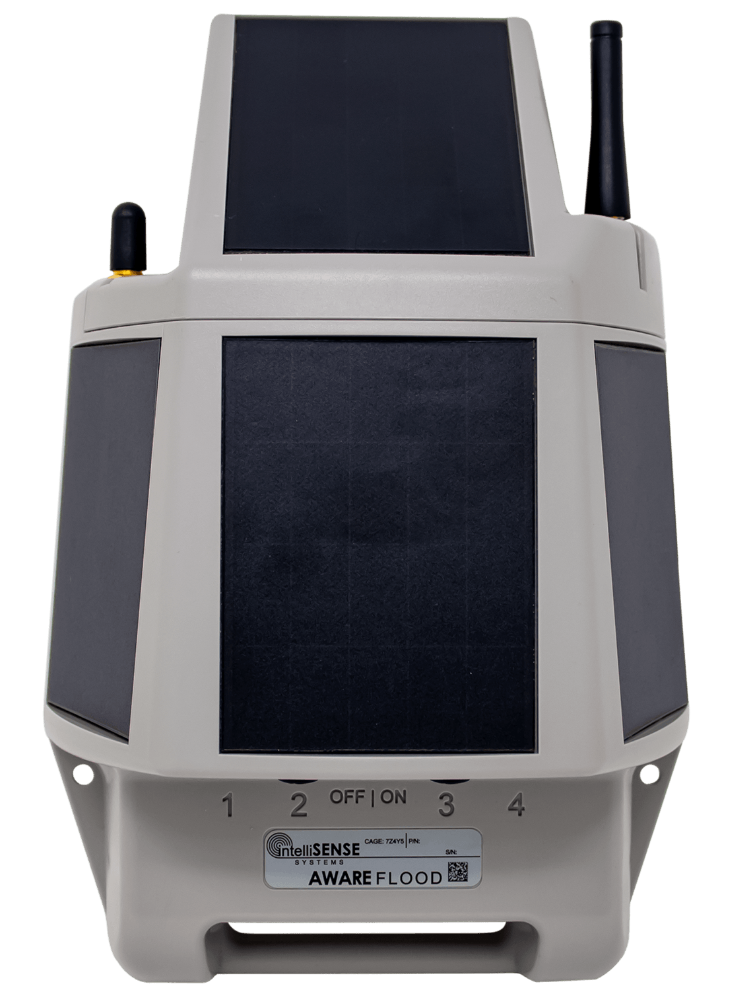
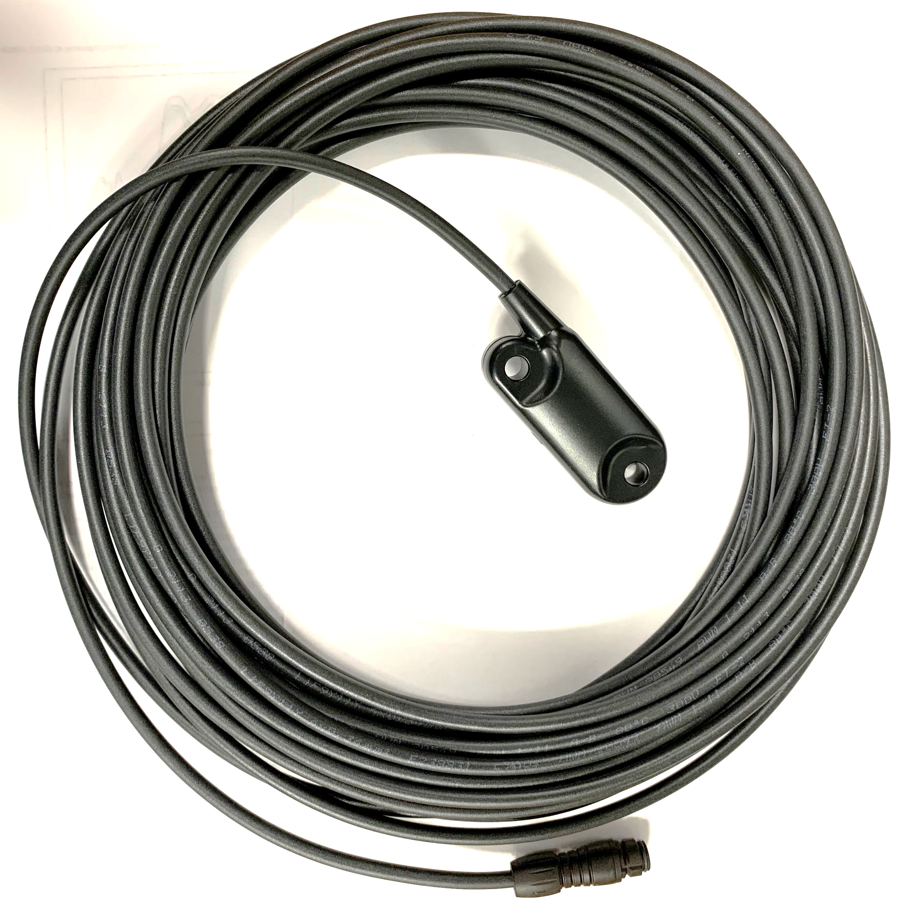
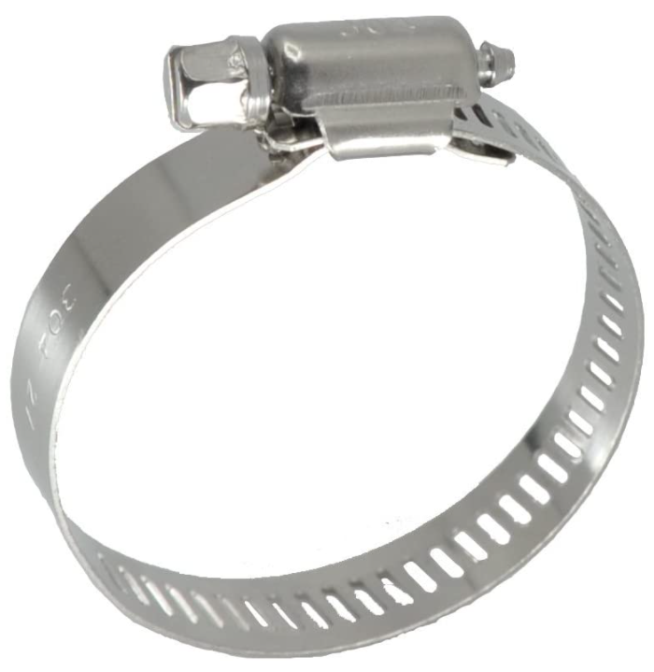
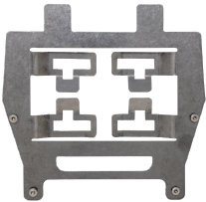
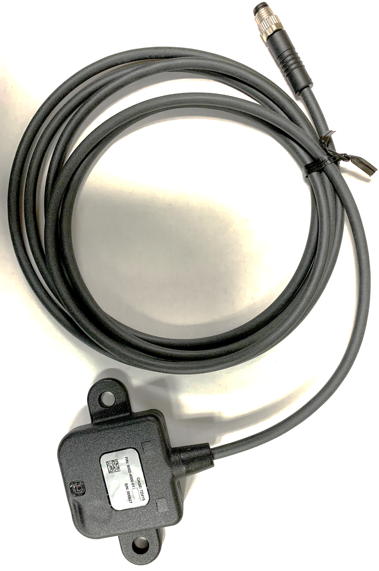
Box Content
AWARE Flood Node with IoT Module and Cellular Antenna
Stainless Steel Universal Mounting Plate
Water Level Pressure (WLP) Module (50 ft. Length)
Stainless Steel Hose Clamps (2)
Torx Head Mounting Screws (2)
Waterproof Camera
Flood Node with Cellular Antenna
Water Level Pressure Sensor
Mounting Plate with Torx Head Screws
Camera
Stainless steel Hose Clamps

Slide 6
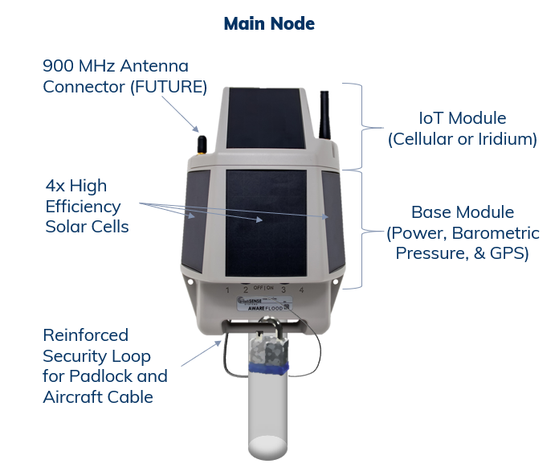
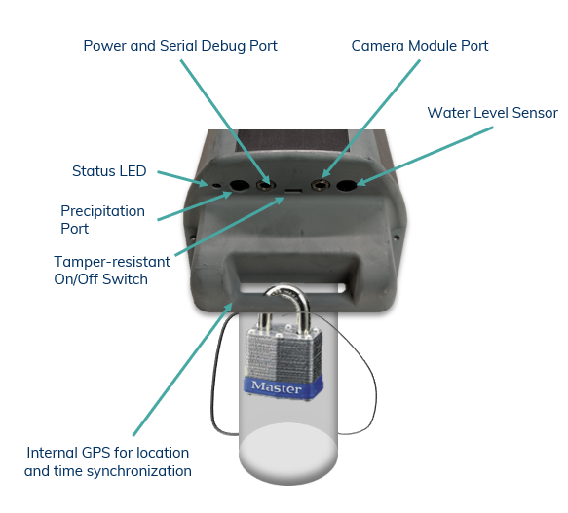
AWARE Flood Node Features
Image Reference: Intellisense Systems
Notes:
The Flood node is equipped with 4 high efficiency solar cells, IoT module which houses the cellular modem), camera/charging port, WLP sensor port, Precipitation port, Internal GPS unit, On/Off switch, and a security loop for a padlock and cable

Slide 7
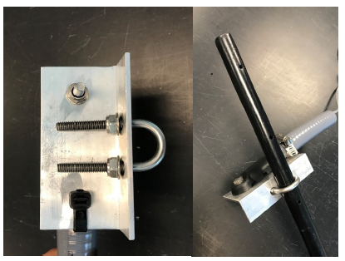
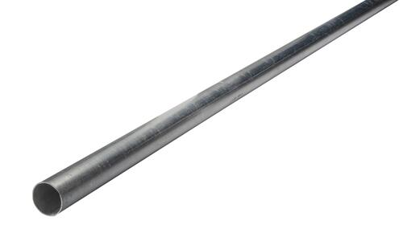
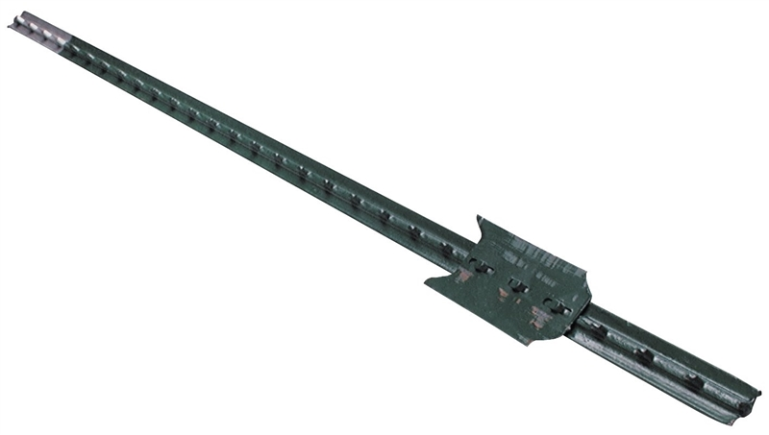
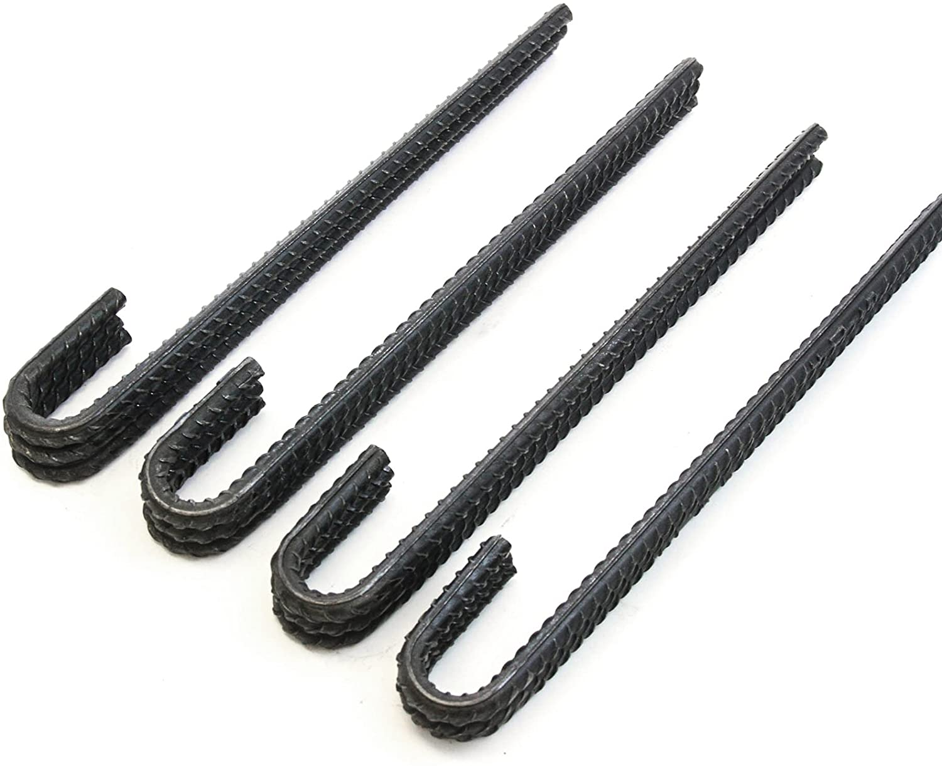
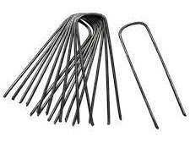
Additional Items Required for Installation (Not in the Box)
1-⅝” Galvanized Fence Post
¾” x 24” Steel Stake
¾” Flexible Conduit / ¾” Rigid conduit
Angle Brackets (1”x2”x4”)
Signage
Fence Post Pipe Clamp
Landscape Staples or J-hooks
Misc. Mounting Hardware
Fence Post
Alternative Design using Angle Brackets
T-post
WLP Sensor Mounting Plate (from Intellisense)
J-hooks
Landscape Staples
Signage
PVC Flexible Conduit

Slide 8
Sample Installation – Jasper County
¾” Flexible conduit with a Junction Box (housing the pressure sensor)
The junction box is covered with a strainer to prevent debris
Flexible conduit is placed in a shallow trench and J-hooked to the ground
Flood Node setup and Signage

Slide 9
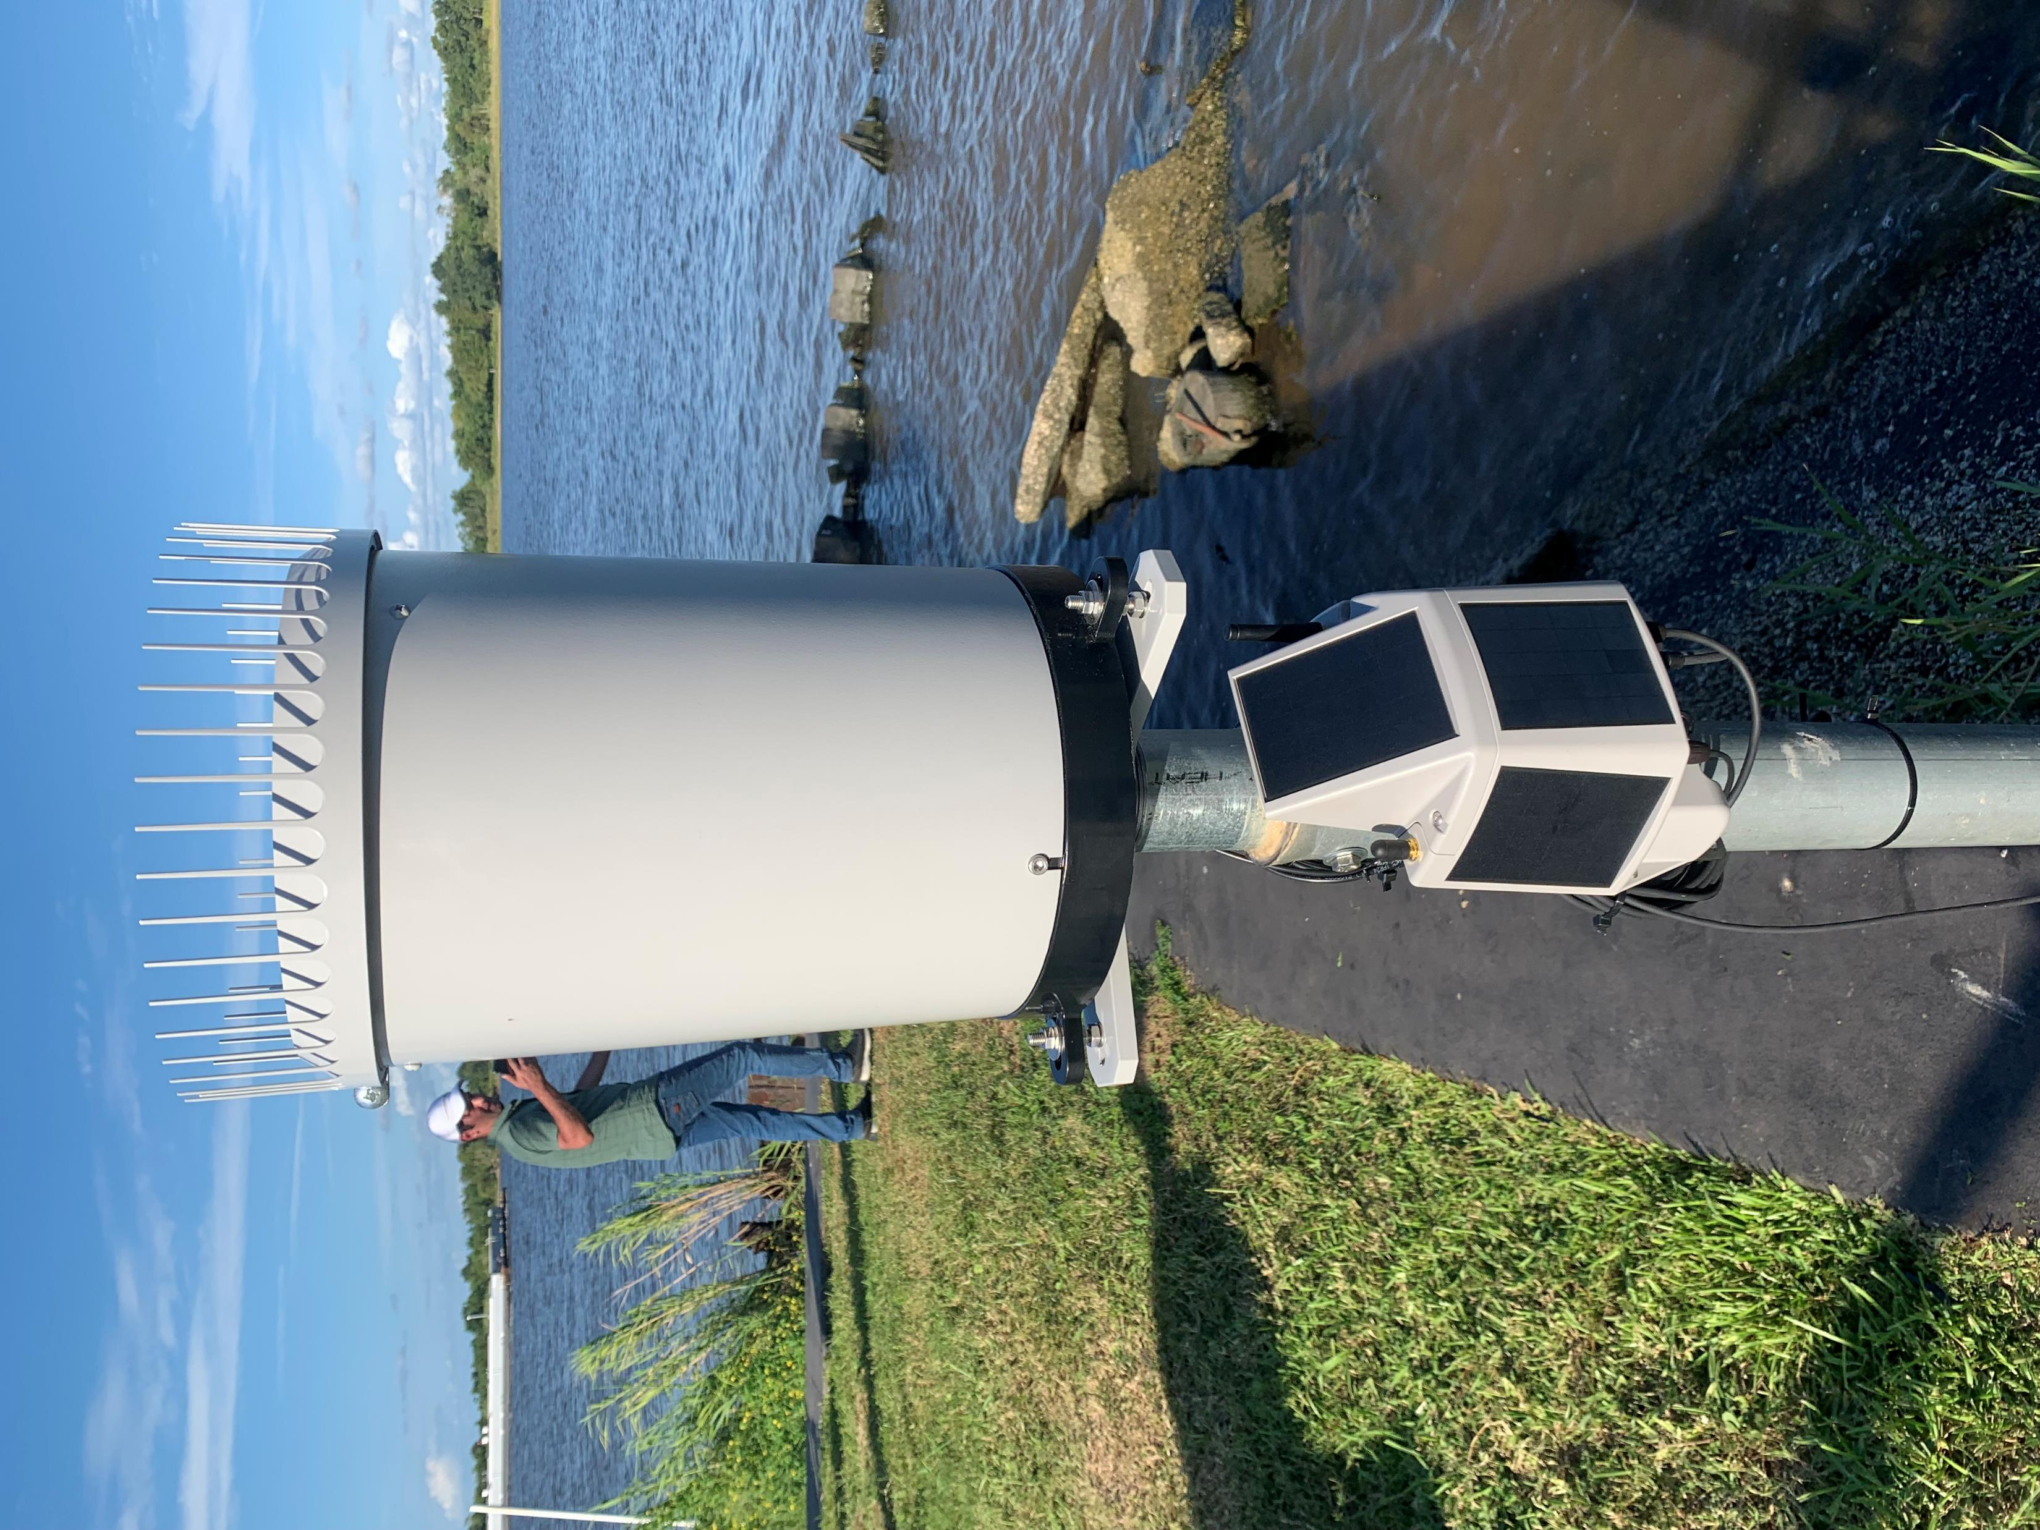
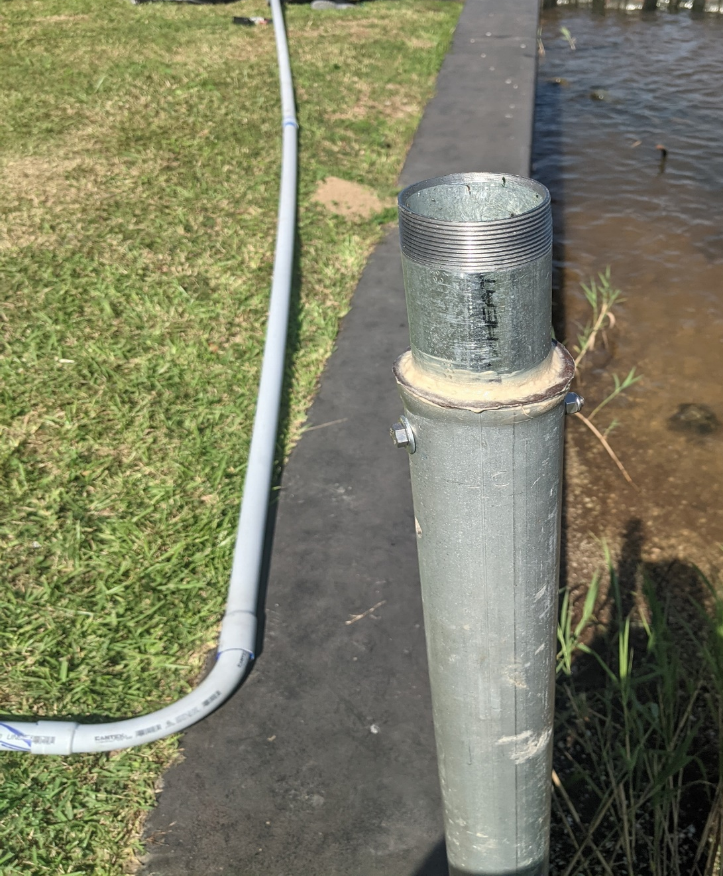
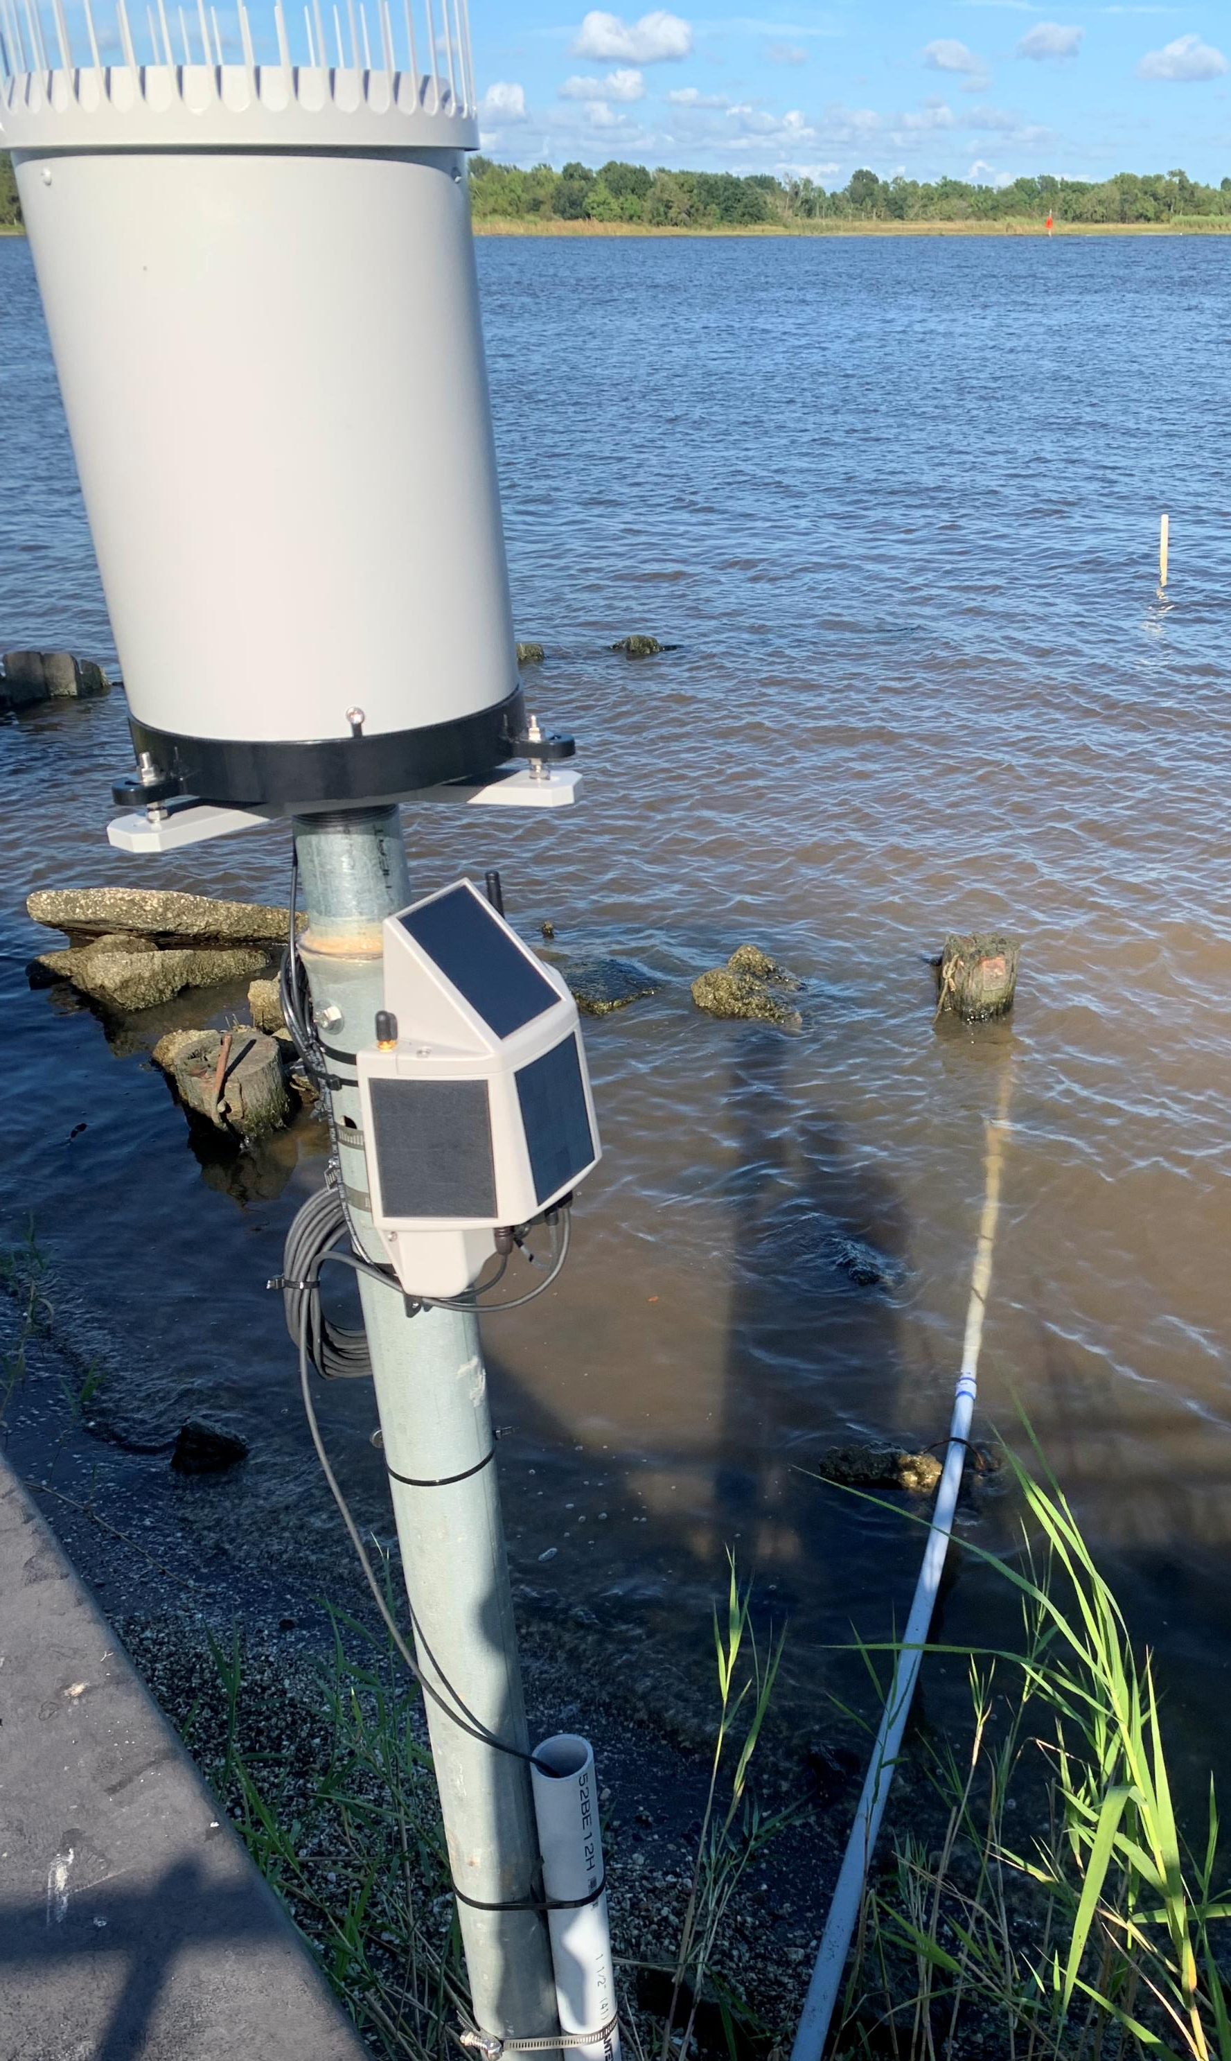
Sample Installation – Port Neches
Flood sensor and Rain gauge installation
Place rain gauge closer to the ground for best result (wind effects at higher elevation)
The rain gauge has a 2” threaded plate underneath
Rain gauge is attached to the 2” threaded galvanized pipe inside a 3” post
Pressure sensor placed inside a Junction box attached to the end of the 1.5” Rigid conduit
Flood Node is mounted on the 3” post facing south

Slide 10
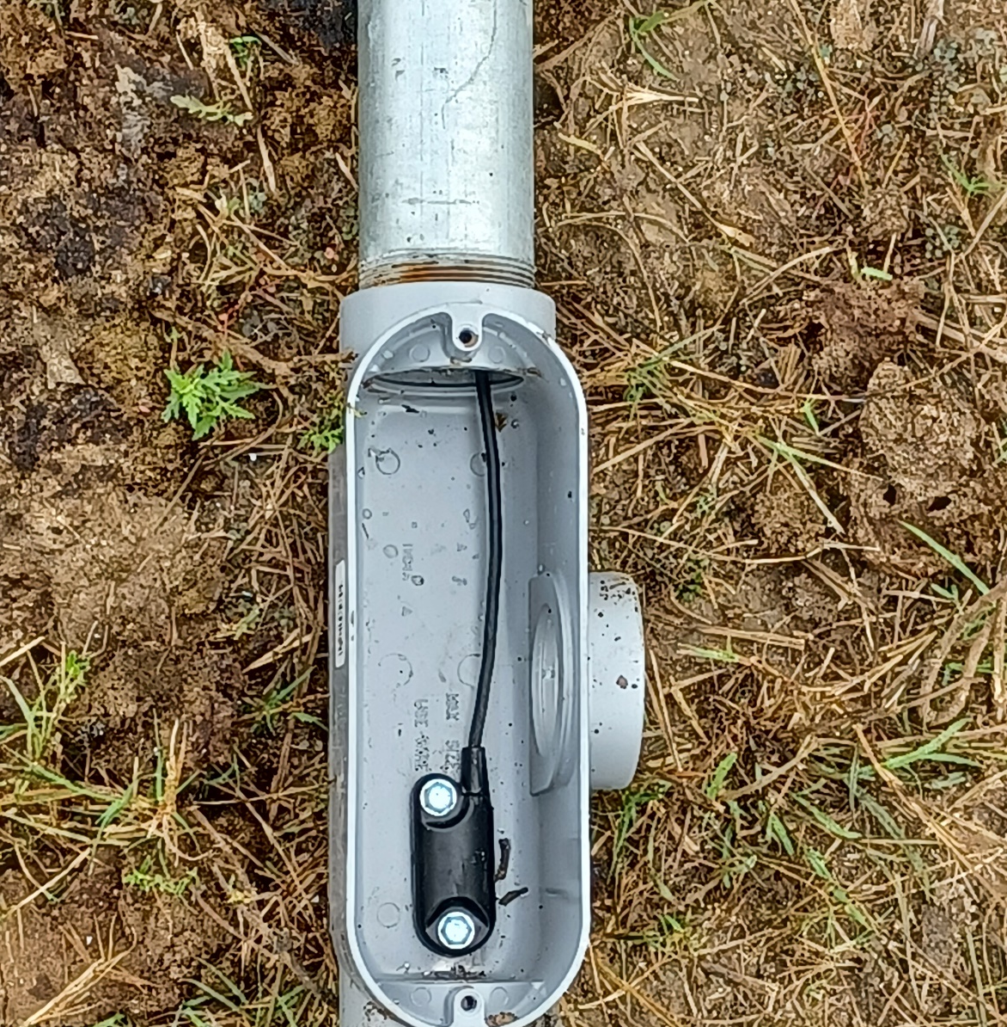
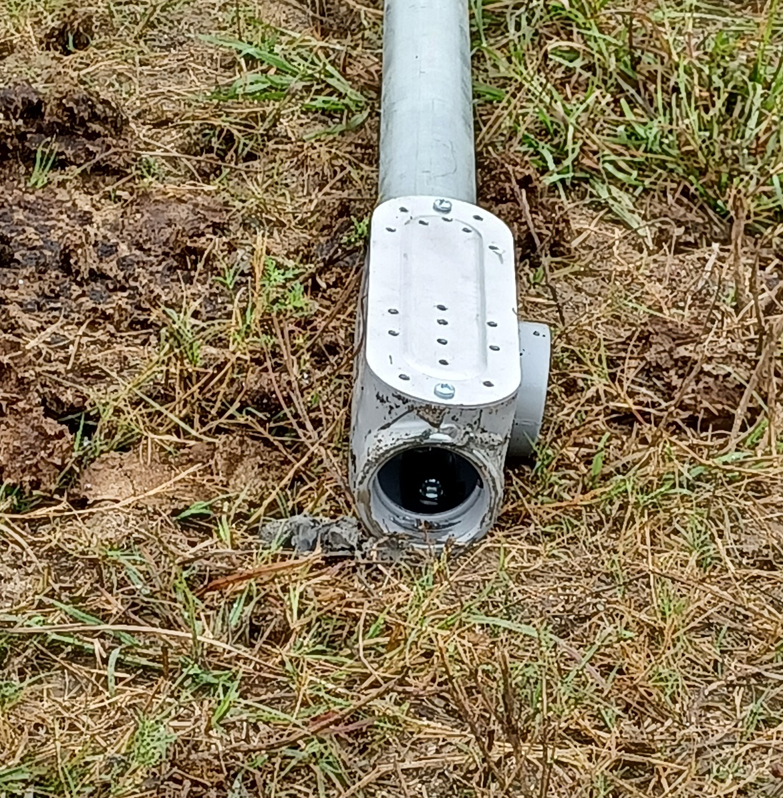
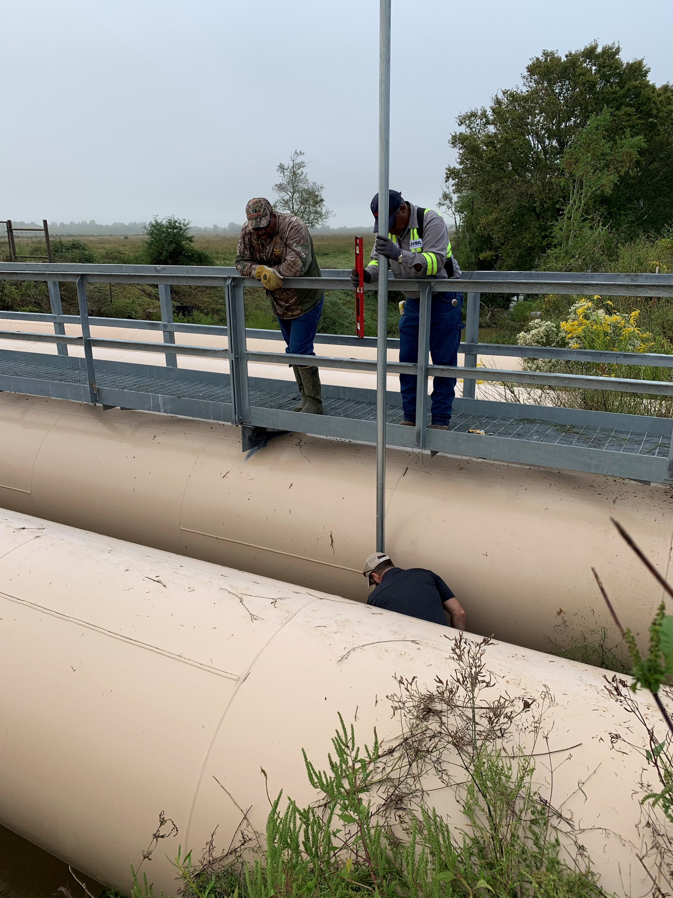
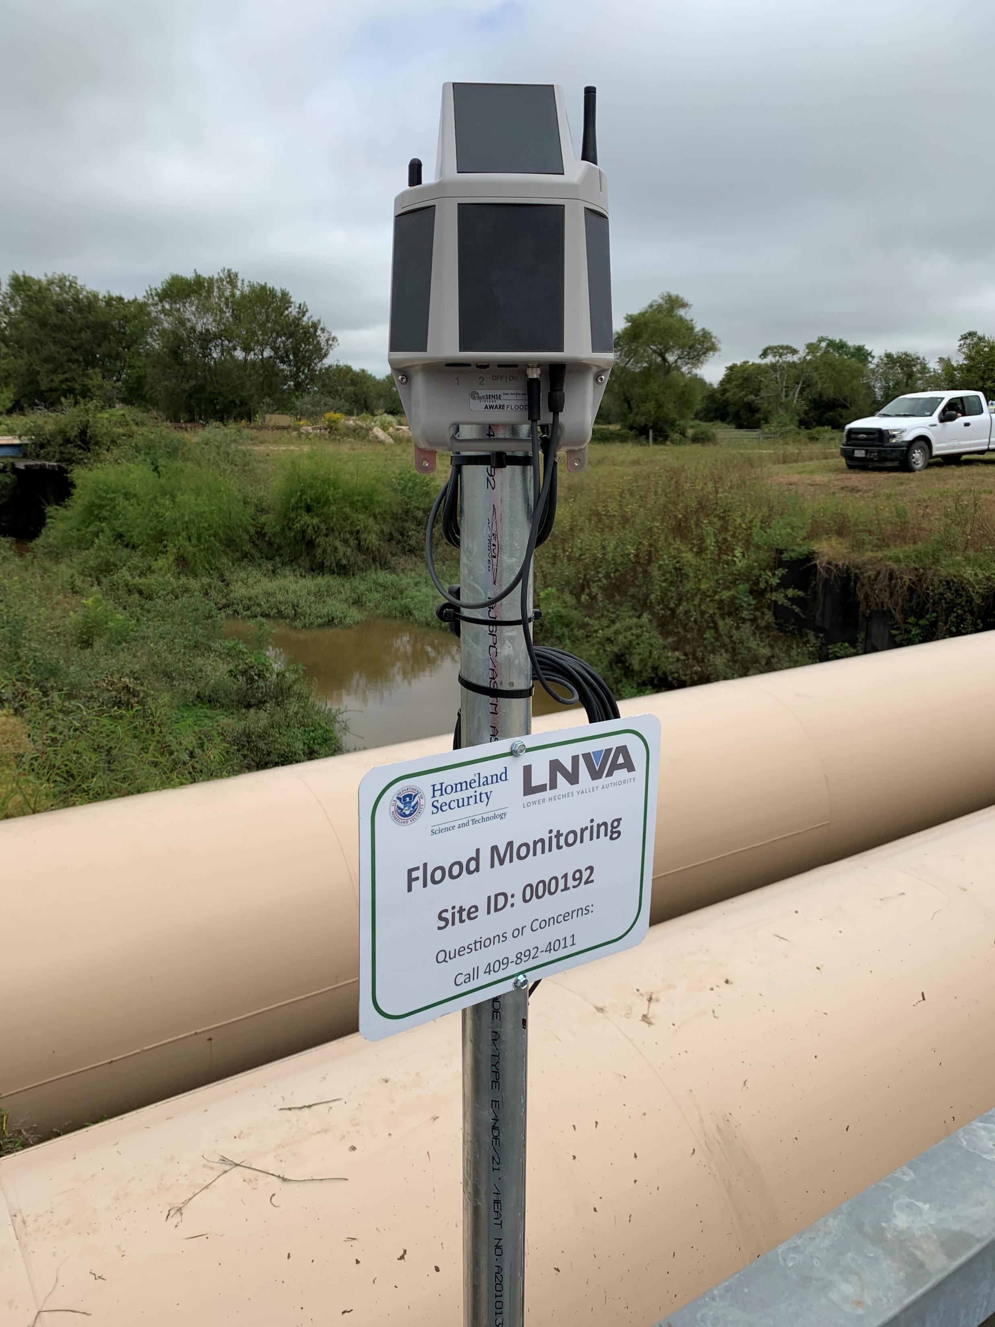
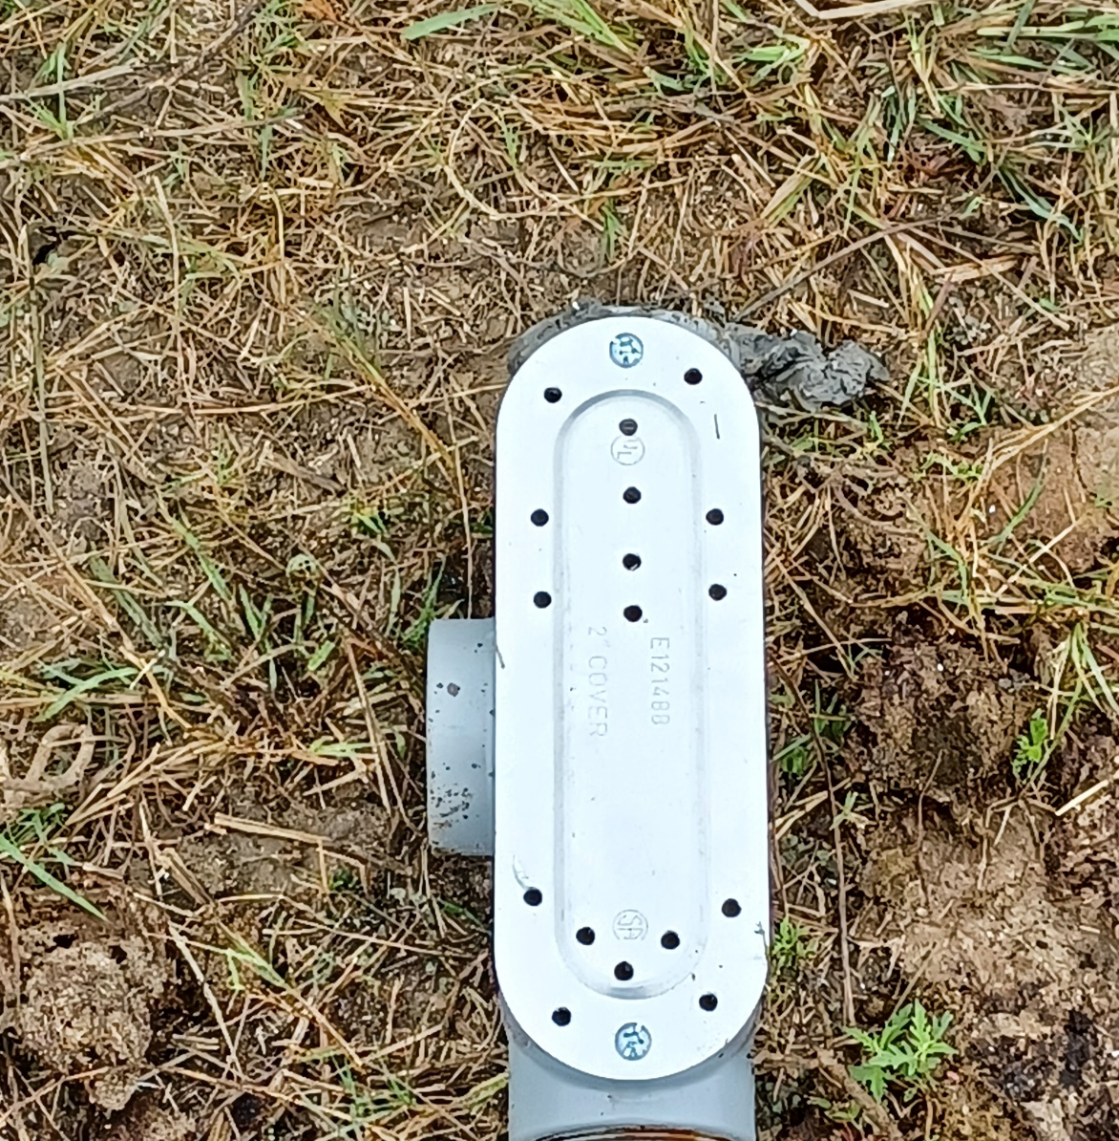
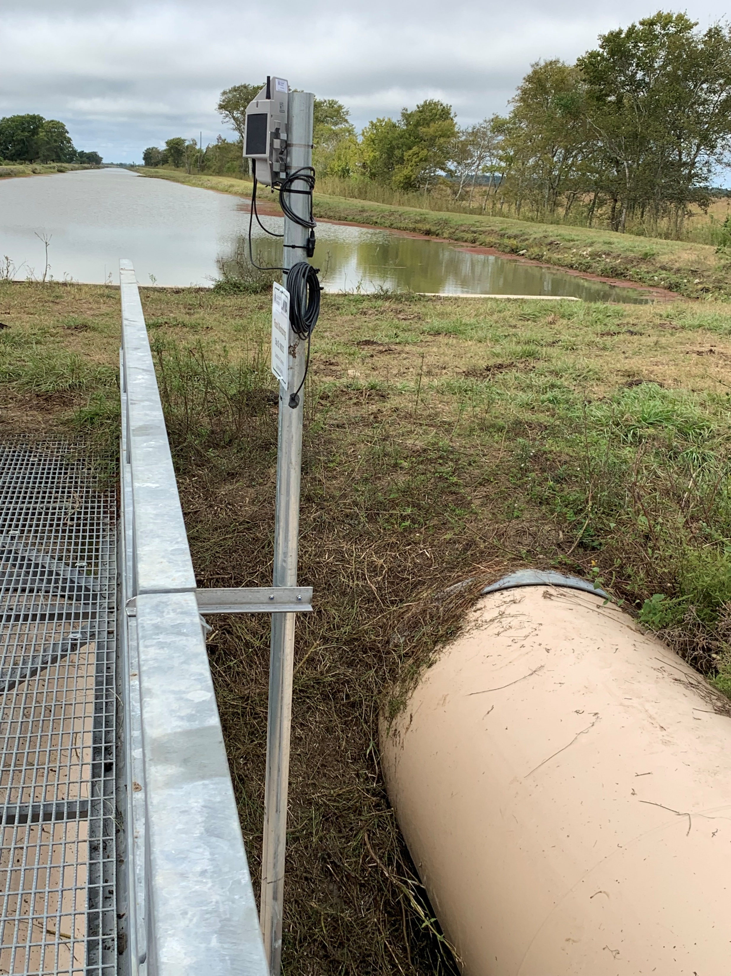
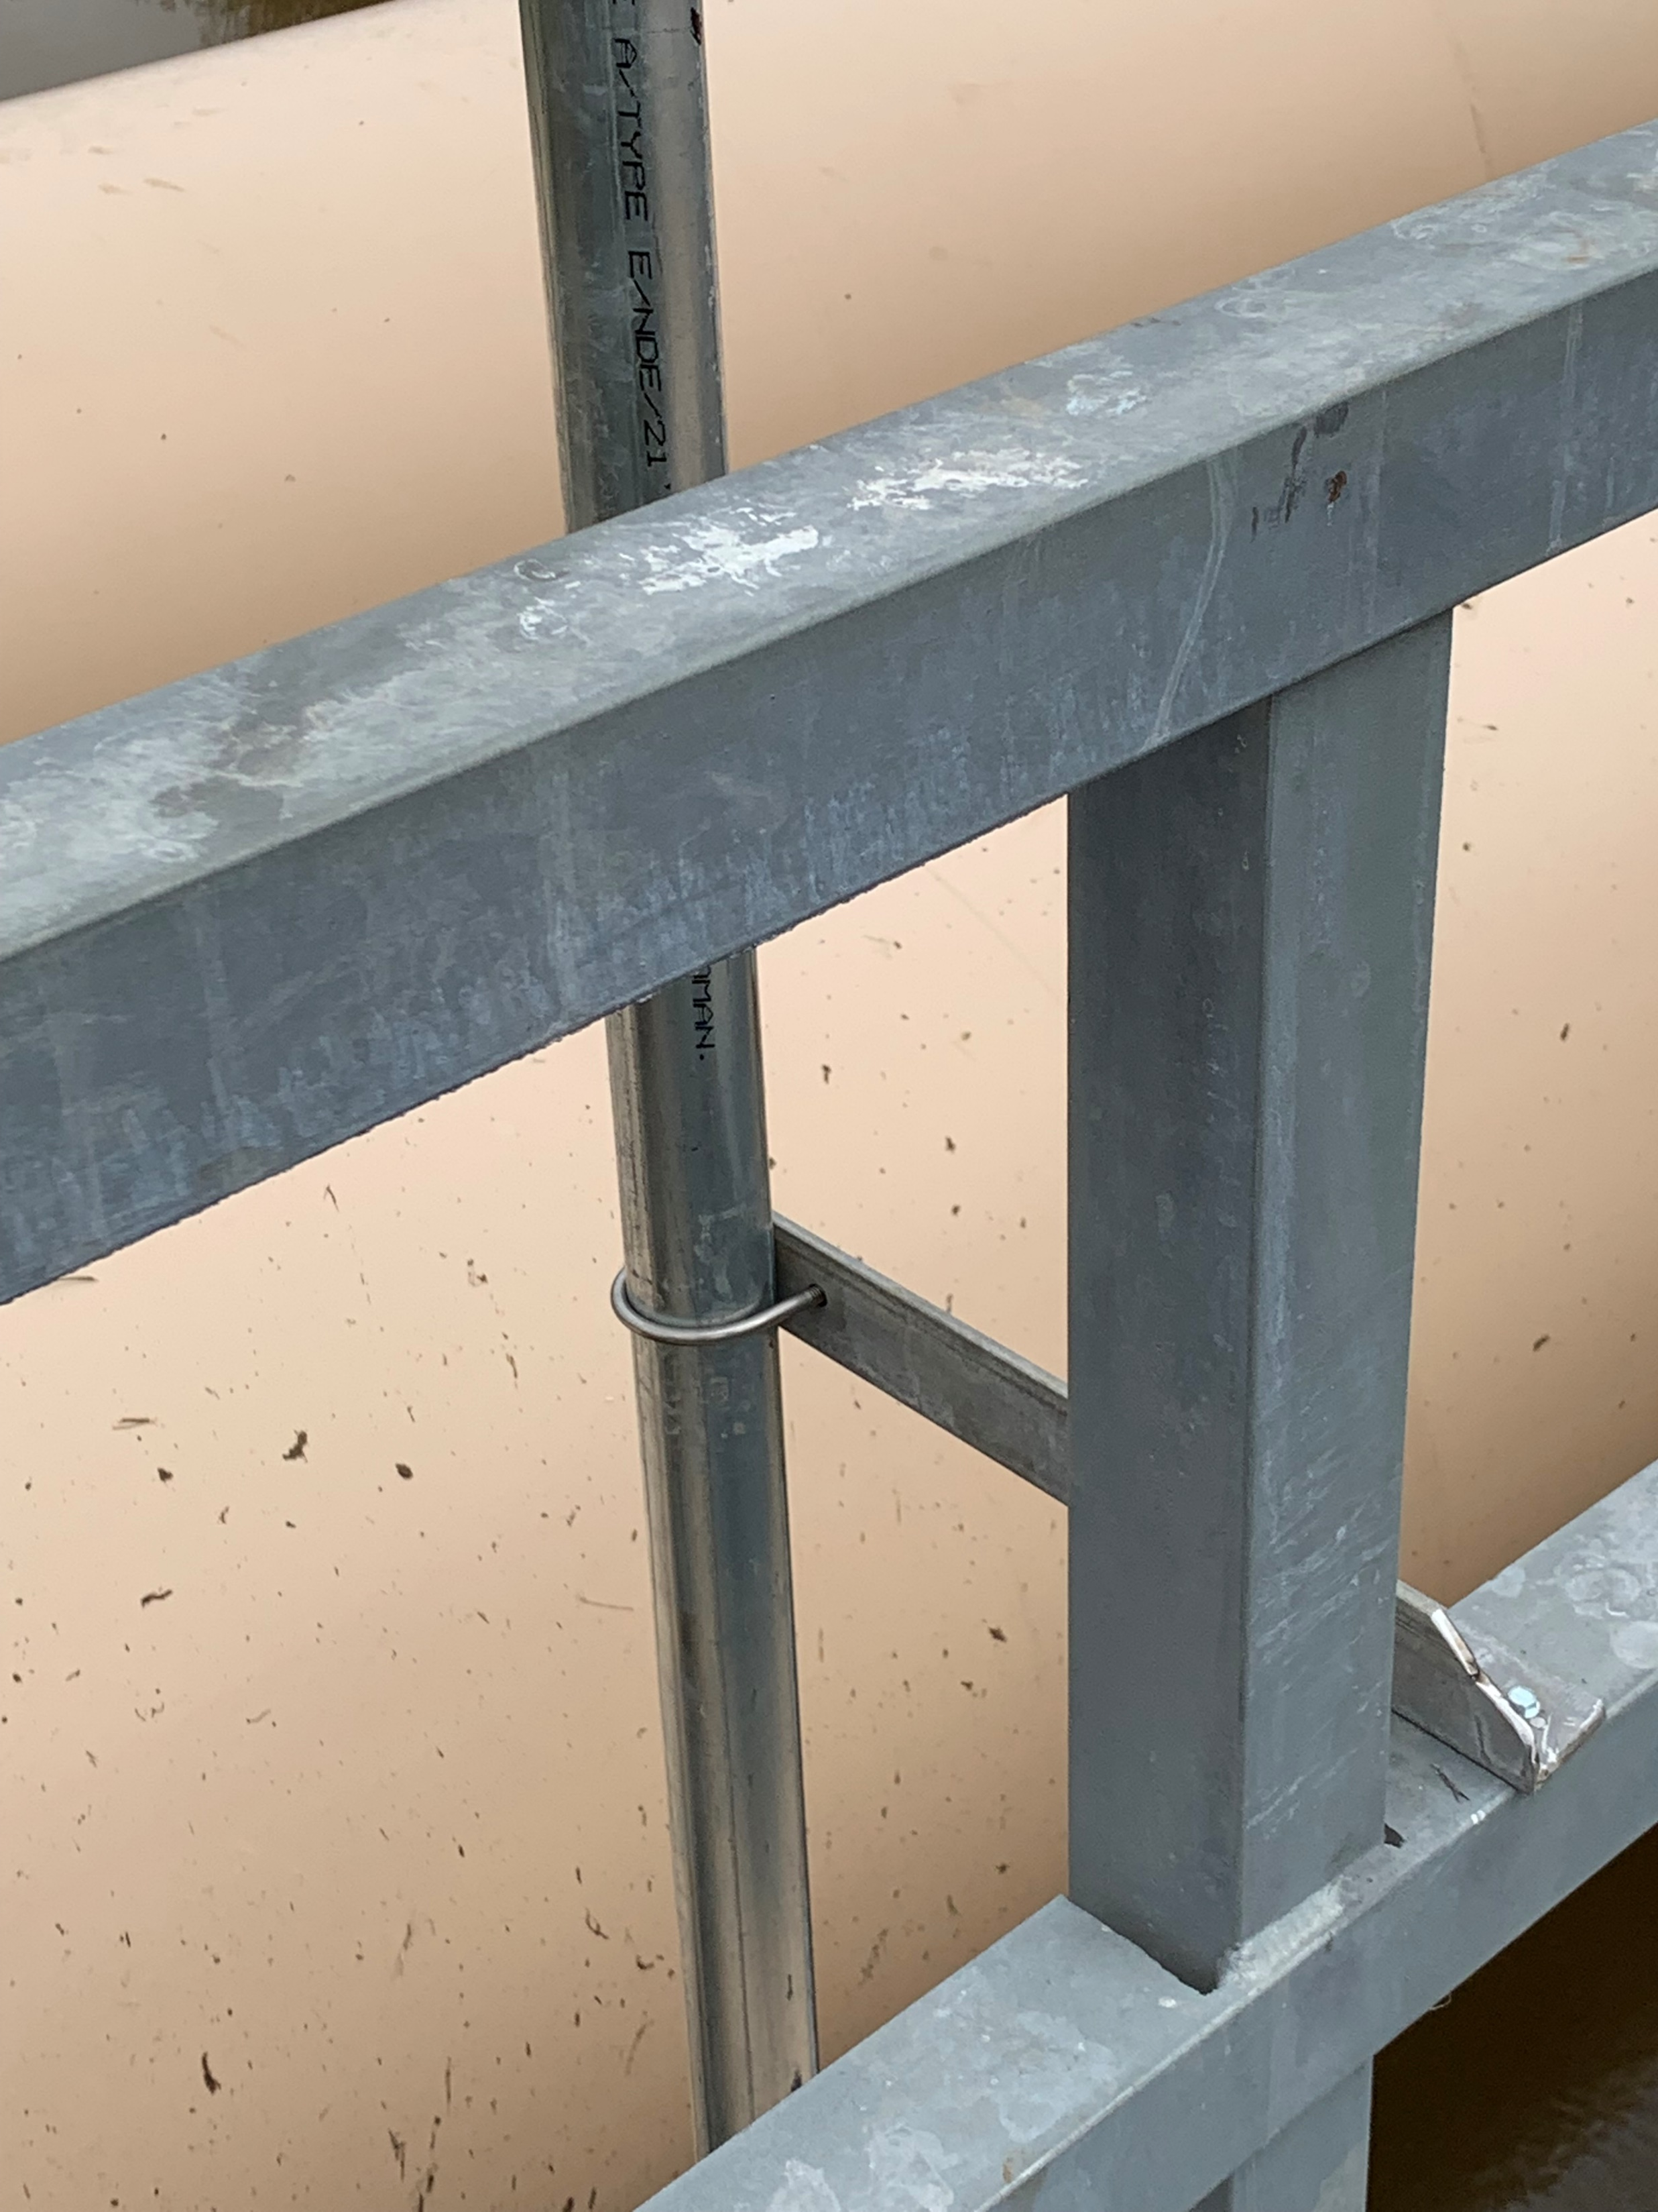
Sample Installation -LNVA
1.5” Galvanized pipe with Pressure Sensor inside the Junction Box
The pipe is anchored to the pedestrian bridge with U clamps and angle plate

Slide 11
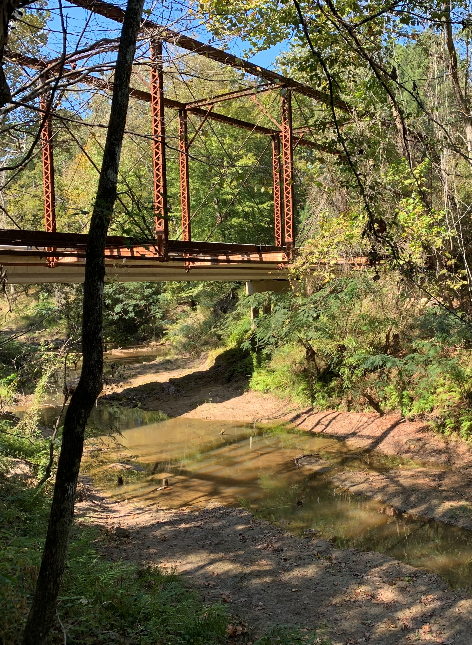
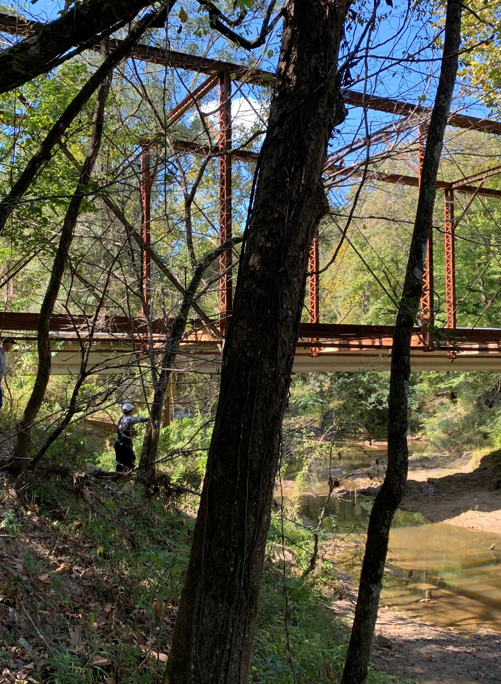
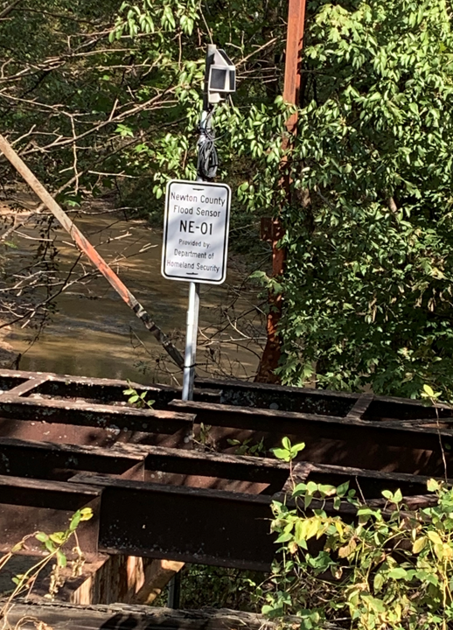
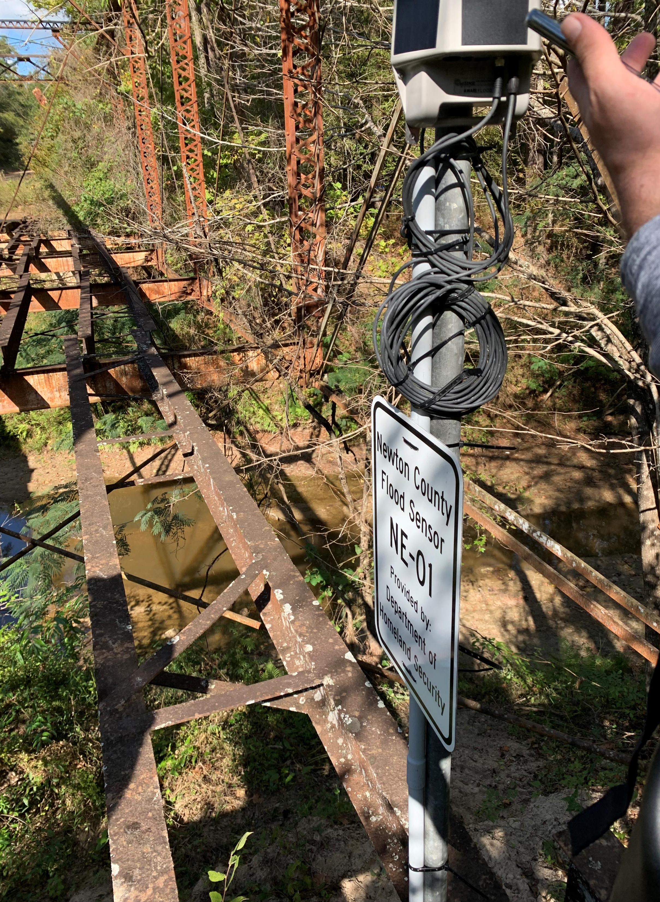
Sample Installation Newton County
Installed at a decommissioned TxDOT Steel Bridge
Flood Node is about 80 ft away from location of Pressure sensor; elevation difference approx. 20 ft
1” Rigid Conduit is buried underground
Node is placed for maximum exposure to sunlight

Slide 12
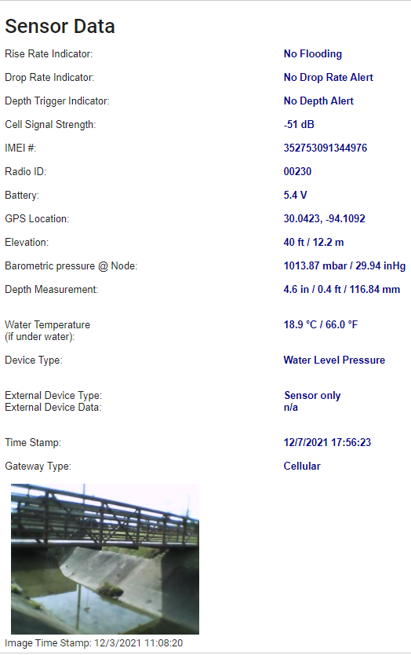
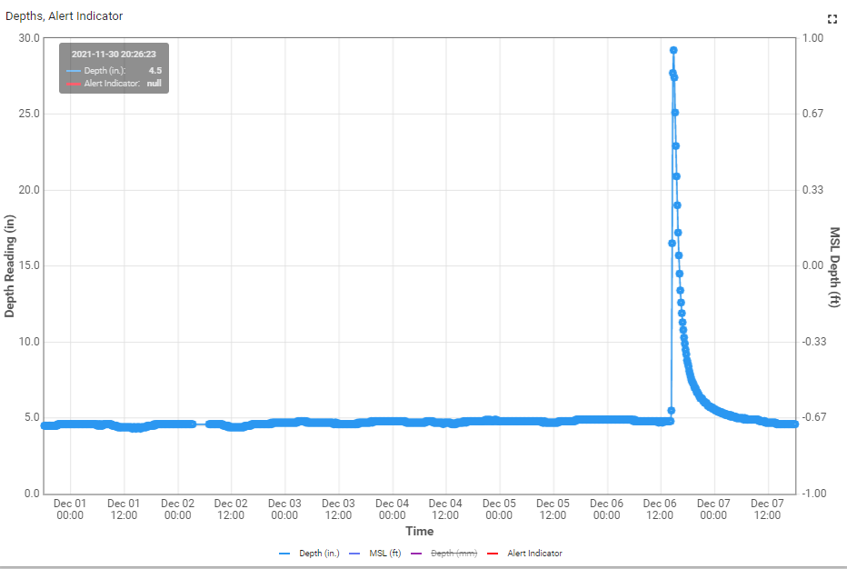
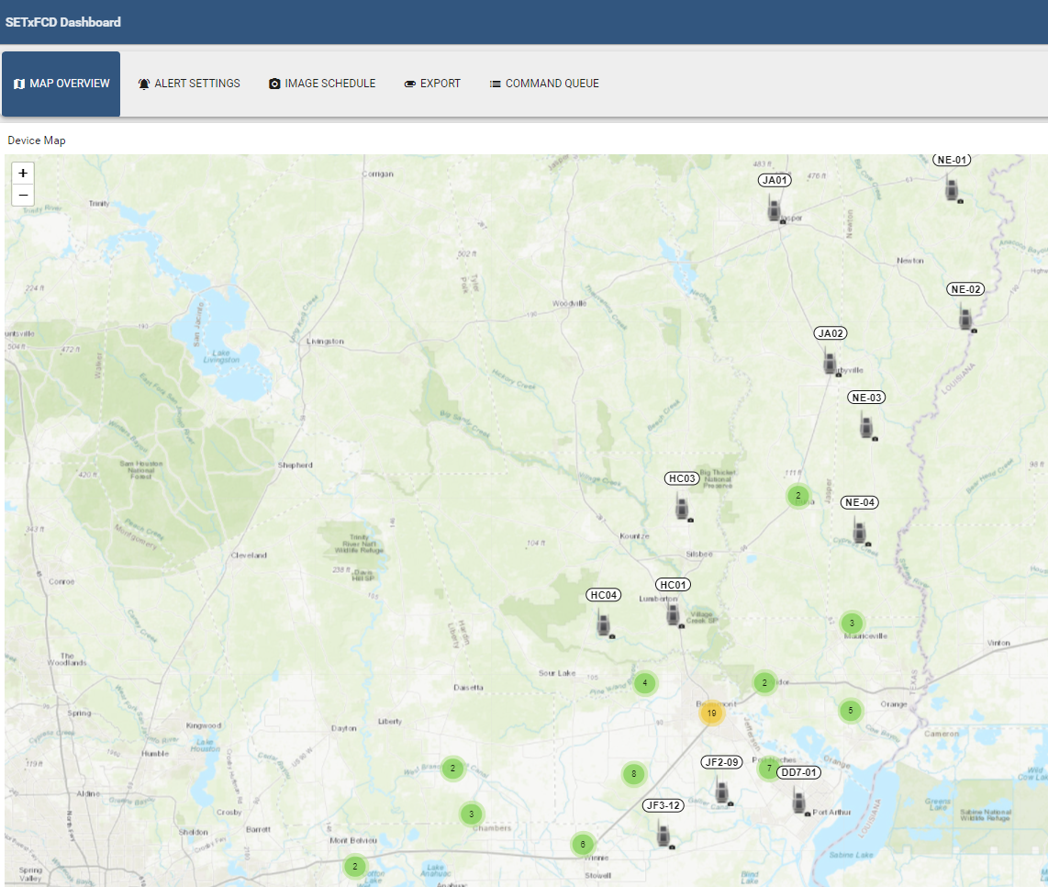
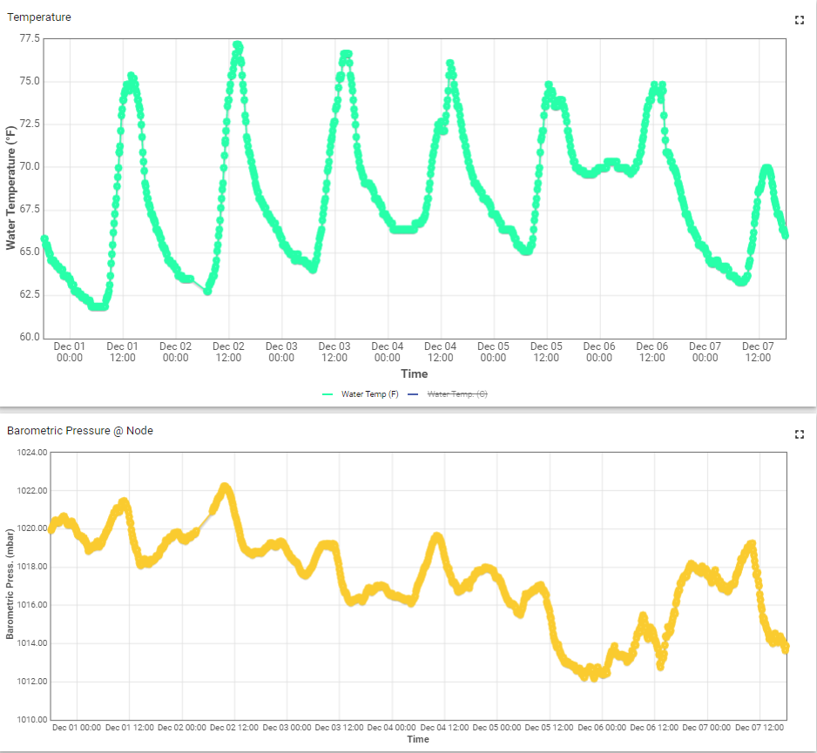
Data Display - Intellisense

Slide 13
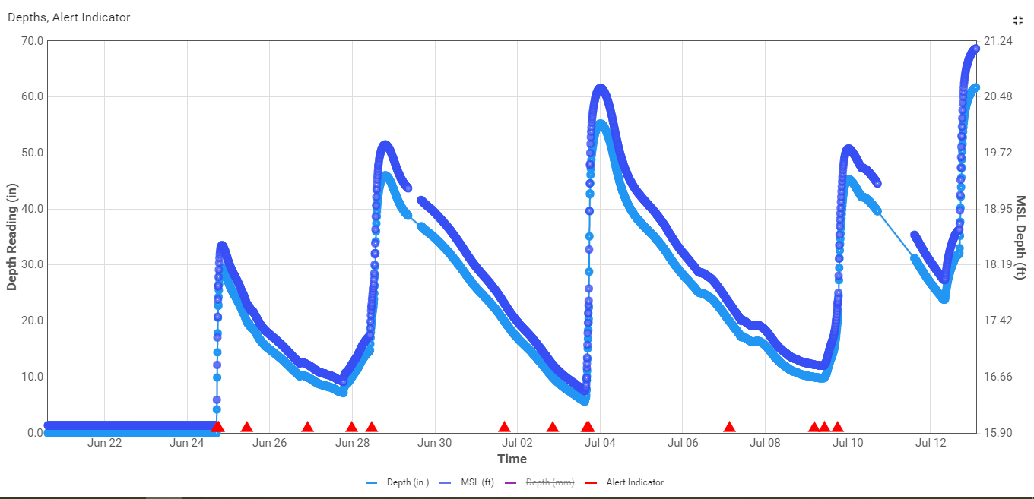
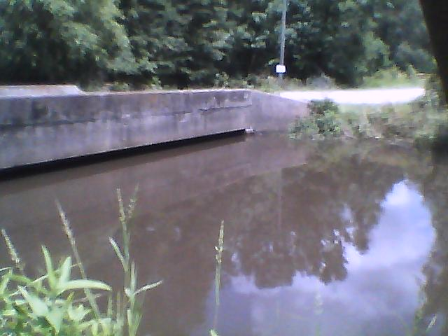
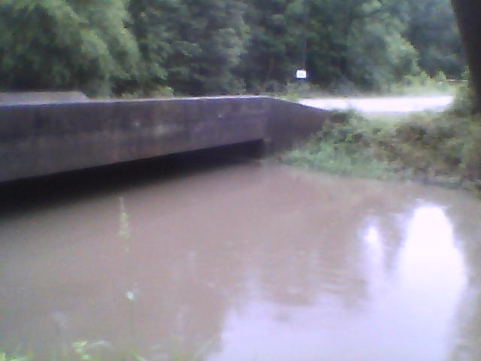
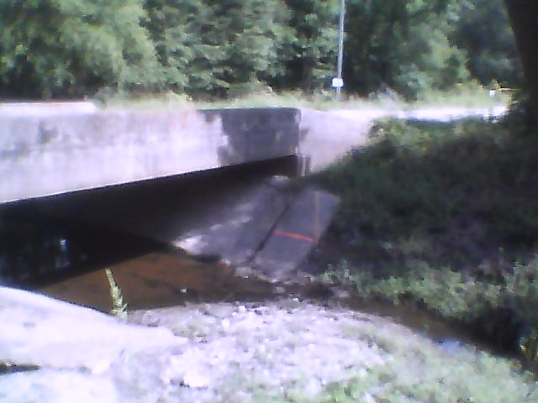
Sample Data Display – Orange County
After Multiple Rain events
Before Rain

Slide 14
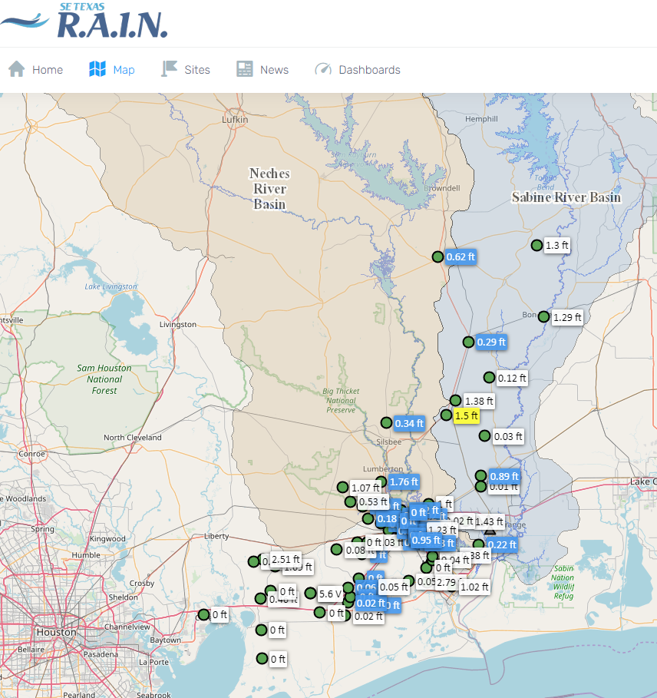
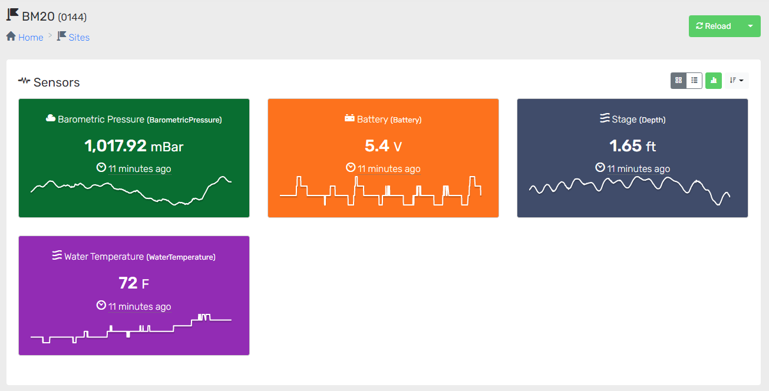
Data Display - OneRain
Sensor data pushed onto Sabine River Authority (SRA) OneRain Server.
Sensor data is available to the public - https://setexasrain.onerain.com/
USGS and Intellisense data is also currently transferred to TranStar Highway flood alert system.

Slide 15
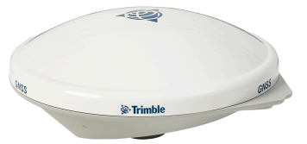
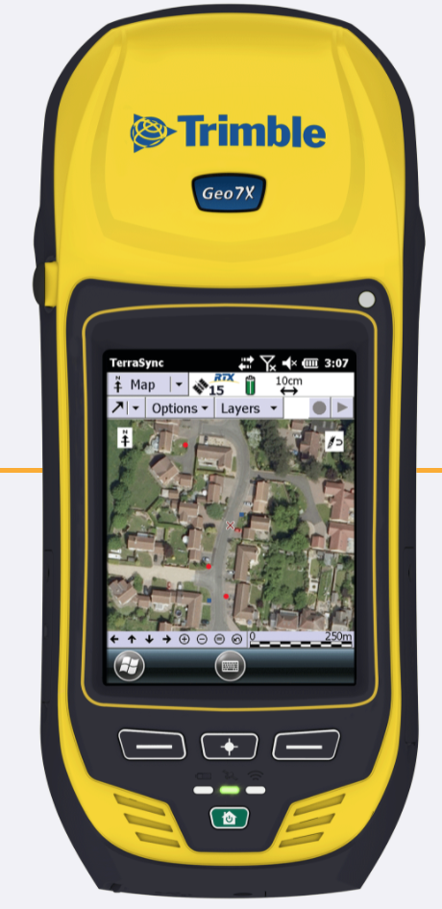
Surveying
External Antenna
Trimble Handheld device
More than 53 sites have been surveyed
To establish thresholds, key elevations need to be determined
Sensor elevation
Top of ditch
Bottom of ditch
Node elevation
Elevation of surrounding infrastructure e.g
Edge of pavement
Bottom of bridge deck
Trimble Geo7x Handheld Device
Trimble Zephyr 3 Rover

Slide 16
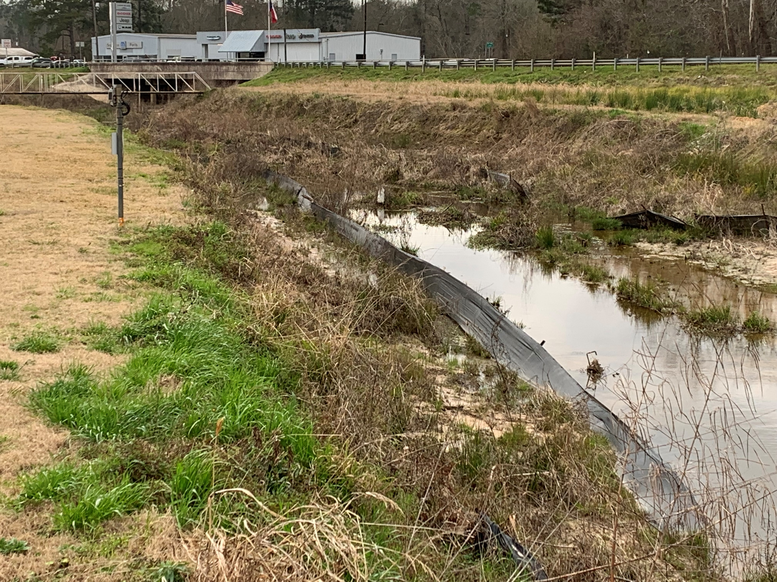
Sample Thresholds (Visual Description)
3 thresholds
Threshold 3 – Bottom of bridge deck
Threshold 2 – High Top of ditch
Threshold 3 – Node
Node
Sensor (Bottom of ditch)
Threshold 1 – Top of drain
Threshold 1 – Low Top of ditch
Threshold 2 – Top of ditch / edge of pavement
Sensor (Bottom of ditch)

Slide 17
Remaining Tasks
Transfer/share sensor data onto OneRain and Transtar
Survey elevation data for remaining sites to establish flood elevation thresholds.
Establish flood alert thresholds on both the Intellisense and OneRain platform
Initiate inundation mapping for thresholds.

Slide 18
Acknowledgements
This work has been funded by the Lower Neches Valley Authority (LNVA). The Sabine River Authority of Texas (SRA), Lamar University through the Center for Port Management, the Center for Resiliency and the Department of Civil and Environmental Engineering. Any opinions, findings, and conclusions or recommendations expressed in this material are those of the author(s) and do not necessarily reflect the views of the sponsors.
Special thanks to many Lamar students, faculty and staff who helped with the project.

Slide 19
Background
David Maidment call September 24, 2019
Establishment of the Flood Coordination Study
LNVA, SRA, LU funding
Calls with TDEM Michael Ouimet late 2020, early 2021 re: sensors
Liv request to SETx FCD to take custody
CRADA and sub-agreements between all entities
Center for Resiliency established Sept. 1, 2022. Funding supports asset management for sensor deployment and study.
Thank you to all the above and others who have effected this!

Slide 20
Questions?
Lamar University
Southeast Texas Flood Control District
Texas Division of Emergency Management
Department of Homeland Security Science and Technology Directorate
Government Agencies
City of Beaumont
Sabine River Authority
Lower Neches Valley Authority
Drainage District 6
Drainage District 7
Chambers County
Hardin County
Jasper County Emergency Management
Jefferson County (Precincts 1 – 4)
Newton County Emergency Management
Orange County Drainage District
Texas Park and Wildlife
Private
ExxonMobil Refinery
Enterprise Chemical Plant

