Slide 1


Site Maps, Base Maps and Flood Maps, Oh My!
Fernando Salas | NOAA/NWS OWP Geo-Intelligence Division
May 12, 2022
“It is as important to represent hydrologic environments precisely with data as it is to represent hydrologic processes with equations.” - David Maidment

Slide 2
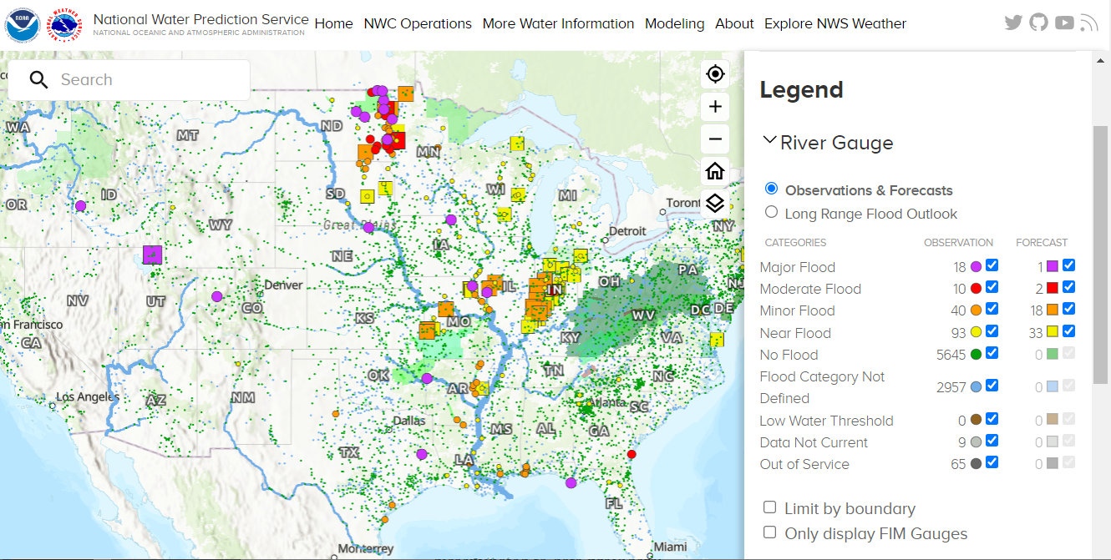
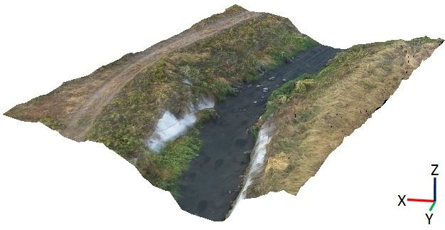
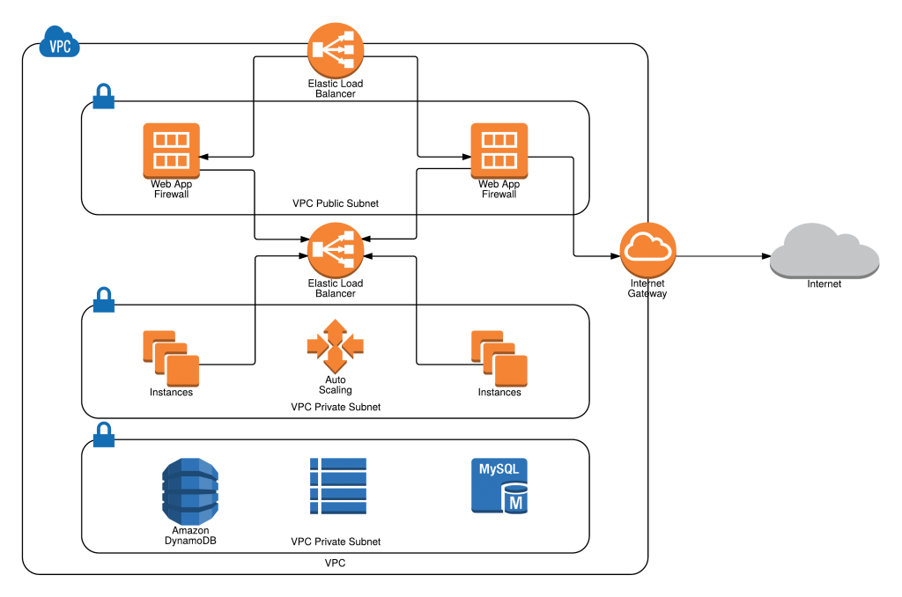
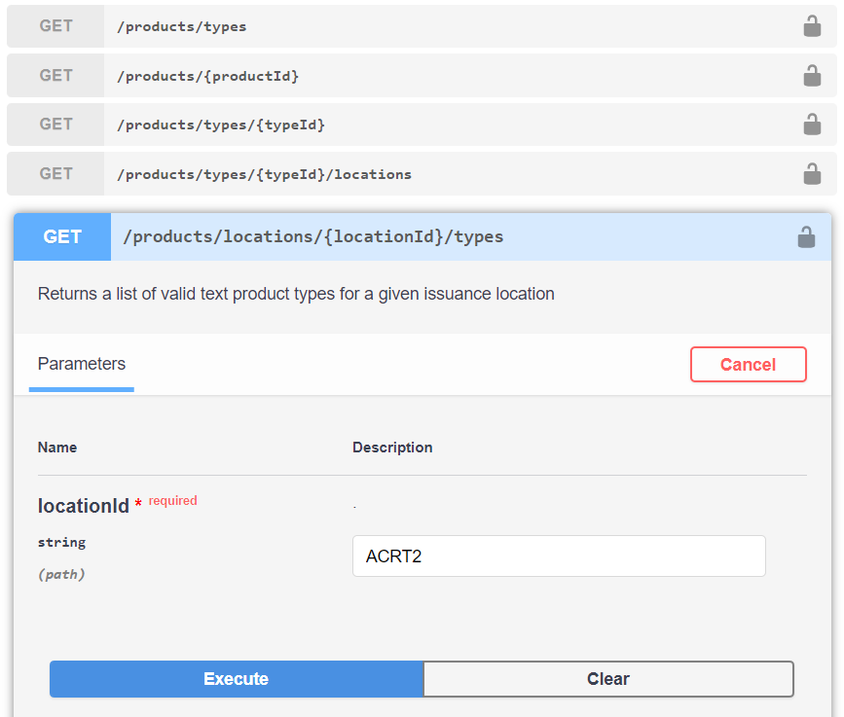
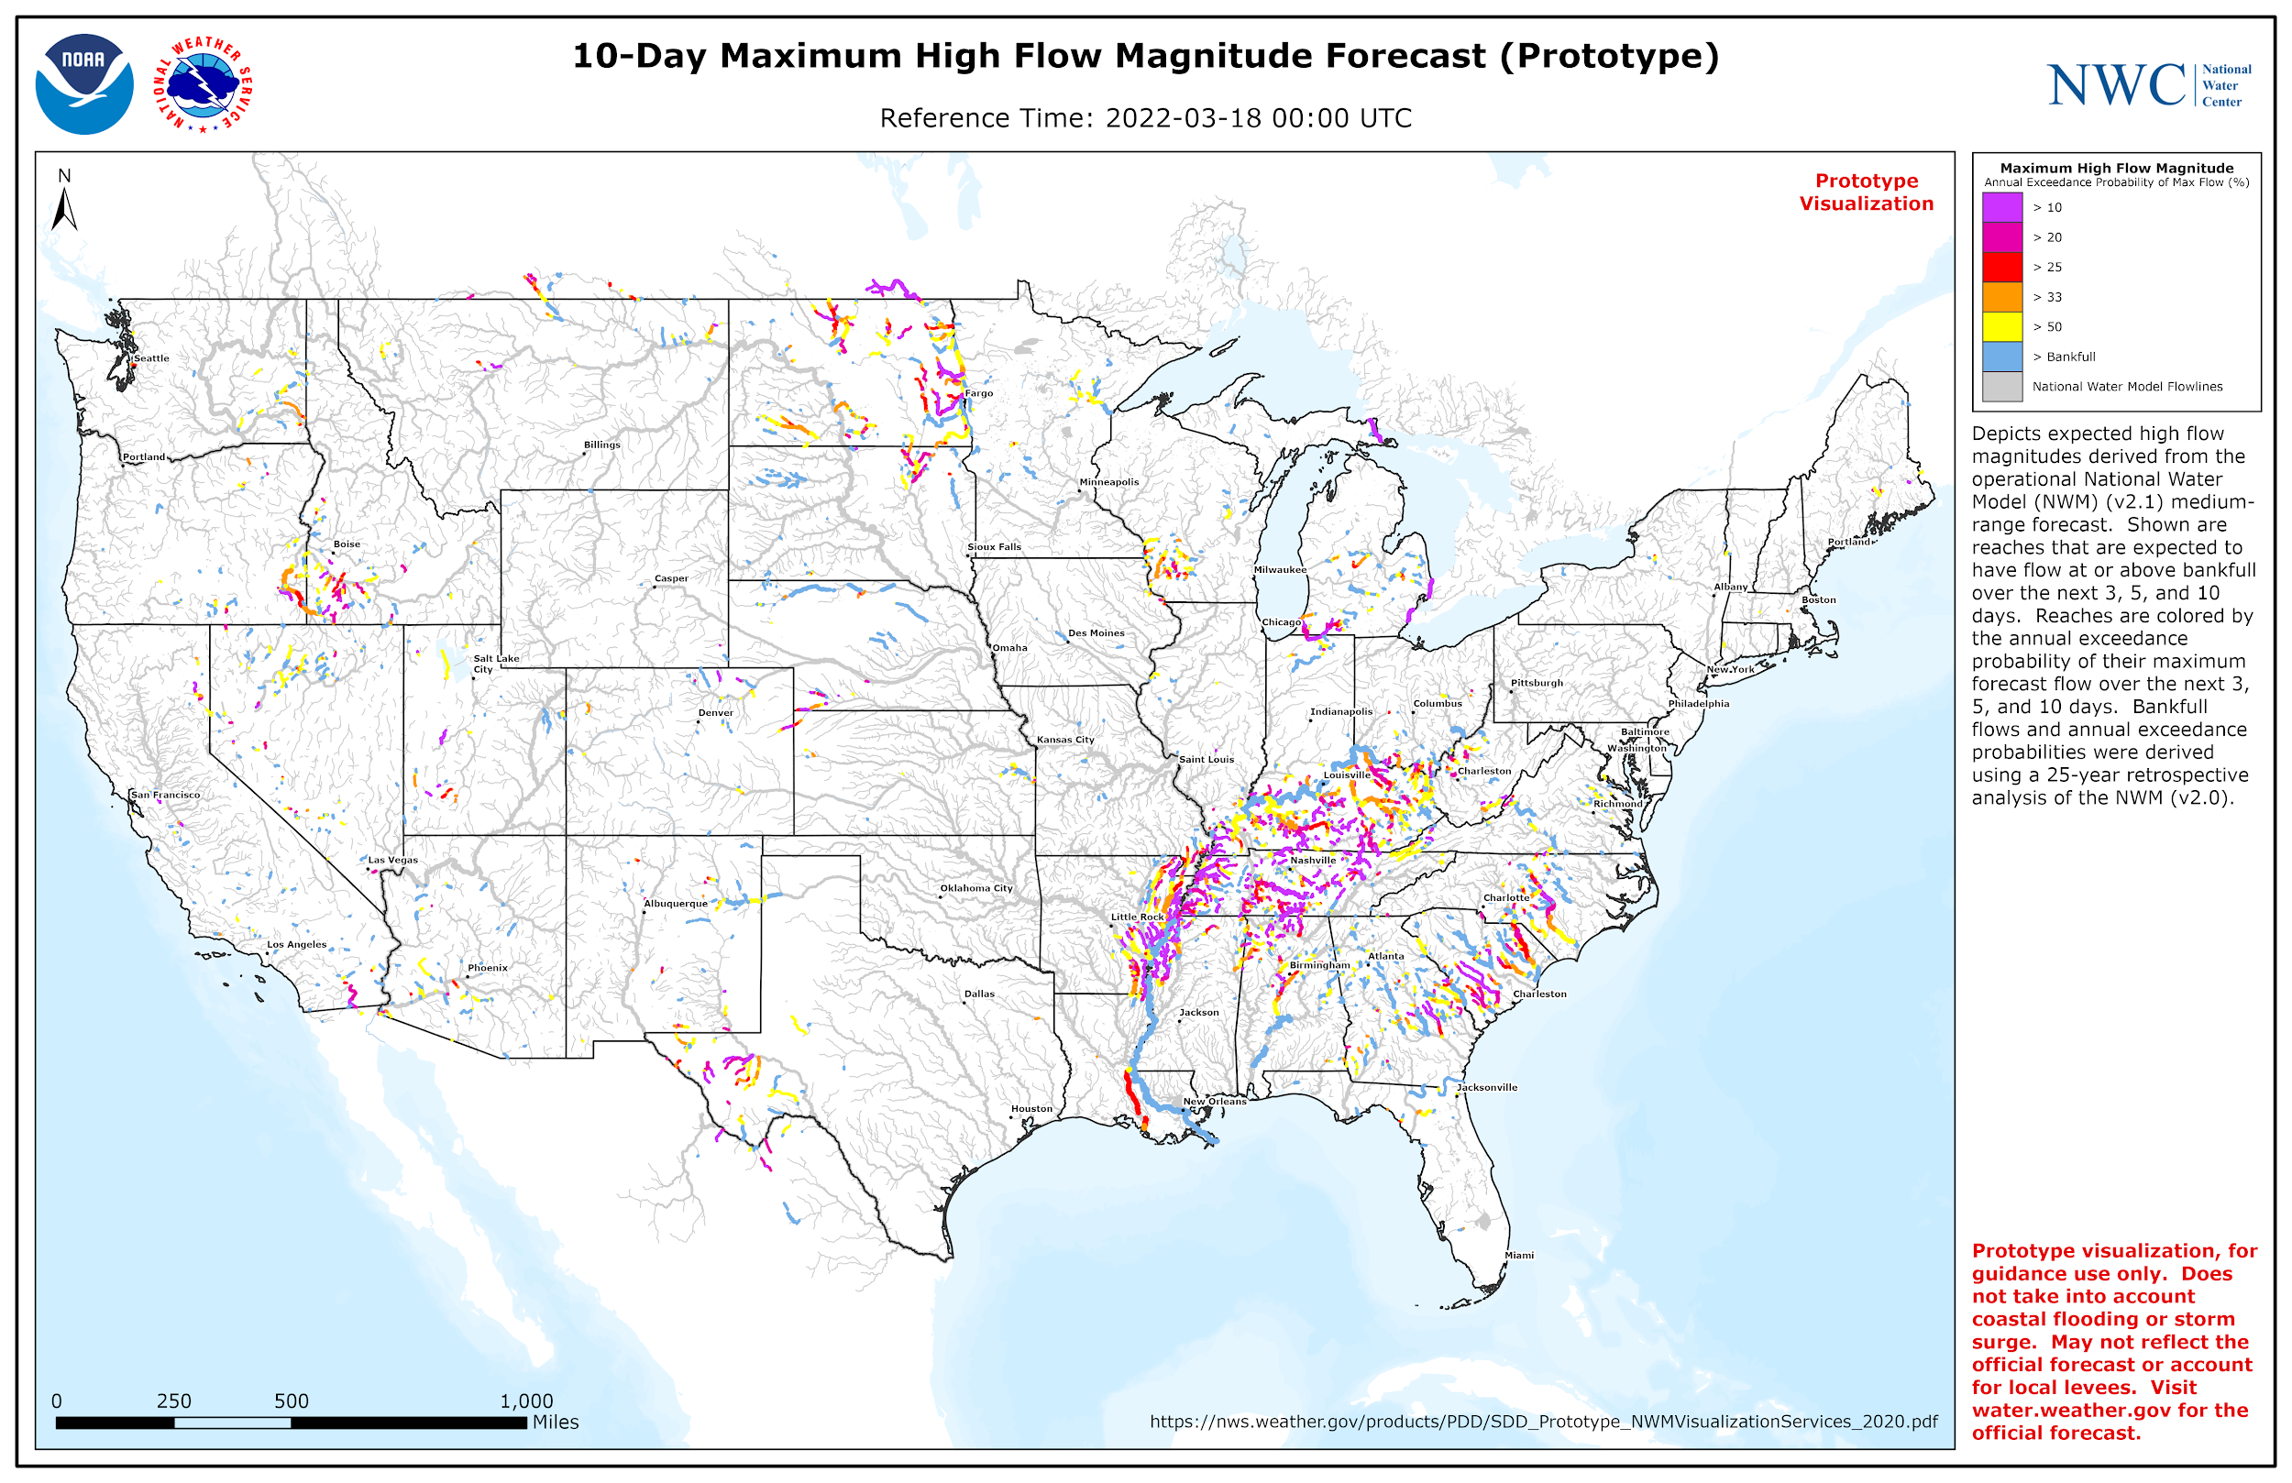
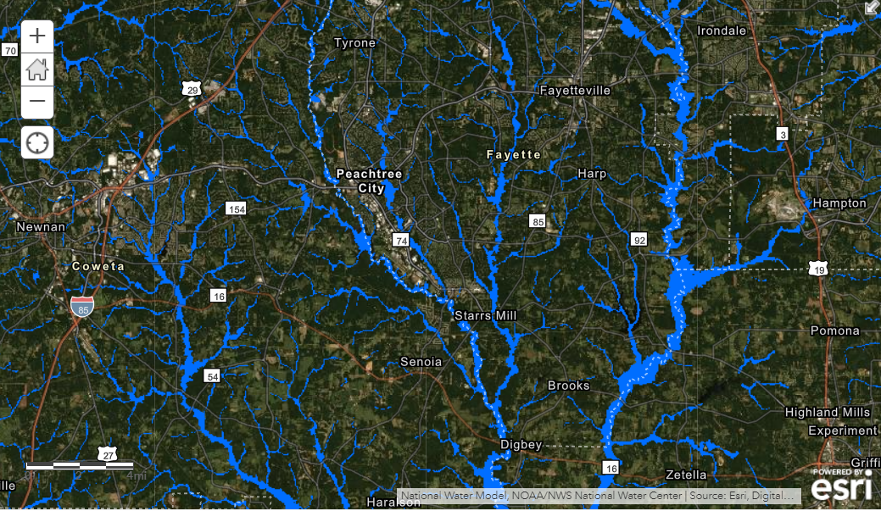
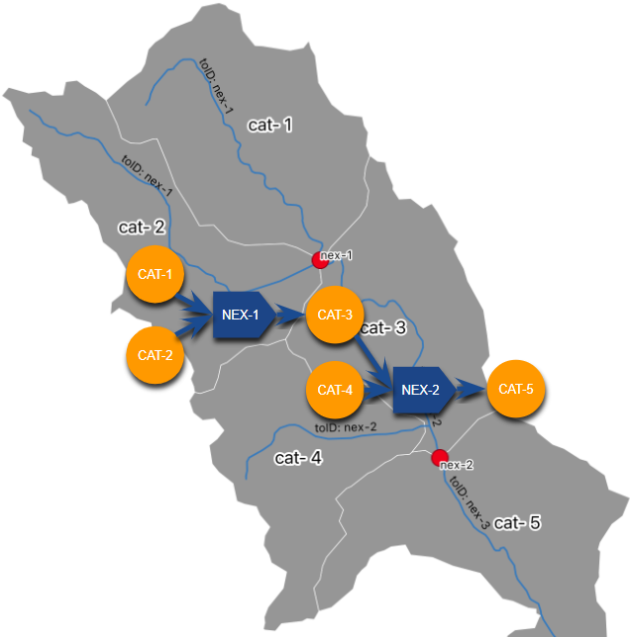
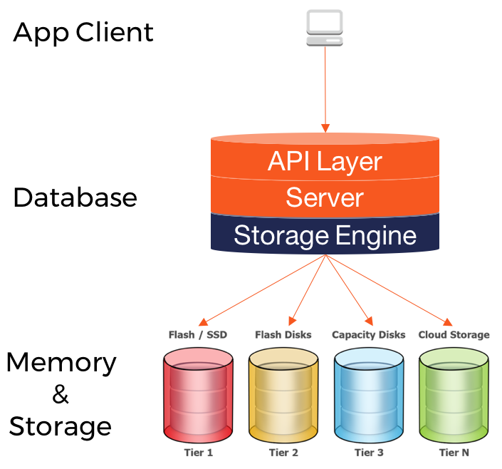
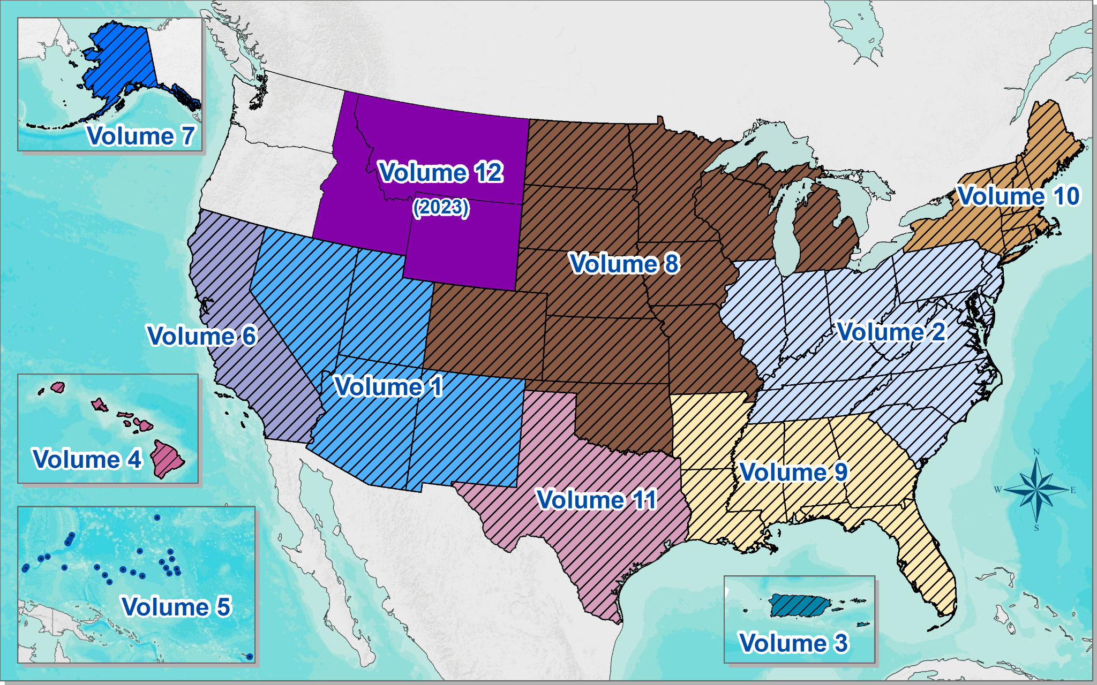
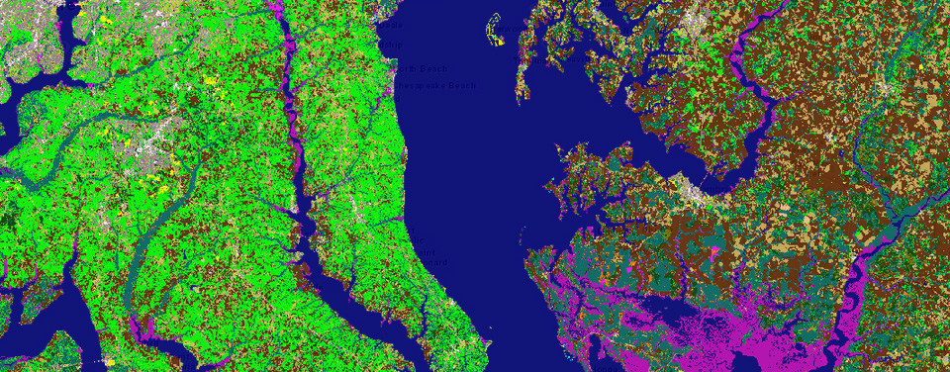
Geo-Intelligence Division (GID) Activities
Common Operating Picture
Cloud
Data APIs
Terrain and Bathymetry
Model Hydrofabric
Prediction Services
Flood Inundation Mapping
Atlas 14 Studies
Land Surface Descriptions
Data Storage

Slide 3


Slide 4
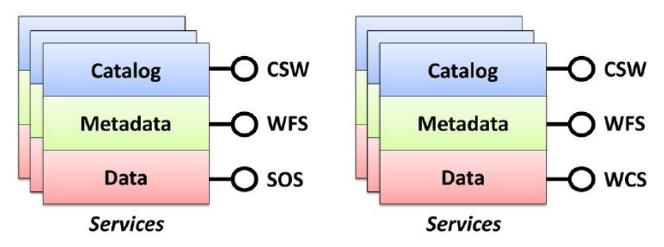

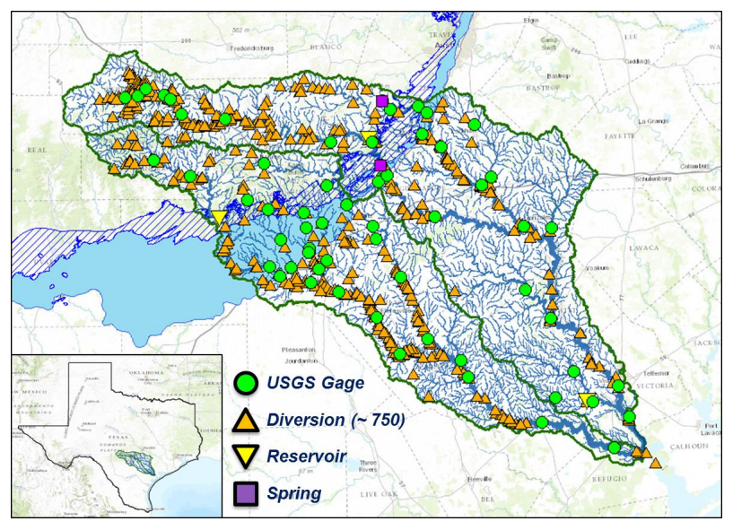
Site Maps, Base Maps and Flood Maps, Oh My!
Key Research to Operations (R2O) Initiatives in GID
Site Maps - Manage and disseminate geospatial and hydrologic information that is FAIR (findable, accessible, interoperable and reproducible).
Base Maps - Implement solution that integrates disparate geospatial and hydrologic datasets. Develop a consistent geospatial hydrofabric that links datasets together and supports the implementation of hydrologic models.
Flood Maps - Develop and evaluate scalable flood inundation mapping capabilities. Implement capabilities in forecast mode in near real-time. Facilitate the provisioning of Impact-Based Decision Support Services (IDSS).
…a blueprint for the application of GIS to operational hydrology….

Slide 5

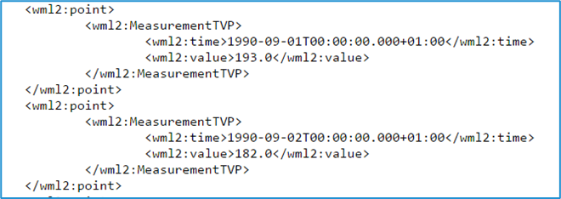
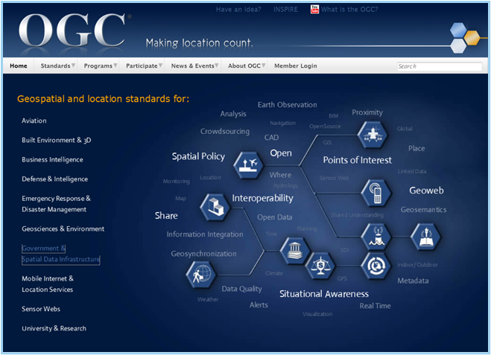
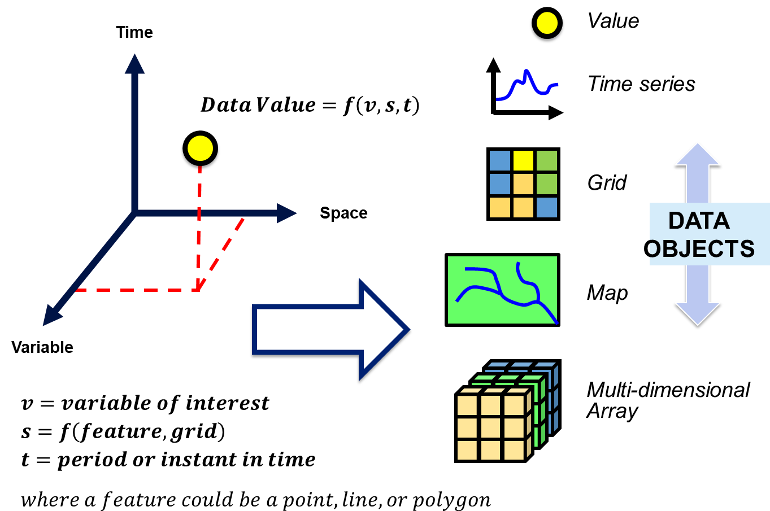
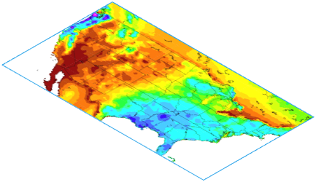
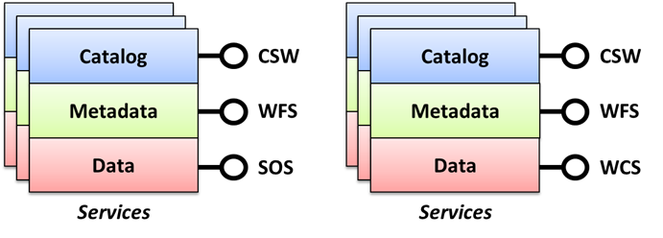
Crossing the Digital Divide
…facilitate access to time series and multi-dimensional arrays alike…

Slide 6
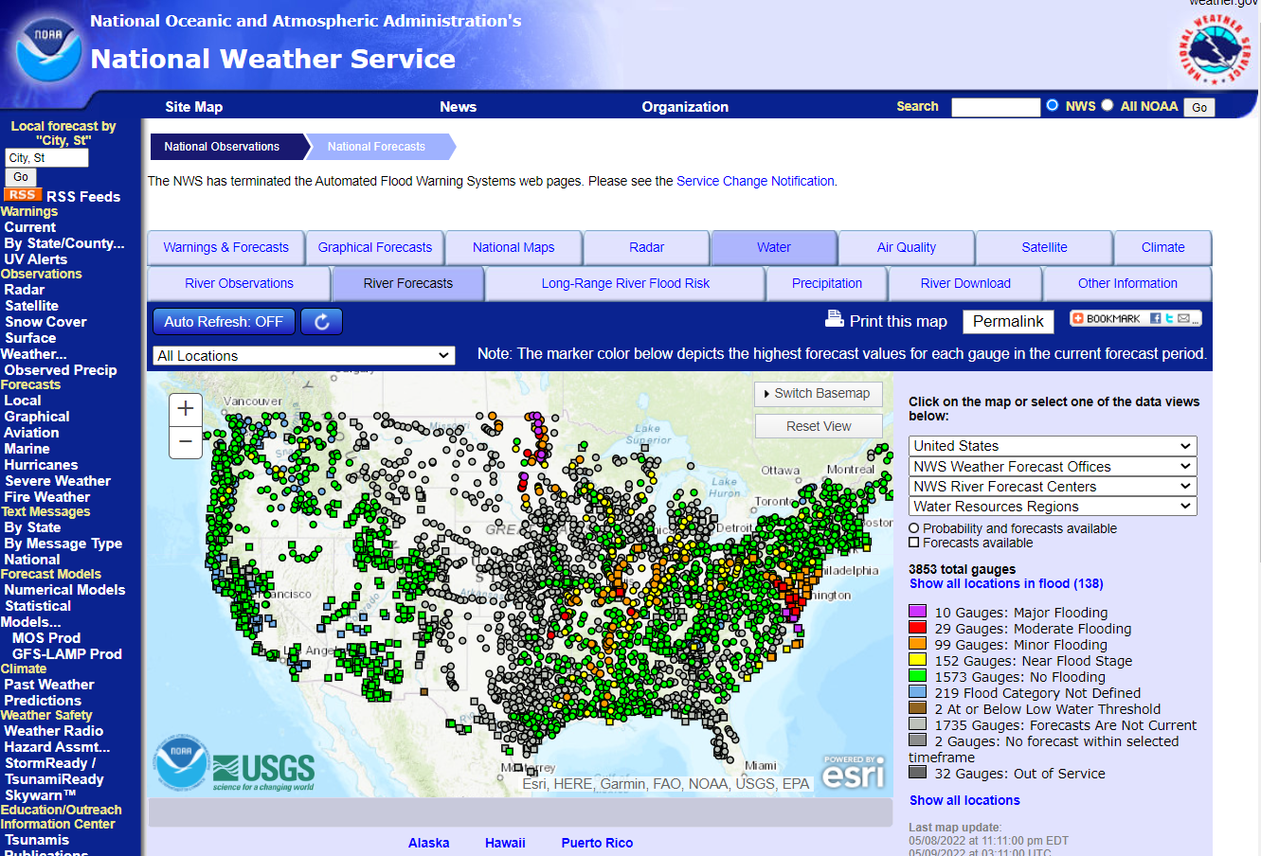
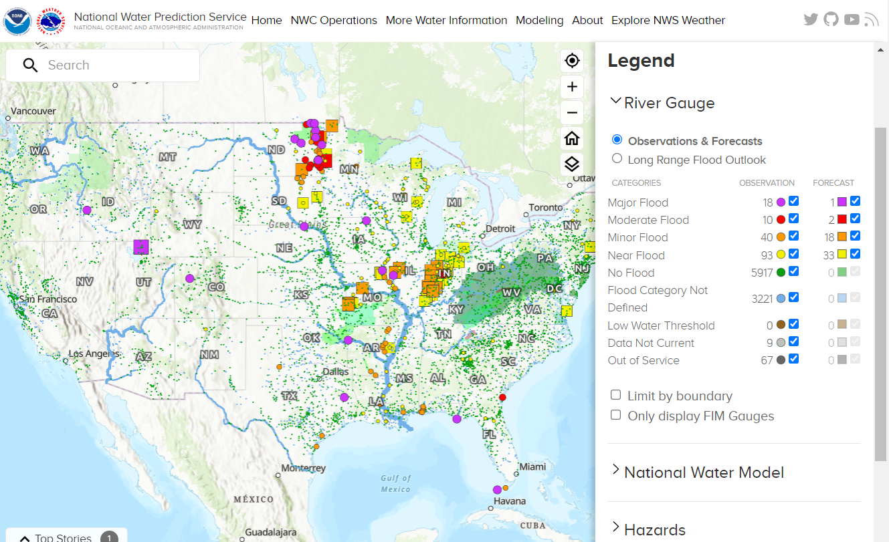
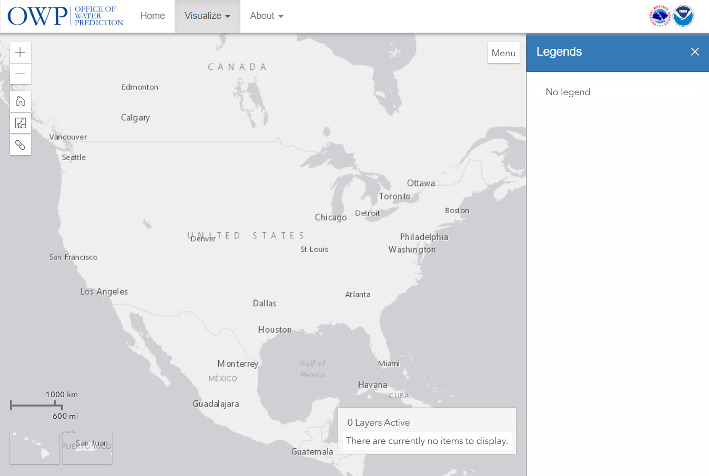
National Water Prediction System
https://water.weather.gov
Advanced
Hydrologic
Prediction
Service (AHPS)
National Water Prediction System
https://water.noaa.gov
…establish a foundation to better disseminate operational hydrologic information….

Slide 7
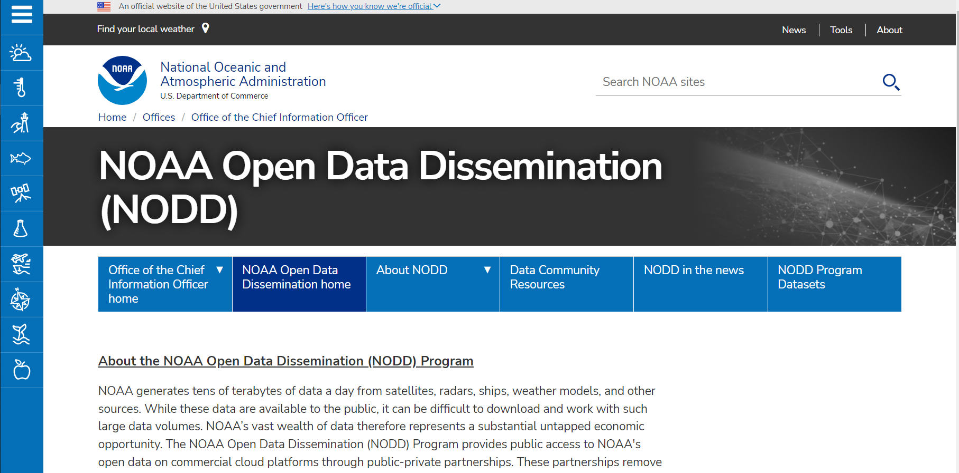

NOAA Open Data Dissemination “Big Data” Program
NWM v2.1 Reanalysis Simulation in Zarr format in AWS
Precipitation, Land and Channel Variables
https://noaa-nwm-retrospective-2-1-zarr-pds.s3.amazonaws.com/index.html

Slide 8
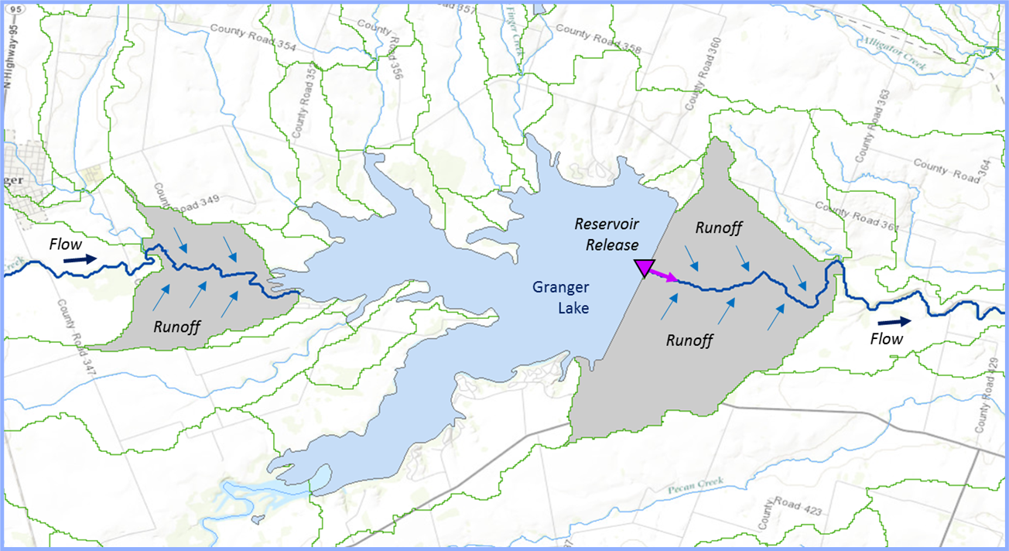
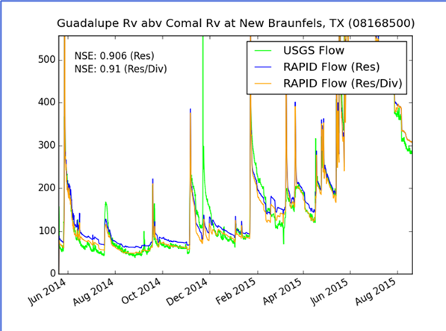
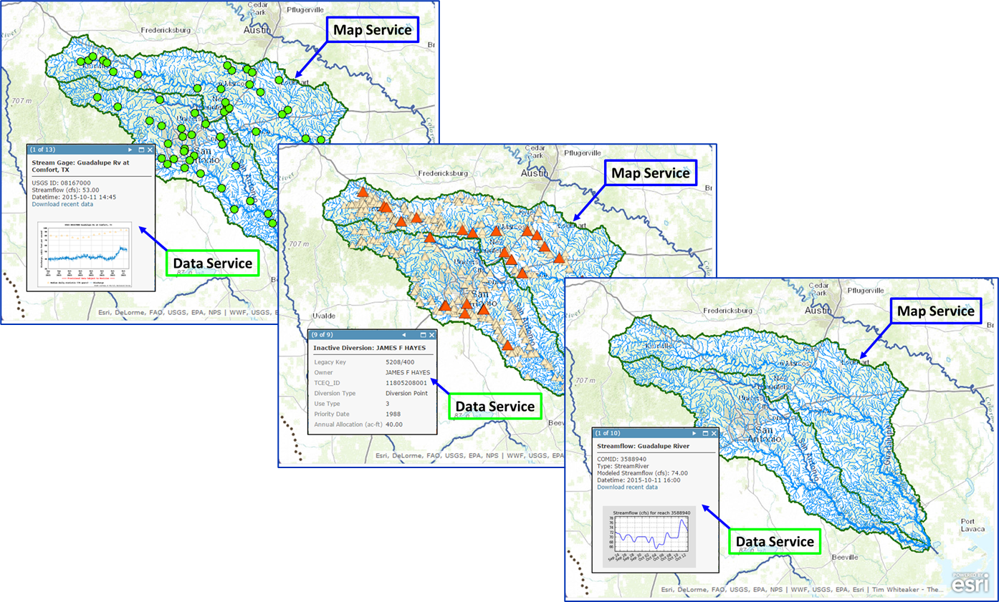
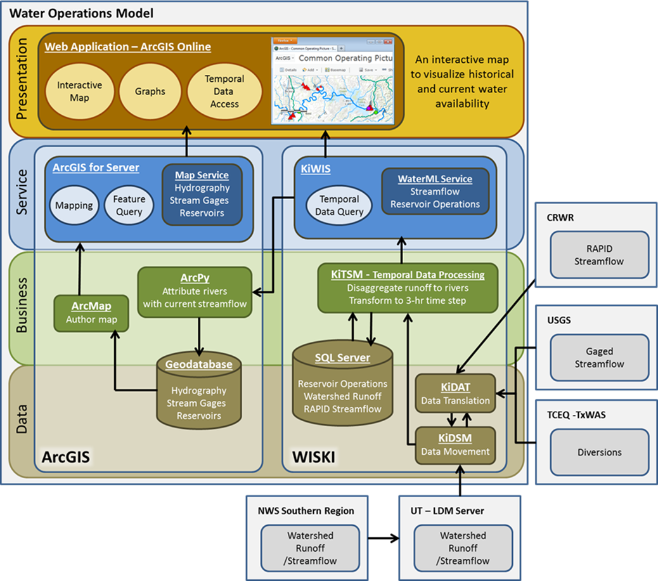
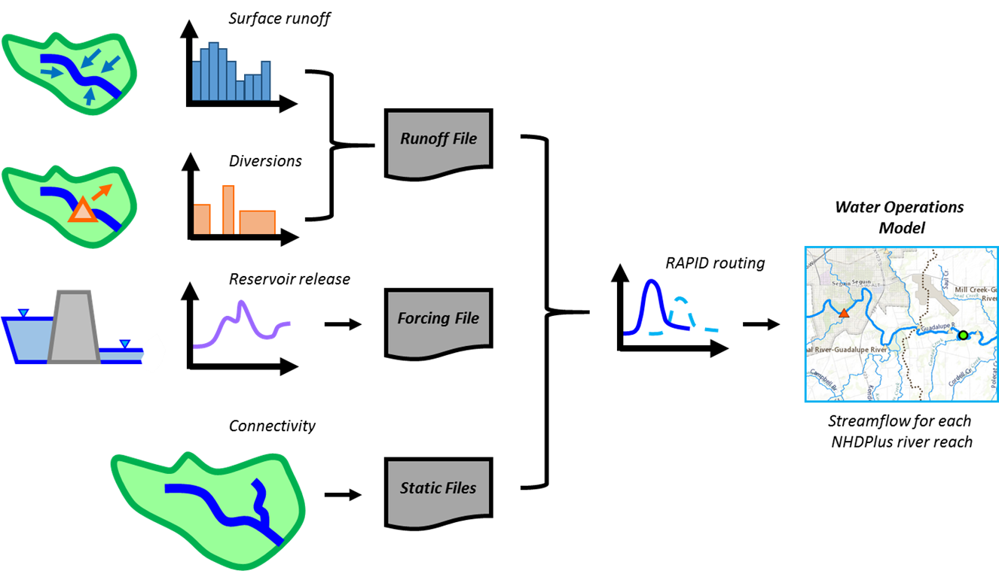
Regional Water Operations Model
…demonstration of real-time streamflow simulation system in continuous and discrete space…

Slide 9
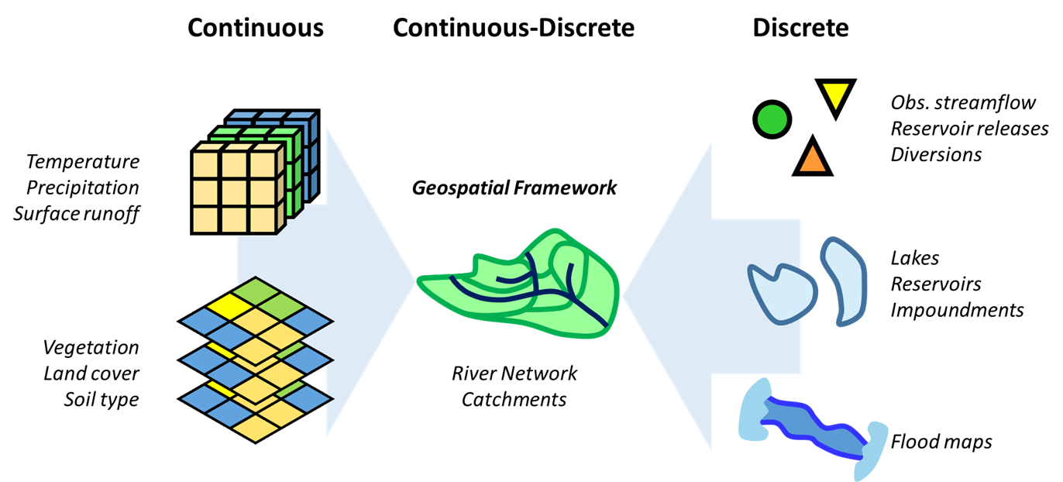
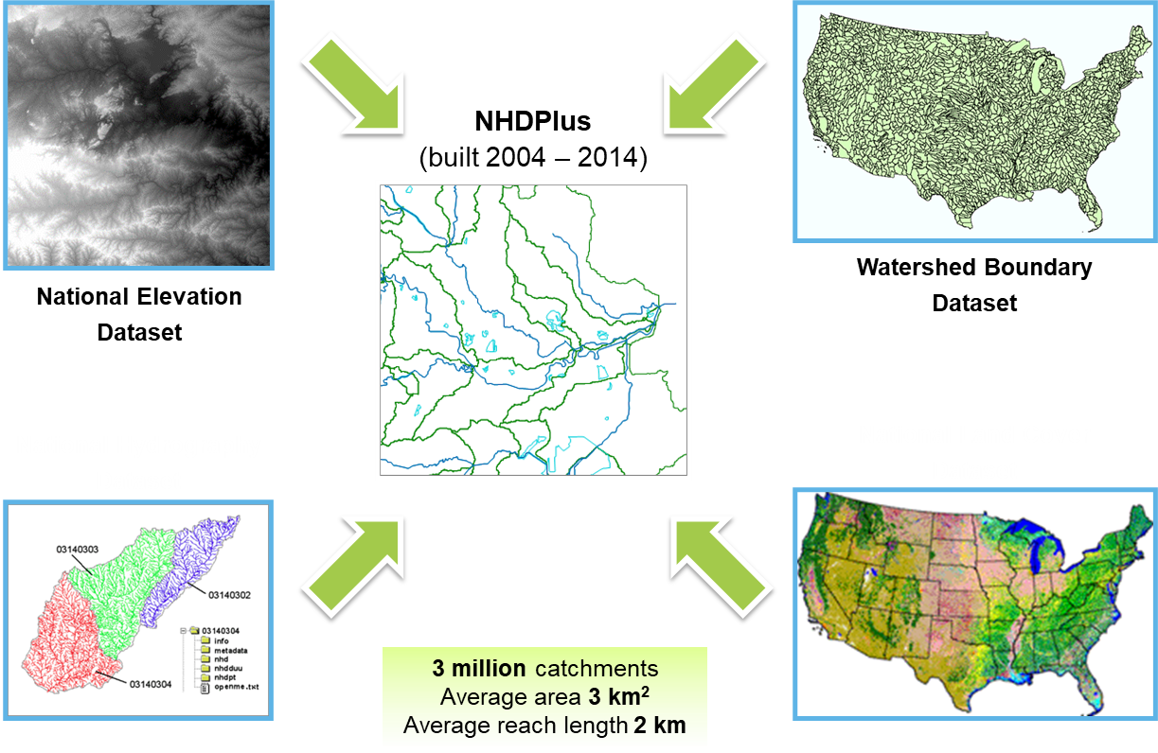
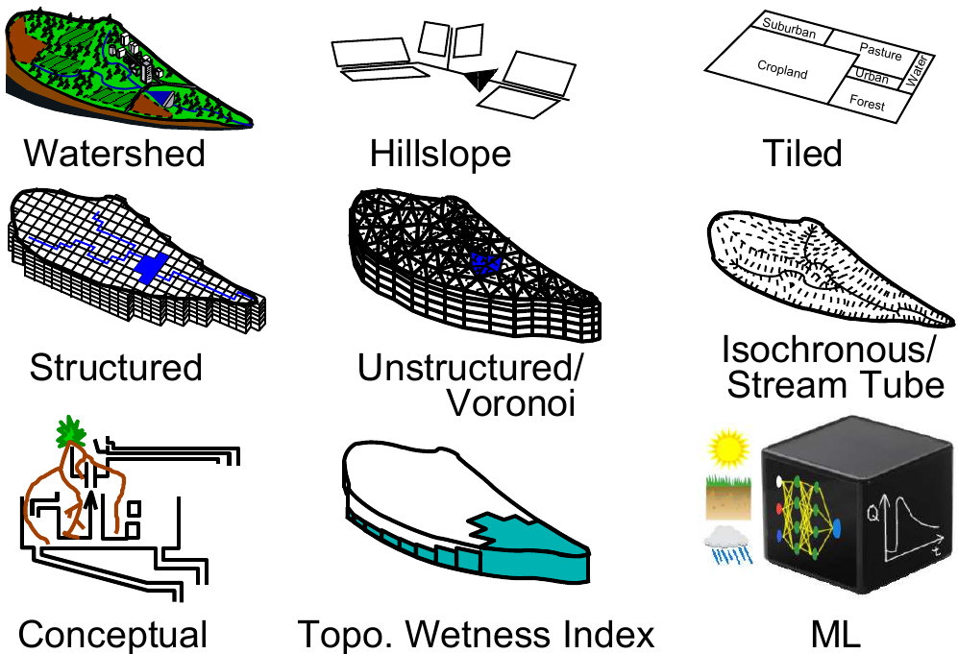
A Geospatial Framework for Operational Hydrology
Reimagined National Water Model via Implementation of Next Generation Water Resources Framework
Conceptual Model
Regional Implementation
and Operational
National Water Model

Slide 10
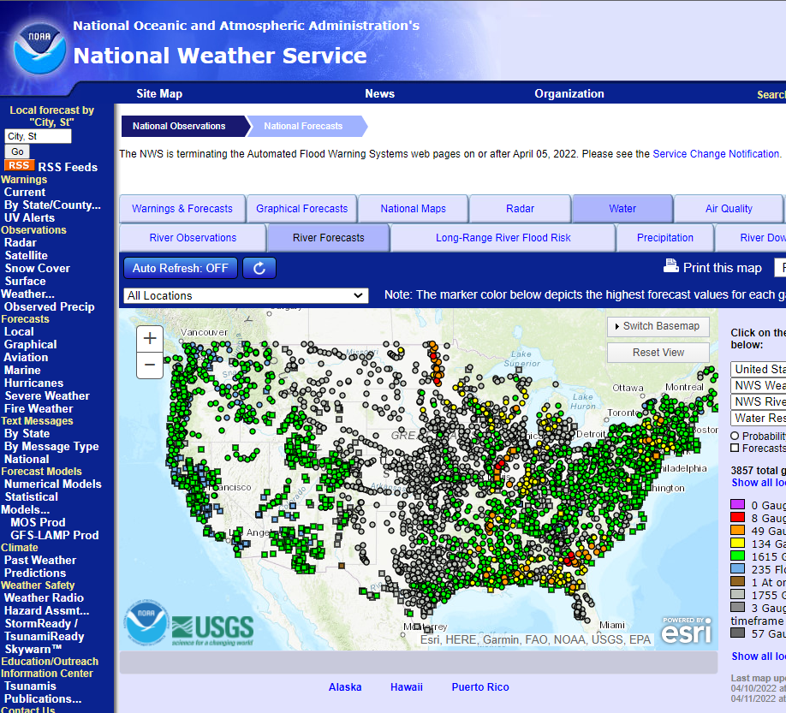
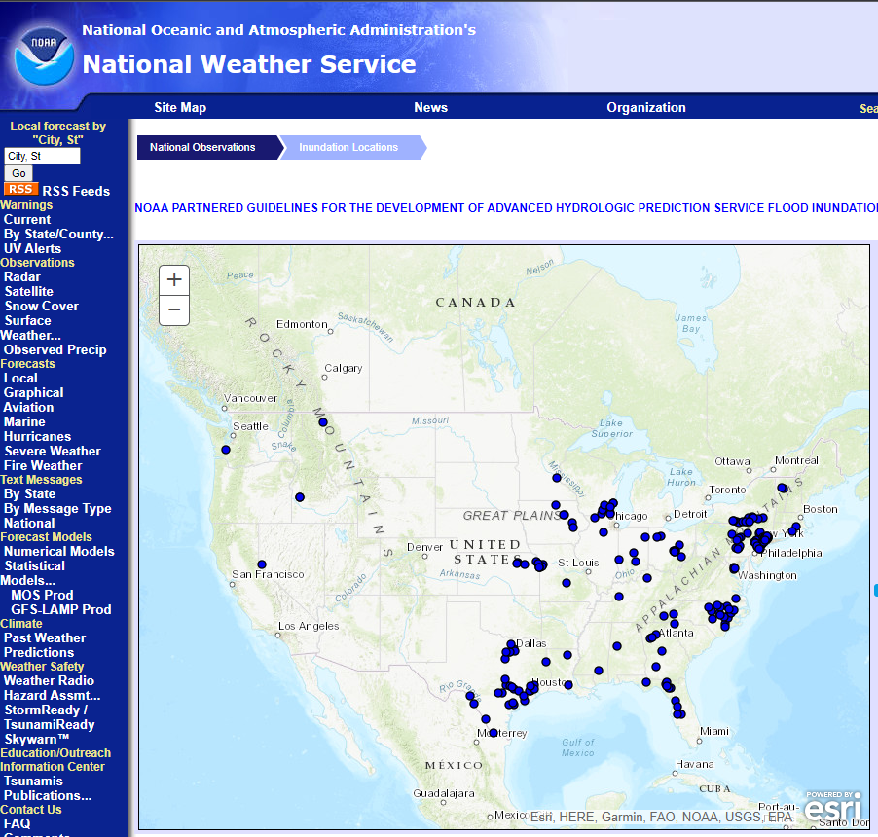
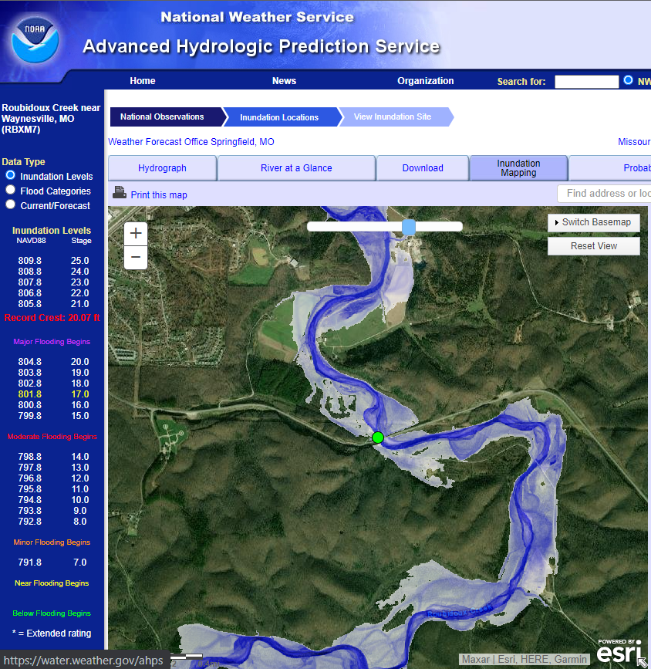
Existing NWS Flood Forecasts and FIM Libraries
MAJOR
MODERATE
Flood
Categories
MINOR
ACTION
AHPS Flood Forecast Points
~3,600 Locations
AHPS Inundation Libraries
~200 Locations
AHPS Inundation Map
RBXM7
AHPS = Advanced Hydrologic Prediction Service
…spatial gaps in FIM coverage today….

Slide 11
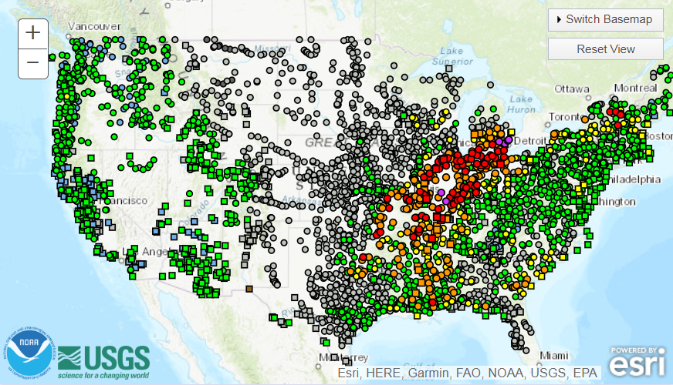
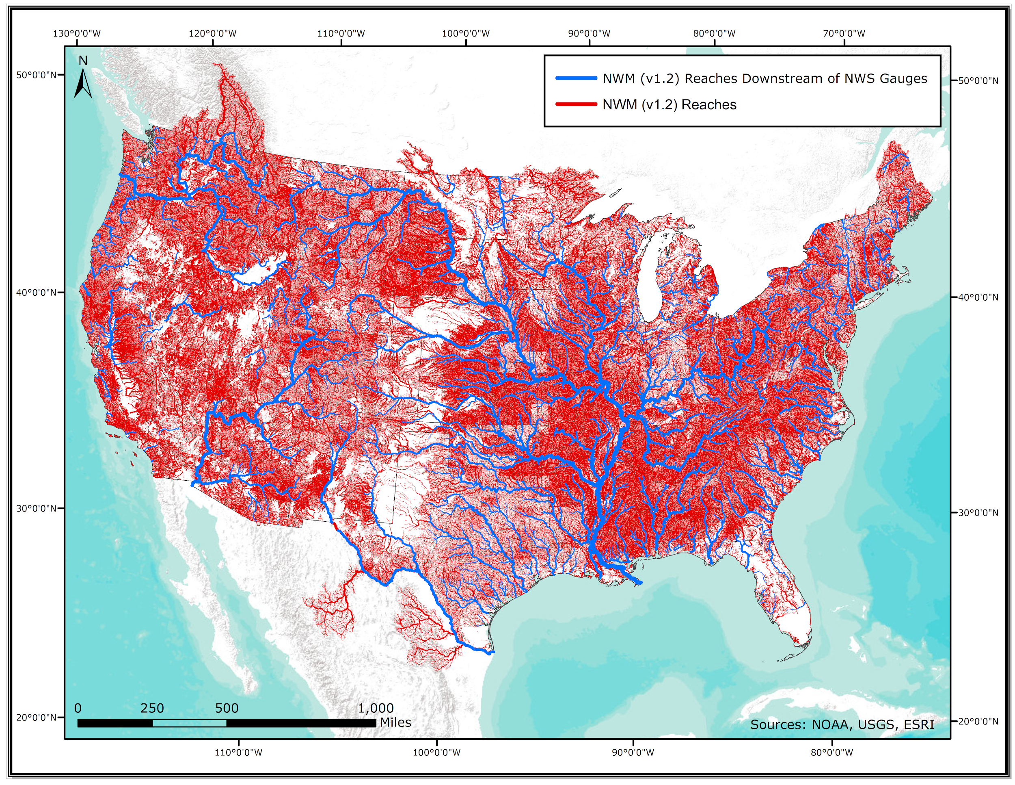
Evolving Water Prediction Capabilities
~3,600 AHPS Forecast Points
RFC CHPS Forecast Models
Forecasts
Extended
RFC
1 forecast point for every 1,000 river miles
(3.4M river miles in U.S.)
~2.7M NWM Forecast Points
National Water Model (NWM)

Slide 12
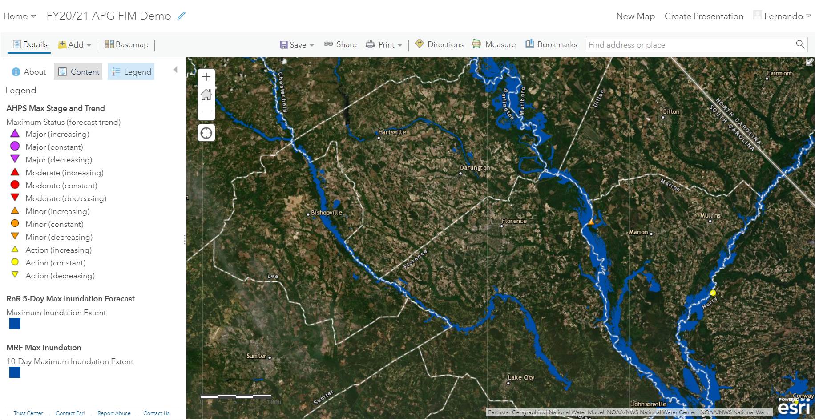
Integration of AHPS, RFC and NWM FIM Services
RFC Inundation
AHPS Forecast
Point
NWM Inundation
AHPS Forecast
Point

Slide 13
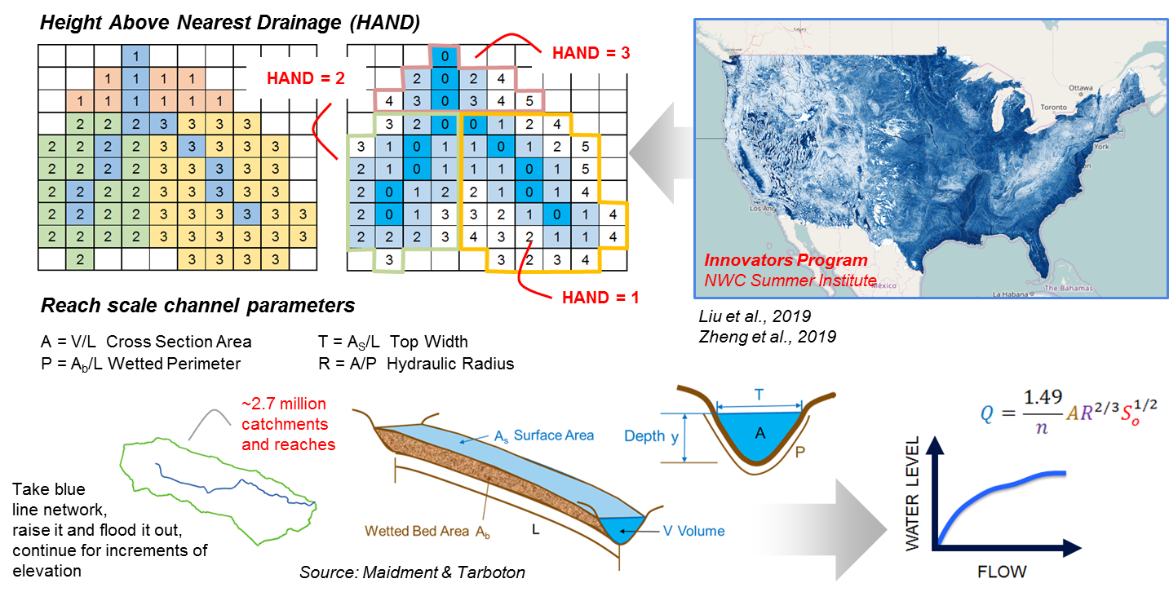
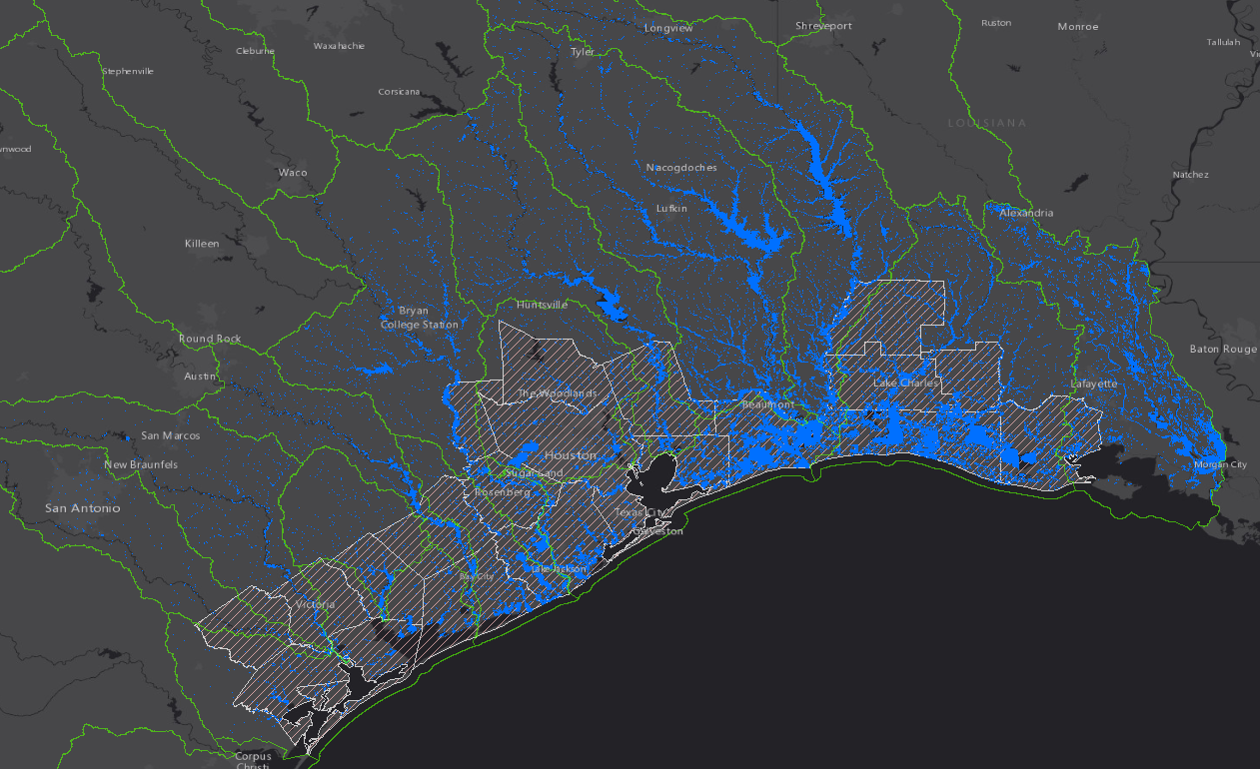
Complementary Flood Mapping Services
…enabling continental scale flood inundation mapping capabilities…

Slide 14
Evolution of Expanded NWS FIM Capabilities
Observe
Flood Inundation Extent and Depth
Collaboration with NOAA NESDIS
Remote sensing products
Local storm reports
Develop
Flood Inundation Mapping Capabilities
Mapping algorithms
Hydraulic models
Channel size and shape estimation
Evaluate,
Validate and Verify Flood Inundation Mapping Capabilities
Benchmark hydraulic model outputs
Observations
Metrics
Uncertainty
Implement
Forecast Flood Inundation Mapping Capabilities
Hybrid local and
cloud infrastructure
Forecast FIM
services
Operations
Opportunities to partner with community to accelerate development and implementation efforts.
Prototype
Demonstrate
Operationalize
2018
2019
2020
2021
2022
2023
Today

Slide 15
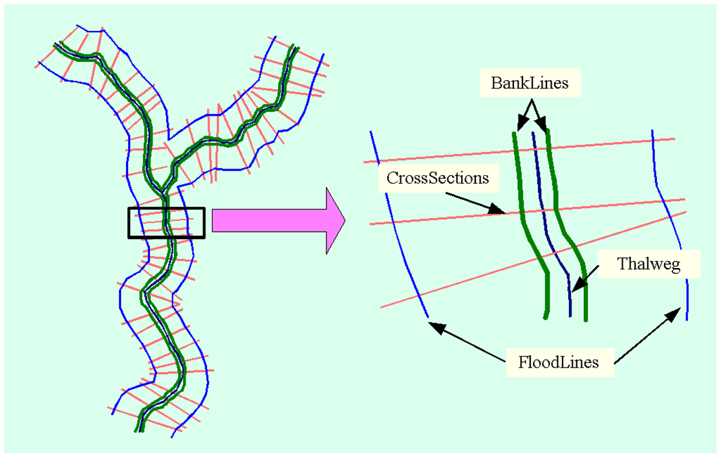
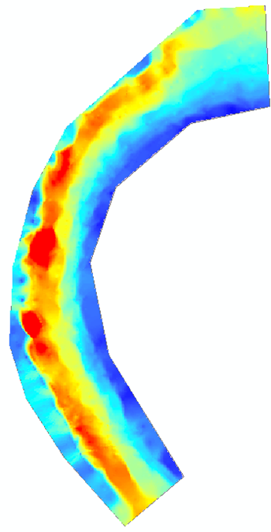

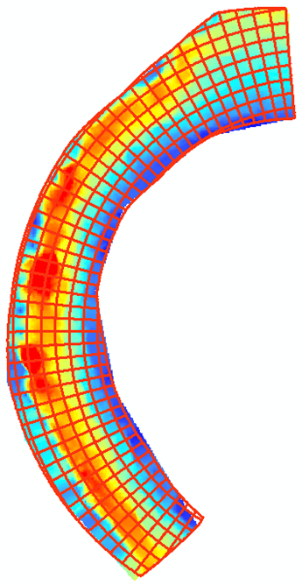
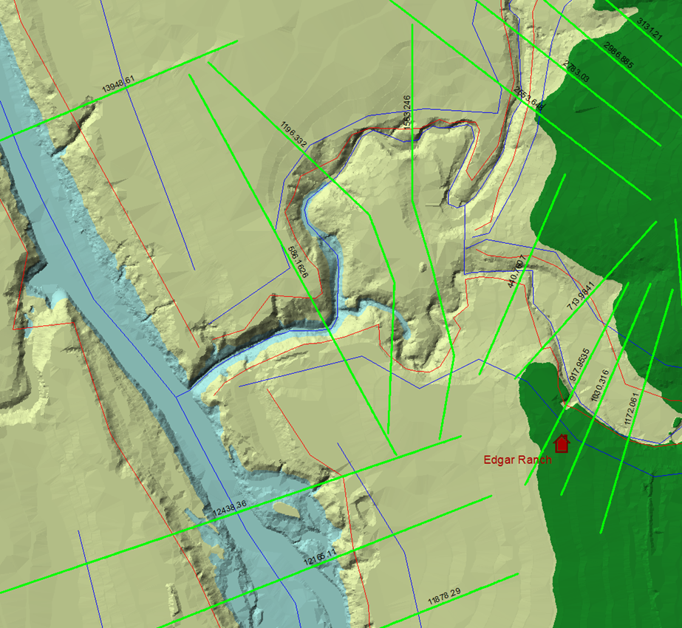
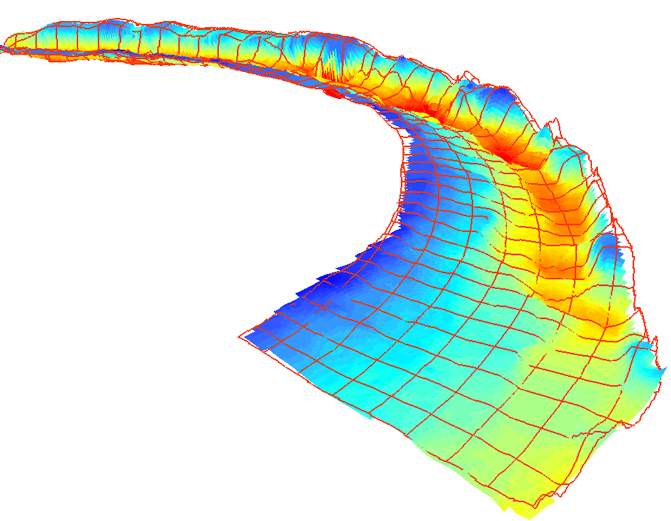
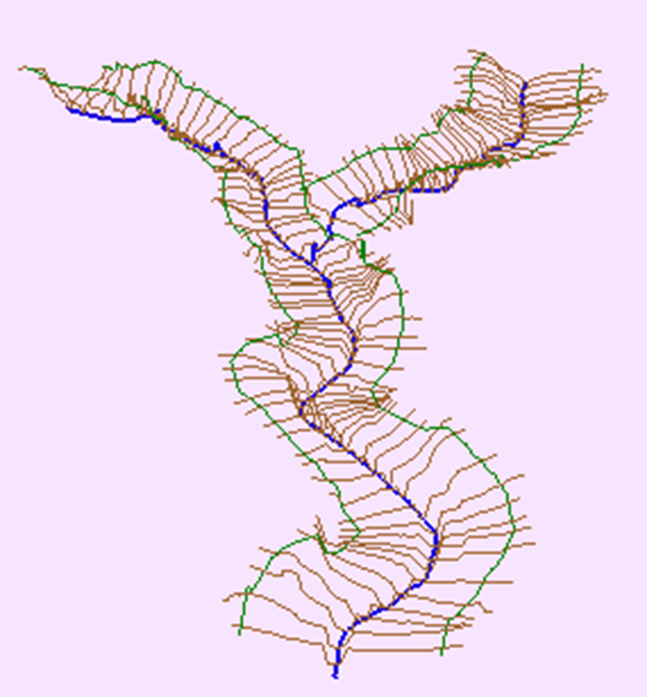
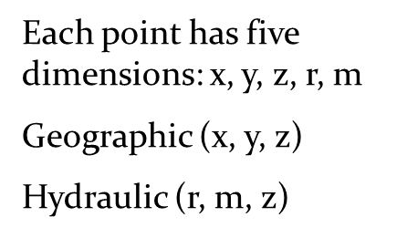
Towards a Standard Data Model for River Channels
Merwade, Whiteaker, Jackson, Djokic and more!

Slide 16
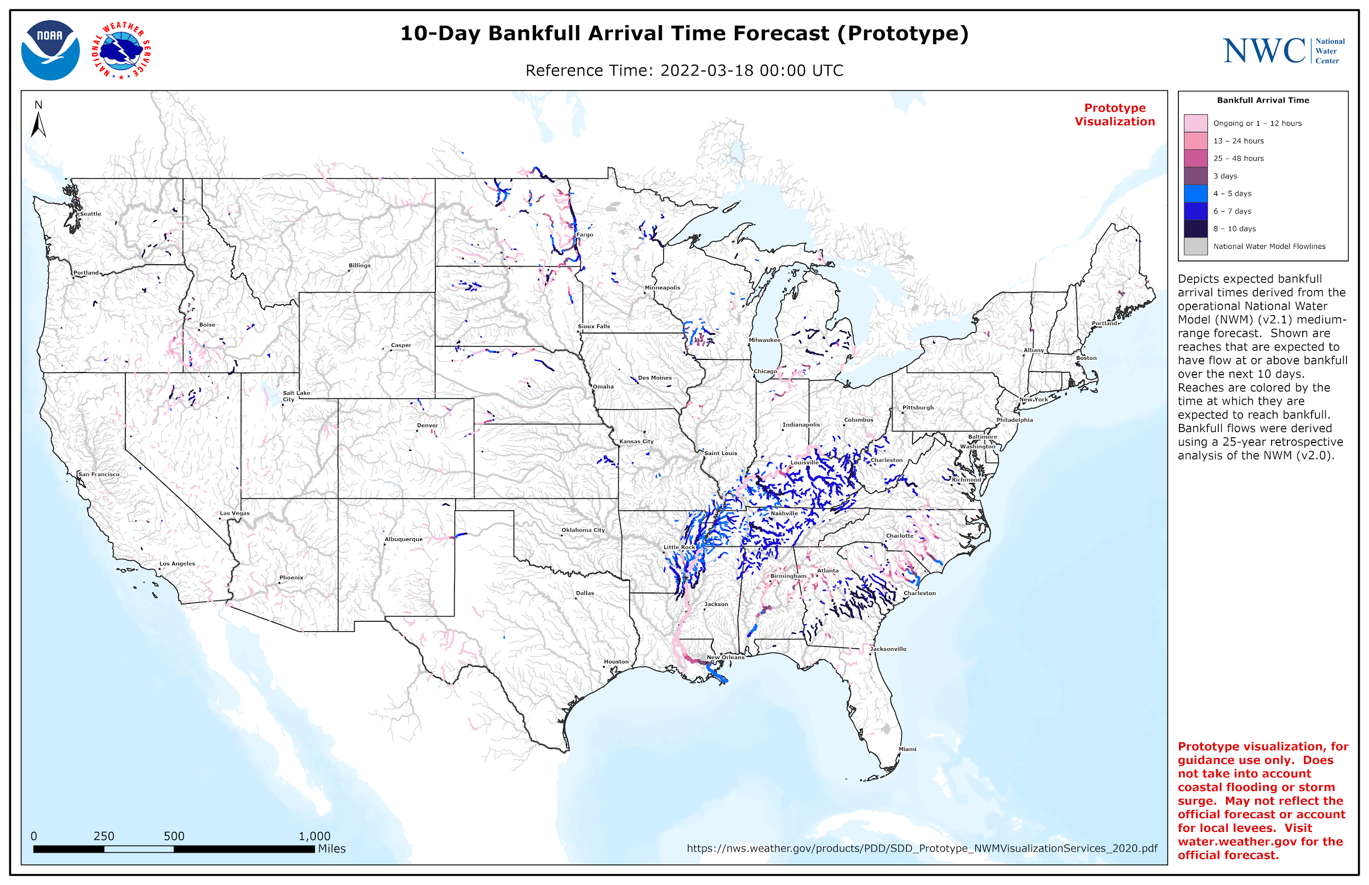
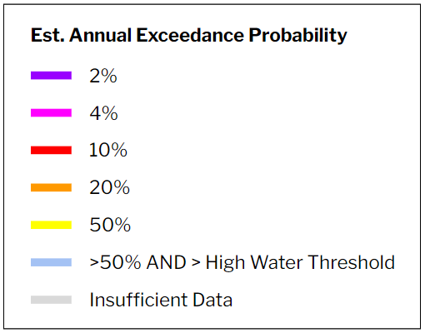
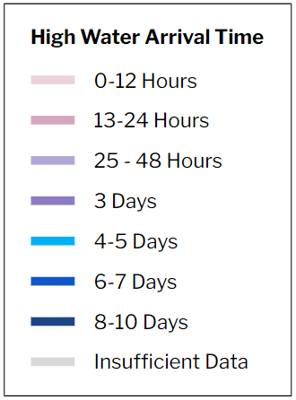
Synthesizing National Water Model Output
10-Day Maximum High Flow Magnitude Forecast (Prototype)
10-Day High Water Arrival Time Forecast (Prototype)
When will the event
occur?
Where is the event?
How bad?
What is the probability
of the event?
10-Day High Flow Magnitude
10-Day High Water Arrival Time
…building a common operating picture for water resources….

Slide 17
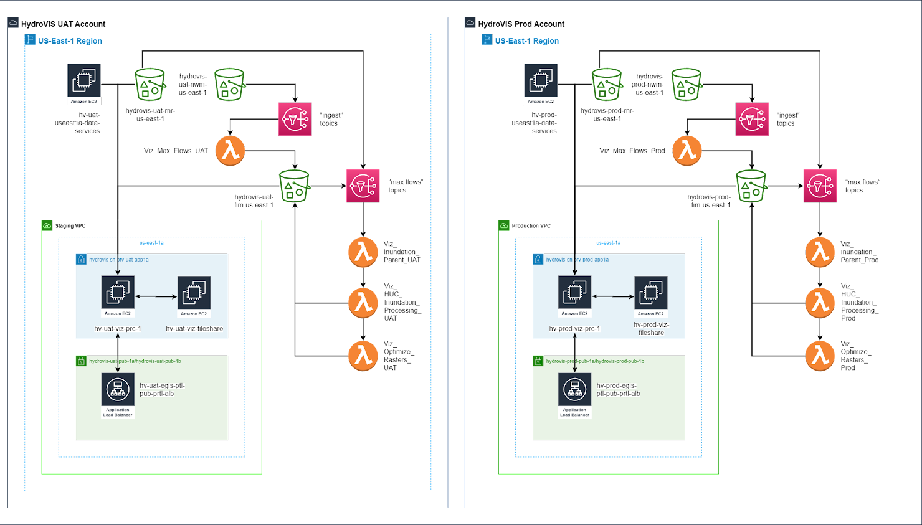
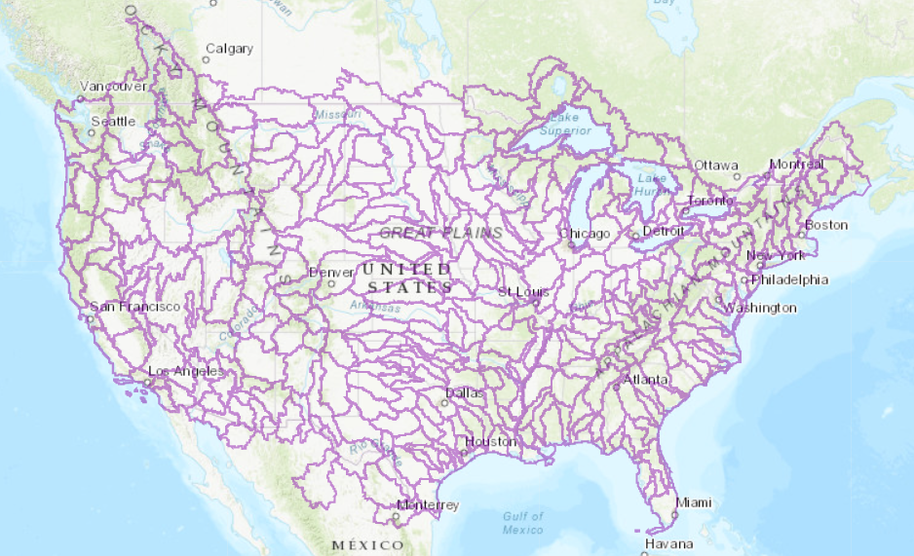




Parallel Processing in the AWS Cloud
HAND Flood Inundation Maps are generated by local raster computation and only where high water is forecast
~ 2,000 lambdas per hour
~ 48,000 lambdas per day
~ 20 min. per forecast map
Cloud Computing
S3 Storage
Event Driven Compute
326 HUC6 CONUS Units
HAND rasters and Rating Curves stored by HUC6 unit
Serverless Functions
Virtual Machines

Slide 18
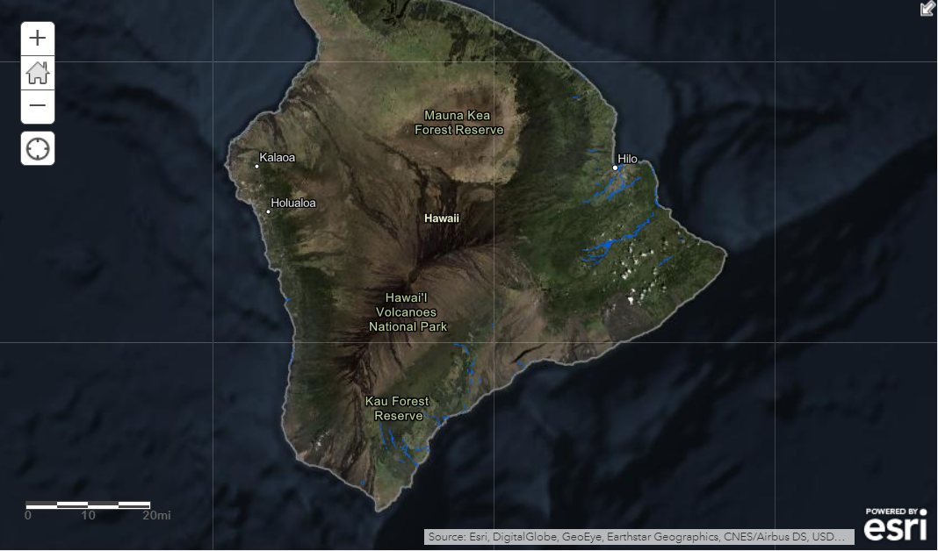

Forecast FIM v3.X Services for 3.4M River Miles
Model: Height Above Nearest Drainage (HAND) terrain model
Resolution: 10-m spatial resolution
Data Production: < 24 hours Code: Open source on GitHub
CONUS
Infrastructure: AWS Public Cloud
System: Hydrologic Visualization
and Inundation Services
(HydroVIS) system
Configurations: Nowcast and Forecast (18-Hour to 10-Day)
Latency: ~ 20 mins or less
Hawaii
Puerto Rico & VI
…coverage across contiguous U.S., Hawaii, Puerto Rico and the U.S. Virgin Islands…

Slide 19
People, Service and Equity
Sharing Information Empowers Others
Maps Bring People Together
Flood Maps Enable Critical Decisions
…thanks for putting water on the map….

Slide 20
Fernando Salas
fernando.salas@noaa.gov

Slide 21
[INSERT TITLE]

