Slide 1





TOPOGRAPHY, GEOMORPHOLOGY, AND FLOOD MODELING
…with a couple of additional stories
Maidment Symposium
12 May 2022
paola passalacqua
Associate Professor, Department of Civil, Architectural and Environmental Engineering, The University of Texas at Austin

Slide 2
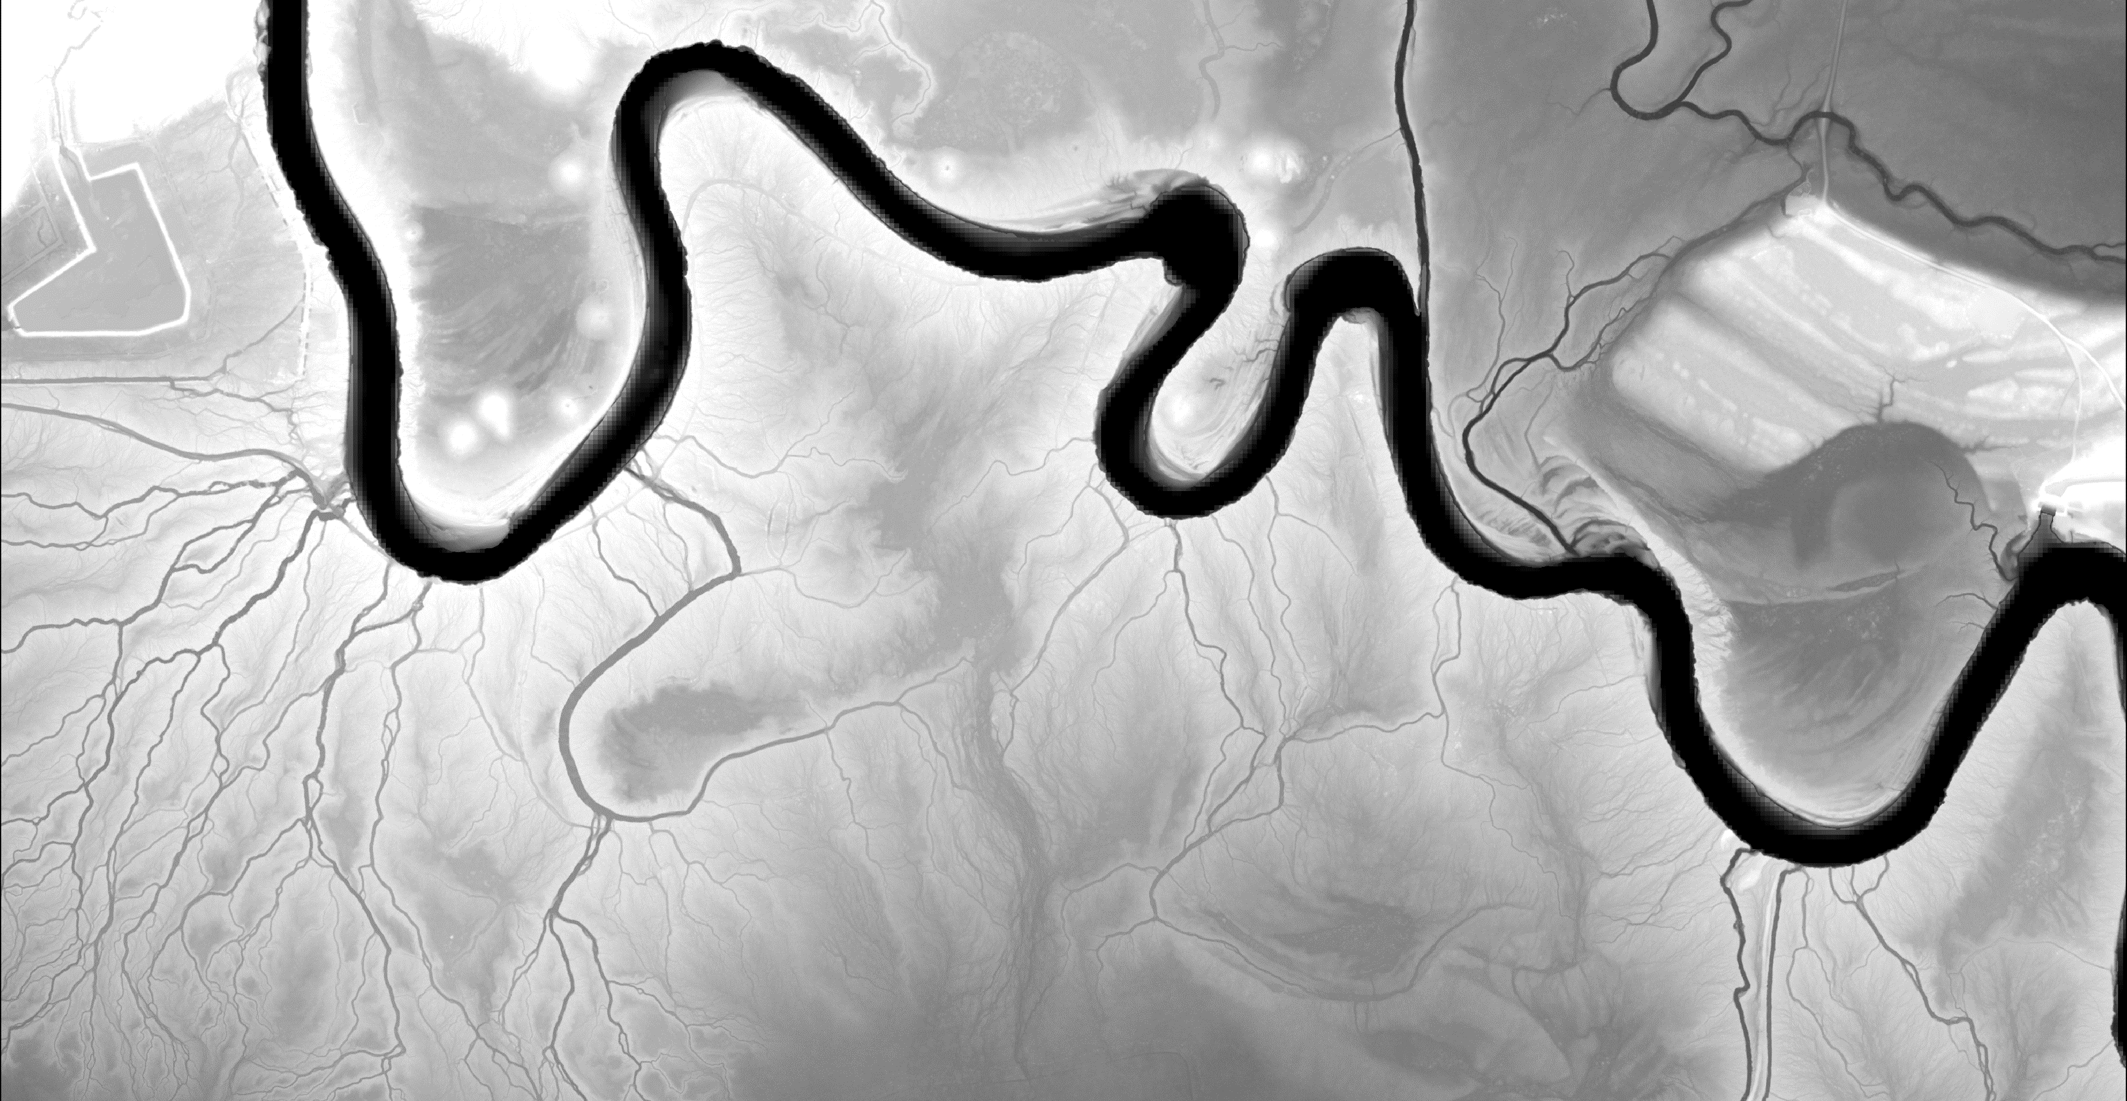
How it all started…

Slide 3
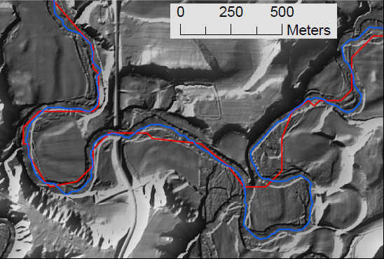
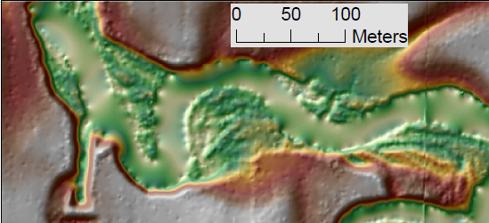
Channel initiation
Identification of accurate centerline
Presence of roads and bridges
Artificial drainage ditches
Small signal to noise ratio
Identification of channel banks

Slide 4
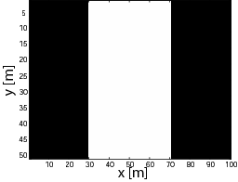
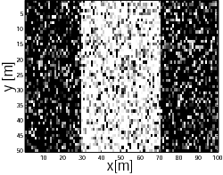
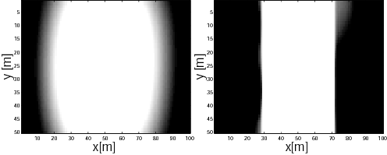
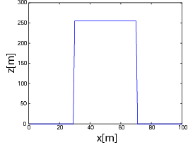
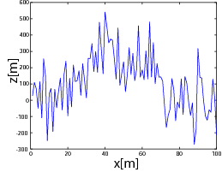
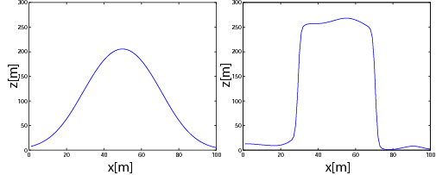
GeoNet: channel extraction from lidar
STEP 1: Nonlinear filtering
Passalacqua et al., JGR-ES, 2010; Perona & Malik, 1990
github.com/passaH2O/GeoNet

Slide 5
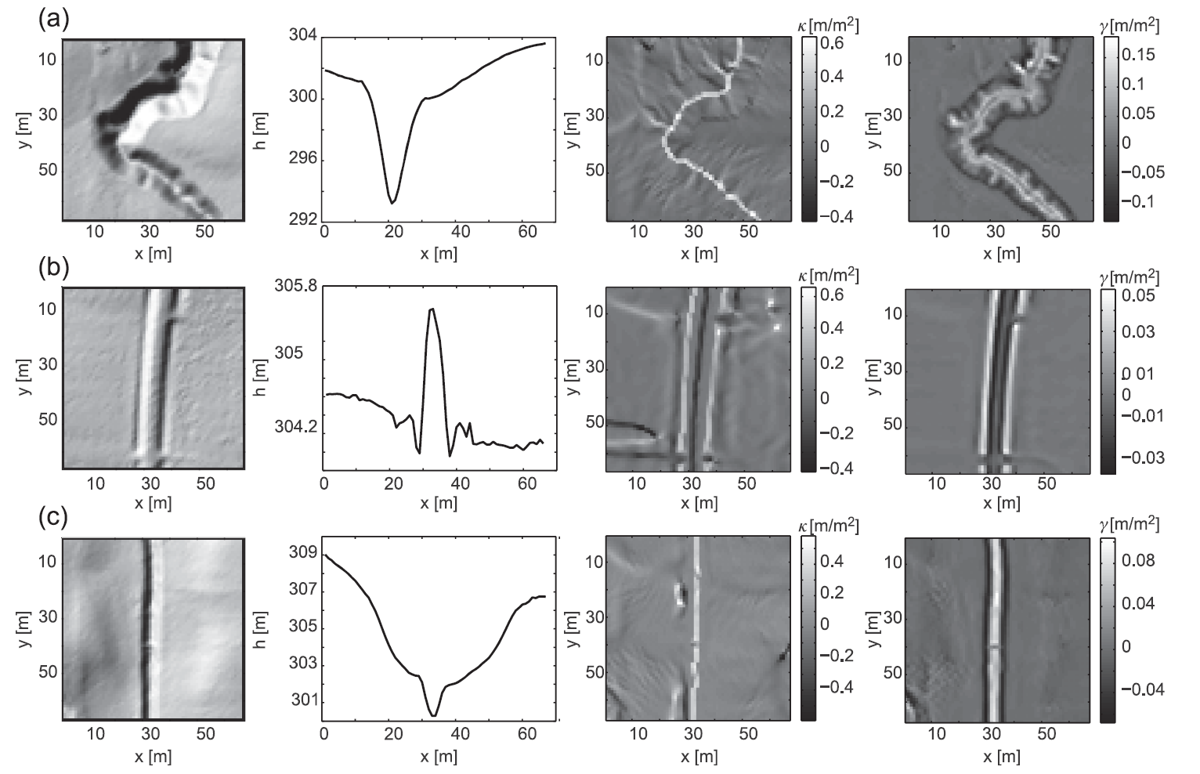
GeoNet: channel extraction from lidar
STEP 2: Statistical analysis of curvature
Geometric
Laplacian
Channel
Road
Ditch
Passalacqua et al., WRR, 2012
github.com/passaH2O/GeoNet

Slide 6
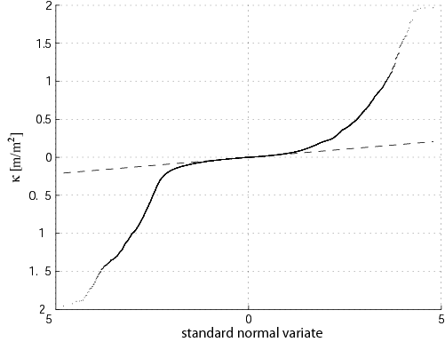
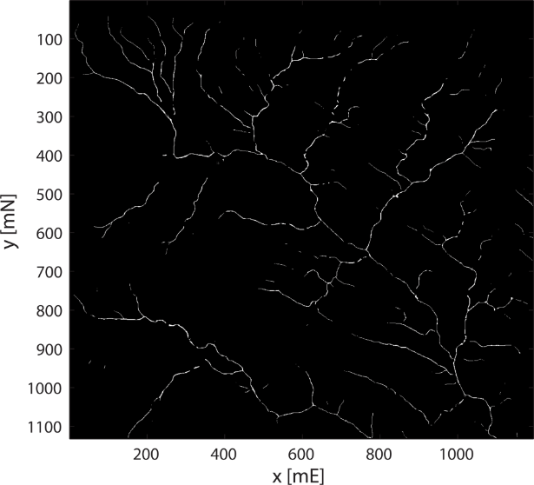
We extract all pixels above a curvature threshold to identify the likely channelized pixels
The point at which the curvature deviates from a Normal distribution in the positive tail is interpreted as the transition from hillslope to valley.
github.com/passaH2O/GeoNet

Slide 7
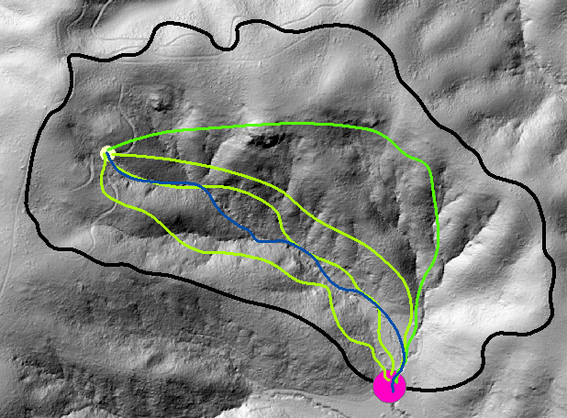
GeoNet: channel extraction from lidar
STEP 3: Channel network extraction
The cost function ψ represents the cost of traveling between point a and point b in terms of, e.g., surface curvature and flow accumulation:
Channel head
Geodesic curve
A
The curve with minimum cost is the geodesic curve:
Channel
Basin outlet
B
Passalacqua et al., JGR-ES, 2010
github.com/passaH2O/GeoNet

Slide 8
David’s enthusiasm for learning new things
…as the first time we met during my interview

Slide 9



HAND requires information on channel centerlines
Flood
Depth
HAND
Normal
Depth
DATUM
Zheng et al., 2018; Zheng et al., 2022

Slide 10
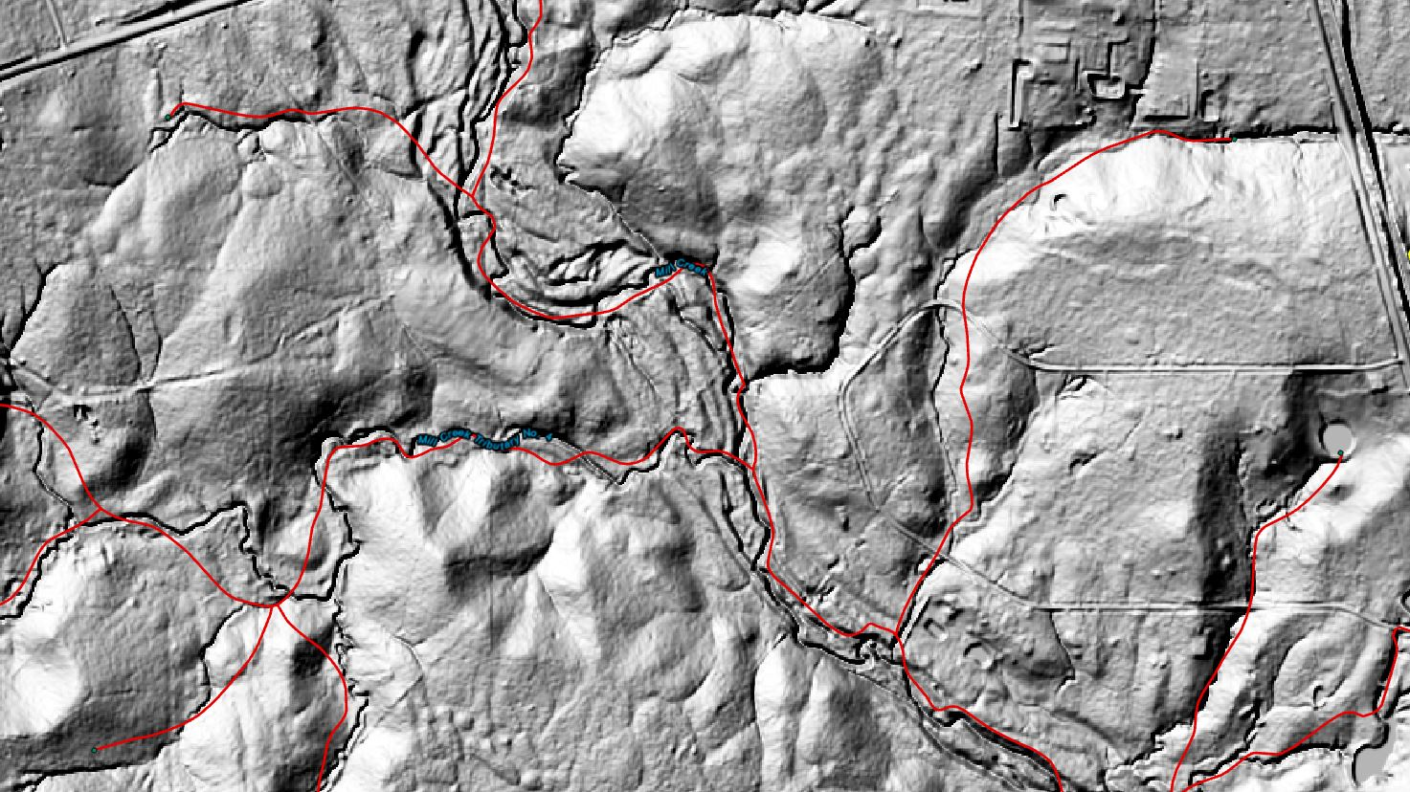

Slide 11
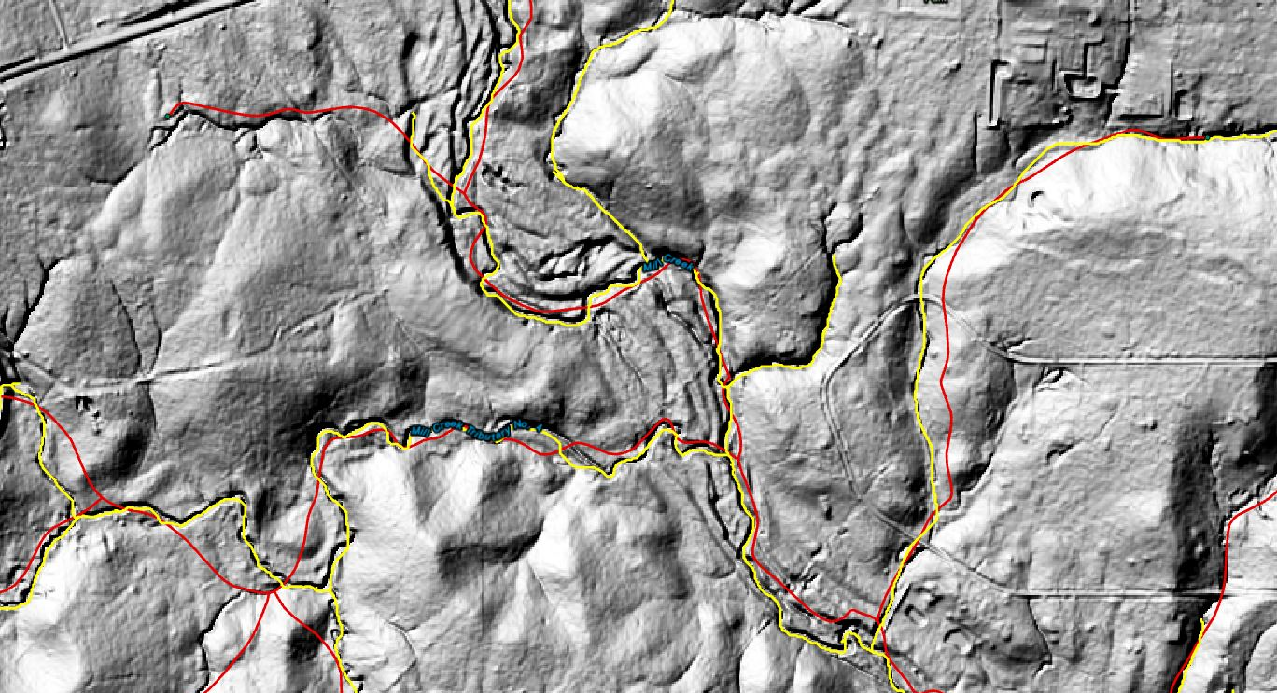
GeoNet could resolve the issues with accuracy of the NHD lines
NHDPlus
GeoNet centerline
Zheng et al., 2018; Zheng et al., 2022

Slide 12
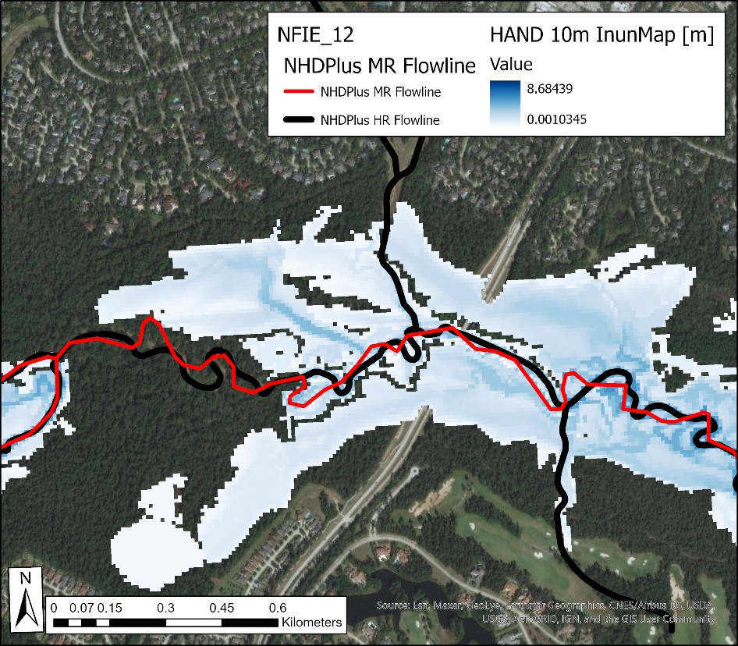
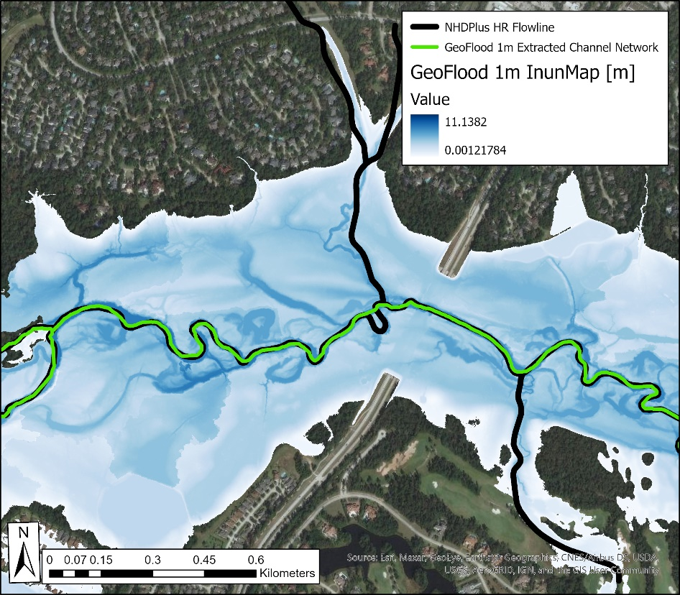
GeoNet combined with HAND became GeoFlood
GeoFlood
NHDPlus HR
Zheng et al., 2018; Zheng et al., 2022

Slide 13
David’s view of any challenge as an opportunity
…as that time he walked into my office while I was preparing for my lecture

Slide 14
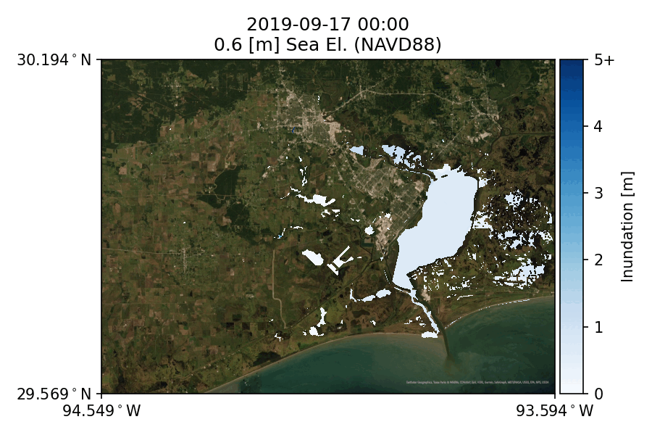
Developing and integrating methods for coastal and pluvial flooding in GeoFlood
Wang et al, in preparation
Preisser et al., under review

Slide 15
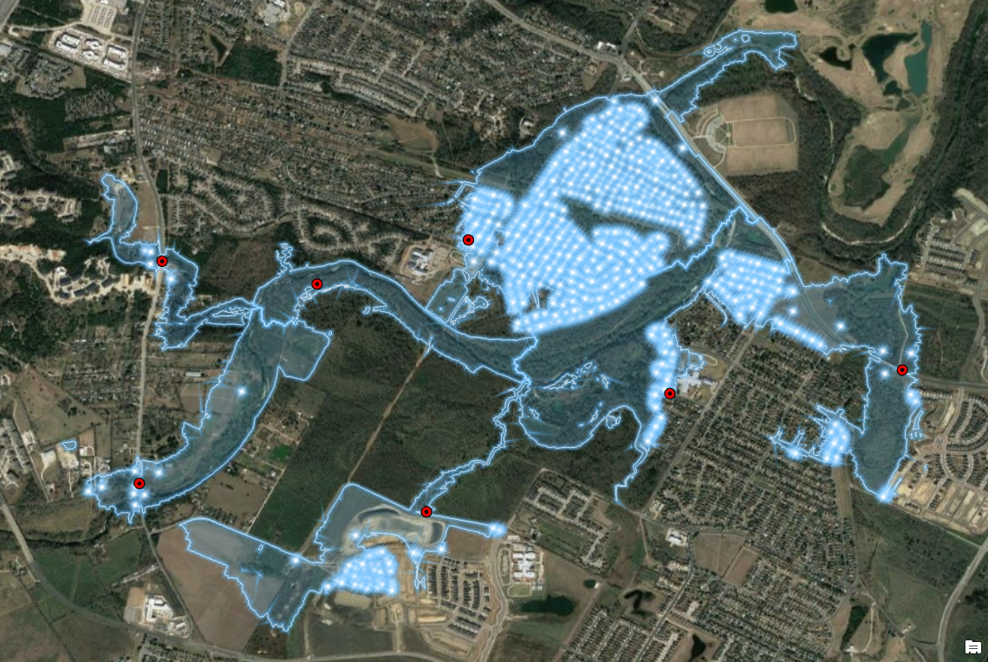

Pin2Flood: providing emergency responders with real time inundation mapping
By standing at the edge of the flood water and clicking their position (pin drop) on a web map. The flood maps are looked up from the library. Results include estimated damage impacts using GIS.
Project funded by Texas Division of Emergency Management for:
Mobile application development
Testing
Implementation
Security/maintenance

Slide 16
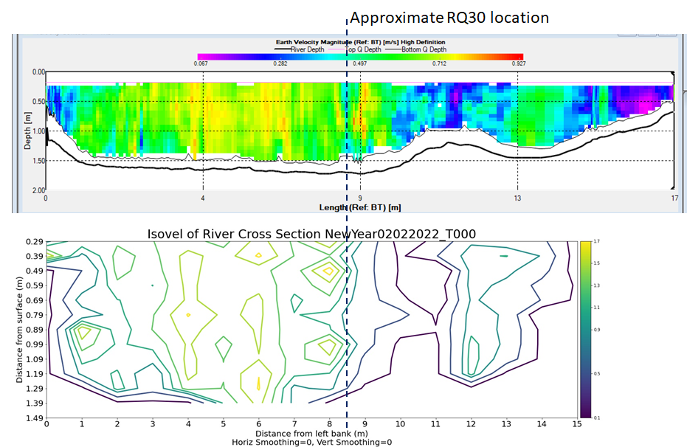
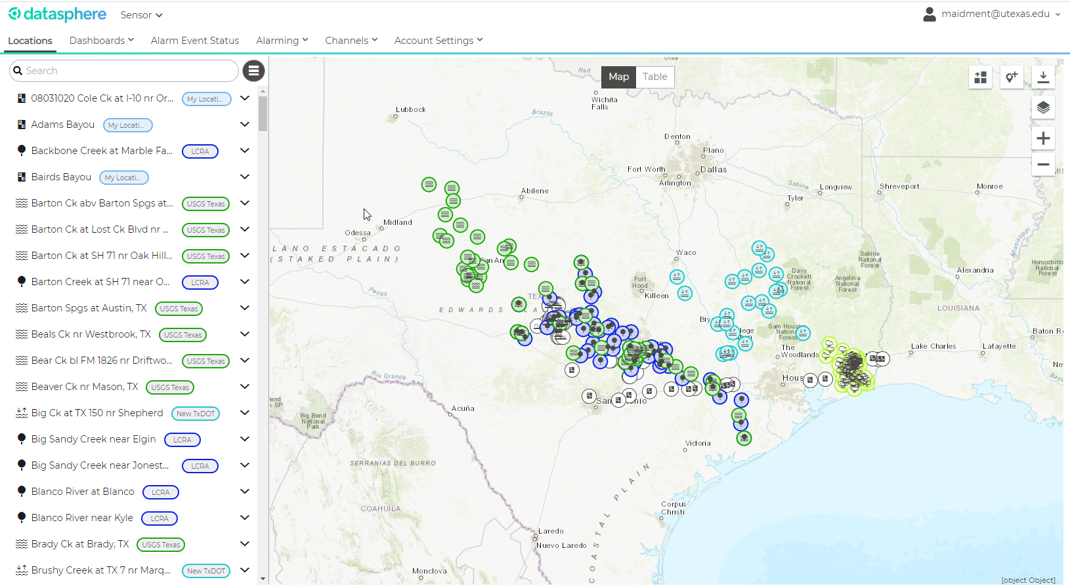
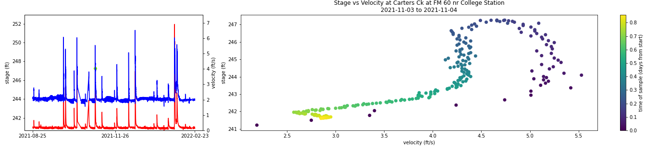
Investigation of river hydraulics and improvement of the NWM
Datasphere
Radar sensor data provides information on river hydraulics -> hysteresis
Integrated into NOAA’s National Water Model via Data Assimilation to improve flood forecasting

Slide 17
David’s ability to have a vision and enable its transformation into operational tools

