Slide 1



World Water Online
Linking people with water data, maps and models everywhere
WWO
CRWR
CRWR

Slide 2



Is Global Geospatial Consciousness Possible?
How to make this work for Water Resources?
Billions
Society
Millions
Application
Users
100’s of Thousands
GIS Professionals
Thousands
Research
Slide from Jack Dangermond’s 2010 ESRI User Conference Plenary Presentation

Slide 3
Is Global Hydrologic Consciousness Possible?
How to make this work for Water Resources?
Billions
Society
Millions
Application
Users
100’s of Thousands
GIS Professionals
Thousands
Research

Slide 4
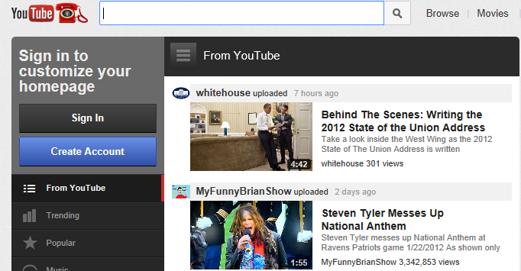
Some Technology Trends ….
Aggregated content on YouTube ….
…. upload 10 years of video every day
800 million users – one person in eight on the earth

Slide 5
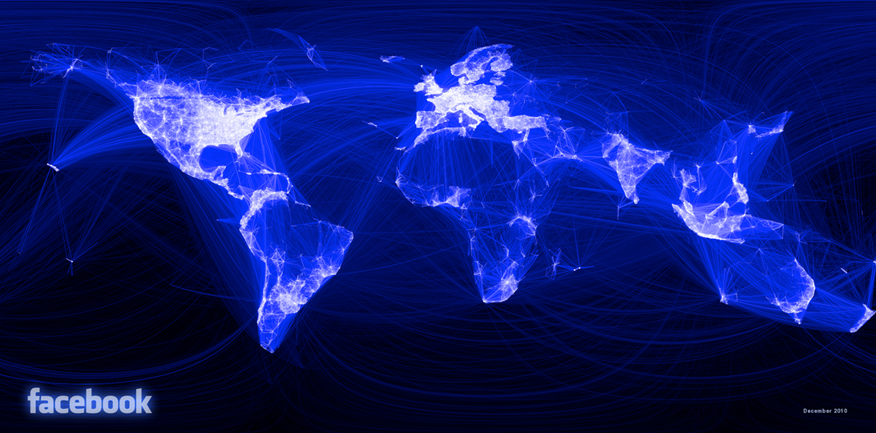
Some Technology Trends ….
Global social networking
800 million users – one person in eight on the earth

Slide 6

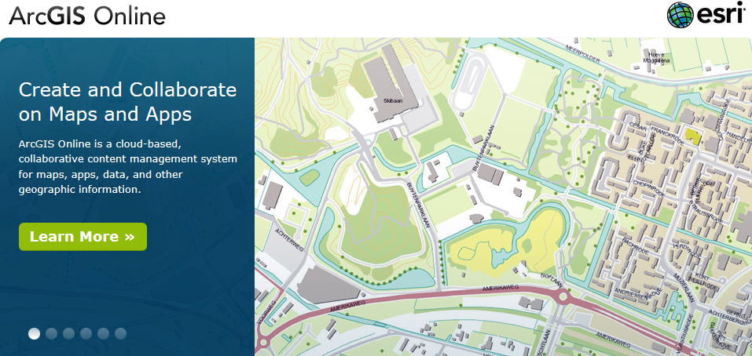


Aggregated content and social networking

Slide 7


Text Messaging, Mobile Phones
Instantaneous machine to machine communication

Slide 8
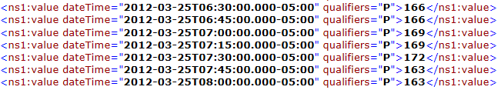
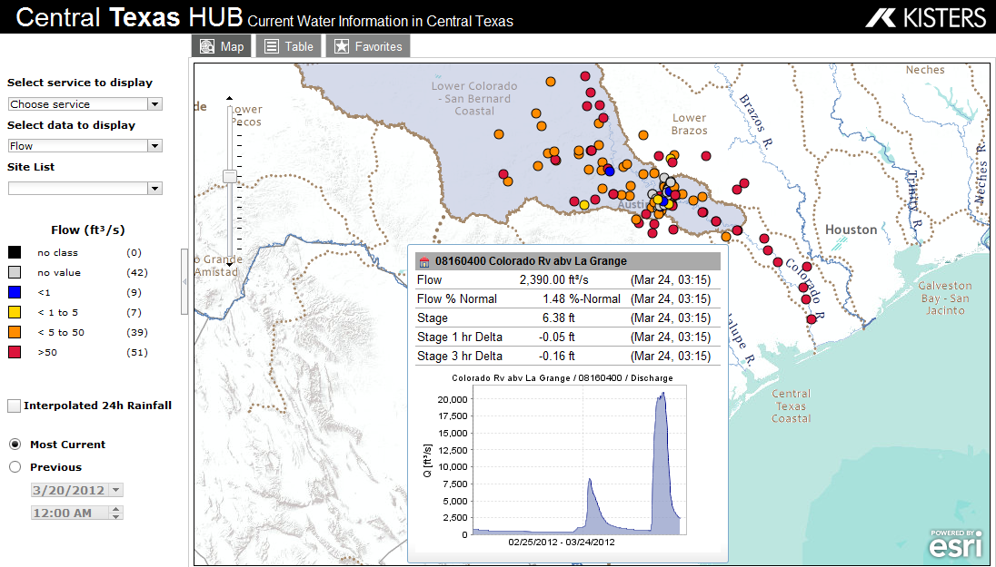
Water Web Services – WaterML and WaterML2
Instantaneous machine to machine communication
http://waterservices.usgs.gov/nwis/iv?sites=08158000&period=P1D&parameterCd=00060
Water web services “hub” ….
…. synthesis of water observation networks

Slide 9
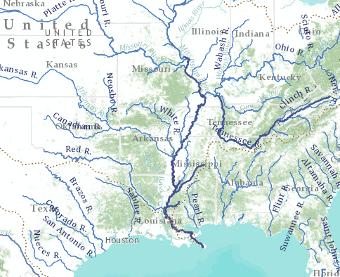
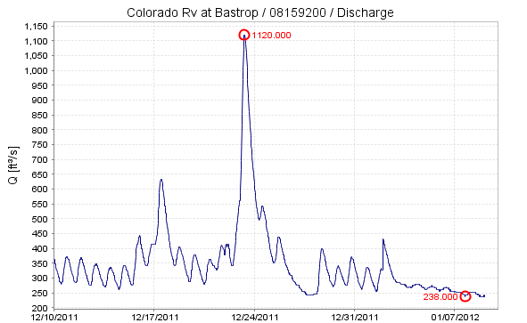
World Water Online
Bring together water information for the whole earth
All spatial scales: global, regional, local
Both geospatial and temporal information
Linking data and modeling
Everything on the web
…. a transformation of our world!

Slide 10
Scales of Application
Assessment
Water and Climate
Global
World
Accounting
How much water?
National
Landscape
Management
Solving water problems
Regional, State
River Basin, Aquifer
Engineering
How does this affect me?
Local, Personal
My house,
my well, my ranch

Slide 11
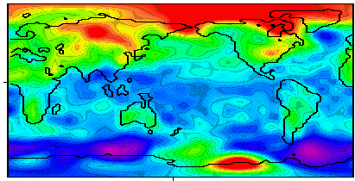
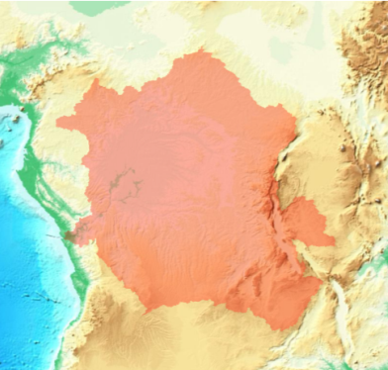
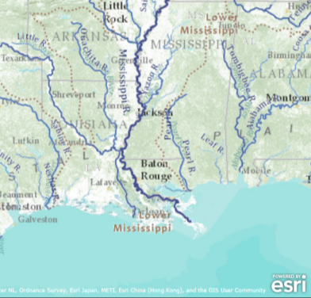
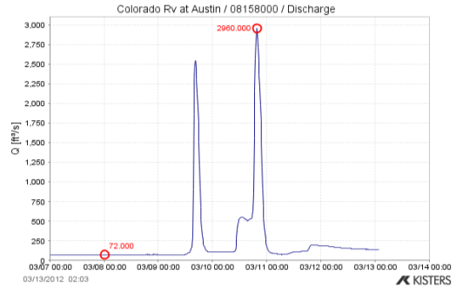
World Water Online
Linking people with water data, maps and models everywhere
Climate
SCALE
Watershed Analysis
River Mapping
Observations

Slide 12






http://worldwateronline.org
Committed to Open Standards
CUAHSI

Slide 13
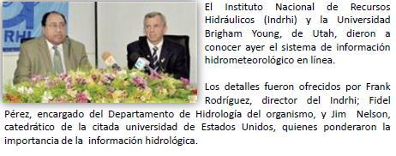

World Water Online in the Dominican Republic

Slide 14
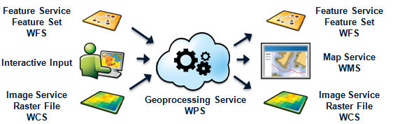
A framework for sharing of data, workflows, and services
Sharing data, workflows, and services
Community driven, participatory
  Authoritative providers
  Best available data
  Making it easier for you to share with each other
Supporting open standards
  WMS, WFS, WCS, WPS, SOS
  REST, SOAP

Slide 15
Session Roadmap
Scale
Global
National
Regional
Local
Demo
Africa
Mexico
US
Texas Region 12
Brushy Creek
Task
Mapping
Analysis
Observations
Modeling

Slide 16
Global scale
Basemaps & Foundational Data
Base maps are the context for explaining: problems, processes, & results
  Continuous coverage facilitates interaction; pan & zoom
  Basis for the non-experts to understand the work of the hydro community
Foundational Data – noun,
  Specific layers/themes of information that are reused frequently, for WWO these are:
    Basemaps
    Flowlines & accompanying network with Flow & Name attributes
    Hydrologic unit polygons & boundaries
    Water body features
    Hydro-conditioned Elevation
  Specific layers/themes of information that one or more other layers/themes are derived from

Slide 17
Globally Consistent Compilation
Basemaps look and function the same everywhere at each scale, so consistently compiled data is a requirement
  Community development of data for and basemaps,
  Workflows and templates will be published late summer of 2012.
It’s already happening:
  Global scales:
    Flowlines: Hydrosheds & Global Topographic Data
    Water Bodies: SRTM & GLWD
    Flow was derived based on:
      WorldClim (UC Berkeley, CIAT, Rainforest CRC)
      GRDC Runoff Grid
      WWF Global 200 Terrestrial Ecoregions
  National
    U.S. NHDPlus
    Mexico:
Notes:
Based on using the GRDC Flow Classes—other geometry had flow classes determined by level 5 watersheds.
We want people to do a better job based on our template

Slide 18
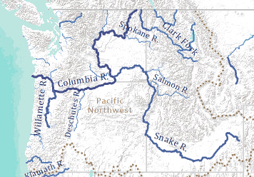
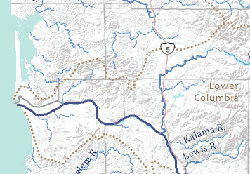
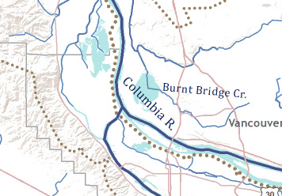
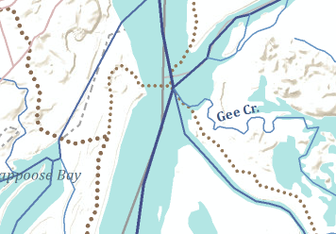
Global Hydro Reference Overlay Online Basemap
Hydro-Centric Design
  Symbology based on Flow
  High quality cartographic portrayal
Multi-scale, Global to Local
Designed to facilitate understanding hydro processes in a geographic context
Used with operational and time series hydro and hydro-related information

Slide 19
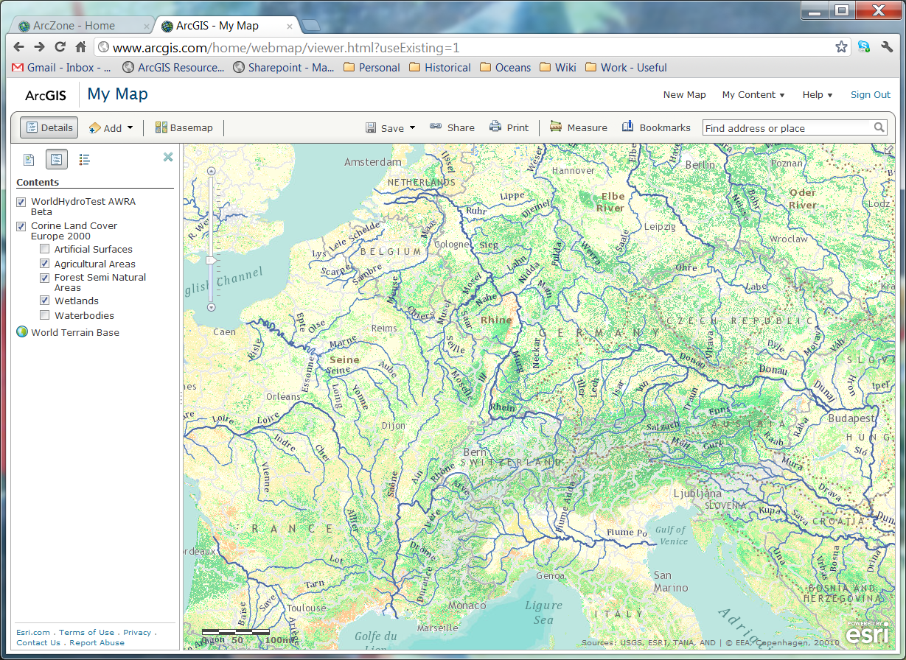
Landcover -- Europe

Slide 20
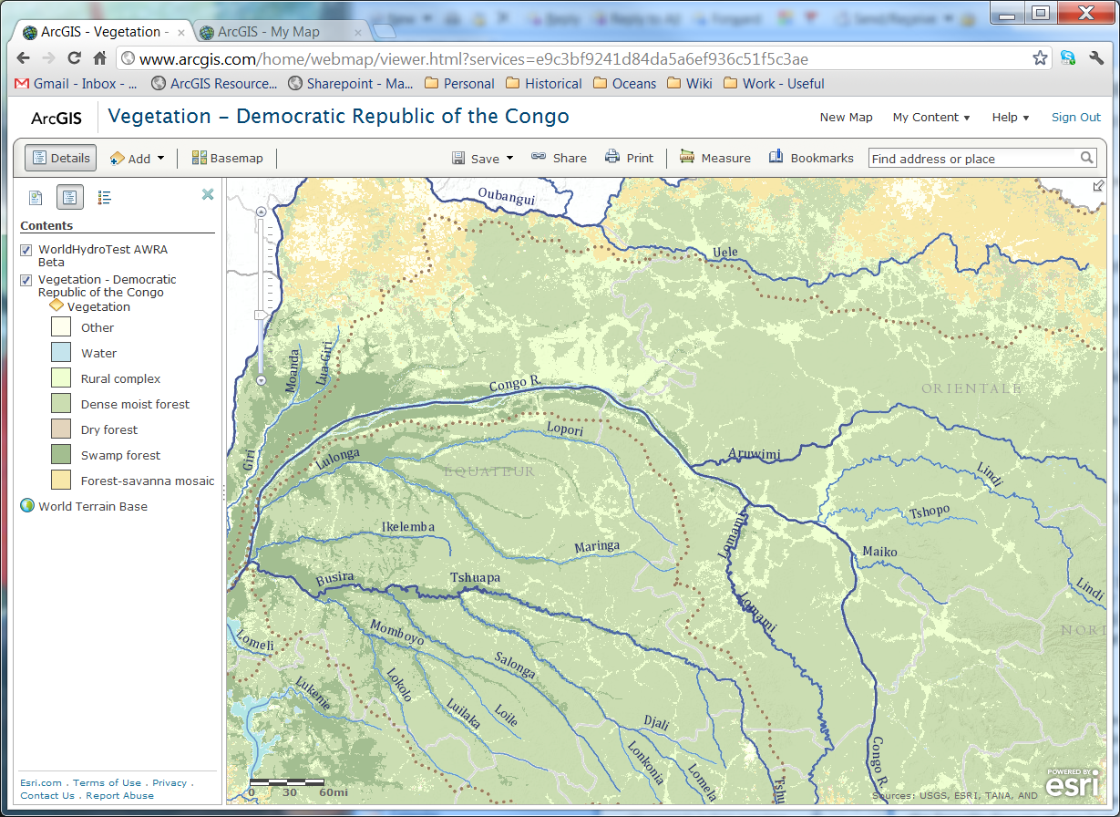
Vegetation – Democratic Republic of Congo

Slide 21
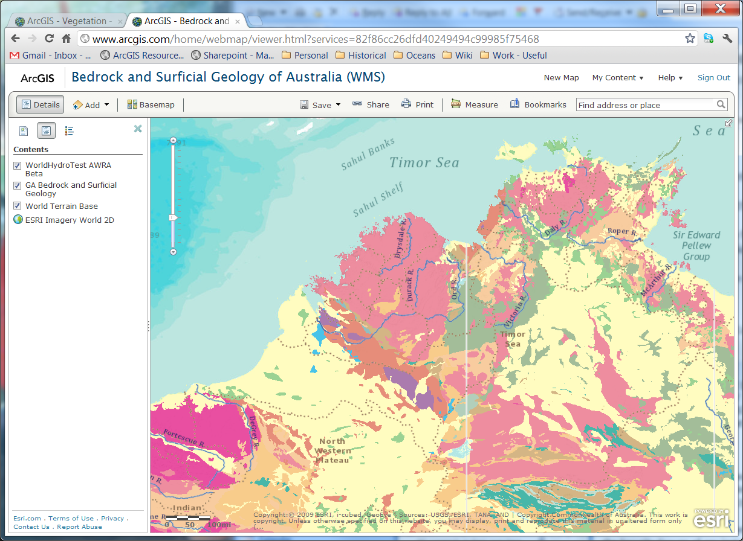
Geology – Australia

Slide 22
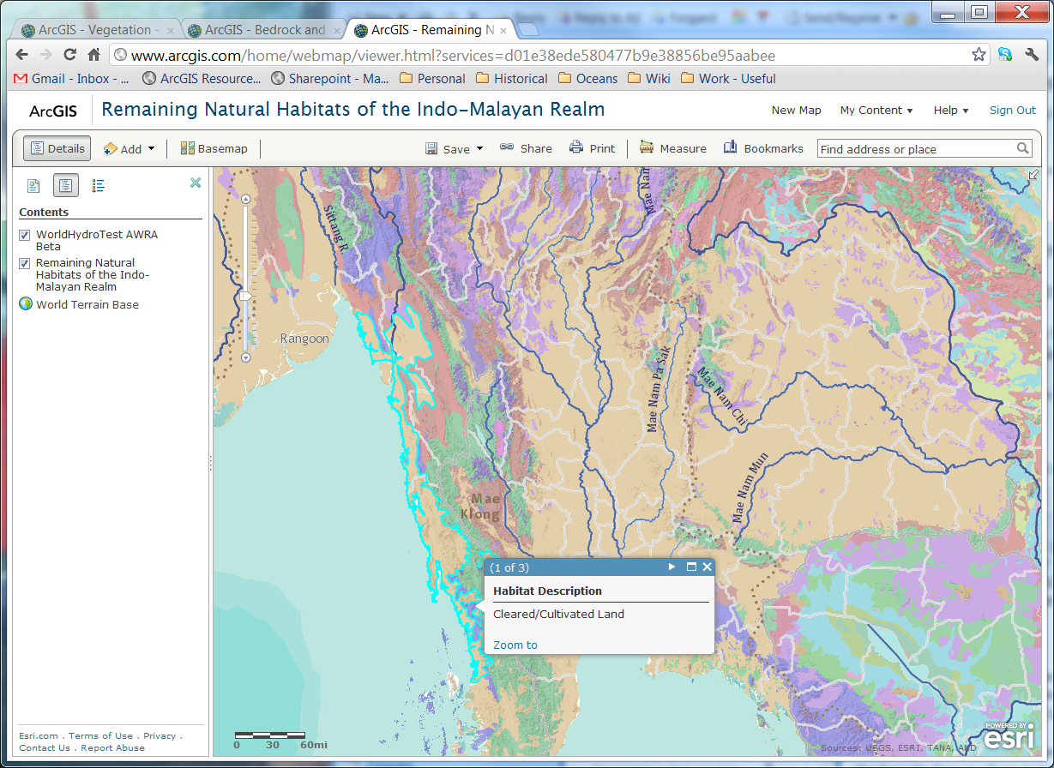
Habitats – Asia

Slide 23
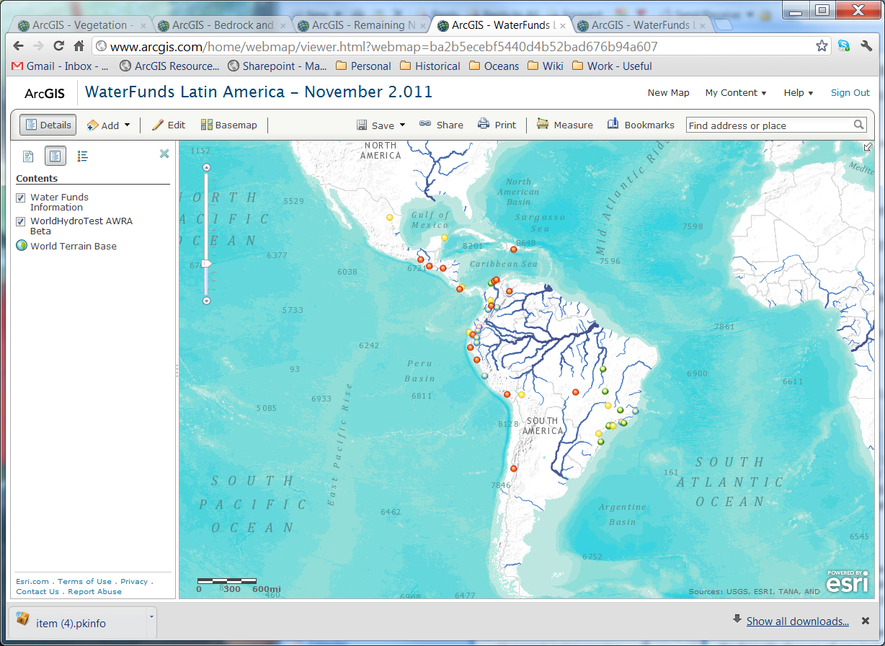
Funding – Central & South America

Slide 24
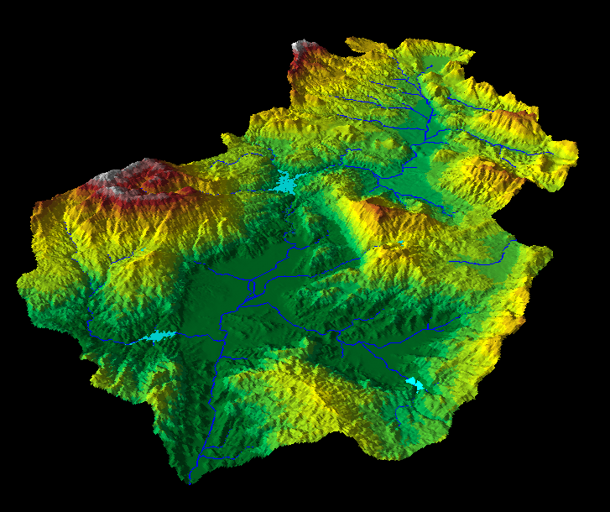
Hydro Analysis Data and Services
Multi-scale - Global to Local
  Develop methodologies for essential resolutions of elevation data (LiDAR, DEMs) to produce a hydrologically conditioned DTM and derivatives and services
Map and Data Services
  Flow Direction
  Flow Accumulation
  Synthetic Stream Network
Analytic Web Services
  Watershed Delineation
  Upstream and Downstream Tracing
  Descriptive Statistics
  Overlay of hydrologically relevant landscape information
    Landcover, Soils, Precipitation, Slope, Flow length, Population, Historic and forecasted climate
Notes:
Hydrologic conditioning of elevation data is a time consuming, specialized skill.
More people want this information than have the skills or time to create it.

Slide 25
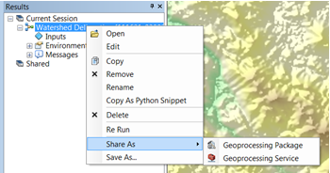
Creating Hydro Analysis Services
Start with authoritative, curated data
Best practice workflows and service scripts designed to be used together.

Slide 26
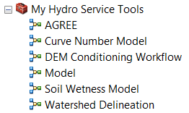
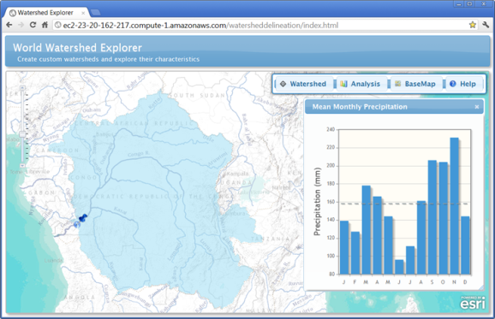
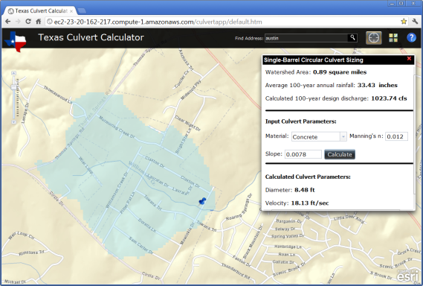
Using Hydro Analysis Services
Use directly in ArcGIS Desktop
In sample client web applications
In your own client web
applications via REST, OGC

Slide 27
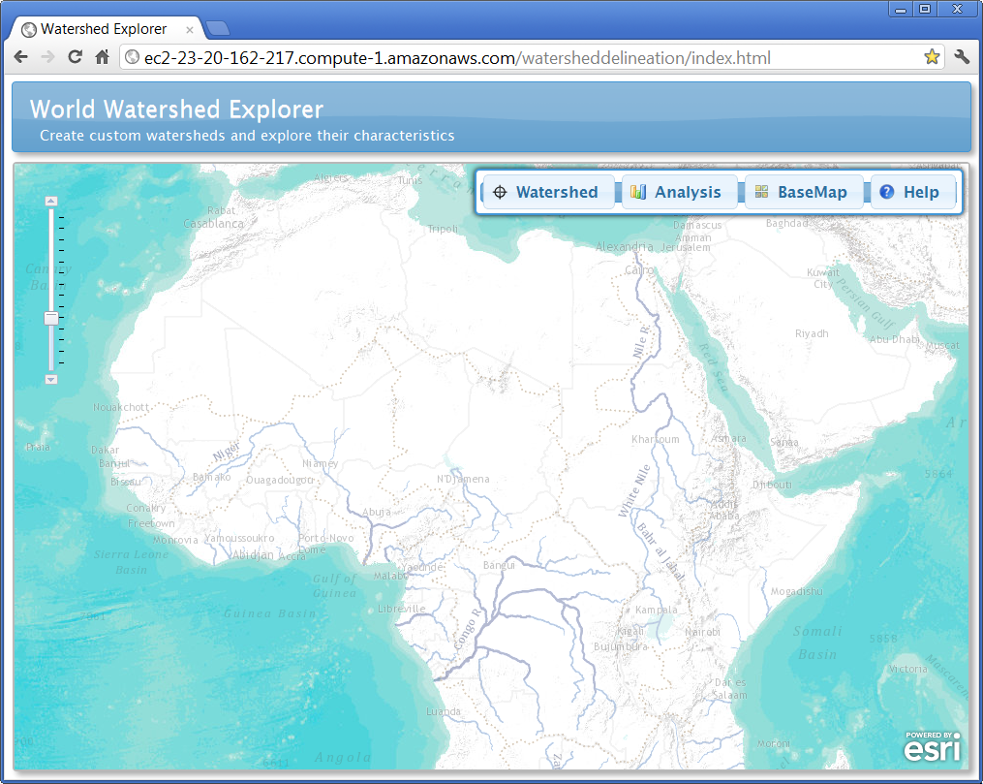

Slide 28
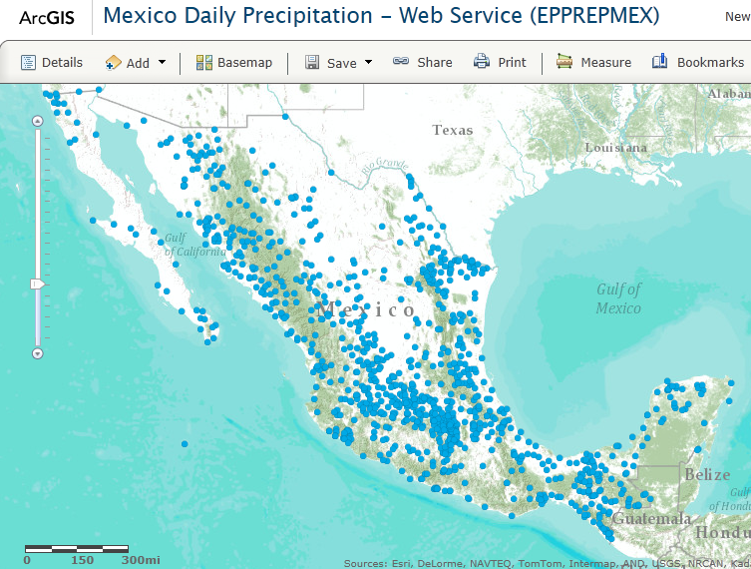
Mexico Precipitation Observations
Collect Gaged Precipitation Data
Compute Mean Annual Statistics
Obtain Mexico 20m DEM from INEGI
Interpolate Mean Annual Precip Map

Slide 29
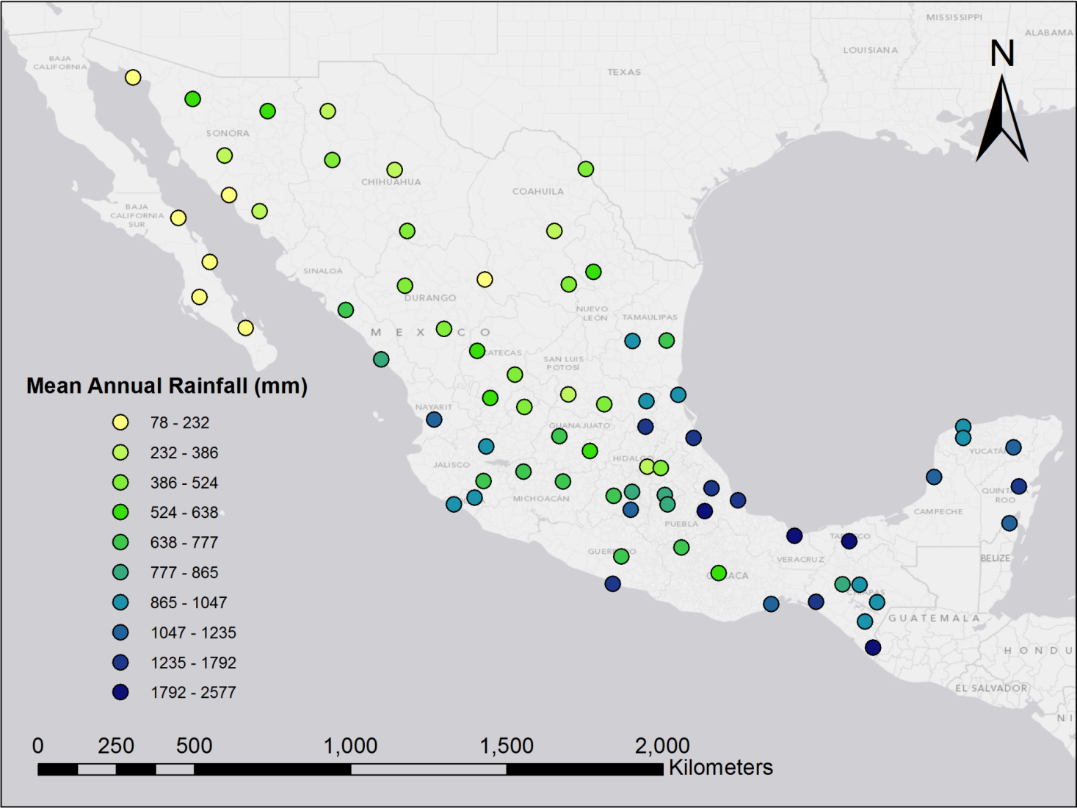
Mean Precipitation at Gages
Collect Gaged Precipitation Data
Compute Mean Annual Statistics
Obtain Mexico 20m DEM from INEGI
Interpolate Mean Annual Precip Map

Slide 30
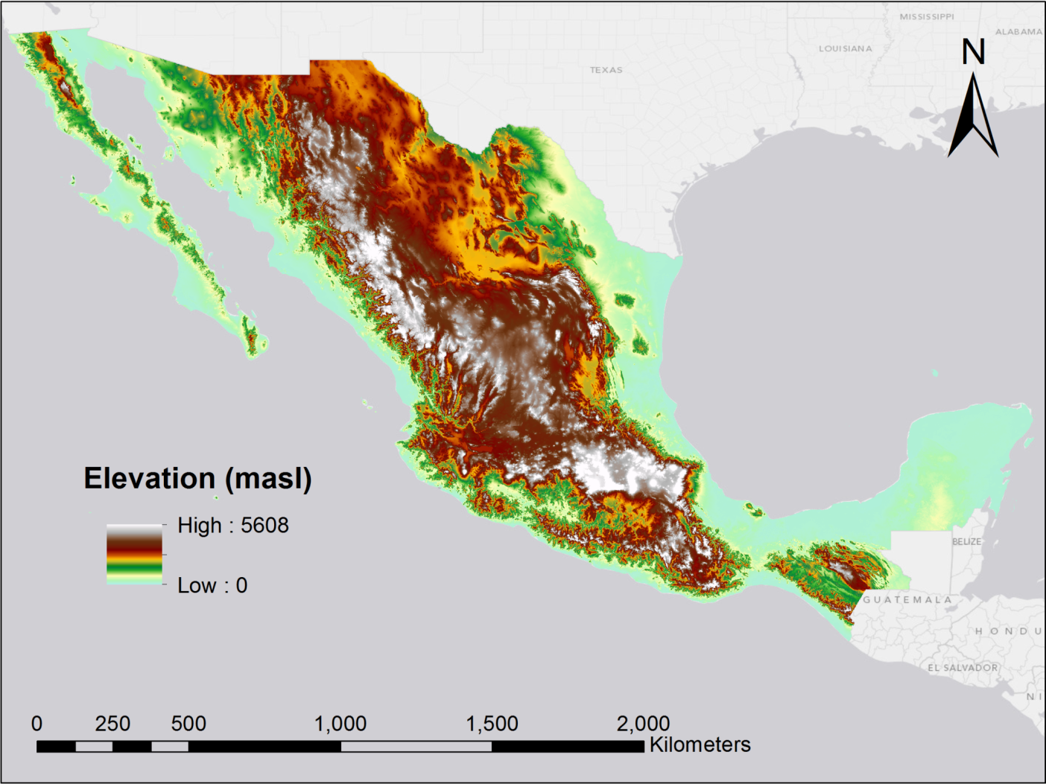
Digital Elevation Model
Collect Gaged Precipitation Data
Compute Mean Annual Statistics
Obtain Mexico 20m DEM from INEGI
Interpolate Mean Annual Precip Map

Slide 31
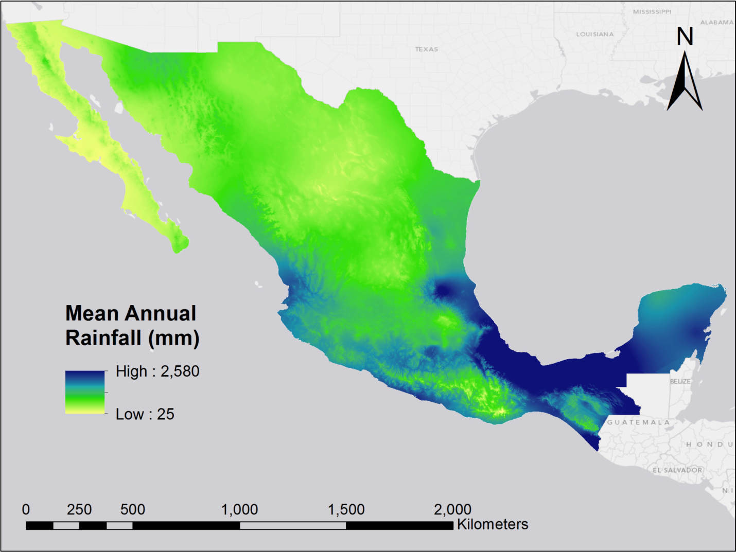
Mean Annual Precipitation Map
Collect Gaged Precipitation Data
Compute Mean Annual Statistics
Obtain Mexico 20m DEM from INEGI
Interpolate Mean Annual Precip Map

Slide 32
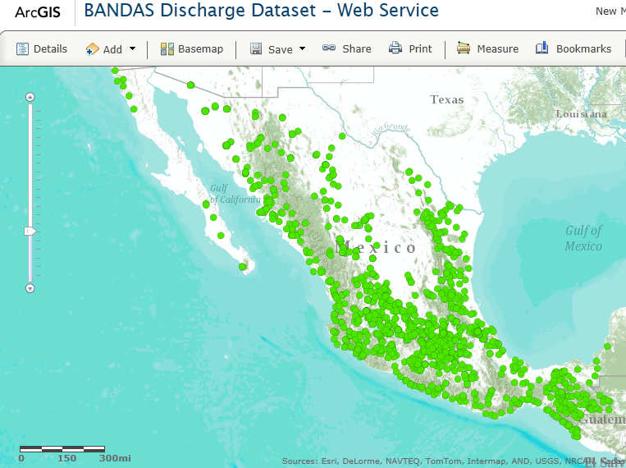
Mexico Streamflow Observations
Collect Gaged Streamflow Data
Hydrography in Vera Cruz Region
Delineate Watersheds at each Stream Gage
Mean Annual Streamflow Map

Slide 33
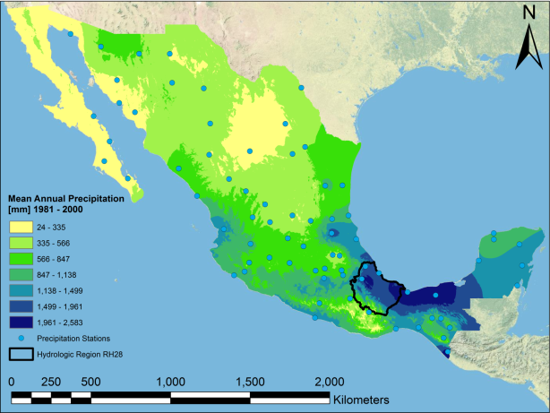
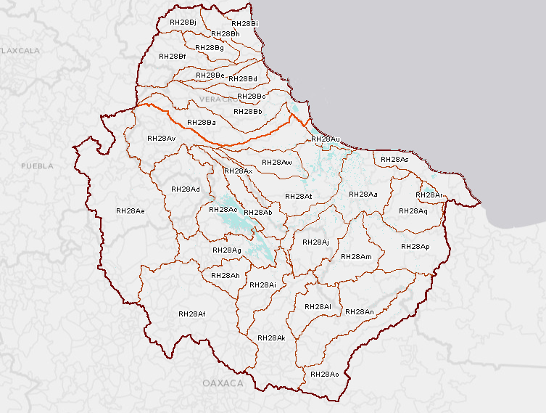
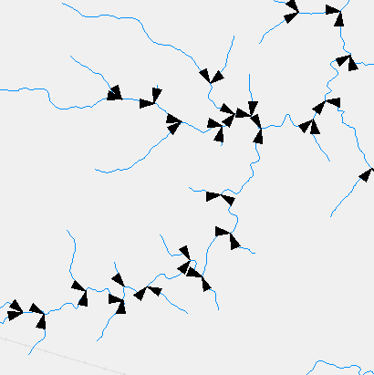
Vera Cruz Hydrography
Collect Gaged Streamflow Data
Hydrography in Vera Cruz Region
Delineate Watersheds at each Stream Gage
Mean Annual Streamflow Map

Slide 34
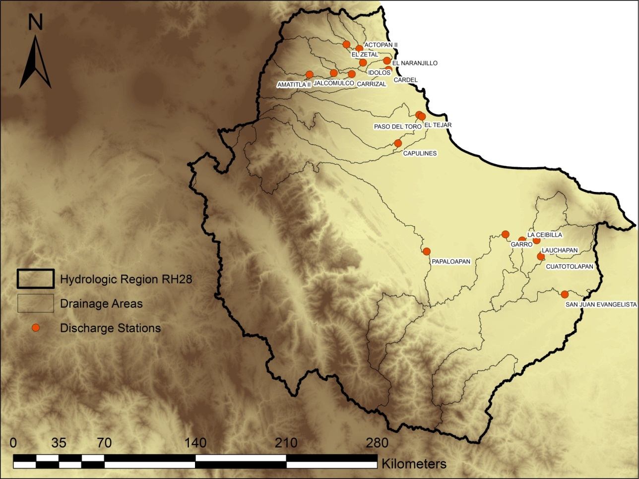
Watersheds for Each Stream Gage
Collect Gaged Streamflow Data
Hydrography in Vera Cruz Region
Delineate Watersheds at each Stream Gage
Mean Annual Streamflow Map

Slide 35
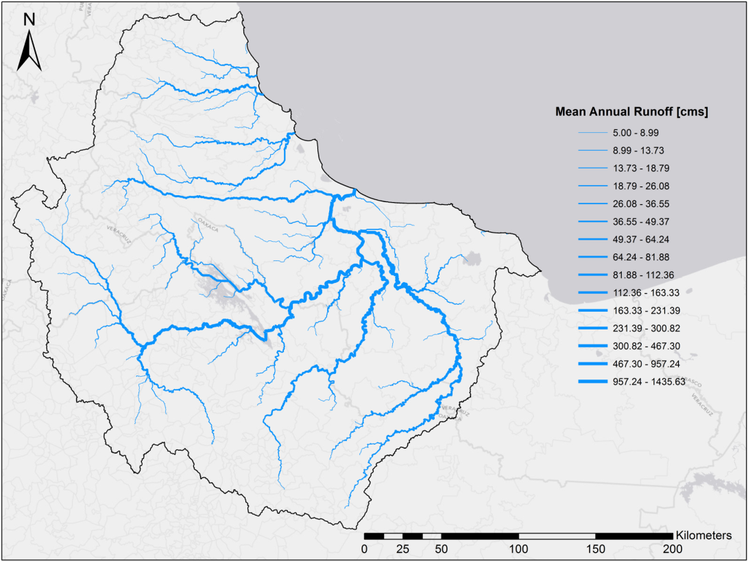

Mean Annual Streamflow Map
Collect Gaged Streamflow Data
Hydrography in Vera Cruz Region
Delineate Watersheds at each Stream Gage
Mean Annual Streamflow Map

Slide 36
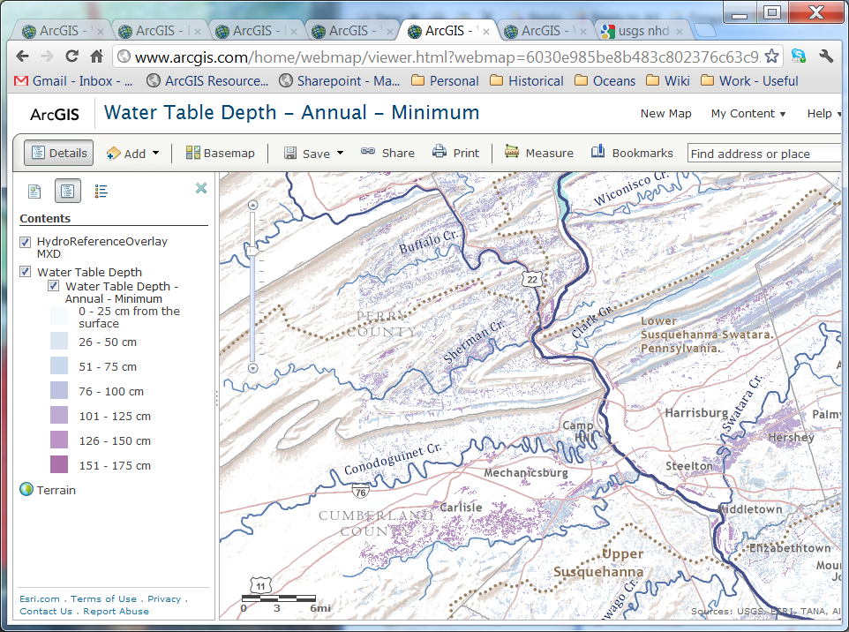
U.S. Story = NHDPlus
Compiled from:
  National Hydrography Dataset (NHD)
  National Elevation Dataset (NED)

Slide 37
U.S. Story = NHDPLus
Seeing hydrography in a intuitive way that supports understanding flow-based analyses
Flow is based on upstream drainage area rather than gauging stations, which are not on every flowing stream
Multi-scale Cartographic presentation
  Same density of features at each scale
  Two scales of generalization (only one remains)
Future Challenges:
  Better integration between elevation, flow network, and hydrological units
  Support more definitions of flow (e.g., include withdrawls)
  Support larger scales

Slide 38


KISTERS TimeSeries HUB
and Central Texas implementation
Stefan Fuest and Phil Stefanoff
WISKI
KiWIS

Slide 39
Common data exchange scenario
Each arrow means discussion & bi-lateral agreement
How do you call your variables
What formats can you deliver data to me
What software system do you use
What is the schedule of your data logger
What is the quality of your data
Do we need a contract
What do I get when I provide something
Global
Global
Global
Global
National
National
National
National
Regional
Regional
Regional
Regional
Local
Local
Local
Local

Slide 40
A KISTERS TimeSeries Hub with KiWIS...
… solves those problems because
It can be community based
It is highly configurable and can mediate terminology
It can easily generate new information products (e.g. 3hr moving totals, …)
Has state of the art interfaces (Authoring via Desktop app, Public interface via Browser, API via standard service types)
Is proven COTS software

Slide 41













KISTERS TimeSeries Hub Principles...
private
Local
Public
Local
Local
Global
emergency
Local
Local
Notification
Local
National
KISTERS
TimeSeries HUB
Local
Services
OGC, CUAHSI,…
business
Local
Services
OGC, CUAHSI,…
Local
Services
OGC, CUAHSI,…
Regional
Services
OGC, CUAHSI,…
Local
university
Local
Local
Local
Professional
engineering
Data providing
Data consuming
Data mediation
Data validation
Information products
TimeSeries WareHouse
Data & Information
dissemination
Data & Information
consumption

Slide 42
Central Texas Implementation
private
Public
Local
Local
Local
Global
emergency
Notification
Local
Local
Local
USGS
KISTERS
TimeSeries HUB
Services
OGC, CUAHSI,…
business
Services
OGC, CUAHSI,…
Services
OGC, CUAHSI,…
Local
Services
OGC, CUAHSI,…
Local
Local
LCRA
Moving totals
Rate of Change
Percentage Normal
university
Local
Professional
Local
Local
City of Austin
engineering
Data providing
Data consuming
Data mediation
Data validation
Information products
TimeSeries WareHouse
Data & Information
dissemination
Data & Information
consumption

Slide 43
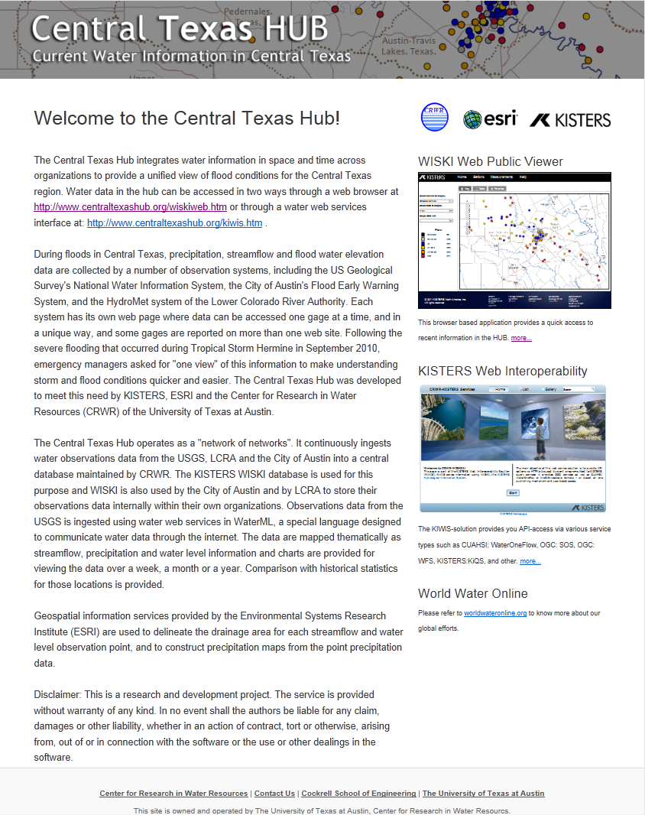
Combine data feeds from national, regional and local sources - USGS, Lower Colorado River Authority, and City of Austin
Display spatial information from ESRI and Time Series data from KISTERS WISKI
KISTERS TimeSeries HUB “in Action”
Flash flood situational awareness and drought contingency planning

Slide 44
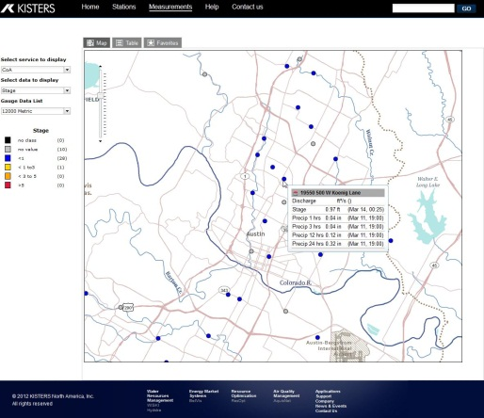
USGS
LCRA
COA
A behind the scenes look...
WISKI
How WISKI turns raw data into actionable information
Develop Derived Data Products
Mapping & Spatial Analysis
Display on Webpage

Slide 45
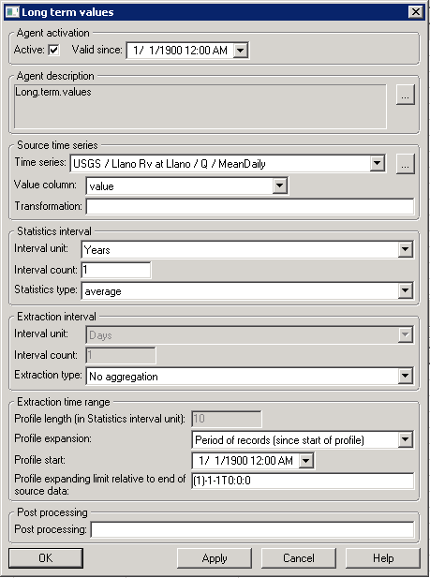
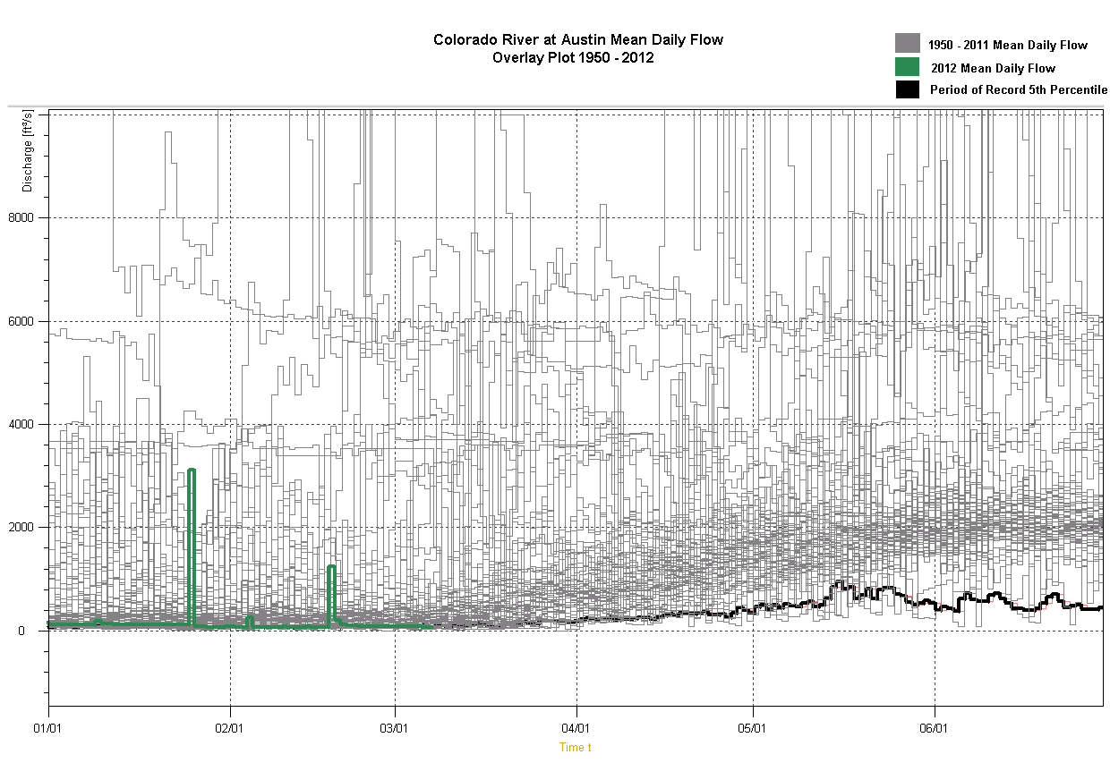
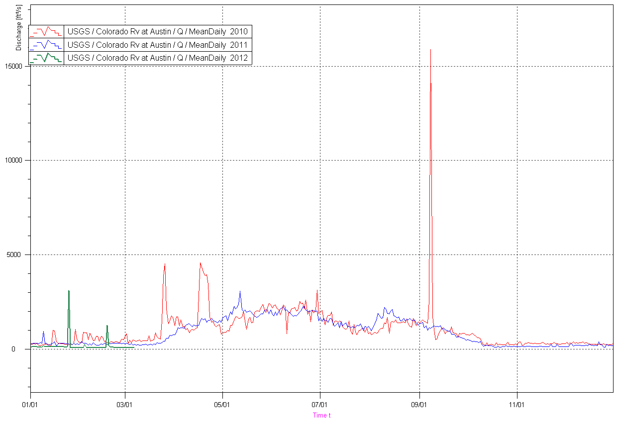
USGS
LCRA
COA
Derived Time Series...
WISKI
Using standard functions to create derived time series (eg. Long term values)
Raw Data
Develop Derived Data Products
Mapping & Spatial Analysis
Display on Webpage

Slide 46
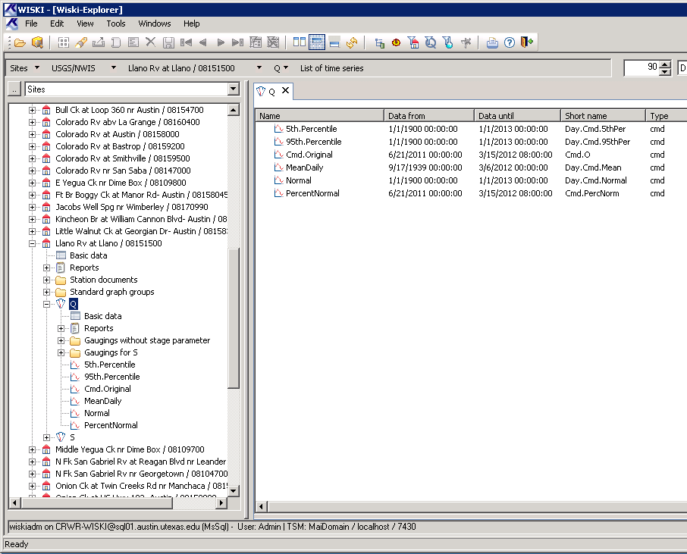
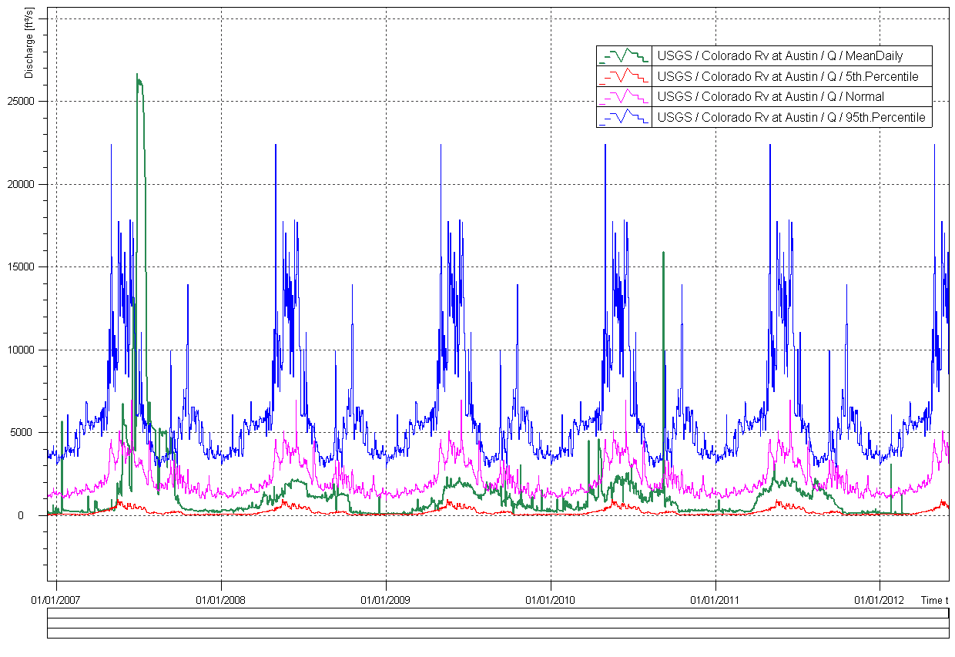
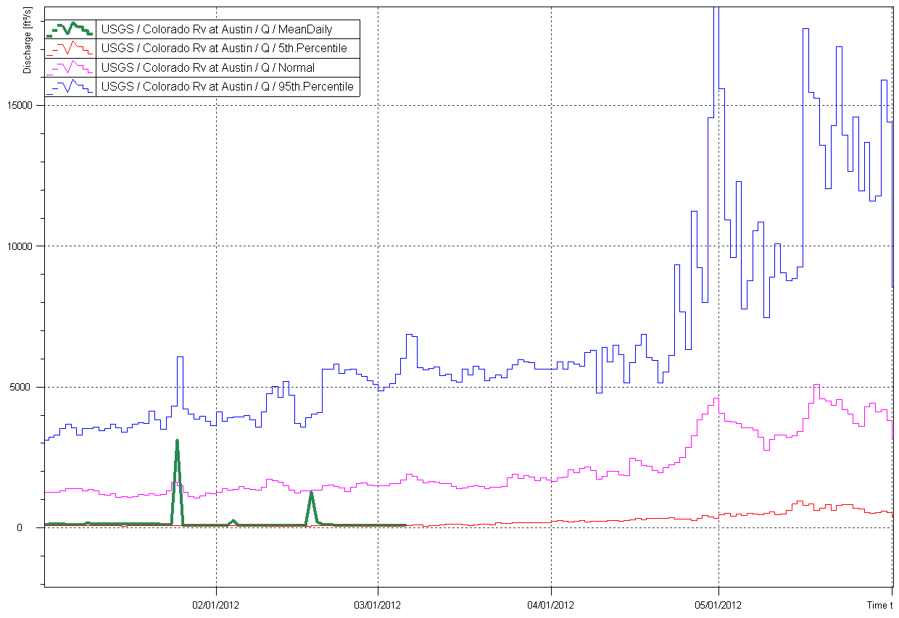
USGS
LCRA
COA
Derived Time Series...
WISKI
Develop Derived Data Products
Derived time series are now part of every station in the network
Mapping & Spatial Analysis
Display on Webpage

Slide 47
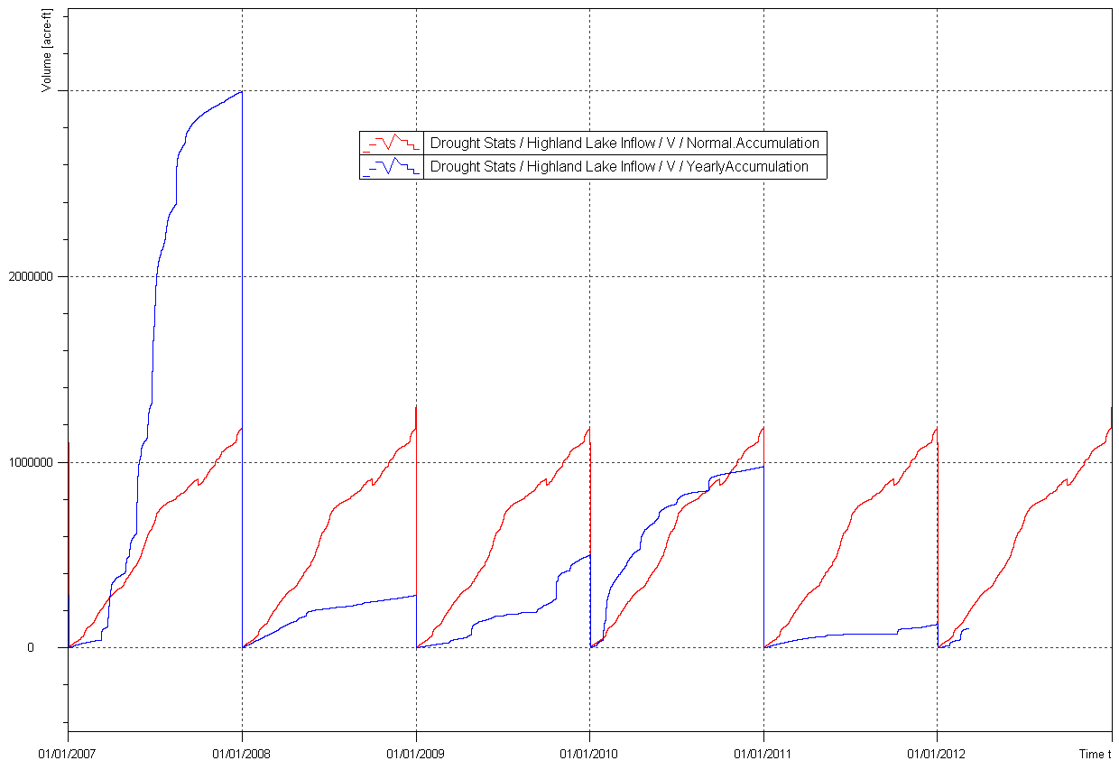
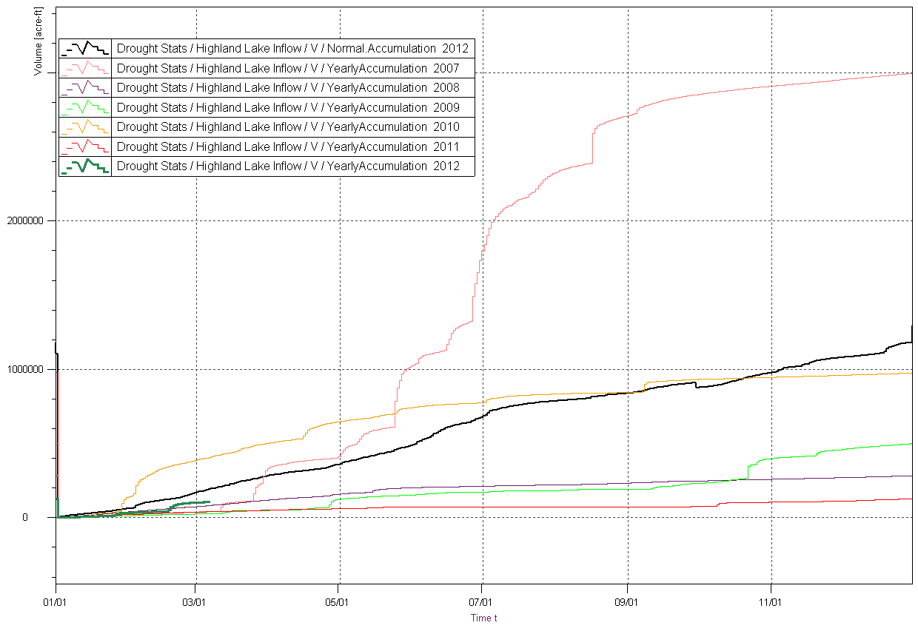
USGS
LCRA
COA
Derived Time Series...
WISKI
Develop Derived Data Products
Cumulative Lake Inflow
Normal Accumulation
Mapping & Spatial Analysis
2012
Display on Webpage

Slide 48

USGS
LCRA
COA
Mapping and Spatial Analysis
WISKI
Develop Derived Data Products
Mapping and spatial analysis of KISTERS derived time series data in ArcGIS
Mapping & Spatial Analysis
Display on Webpage

Slide 49



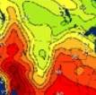


KISTERS / ESRI Integration
Browser
WebSolution
Station
pages
Time
Series
widget
Mapping
REST/JSON services
Time Services
OGC, CUAHSI, REST…
GIS Services
OGC, REST...
W7 Database
ArcGIS
Server

Slide 50

Integrate, Standardize
and Share
Hydrological Data
KISTERS TimeSeries HUB with KiWIS integrates all forms of hydrological data from different sources, domains, formats and spatial and temporal resolutions. A robust set of timeseries authoring tools in WISKI enables users to develop a multitude of derived data sets that are then shared through a standardized view using web modules like WISKI Web Pubic/Pro.

Slide 51
KiWIS Features & Benefits
Service oriented architecture
KISTERS high speed data protocol
Supported standards: WaterML 2.0, WaterML1, SOS, WaterOneFlow
Command return formats: ASCII, HTML, CSV, XLS, JSON, GeoJSON and PNG/JPG
Service multiple data sources at once
KiWIS GUI: configurable, intuitive, easy to use
Integration with KISTERS time series archives

Slide 52
Building the synergy between Time and Space...
Come to our booths to learn more….

Slide 53






Regional to Engineering Scale
HUC8
HUC12
Catchment
Personal – a flooded home
Engineering Hydrology
Engineering Hydraulics

Slide 54

Tropical Storm Hermine in Texas
Sept 7-8, 2010

Slide 55

HUC-12 Subwatershed 120702050401
Upper Brushy Creek
Hermine Flooding
Flood Control Dams

Slide 56

Flood Monitoring System
http://www.ubcwcid.org/Overview/Overview.aspx?id=1

Slide 57



Flood Control Dam

Slide 58

GIS Hydrology Analysis (HEC-GeoHMS) using 10ft DEM derived from LIDAR

Slide 59

HEC-HMS Flood Discharge Model

Slide 60
Engineering Hydraulics
Personal – a flooded home

Slide 61

Flooding Occurred Here during Tropical Storm Hermine in September 2010
What happens to the flooding of this home if we remove this lower water crossing and build a bridge instead?

Slide 62

HEC-RAS Flood Elevation Model
using 1 ft DEM derived from LIDAR
Cross-Sections for HEC-RAS model

Slide 63



HEC-RAS Flood Water Surface Elevation Model

Slide 64

Flood Inundation Map

Slide 65

Flood Impact on Houses

Slide 66


Rain Map to Flood Map
Connect the Models to Real-Time Observations in Brushy Creek

Slide 67


Brushy Creek in ArcGIS Online
http://www.arcgis.com/home/search.html?q=brushy&t=content

Slide 68

Resources & Community
Call for Participation to Share Hydro GIS Tradecraft
  ArcGIS Hydro Resource Center
  Serves the Community that drives it (you)
  Useful Examples (templates
  Education (tutorials to backgrounders)
  Current information on the state of Hydro GIS
    Blog
    Forums
    Featured Content
      Apps
      Maps
      Data
      Tools

Slide 69


Slide 70
http://worldwateronline.org
Committed to Open Standards
CUAHSI

