Slide 1
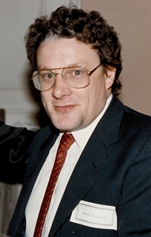
David R. Maidment My Life and Career at UT Austin
(1981 – 2018)
Presented at
Maidment Retirement Event
Etter-Harbin Alumni Center
University of Texas at Austin
26 October 2018

Slide 2
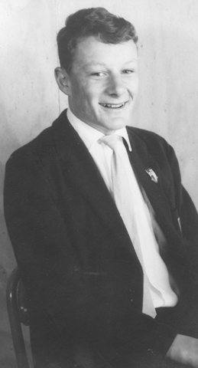
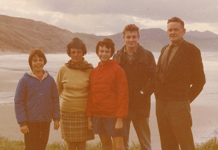
In the beginning ….
David, age 10 in elementary school
David’s family
Two younger sisters
Jane and Wendy
David graduating from
High School
Age 17, December 1967

Slide 3
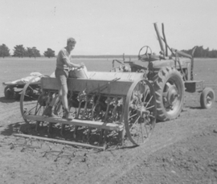
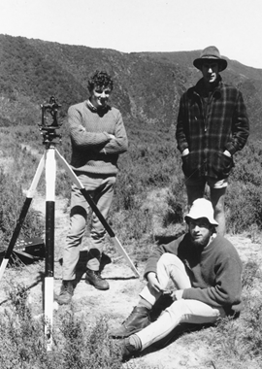
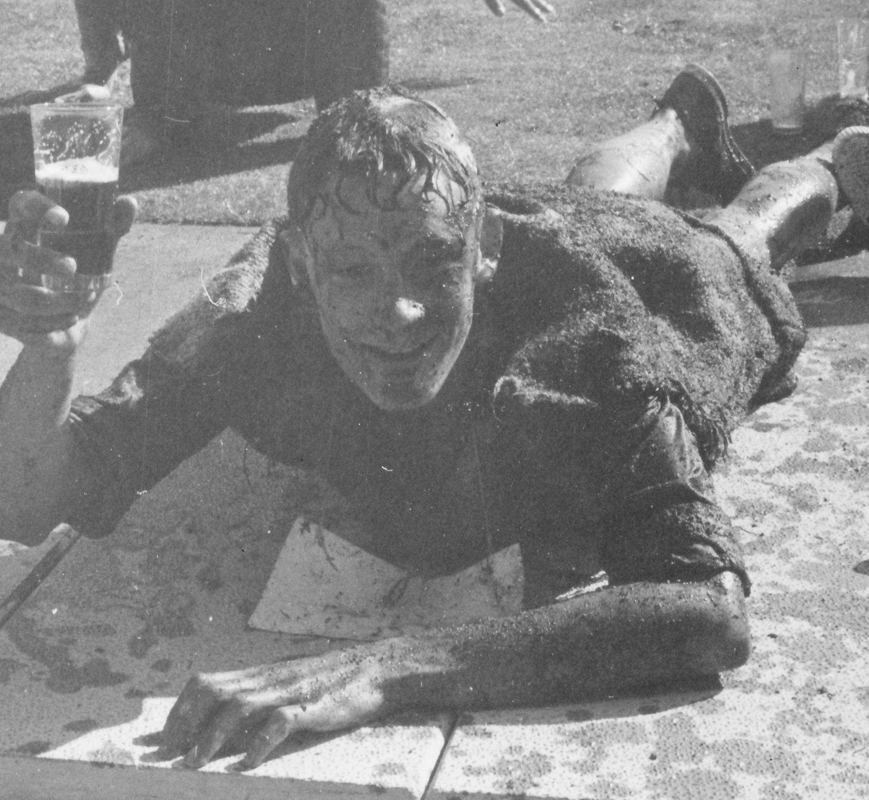
Going to University (1968-1971) …
Becoming an
agricultural engineer
Learning a
few other things!
Bachelor of Agricultural
Engineering with first
class honors, 1971

Slide 4
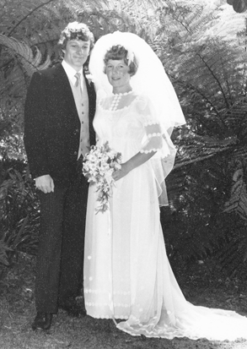
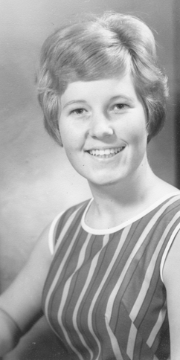
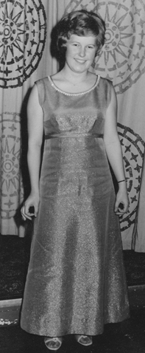
Helen comes on the scene (1969) …
We become engaged, February 1972
Married in February 1973
David 23, Helen 21
Leave for Illinois 4 days later
Helen, age 17
First ball dress

Slide 5
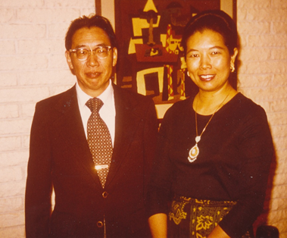
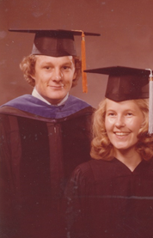
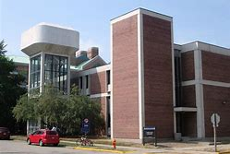
Illinois calls (1972-76) …
David’s Advisor, Ven Te Chow
and wife, Lora Chow
Hydrosystems Laboratory
David: MS in Civil Engineering, 1974
PhD in Civil Engineering, 1976
Helen: MS in Science Education, 1975

Slide 6
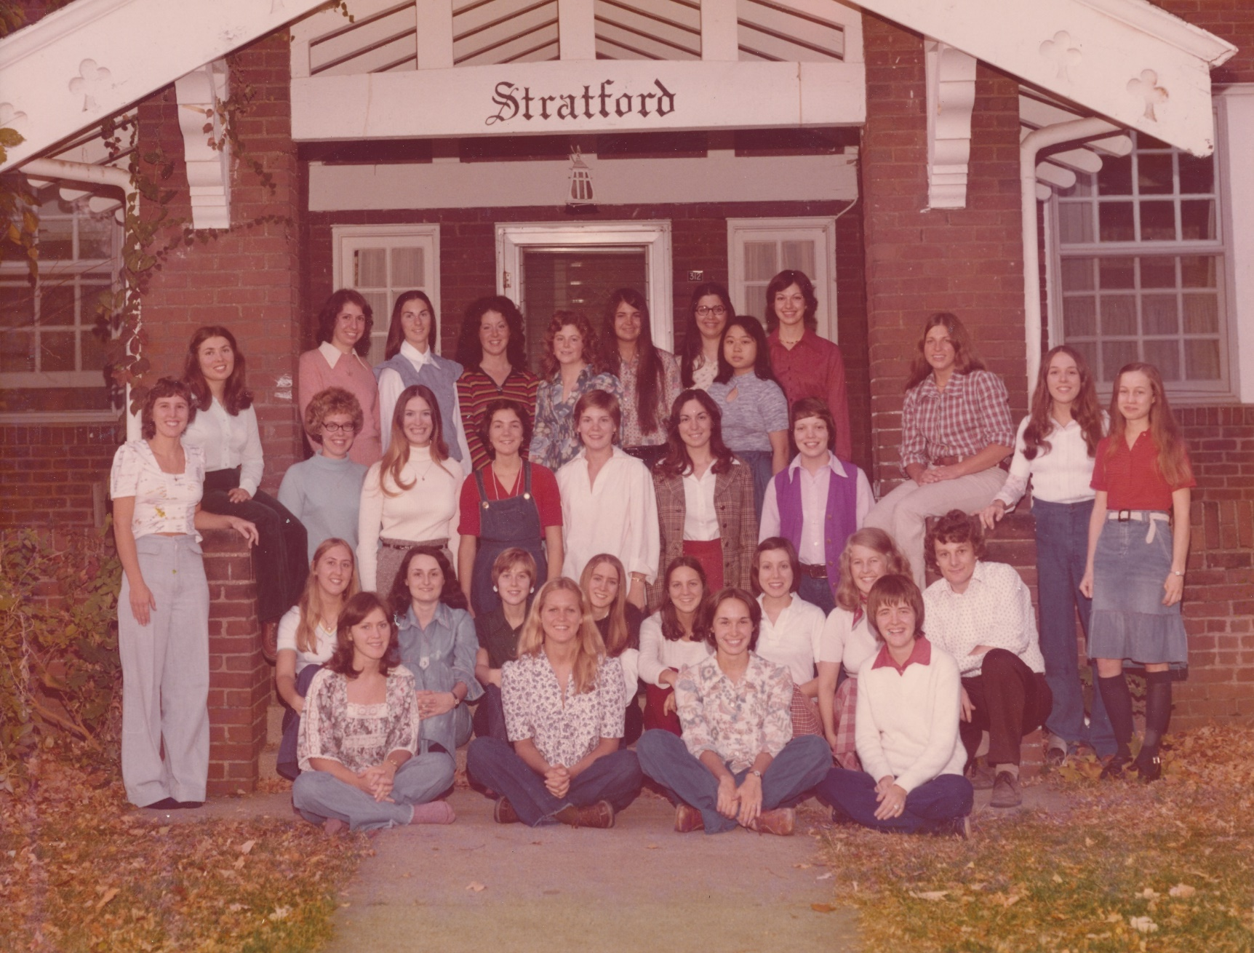
Being Houseparents (1974-76) …
To 30 undergraduate
women students
While we were still
graduate students

Slide 7
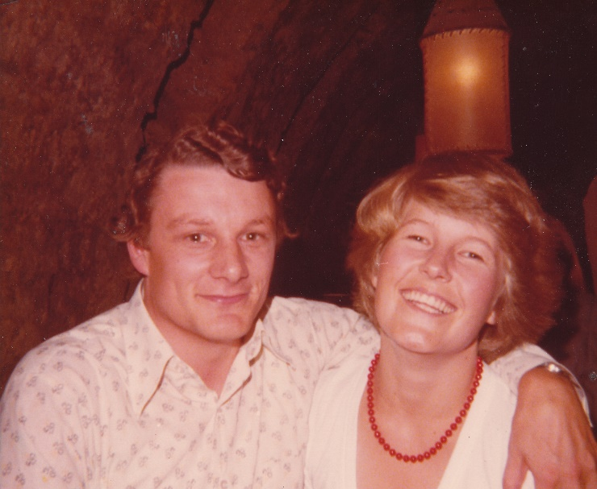
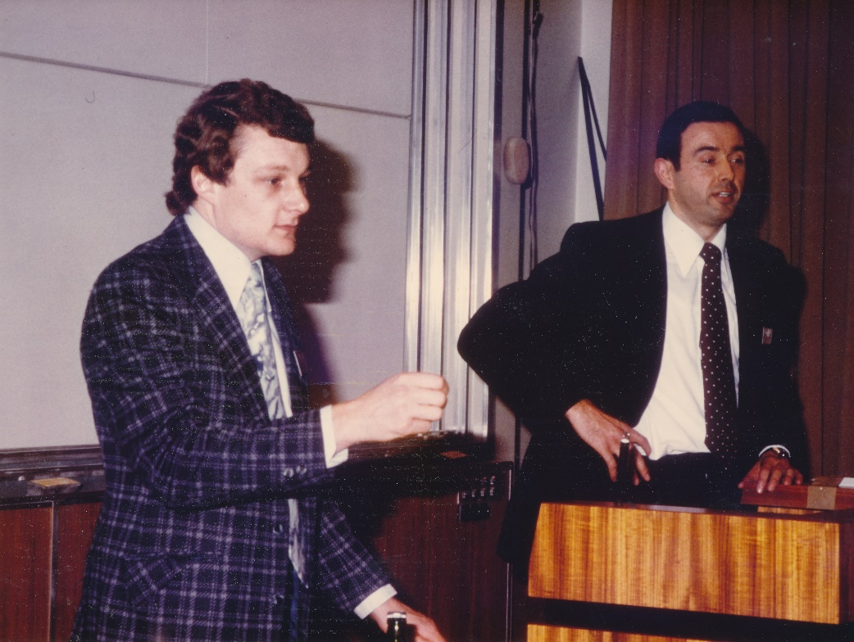
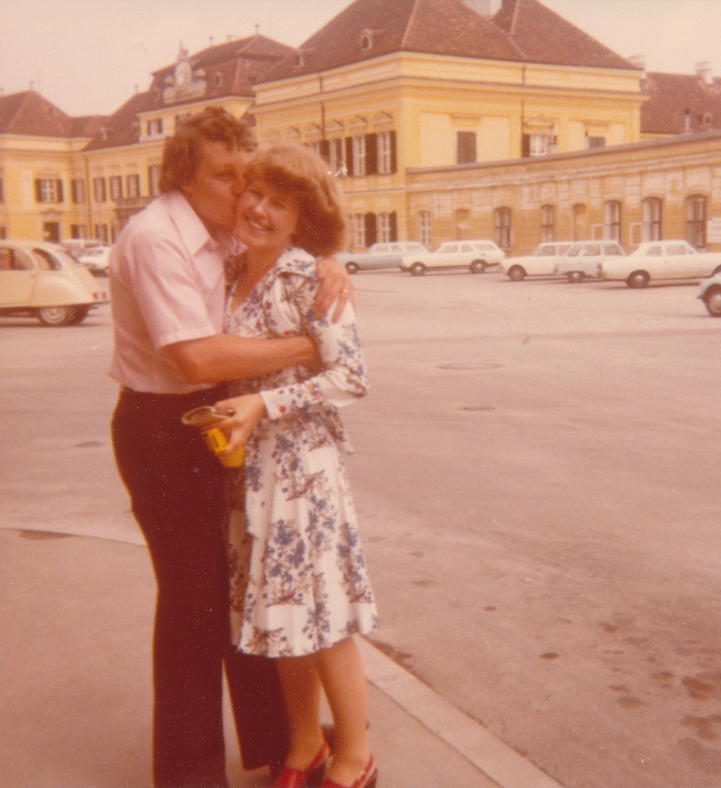
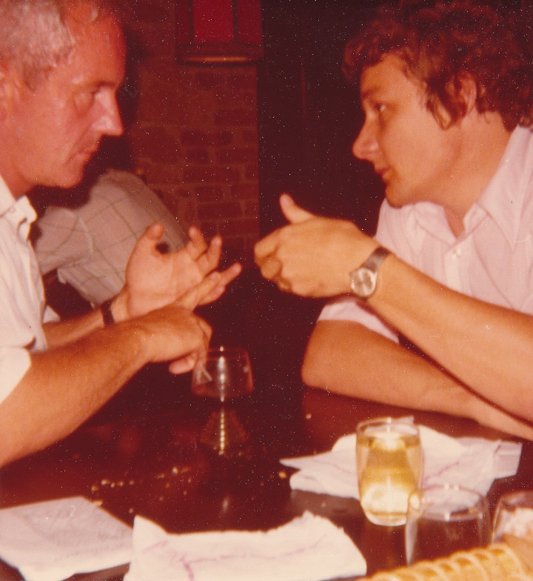
Off to Europe (1976-77) …
Schloss Laxenburg
Vienna, Austria
David works as a Visiting Scholar
with colleagues from Bulgaria and Poland

Slide 8
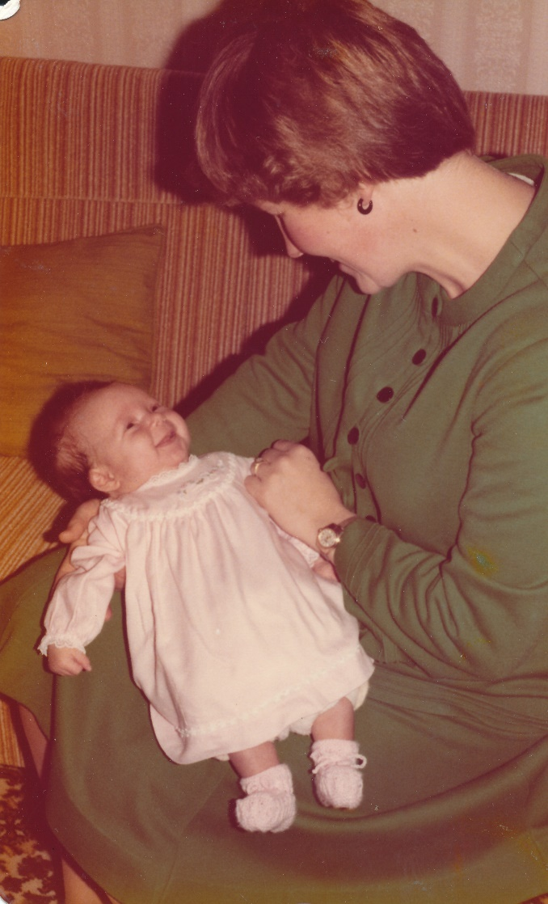
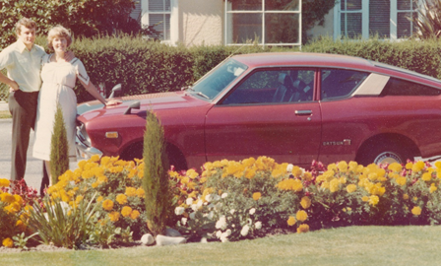
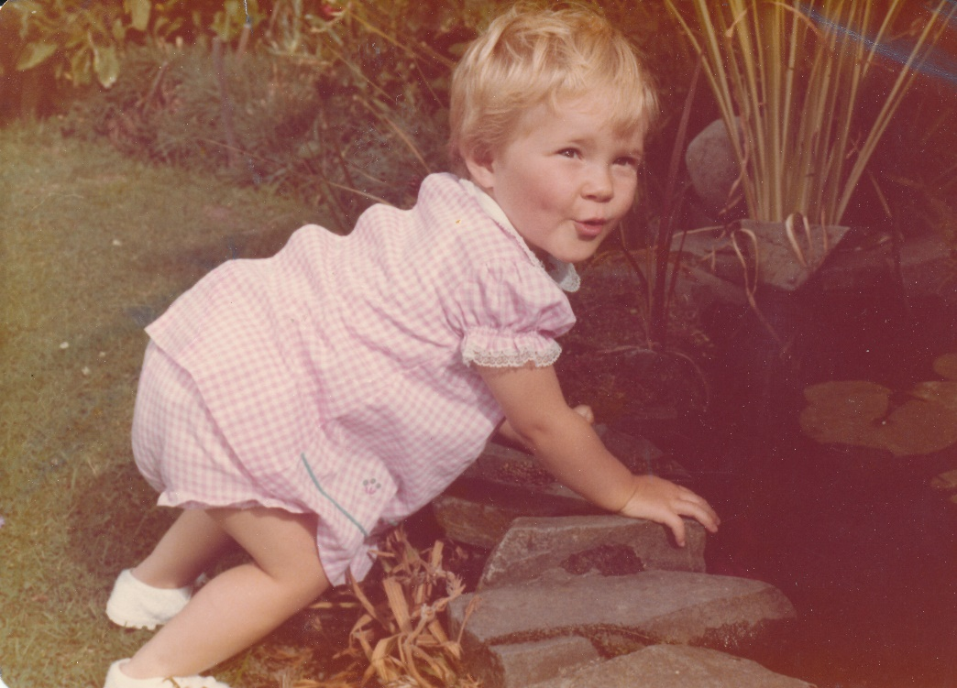
Back to New Zealand (1978-1980) …
David works as a scientist
for the Ministry of Works
and Development
Amy born May 1978
Linda born May 1980

Slide 9
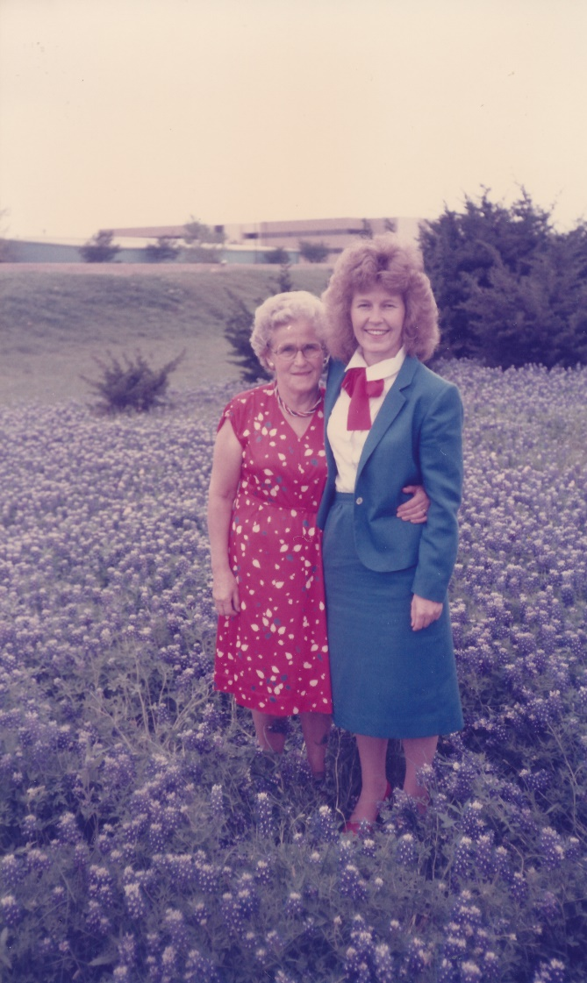
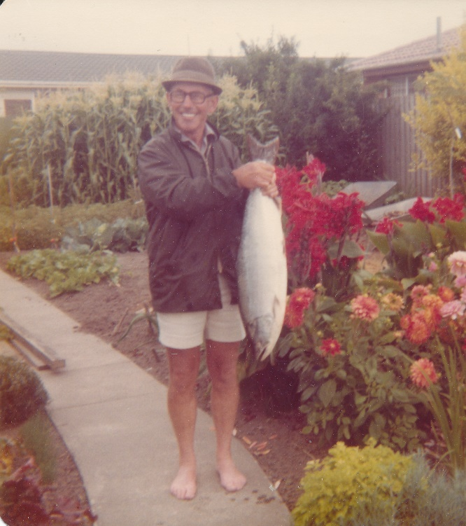
Helen’s Father (Arnold) and Mother (Rachel) …
A wonderful influence in our lives

Slide 10
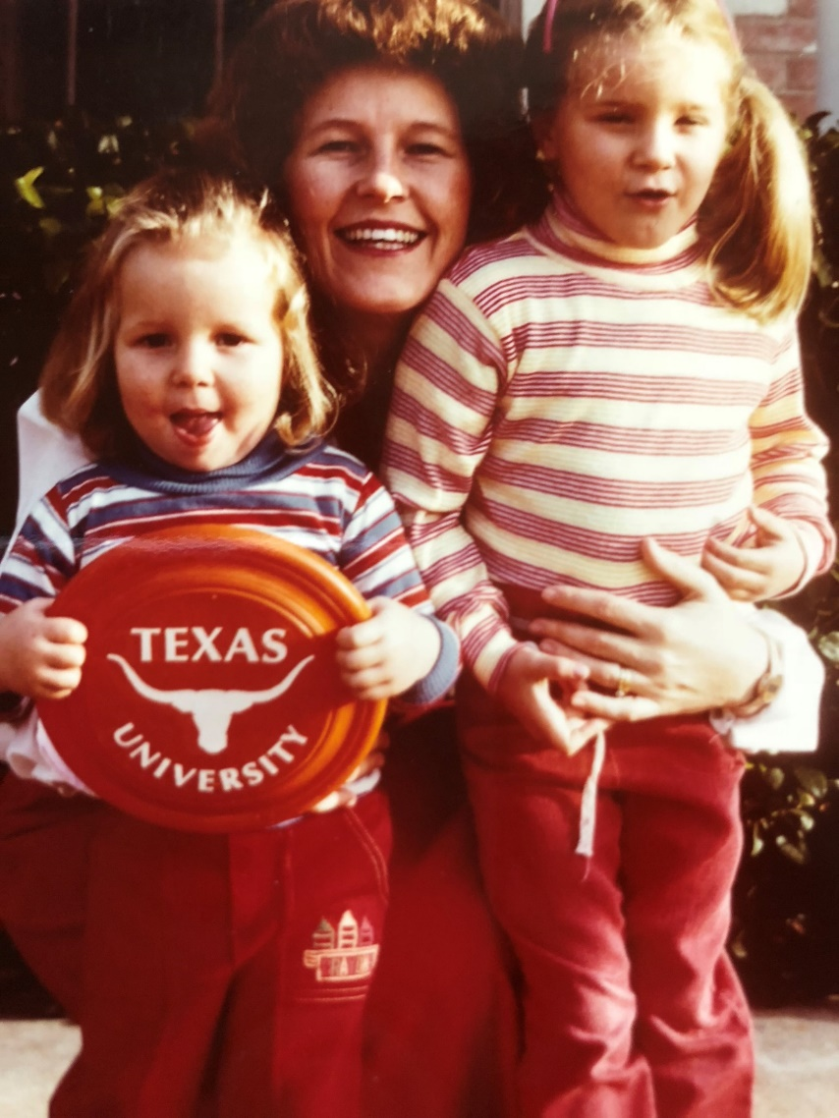
We come to Texas in 1980 …
Visiting Assistant Professor
Dept of Civil Engineering 1980-81
1981 to present

Slide 11
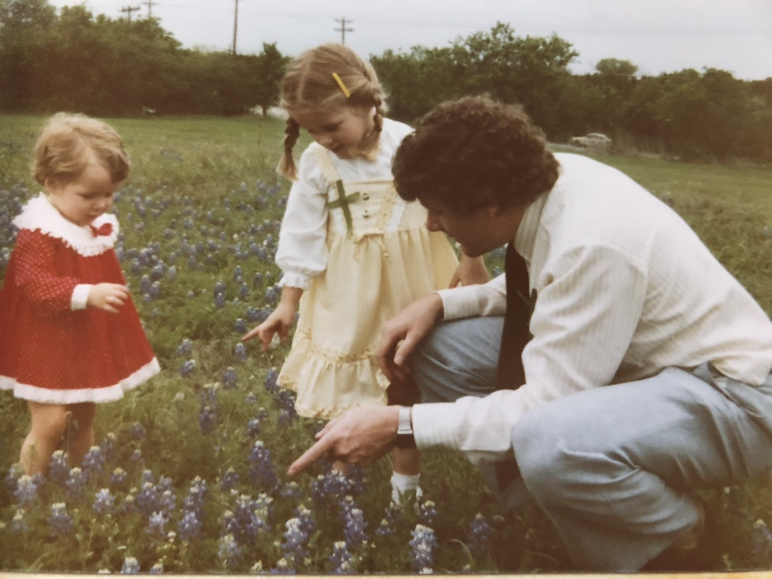
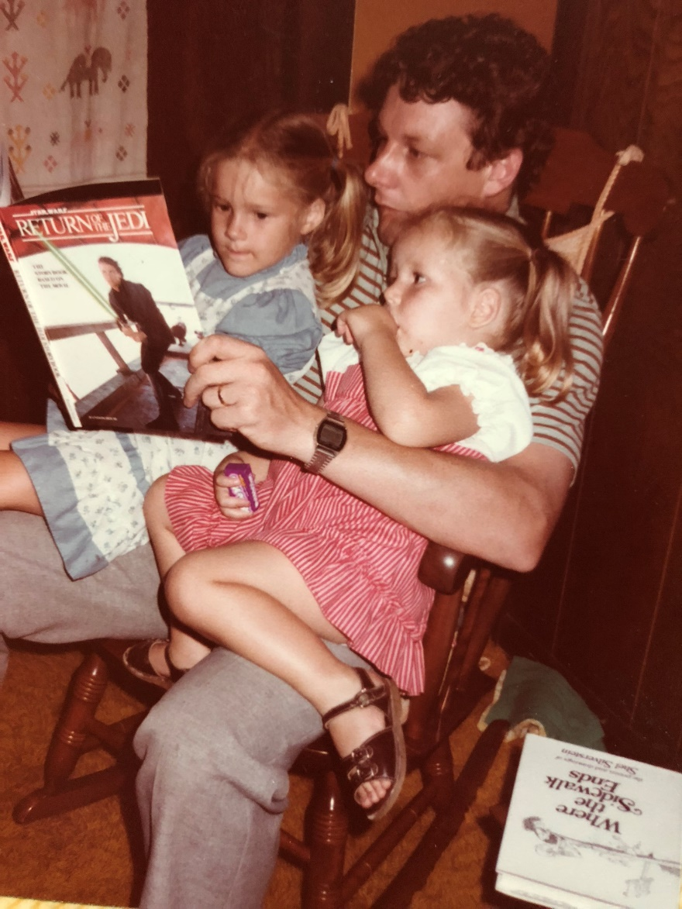
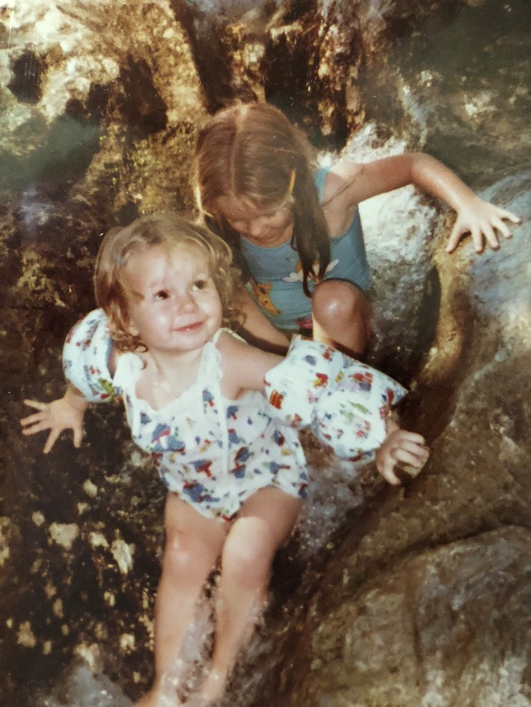
Being a Dad…
David was “Mr Mom” for four years
while Helen went to Medical School

Slide 12
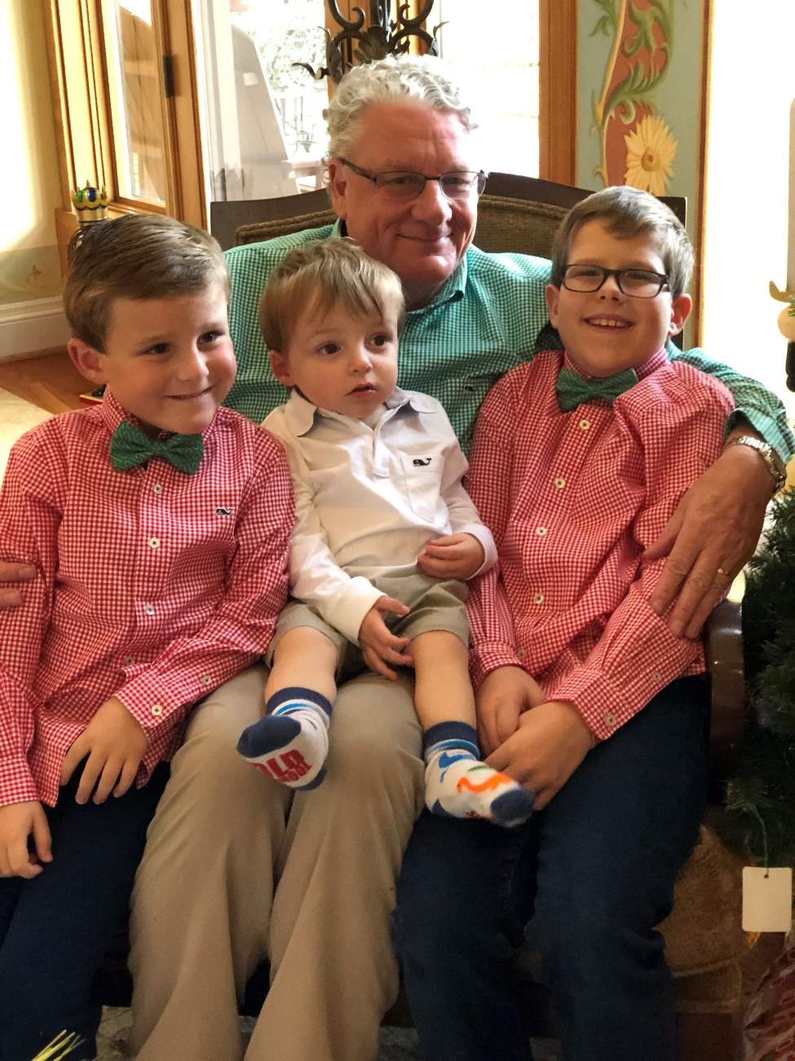
Being a Grandad…
Our family, October 2016
David
Peter
Matthew
Ben, Amy, David, Helen, Linda, Kevin
Matthew, David, Peter

Slide 13
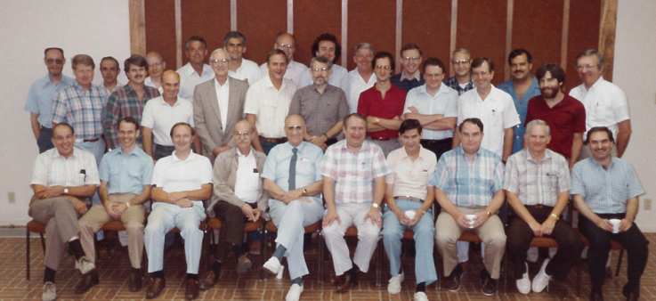
Life at UT Austin …
The Civil Engineering faculty, late 1980’s

Slide 14
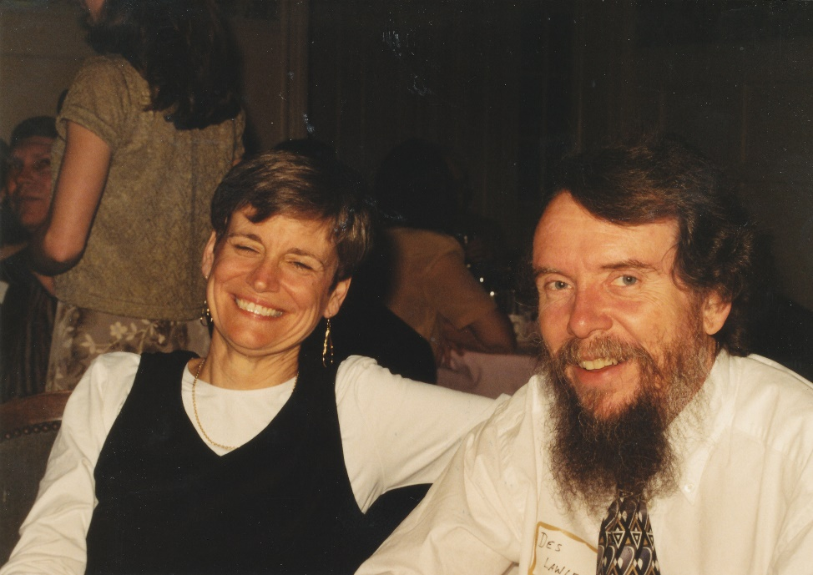
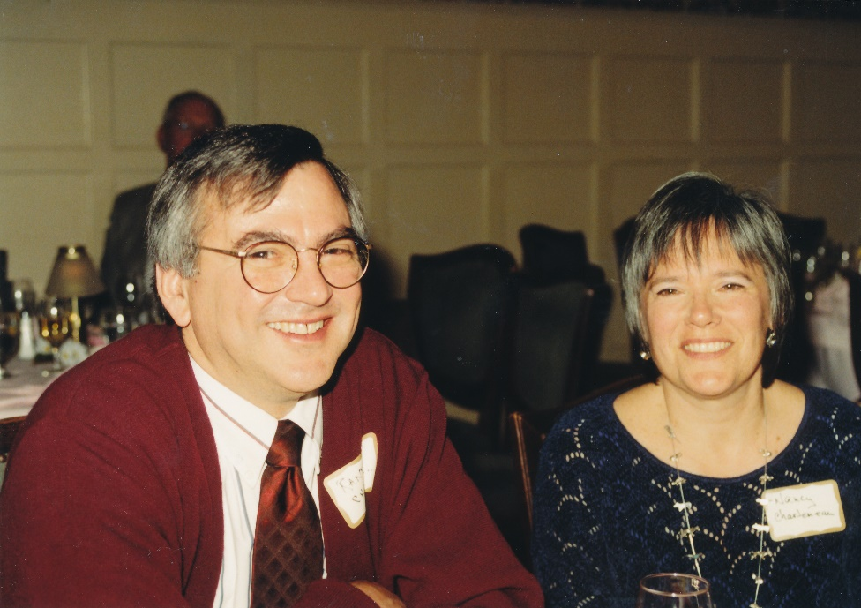
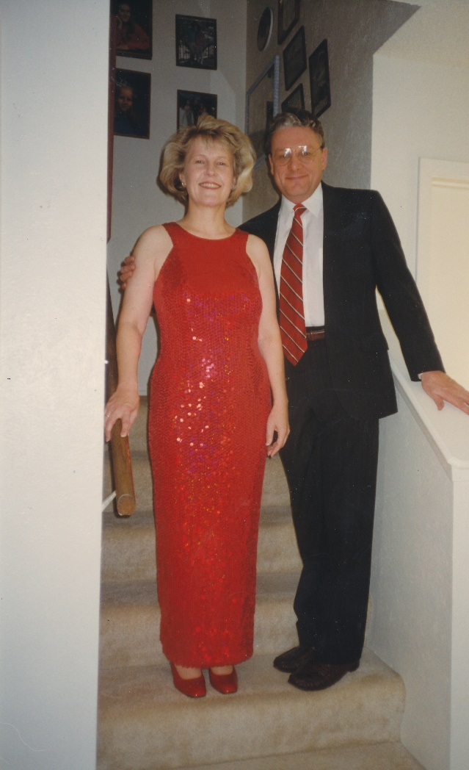
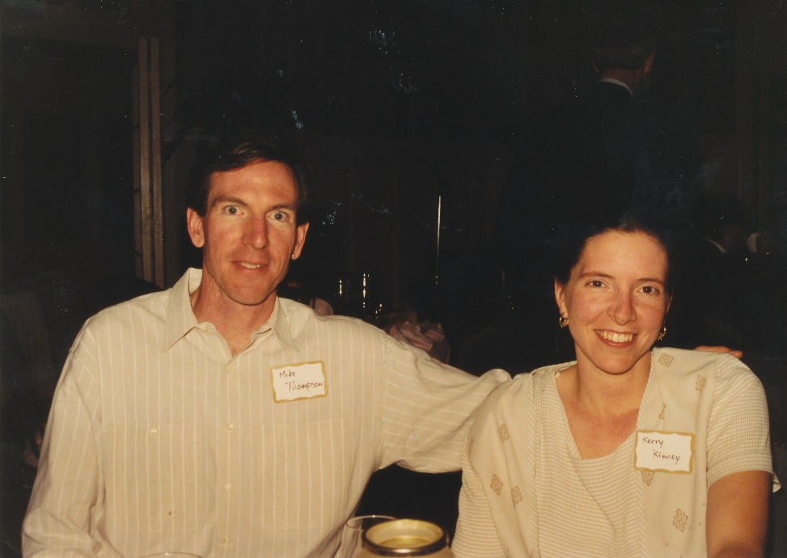
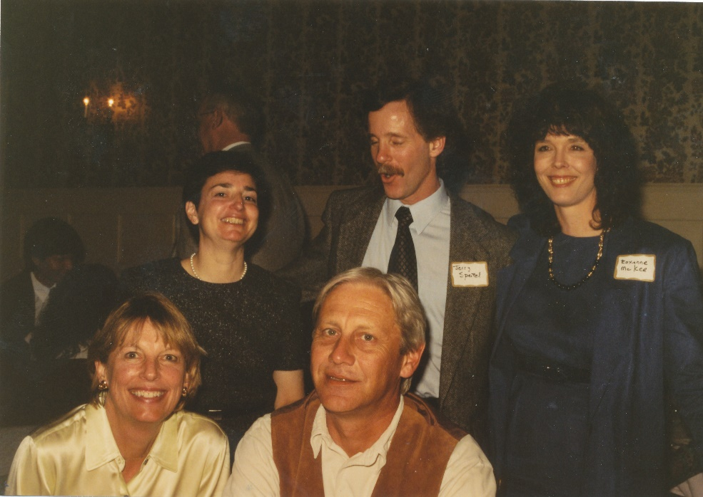
25th wedding
anniversary …
EWRE faculty 20 years ago
February 1998

Slide 15
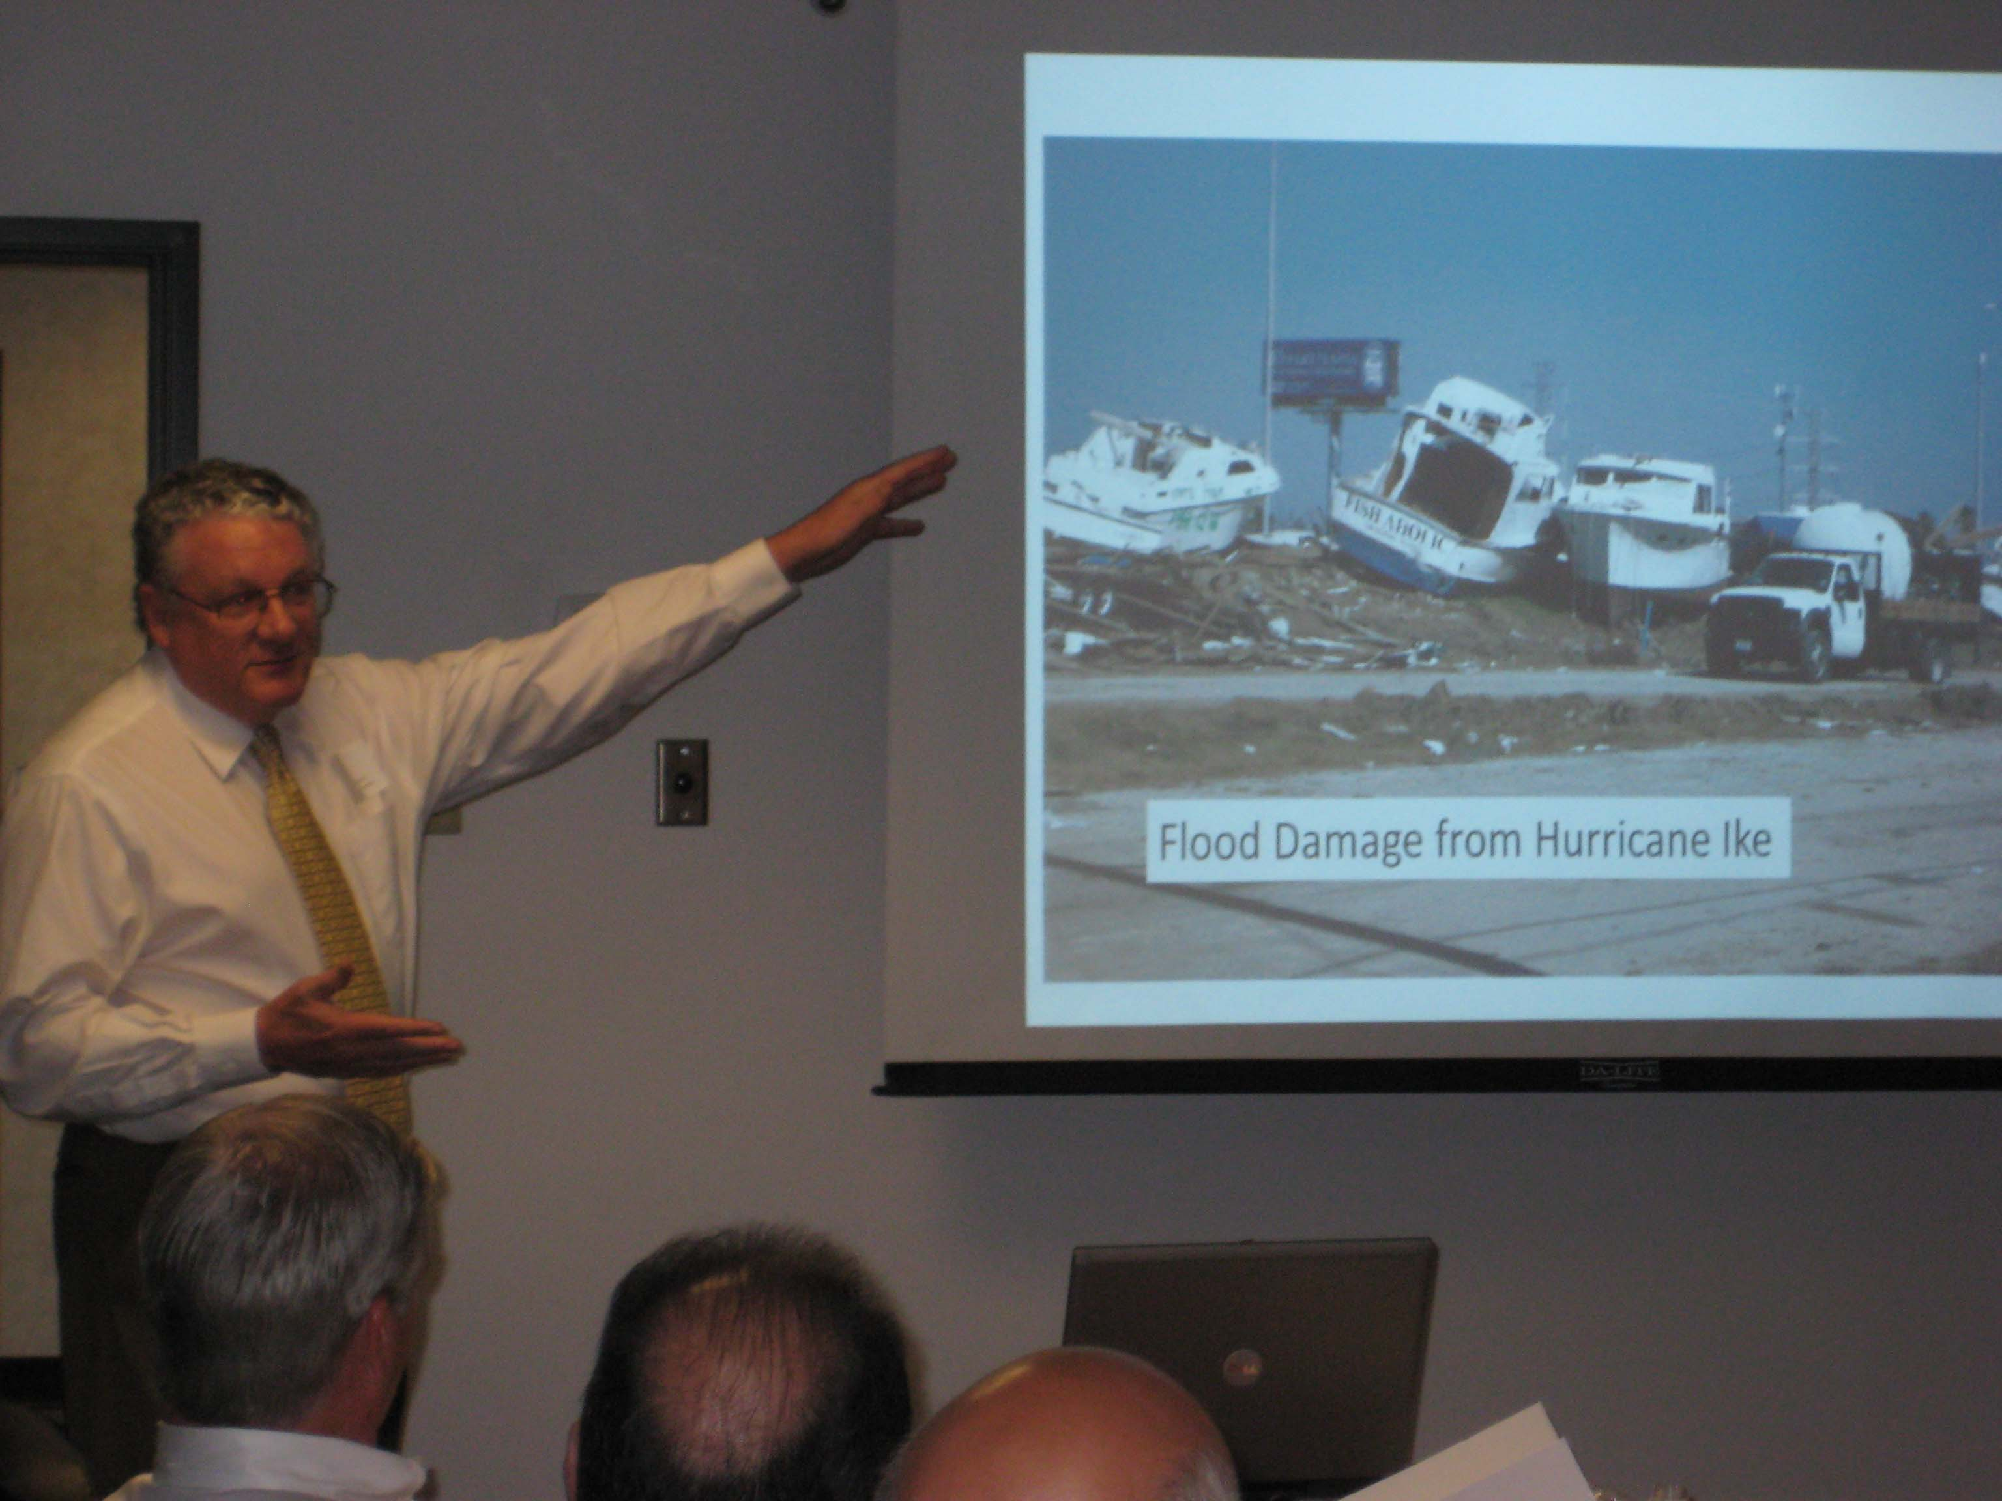
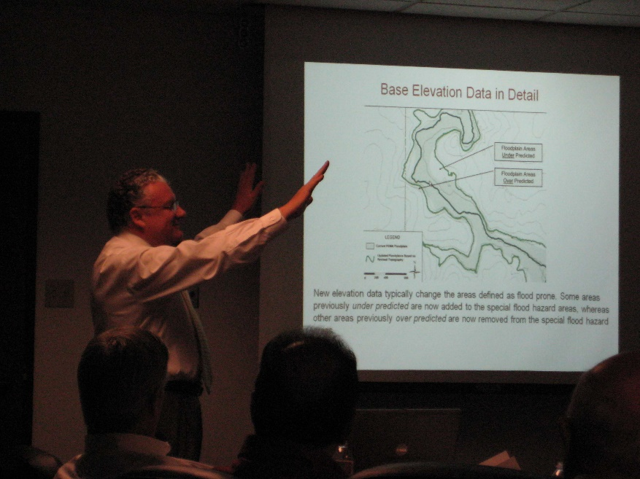
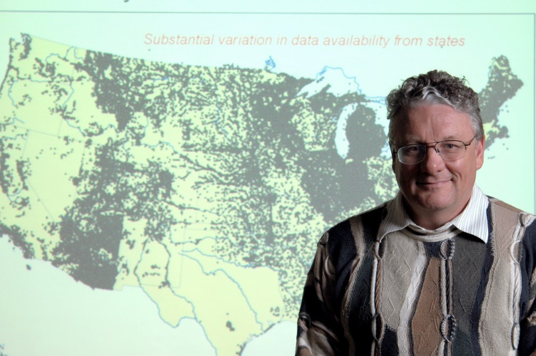
Being a teacher…

Slide 16
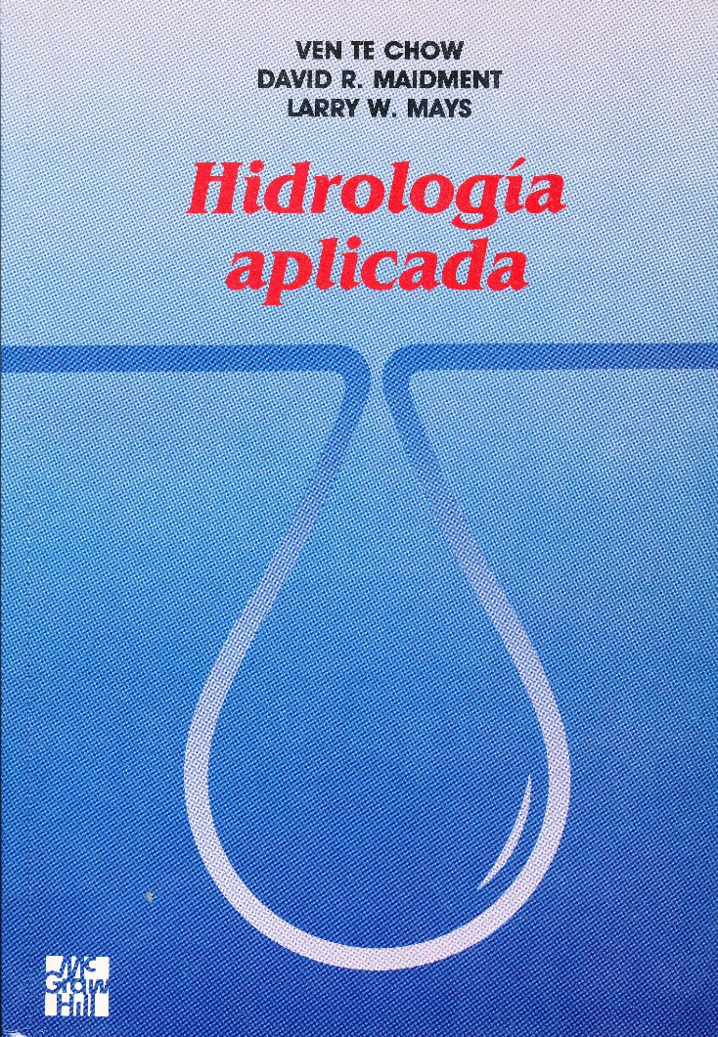
Applied Hydrology Textbook
Spanish
translation
1994
McGraw-Hill
1988
572 pages

Slide 17
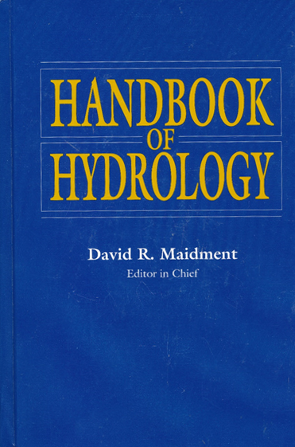
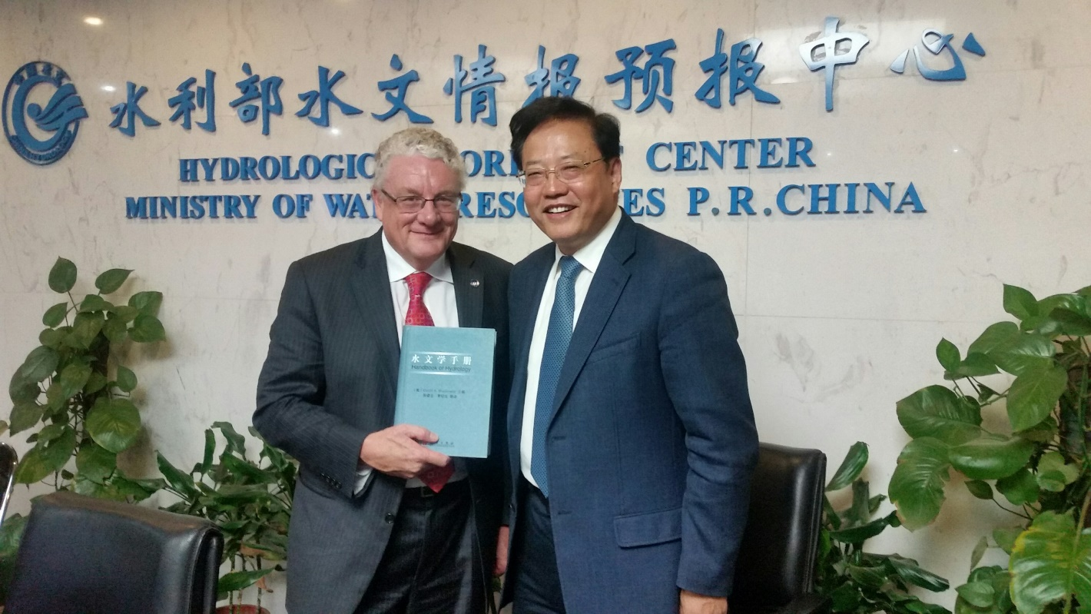
Handbook of Hydrology (1989-1993) …
McGraw-Hill
1993
Chinese translation
2002
1400 pages

Slide 18
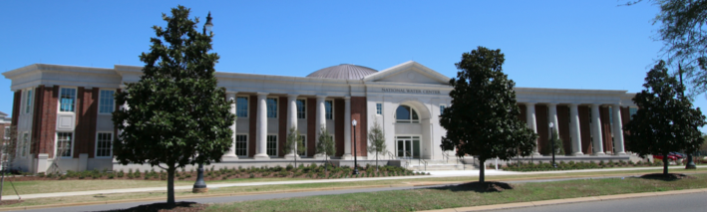
Prototype developed at UT Austin
Now operated continuously by National Weather Service

Slide 19
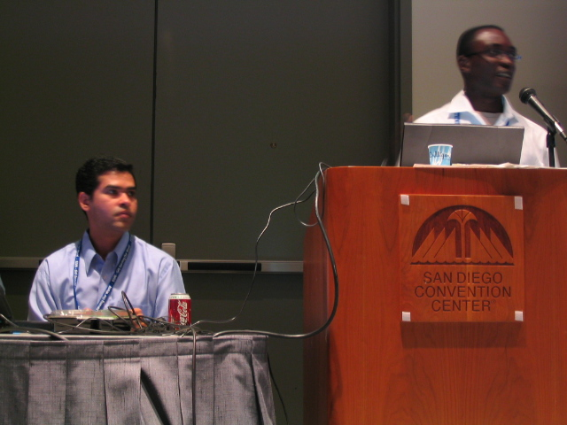
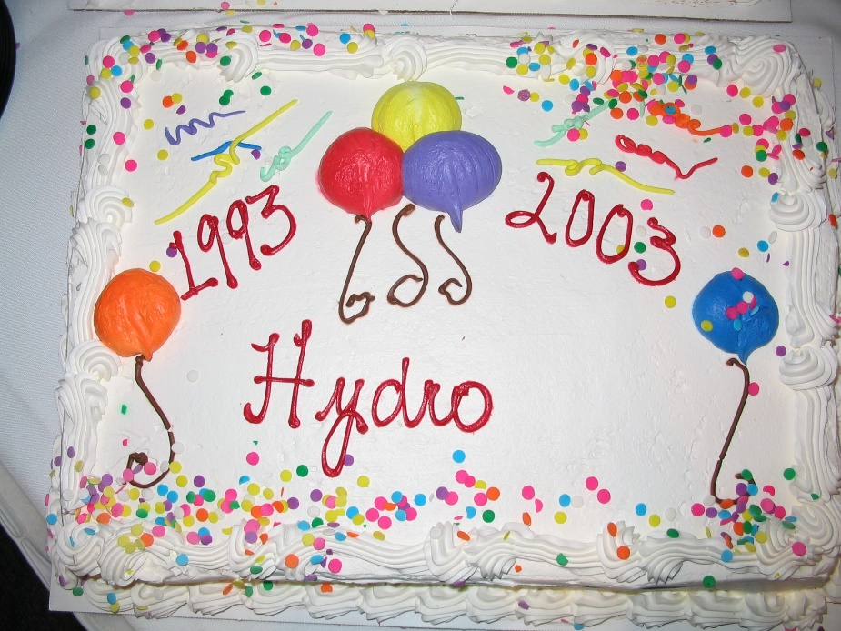
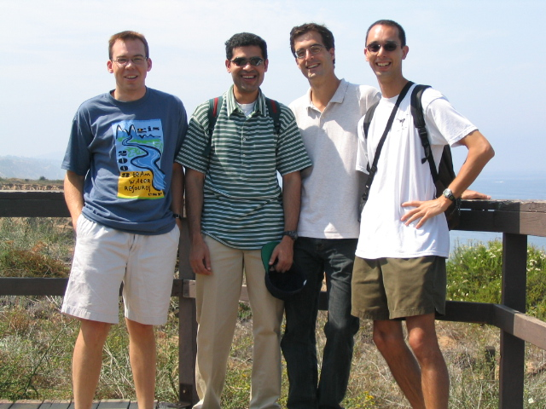
ESRI User Conference in San Diego …
An annual trip

Slide 20
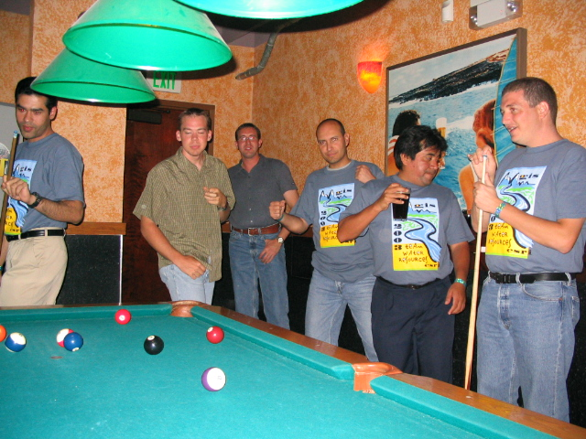
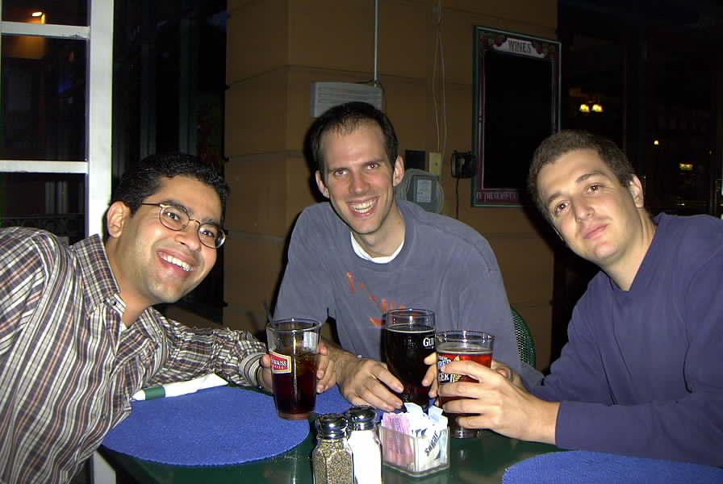
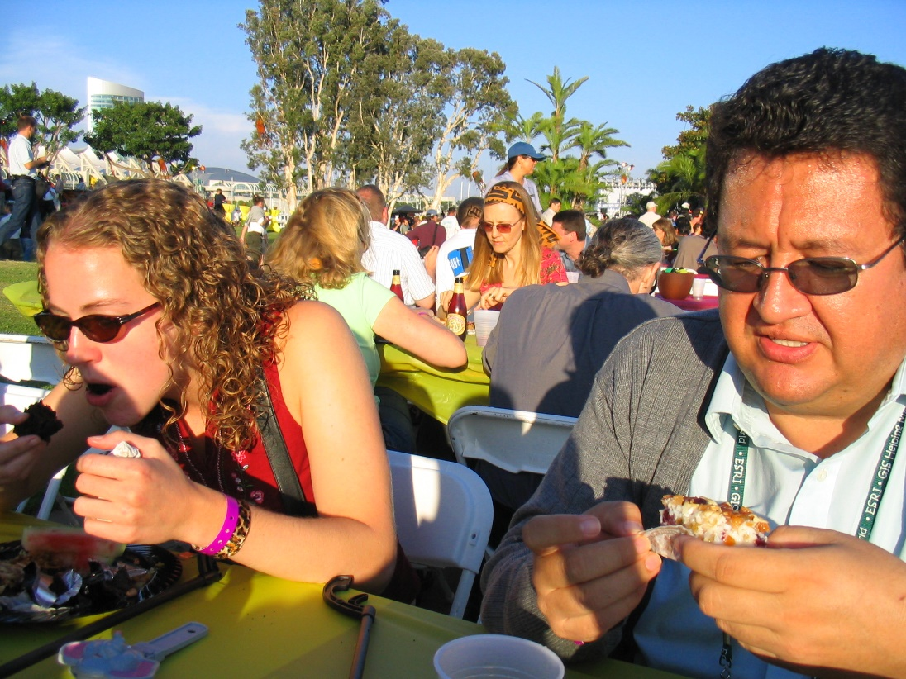
Wonderful graduate students …

Slide 21
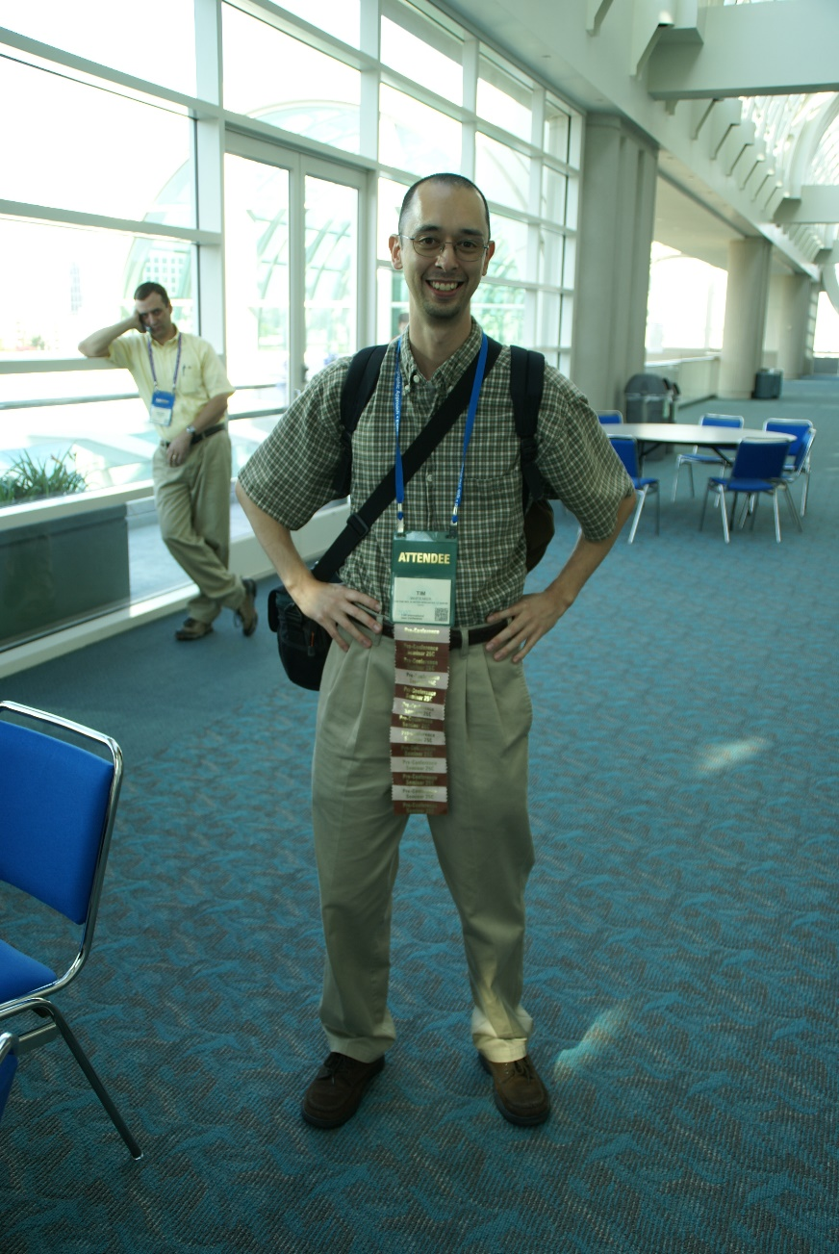
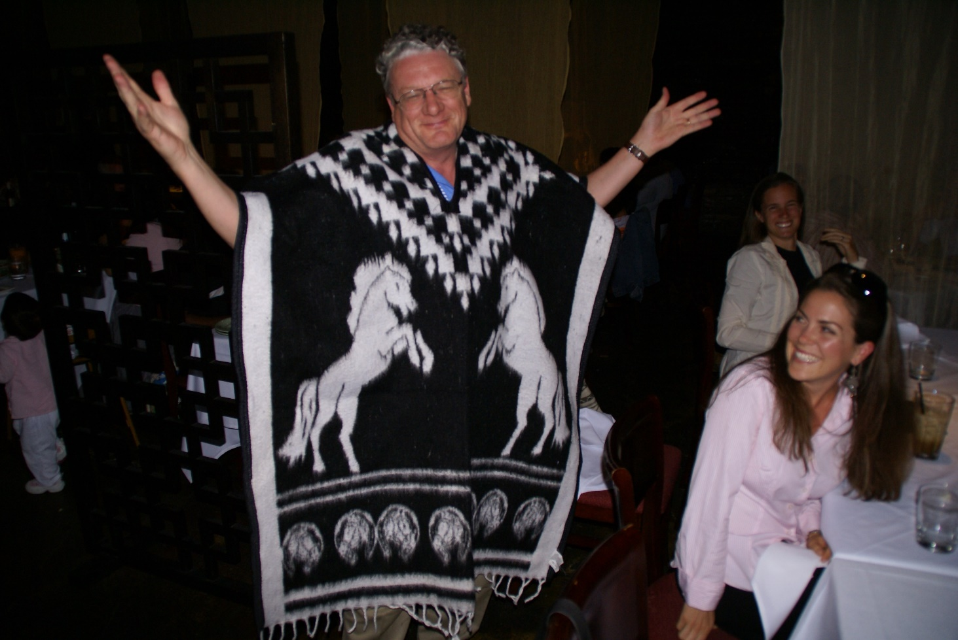
We have fun at the conference …

Slide 22
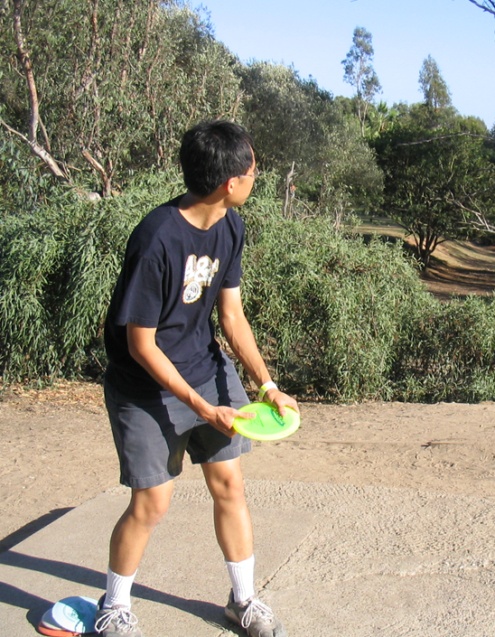
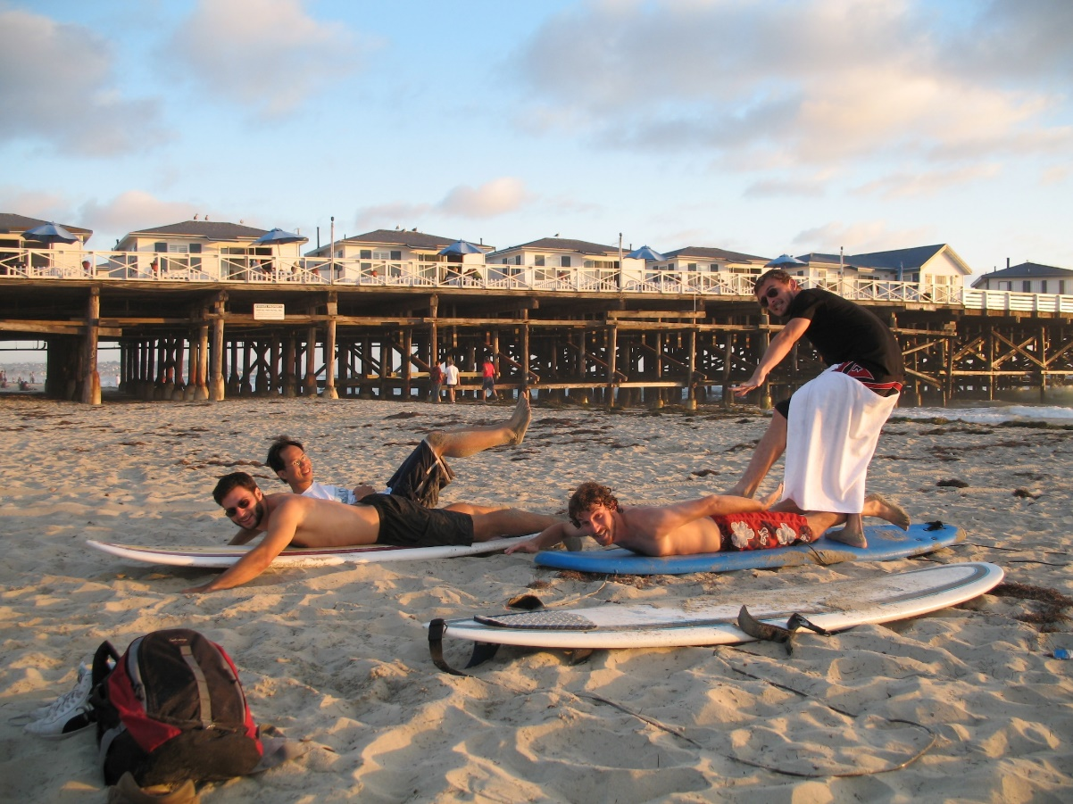
And in a few other activities …

Slide 23
Friends to remember …

Slide 24
Students become colleagues at ESRI…

Slide 25
Graduation Days …

Slide 26
Seeing students again …
Ahmad Tavakoly
Reem Zoun

Slide 27
Election to National Academy of Engineering…

Slide 28
My friends and colleagues for 38 wonderful years!
Environmental and Water Resources Engineering Faculty, April 2016

