Slide 1
Brushy Creek
Alex Chan, rukundo gahigiro, ning zhang

Slide 2
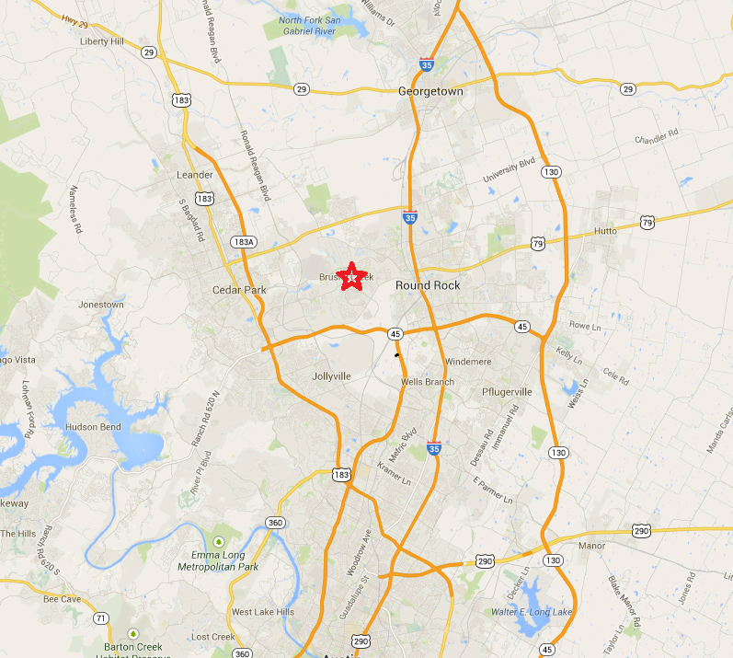
Introduction

Slide 3
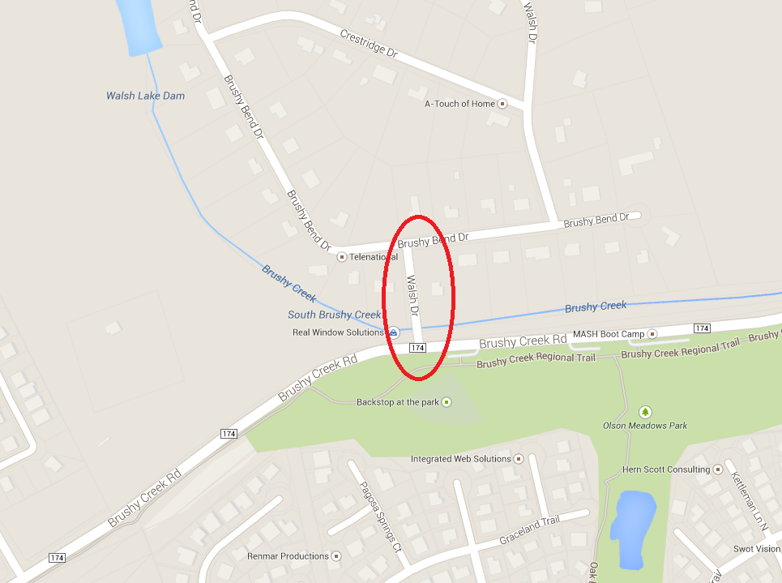
Introduction

Slide 4
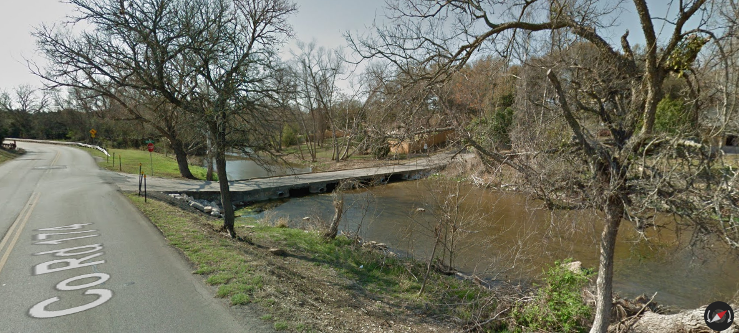
Introduction

Slide 5
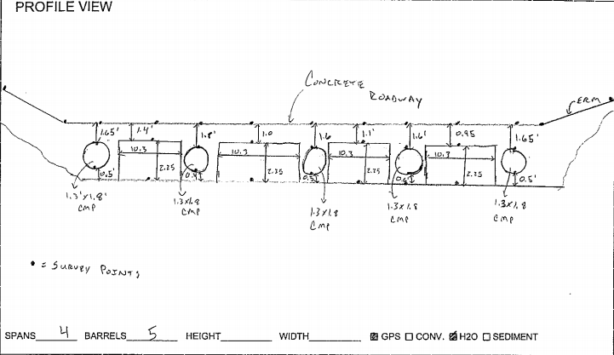
Introduction

Slide 6
Step 1: Representation
How should the study area be described?

Slide 7
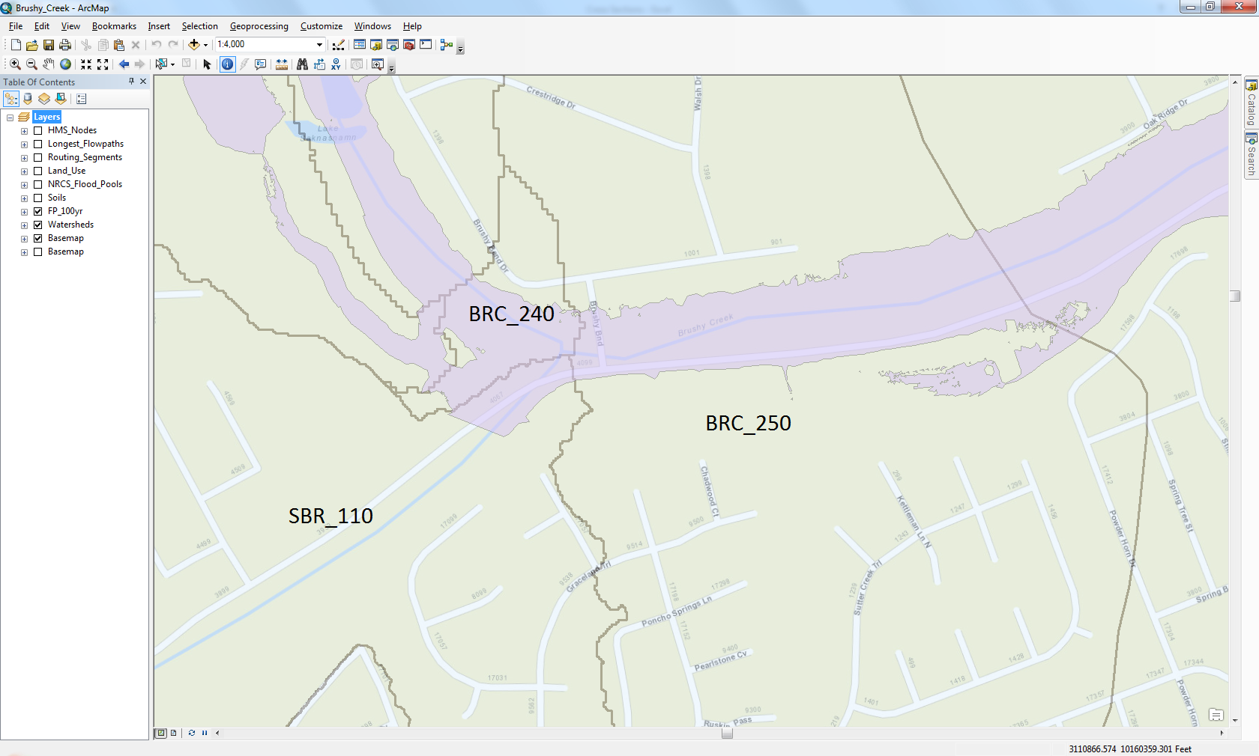
Step 1: Representation

Slide 8
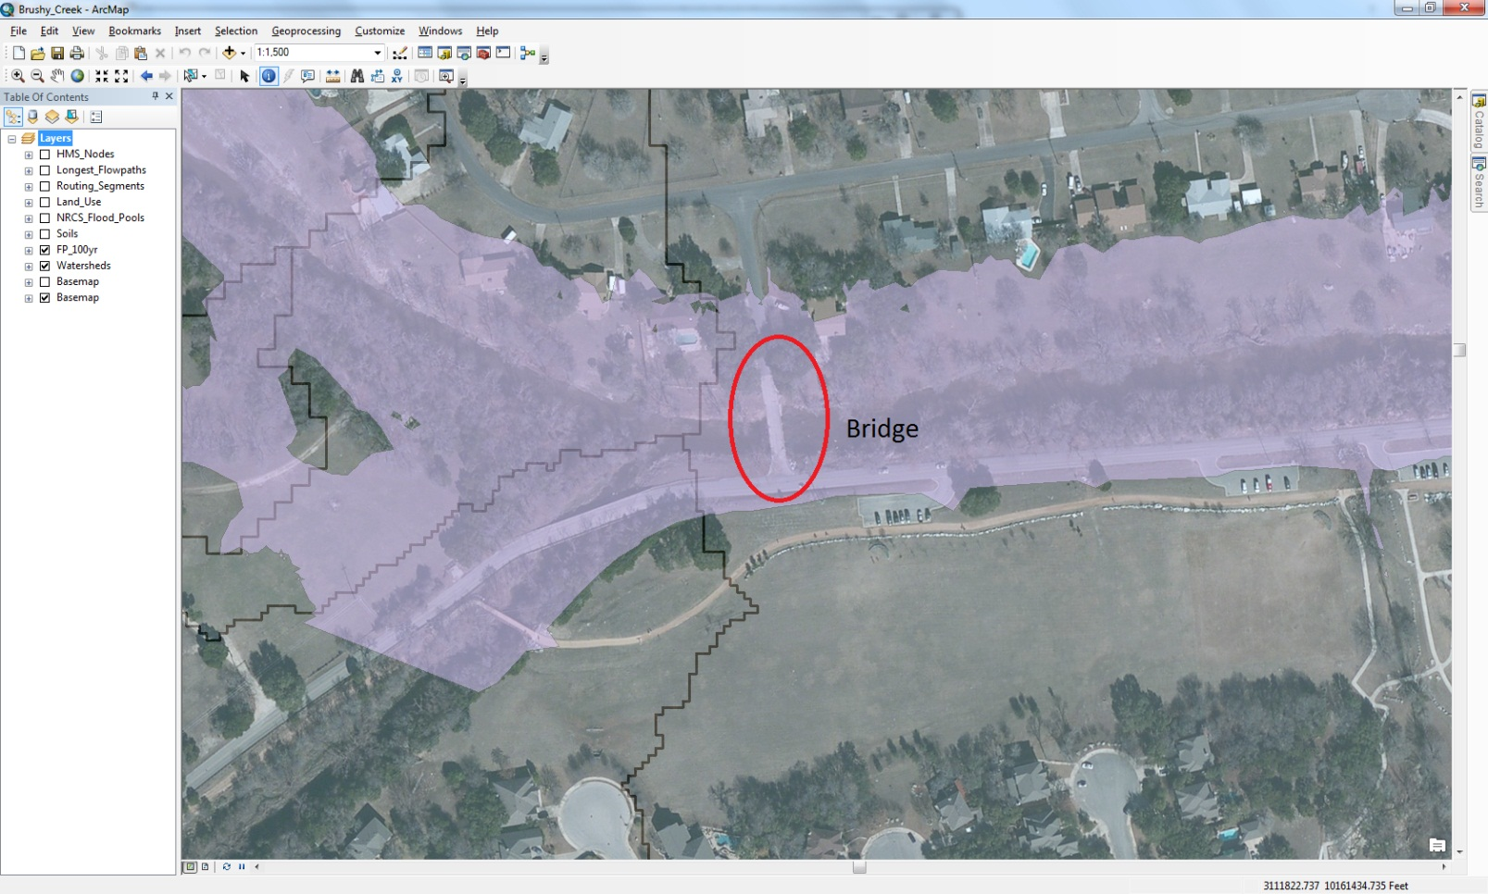
Step 1: Representation

Slide 9
Step 2: Process
How does the study area operate?

Slide 10
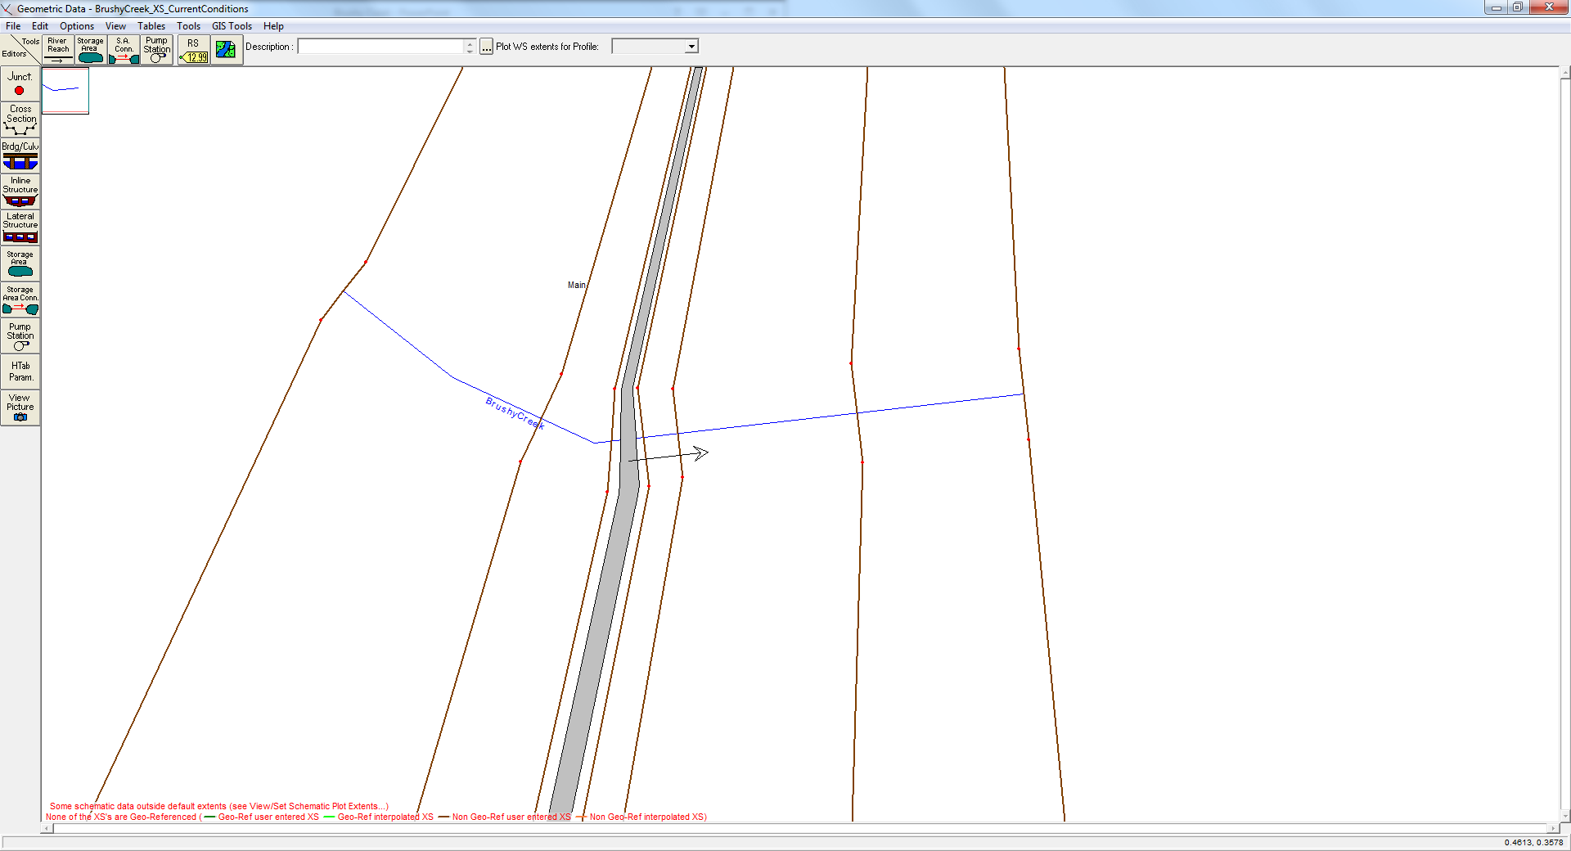
Step 2: Process

Slide 11
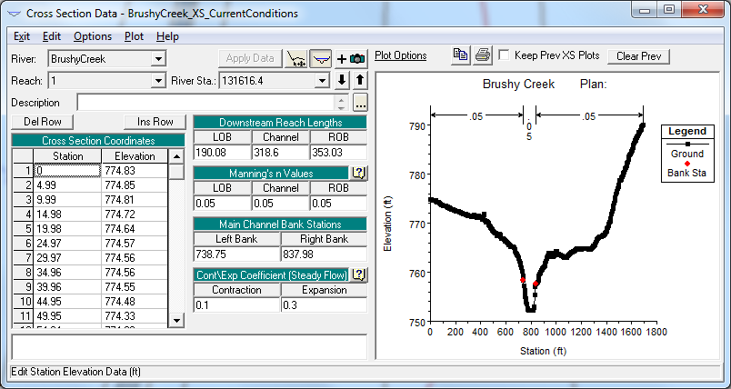
Step 2: Process

Slide 12
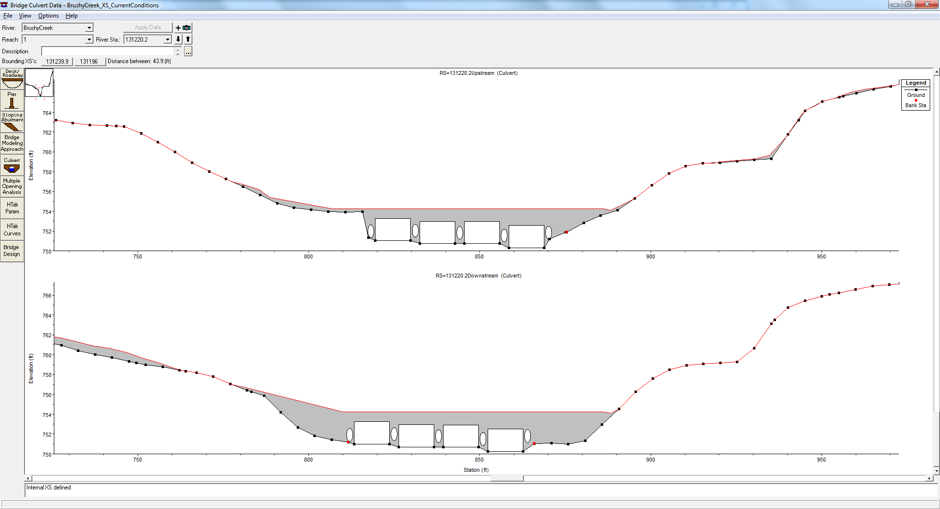
Step 2: Process

Slide 13
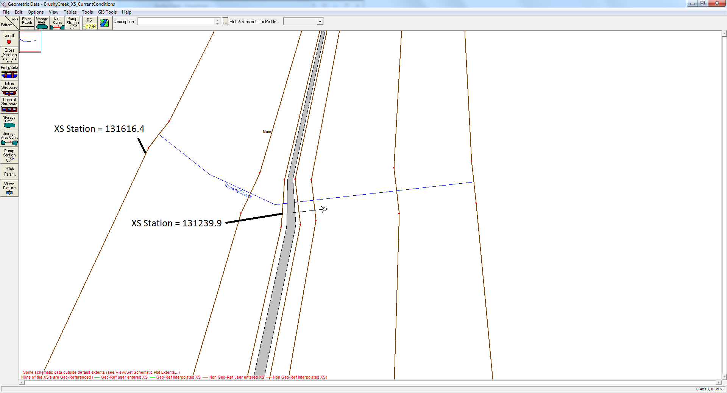
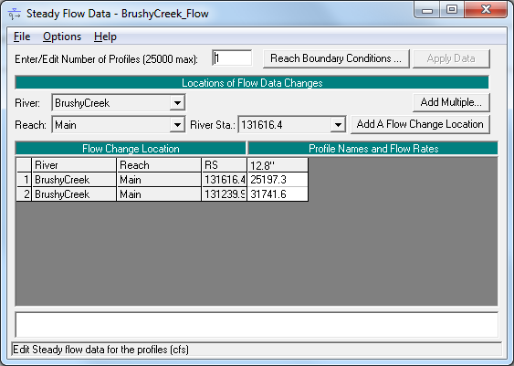
Step 2: Process

Slide 14
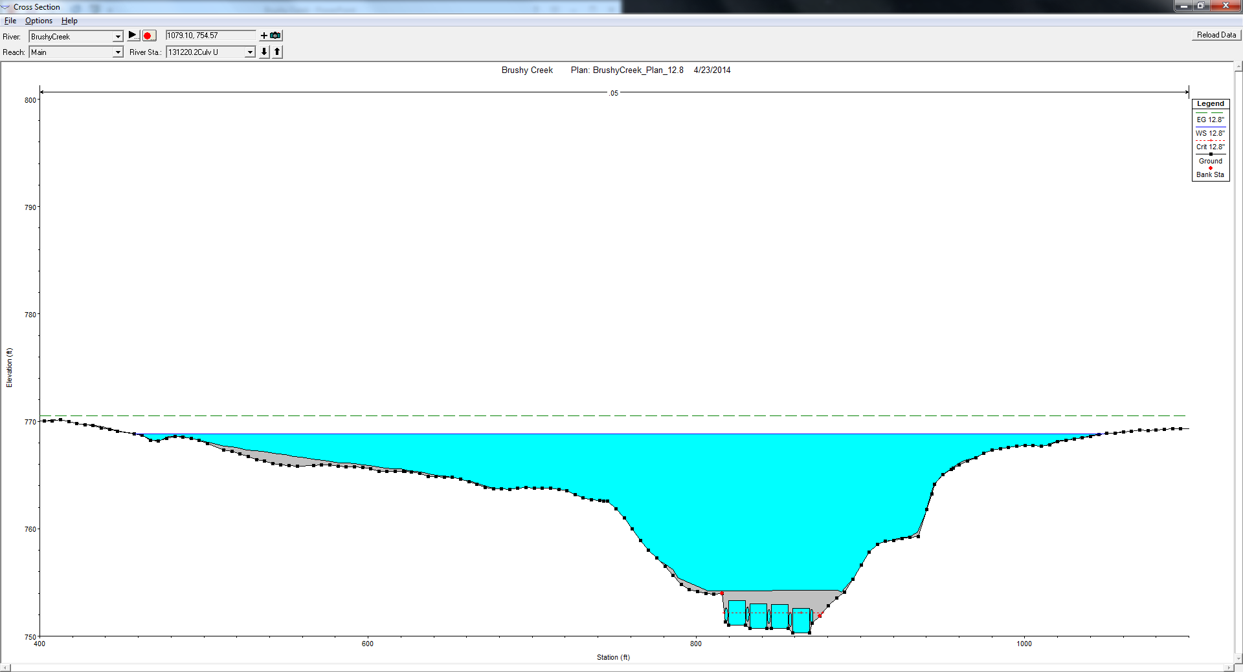
Step 2: Process

Slide 15
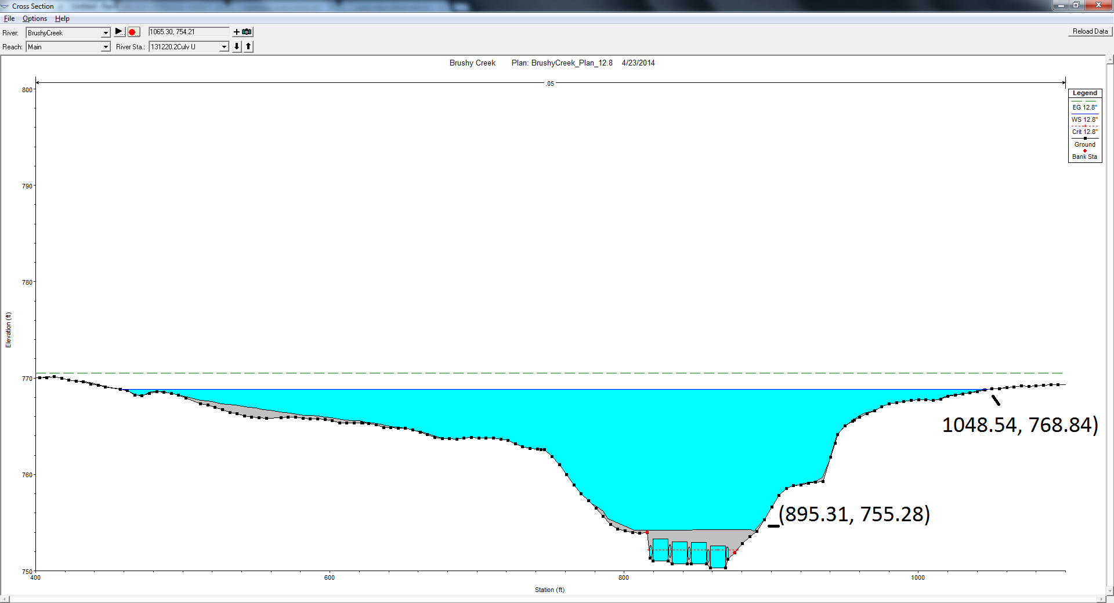
Step 3: Evaluation
Is the current study area working well? No!
  Bridge becomes unusable
  Water elevation rises significantly
  Houses are in flood zone

Slide 16
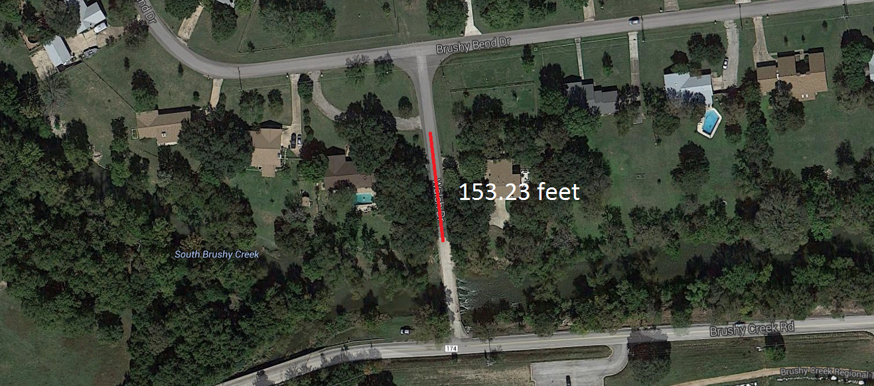
Step 3: Evaluation

Slide 17
Step 4: Change
Remove the bridge
Design a different bridge
Divert flow to the park to the south via pipe or another channel
Notes:
Instead of two rivers merging we have two separate channels. Diversion can be via pipe (use manning’s then) or another channel

Slide 18
Step 5: Impact
What differences would the changes cause?

Slide 19
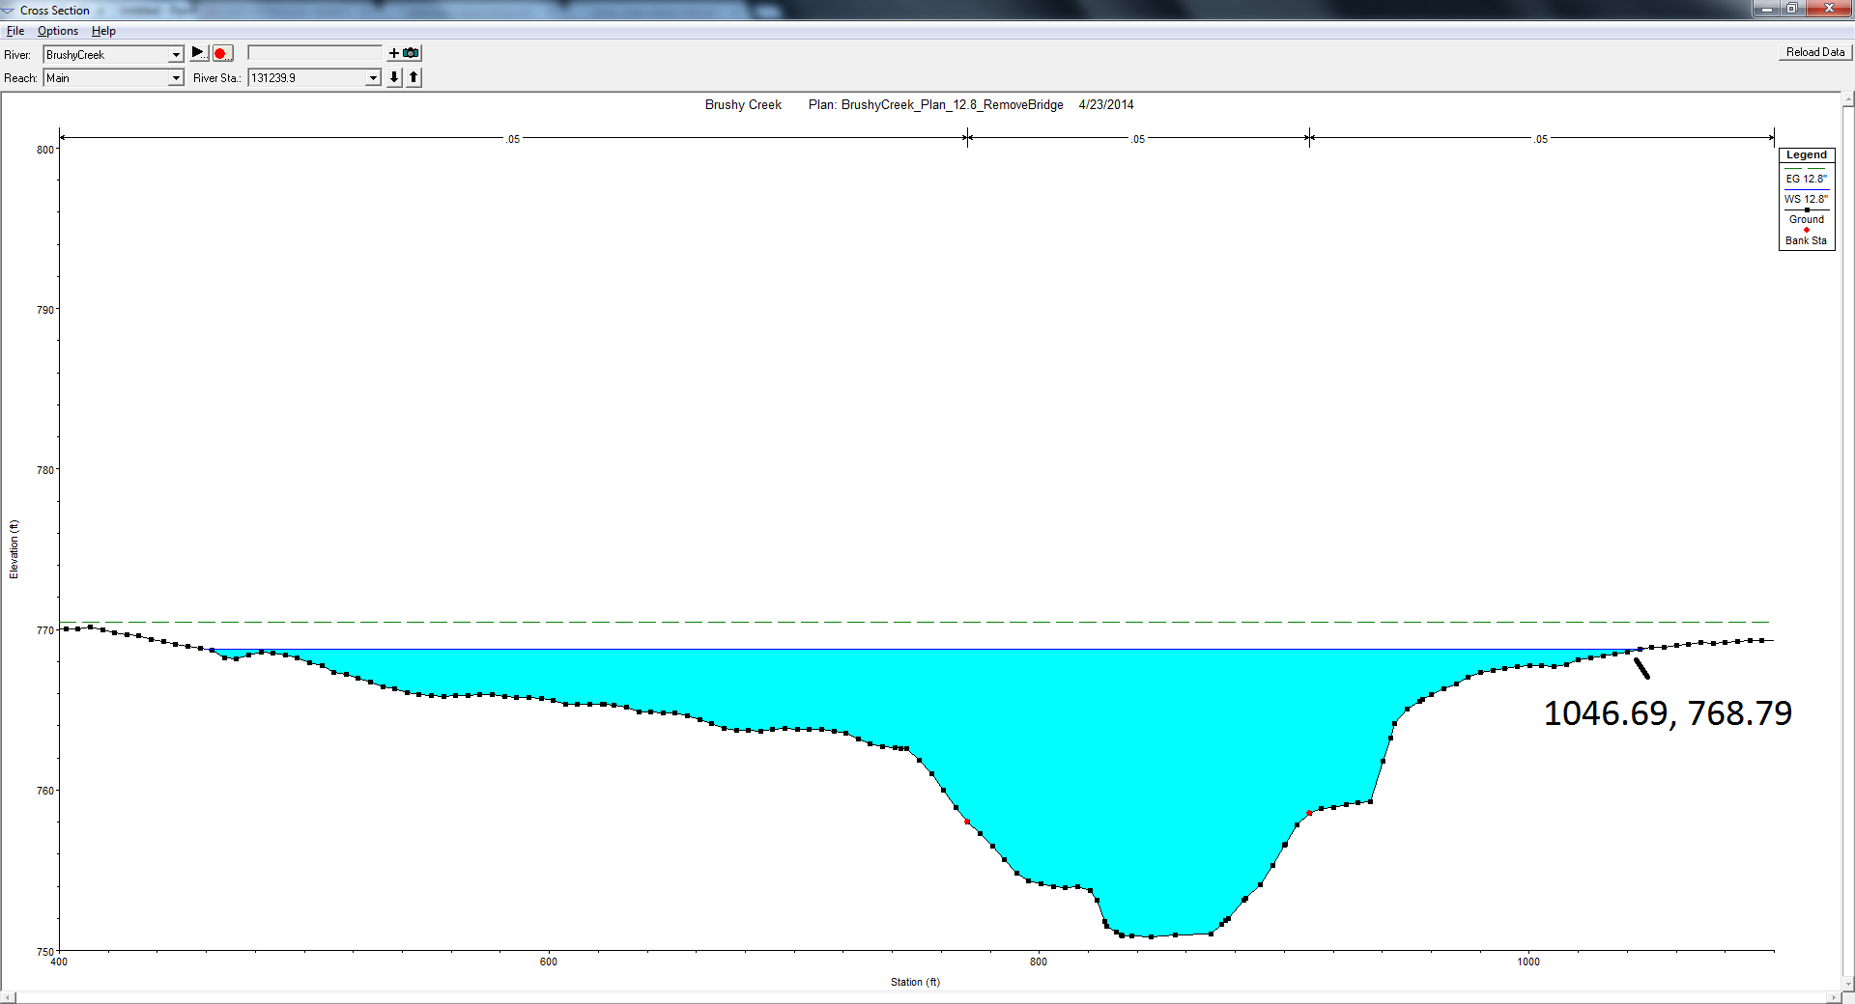
Impact
Option 1: Remove Bridge:

Slide 20
Step 5: Impact
Removing the bridge:
  Decreases the spread of the water on the north bank by 1.85 ft
  Decreases water surface elevation by 0.05 ft

Slide 21
Step 5: Impact
Option 2: Design a different bridge
  Haven’t done this yet.
  But given the negligible impact removing the bridge had, a different bridge is unlikely to make much of a difference

Slide 22
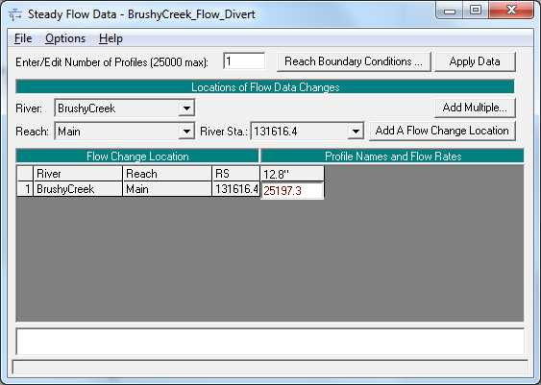
Step 5: Impact
Option 3: Divert flow

Slide 23
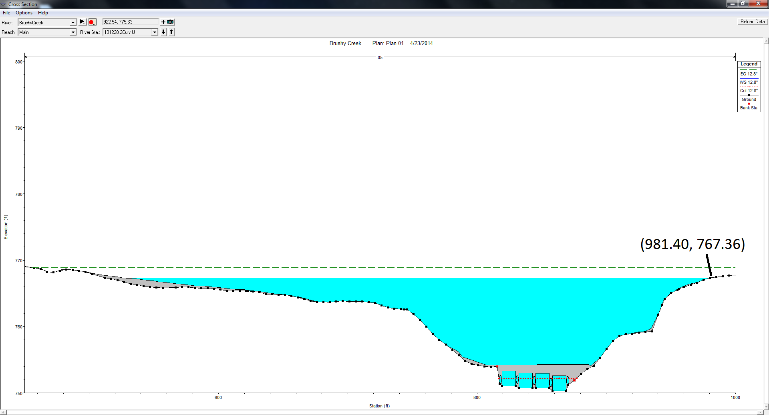
Step 5: Impact

Slide 24
Step 5: Impact
Diverting flow from the tributary:
  Decreases the spread of the water on the north bank by 67.14 ft
  Decreases water surface elevation by 1.43 ft

Slide 25
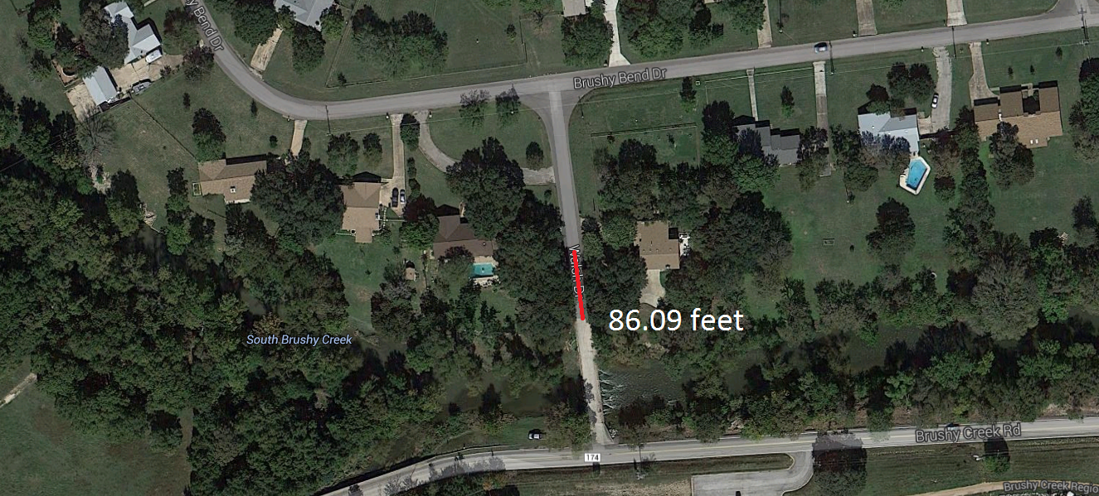
Step 5: Impact

Slide 26
Step 6: Decision
So far, diverting the flow is the only option with any appreciable effect.
We will construct a basemap with a floodplain map based on that HEC-RAS run

Slide 27
Questions?

