Slide 1
UT Campus: Burdine Hall
Group 10
Abby Stout
Alexis Sheehan
Phillip Kenny

Slide 2
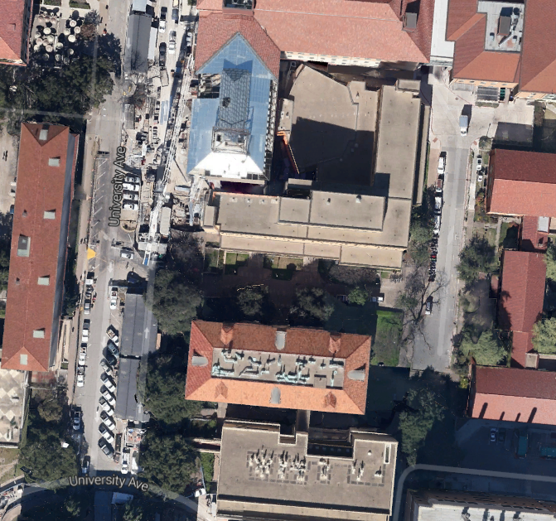
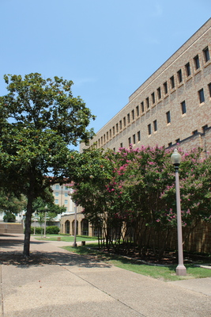
Background
Study Area: Walkway between Burdine Hall and the Pharmacy Buildings
Burdine
Hall
Burdine Hall
Study Area
College of Pharmacy
Walkway

Slide 3
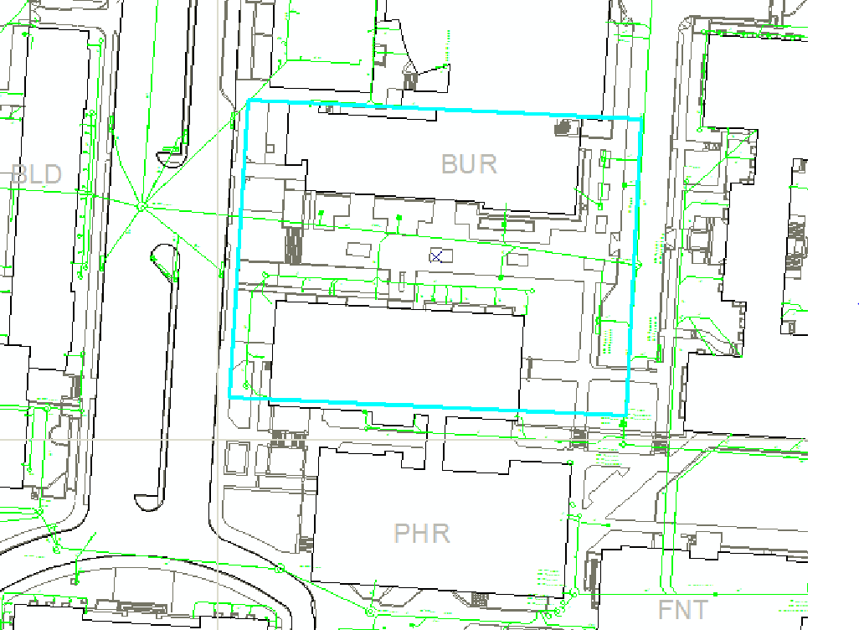
Representation
ArcGIS Basemap

Slide 4
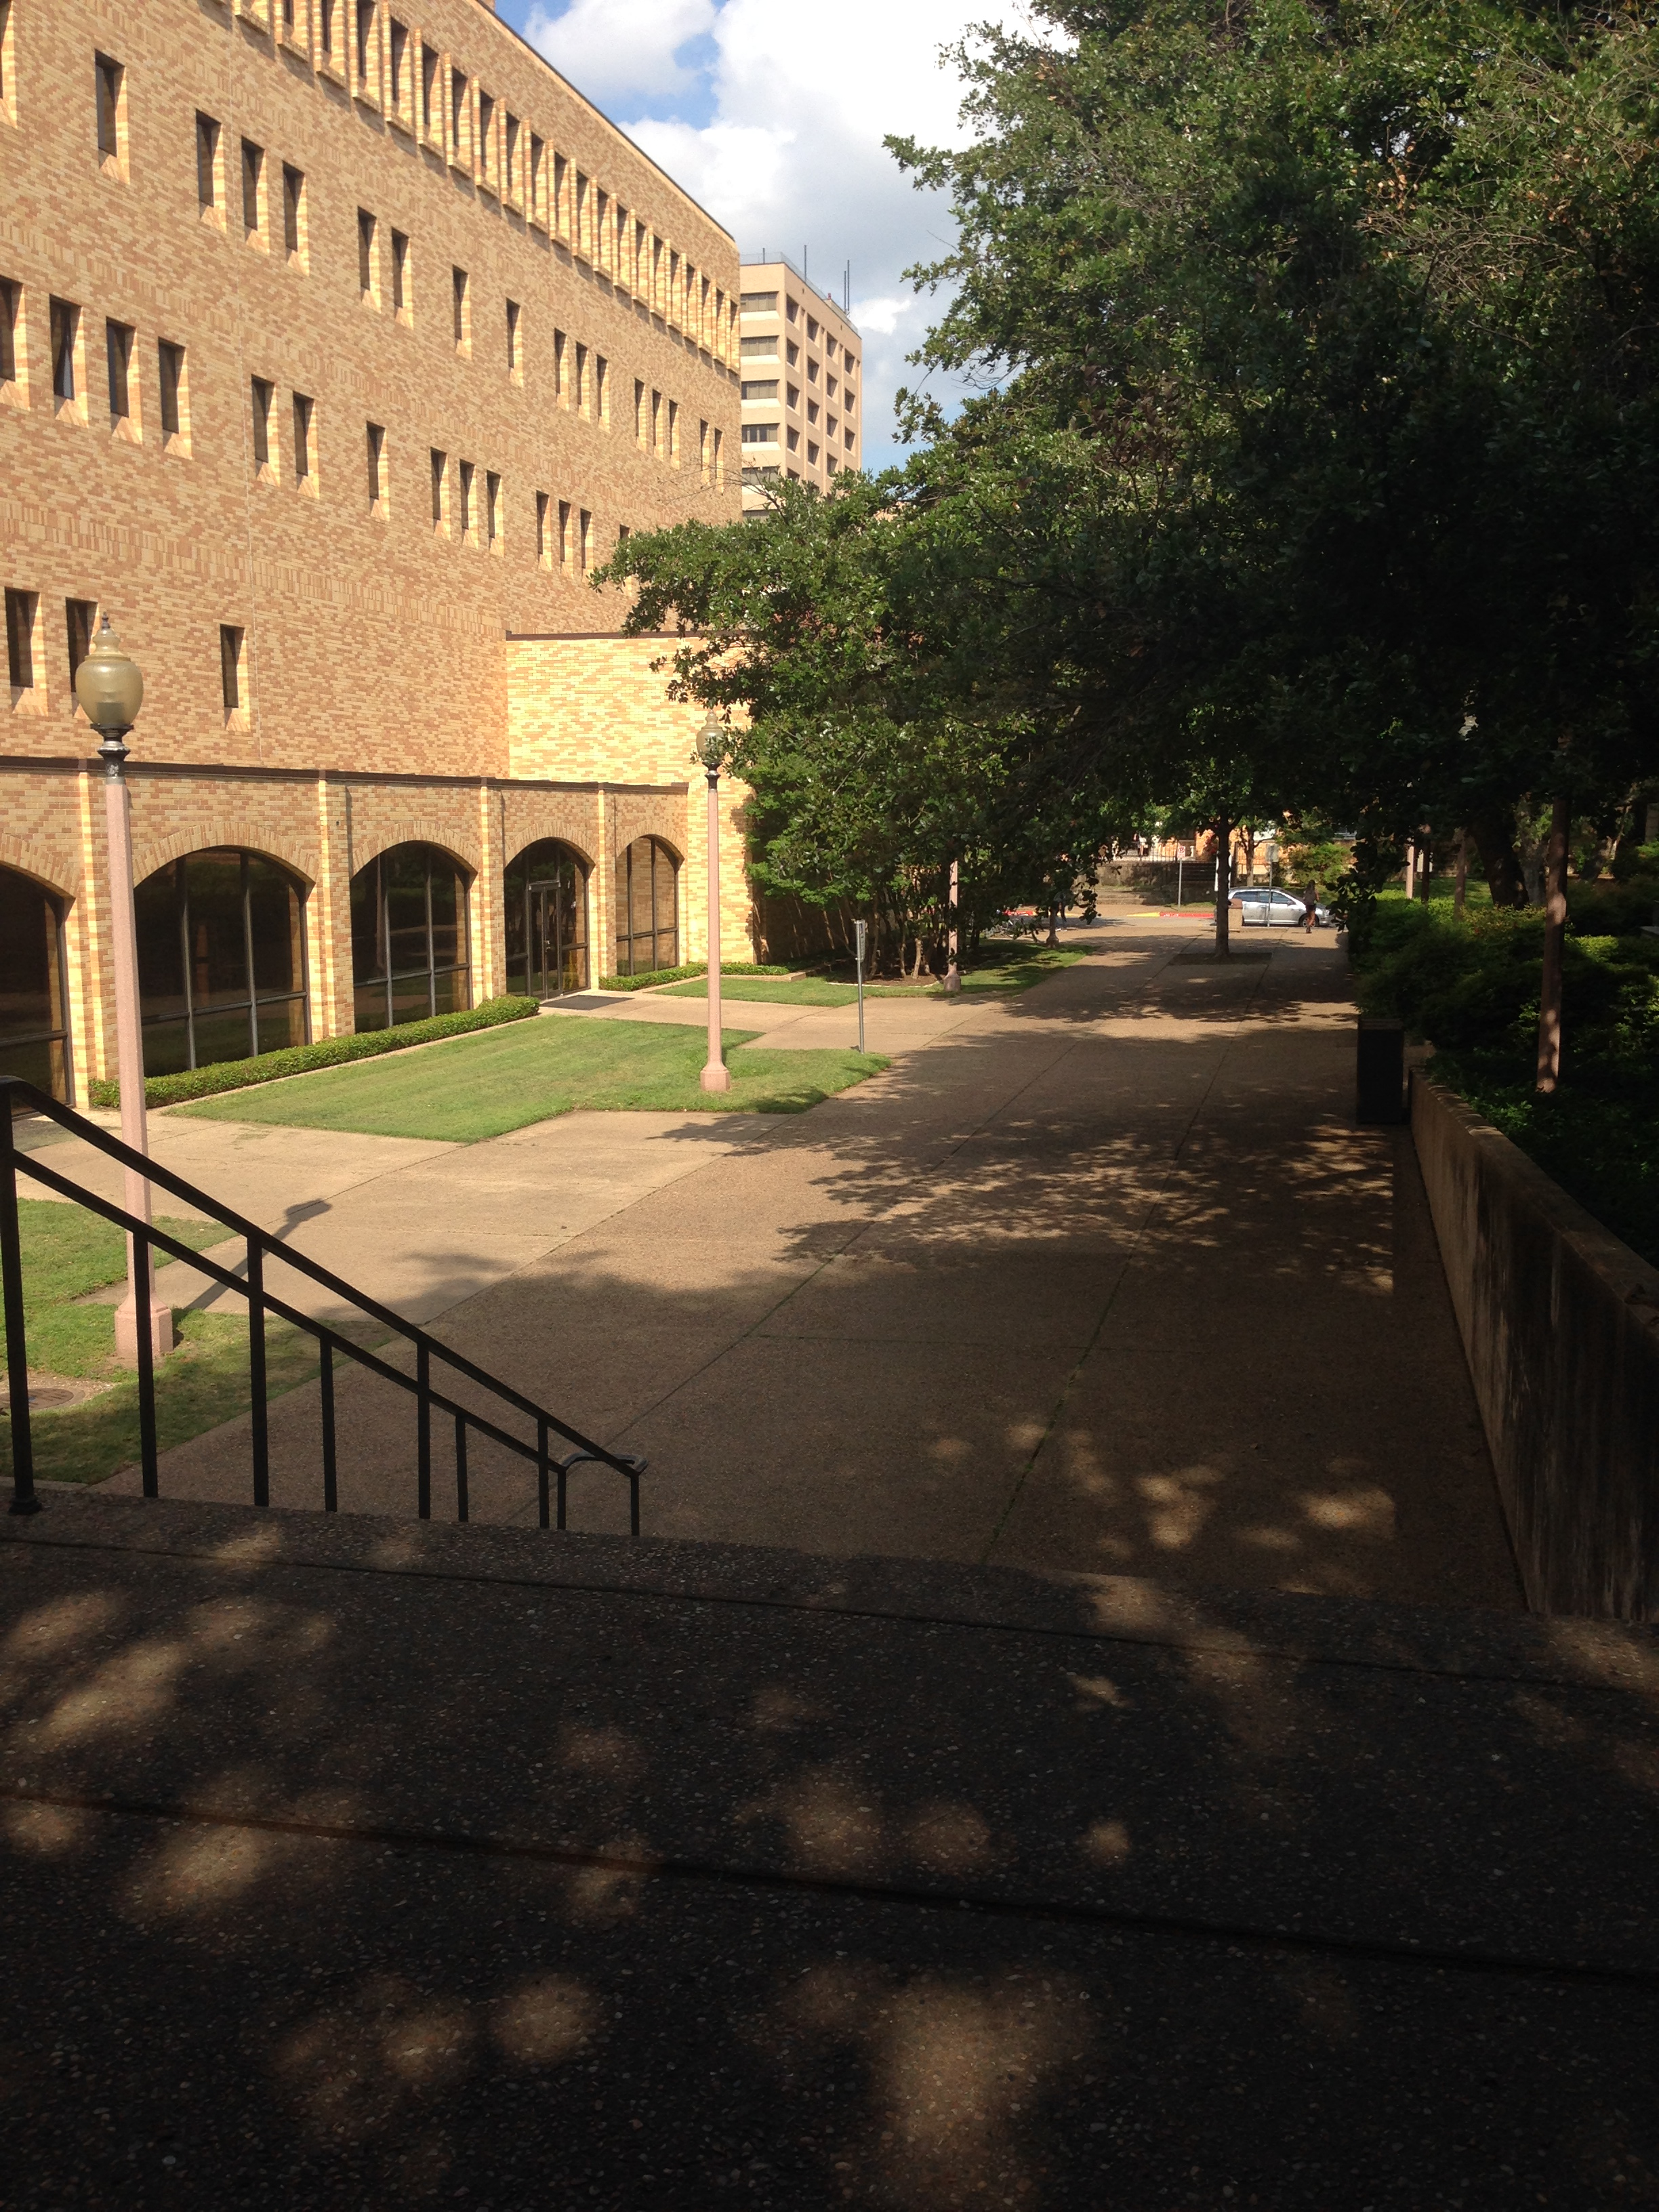
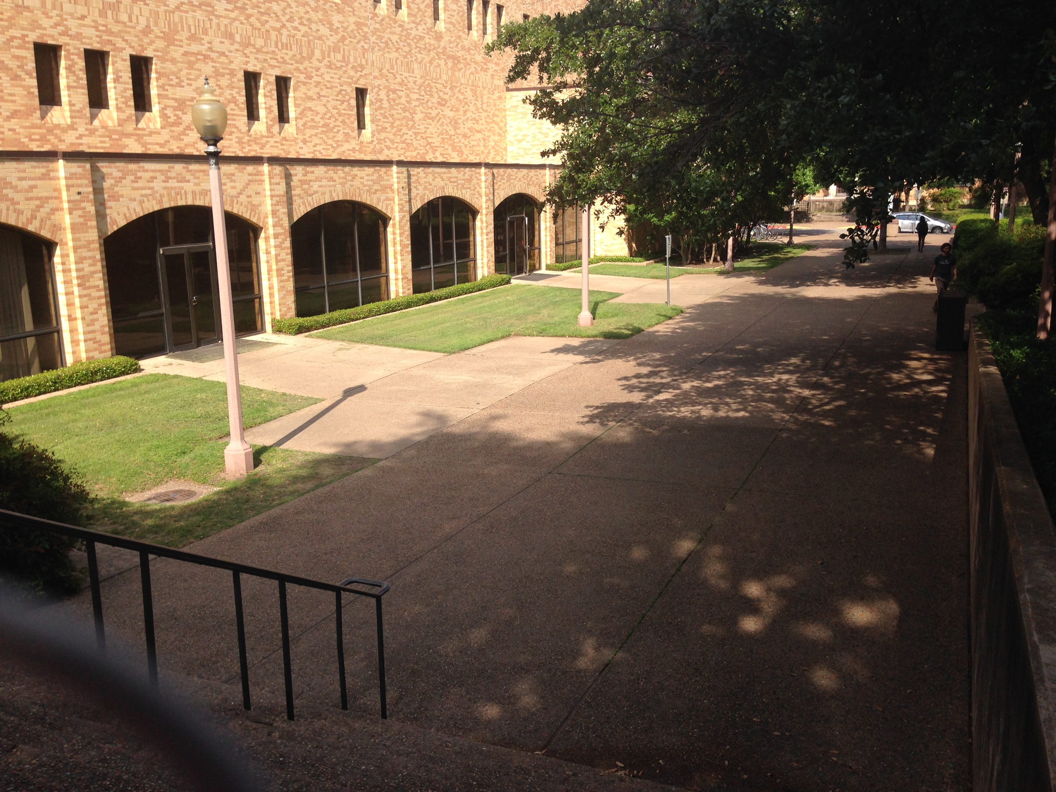
Process
How does the study area currently operate?

Slide 5
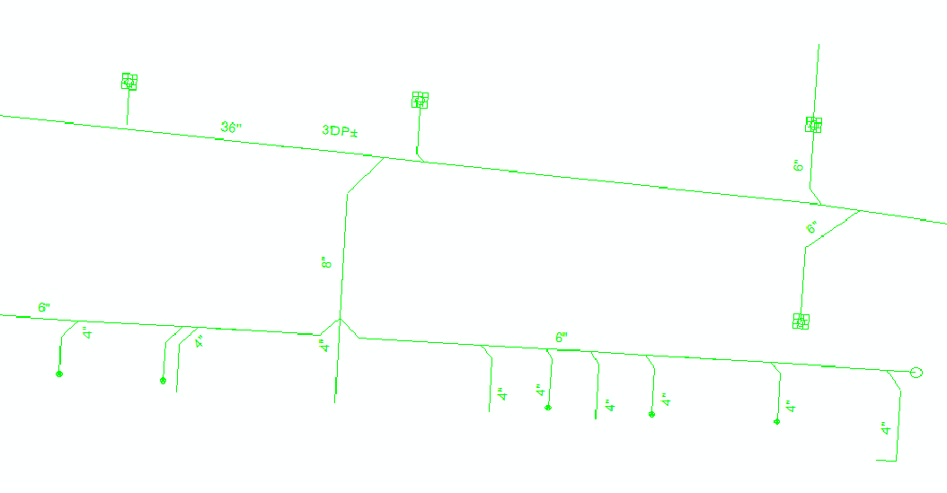
Process
Burdine
Main Problem Area
Pharmacy Building

Slide 6
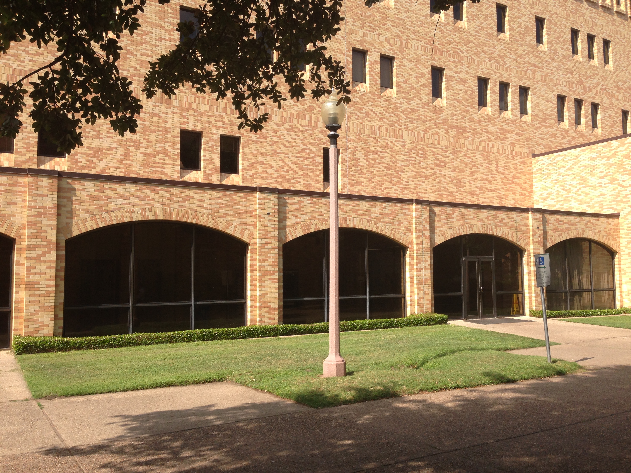
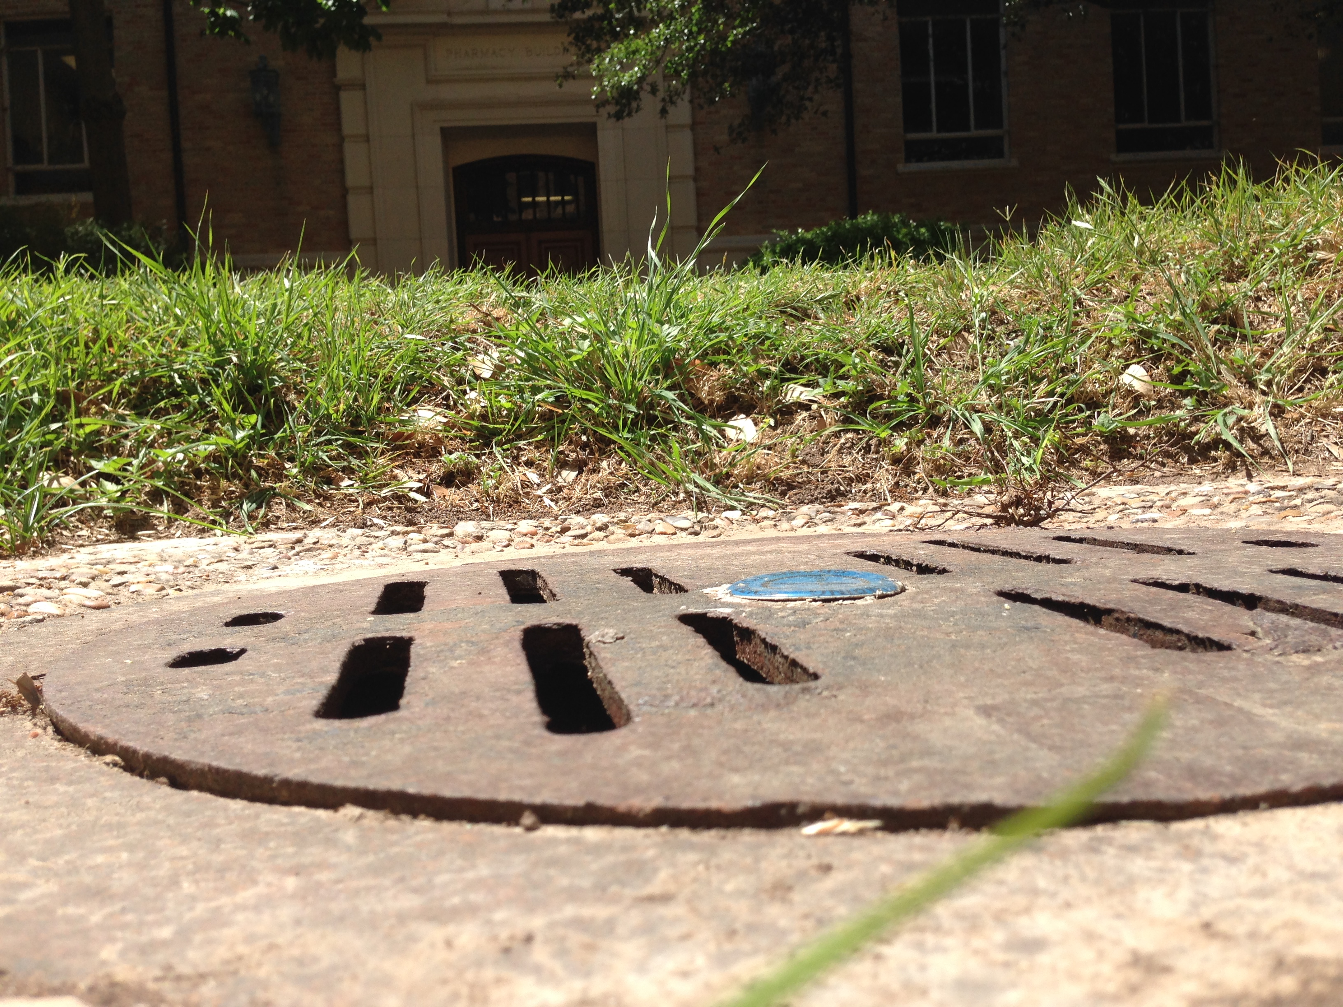
Evaluation
Is the current study area working well?
7”

Slide 7
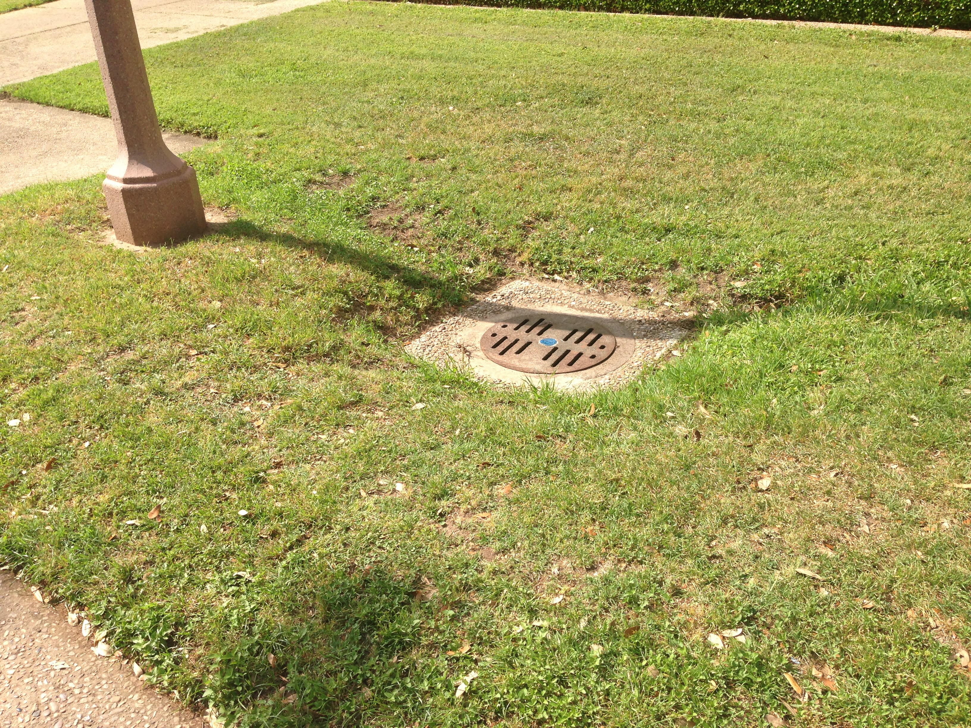
Evaluation

Slide 8
Table 2-4. Intensity-Duration-Frequency Table for Austin and Travis County
Intensity of Precipitation (inches per hour)
Recurrence Interval (year) | 5 min* | 15 min | 30 min | 1-hr | 2-hr | 3-hr | 6-hr | 12-hr | 24-hr
2 | 5.76 | 3.92 | 2.64 | 1.72 | 1.08 | 0.773 | 0.445 | 0.255 | 0.143
5 | 7.39 | 5.04 | 3.42 | 2.28 | 1.45 | 1.04 | 0.593 | 0.339 | 0.208
10 | 8.57 | 5.88 | 3.96 | 2.68 | 1.71 | 1.24 | 0.702 | 0.401 | 0.254
25 | 10.1 | 7.04 | 4.72 | 3.28 | 2.1 | 1.52 | 0.857 | 0.492 | 0.318
50 | 11.2 | 8.04 | 5.36 | 3.79 | 2.44 | 1.76 | 0.99 | 0.572 | 0.37
100 | 12.5 | 9.16 | 6.08 | 4.37 | 2.83 | 2.04 | 1.14 | 0.663 | 0.424
250 | 14.5 | 10.9 | 7.14 | 5.26 | 3.43 | 2.46 | 1.37 | 0.806 | 0.501
500 | 15.9 | 12.4 | 8.04 | 6.06 | 3.97 | 2.84 | 1.58 | 0.934 | 0.564
Table 2-3. Depth-Duration-Frequency Table for Austin and Travis County
Depth of Precipitation (in inches)
Recurrence Interval (year) | 5 min* | 15 min | 30 min | 1-hr | 2-hr | 3-hr | 6-hr | 12-hr | 24-hr
2 | 0.48 | 0.98 | 1.32 | 1.72 | 2.16 | 2.32 | 2.67 | 3.06 | 3.44
5 | 0.62 | 1.26 | 1.71 | 2.28 | 2.89 | 3.13 | 3.56 | 4.07 | 4.99
10 | 0.71 | 1.47 | 1.98 | 2.68 | 3.42 | 3.71 | 4.21 | 4.81 | 6.1
25 | 0.84 | 1.76 | 2.36 | 3.28 | 4.2 | 4.55 | 5.14 | 5.9 | 7.64
50 | 0.94 | 2.01 | 2.68 | 3.79 | 4.88 | 5.28 | 5.94 | 6.86 | 8.87
100 | 1.05 | 2.29 | 3.04 | 4.37 | 5.66 | 6.11 | 6.85 | 7.96 | 10.2
250 | 1.21 | 2.73 | 3.57 | 5.26 | 6.86 | 7.38 | 8.24 | 9.67 | 12
500 | 1.33 | 3.11 | 4.02 | 6.06 | 7.94 | 8.51 | 9.47 | 11.2 | 13.5
* The 5-min rainfall depths were calculated using the 5-min rainfall intensity values from Table 2-4.

Slide 9
TABLE 2-1
RATIONAL METHOD RUNOFF COEFFICIENTS FOR COMPOSITE ANALYSIS
Runoff Coefficient (C)
 | Return Period
Character
of Surface | 2 | 5 | 10 | 25 | 50 | 100 | 500
 | Years | Years | Years | Years | Years | Years | Years
DEVELOPED
Asphaltic | 0.73 | 0.77 | 0.81 | 0.86 | 0.9 | 0.95 | 1
Concrete | 0.75 | 0.8 | 0.83 | 0.88 | 0.92 | 0.97 | 1
Grass Areas (Lawns, Parks, etc.)
Poor Condition*
Flat, 0-2% | 0.32 | 0.34 | 0.37 | 0.4 | 0.44 | 0.47 | 0.58
Average, 2-7% | 0.37 | 0.4 | 0.43 | 0.46 | 0.49 | 0.53 | 0.61
Steep, over 7% | 0.4 | 0.43 | 0.45 | 0.49 | 0.52 | 0.55 | 0.62
Fair Condition**
Flat, 0-2% | 0.25 | 0.28 | 0.3 | 0.34 | 0.37 | 0.41 | 0.53
Average, 2-7% | 0.33 | 0.36 | 0.38 | 0.42 | 0.45 | 0.49 | 0.58
Steep, over 7% | 0.37 | 0.4 | 0.42 | 0.46 | 0.49 | 0.53 | 0.6
Good Condition***
Flat, 0-2% | 0.21 | 0.23 | 0.25 | 0.29 | 0.32 | 0.36 | 0.49
Average, 2-7% | 0.29 | 0.32 | 0.35 | 0.39 | 0.42 | 0.46 | 0.56
Steep, over 7% | 0.34 | 0.37 | 0.4 | 0.44 | 0.47 | 0.51 | 0.58
UNDEVELOPED
Cultivated
Flat, 0-2% | 0.31 | 0.34 | 0.36 | 0.4 | 0.43 | 0.47 | 0.57
Average, 2-7% | 0.35 | 0.38 | 0.41 | 0.44 | 0.48 | 0.51 | 0.6
Steep, over 7% | 0.39 | 0.42 | 0.44 | 0.48 | 0.51 | 0.54 | 0.61
Pasture/Range
Flat, 0-2% | 0.25 | 0.28 | 0.3 | 0.34 | 0.37 | 0.41 | 0.53
Average, 2-7% | 0.33 | 0.36 | 0.38 | 0.42 | 0.45 | 0.49 | 0.58
Steep, over 7% | 0.37 | 0.4 | 0.42 | 0.46 | 0.49 | 0.53 | 0.6

Slide 10
Calculation of Flow with Current Settings
Recurrence Interval (year) | 5 min* | C (impervious) | C (pervious) | C (avg) | A (acres) | Q (cfs) | Main Grate: 90% Q (cfs)
2 | 5.76 | 0.75 | 0.21 | 0.614 | 0.155 | 0.548 | 0.493
5 | 7.39 | 0.8 | 0.23 | 0.656 | 0.155 | 0.751 | 0.676
10 | 8.57 | 0.83 | 0.25 | 0.684 | 0.155 | 0.907 | 0.817
25 | 10.1 | 0.88 | 0.29 | 0.731 | 0.155 | 1.144 | 1.029
50 | 11.2 | 0.92 | 0.32 | 0.769 | 0.155 | 1.333 | 1.200
100 | 12.5 | 0.97 | 0.36 | 0.816 | 0.155 | 1.580 | 1.422
500 | 15.9 | 1 | 0.49 | 0.871 | 0.155 | 2.146 | 1.931
% Impervious | 74.8
% Grasses | 25.2
Total Area (sqf) | 6745
Pervious Cover (sqf) | 1700
d (in) | d (ft) | P (ft) | Cw | Qmax (cfs)
1 | 0.083 | 1.5 | 3.0 | 0.108
2 | 0.167 | 1.5 | 3.0 | 0.306
3 | 0.250 | 1.5 | 3.0 | 0.563
Equation for maximum inlet intake:
Q_{i} = C_{w}Pd^{1.5}

Slide 11
Change
We plan to utilize Low Impact Development (LID) strategies to reduce stormwater runoff in our study area and potentially improve water quality through stormwater detention
The runoff from drains in this area exits to Waller Creek
LID strategies:
Bioswale that uses natives plants
Pervious pavement
Also, different drain coverings need to be considered if LID methods don’t reduce flow enough

Slide 12
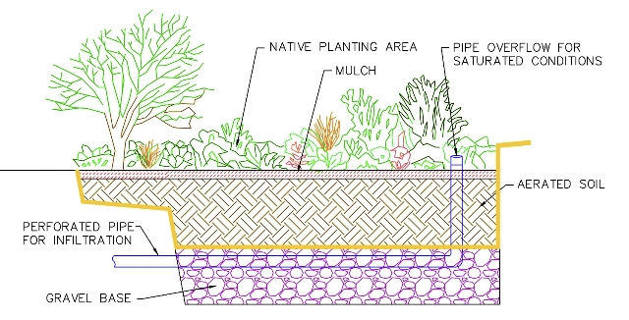
Bioswale
To start, this area needs to be leveled so that stormwater flow can easily reach the drain without any impedance
After that a swale can be dug out
Implement native plants into swale

Slide 13
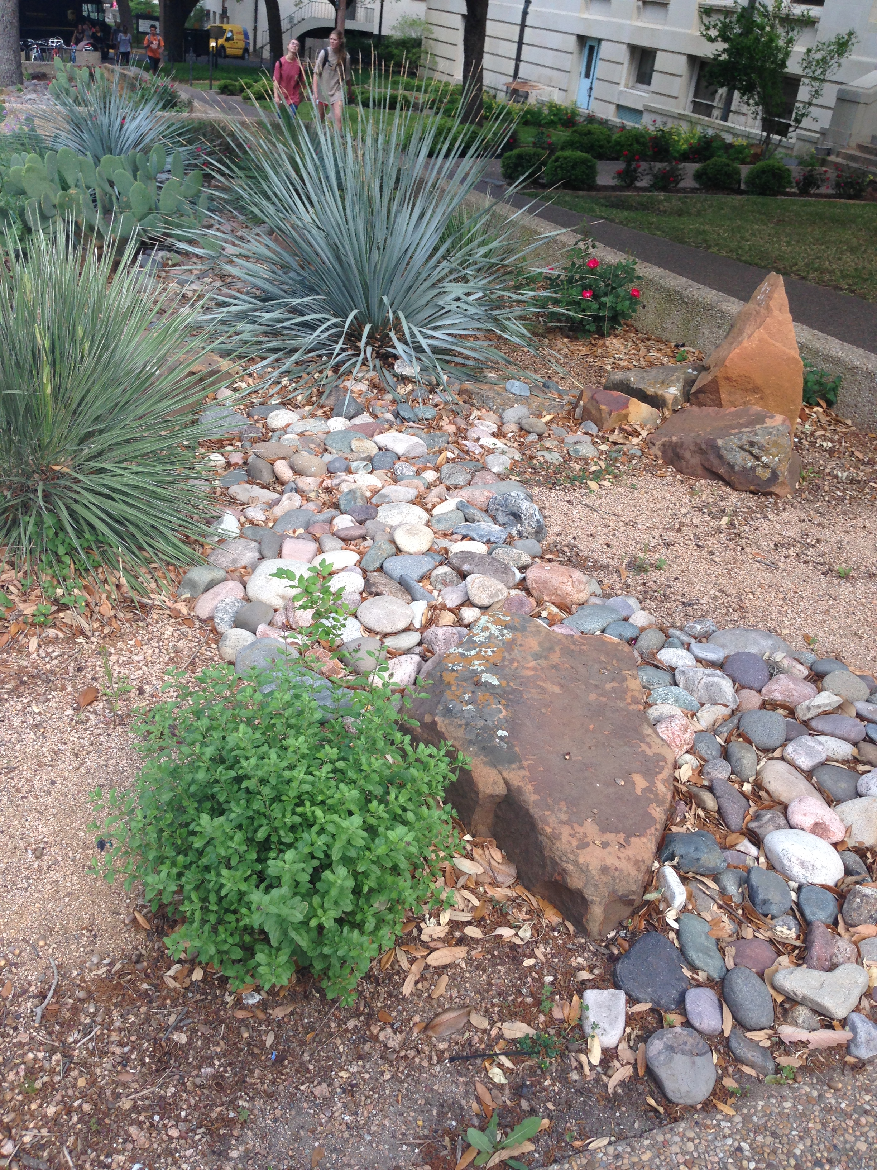
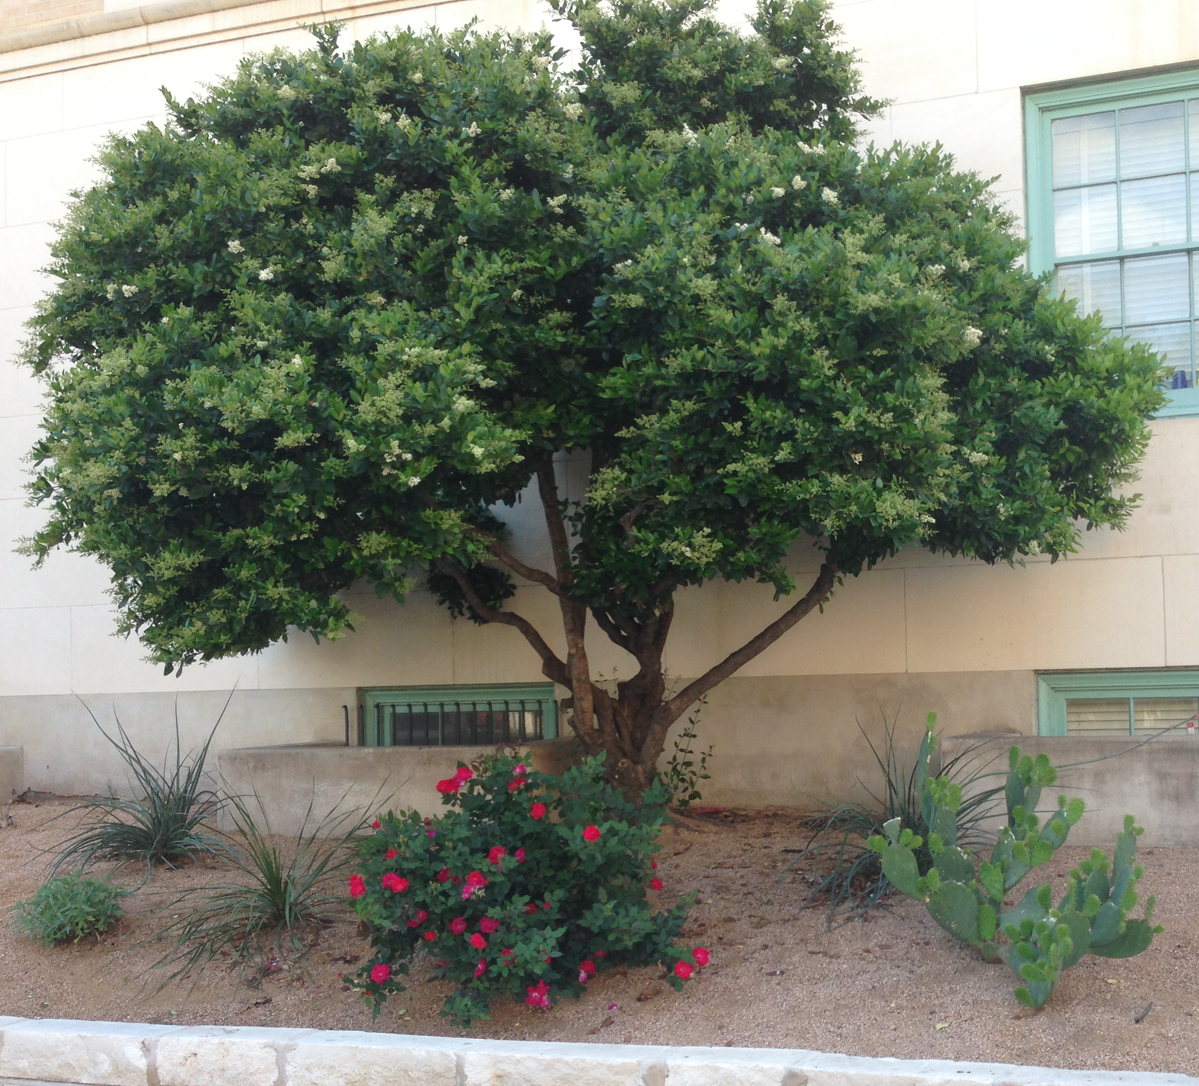
Native Plants

Slide 14
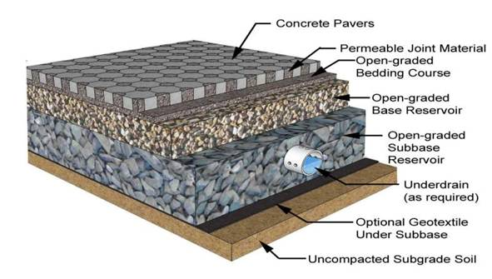
Pervious Pavement

Slide 15
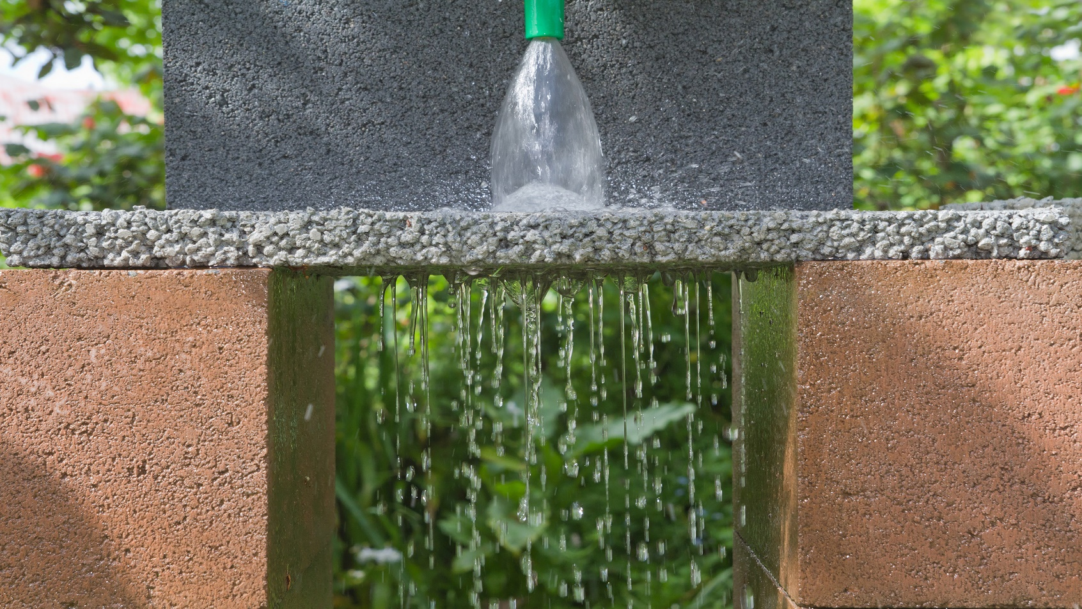
Close-up View (Open-graded Bedding Course)

Slide 16
Austin, TX Watershed Protection Department
Environmental concerns and allowed uses:
Porous pavement is currently only allowed for pedestrian use and not for parking lots, stormwater hot spots, or areas where land use or activities generate highly contaminated runoff.
Since porous pavement is an infiltration practice, it should not be applied at stormwater hot spots due to the potential for ground water contamination.
Environmental Criteria Manual 1.6.7.E of the Environmental Criteria Manual

Slide 17
Impact
How much would flow be reduced?
We still need to calculate the exact amount that the pervious pavement would reduce flow (how much water the pavement can “absorb”) and how much water a potential bioswale could hold

Slide 18
Permeable vs. Impermeable
Land Cover | Infiltration Rates (in/hr) | Runoff Coefficient, C
Permeable Interlocking Concrete Pavement | Up to 50 in/hr with maintenance. 3-4 in/hr without. | 0.00 – 0.30
Impervious Asphalt or Concrete Pavement | 0 in/hr | 0.90 – 0.95
Recurrence Interval (year) | 5 min* | C (impervious) | C (pervious) | C (avg) | A | Q | % Flow Main Grate
2 | 5.76 | 0.1 | 0.21 | 0.128 | 0.155 | 0.114 | 0.103
5 | 7.39 | 0.15 | 0.23 | 0.170 | 0.155 | 0.195 | 0.175
10 | 8.57 | 0.2 | 0.25 | 0.213 | 0.155 | 0.282 | 0.254
25 | 10.1 | 0.25 | 0.29 | 0.260 | 0.155 | 0.407 | 0.366
50 | 11.2 | 0.3 | 0.32 | 0.305 | 0.155 | 0.529 | 0.476
100 | 12.5 | 0.35 | 0.36 | 0.353 | 0.155 | 0.682 | 0.614
500 | 15.9 | 0.4 | 0.49 | 0.423 | 0.155 | 1.041 | 0.937

Slide 19
Decision
Analyze results of flow reduction from each LID strategy
Determine cost efficiency of each option
Choose one or both to implement based on overall potential drainage improvements

Slide 20
Sources
Design of concrete paver systems: http://vwrrc.vt.edu/swc/NonPBMPSpecsMarch11/VASWMBMPSpec7PERMEABLEPAVEMENT.html
Smith, D. 2006. Permeable Interlocking Concrete Pavement-selection design, construction and maintenance. Third Edition. Interlocking Concrete Pavement Institute. Herndon, VA.
Table with runoff coeff. and zoomed in paver image - http://www.ncsu.edu/picp/FactSheets/DesignProfessionals-PICP.pdf
Austin, TX watershed protection department: https://austintexas.gov/faq/porous-pavement
Permeable pavement demonstration: http://en.wikipedia.org/wiki/Permeable_paving
City of Austin Drainage Criteria Manual

Slide 21
Questions?

