Slide 1
Waller Creek Flooding along 45th Street
Design Project
C E 365K- Hydraulic Engineering Design
Group 11: Scott Cameron, Matthew Strumeyer, Juhn-Yuan Su
Dr. D. R. Maidment

Slide 2
Overview
Discussion on Location
Hydrodesign Process:
  Representation
  Process
  Evaluation
  Change
  Impact
  Decision
Recommendations

Slide 3
Waller Creek
Flooding as a Fundamental Problem (Primary focus of Project)
  2/3 of Natural Disasters due to Flooding
  Examples of Flooding Disasters: Halloween Flood (10/31/2013), Sandy (2012); a lot of them over the world!
Water Quality another issue (will not be the primary focus of project)
  Buildings simply “getting rid of water as quickly as possible”
  NOT the primary emphasis for this project

Slide 4
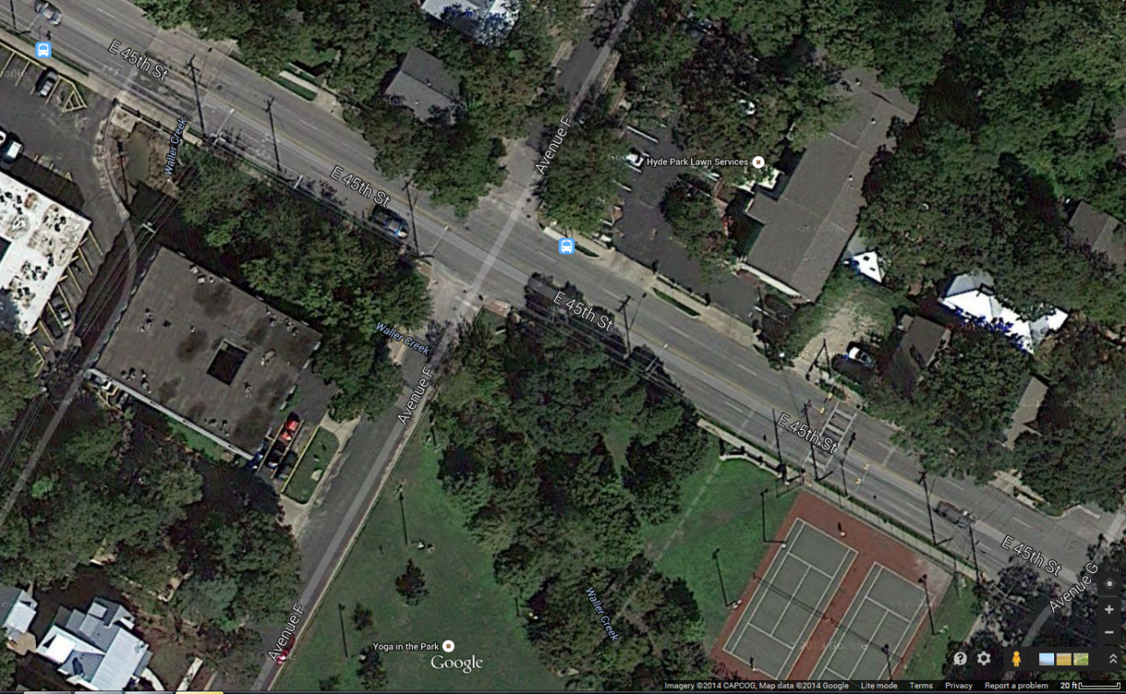
Area of Study
Apartment Complex
FOCUS OF PROJECT: 45th Street and Avenue F Area
  Apartment Complex

Slide 5
Representation
How can the Study Area be Described?
Waller Creek through Avenue F and 45th Street
Approximately 22,500 feet from downstream of Waller Creek Reach
Apartment on one side of creek and road on another

Slide 6
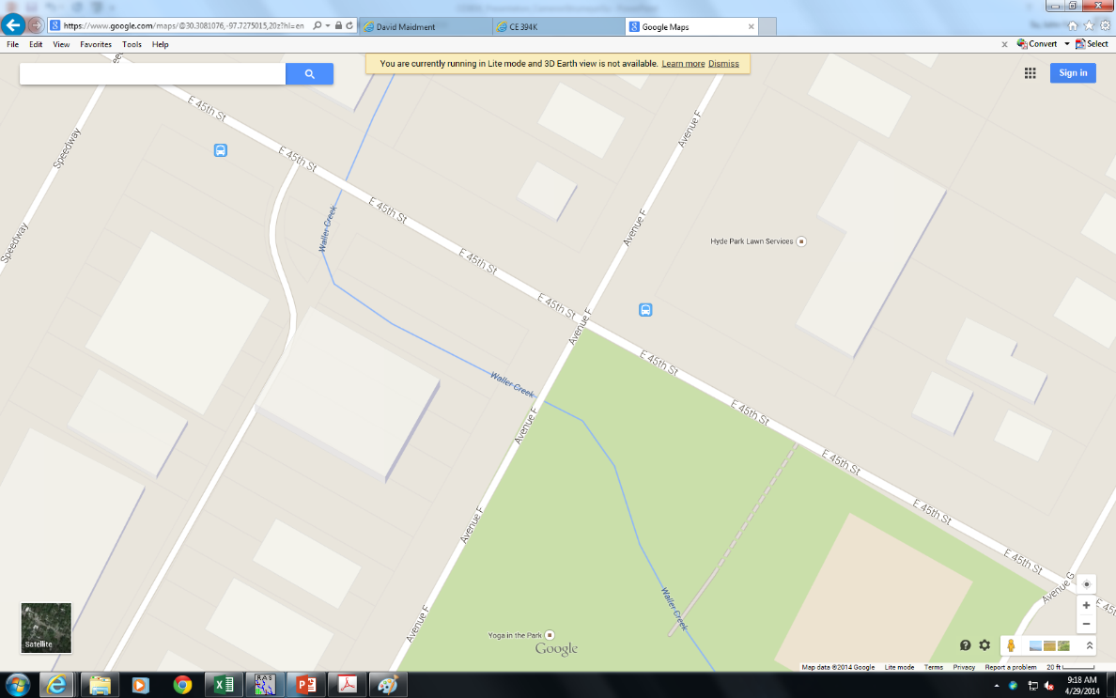
PROCESS
How does the Study Area Operate?
Bridges
Waller Creek flows downstream along the route indicated
Flows through the park
Two Bridges:
  45th Street
  Avenue F

Slide 7
Evaluation
Is the Study Area Working Well?
NO!!!
The Apartment Complex Directly in the 25-year AND 100-year Floodplain
Karl McArthur: Flooding Problems between 41st and 47th Street
  Particularly Area on the right

Slide 8
EVALUATION

Slide 9
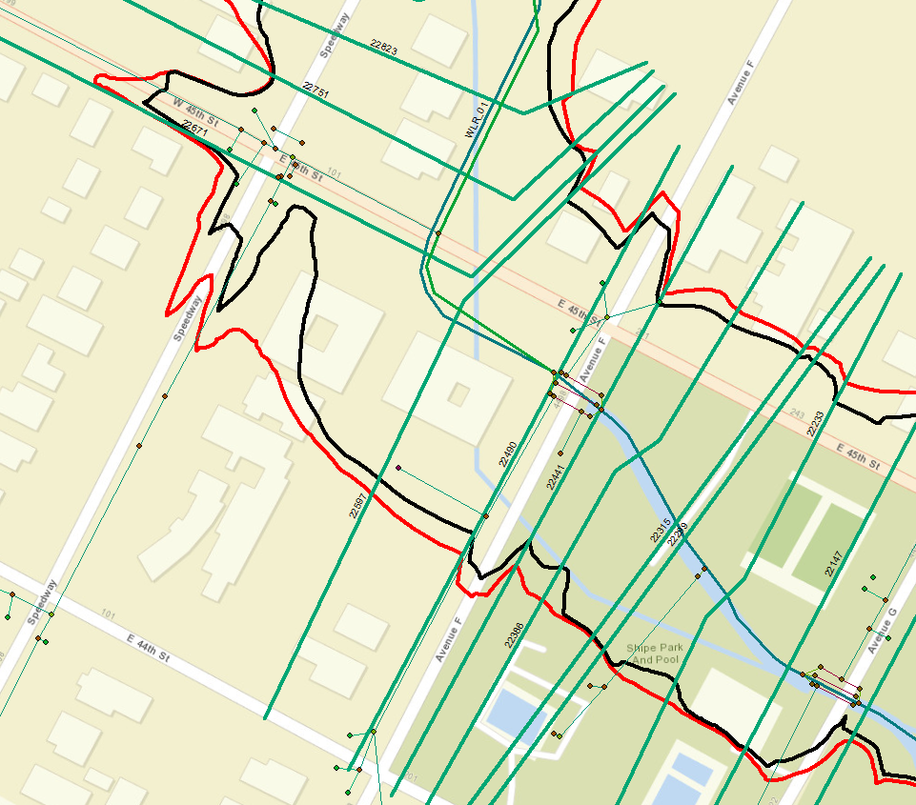
Cross Section to Modify

Slide 10
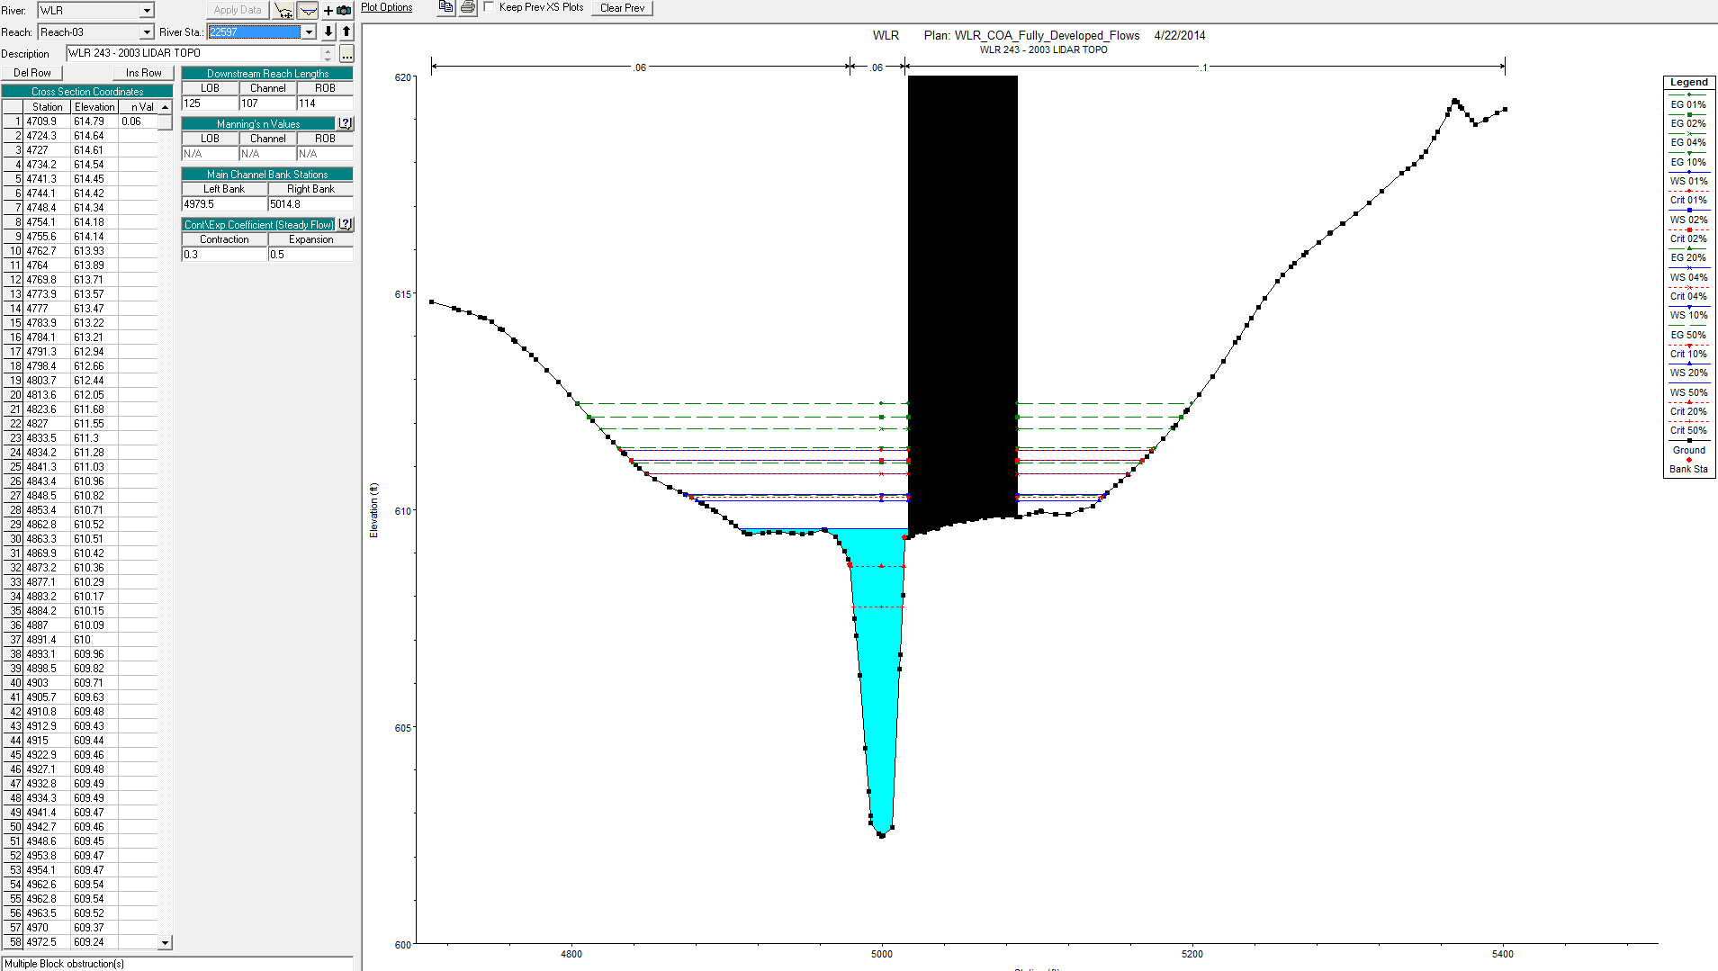

Slide 11
CHANGE
How might the Study Area be Altered?
SOLUTIONS PROPOSED:
  Do Nothing
  Get Rid of the Apartment
  Elevate the Apartment
  Elevate BOTH the Apartment and the Road
USE HEC-RAS for the Simulation Models

Slide 12
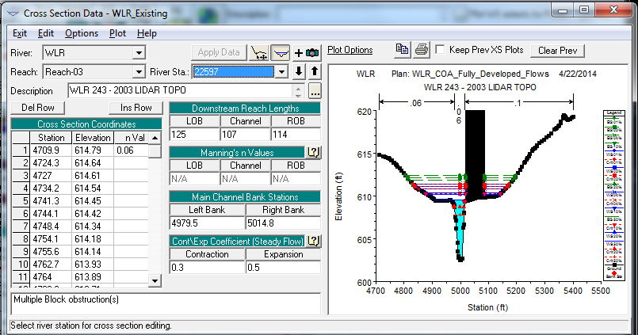
SOLUTION 1: DO NOTHING

Slide 13
SOLUTION 1: DO NOTHING
Return Period | Q total | Min. Ch. El. | WS El. | Crit. W.S. | E.G. El. | EG slope | V | Flow A | T | Nf
years | cfs | ft | ft | ft | ft | ft/ft | ft/s | ft^2 | ft
2-year | 1240 | 602.46 | 609.57 | 607.76 | 610.34 | 0.01087 | 7.03 | 186.49 | 109.35 | 0.56
5-year | 1680 | 602.46 | 610.21 | 608.69 | 611.08 | 0.011313 | 7.78 | 278.66 | 188.62 | 0.58
10-year | 1990 | 602.46 | 610.35 | 610.29 | 611.43 | 0.01391 | 8.77 | 305.47 | 200.22 | 0.64
25-year | 2440 | 602.46 | 610.83 | 610.83 | 611.86 | 0.013036 | 8.96 | 411.96 | 240.75 | 0.63
50-year | 2800 | 602.46 | 611.13 | 611.13 | 612.13 | 0.012696 | 9.12 | 486.5 | 259.1 | 0.63
100-year | 3260 | 602.46 | 611.37 | 611.37 | 612.45 | 0.013606 | 9.67 | 549.15 | 272.32 | 0.66

Slide 14
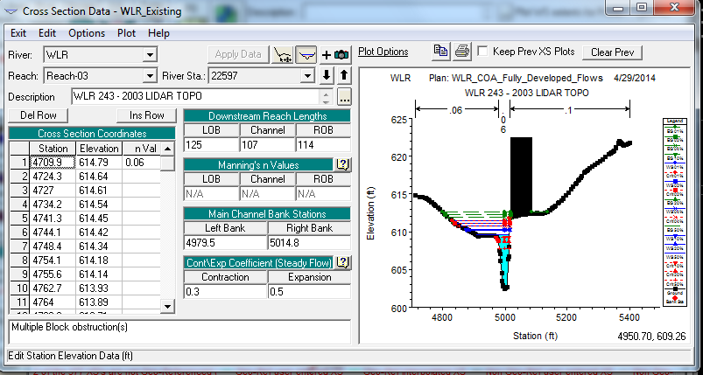
SOLUTION 2: Elevate the Apartment (Right OverBank)
Raise the Apartment by 2.5 Feet
In HEC-RAS, Raise the Right Overbank (ROB)
  Decreases the Flow Area

Slide 15
Solution 2: Raise the Apartment
ROB | Q total | Min. Ch. El. | WS El. | Crit. W.S. | E.G. El. | EG slope | V | Flow A | T | Nf
2.5 ft up | cfs | ft | ft | ft | ft | ft/ft | ft/s | ft^2 | ft
2-year | 1240 | 602.46 | 609.57 | 607.76 | 610.34 | 0.010868 | 7.03 | 186.52 | 109.36 | 0.56
5-year | 1680 | 602.46 | 610.2 | 608.69 | 611.09 | 0.011539 | 7.85 | 263.31 | 135.57 | 0.58
10-year | 1990 | 602.46 | 610.33 | 610.14 | 611.46 | 0.014522 | 8.93 | 280.22 | 141.95 | 0.66
25-year | 2440 | 602.46 | 610.76 | 610.76 | 611.95 | 0.014774 | 9.46 | 347.47 | 165.9 | 0.67
50-year | 2800 | 602.46 | 611.09 | 611.09 | 612.27 | 0.014379 | 9.66 | 404.02 | 177.41 | 0.67
100-year | 3260 | 602.46 | 611.38 | 611.38 | 612.63 | 0.015005 | 10.16 | 456.41 | 185.55 | 0.69

Slide 16
SOLUTION 2 Results
Pros
Cons
Lowered Top Width by 45 Feet for 5-year Return Period
Allows greater Flow Velocity THOUGH Smaller Flow Area
Requires People to Move Out and then Move Back In
Need a Machine to Literally Elevate the Apartment
Need Soil Fill to Add Below the Apartment

Slide 17
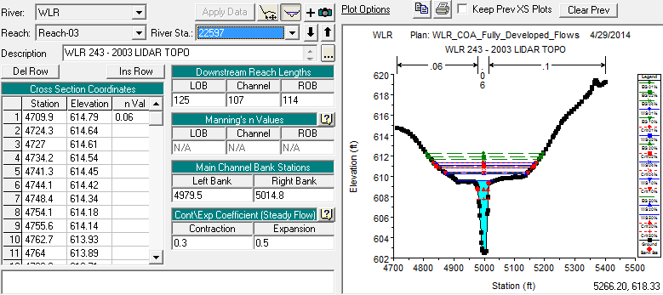
Solution 3: Destroy the Obstruction
NO Change in Elevation of LOB or ROB
Water Surface Elevations still the same

Slide 18
SOLUTION 3: Destroy the Obstruction
Destroy | Q total | Min. Ch. El. | WS El. | Crit. W.S. | E.G. El. | EG slope | V | Flow A | T | Nf
Apartment | cfs | ft | ft | ft | ft | ft/ft | ft/s | ft^2 | ft
2-year | 1240 | 602.46 | 609.57 | 607.76 | 610.33 | 0.010857 | 7.03 | 188.34 | 127.75 | 0.56
5-year | 1680 | 602.46 | 610.26 | 608.69 | 611.03 | 0.010376 | 7.49 | 326.45 | 261.92 | 0.56
10-year | 1990 | 602.46 | 610.43 | 610.39 | 611.34 | 0.012021 | 8.23 | 374.12 | 277.41 | 0.6
25-year | 2440 | 602.46 | 610.83 | 610.83 | 611.7 | 0.01169 | 8.48 | 490.42 | 310.3 | 0.6
50-year | 2800 | 602.46 | 611.05 | 611.03 | 611.94 | 0.011974 | 8.78 | 561.98 | 324.64 | 0.61
100-year | 3260 | 602.46 | 611.36 | 611.29 | 612.21 | 0.011636 | 8.93 | 663.81 | 341.84 | 0.61

Slide 19
SOLUTION 3: Destroy the OBSTRUCTION
Pros
Cons
Flow Velocity has Decreased due to Larger Flow Area
Less Worries on People along Waller Creek at Avenue F getting Flooded
Top Width Increased Significantly
Where are all those people in the apartment going to go?
  MIGHT BE UT STUDENTS!!

Slide 20
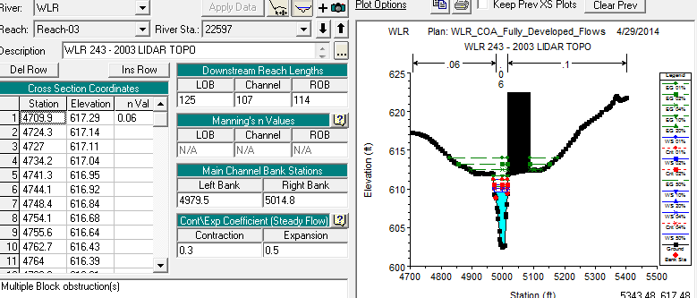
SOLUTION 4: Raise the Left and Right Overbanks
Raise Both Sides of the Channel by 2.5 feet
  Road
  Apartment Complex
Helps solve issue on Flooding along Apartment and Road

Slide 21
Solution 4: Raise the left and right overbanks
Elevate LOB and ROB by 2.5 feet | Q total | Min. Ch. El. | WS El. | Crit. W.S. | E.G. El. | EG slope | V | Flow A | T | Nf
 | cfs | ft | ft | ft | ft | ft/ft | ft/s | ft^2 | ft
2-year | 1240 | 602.46 | 609.57 |  | 610.34 | 0.010909 | 7.04 | 179.09 | 42.77 | 0.56
5-year | 1680 | 602.46 | 610.09 |  | 611.22 | 0.014106 | 8.56 | 201.65 | 43.64 | 0.64
10-year | 1990 | 602.46 | 610.13 |  | 611.68 | 0.019369 | 10.07 | 203.13 | 43.7 | 0.76
25-year | 2440 | 602.46 | 610.06 | 610.03 | 612.47 | 0.030396 | 12.52 | 200.21 | 43.58 | 0.95
50-year | 2800 | 602.46 | 610.54 | 610.54 | 613.15 | 0.029632 | 13.08 | 221.53 | 44.39 | 0.95
100-year | 3260 | 602.46 | 611.18 | 611.18 | 613.98 | 0.028059 | 13.62 | 249.89 | 45.45 | 0.94

Slide 22
SOLUTION 4: Raise the Left and Right Overbanks
Pros
Cons
Significantly decreased the Top Width
  All to Top Width in the 40s feet
Increased Flow Velocity though with Much Smaller Flow Area
Traffic Accidents due to Elevated Road???
  Means: Need to Raise 45th Street Upstream (cost-inefficient)
Soil Fill Needed
Cost- High; Need to Raise Apartment and Road

Slide 23
Solution Choice
Conclude: Solution 2 (Elevate Apartment by 2.5 feet) is the most cost-effective solution
2.5 Feet- Neutral Selection for Elevation
  Water-Surface Level for 100-year Storm Still Below Apartment

Slide 24
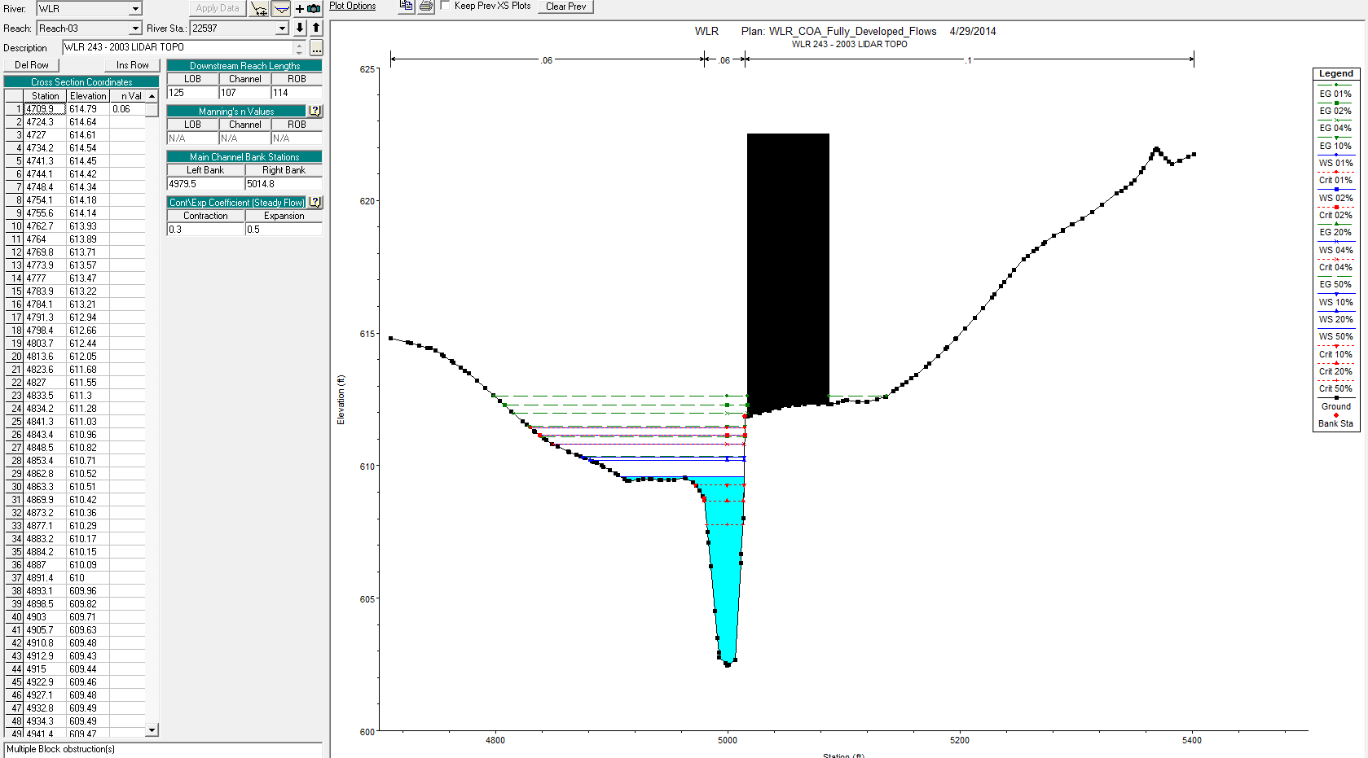
Photo of HeC-RAS model

Slide 25
Progress
Auto-CAD Drawing of Waller Creek and Raised Apartment Elevation Needed!
Incorporation into ArcGIS with the Raised HEC-RAS Model
FOR MATT AND SCOTT: Please add any of the AutoCAD or GIS models with the solution if updated.

Slide 26
QUESTIONS?
Thank you!

