Slide 1
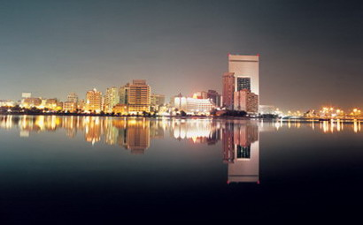
Northern Channel Jeddah
By: Julia Cavell, Peter Erni, and Sam Kunz

Slide 2
Overview
Representation
  Description of Study Area
Process
  HEC-HMS Modeling
Evaluation
Change
  How to alter current channel
Impact
  How change would effect flooding
Decision
  What solutions are most efficient
Further Work and Planning

Slide 3
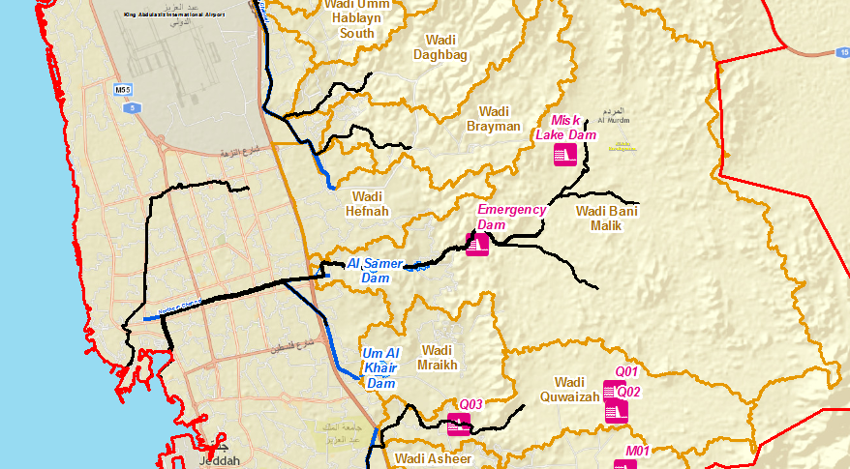
Representation
Base Map for Study Area

Slide 4
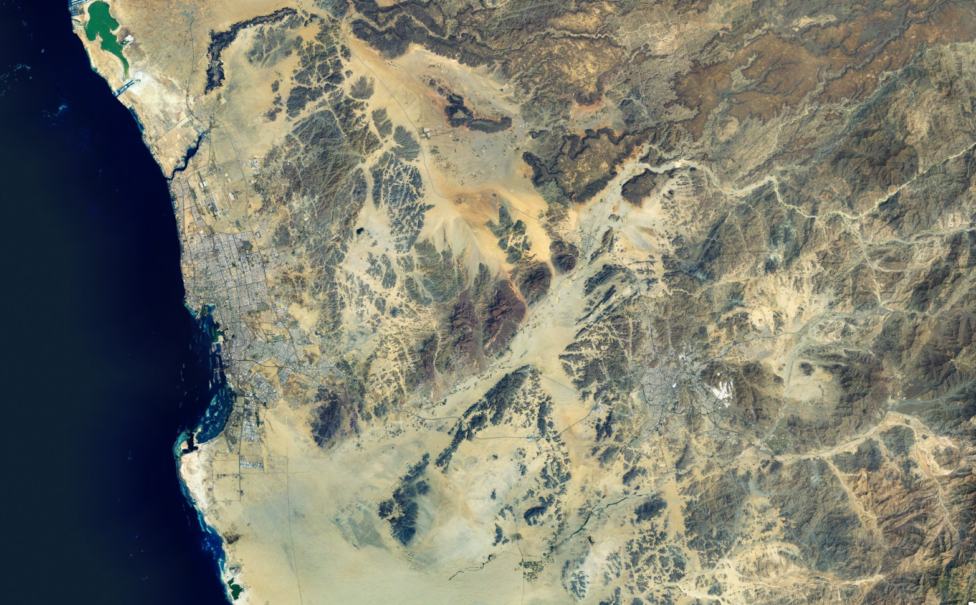
Map Showing Mountainous Regions Surrounding Jeddah

Slide 5
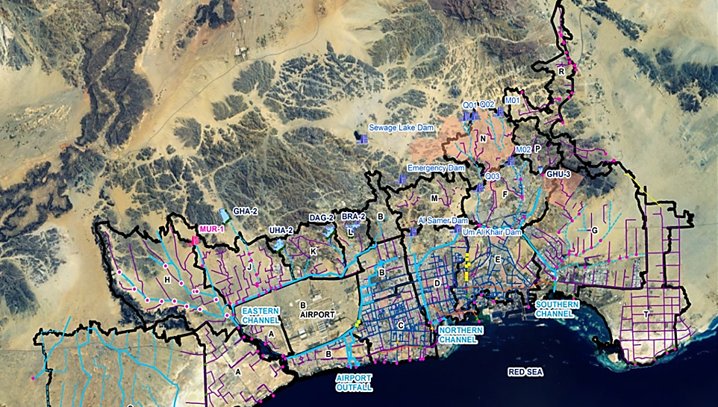
New Channels Implemented by AECOM

Slide 6
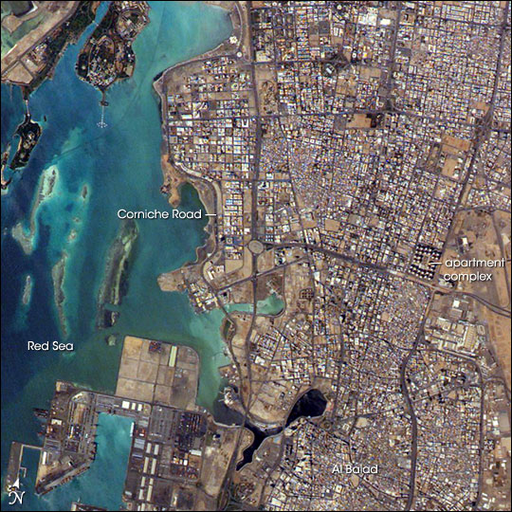
Description of Jeddah
Jeddah is a arid city with a coastal plain
Surrounded by mountains
Flat and steep set of mountains around the city
When rainfall occurs it goes down the mountain
  Then goes through the city

Slide 7
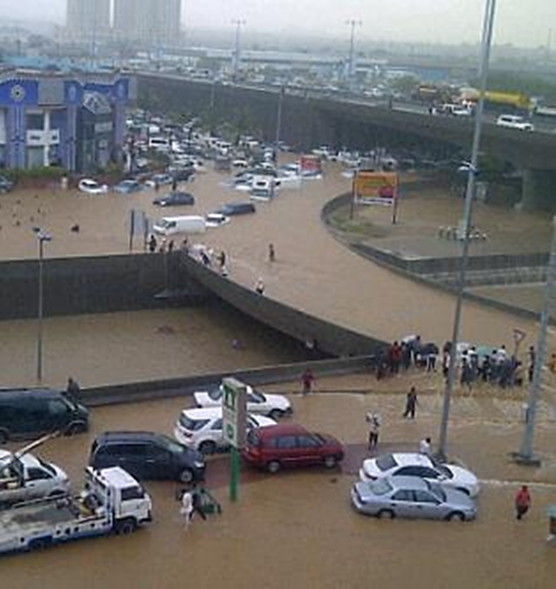
Process
3.5 Million people
2.1 inches of rainfall annually
Except on two days when Jeddah experienced heavy rainfall
November 26th, 2009 Jeddah was inundated with 4.37 inches of rain
This was approximately 1.46 inches per hour of rainfall

Slide 8
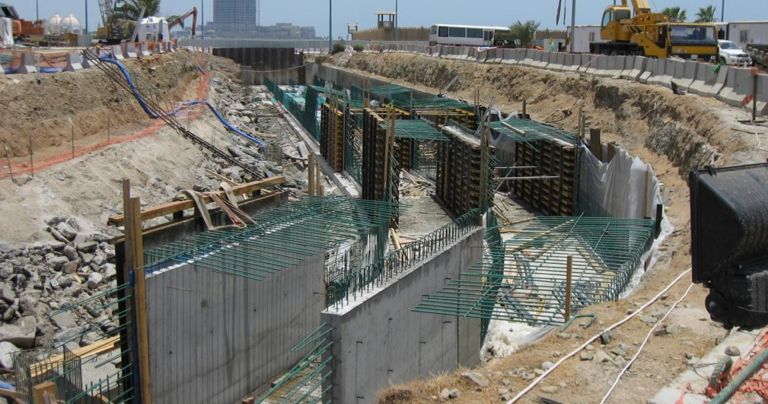
Current Situation
AECOM built channels to bring flow through the city to Red Sea
Channels allow for 500 year floods
There is still a chance of greater floods due to dam breaches, extreme rainfalls, and climate change

Slide 9
Evaluation
AECOM’s work does not account for 1000 year flood periods
According to HEC-HMS models, the losses and flow calculated were extremely close to recorded data from the region.
Due to high level intensity rainfall, the city of Jeddah has periods/days where severe flooding occurs
Mountainous regions around the city contribute to this flooding
  Rainfall from mountains flow directly into city
  Steep slopes lead to faster flows

Slide 10
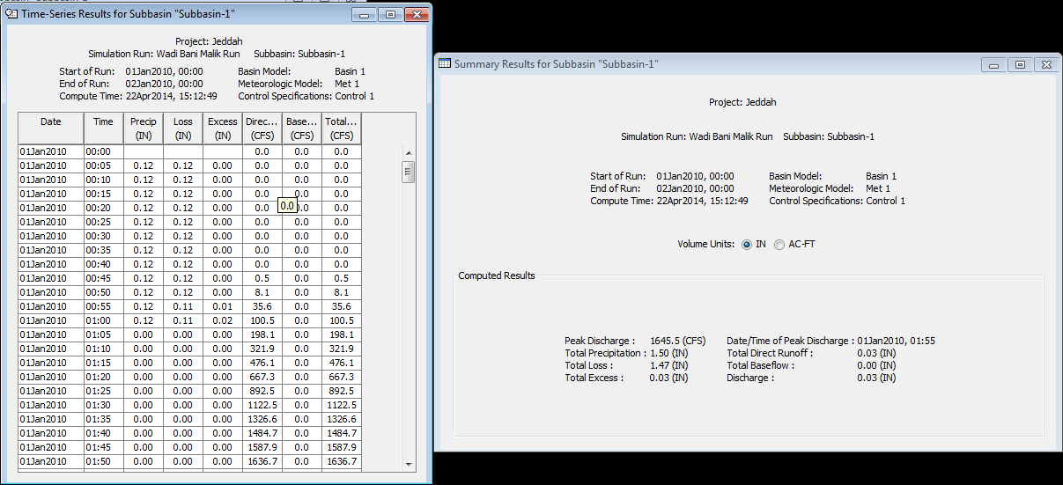
Data for 100 Year Flood (1.5 in/hr)
Peak Discharge of 46.6 m^3/s
(Source: Ben Pope)

Slide 11
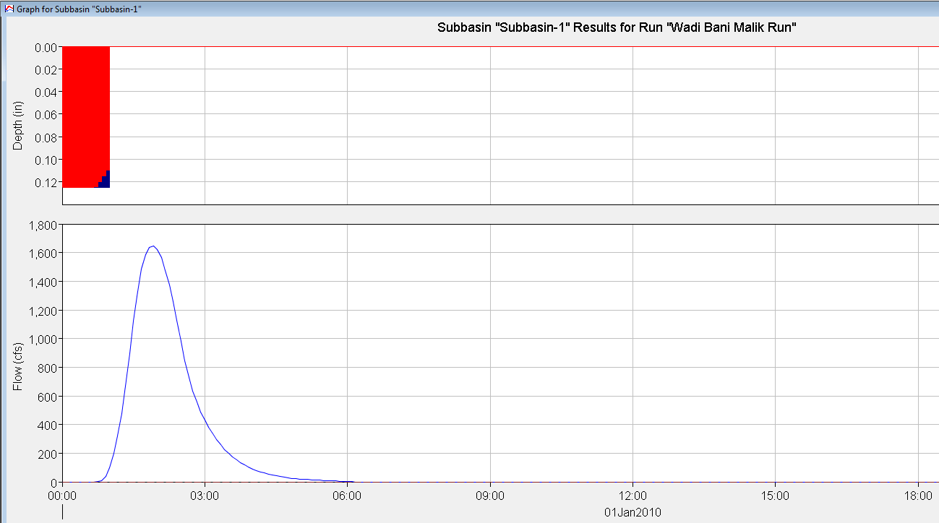
HEC-HMS Model
Wadi Bani Malik Basin

Slide 12
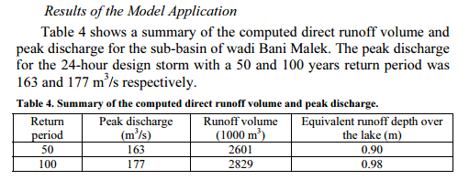
Known Data
Our calculated peak discharge was 186.4 m^3/s for a 24-hour design storm

Slide 13
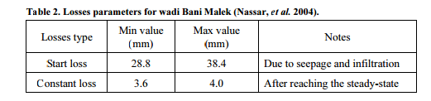
Losses
Calculated losses = 37.338 mm
This falls within the range of Total Losses (32.4 - 42.4 mm)

Slide 14
Scope of Work and Change
Show the resulting flow through Jeddah
Reduce flooding of the city during heavy rainfall events
Focus on two drainage areas: Wadi Bani Malik and Wadi Mraik
Dams within each drainage area
  Lead to channel which lead to Northern Channel
  Northern Channel leads to Red Sea

Slide 15
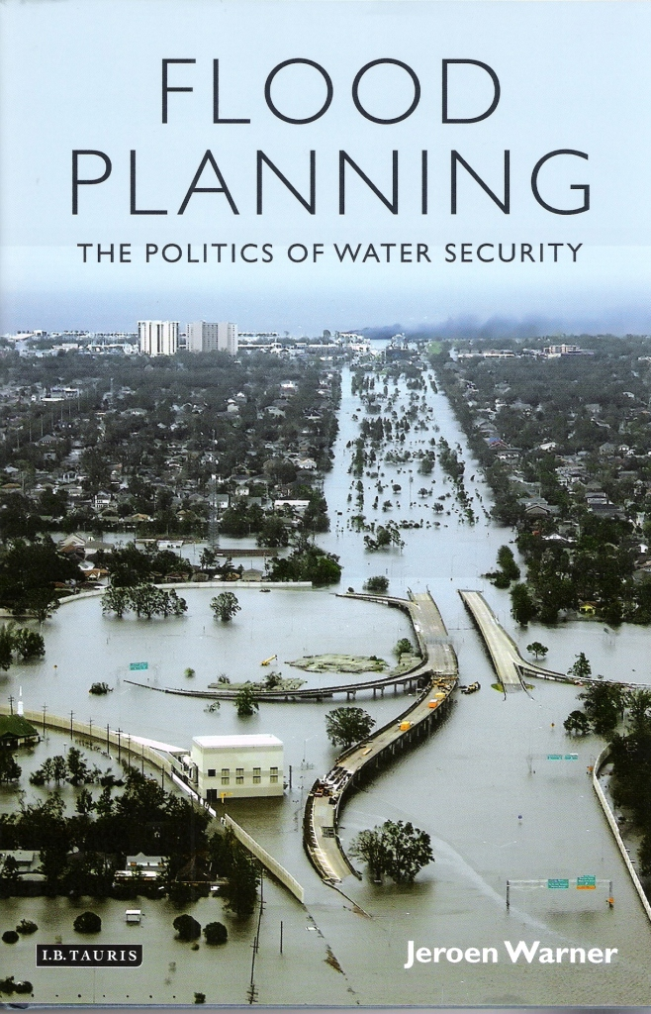
Solutions & Alternatives
We must account for the additional 9.4 m^3/s peak discharge
Design new channel that can allow for 1000 year flood discharge
Given the width of the basin to be 5.3 miles, we propose an increase to 5.7 miles (~30,000 ft) in basin width to reduce

Slide 16
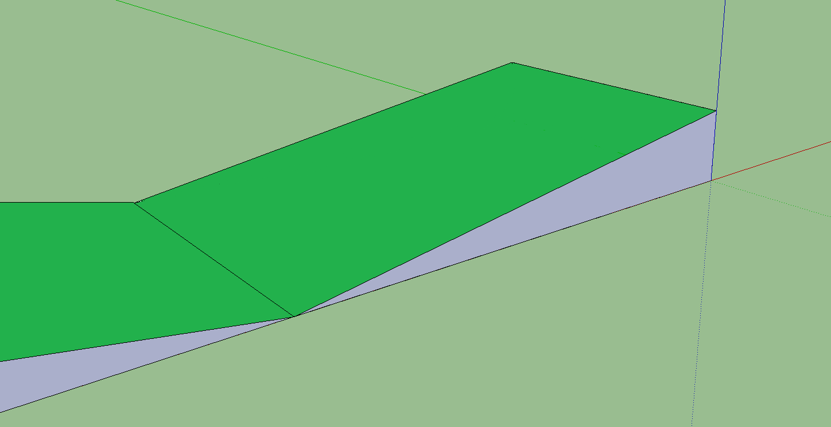
Wadi Bani Malik Area Drawing
Cross Section of Improved Northern Channel

Slide 17
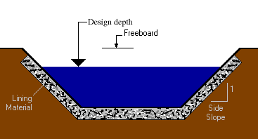
Impact
Building a bigger channel leads to:
  Less flooding
  Less loss of lives
  Security for citizens of Jeddah
  Increase in tourism of people travelling to Mecca
King Abdullah Aziz:
  Human life cannot be measured by money
  Must do all we can to limit lives lost
  Budget not a problem

Slide 18
Decision
Build a bigger channel that leads to the Red Sea
Allow for great flow through the channel
Minimize impacts on the city
Minimize loss of life in Jeddah

Slide 19
Further plans
Design a channel in AutoCAD that can hold the discharge for a 1000 year flood
Research chances of higher precipitation days in Jeddah
Implement data from Wadi Mraikh
Understand how dams impact basin area and discharge
Cost analysis for upgrading the channel
Show impact of less flooding on city and tourism

