Slide 1
Erosion Along Waller Creek
Jackelin Leal
Carolina Hernandez
Leif Moore

Slide 2
Representation
Process
Evaluation
Change
Impact
Decision

Slide 3
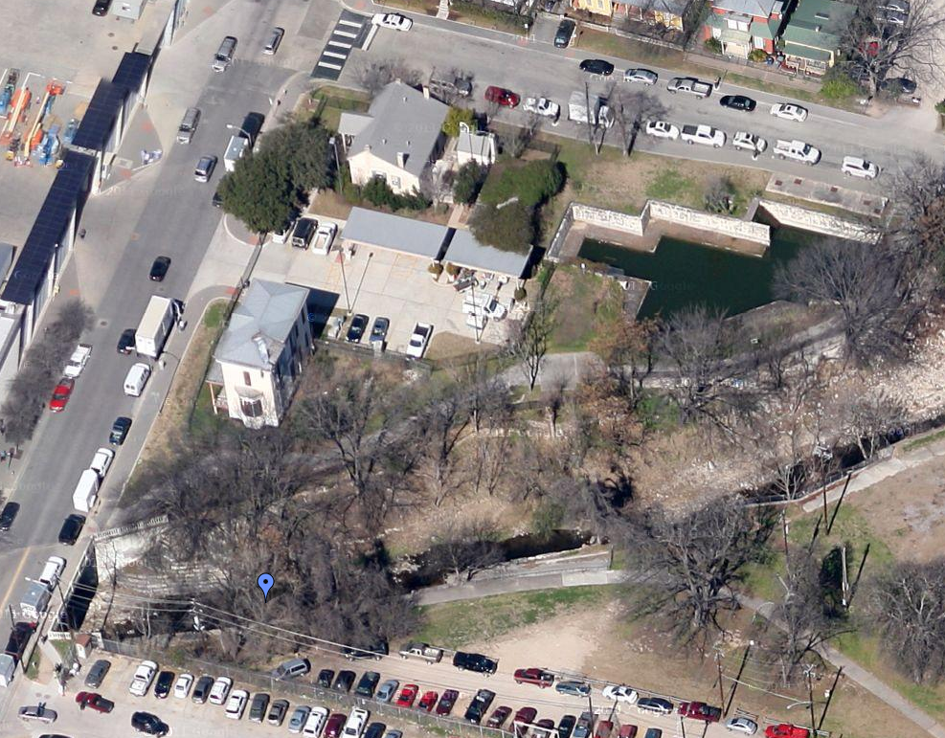
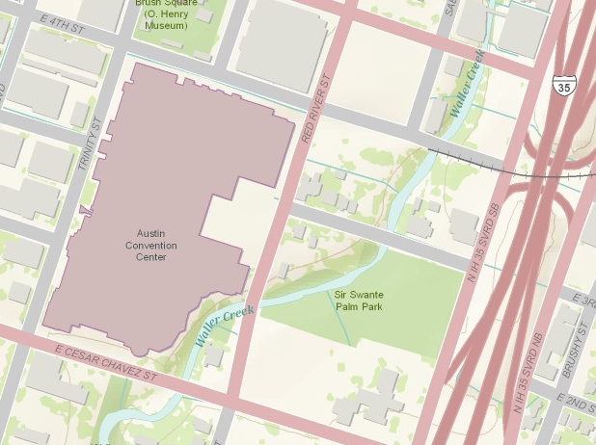
Location
E 3RD STREET
RED RIVER STREET
Waller Creek
STUDY AREA

Slide 4
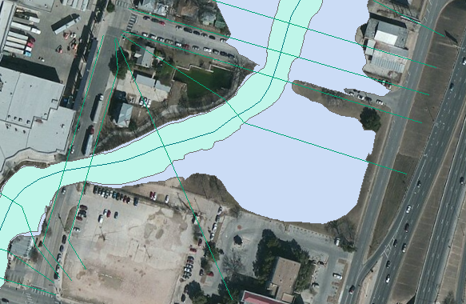
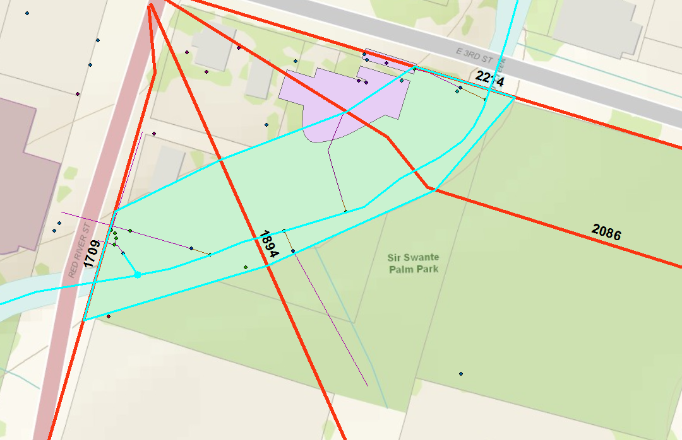
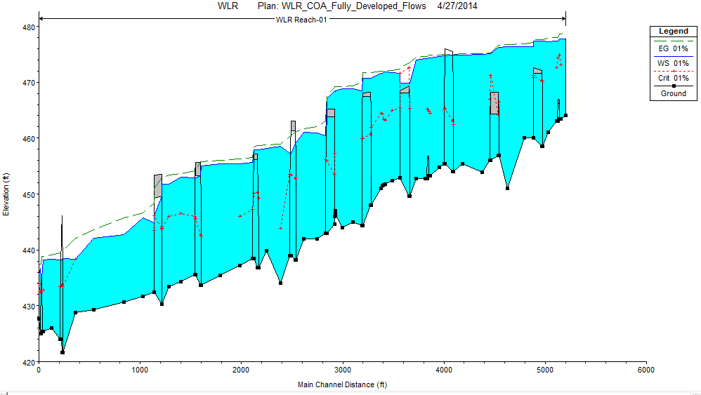
How should the study area be described?

Slide 5
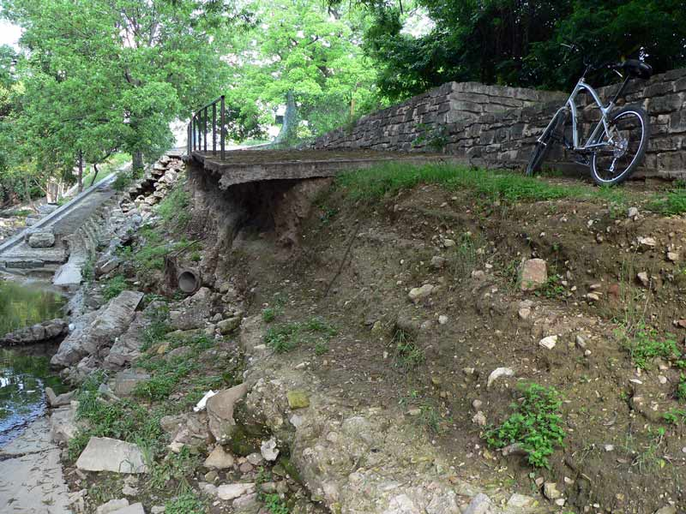
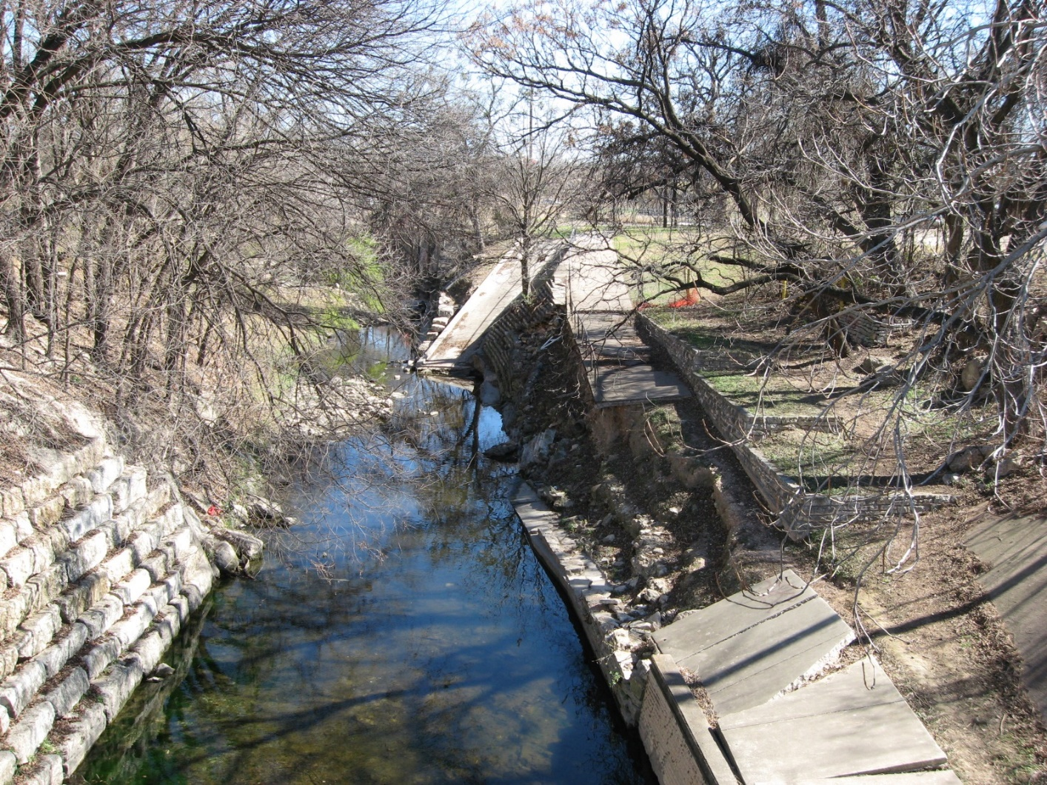
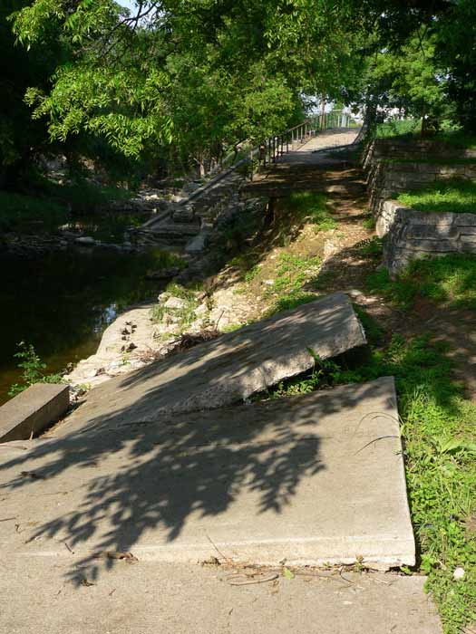
How does the study area operate?

Slide 6
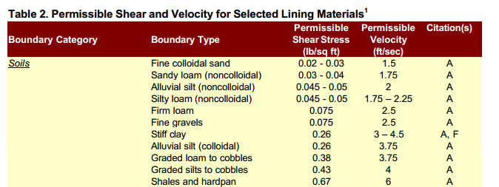
Is the current study area working well?
Cross Section | 1709 | 1894 | 2086 | 2214
W.S. Elev (ft) | 455.26 | 455.46 | 455.53 | 456.11
Avg. Vel. (ft/s) | 7.04 | 7.61 | 9.44 | 8.56
Shear (lb/sq ft) | 0.97 | 1.15 | 1.81 | 1.49

Slide 7
How can the study area be altered?
Options to prevent erosion:
  Increase Cross-sectional area of channel to reduce flow rate and therefore shear force (Alternatives A, B and C).
  Stabilize the stream using materials that can withstand a higher shear (Alternatives D and E).

Slide 8

Alternative A:
Dredging 0.5 ft
Cross Section | 1709 | 1894 | 2086 | 2214
W.S. Elev (ft) | 455.01 | 455.39 | 455.45 | 455.61
Avg. Vel. (ft/s) | 6.92 | 6.27 | 7.47 | 7.84
Shear (lb/sq ft) | 0.94 | 0.76 | 1.11 | 1.26

Slide 9
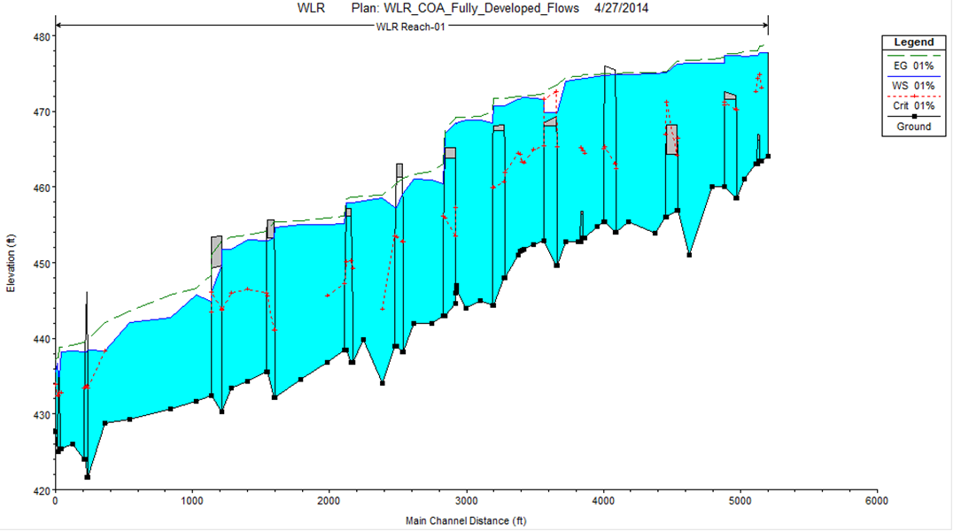
Alternative B:
Dredging 2 ft
Cross Section | 1709 | 1894 | 2086 | 2214
W.S. Elev (ft) | 454.68 | 454.96 | 454.98 | 455.14
Avg. Vel. (ft/s) | 6.56 | 6.19 | 7.6 | 8.12
Shear (lb/sq ft) | 0.83 | 0.74 | 1.15 | 1.36

Slide 10
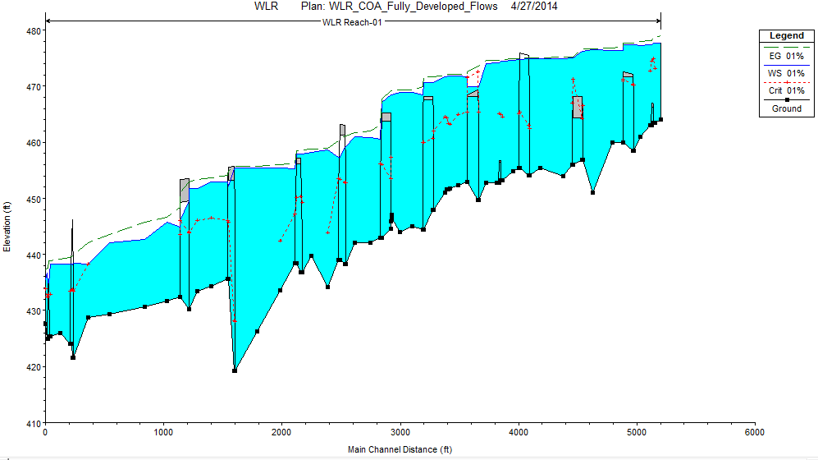
Alternative C:
Dredging 15 ft
Cross Section | 1709 | 1894 | 2086 | 2214
W.S. Elev (ft) | 455.42 | 455.46 | 455.35 | 455.32
Avg. Vel. (ft/s) | 4.07 | 4.42 | 6.32 | 8.01
Shear (lb/sq ft) | 0.3 | 0.35 | 0.76 | 1.32

Slide 11
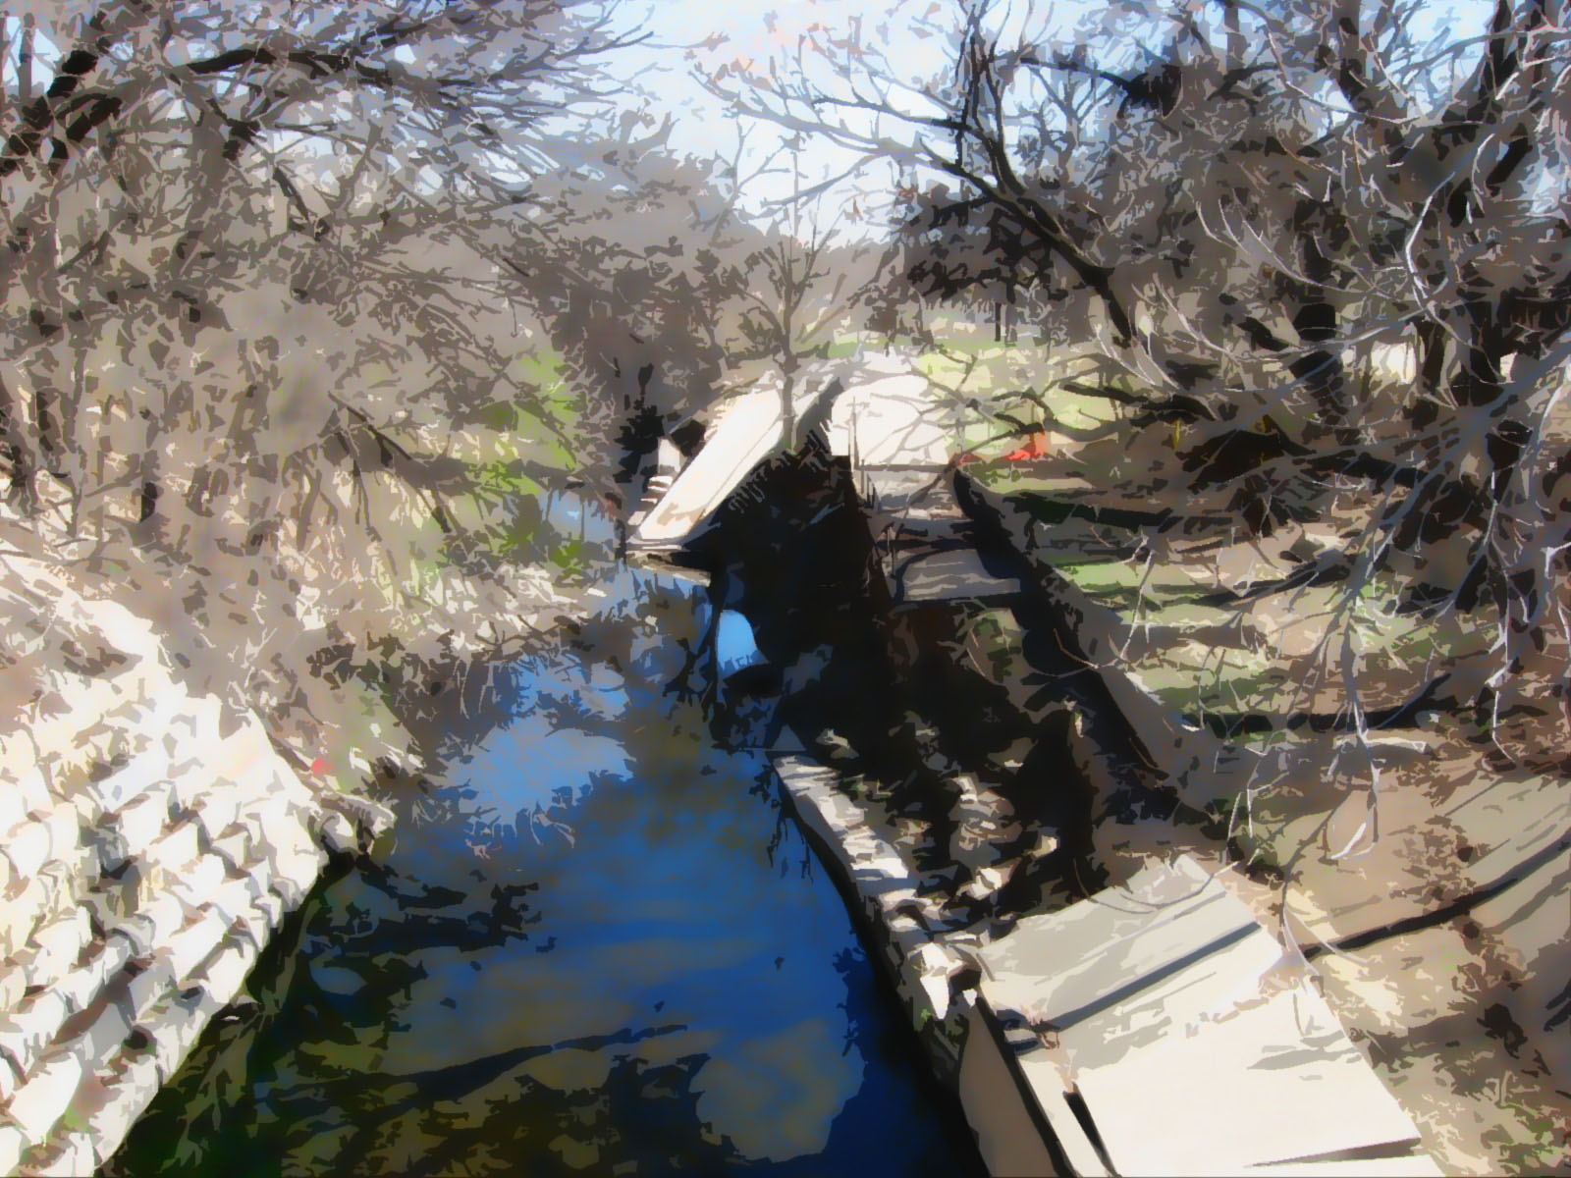
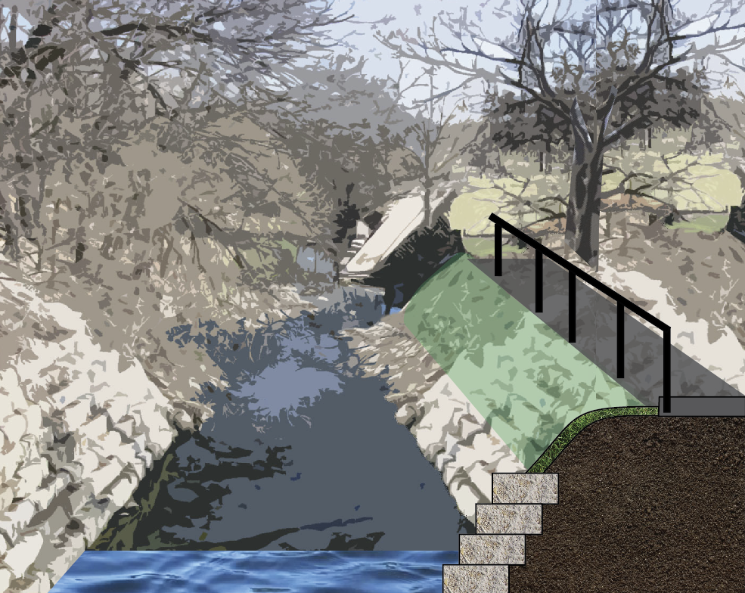
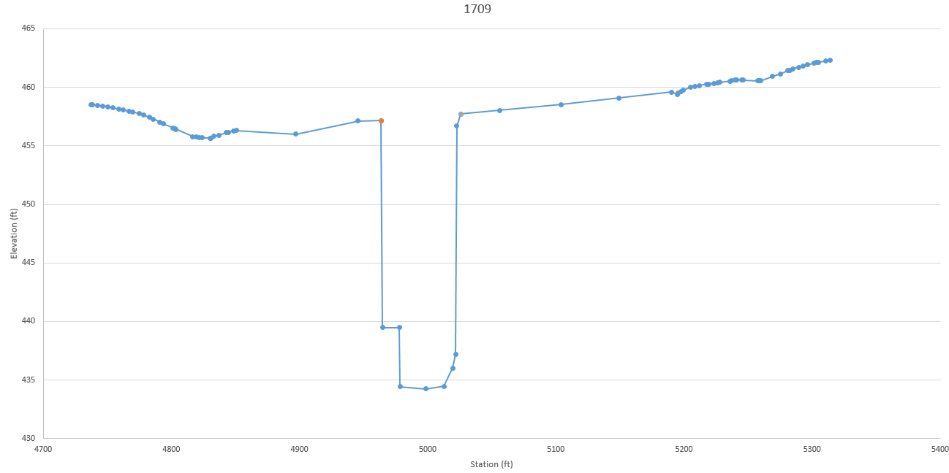
Alternative D
Armor stream bank with limestone terraces beneath pathway.
Cross Section | 1709 | 1894 | 2086 | 2214
W.S. Elev (ft) | 455.83 | 456.15 | 456.32 | 456.54
Avg. Vel. (ft/s) | 7.35 | 7.18 | 8.38 | 8.27
Shear (lb/sq ft) | 1.07 | 1.01 | 1.41 | 1.38

Slide 12
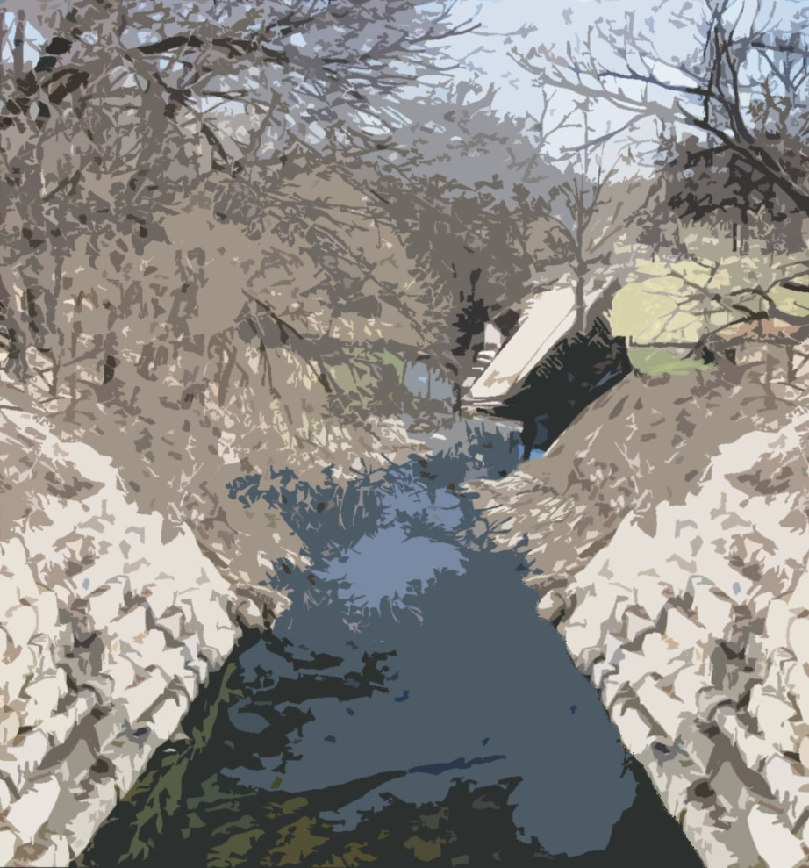
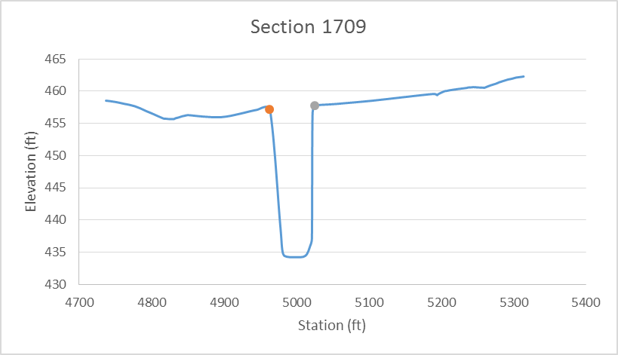
Alternative E
Limestone retaining wall similar to the one on the opposite side of the channel extending from cross-section 1709 to 1894.
Cross Section | 1709 | 1894 | 2086 | 2214
W.S. Elev (ft) | 456.18 | 456.82 | 457.06 | 457.15
Avg. Vel. (ft/s) | 8.06 | 6.83 | 7.42 | 7.88
Shear (lb/sq ft) | 1.28 | 0.91 | 1.09 | 1.23
Notes:
Left side 125% slope, Right Side 217%

Slide 13
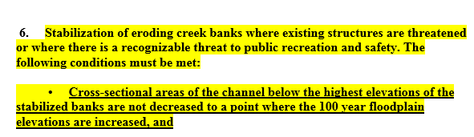
How might the study area be altered?
Alternatives A, B, and C considered not acceptable due to City of Austin standards as provided by Environmental Criteria Manual
Alternatives D and E considered feasible and meets USACE shear criteria
Decision depends on the need for the path, which is currently being blocked off.

Slide 14
What differences might the changes cause?
 |  |  | A | B | C | D | E
 | Alternative | Original | Dredge 0.5 ft | Dredge 2 ft | Dredge 15 ft | Rebuild Path | Retaining Wall
Cross Section 1709 | Flow Velocity (ft/s) | 7.04 | 6.92 | 6.56 | 4.07 | 7.35 | 8.06
 | Shear Force (ft-lb/s) | 0.97 | 0.94 | 0.83 | 0.3 | 1.07 | 1.07
 | Water Surface Elevation (ft) | 455.26 | 455.01 | 454.68 | 455.42 | 455.83 | 456.18
 | Meets Criteria | No | No | No | No | Yes | Yes
Cross Section 1894 | Flow Velocity (ft/s) | 7.61 | 6.27 | 6.19 | 4.42 | 7.18 | 6.83
 | Shear Force (ft-lb/s) | 1.15 | 0.76 | 0.74 | 0.35 | 1.01 | 1.41
 | Water Surface Elevation (ft) | 455.46 | 455.39 | 454.96 | 455.46 | 456.15 | 456.82
 | Meets Criteria | No | No | No | No | Yes | Yes
Cross Section 2086 | Flow Velocity (ft/s) | 9.44 | 7.47 | 7.6 | 6.32 | 8.38 | 7.42
 | Shear Force (ft-lb/s) | 1.81 | 1.11 | 1.15 | 0.76 | 1.41 | 1.38
 | Water Surface Elevation (ft) | 455.53 | 455.45 | 454.98 | 455.35 | 456.32 | 457.06
 | Meets Criteria | No | No | No | No | Yes | Yes
Cross Section 2214 | Flow Velocity (ft/s) | 8.56 | 7.84 | 8.12 | 8.01 | 8.27 | 7.88
 | Shear Force (ft-lb/s) | 1.49 | 1.26 | 1.36 | 1.32 | 1.38 | 1.01
 | Water Surface Elevation (ft) | 456.11 | 455.61 | 455.14 | 455.32 | 456.54 | 457.15
 | Meets Criteria | No | No | No | No | Yes | Yes

Slide 15
How should the study area by changed?
Final decision depends on the necessity for the walking trail, which is currently being blocked off.

Slide 16
Questions?

