Slide 1
CPE Hydraulic Investigation
By: Kelly Best, Chelsea Burkett, and Shannon Sullivan

Slide 2
Overview
Representation: How should the study area be described?
Process: How does the study area currently operate?
Evaluation: Is the current study area working well?
Options: How might the study area be altered?
Impact: What differences would these changes cause?
Final Decision: How should the study area be changed?

Slide 3
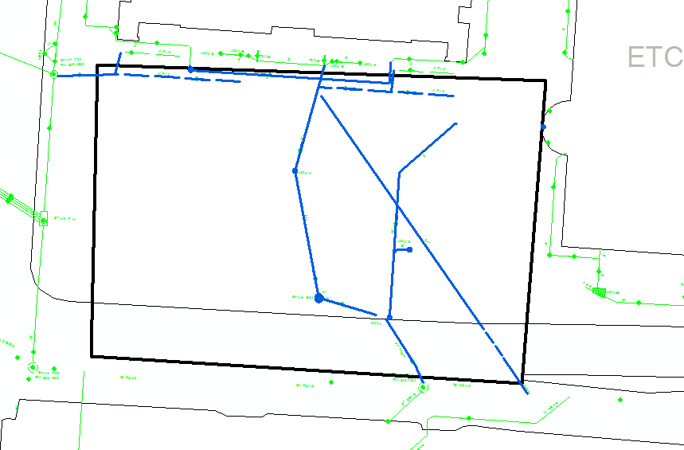
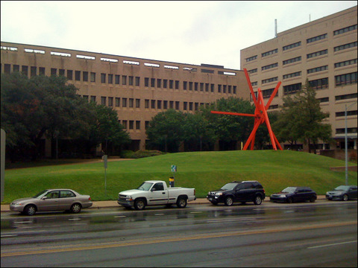
Representation of Area
Area of focus is around the CPE Plaza
Grassy area around the clock-knot sculpture
Basemap shows current piping system running through the area

Slide 4
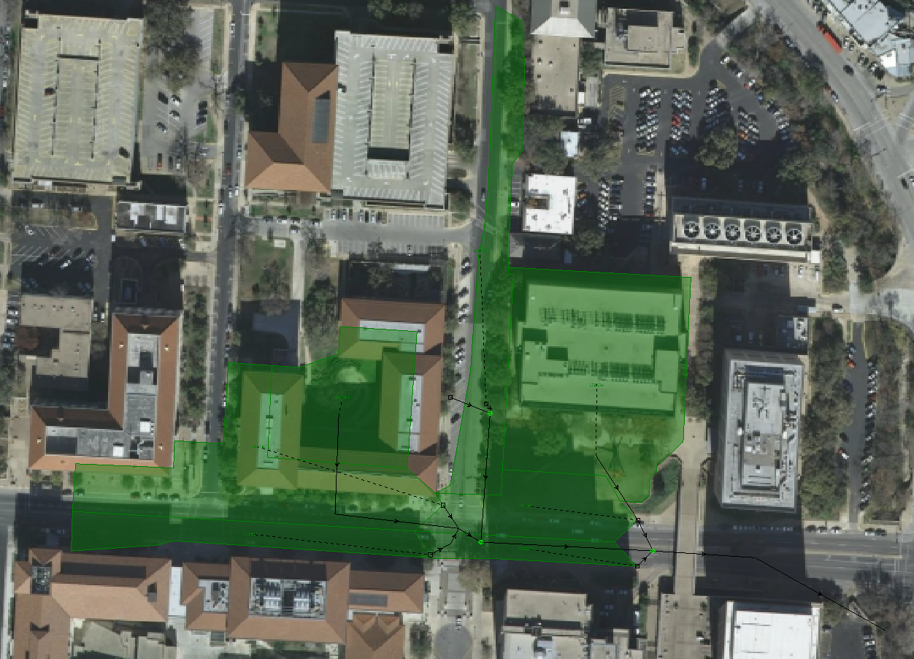
Representation of Area
Catchment area that drains to this point is shown in green
Two inlets for the drainage area

Slide 5
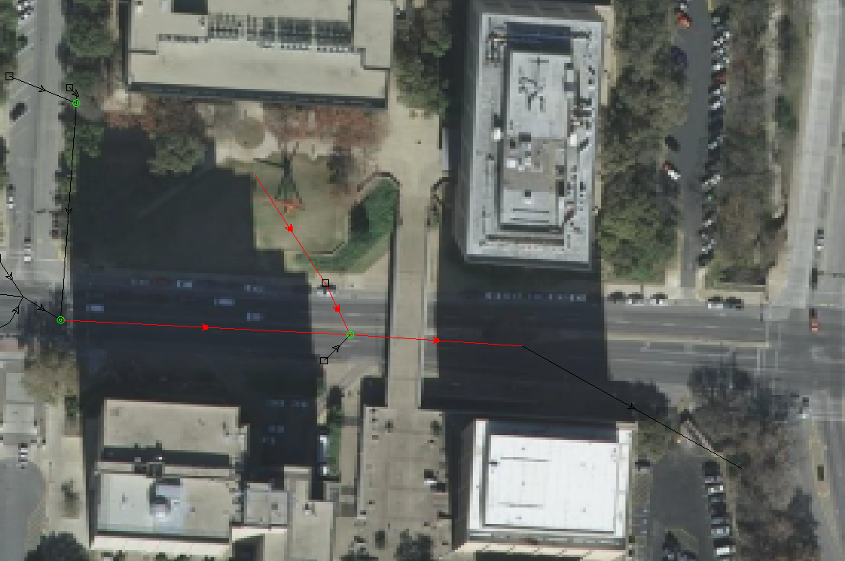
Current Process
Red – Major pipeline affected by drainage of area
Yellow – Manholes affected by the area
Blue – Inlets of the catchment area
Black – Pipelines that flow into and out of major pipeline
Reference: Carlos Galdeano
Notes:
This shows simplistically the pipe system considered in our work. The middle yellow manhole is the manhole that is being overly saturated and under significant pressure when not flooded. This system does not contribute to flooding down Dean Keeton since all flow exits system at outflow to Waller Creek. This provides more significance to the rain garden since any water quality control that is released to Waller Creek help the creek’s bacterial content.

Slide 6
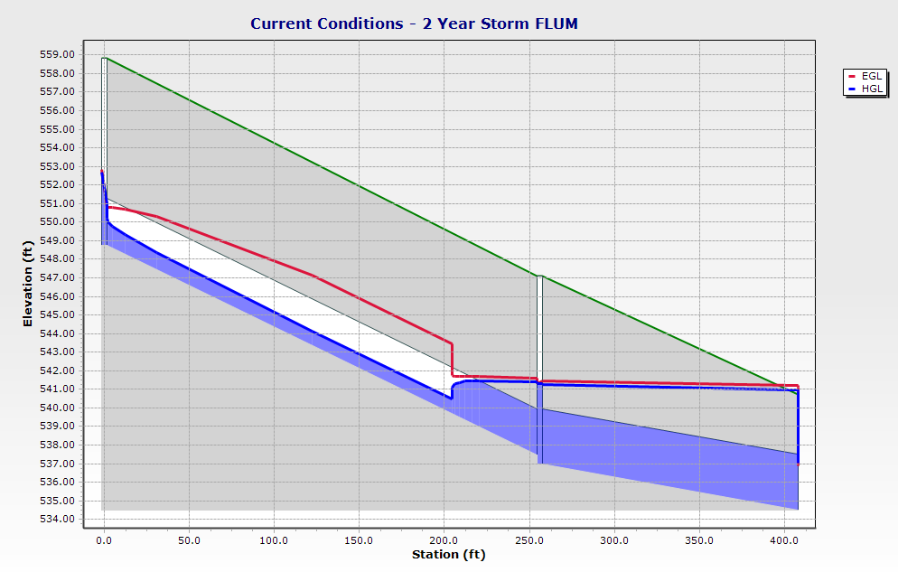
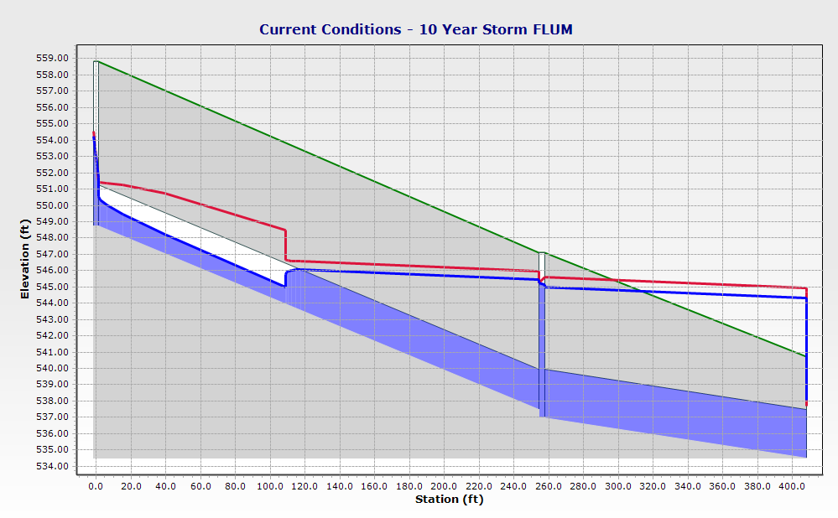
Evaluation of Current Operations
Manhole
Notes:
This shows the 2 and 10 year flood. The green line is the ground level, the purple shaded area is the pipe, the vertical purple line is the manhole, the red line is the EGL and the horizontal purple line is the HGL. Currently the system is functional under both, however in the 10 year flood, the water level rises above ground level which causes the pipe to start flowing under pressure.
FLUM – Future Land Use Map

Slide 7
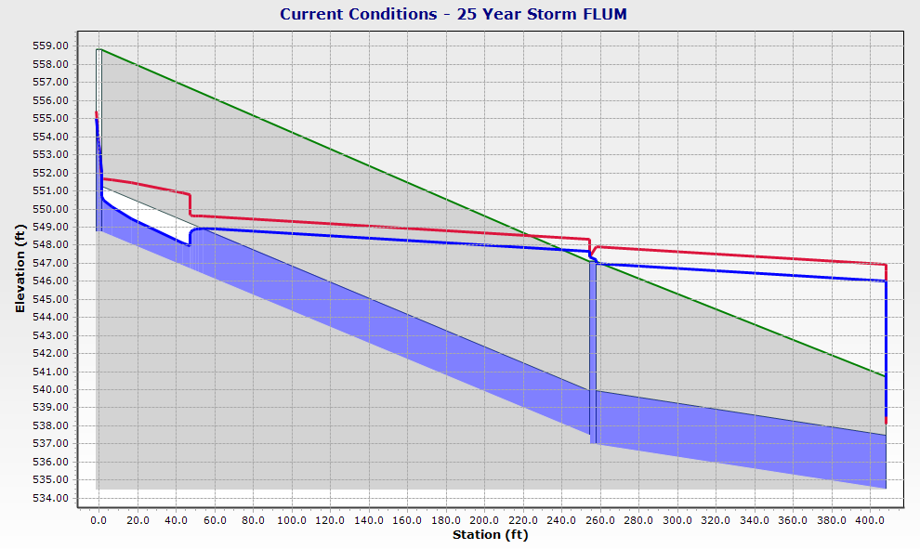
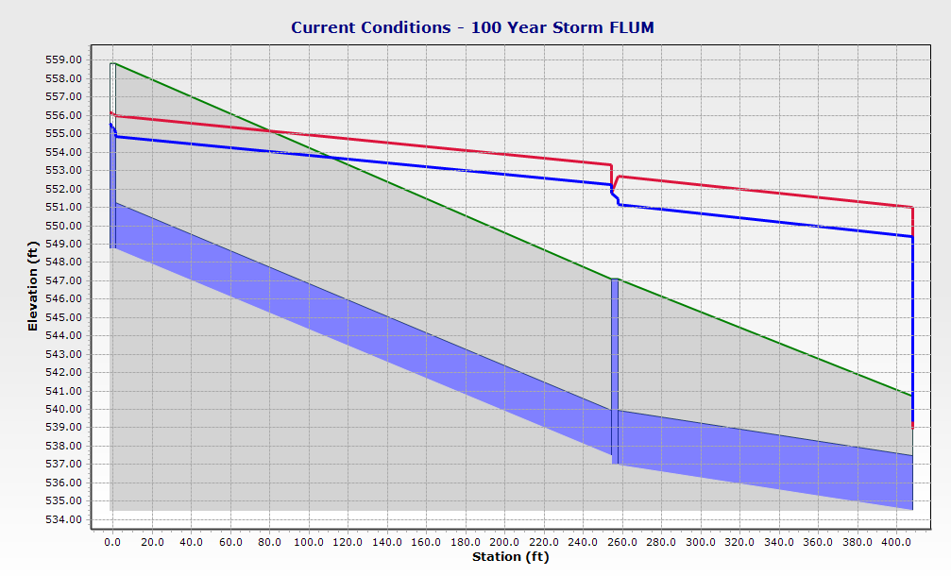
Evaluation of Current Operations
Manhole
Notes:
This is the graph of the 25 and 100 year flood. At 25 year flood level is when the problem starts to occur. Here the EGL and HGL rise above the ground level saturating the manhole. This causes the flow to back up and the manhole to be flooded. When this happens, the manhole and pipe system is no longer functioning.

Slide 8
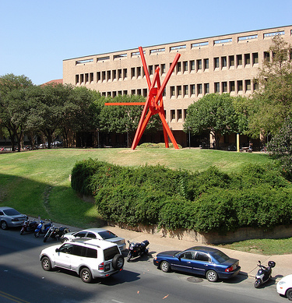
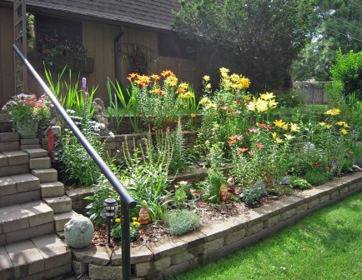
Options
Option 1: Rain Garden
Calculations of area required to do this is shown to the right
Potentially could help prevent flooding, improve water quality, and improve aesthetics
Drainage Area
CPE Roof | 42086 | ft²
CPE Plaza | 4000 | ft²
Σ | 46086 | ft²
Ideal Rain Garden Size | 7681 | ft²
Option 2: Additional Piping under the Pedestrian Bridge
Would help alleviate standing water on bridge during storms
Creates more flow to the piping system

Slide 9
Still To Come…
We plan to meet with the TA to discuss modeling the impact using StormCAD
CAD design of rain garden
Creation of final database and decision

Slide 10
Questions?

