Slide 1

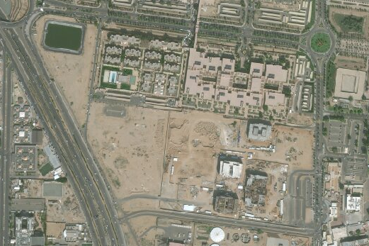
Drainage System at King Abdulaziz University (KAU)
Osama El-Quqa, Luis Galindo, Sarah Seraj

Slide 2
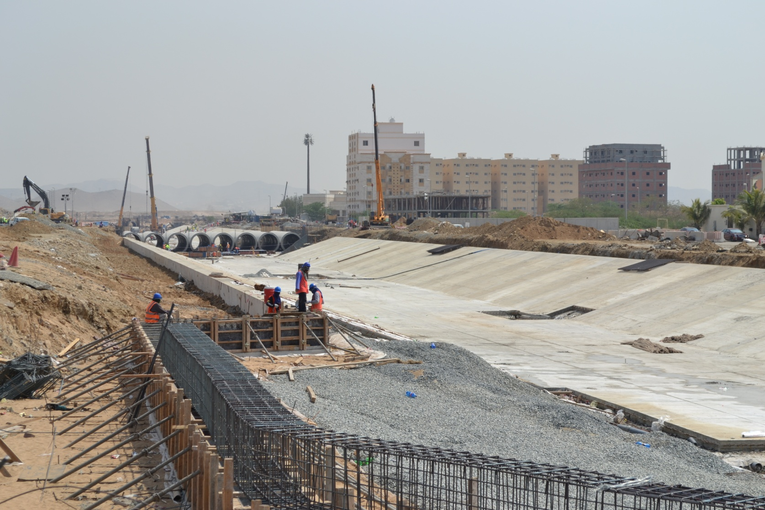
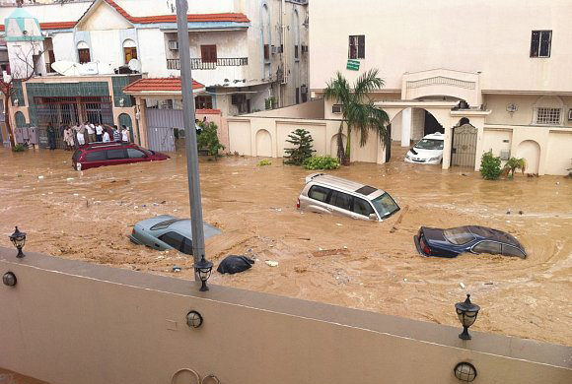
Flooding at Jeddah and King Abdulaziz University
Annual Rainfall = 2.1”
Nov 25, 2009: 3.5” of rain in 4 hrs. 472 casualties
Jan 26, 2011: 4” of rain in 4 hrs. 160 casualties
Area around university was badly hit
Nearby highway knocked down
AECOM called to emergency action
Scott Edelman
FloodList
Notes:
2009 and 2011 flash flood – statistics
Where Jeddah’s infrastructure failed
AECOM aid
3.5” of rain in 4 hours on November 25, 2009, 472 casualties, Cars washed away, thousands made homeless (Compare to annual Jeddah rain of 2.1”)
4” of rain in 4 hours on January 26, 2011, 160 casualties
AECOM called to action. Emergency implementation of dams and channels
http://www.arabianbusiness.com/jeddah-floods-cause-427m-damage-at-saudi-university-10230.html
Damage caused by flash floods in the Saudi Arabian city of Jeddah caused SR1.6bn ($427m) worth of damage at King Abdulaziz University (KAU), officials revealed.
http://xrdarabia.org/2009/11/26/reporting-the-jeddah-floods/
Haramain Highway knocked down, forcing the closure of that route between Jeddah and Mecca.
http://floodlist.com/asia/jeddah-flood-defences

Slide 3
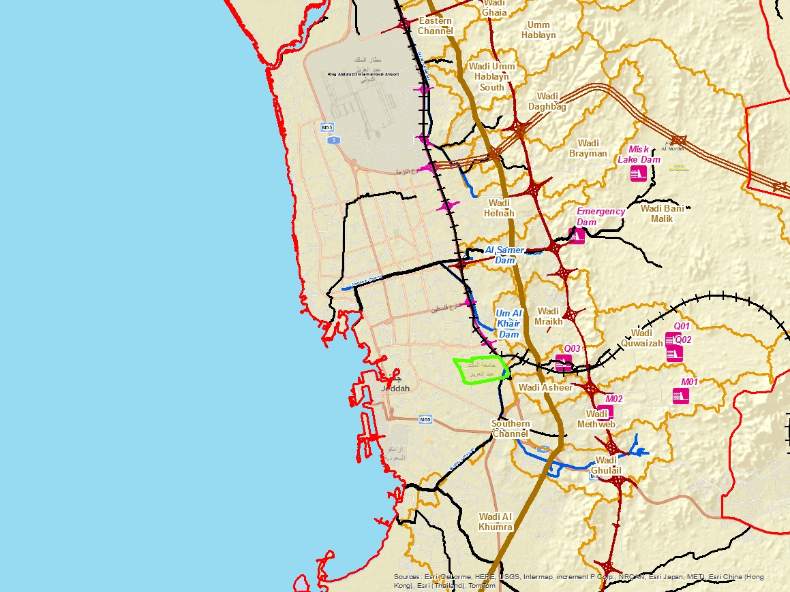
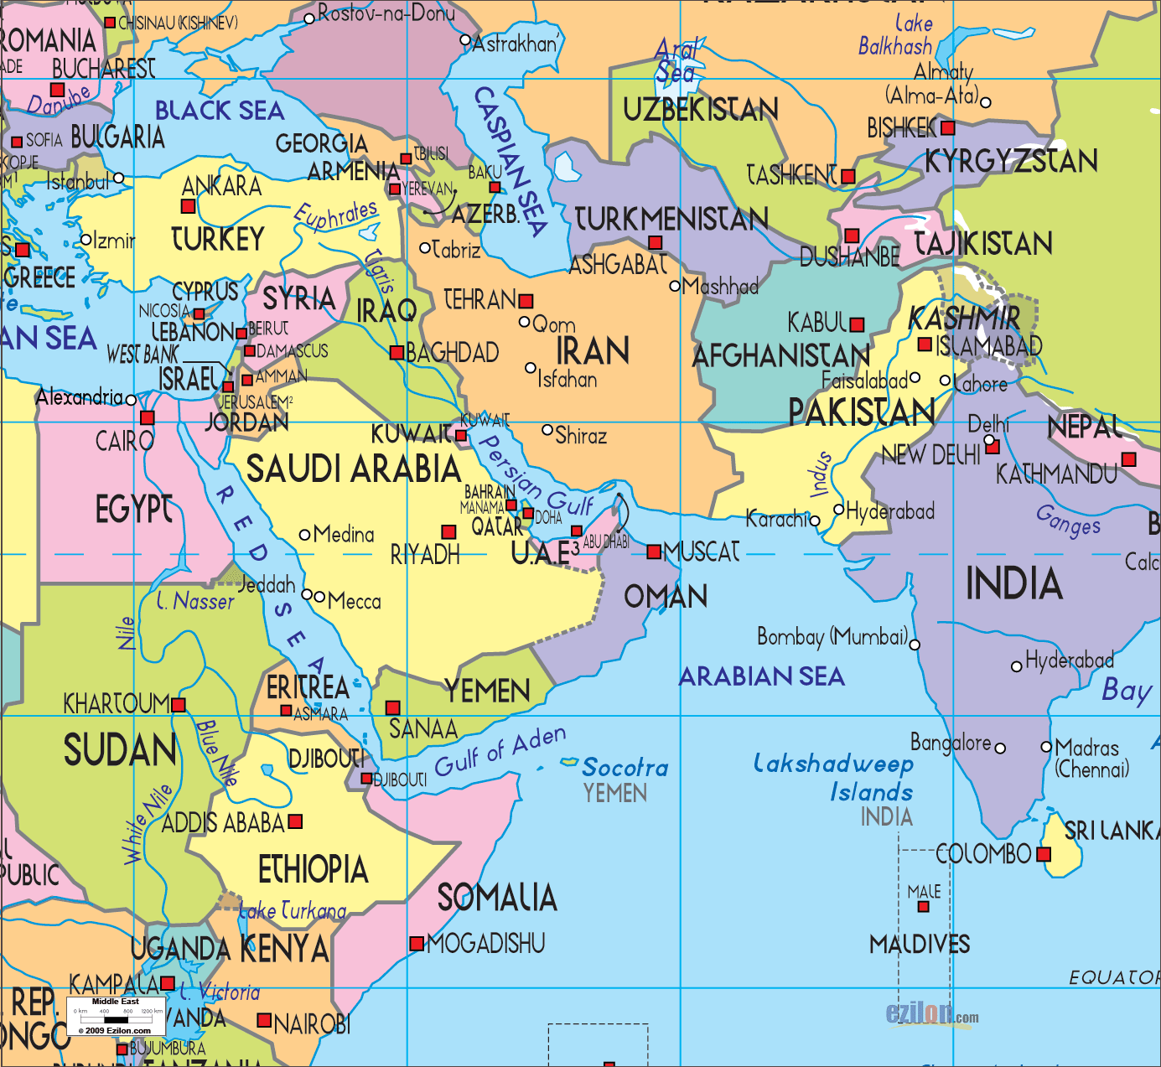
Location and Characteristics of KAU
Airport
Jeddah
KAU
Notes:
Start with overview of middle east and then use animations to zoom into Jeddah
Basic Basemap, DEM Basemap, Contour Basemap-
Distance to Ocean: 4.5 km to ocean
Assumption: KAU is one watershed
Overall we want to reduce probability of flooding

Slide 4
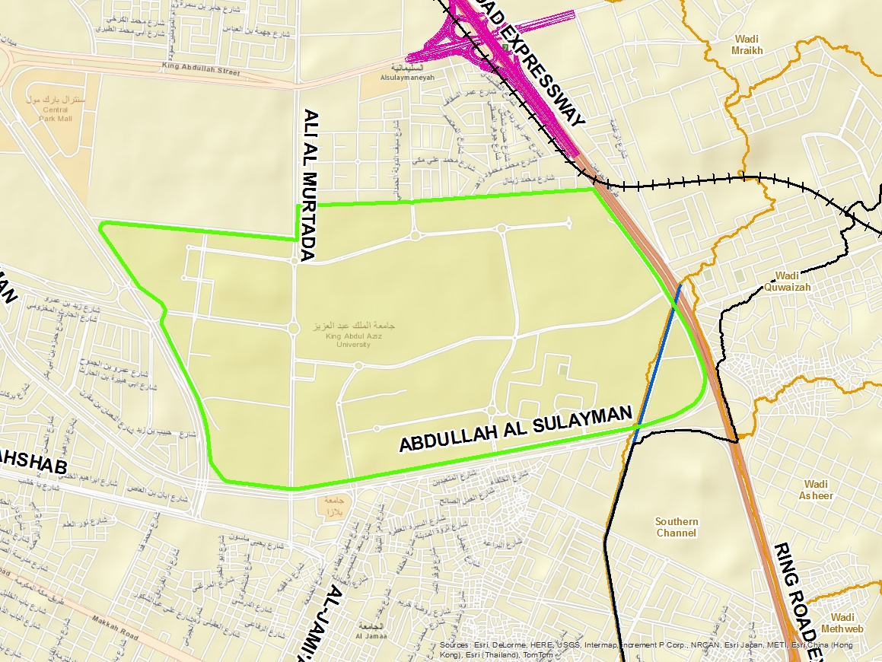
Basic Basemap
Notes:
Area of 6.1 km2

Slide 5
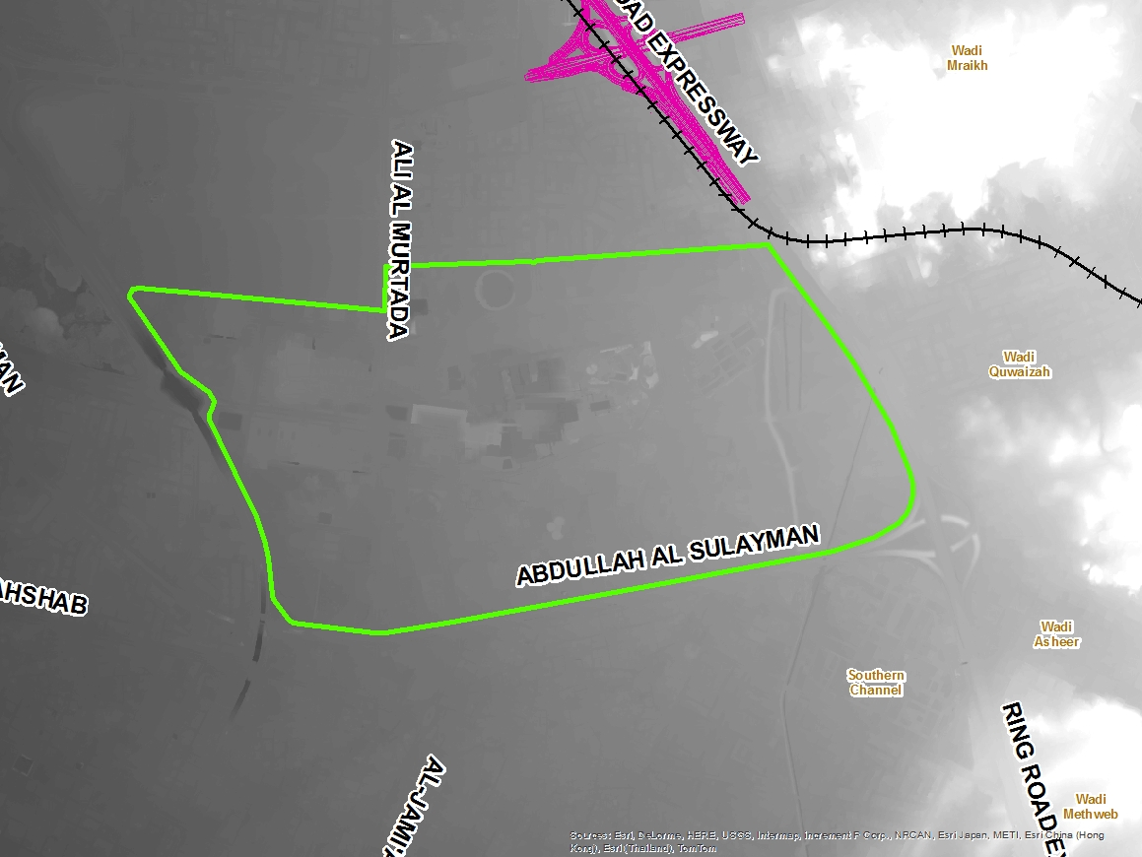
Digital Elevation Model Basemap
Notes:
Raster data

Slide 6
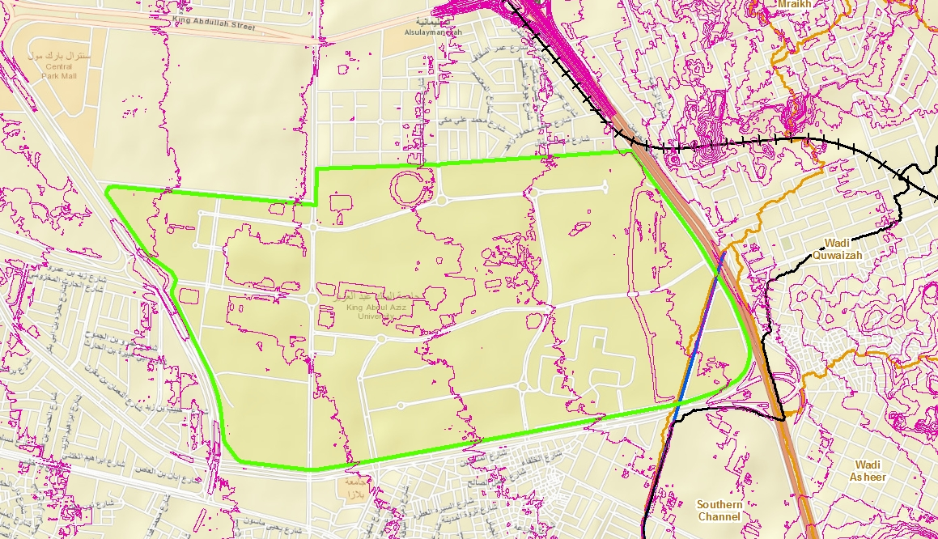
Proposed Project
Design drainage system at KAU
  Reduce probability of flooding
Assuming one large watershed
  Water flows to detention pond at lowest point
Notes:
Know elevations (22m – 47m)
Why a detention pond (maybe visual?)
Watershed -> detention pond -> pipe -> red sea/southern channel
List alternatives to discharge of runoff-
Three choices:
1. Northern channel: Too far
2. Southern channel: also too far
3. To Ocean:
a) pipe either over land
b) under land
c) trapezoidal (like southern)

Slide 7
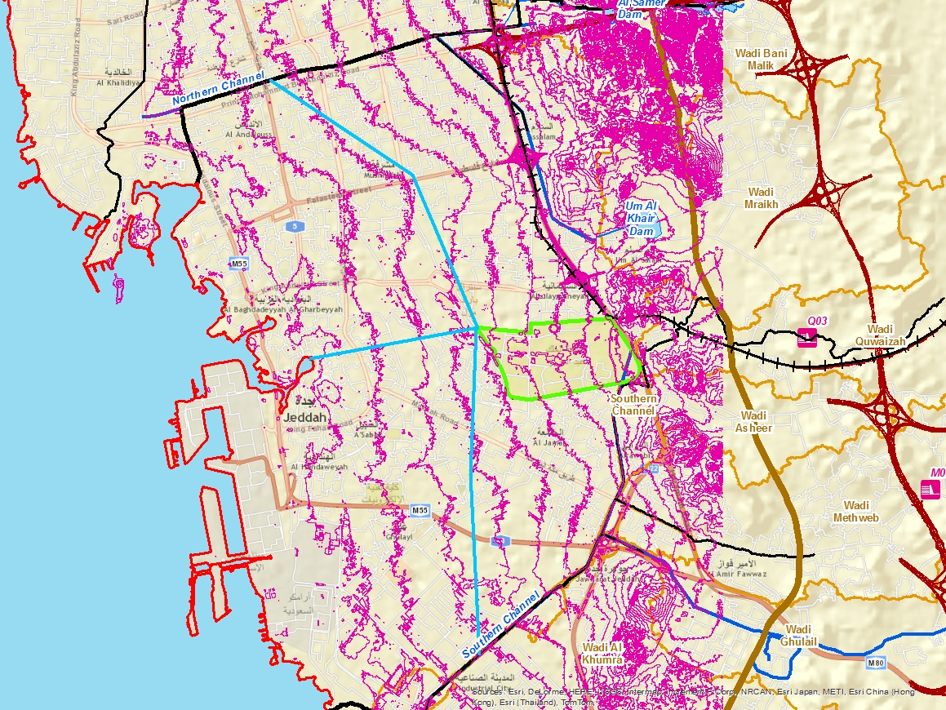
Alternatives
A
C
B
Alternative | Distance
A: To Northern Channel | 8.7 km
B: To Southern Channel | 8.5 km
C: To Red Sea | 4.5 km
Notes:
Three Options:
Pipe under land
Pipe over land
Trapezoidal channel
Either way, the water should be treated beforehand

Slide 8
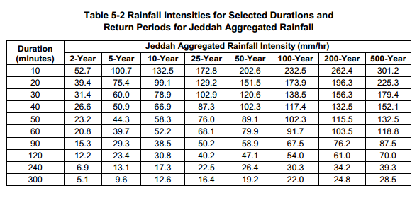

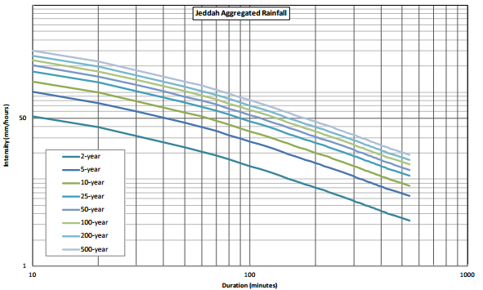
HEC-HMS Model
Watershed Parameter Calculations
  Area: ~6.138 Km²
  Impervious: 53%
  Curve Number: 87
  Initial Abstraction: 7.59 mm
  Lag Time: 216 min
Jeddah Aggregated Rainfall
Intensity (mm/hr)
Time
Notes:
To create the HMS model, we assumed that the university was one big watershed for simplicity and time constraint reasons. Some of the parameters that we had to calculate for the watershed include:
Area – this was done by using the measuring tool on ArcGIS and resulted in an average of 6.138 km2
The impervious cover was determined by using areal data from ArcGIS and calculating the ratio of impervious to total area of KAU
Using recommendations from the Jeddah design manual and the impervious percentage value, a weighted curve number of 87 was calculated.
Using the curve number, the soil storage coefficient was calculated which was used to determine the initial abstraction giving a value of 7.59 mm.
Lastly, the lag time was approximated to be 216 min where we assumed a 6 hour time of concentration as stated in the manual. We also verified this assumption by using the SCS lag time equation to estimate time of concentration as stated in SCS, 1985 manual
The next step in the HMS model was to create a precipitation model. Luckily for us, we were given the rainfall intensity duration data for various return periods. For our purposes we decided to perform a 100 year flood analysis.
The data was imported into HMS as a frequency storm and with this final piece to the puzzle we were able to create our watershed model for KAU. Illustrated on the screen right now is the unit hydrograph for KAU along with a plot of excess precipitation and precipitation loss. What this model plot showed us is that the university has a lot of excess precipitation. In fact, during a three day analysis and a total precipitation of 51 mm (or 2 inches), the university has a peak discharge of almost 13,000 m3/s that occurs by 5 am of the first day of rain! By identifying this discharge, we concluded that a) we needed to find a solution to slow the discharge down and b) we need to create a pipe/channel network to discharge the excess flow.
Assumptions: CN, lag time, Ia, etc.
Inform how we calculated impervious percentage
How the precipitation model was created: include IDF curves and rain intensity tables
Hydrograph, screenshots
Mention that we are working on creating detention pond/basin

Slide 9
HEC-HMS Model
Notes:
To create the HMS model, we assumed that the university was one big watershed for simplicity and time constraint reasons. Some of the parameters that we had to calculate for the watershed include:
Area – this was done by using the measuring tool on ArcGIS and resulted in an average of 6.138 km2
The impervious cover was determined by using areal data from ArcGIS and calculating the ratio of impervious to total area of KAU
Using recommendations from the Jeddah design manual and the impervious percentage value, a weighted curve number of 87 was calculated.
Using the curve number, the soil storage coefficient was calculated which was used to determine the initial abstraction giving a value of 7.59 mm.
Lastly, the lag time was approximated to be 216 min where we assumed a 6 hour time of concentration as stated in the manual. We also verified this assumption by using the SCS lag time equation to estimate time of concentration as stated in SCS, 1985 manual
The next step in the HMS model was to create a precipitation model. Luckily for us, we were given the rainfall intensity duration data for various return periods. For our purposes we decided to perform a 100 year flood analysis.
The data was imported into HMS as a frequency storm and with this final piece to the puzzle we were able to create our watershed model for KAU. Illustrated on the screen right now is the unit hydrograph for KAU along with a plot of excess precipitation and precipitation loss. What this model plot showed us is that the university has a lot of excess precipitation. In fact, during a three day analysis and a total precipitation of 51 mm (or 2 inches), the university has a peak discharge of almost 13,000 m3/s that occurs by 5 am of the first day of rain! By identifying this discharge, we concluded that a) we needed to find a solution to slow the discharge down and b) we need to create a pipe/channel network to discharge the excess flow.
Assumptions: CN, lag time, Ia, etc.
Inform how we calculated impervious percentage
How the precipitation model was created: include IDF curves and rain intensity tables
Hydrograph, screenshots
Mention that we are working on creating detention pond/basin

Slide 10
Detention Pond Design (100 year flood)
Calculating storage volume using straight line method
Jeddah Stormwater Design Manual 2011
Surface water flow into Red Sea from West of Jeddah = 4.6m³/s (Subyani 2009)
Storage volume reqd = 388,000 m³
Q=4.6 m³/s
Notes:
Design assumption
Screenshot of flow vs time curve on Jeddah Manual for determining volume of basin
Initial detention volume will be calculated using the straight line method. First, a flow hydrograph produced using the method described in Section 5.5 should be plotted; then a straight line running from 0 to the point on the hydrograph, after the peak, that corresponds to the allowable receiving channel flow rates (Section 5.8.1) will be plotted on top of the hydrograph. The volume represented by the area between these two curves is the detention volume that should be used (see Figure 5-6).

Slide 11
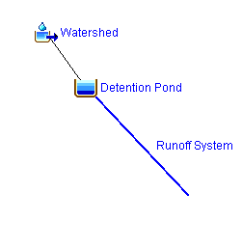
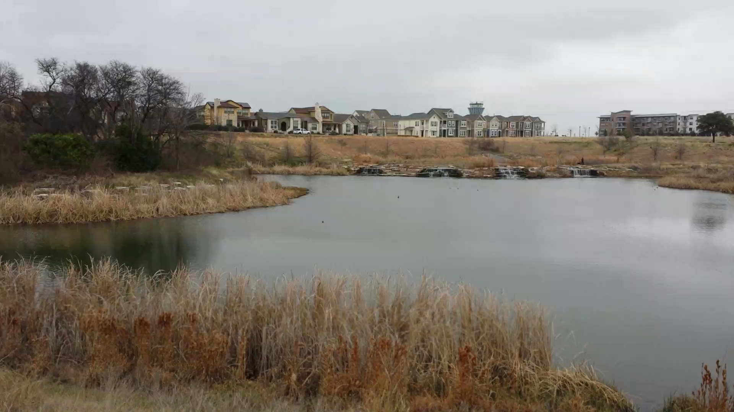
Future Work
Complete HEC-HMS model
Full design of detention pond
Pipe/channel network
Notes:
Hms model including watershed, basin, and discharge pipe/channel
Design of detention pond
ArcGIS
-contour lines, basemap, and location of proposed piped.

Slide 12
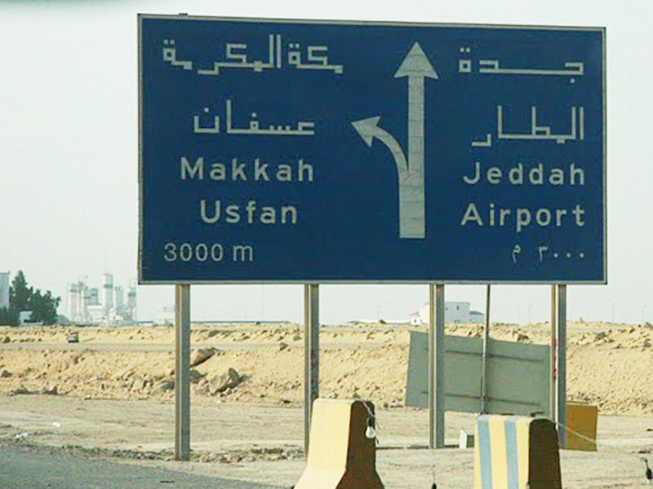

Notes:
Hms model including watershed, basin, and discharge pipe/channel
Design of detention pond
ArcGIS

