Slide 1
Effects of Pervious Pavement on Speedway
by
Zaid Admani
Steven Zhao
Brent Crawford

Slide 2
OBJECTIVE
To determine the benefits of pervious pavement and how it will enhance sustainability and reduce storm water runoff on campus.

Slide 3
Project Scope
Describe the study area
Evaluate the current flow condition of the study area
Determine how pervious pavement will reduce storm water runoff and ponding and improve water quality
Quantify the impacts of pervious pavement
Decide on the most optimal design for our study area

Slide 4
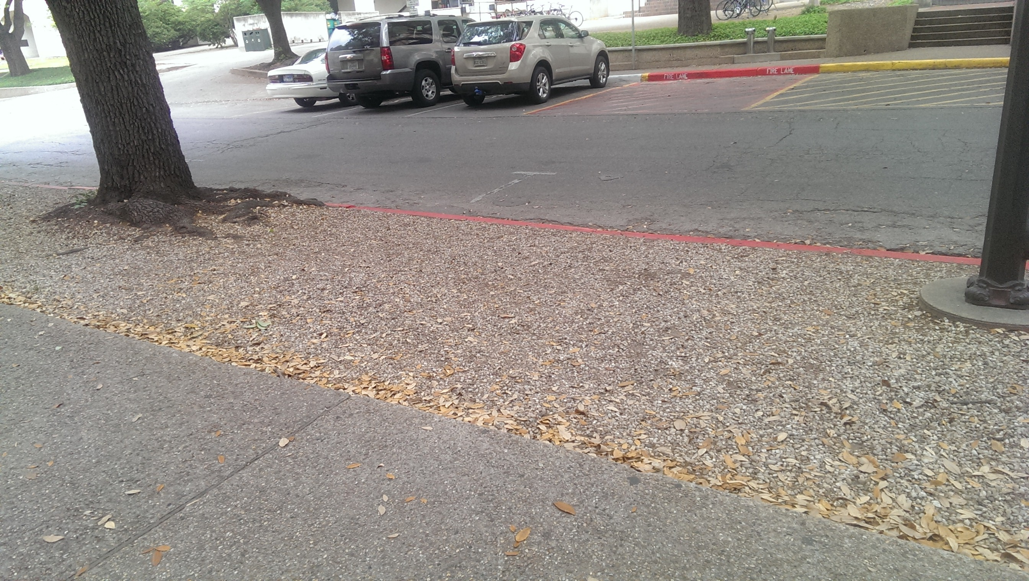
Study Area
1000 ft²
Loose gravel and sand
Ponding after rainfall
No filter medium
SPEEDWAY

Slide 5
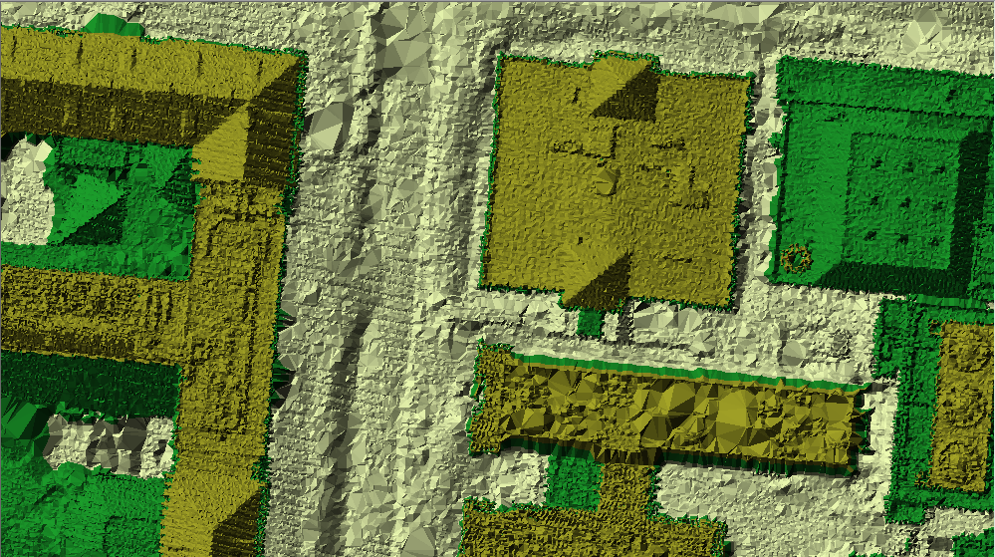
LiDAR

Slide 6
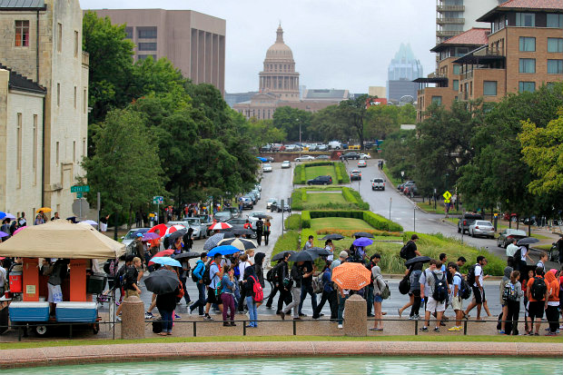
Operation
High foot traffic area
Used for bike racks
Slight ponding
mudding
Storm water runoff into street

Slide 7
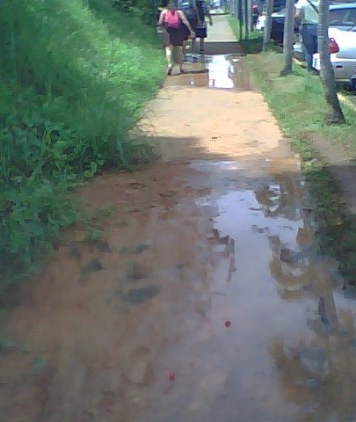
Evaluation
Current ponding causes mudding
Stagnated water after rainfall
No sufficient filtering of water

Slide 8
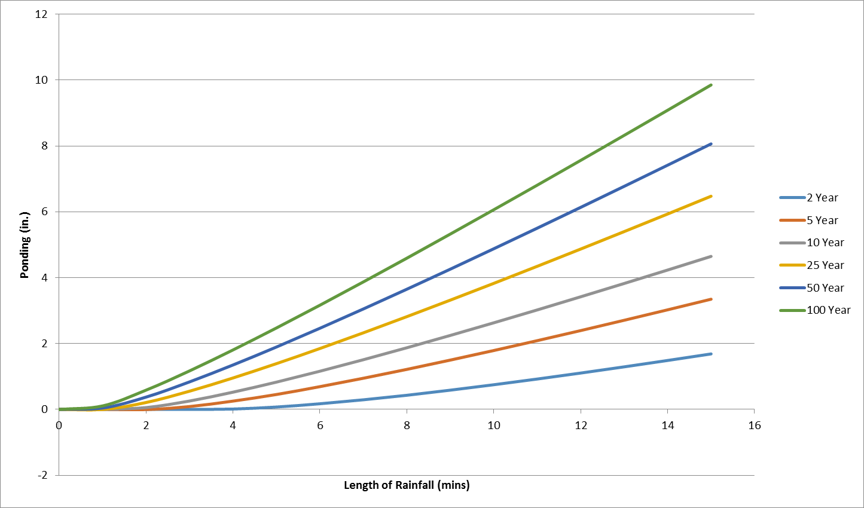
Ponding from 15 min Rainfall

Slide 9
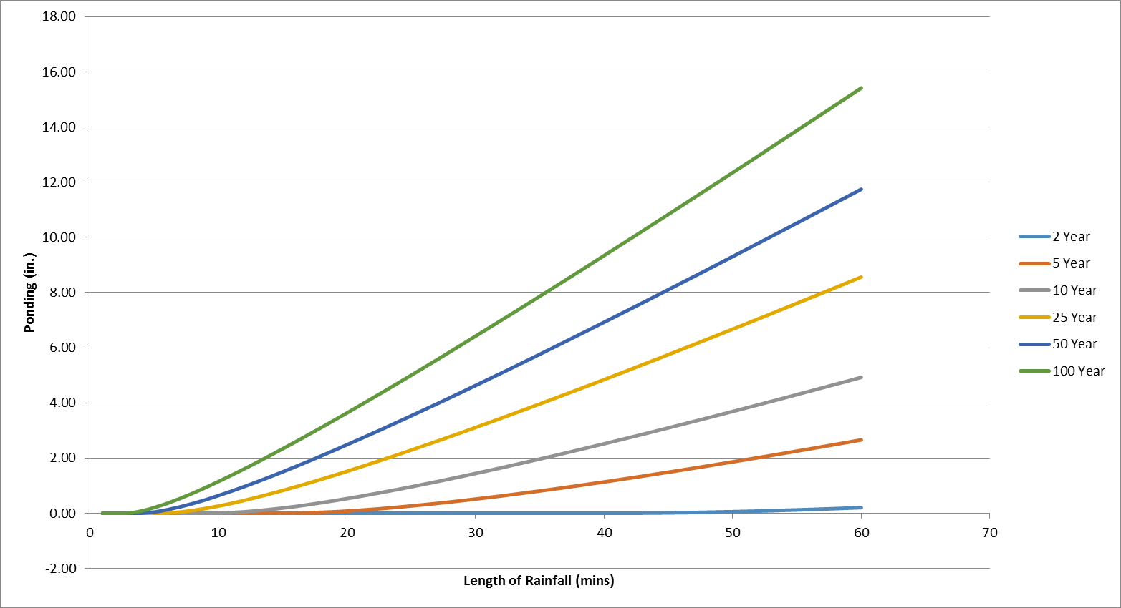
Ponding from 60 min Rainfall

Slide 10
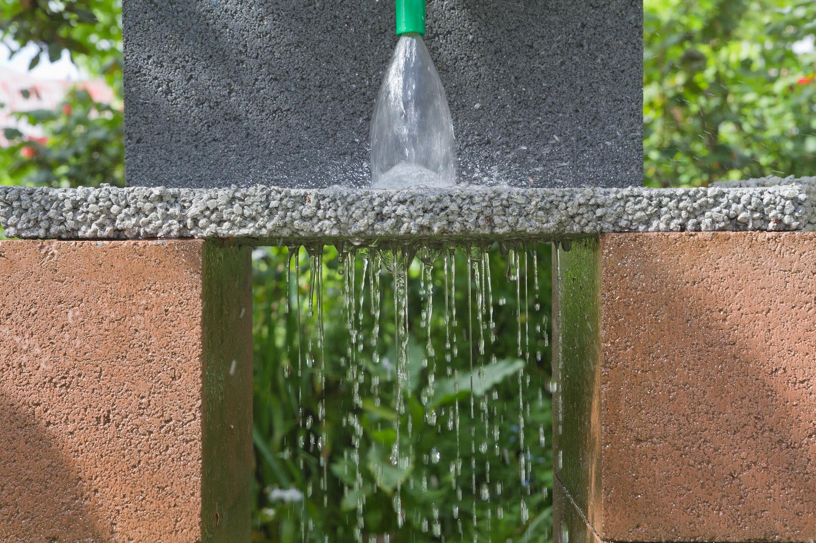
Potential Solutions
Bio retention
Upgrade soil or plant vegetation
Pervious pavement

Slide 11
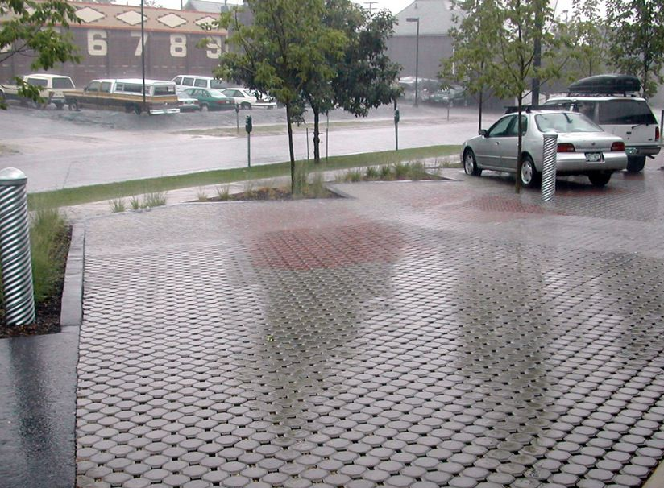
Pervious Pavement
Reduces:
Peak flow of storm water up to 50 %
Ponding
Improves:
Water quality
Curb appeal

Slide 12
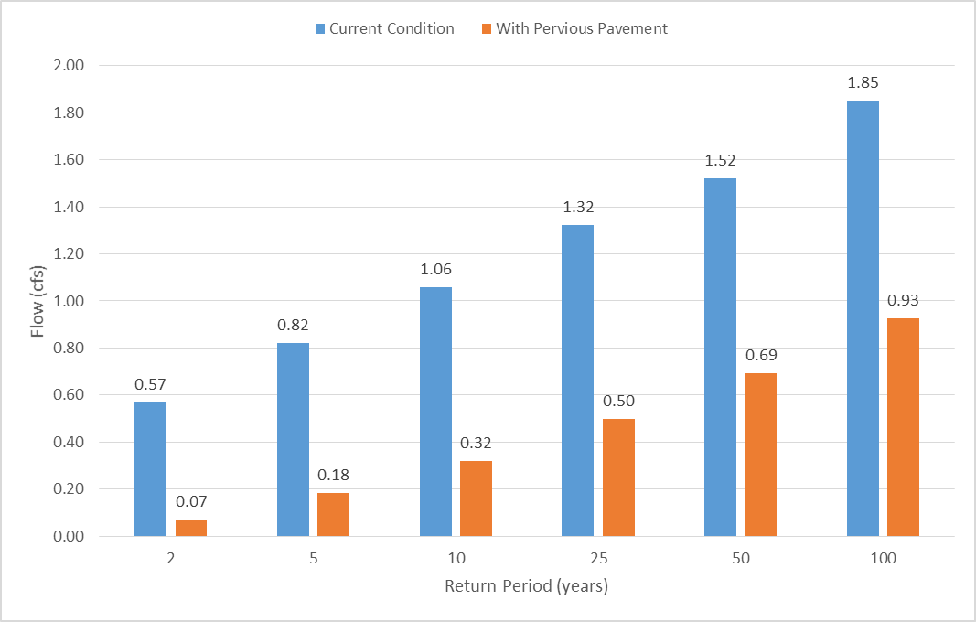
Reduction of Peak Flow

Slide 13
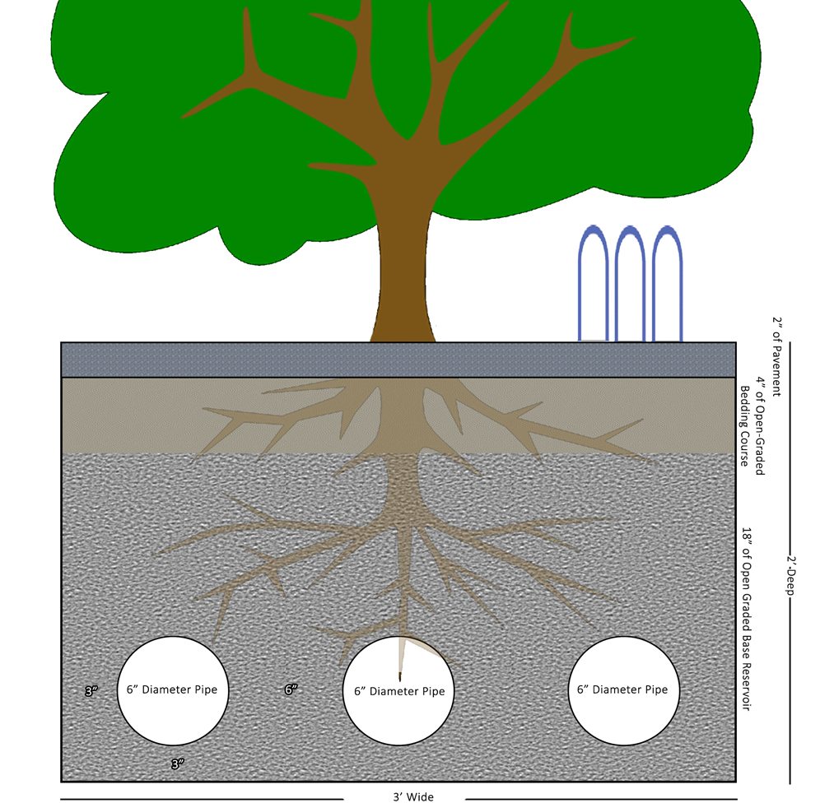
Cross Section

Slide 14
Side View

Slide 15
Water Quality Treatment
Reduction of hydrocarbons( motor oil, grease, and gasoline)
PAH’s
Metals (Pb, Cu, Zn, Cd, Cr)
Sediment
Nutrients
Chloride
Bacteria

Slide 16
Conclusion
Mudding and ponding on Speedway from rainfall events
Installation of pervious pavement
Reduction in peak flow by 50%
Elimination of ponding
Improved water quality
Adds utility(ex. more bike racks)
Future Plans
Determine layout and dimensions of pervious pavement
Determine aggregate size for open graded base

Slide 17
QUESTIONS?

