Slide 1
ECJ Parking lot redesign UT AUSTIN: Group 5
BENJAMIN CHILTON
STEVEN ANDREW MARTIN
ROSE SCHNEIDER
Notes:
WaterWorks Design Studies
Group 5

Slide 2
Overview
Define Study Area
Current Operation & Problems
Research & Design Challenges
Calculations
Final Design Decision
Next Steps

Slide 3
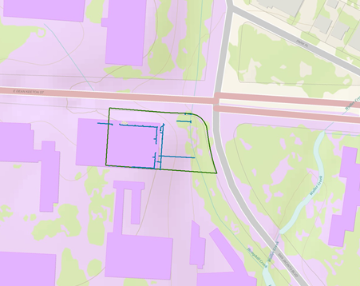
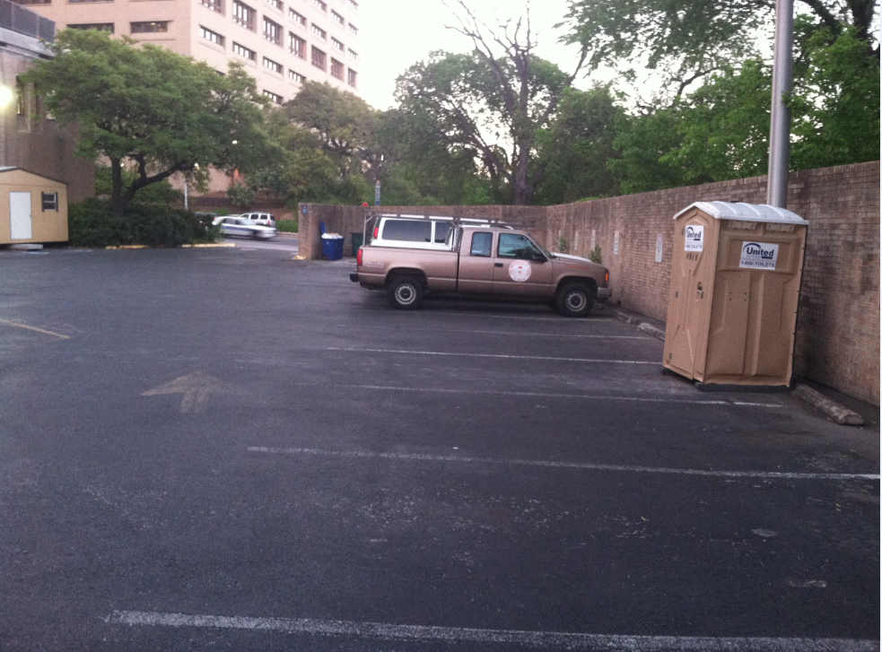
Step 1: Representation
Notes:
Step 1: How should the study area be described?
Explain the parking lot as the study area, as well as the wall between the parking lot and Waller Creek

Slide 4
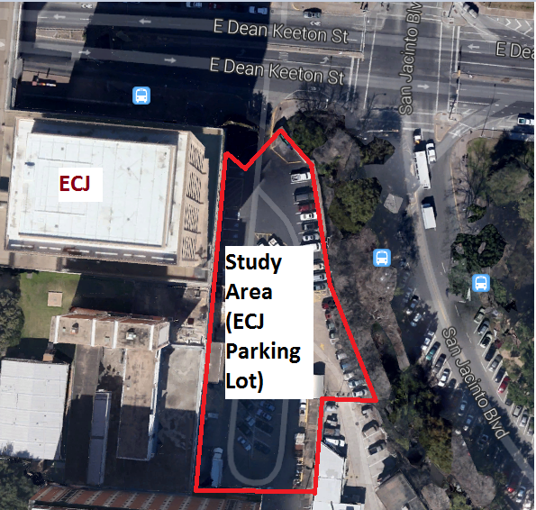
Step 1: Representation
Notes:
Total area in red: 35,300 sq. ft.

Slide 5
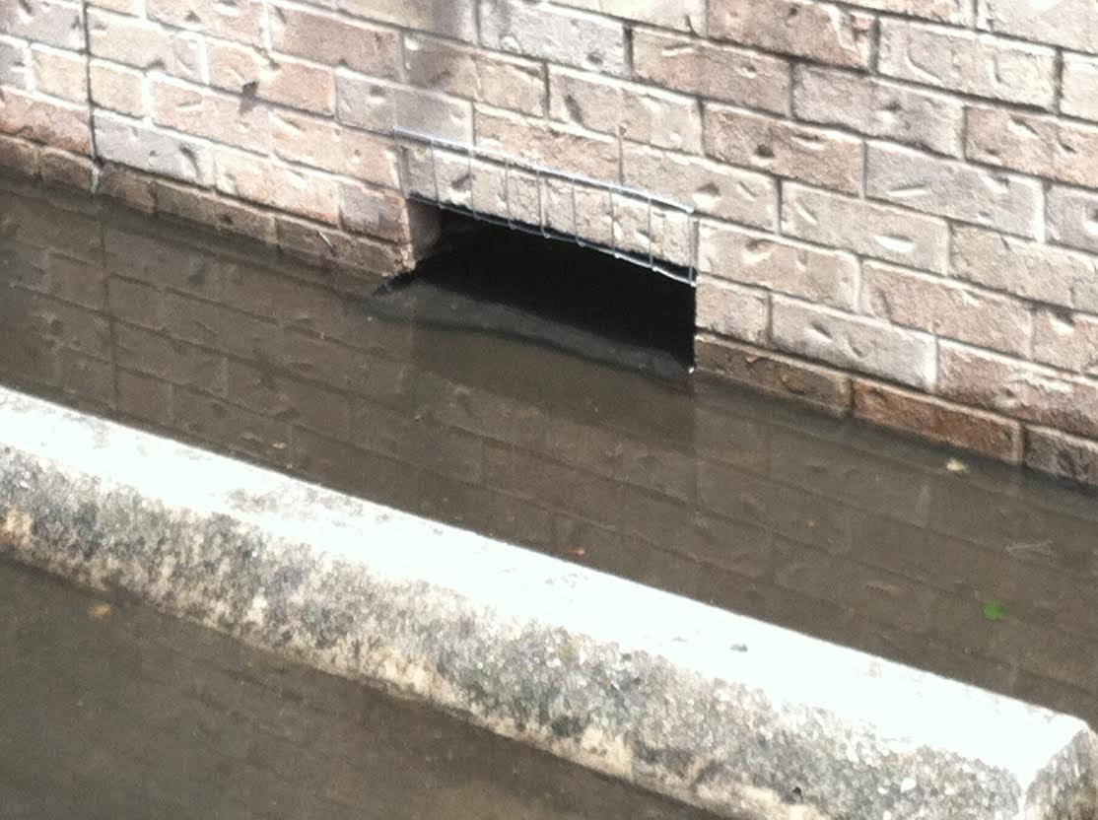
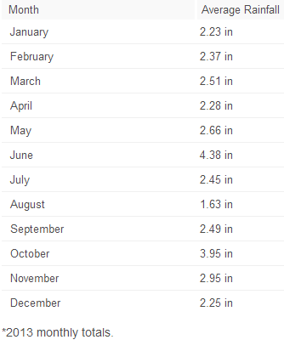
Step 2: Process
Average Annual Rainfall: 32.15 in
Roof flow piped directly into Waller Creek
Flow from parking lot to Waller Creek
Notes:
Step 2: How does the study area operate?
http://average-rainfall.findthebest.com/l/240/Austin-Texas

Slide 6
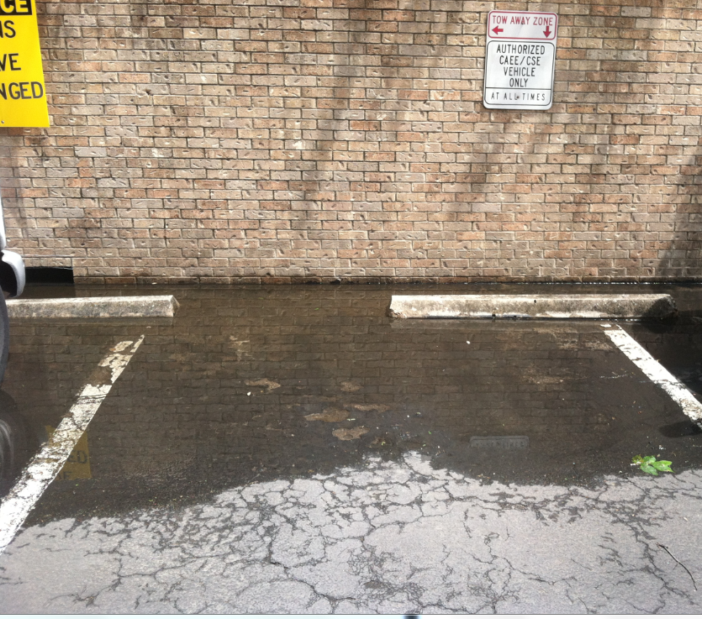
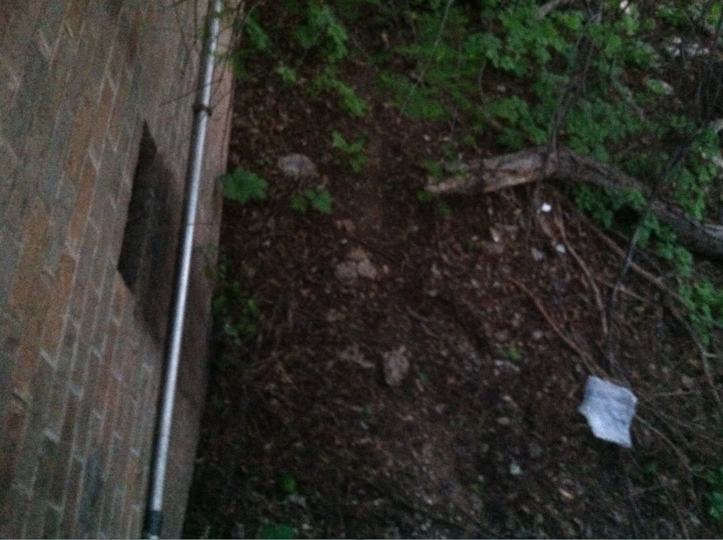
STEP 3: EVALUATION
Inadequate drainage
Unfiltered runoff
Large obtrusive wall
Erosion of soil
Uncontrolled flow
Wasted space
Notes:
Step 3: Is the current study area working well?

Slide 7
Step 4: Change
Remove and replace the existing wall
Porous pavement
Rain garden
Notes:
Step 4: How might the study area be altered?
*We met with Dr. Barrett over at PRC to talk about the changes we planned to make in this area. When we first started this, we first envisioned replacing all of the asphalt with porous pavement. After researching

Slide 8
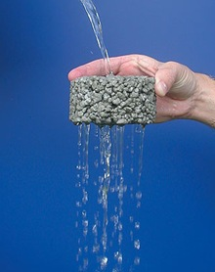
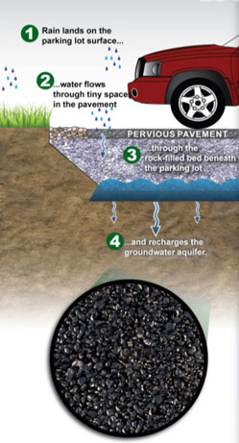
Porous Pavement
Pavement surface with a stone reservoir underneath
Temporarily stores surface runoff before infiltrating it into the subsoil
Incorporates void spaces that allow infiltration
Notes:
Increases groundwater recharge
Reduces pollutants in stormwater runoff
Helps alleviate flooding and contamination to creeks, streams, etc.

Slide 9
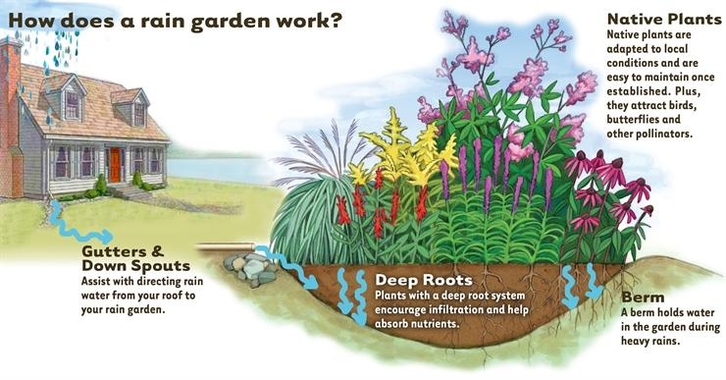
Rain Garden
Capture stormwater and provide for natural infiltration
Decrease flooding risks
Filter pollutants
Alleviate erosion

Slide 10
Design Layout
Total area: 35,300 ft²
Asphalt: 14,700 ft²
Porous pavement: 17,900 ft²
Rain garden: 2,717 ft²
Notes:
initial look - drawn *Ben insert Here
Total area - 35,300 sq ft
Rain garden - 2,717 sq ft
Porous pavement - 17,900 sq ft
Asphalt - 14,700 sq ft

Slide 11
Step 5: Impact, Rain Garden
Notes:
Step 5: What differences would the changes cause?
*Evaluation
*How much water would filter through the pavement
*How much water would filter through the rain garden
*Impacts/improvements this would have

Slide 12
Step 5: Impact, Porous Pavement

Slide 13
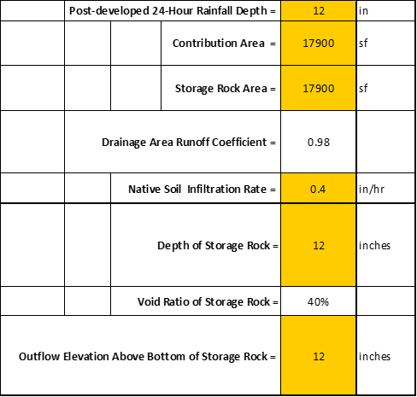

Slide 14
Step 6: Decision
Notes:
*Insert CAD Drawing Here!
Step 6: How should the study area be changed?
Overall look here

