Slide 1
LID Improvements
Lee Elementary School
Lauren Goulding, Ben Steger, Austin Henson, Ben Beverly

Slide 2
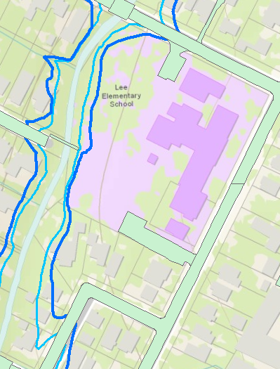
Site Representation
Lee Elementary
Residential area, with several houses in flood plain

Slide 3
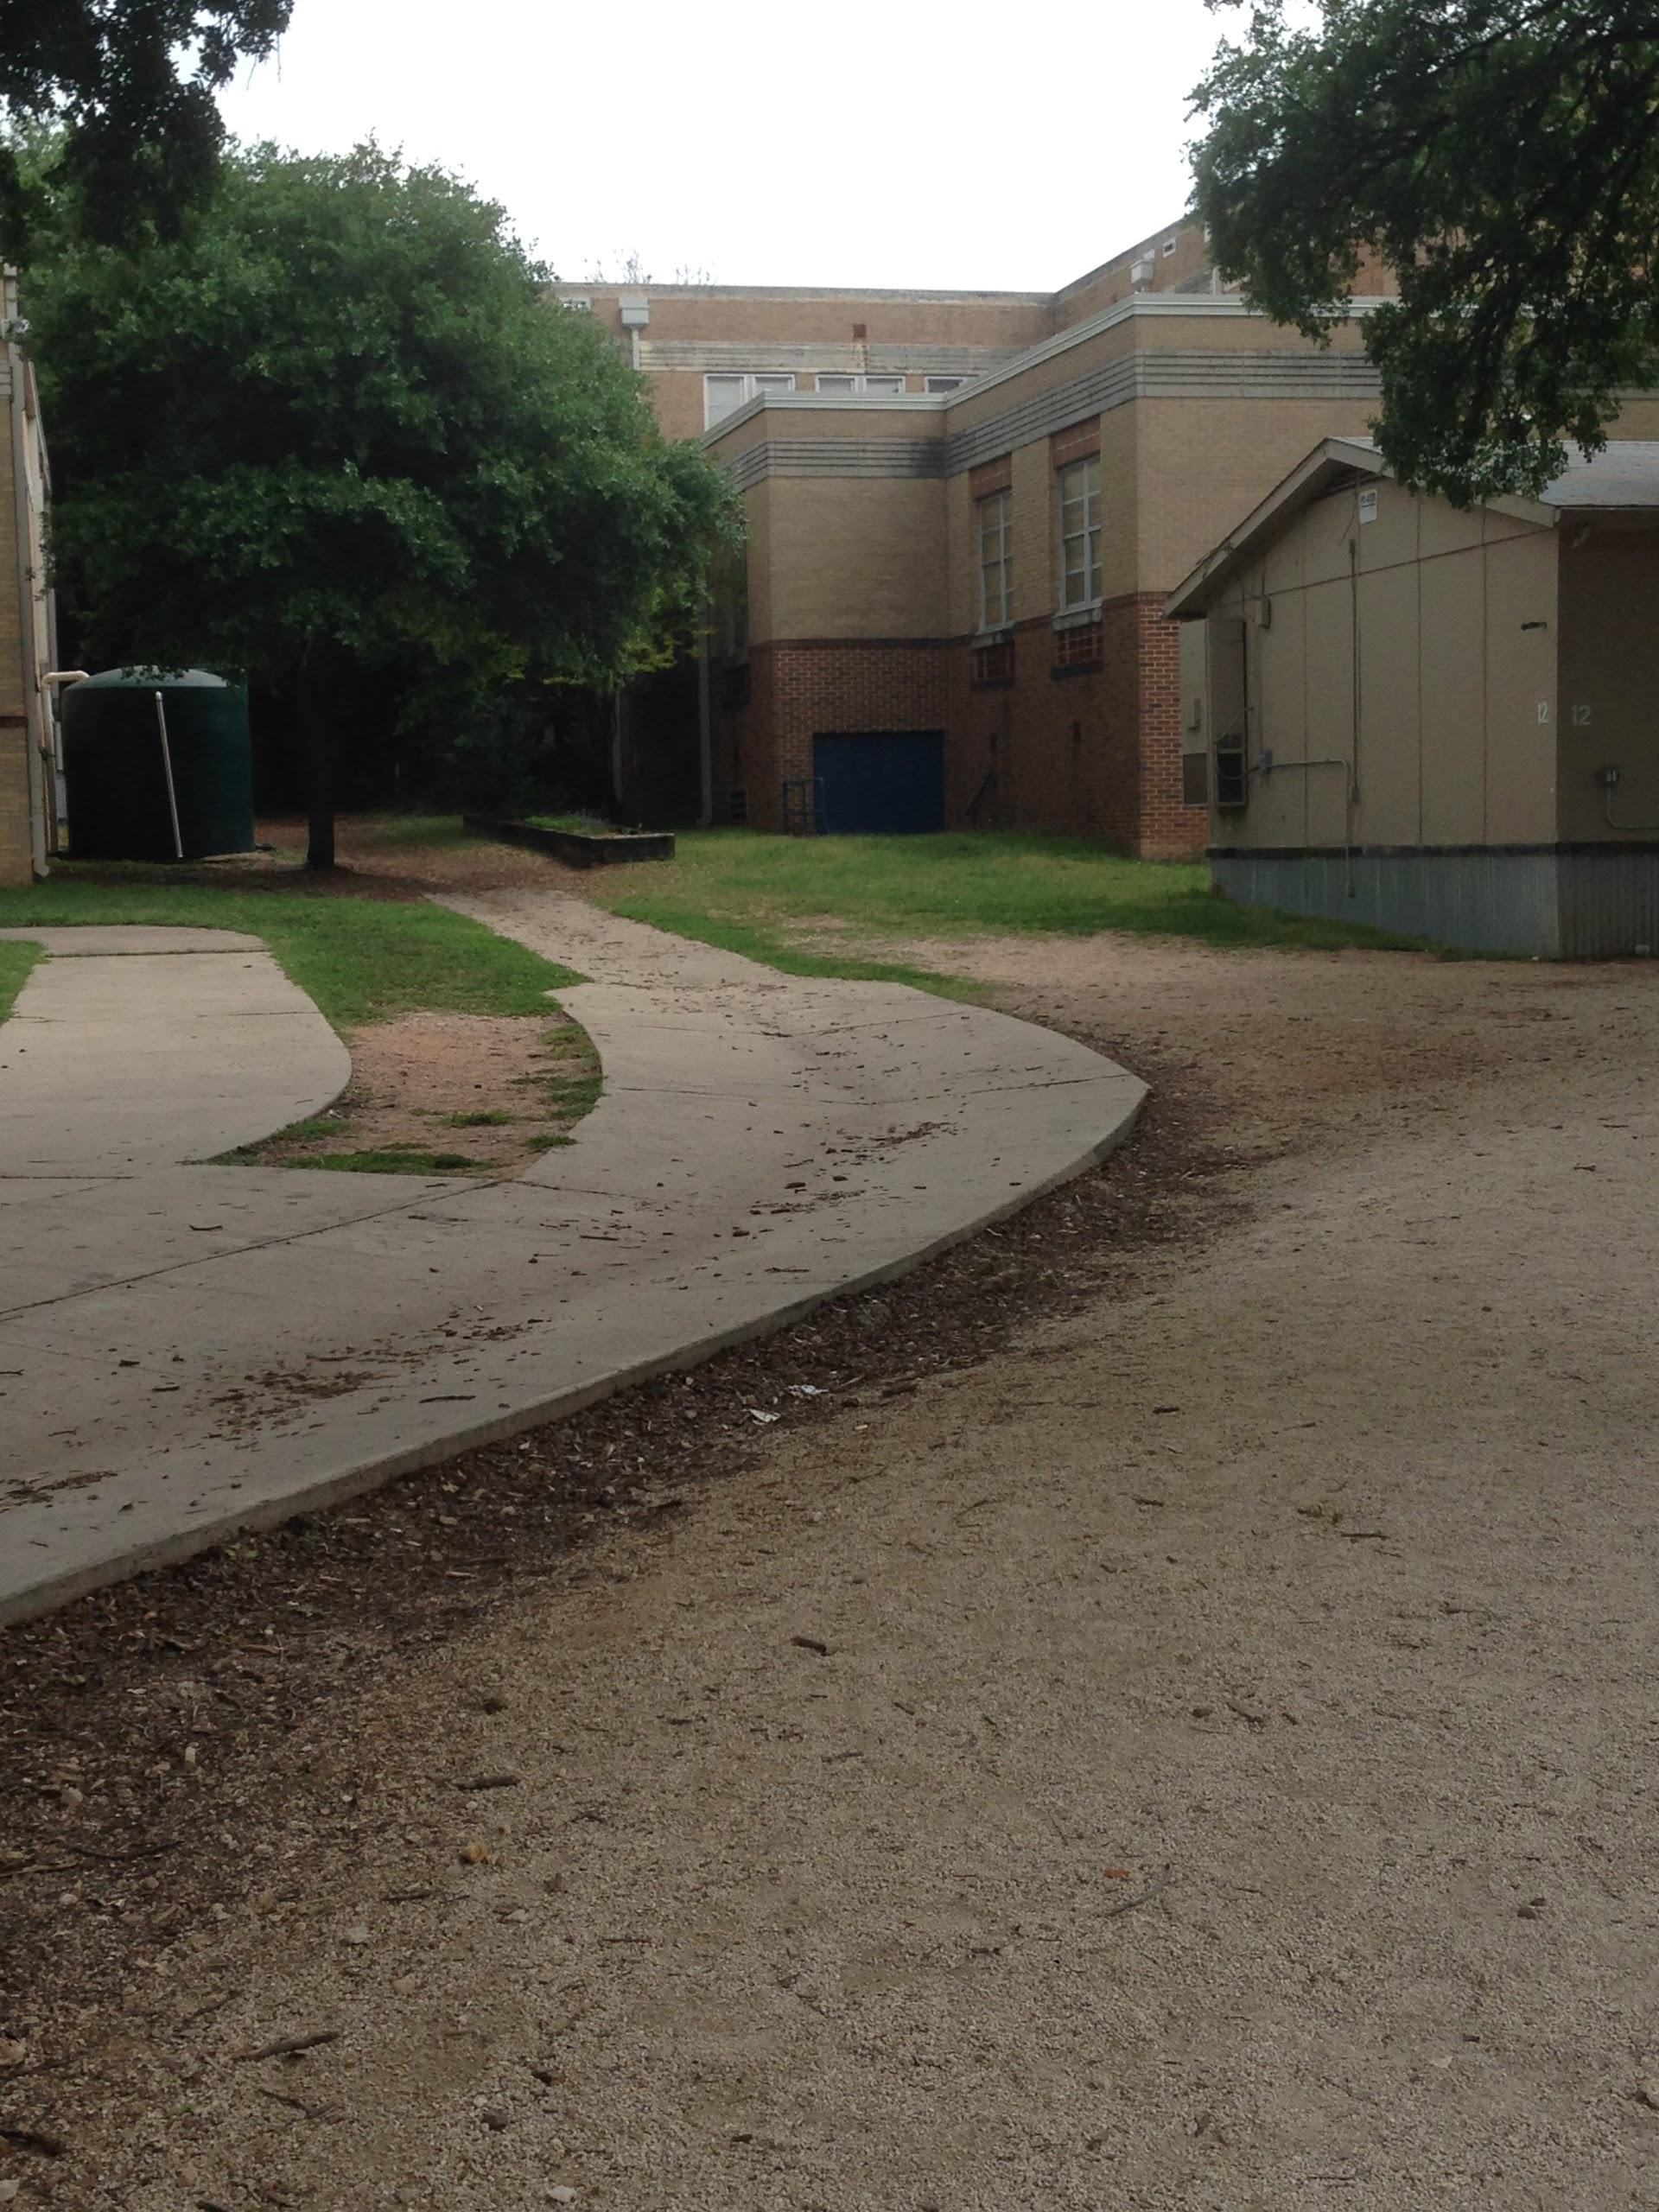
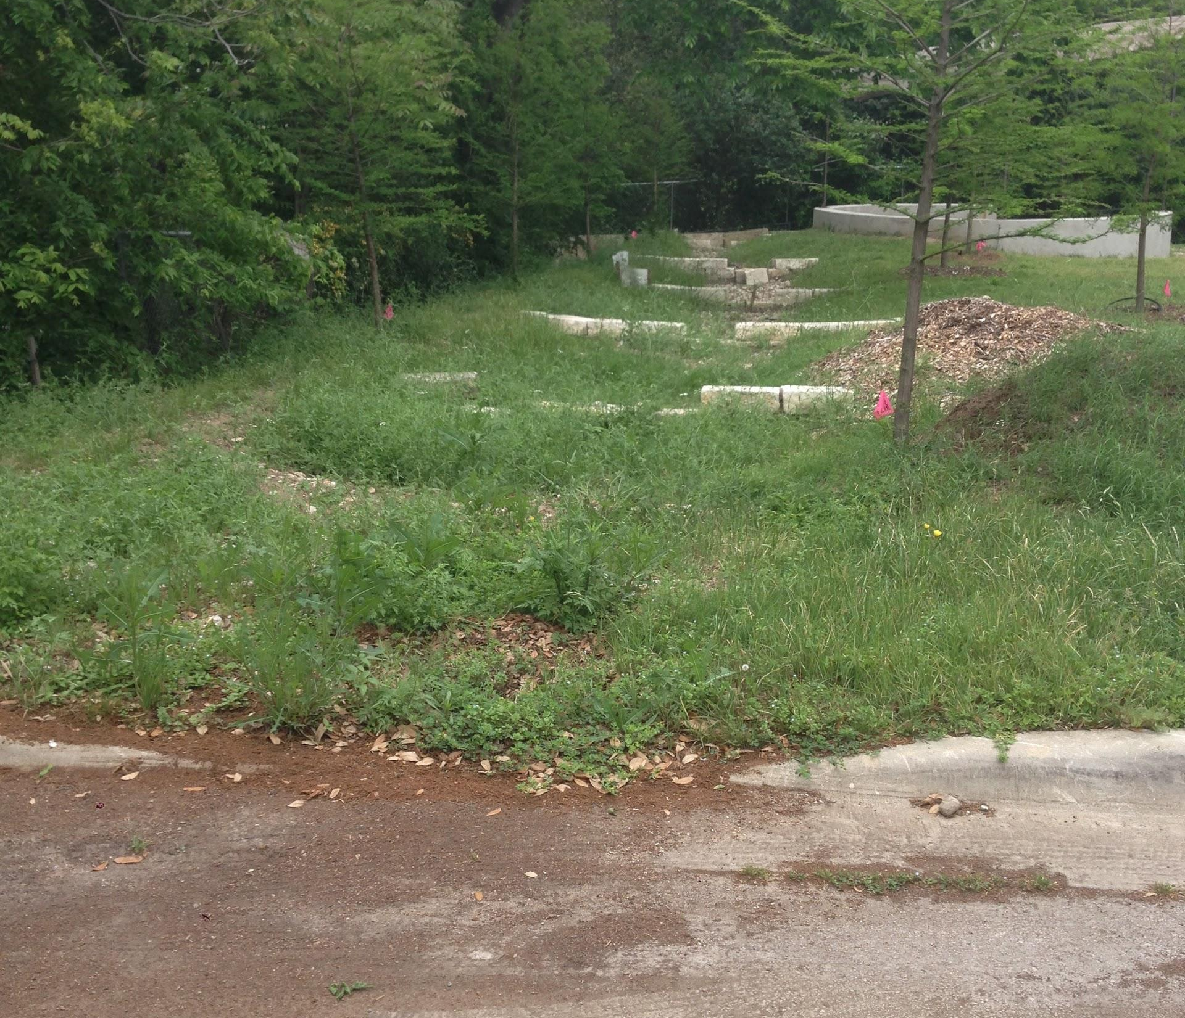
Site Representation

Slide 4
Site Process
Runoff from Lee Elementary flows across open land directly into Waller Creek
Erosion of compacted dirt along creek bank

Slide 5
Evaluation
Haphazard drainage at Lee Elementary allows for increased runoff velocity
Downstream homes in floodplain are at severe flood risk

Slide 6
Changes - Lee Elementary
Preserve function of space: play areas & soccer field
Reduce Peak Discharge
Reducing unchecked flow down creek banks

Slide 7
HEC-HMS Results for 25-Year Storm
Curve number: 96
100% Impervious cover
Drainage Area of 1.623 Acres

Slide 8
Impact
Constructed wetlands will:
Slow down water, reduce erosion
Aesthetic improvements
Lessen likelihood of downstream flooding
Remove BOD, suspended solids, and nitrogen

Slide 9
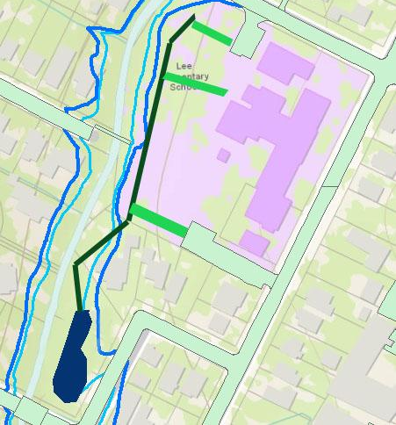
Recommendation
Swales and pipeline
Flood-resilient wetlands
Per EPA Design Manual
Runoff area too large for rain garden
Home buyouts

