Slide 1
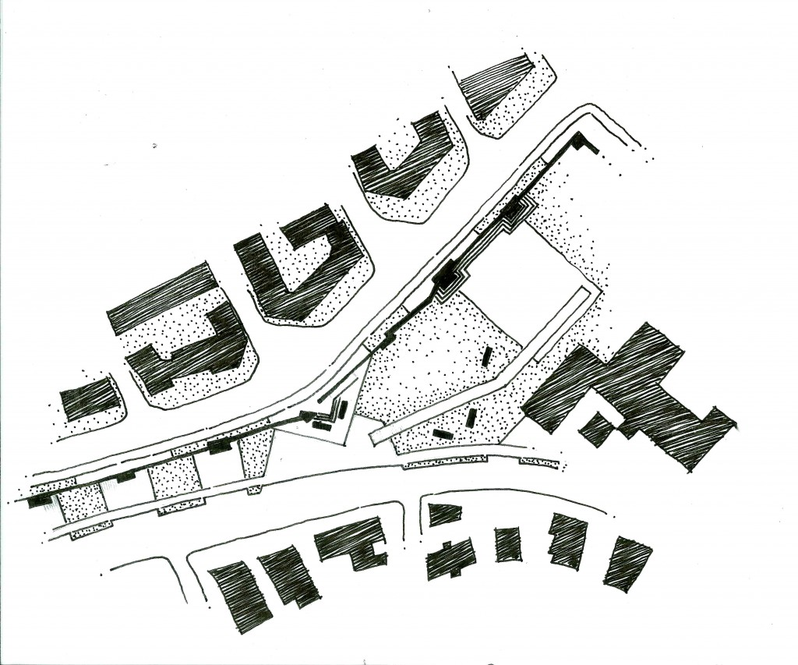
Permeable Concrete on the UT-Austin campus
Albert Bedia
Juan Pablo Gevaudan
Cassandra Pham

Slide 2
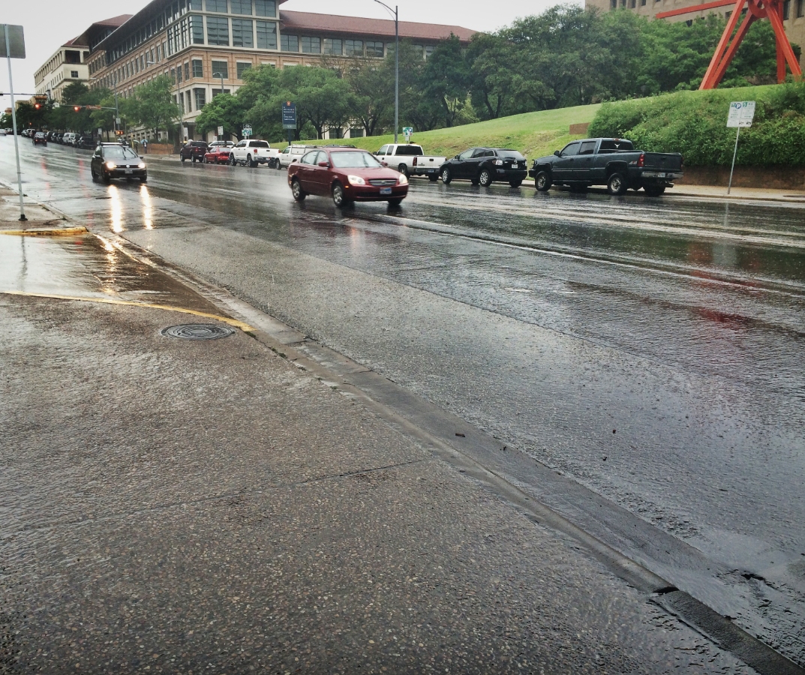
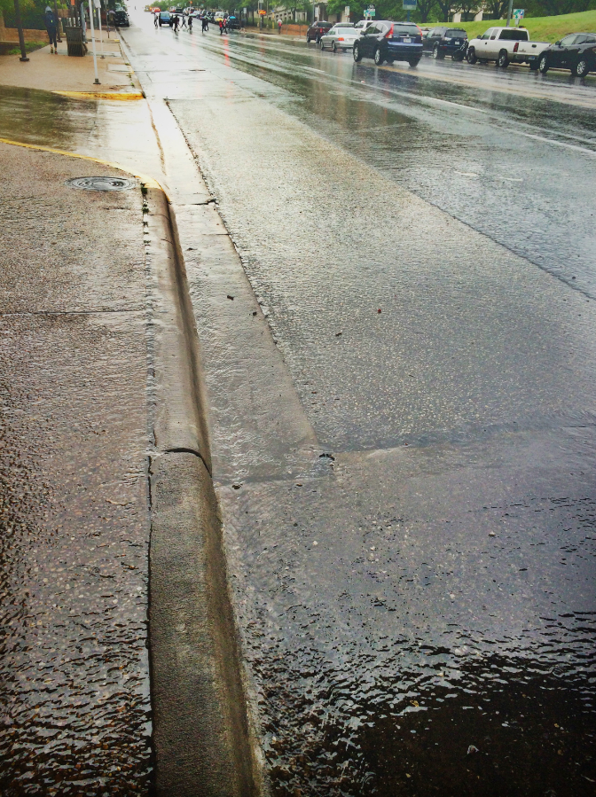
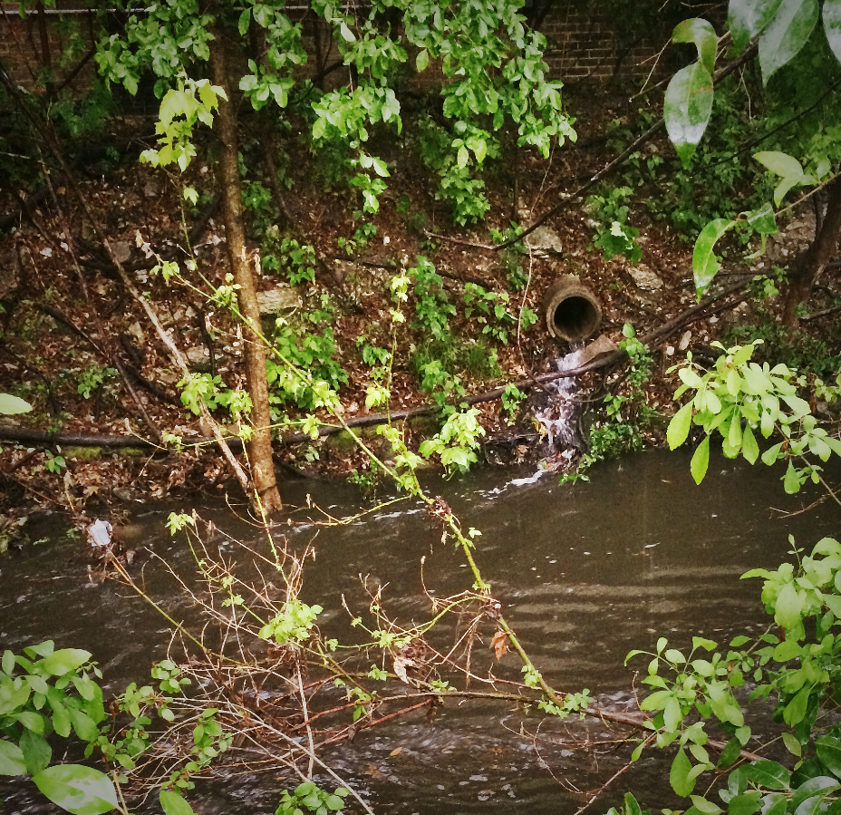
Motivation
1
What are we interested in?
2
Why is this issue important?

Slide 3
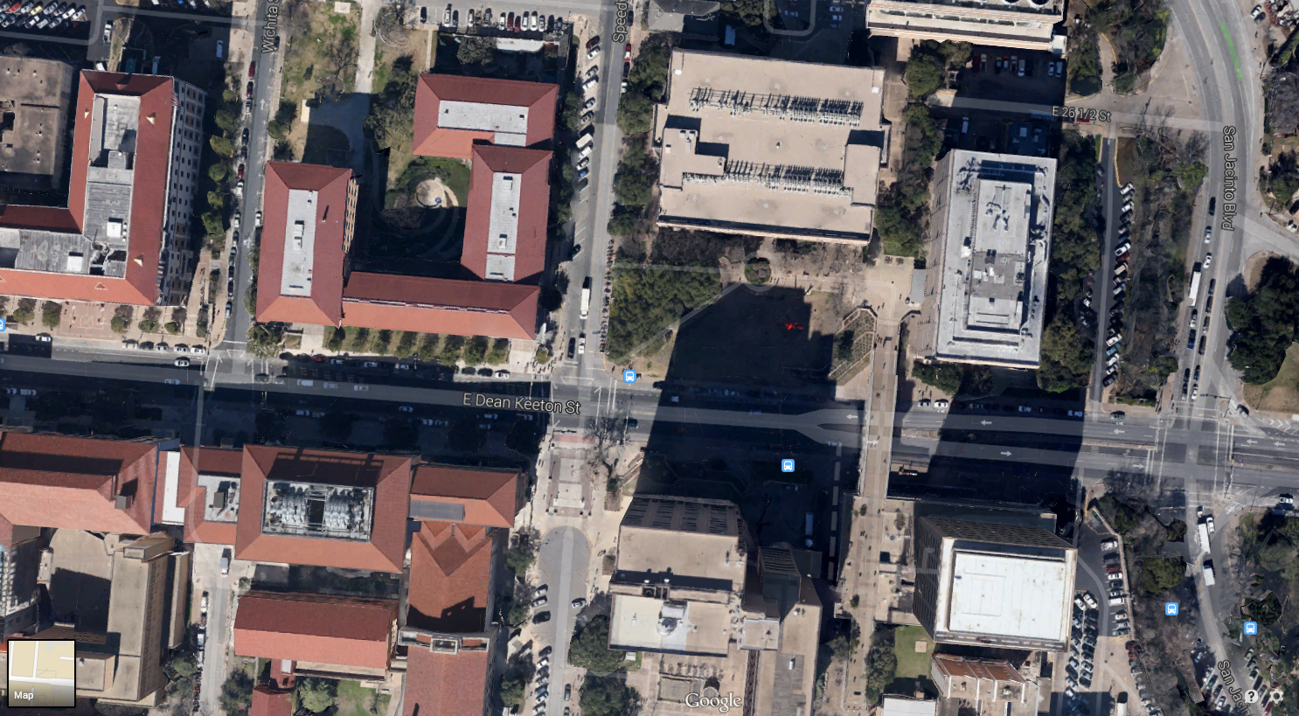
Study Area
Notes:
HydroDesign Process
Representation
Objective
Scope

Slide 4
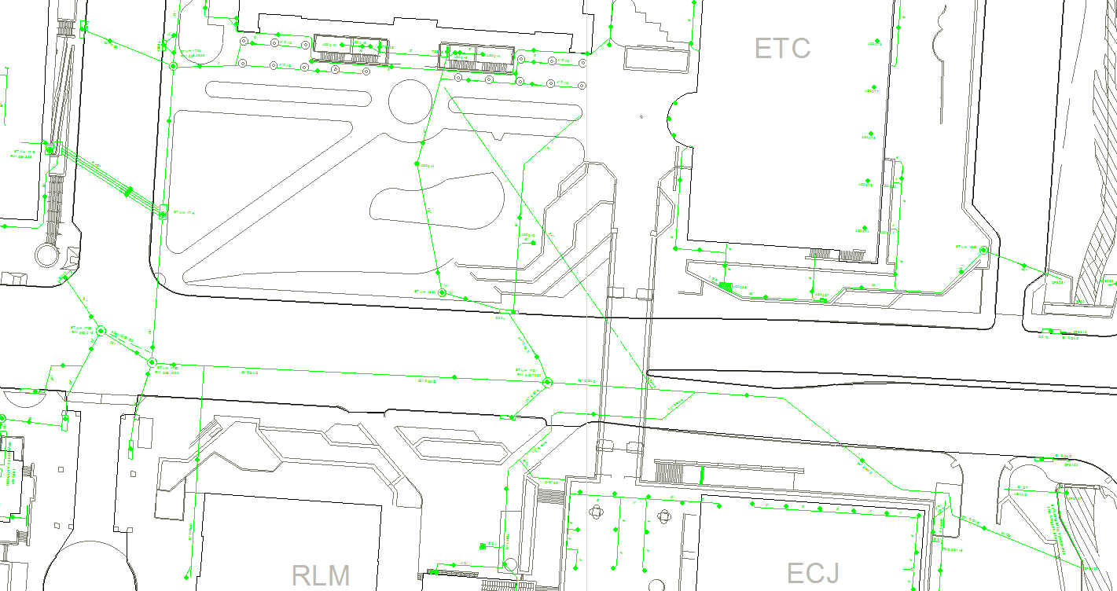
How Does the Study Area Operate?

Slide 5
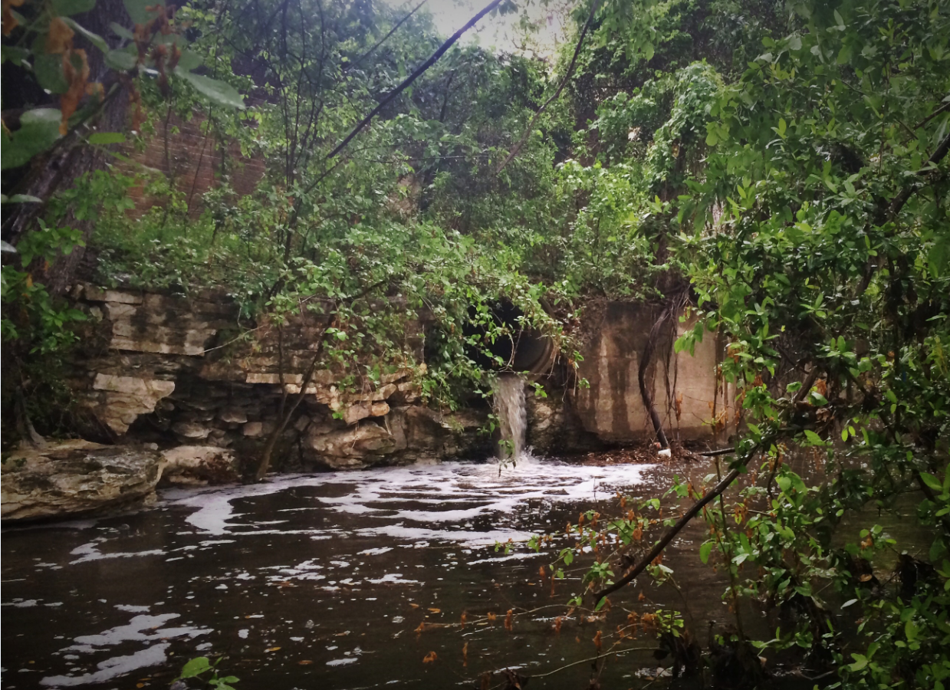
Is the Current Study Area Working Well?
Large stormwater flows
Poor water quality
High concentration of TSS in stormwater
1
2
3

Slide 6
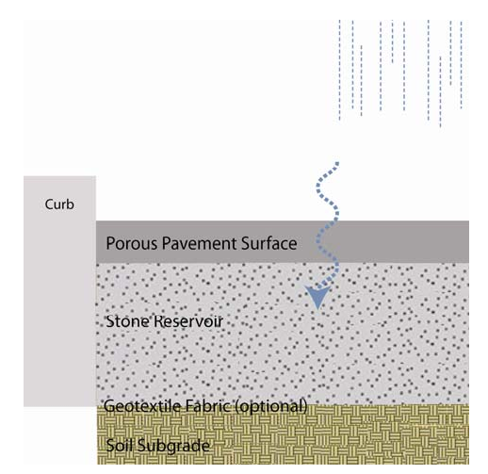

How Might The Study Area Be Altered?
Permeable Concrete – God of all concrete “hole-y”
Figure of basic components of a porous pavement system

Slide 7
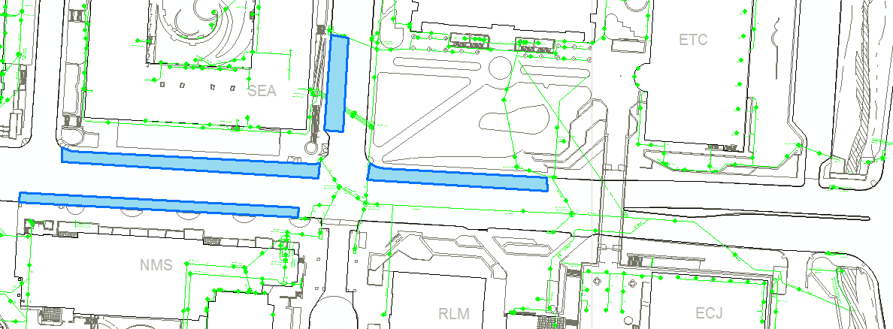
How Might The Study Area Be Altered?
Implement permeable concrete on parking area sections of Dean Keeton and Speedway
2023 ft²
2544 ft²
1800 ft²
2776 ft²
Total: 9143 ft²

Slide 8
What Differences would the Changes Cause?
Table of Percent of pollutants removed through use of Permeable Concrete

Slide 9
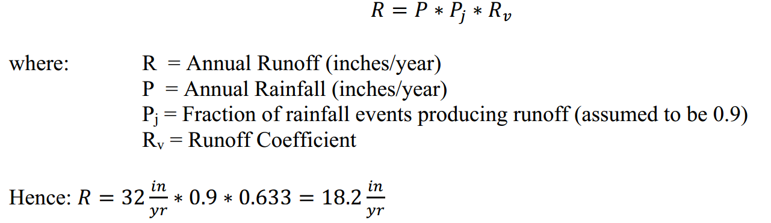
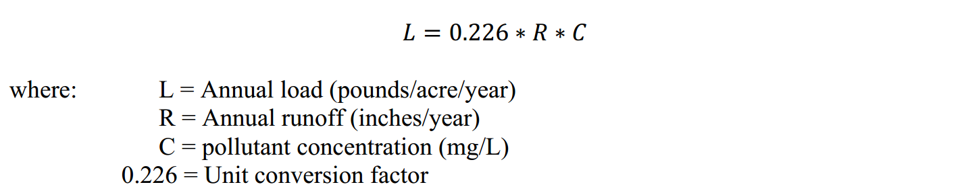
What Differences would the Changes Cause?
Notes:
Data collected by Dr. Barrett (a professor at our university) was used to calculate a runoff coefficient for a location close to our site, yielding Rv = 0.633 (see Figure 4). We assume that this runoff coefficient is valid for our site as well, and note that the average annual rainfall for Travis County is 32 inches/year (Barrett, 2005).

Slide 10
Table of Calculation of annual pollutant loads with and without Permeable Concrete
Notes:
Our permeable concrete system have the potential to achieve significant reductions in the total annual discharge of the above pollutants. This will result in an improvement of the health of Waller Creek.

Slide 11
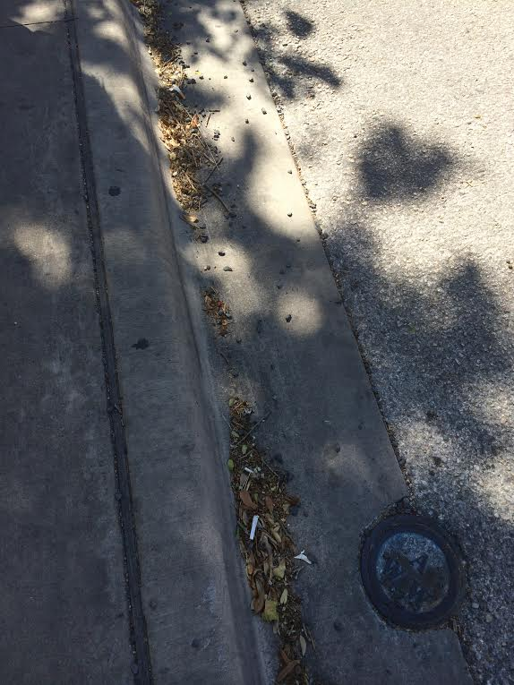
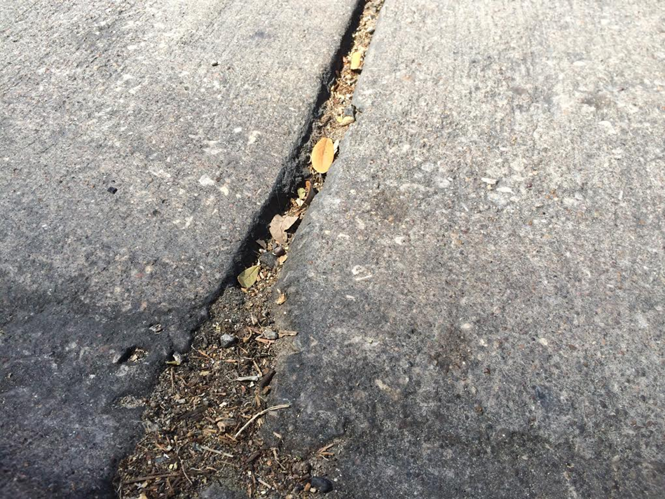
Operation and Maintenance
Stormwater runoff carries particles and sediments
  Clogging occurs
  Reduces the durability of the permeable concrete
Sediments
As a solution ➔ Implementation of Stormwater Grate System
Stormwater Runoff
Clogging
Reduces Durability
Sediments
Stormwater Runoff
Clogging
Reduces Durability
Sediments
Collected by Stormwater Grates

Slide 12
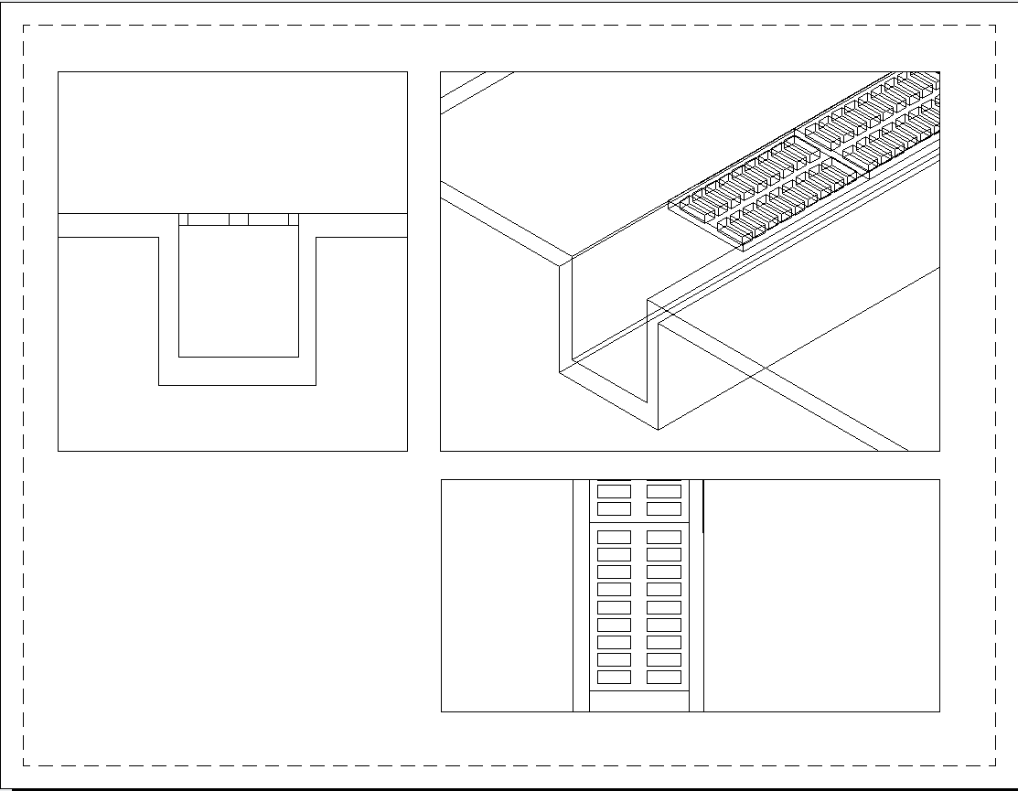
Simulation Model of Storm Water Grate
Front View
Storm Water Grate
Permeable Concrete
Isometric View
Stone Reservoir
Sheet Flow
Top View

Slide 13
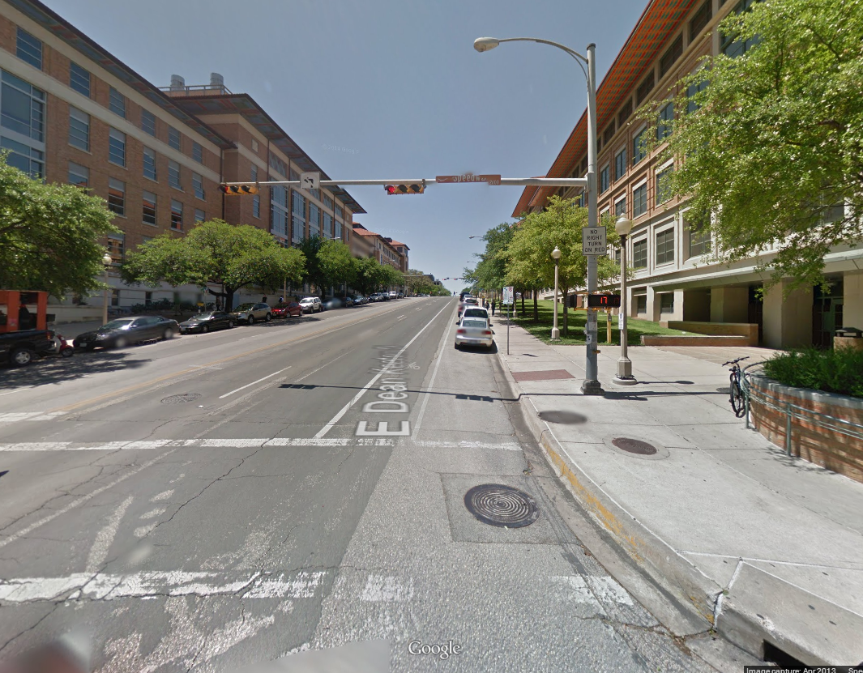
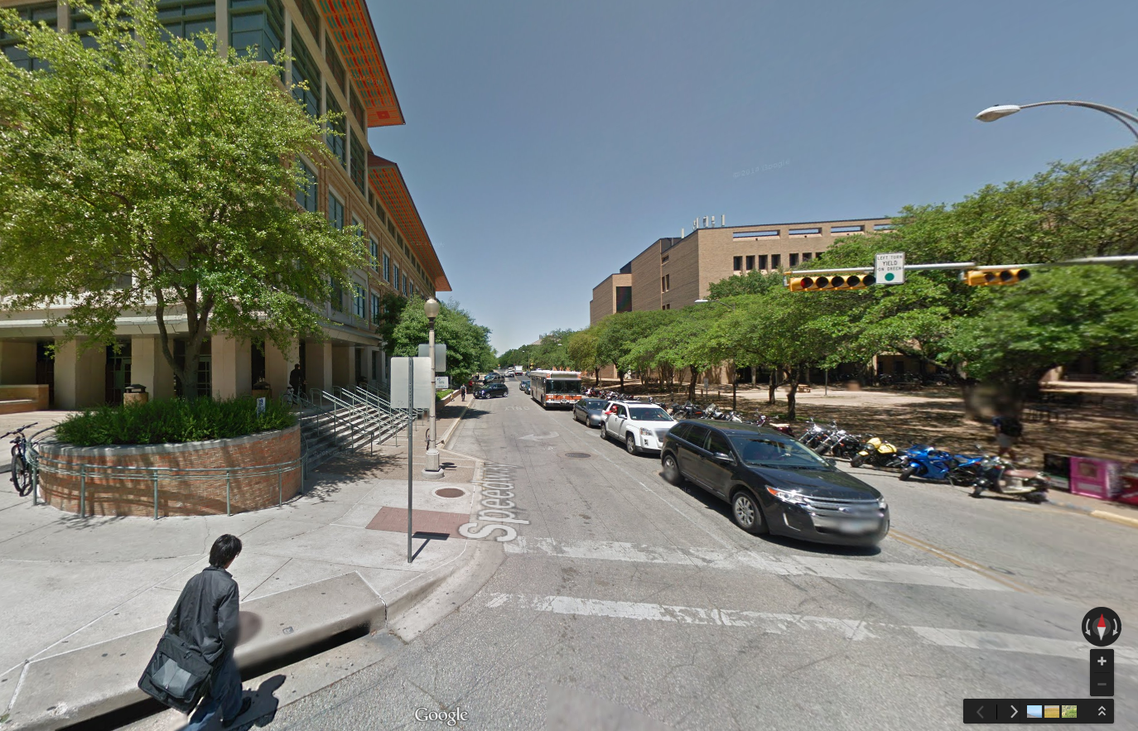

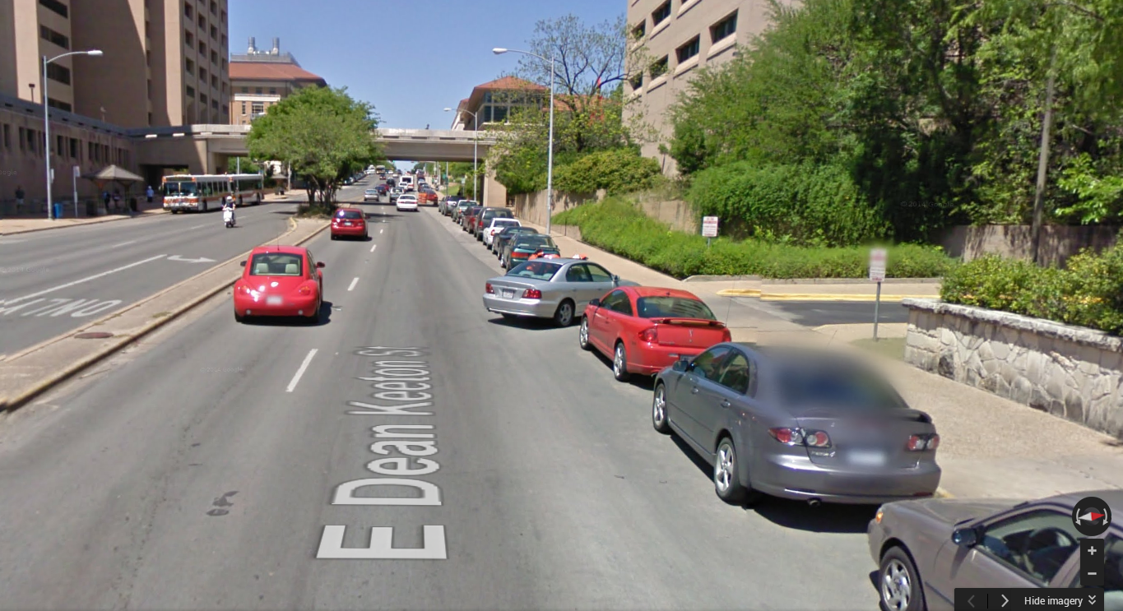
How Should the Study Area Be Changed?
Water flow

Slide 14

How Should the Study Area Be Changed?
Discrete Particle Settling: Stoke’s Law
- Assumes Laminar Flow

Slide 15
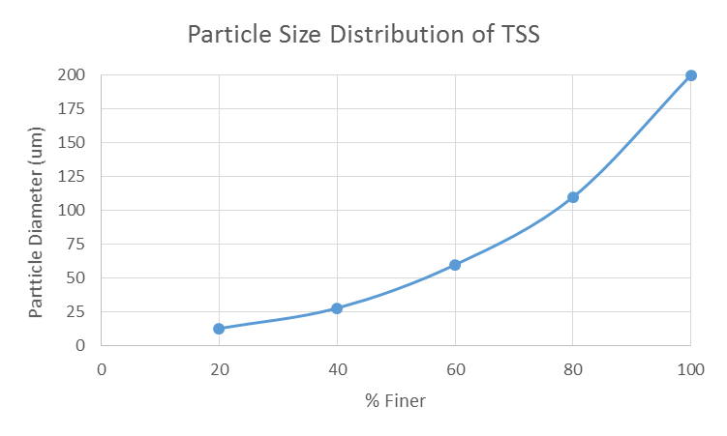
How Should the Study Area Be Changed?

Slide 16
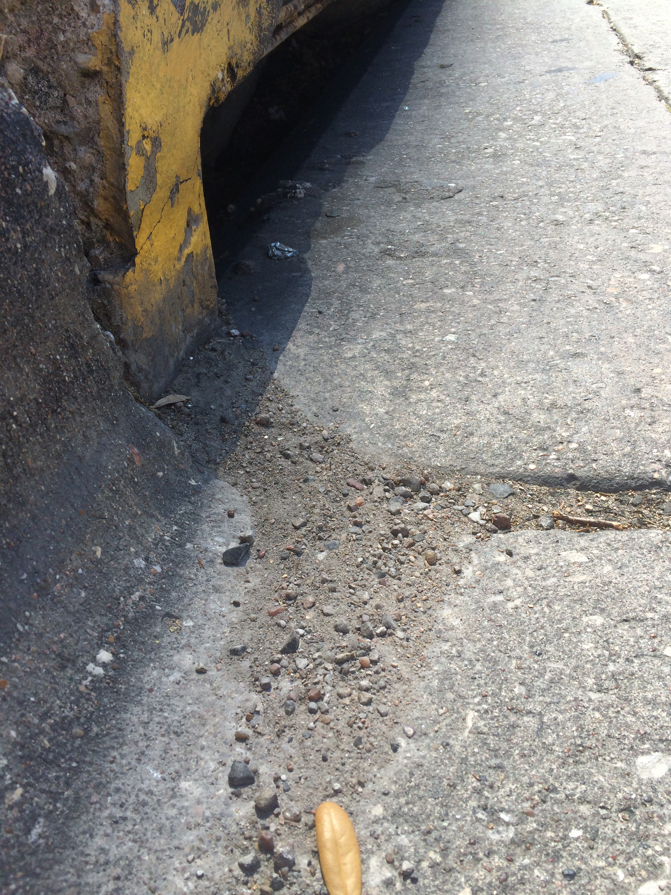
How Should the Study Area Be Changed?
Laminar flow does not represent the actual flow in design

Slide 17
Summary
Decision - ~9,000 Square Feet of Permeable Concrete
Anticipated key project element – Stormwater Grate to improve durability of permeable concrete
Overall Goal – Reduce stormwater pollutants and flow
Next steps – analyze turbulent flow in the stormwater grates

Slide 18
Questions?

