Slide 1
Eastwoods Park at Waller Creek
Antonio Ramirez, Christian Mercado, Fitsum Tesfa, Marie Thornton
Notes:
Marie

Slide 2
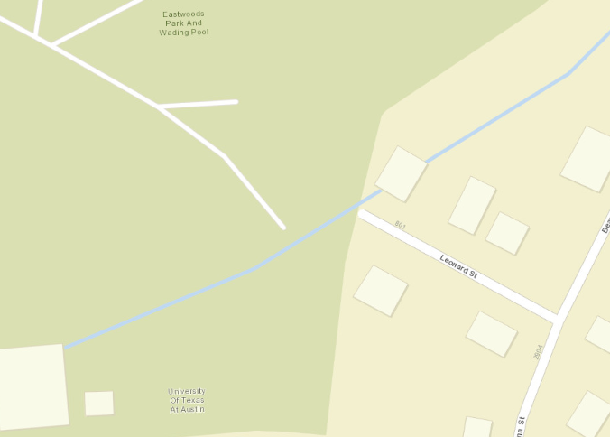
Representation: Basemap
Notes:
Marie

Slide 3
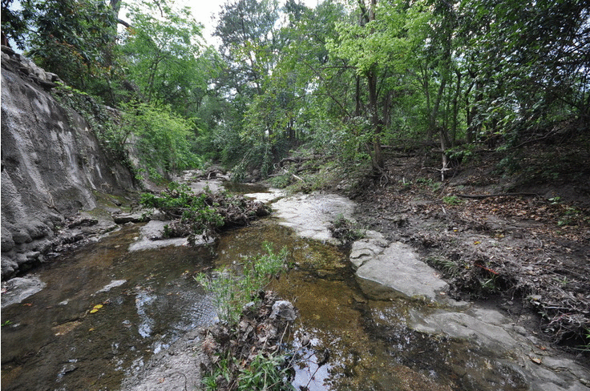
Representation: Site Location
Notes:
Marie

Slide 4
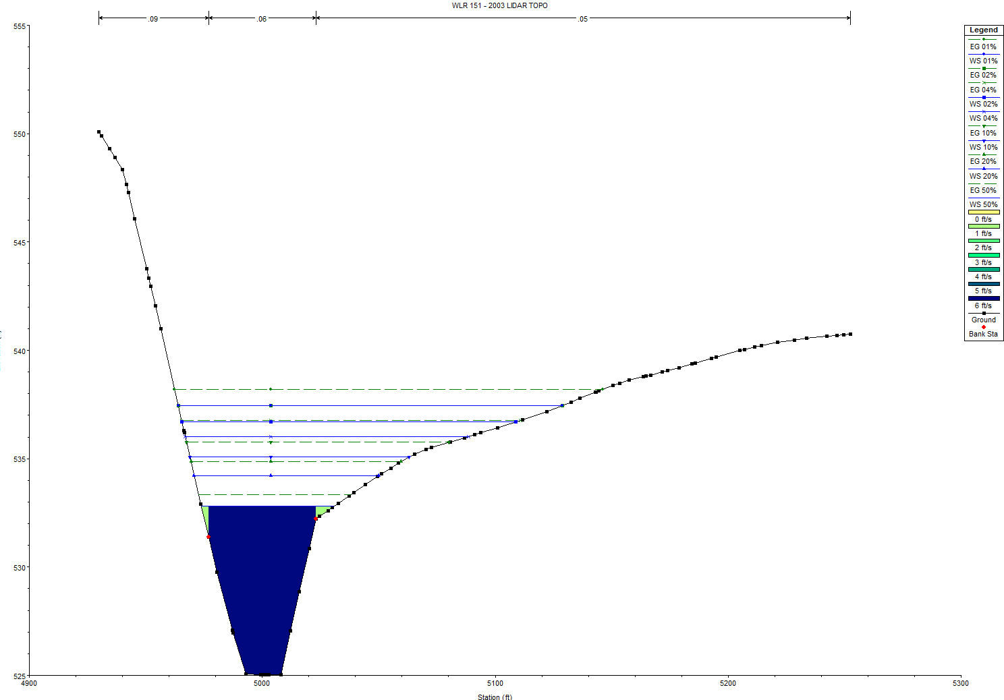
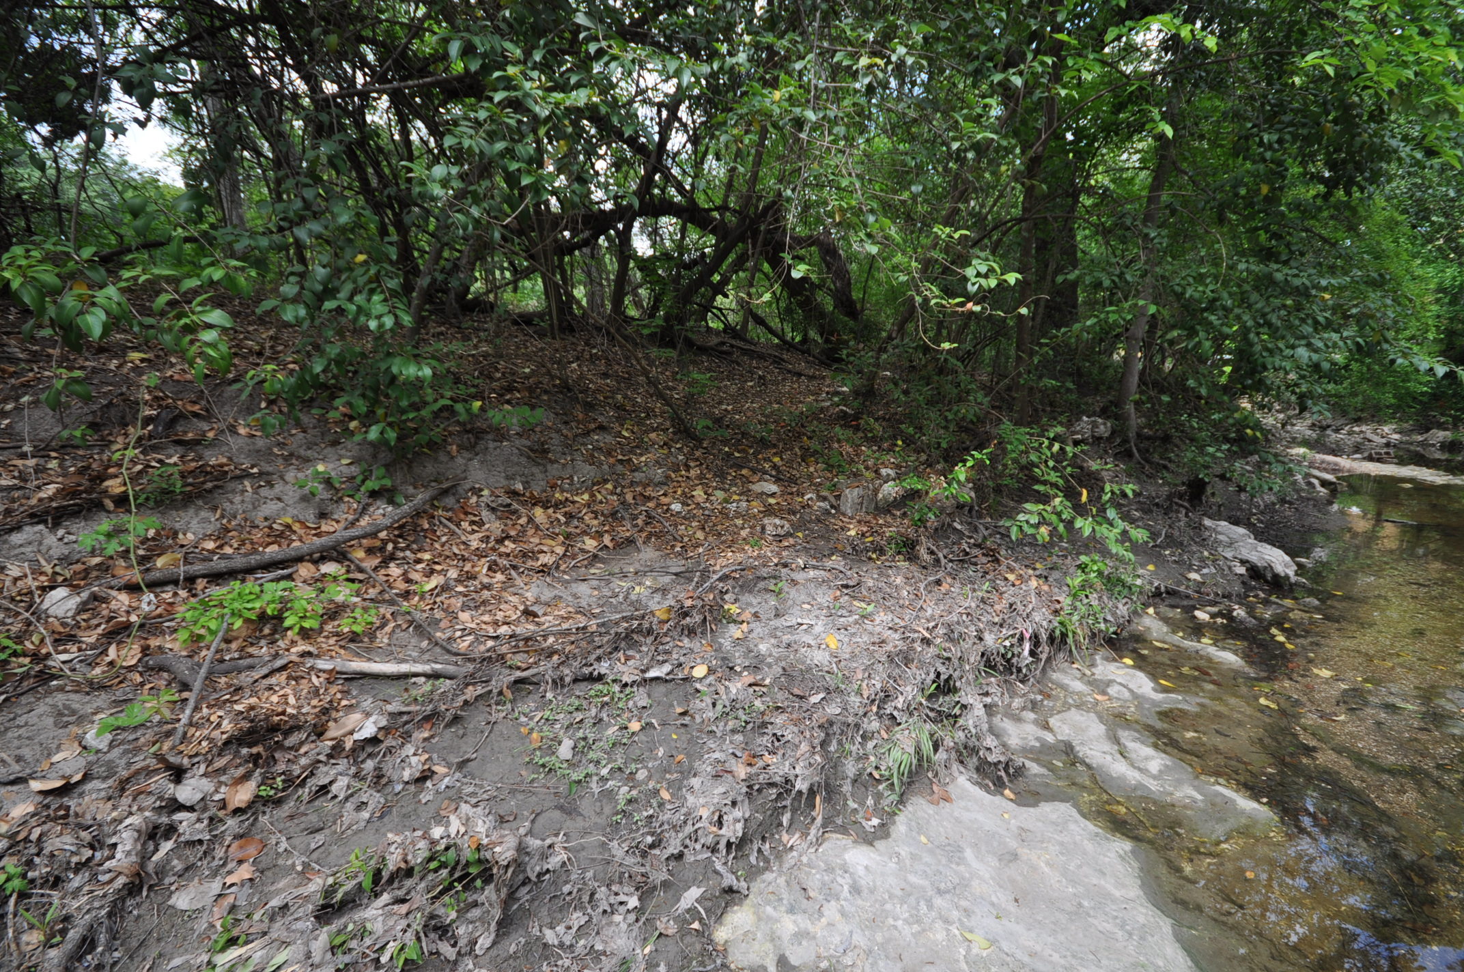
Process: How does the area operate?
Station 14014
Notes:
Chris

Slide 5
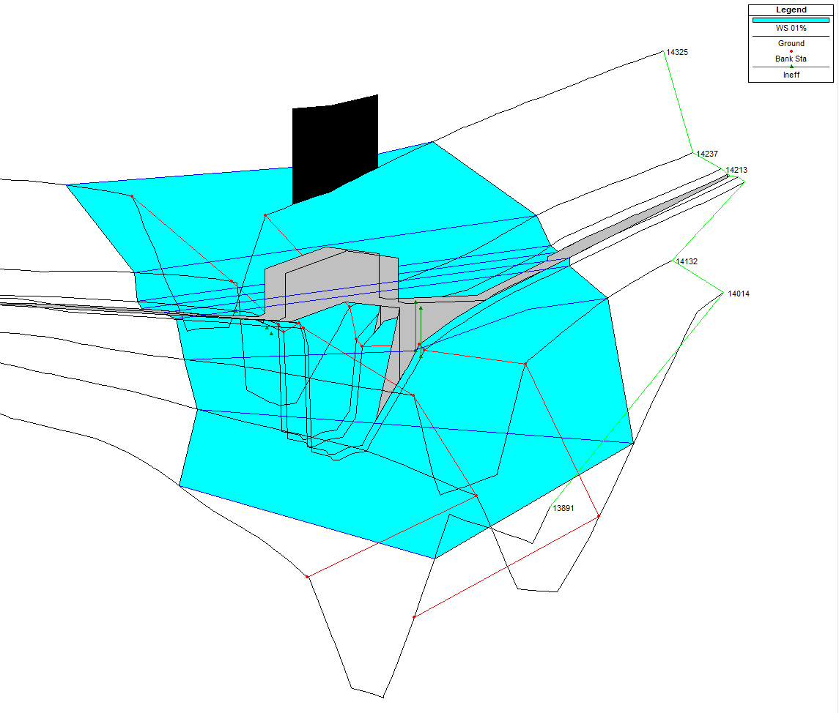
Process: How does the area operate?
House
539.28’
100 Year Storm
Notes:
Chris

Slide 6
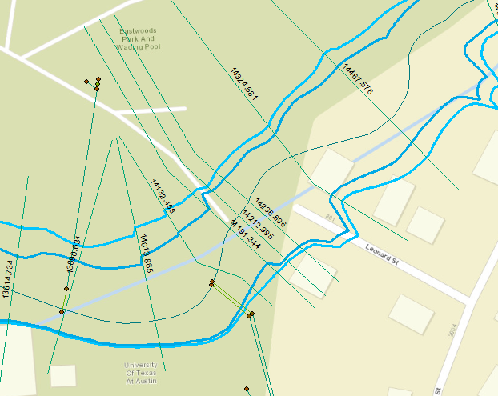
Evaluation: Is the area working well?
100 year floodplain
25 year floodplain
Notes:
Fitsum

Slide 7
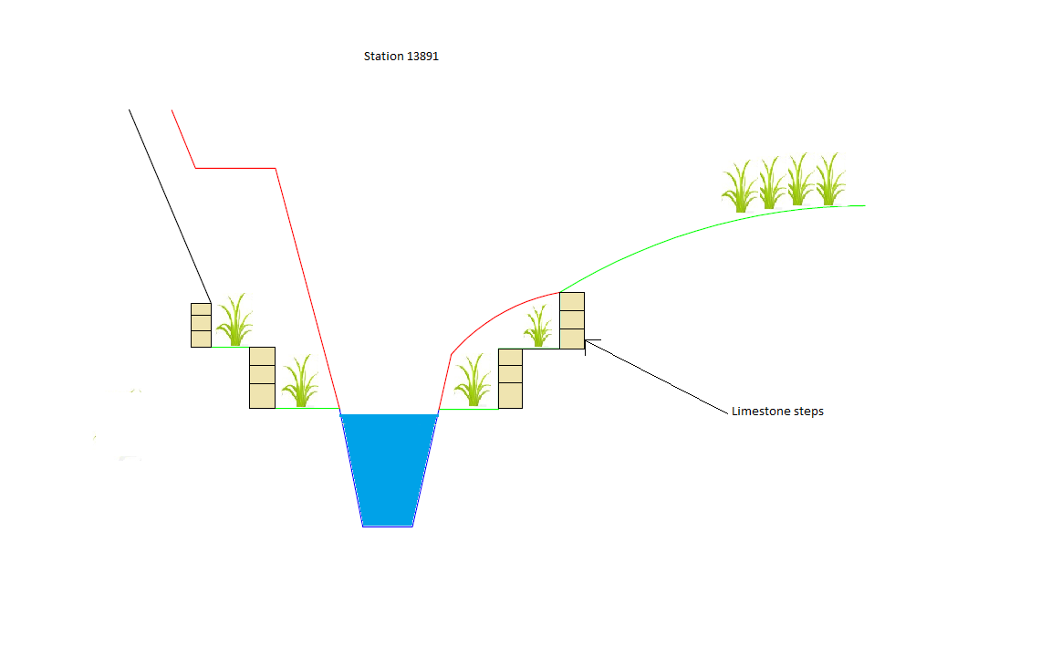
Change: Implemented Project
Station 13891
Terraces on both sides of creek from Station 13891-14191
Terraces on one side of creek for Station 14213
Notes:
Fitsum

Slide 8
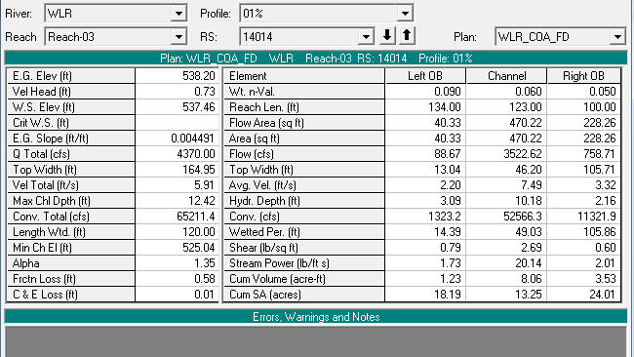
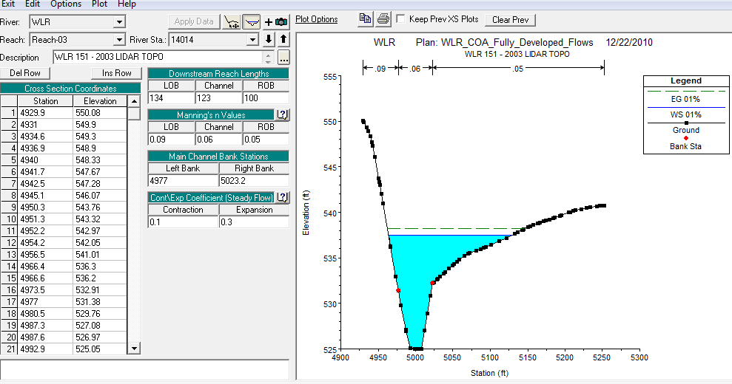
Impact: HEC-RAS Model
Cross section
Notes:
Antonio

Slide 9
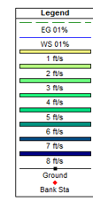
Impact: HEC-RAS Model
Notes:
Antonio

Slide 10
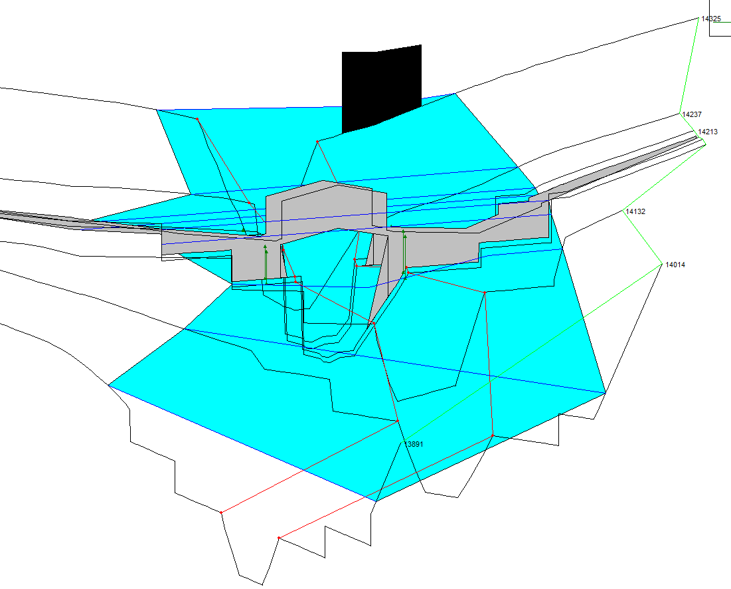
Impact: HEC-RAS Model
538.89’
100 Year Storm
Notes:
Antonio

Slide 11
Decision: Summary
Station 14014
Year Storm | LB Velocity Decrease | RB Velocity Decrease | LB Shear Decrease | RB Shear Decrease
100 Year | 15% | 20% | 35% | 40%
50 Year | 18% | 11% | 39% | 32%
25 Year | 20% | 10% | 41% | 29%
10 Year | 22% | 23% | 41% | 41%
5 Year | 5% | -17% | 21% | -9%
2 Year | 25% | -30% | 42% | -36%
Station 14014
Year Storm | Water Elevation (ft) | Inches Decreased
100 Year | 537.01 | 5.40
50 Year | 536.18 | 6.24
25 Year | 535.45 | 6.84
10 Year | 534.4 | 8.04
5 Year | 533.49 | 8.52
2 Year | 531.94 | 10.44
Implement Rain Terraces on Banks of Waller Creek for Stations 13891- 14213
Channel Cleanup of Debris
Decreased flooding hazards
Decreased bank erosion
Notes:
Chris

