Slide 1
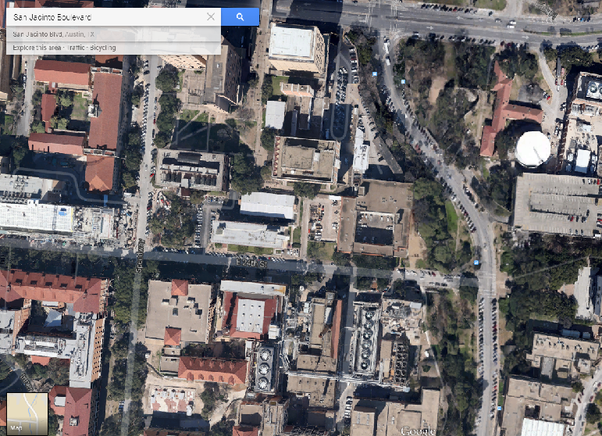
Bioretention on San Jacinto Boulevard
Group 9:
Zachary Steeg
Janelle Wong
Yu-Han Yang
Notes:
J

Slide 2
Summary
1) Representation of Study Area
2) How does the study area operate?
3) Evaluation of how the area operates
4) How can we improve this area?
5) Impact of improvements
6) Future goals
Notes:
J

Slide 3
Study area and operation
Focus on San Jacinto Boulevard in-between Dean Keaton and Darrell K. Royal Stadium
San Jacinto Boulevard experiences heavy foot and vehicular traffic and runs along Waller Creek
Left side is grassy while the right is mostly impervious cover.
Street run-off either passes through the grass or goes from the street to inlets, pipes, and then discharges into the creek
Notes:
Z

Slide 4
Runoff volume and quality
Annual runoff was calculated using the “simple method”, and by utilizing data Dr. Barrett obtained near our site location.
This could then be used to calculate the annual loads of concentrations.
The main containments sought to be removed are: E. coli, Copper, Lead, Zinc, Phosphorous, Nitrogen and TSS. The percentages these a bio retention area can remove varies greatly due to design parameters
Notes:
Zach: yearly volume of water + some pollutants (concentrations)

Slide 5
Improvement - BIoretention
Bioretention Basins are designed to hold water, allow infiltration, and discharge it downstream.
City of Austin refers to this process as biofiltration as it oftentimes uses plants in conjunction with other media to filter water.
Can significantly reduce volume of runoff
Offers high filtration of pollutants
Aesthetically appealing
Notes:
Janelle

Slide 6
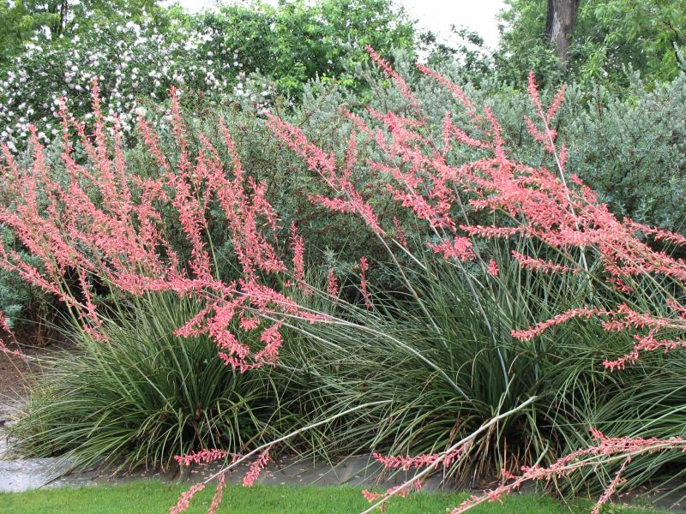
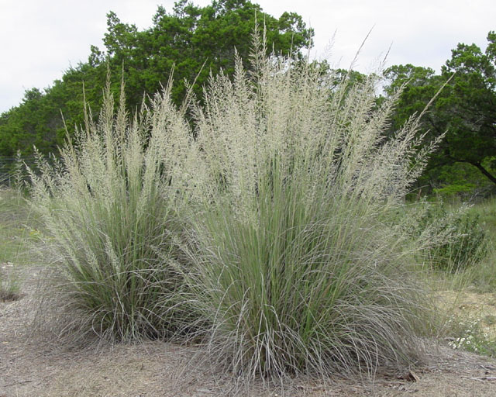
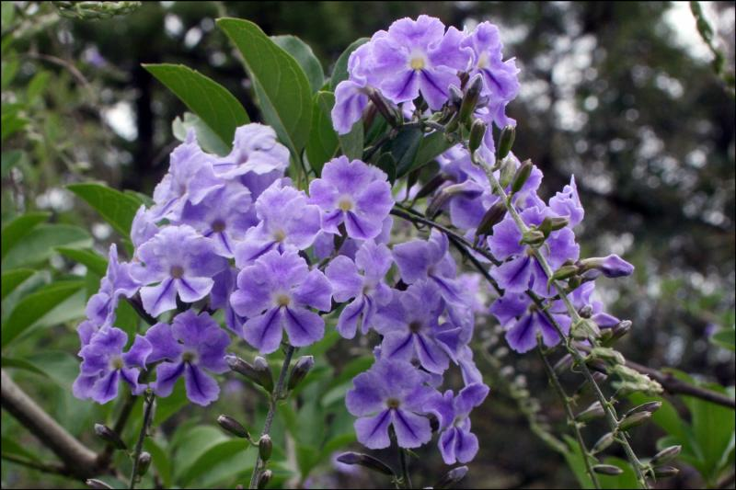
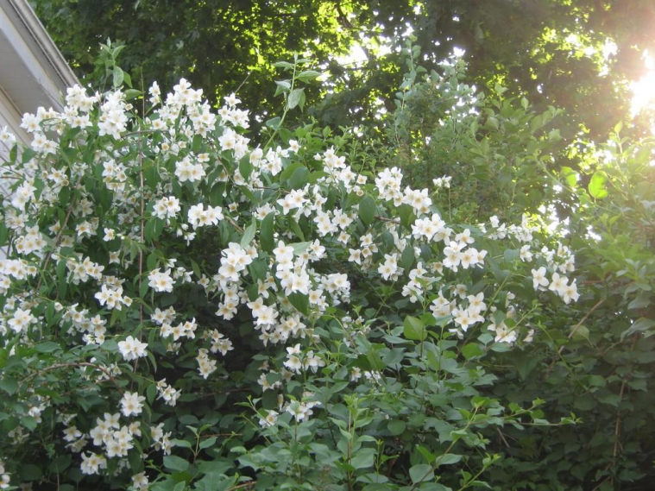
Vegetation
Red Yucca
Big muhly
Mock orange
Skyflower
Notes:
Yu-han, in charge of 3-4 plant species we’re looking @ and some basic information + pictures
Might be good if we want to have an accurate pricing on plants:
http://austinnativelandscaping.com/xeriscape-texas-native-plants-for-drought-toleran-landscaping-in-austin-texas/

Slide 7
Sites
Area | Ft²
I | 700
II | 460
III | 709
∑ | 1869
I
II
III
Notes:
Z

Slide 8
Site iii proposed plan
Notes:
janelle

Slide 9
Impact
L = 0.226 * R * C
L = Annual Load (pounds/acre/year)
R = Annual Runoff (inches/year) = 16.4 inches/year
C = pollutant concentration (mg/L)
Notes:
Yu-han, pollutant removal

Slide 10
Future goals
AutoCAD Drawings
GIS representation of final implementation
Further consultation and finalize design of 2 other feasible areas
Cost Estimation
Further investigation into exact contaminant removal
Notes:
Zach, future goals

Slide 11
Questions?
?

