Slide 1
City of Austin Watershed Protection Department CIP Project design/implementation
March 27, 2014
Notes:
Thank you for the opportunity to show the committee what the Watershed Protection Department has been able to accomplish with the 2006 bond funding and for what could be accomplished with future funding.

Slide 2
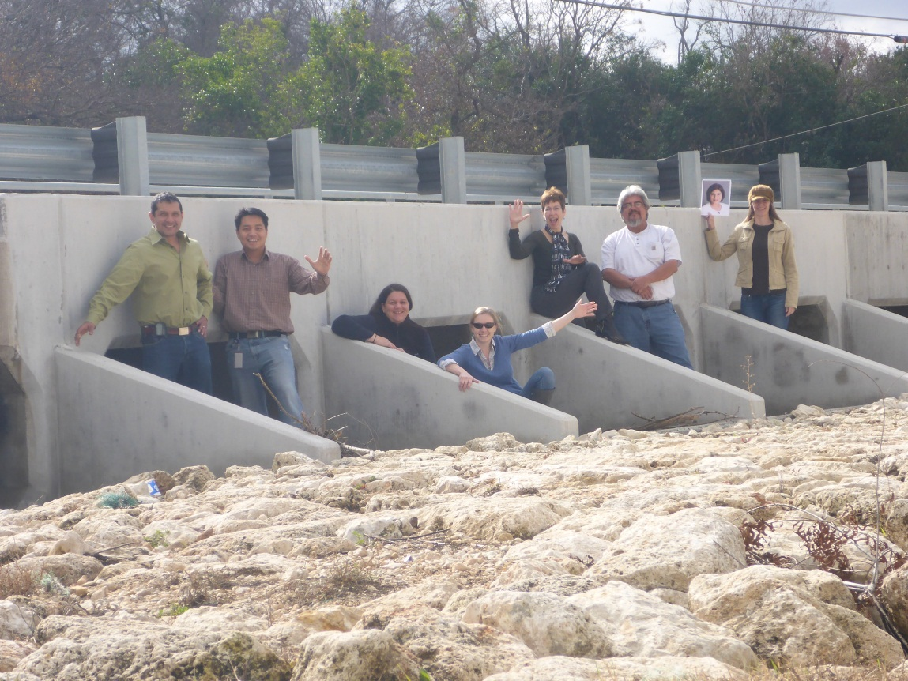
Steps of a CIP Project
Identify
Verify
Prioritize
Analyze
Design
Permit
Project Manual
Construction Oversight

Slide 3
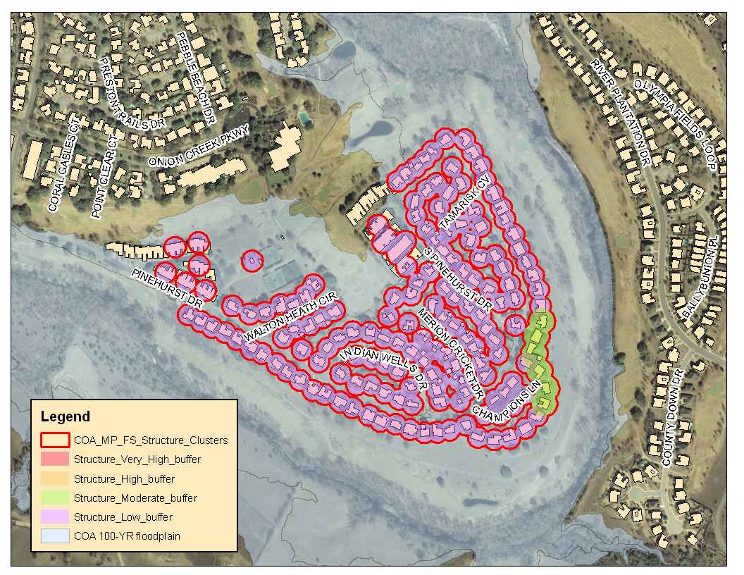
Identify: Locating the problem
Goal: Reduce flood hazards to citizens of Austin

Slide 4
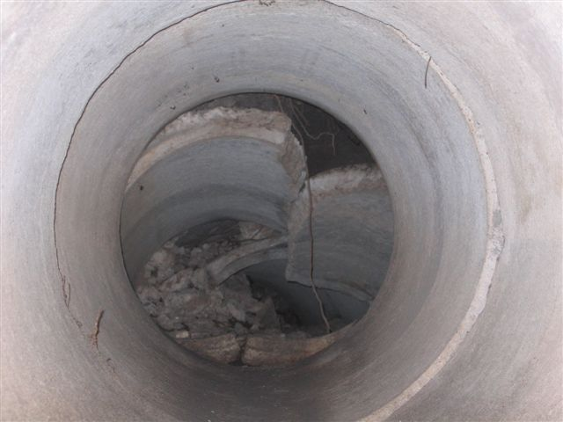
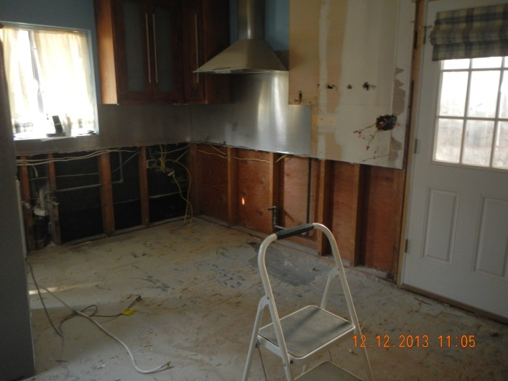
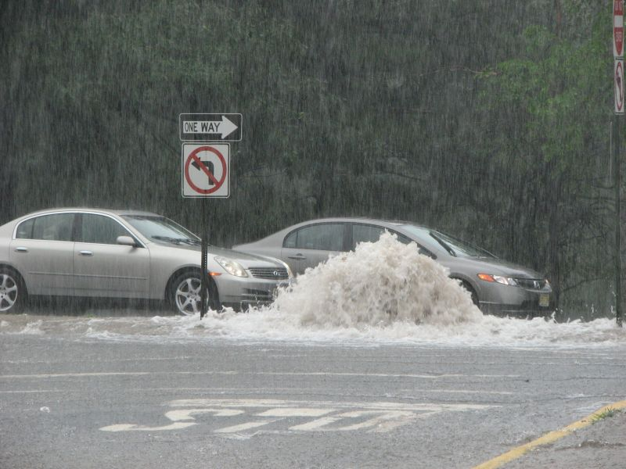
Sometimes the flooding is away from the creeks due to undersized storm systems or failed storm pipes

Slide 5
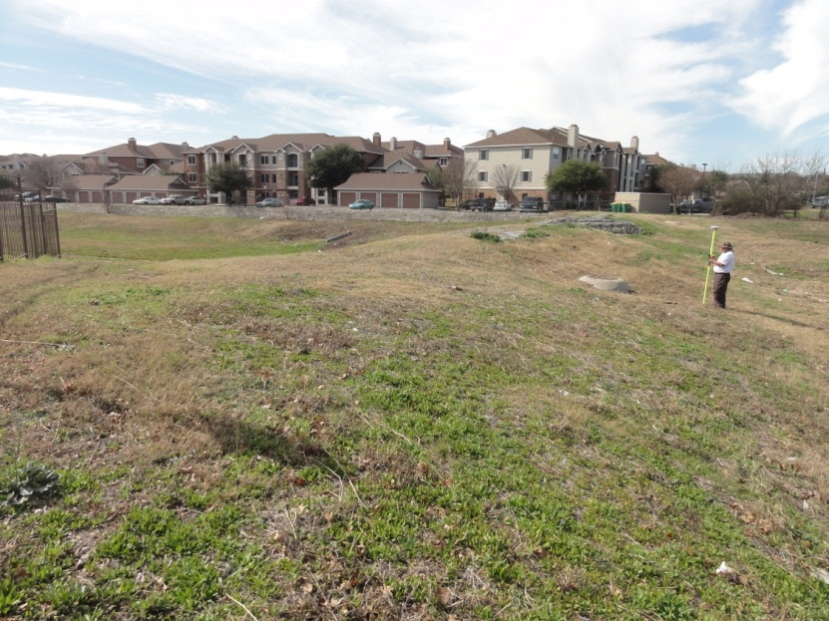
Identify: Locating the problem
WPD master plan
Floodplain maps
Drainage complaints
StormCAD models
Annexation reviews
Infrastructure Assessment

Slide 6
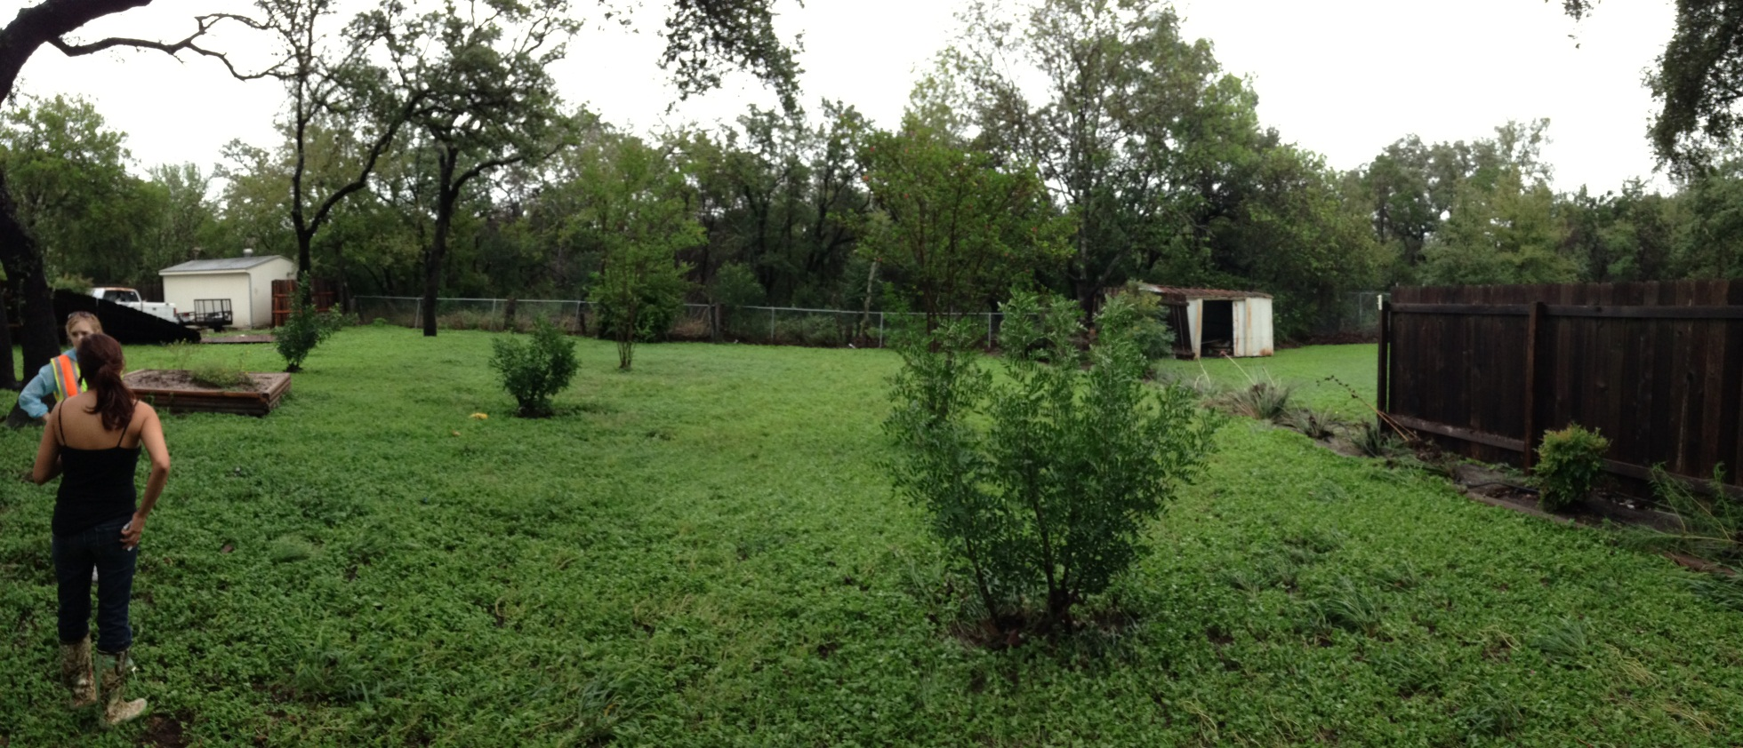
Verify: Define the problem
Field Visit
Survey
Post-storm investigations
Model development
TV inspections

Slide 7
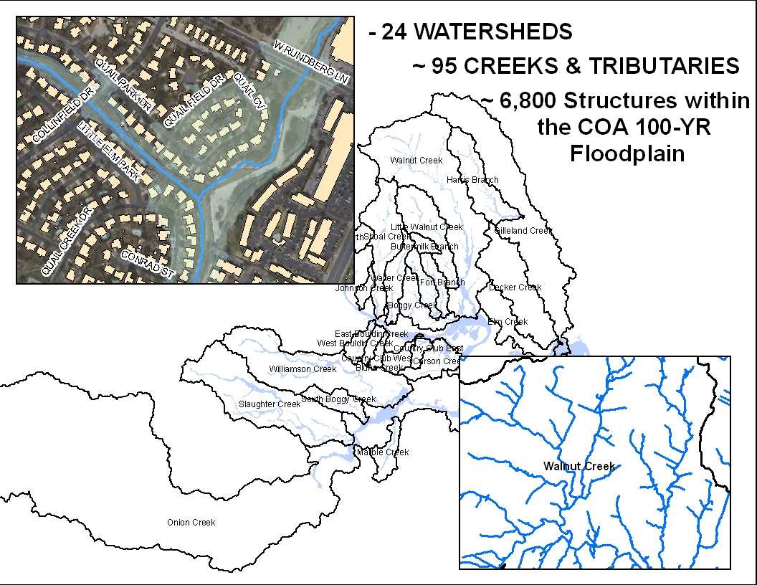

Slide 8
Localized Flood Hazard Mitigation Program
FOD Field Engineering
FOD Pipe Condition Assessment
Rehabilitation & Construction
Inspection and Cleaning
Partnership Opportunities
Inlet: > 32,000
Manhole: > 4,000
Outfall: >5,000
Storm Drain System: ~1000 mi.

Slide 9
Master Plan Objectives
Develop Flood Scores* for 28 Watersheds with:
Updated, Current Resources
Revised, Streamlined Methodology
* Flood Score: A “first cut” estimation of potential flooding severity for structures and street crossings due to creek bank overtopping. These scores will be used to identify the need for improvement projects and prioritize project areas based on their relative scores.

Slide 10
Master Plan Objectives
Capital Improvement Projects: Identifying Priorities
Flood scores
Feasibility Assessments
Multi-mission objectives
Cost
Access
Impact to citizens
Evaluate projects ranging in scale from a roadway crossing improvement to regional detention ponds

Slide 11
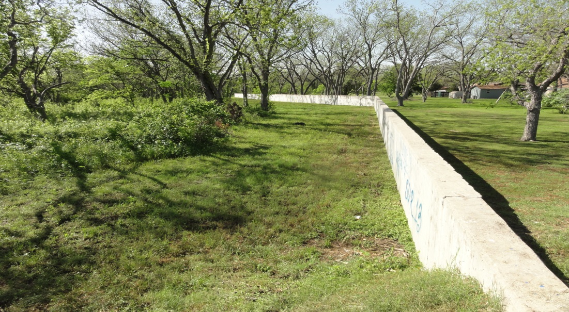
Analyze: Define the solution
Raise roadways
Improve stormwater conveyance under roadways with culverts or bridges
Regional detention ponds
Property buyouts
Channel conveyance modifications
Channel diversions
Storm drain repair/replace
Storm drain conveyance improvements
Green stormwater infrastructure

Slide 12
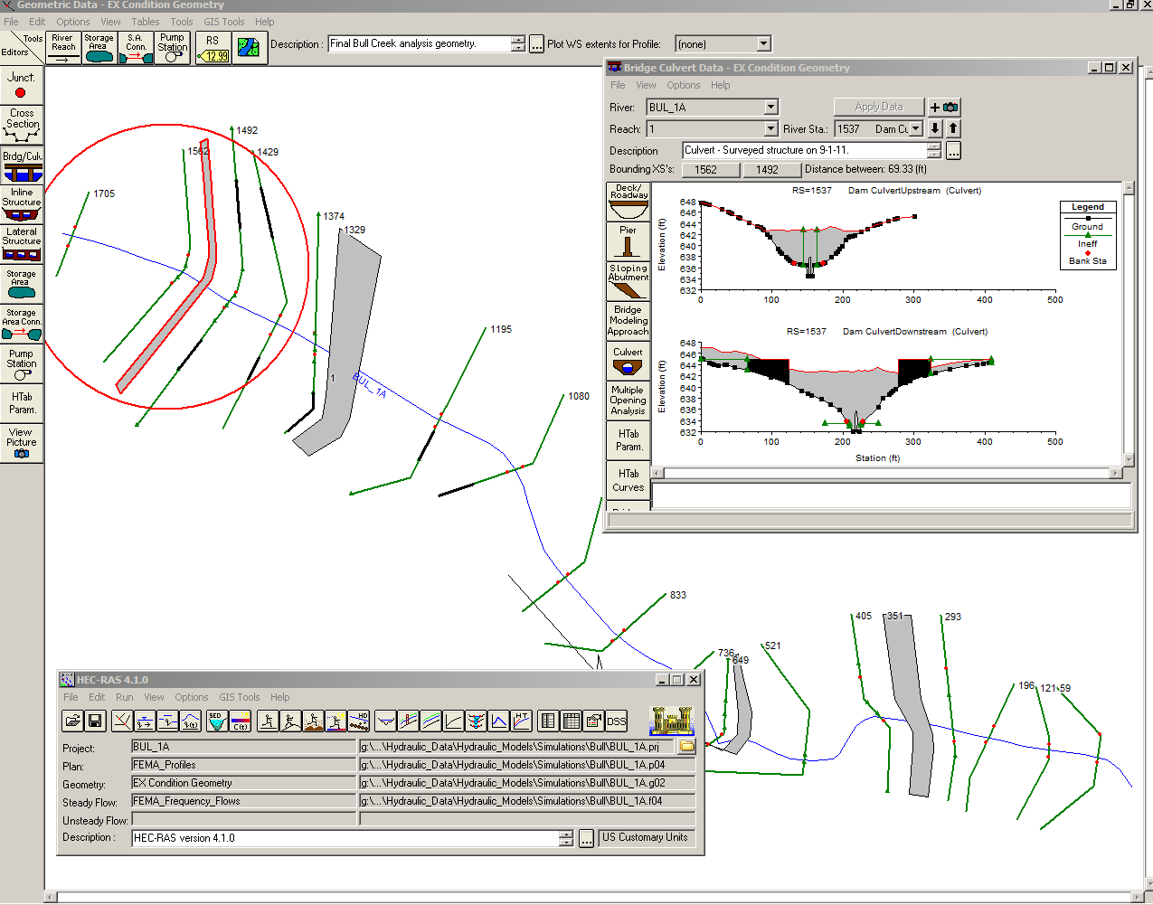
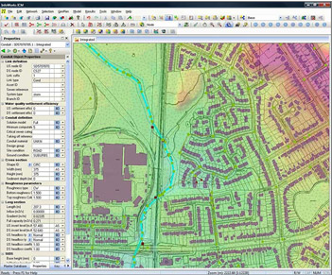
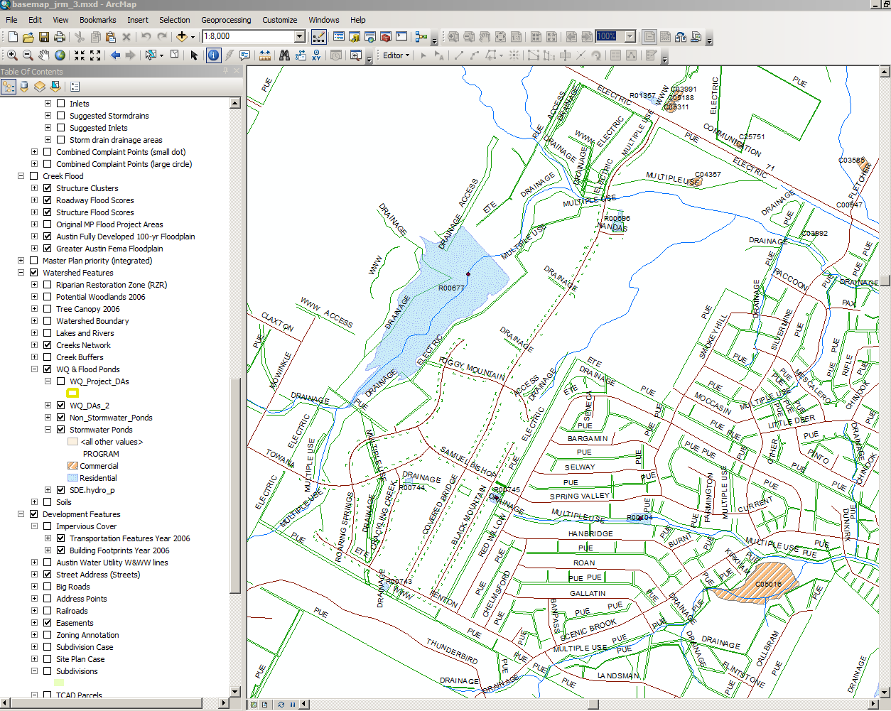
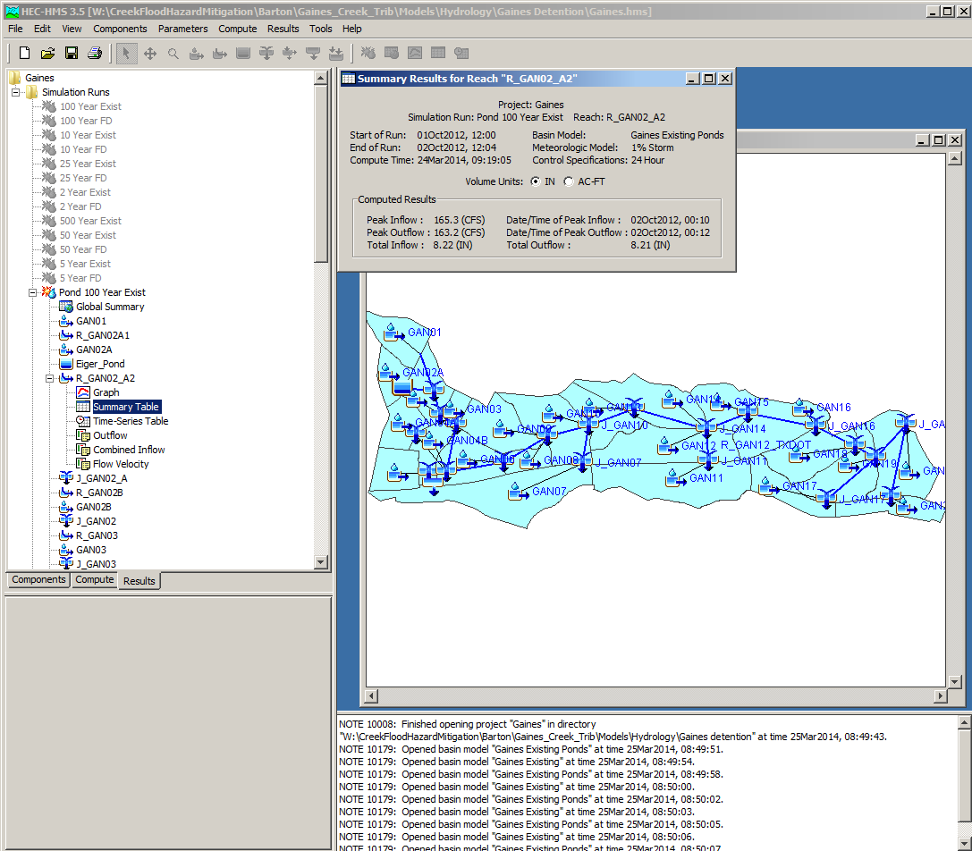
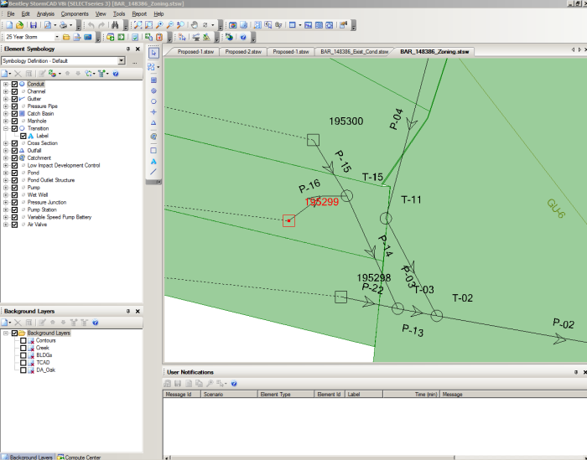
Analyze: Model Development

Slide 13
Analyze: Preliminary Engineering
Contents:
Site Investigation
Survey
Model development/review
Utility Assessment
Impact to WPD mission
Impact to COA mission
Alternatives analysis
Cost estimate
Recommendation
Team
WPD Engineer (P.E.)
WPD Engineer (EIT)
Mission Integration Reps

Slide 14
Analyze: Preliminary Engineering
Identify all scope items including:
Flooding – no adverse impact
Erosion – improve /no adverse impact
Water quality – improve/no adverse impact
Use of privately owned land – easements
Use of publicly owned land – utilities
Connectivity – roadway, bike/pedestrian pathway
Neighborhood plan

Slide 15
Design: Construction Plan Set
Contents:
Drainage Maps
Erosion/Sedimentation Plan
Traffic Control
Site Plan View
Cross-Sections
Landscape Plan
Structural Details
Team:
Project Engineer
Project Manager (COA)
Drainage Engineer
Geotechnical Engineer
Structural Engineer
Landscape Architect
CAD Designer
Surveyor

Slide 16
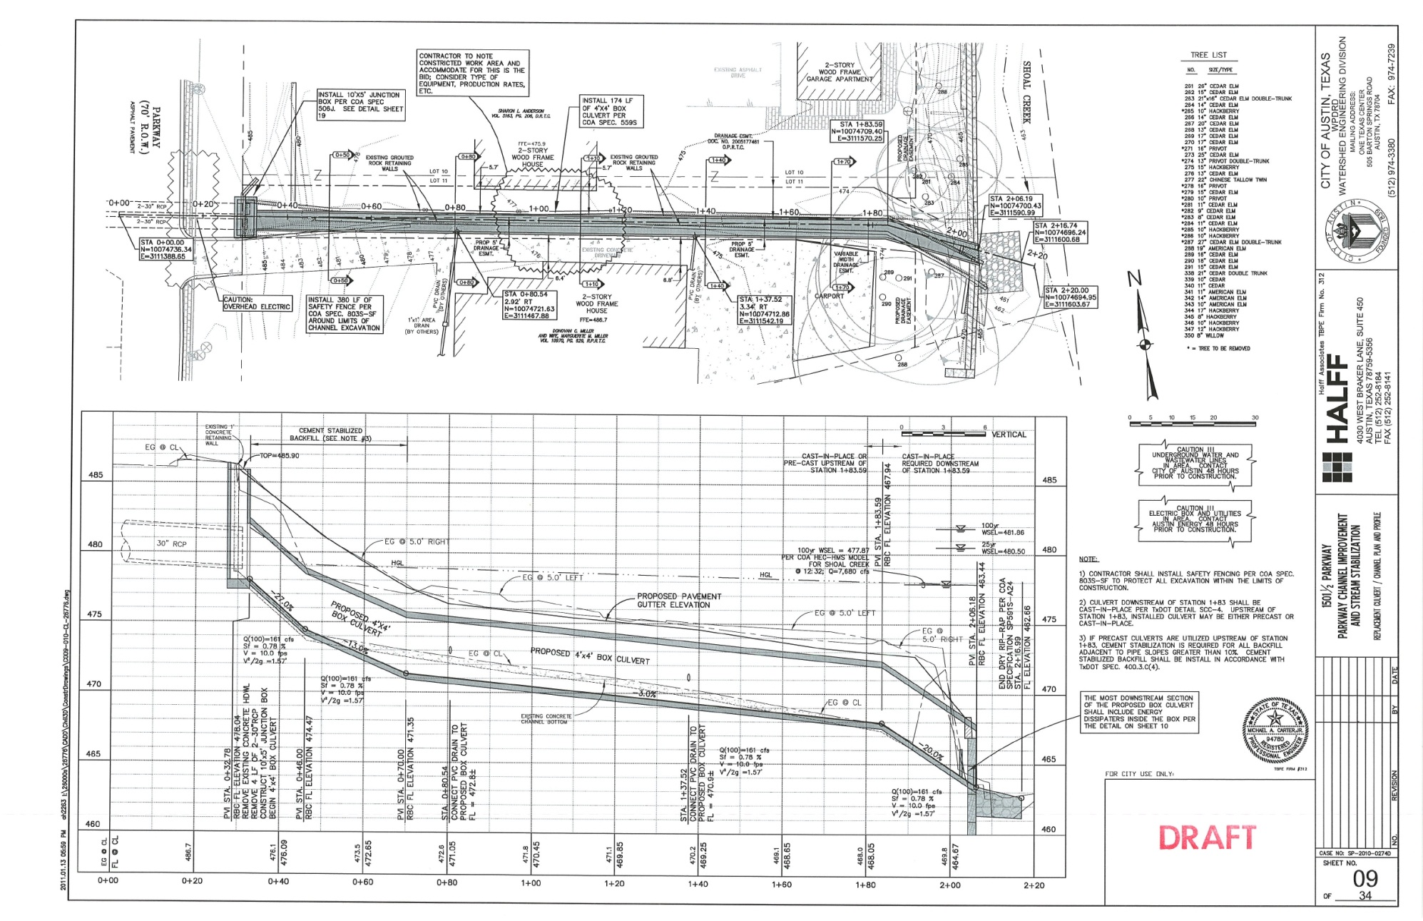
Design: Construction Plan Set
WPD Engineer Role

Slide 17
Design: Permit
Reviewed for:
Compliance with code and criteria
Land development code
Drainage criteria manual
Environmental criteria manual
Transportation criteria manual
Appropriate access/easement
No adverse impact
Role of the WPD Engineer:
Set up the project prior to permitting
Conduit of information between PM, consultant, and reviewer

Slide 18
Design: Project Manual
What is the purpose of a project manual?
Provides a narrative to the plan set
Describes the materials and methods of construction
Quantifies items for a bid
Contents
Bidding requirements
Contract forms
Summary of work
Geotechnical report
Bid items
COA standard technical specifications
Special provisions
Special specifications
Stormwater pollution prevention plan

Slide 19
Construction: Implementing Design
Team
COA Project Manager
WPD Project Engineer
Consultant Project Engineer
Contractor Superintendent
COA Construction Inspector
COA Environmental Inspector
Role of WPD Engineer:
Weekly construction meetings
Provide information to residents
Review change orders

Slide 20
Parkway Channel Improvement and Stream Stabilization
CIP ID No. 5789.087
Final Completion June 2012

Slide 21
WPD Mission Goals
Flood Control
Increased capacity of infrastructure from Parkway Drive to Shoal Creek, replaced failing masonry wall channel with ~ 175-ft of 4x4 box culvert
Erosion Control
Stabilized culvert outlet and 170-ft of eroded creek bank with combination of MSE walls, soil lifts, vegetation, armored transitions
Riparian Restoration
Removed invasive plants from creek bank and private property and replaced with natives and adapted natives.
Field Operations
Provided permanent access to Shoal Creek down to the N. Lamar culvert system

Slide 22
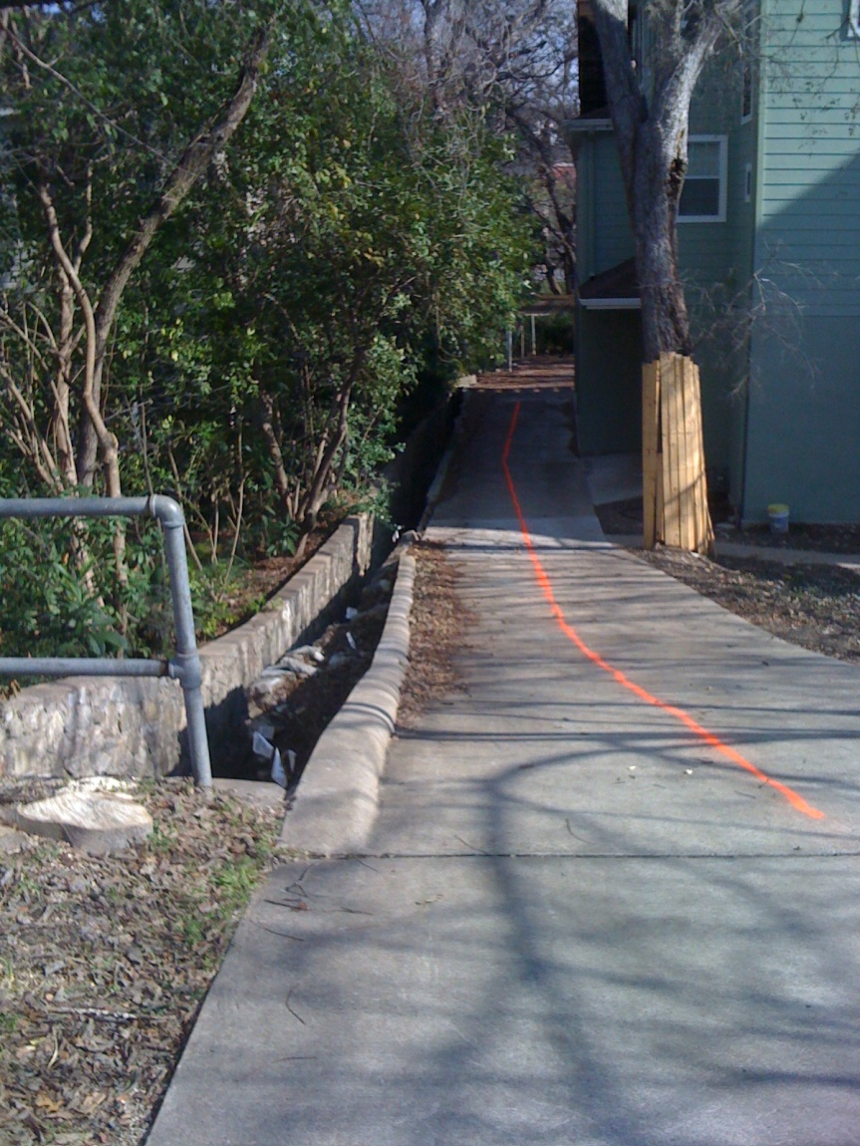
Before & After

Slide 23
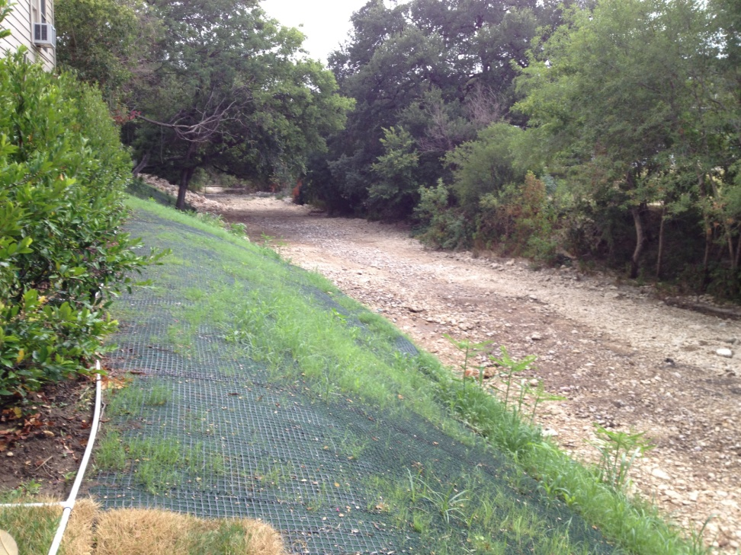
Before & After

Slide 24
Before & After

Slide 25
Construction
January 2012: Excavating & forming the junction box

Slide 26
Construction
February/March 2012: Excavating & placing precast box culverts, 1501 Parkway driveway

Slide 27
Construction
April 2012: Forming cast-in-place culvert, MSE wall

Slide 28
Construction
April/May 2012: MSE wall

Slide 29
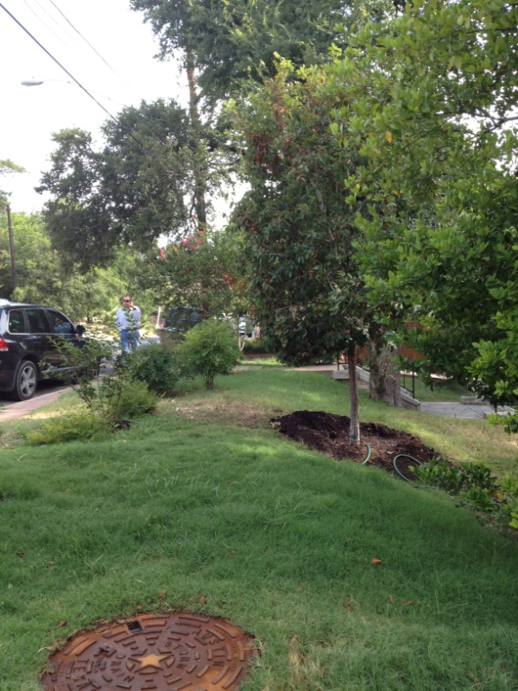
Construction
June 2012: Vegetation

Slide 30
Schedule
Preliminary Phase: 2007-2009
Acquired funding
Design Phase: January 2009 – July 2011 (2 1/2 YR)
30% June 2009
60% August 2009
90% July 2010
Additional easement & scope
Scope revision between Sept. 2009-March 2010
Extension of bank stabilization, additional landscaping
Permitting September 2010 – April 2011
Project Manual Finalized May 2011-June 2011
Bid Phase: July 2011 – November 2011 (5 months)
1 rebid
Construction Phase: December 2011-June 2012 (7 months)

Slide 31
Public Private Partnership (P3) South Shore Storm Drain Improvements
Project# 5789.100
Final Completion December 2012

Slide 32
Proposed Private Development

Slide 33
Current View of Development

Slide 34
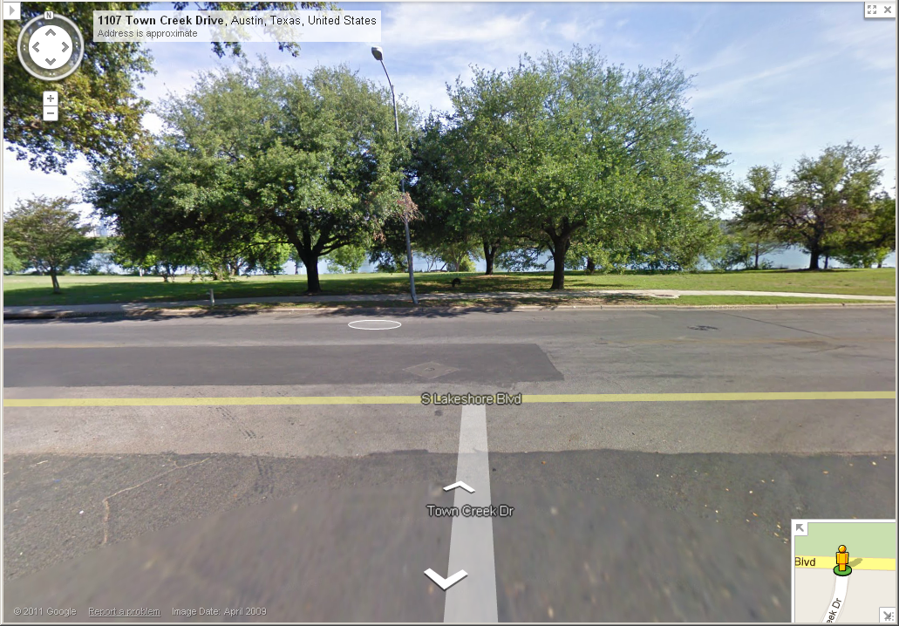
Approximate alignment of existing 36” pipe (from South Lakeshore)

Slide 35
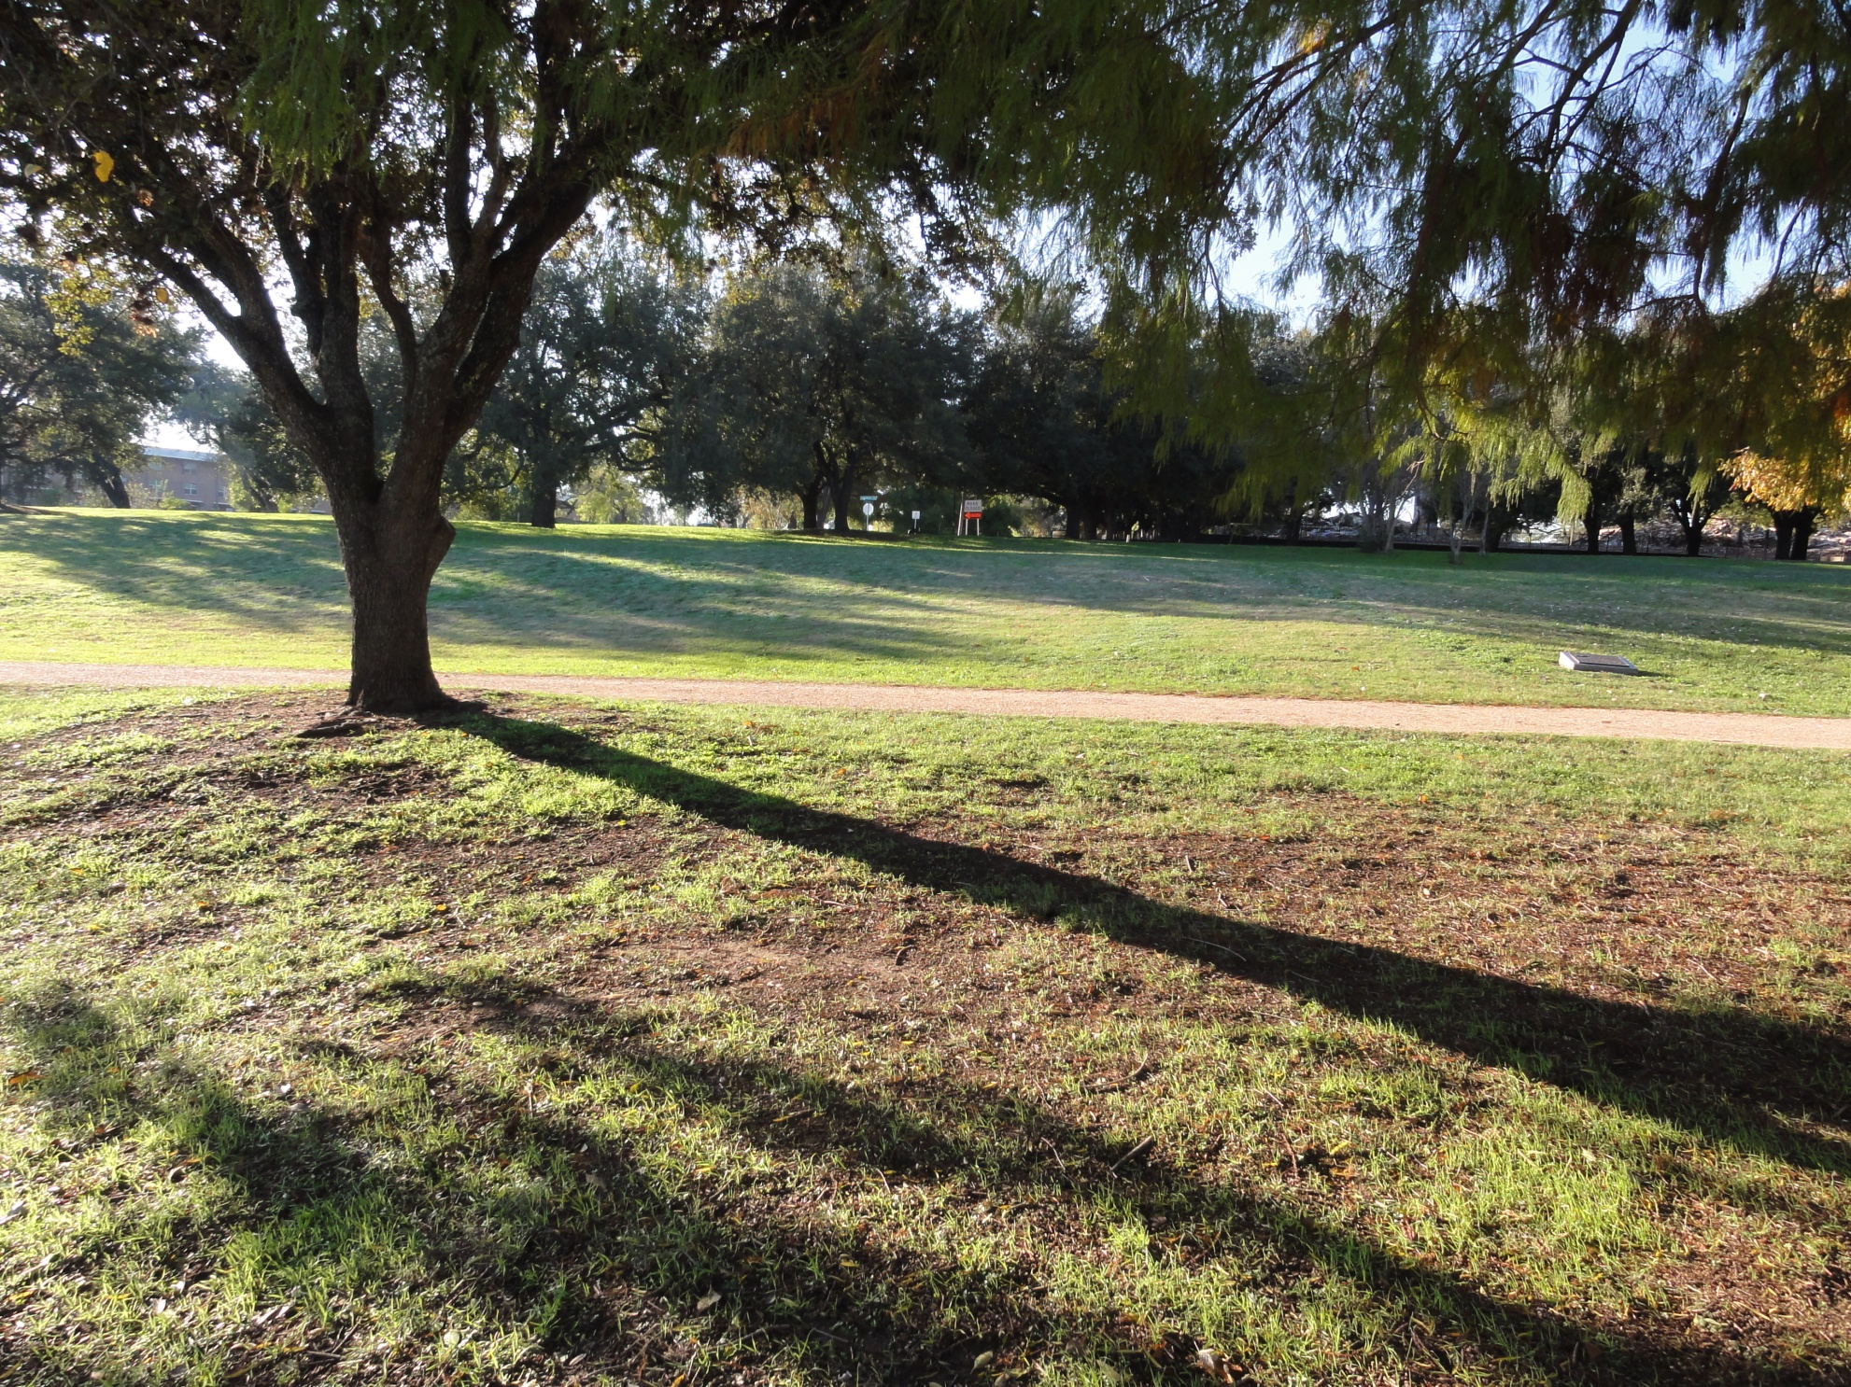
Approximate alignment of existing 36” pipe (from outfall)
Existing 36” Pipe

Slide 36
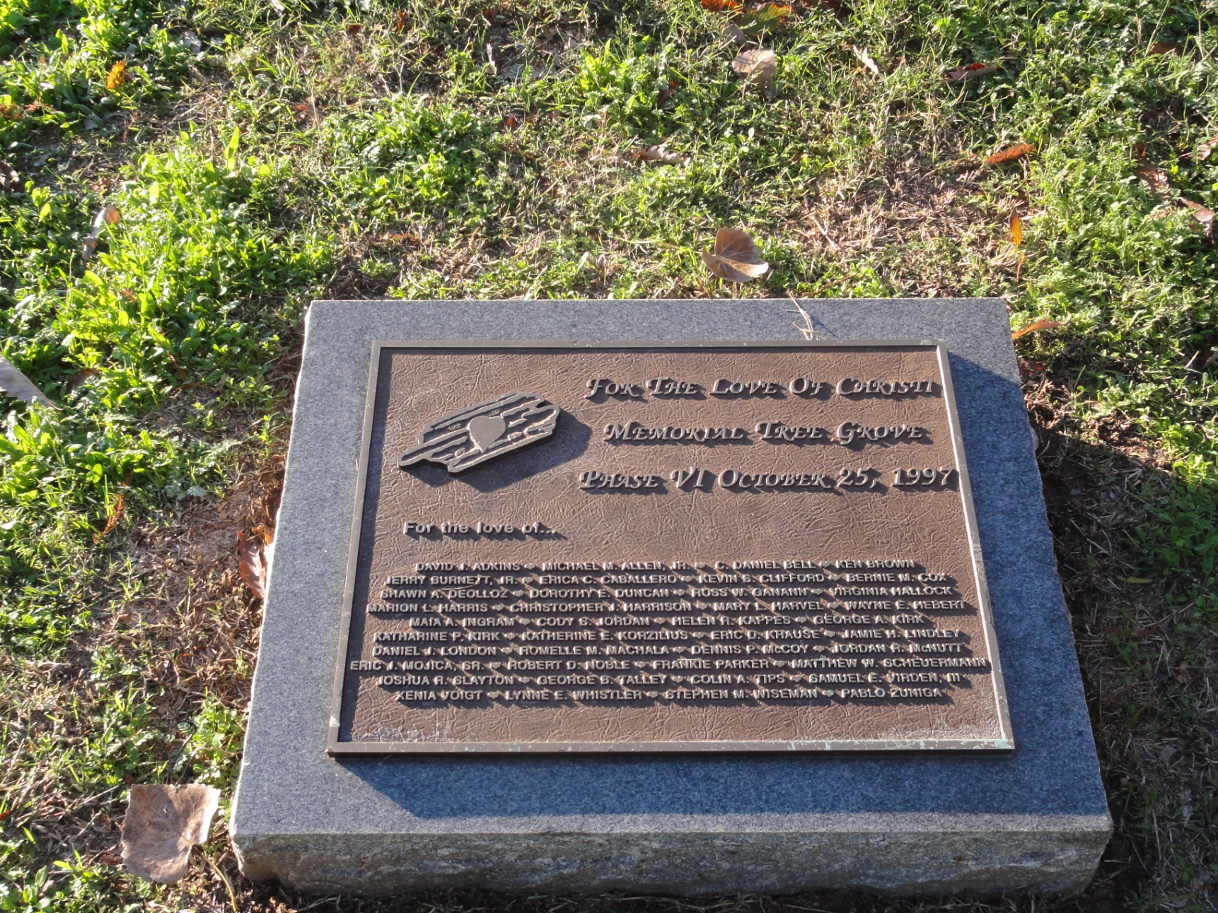
The existing 36” pipe crosses through a memorial tree grove with protected and heritage class trees in the nearby areas.

Slide 37
Approximate alignment of proposed 60” pipe (from South Lakeshore)

Slide 38
Planning Needed Beyond Project

Slide 39
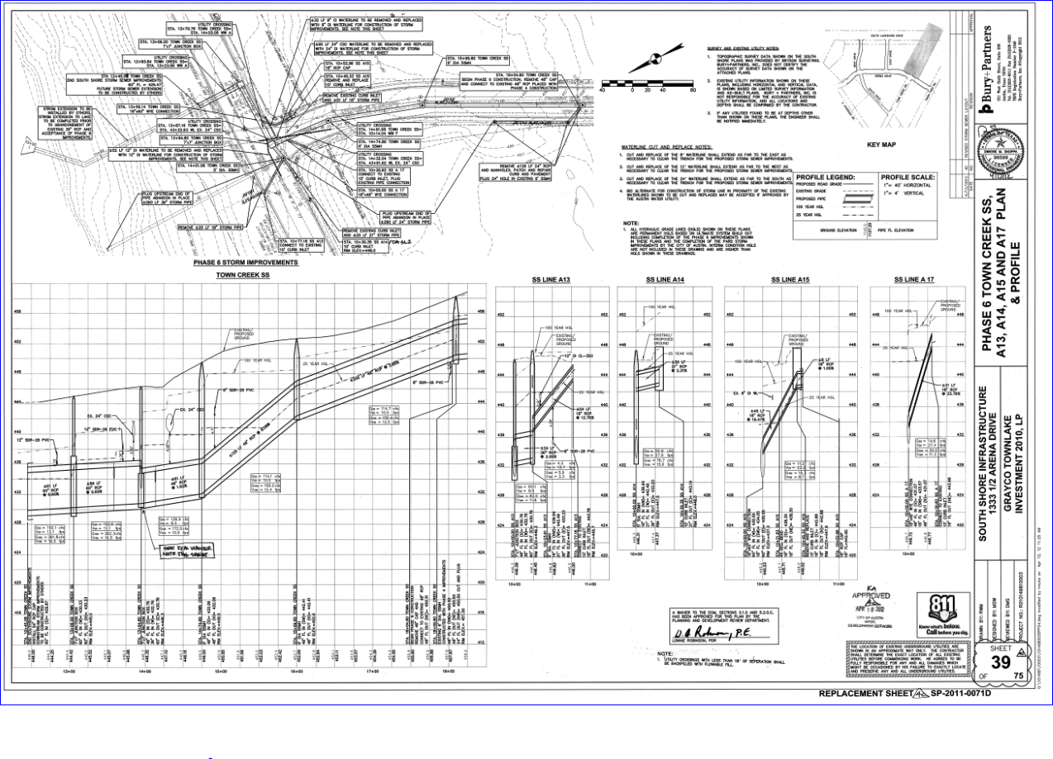
Development Engineer

Slide 40
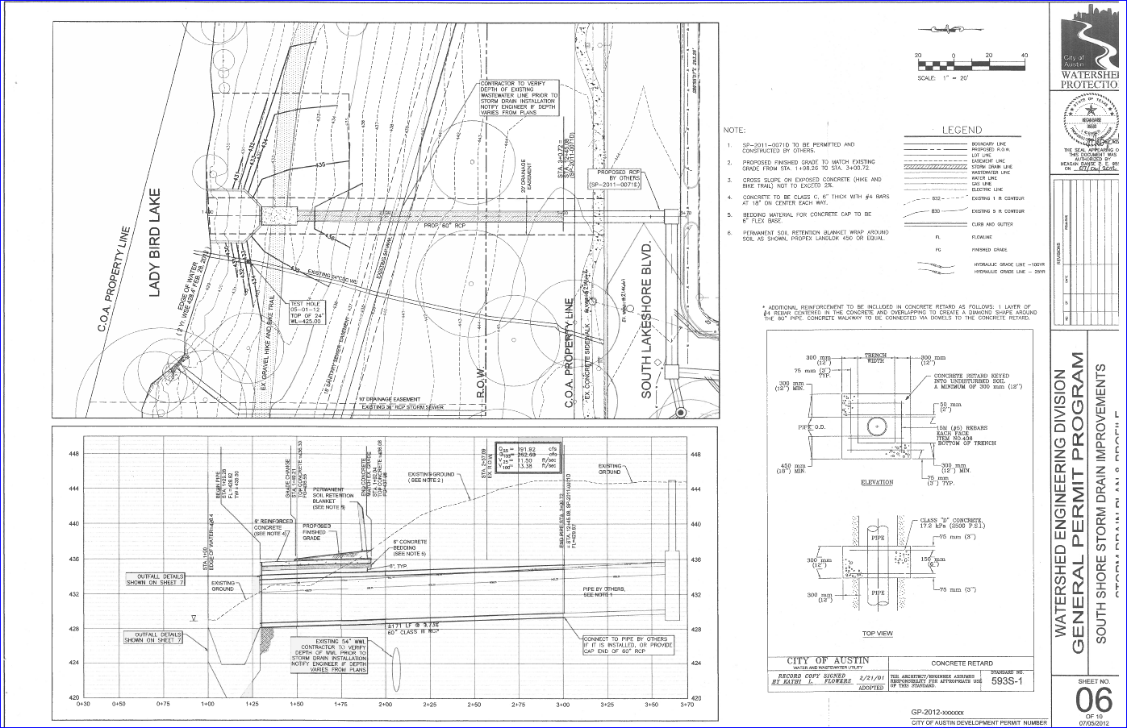
City Design

Slide 41
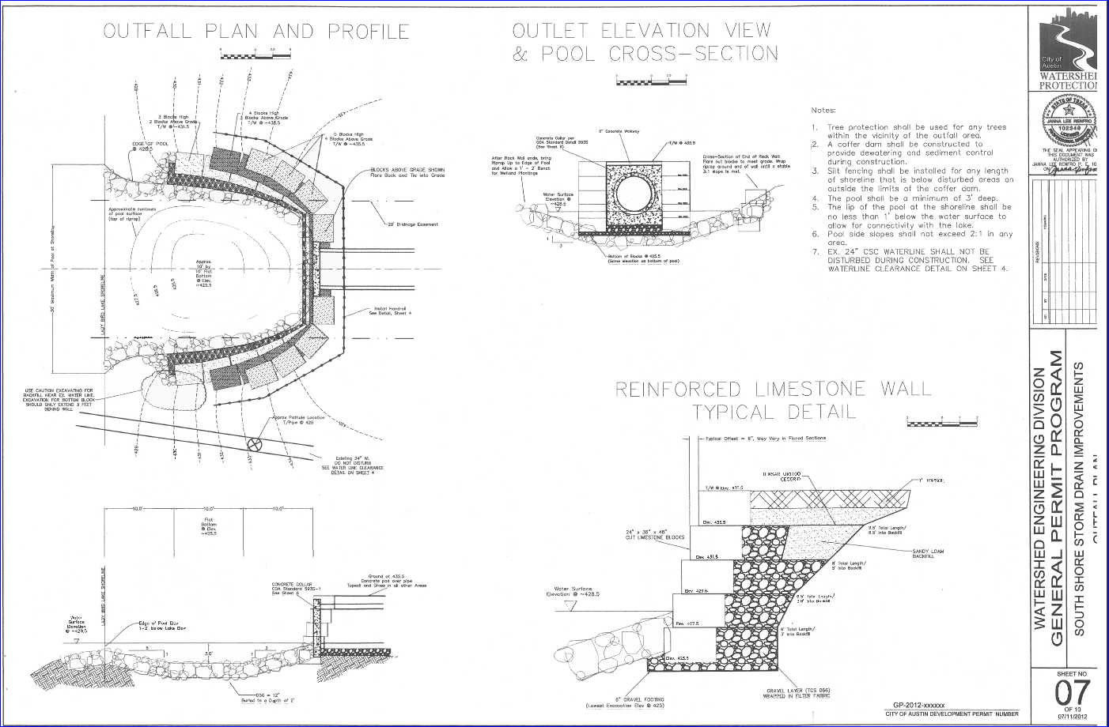
City Design

Slide 42
Project Details
Location
South Shore PUD – Lake Shore Blvd. & Town Creek Dr.
Opportunity
Partner with a developer to upgrade an underperforming storm drain in a re-developing area
Cost Participation & Reimbursement project
Developer was supplied with $33,000 in pipe material and reimbursed $440,000 for design and construction of storm drain improvements.
Cost Effectiveness
Saved $1.28-million compared to constructing projects alone without partnership

Slide 43
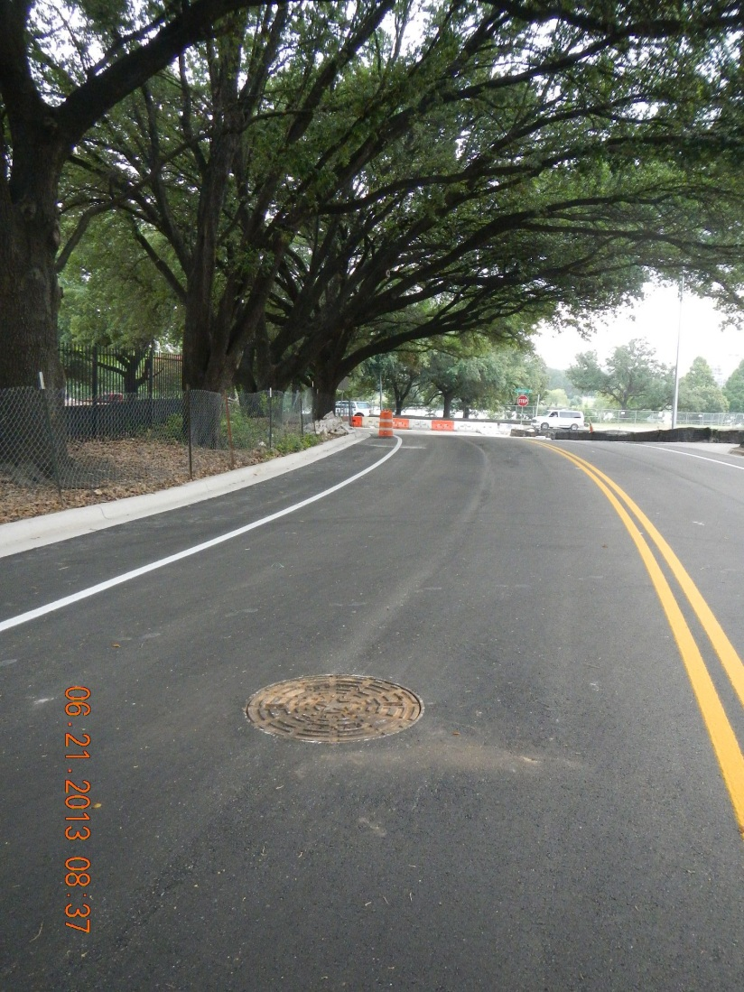
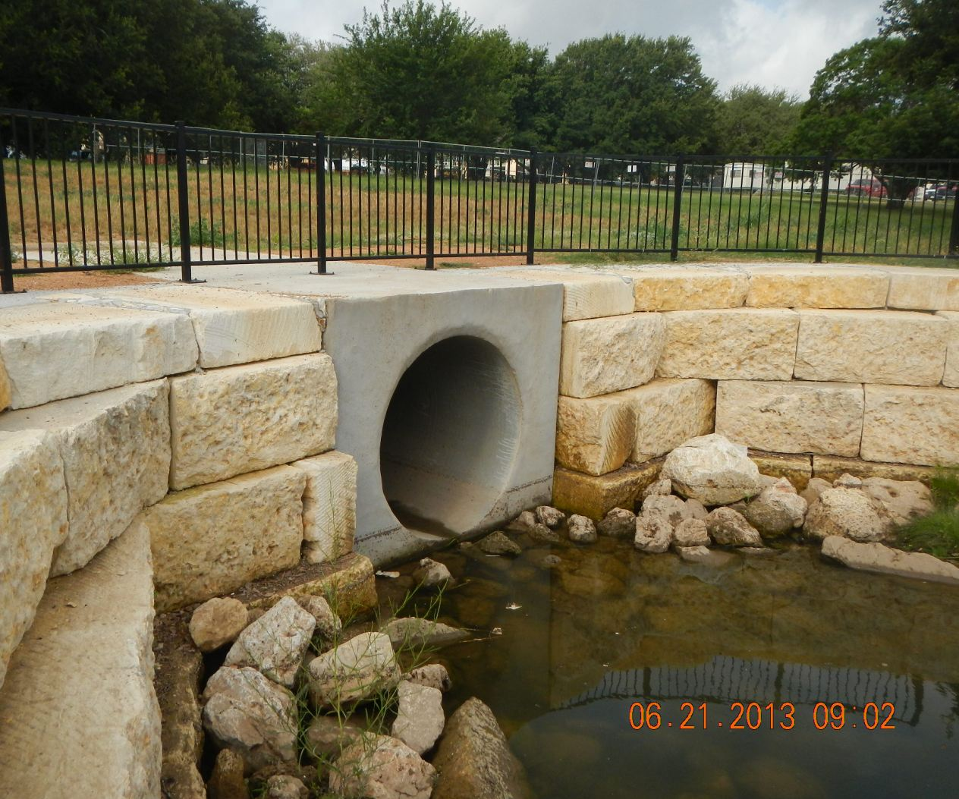
South Shore Storm Drain Improvements Project# 5789.100

Slide 44
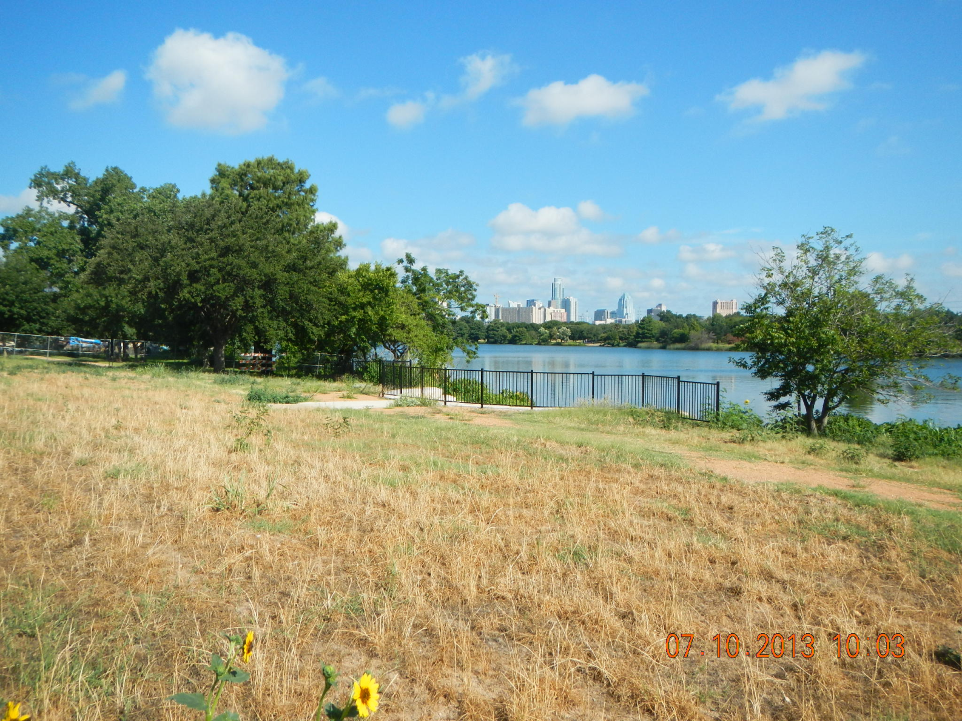
Bonus Feature – New Photo Opportunity with Austin Skyline in the Background

