Slide 1
Stormwater Best Management Practices
Michael Barrett, Ph.D., P.E.
University of Texas at Austin

Slide 2
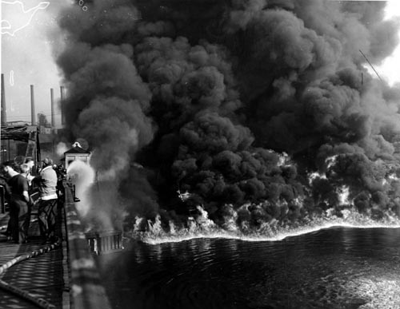
Cuyahoga River, Cleveland

Slide 3
Dates to Remember
1948 Federal Water Pollution Control Act passed by Congress
1972 Clean Water Act prohibits any discharge of pollutants without NPDES permit - (fishable and swimmable)
1987 Clean Water Act amended to require permits for stormwater discharges
2003 NPDES Phase II permits required

Slide 4
Clean Water Act
Requires NPDES permit for stormwater from cities, industry, construction sites
Requires assessment of beneficial uses and impairments of receiving waters
Impaired segments reported to EPA – 303(d) list.
Development of TMDL (total maximum daily load) for impaired segments

Slide 5
Common Impairments
Constituent/Parameter | Number of Water Bodies Impaired
Bacteria | 418
Low Dissolved Oxygen Concentration | 130
PCBs | 104
Salinity | 102
Dioxins | 90
Mercury | 75

Slide 7
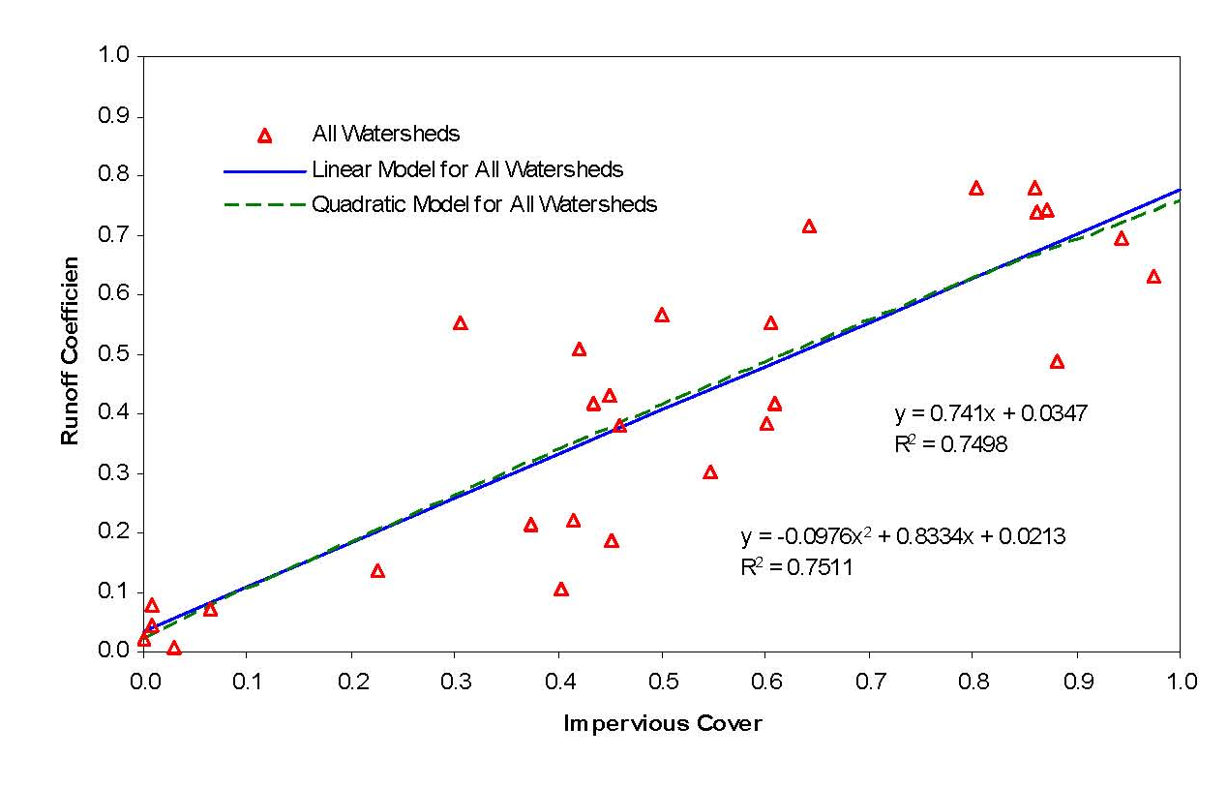
Impervious Cover and Runoff

Slide 8
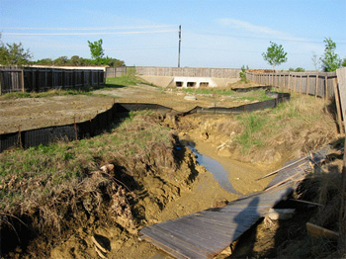
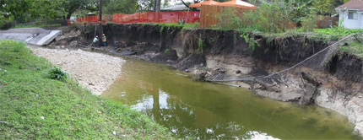
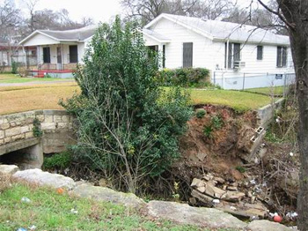
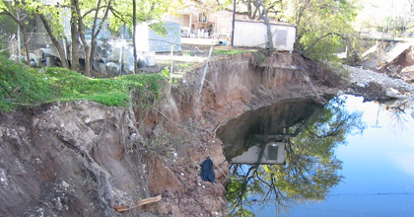
Channel Degradation
Bear Creek
Fort Branch
ShoalCreek
Boggy Creek

Slide 9
Constituents in Urban Runoff
Bacteria
Nutrients
Insecticides
Herbicides
Metals – zinc, copper, lead
Hydrocarbons – PAHs
Sediment

Slide 10
Sources of Pollutants
Vehicles – Tires, Brake pads, Fluids, Tracking
Atmospheric Deposition
Fertilizers
Pesticides
Pets
Pavement abrasion
Channel Erosion

Slide 11
Requirements for Stormwater Treatment
City of Austin – Required since 1981, mainly sand filters
TCEQ – Requires removal of 80% of sediment in stormwater for Edwards Aquifer
LCRA – Requires 70-75% removal of sediment, phosphorus, and oil & grease for Highland Lakes

Slide 12
Treatment Difficulties
Runoff occurs on an irregular basis
Volume and rate of runoff from storms is highly variable
Quality of runoff varies from storm to storm
Concentrations of constituents of concern often very low

Slide 13
“First Flush” of Pollutants
Stenstrom & Kayhanian, 2005

Slide 14
Best Management Practice (BMP) Selection
End-of-pipe
  Fewer facilities to manage, inspect, and maintain
  Little volume control
  Little redundancy
Onsite
  Maintain pre-development hydrology
  Low Impact Development (LID) – “Green Infrastructure”
  Lower cost
  More facilities

Slide 15
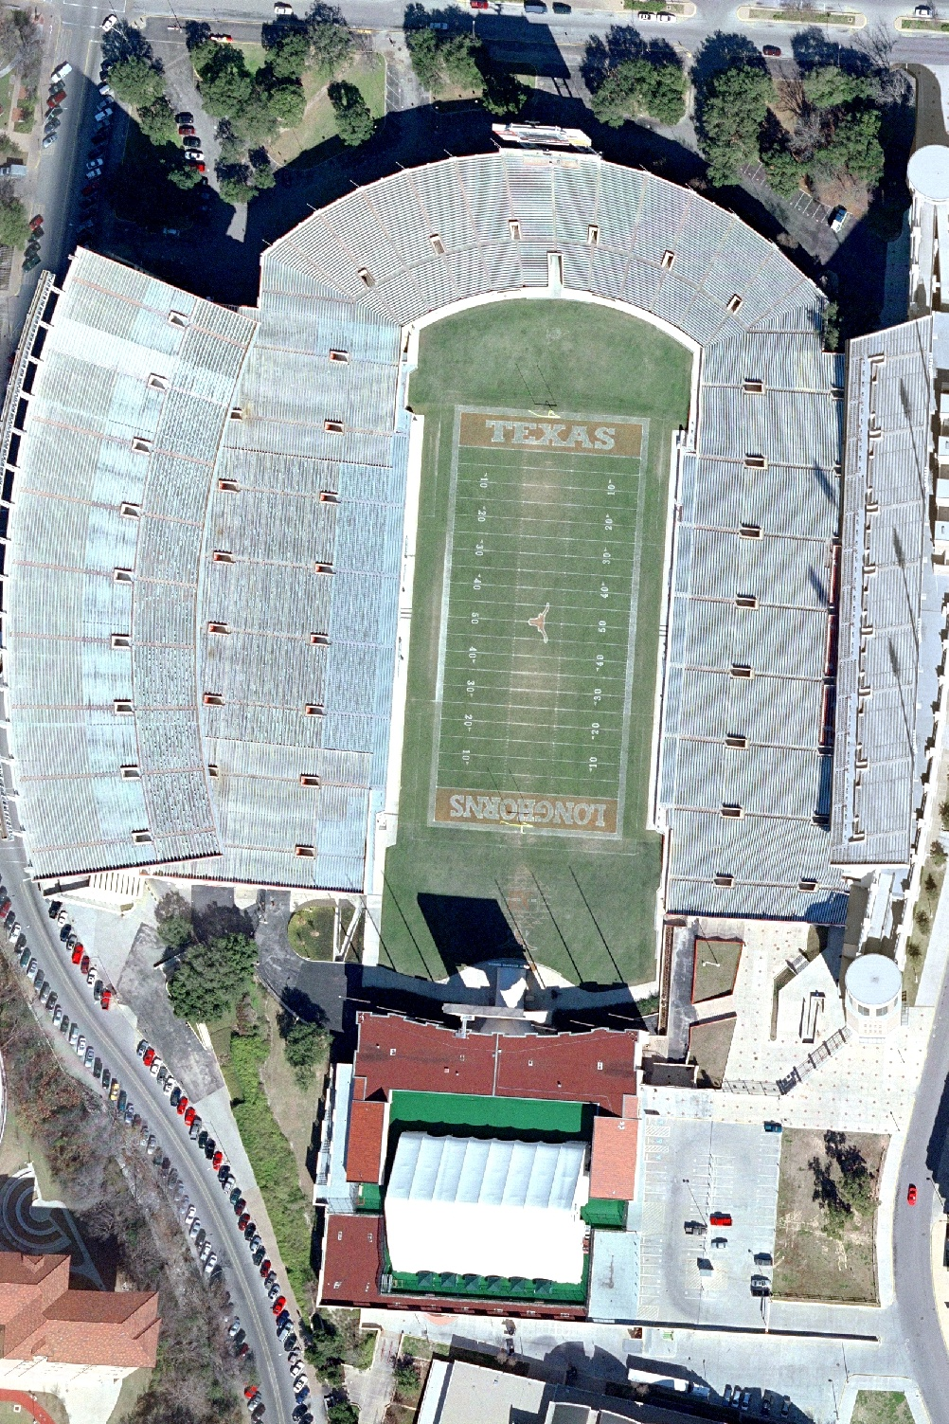
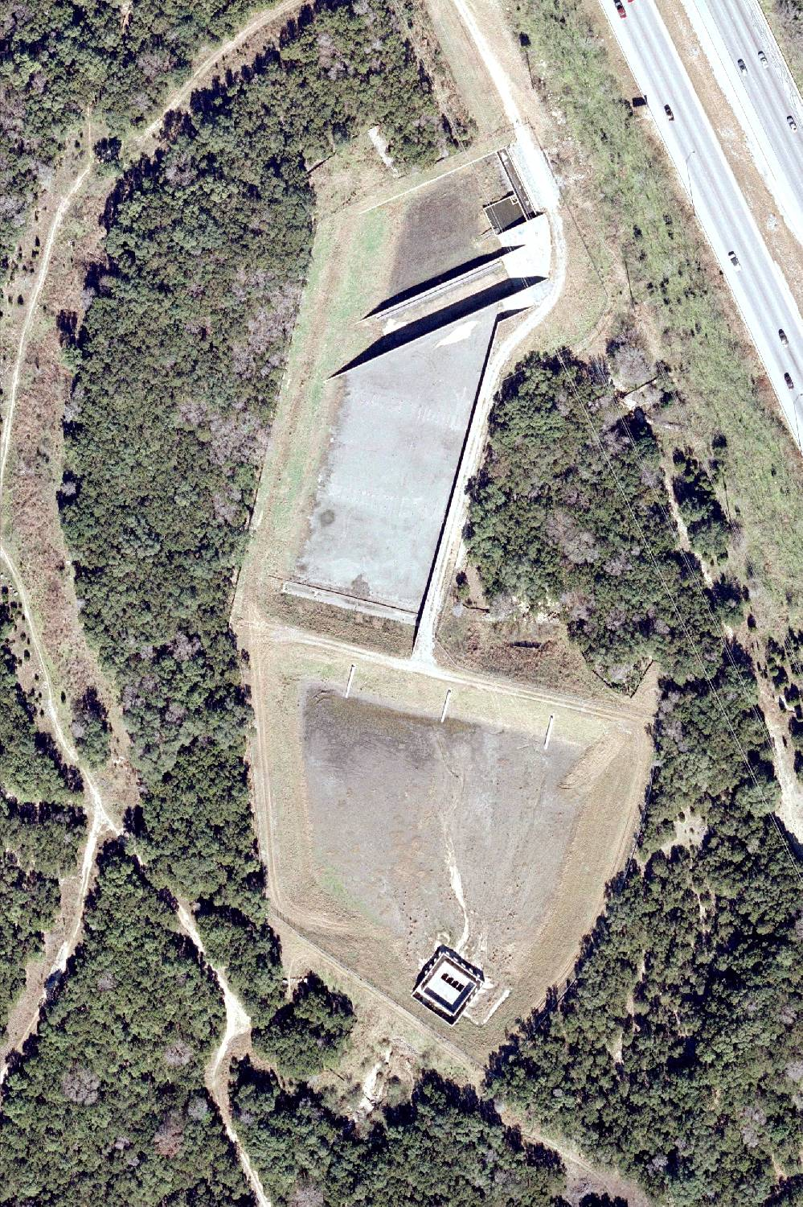
Courtesy Matt Hollon
1,000 ft
Loop 360
TxDOT Pond
Notes:
Extreme example of end of pipe.

Slide 16
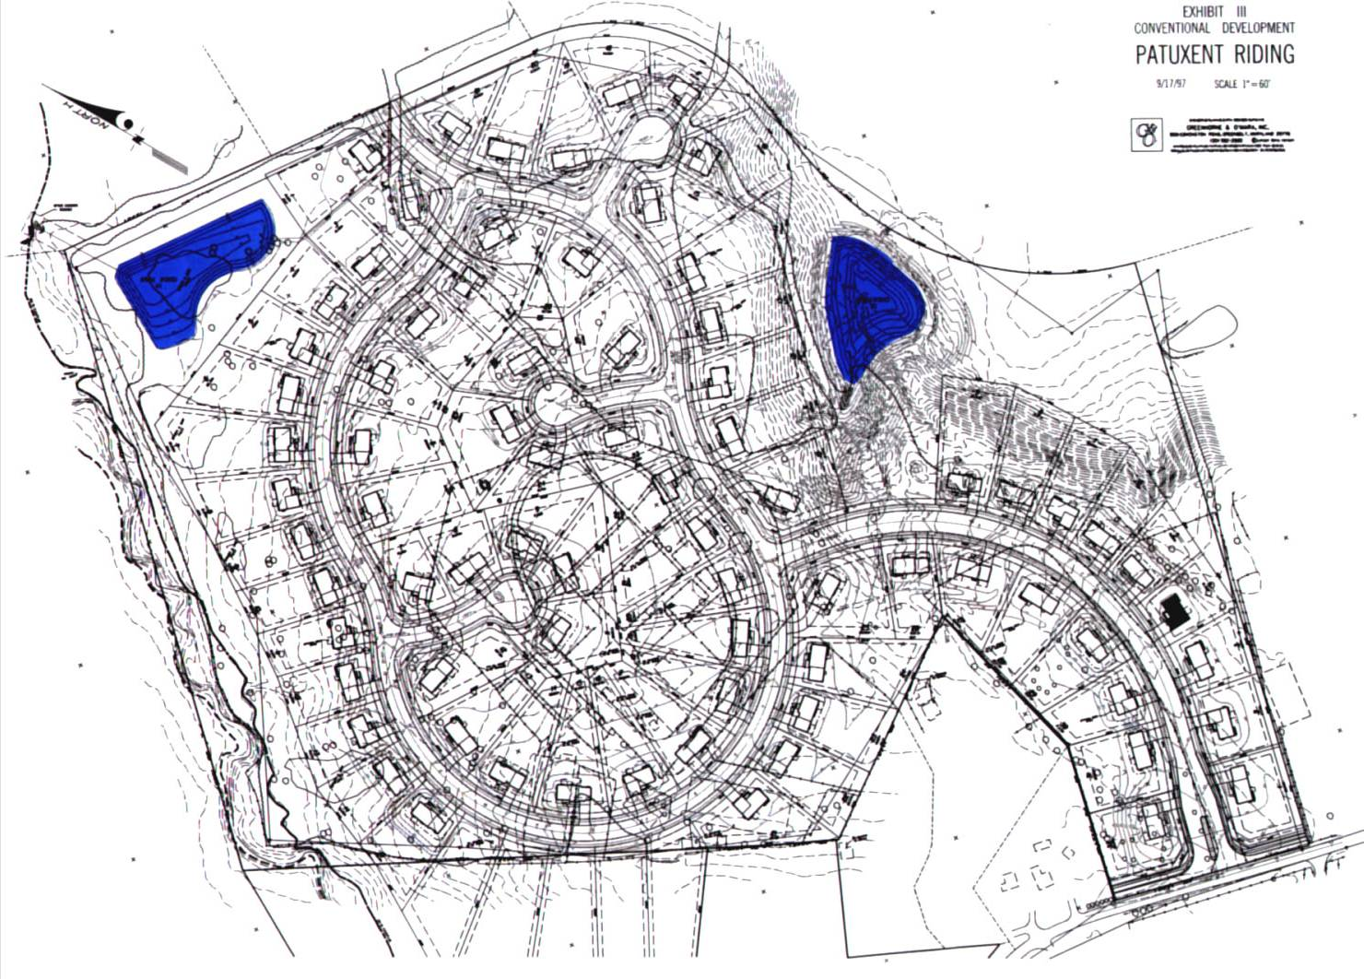
Conventional Development

Slide 17
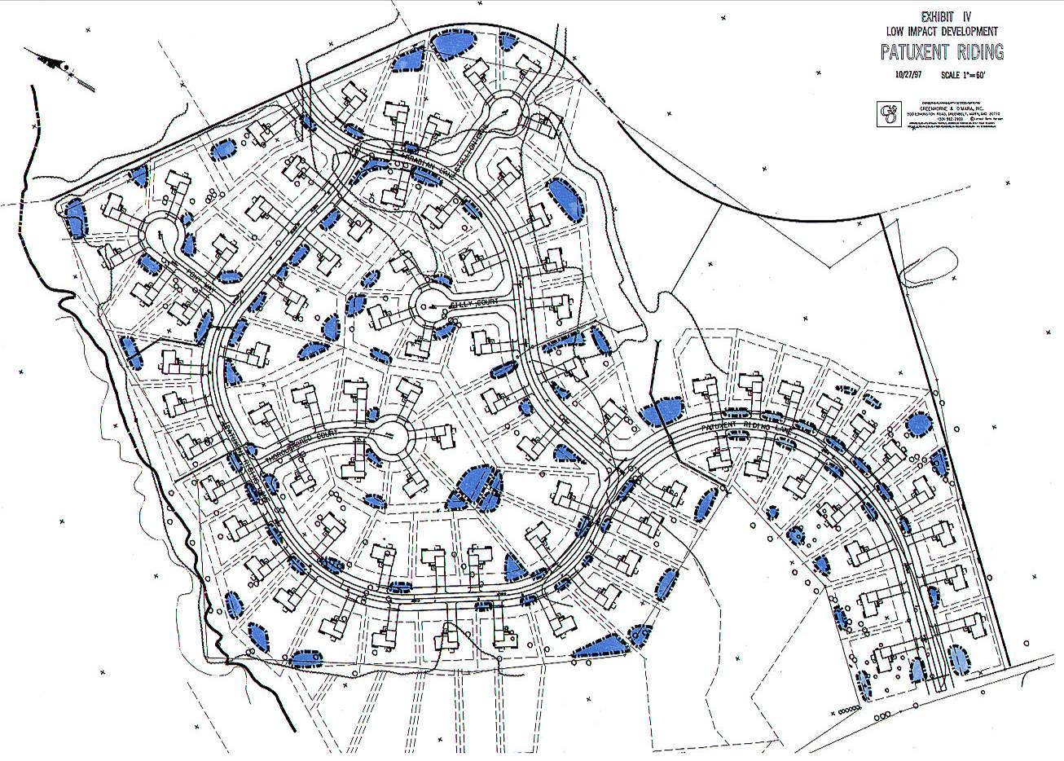
LID Development
Multiple Systems
Disconnected Decentralized Distributed Multi-functional

Slide 18
Pollutant Removal Mechanisms
Particle settling
Filtration
Biological uptake/degradation
Infiltration
Volatilization
Photodegradation
Oxidation

Slide 19
Typical LID Practices
Bioretention/rain gardens
Porous Pavement
Vegetated swales and buffer strips
Green roofs

Slide 20
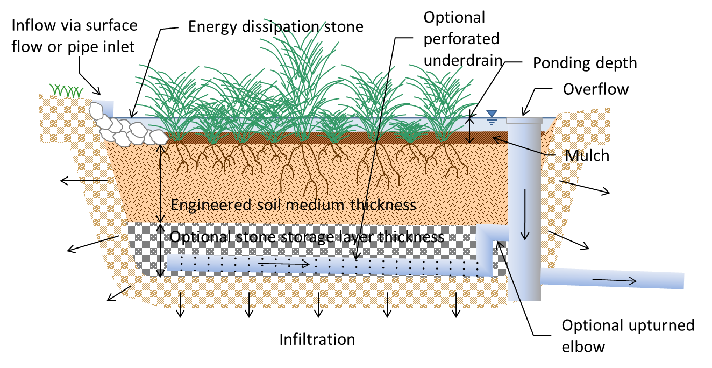
Bioretention

Slide 21
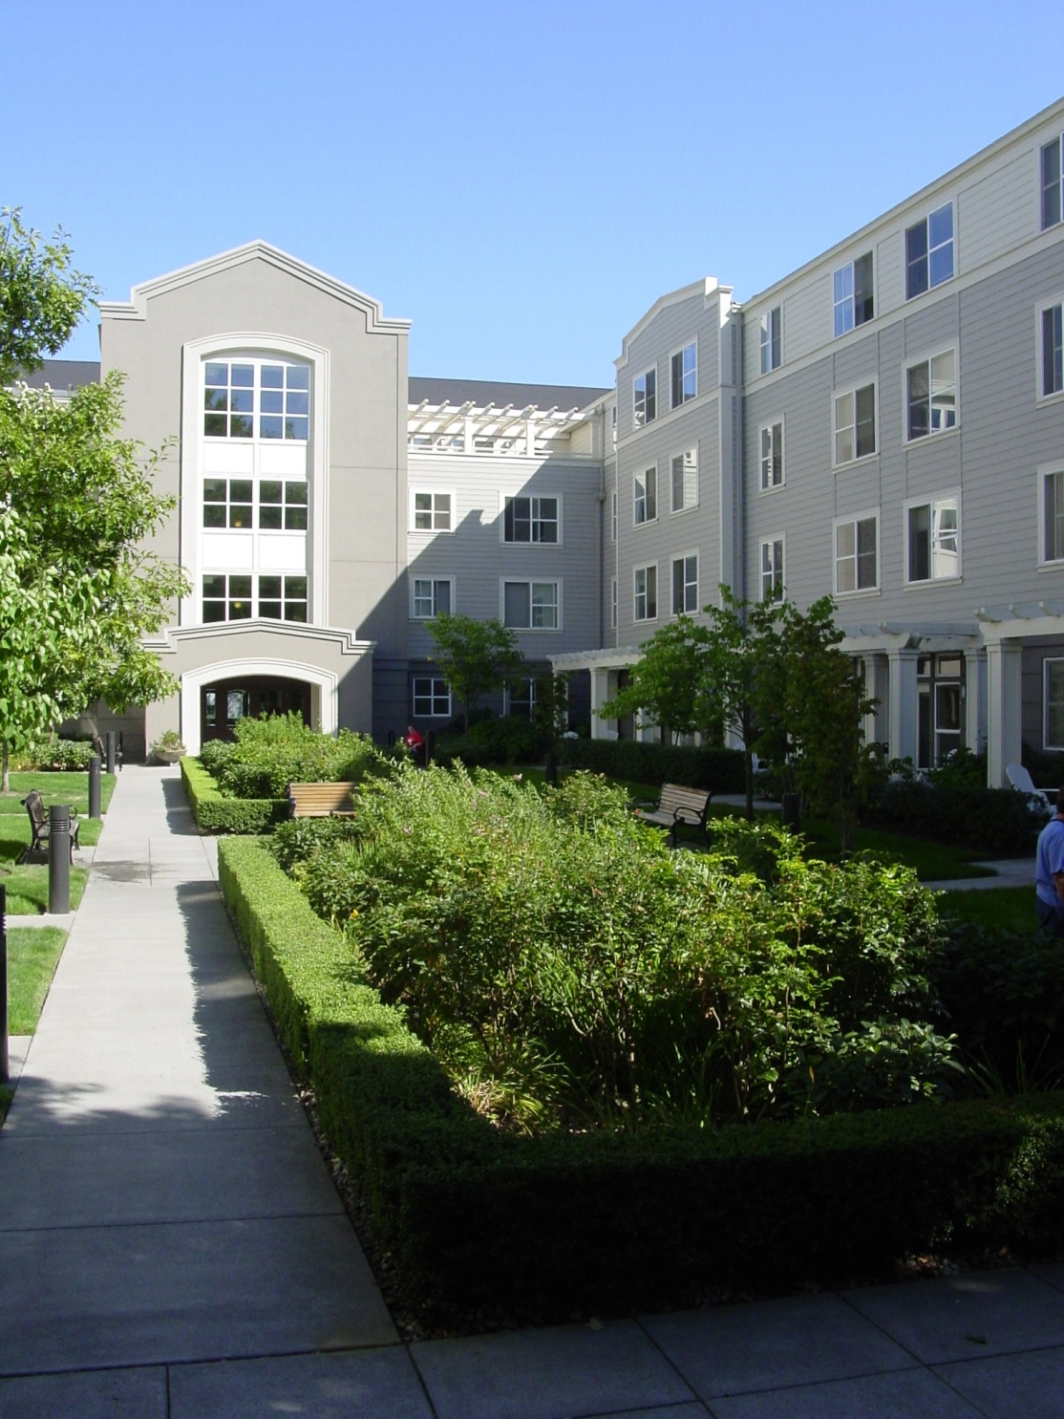
Bioretention

Slide 22
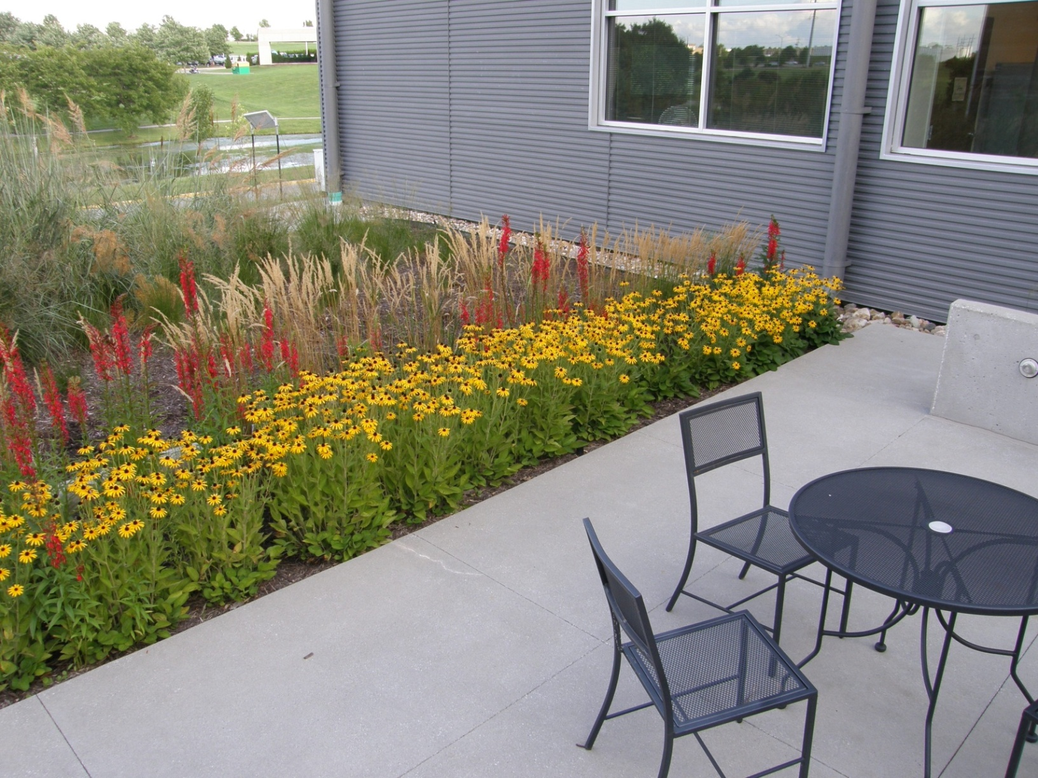

Slide 23
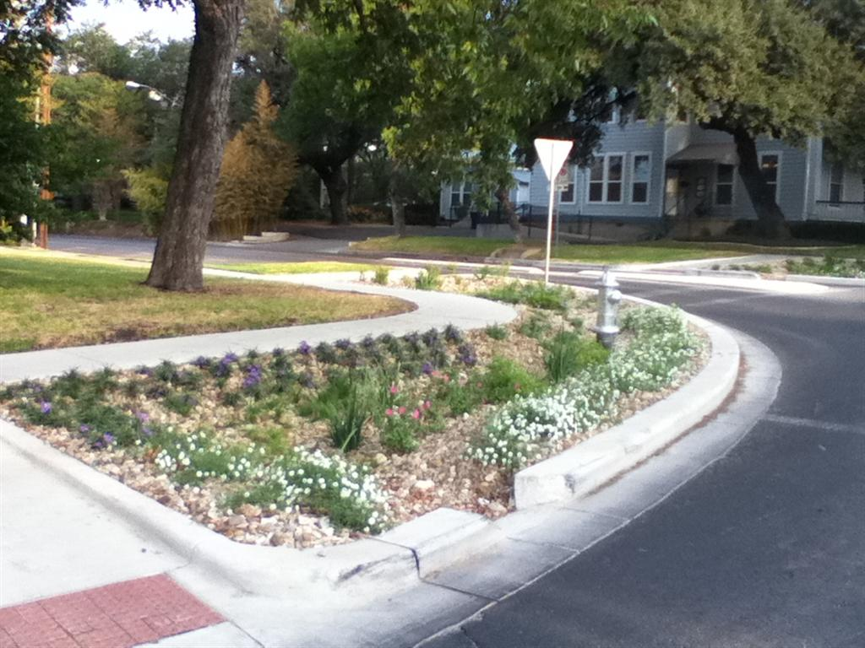
10th & Rio Grande
Image courtesy Tom Franke

Slide 24
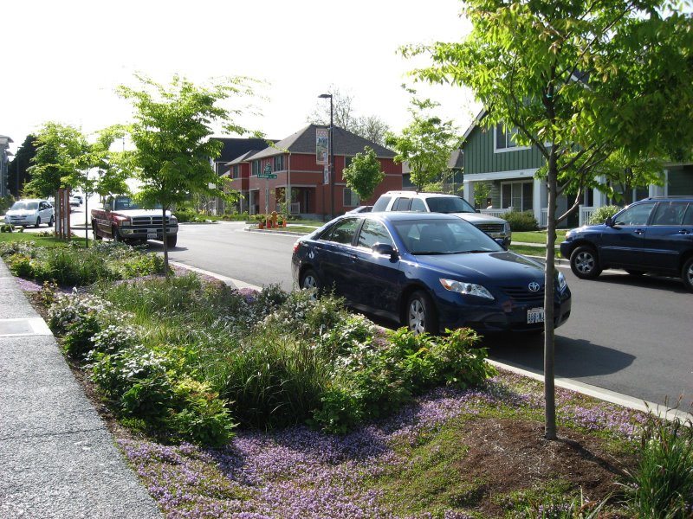
Curbside Bioretention

Slide 25
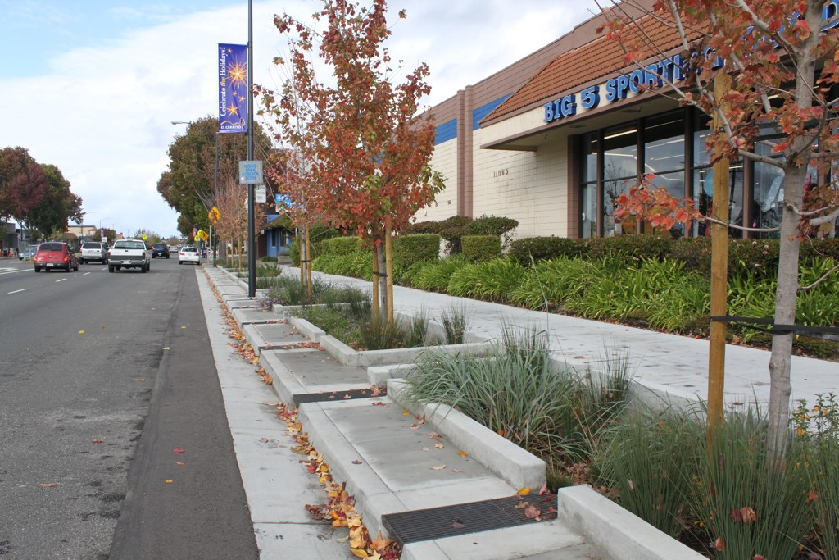
Setback Bioretention

Slide 26
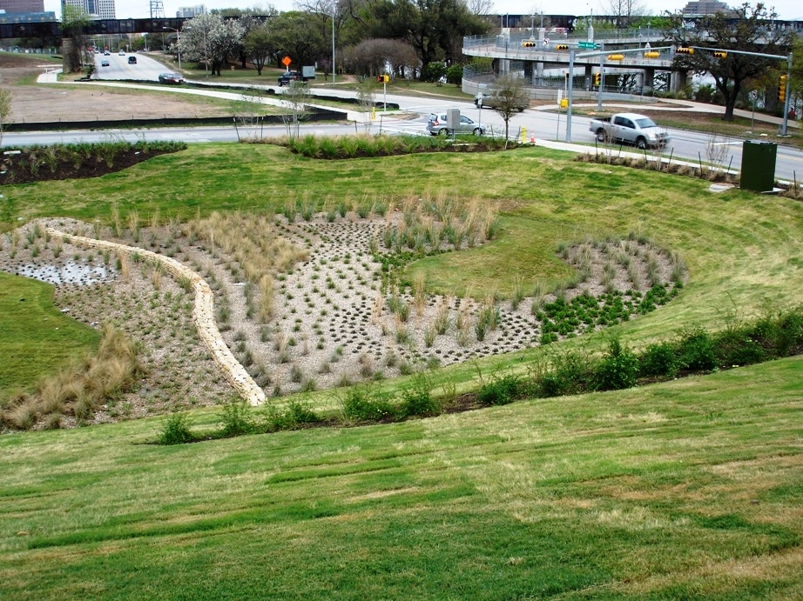
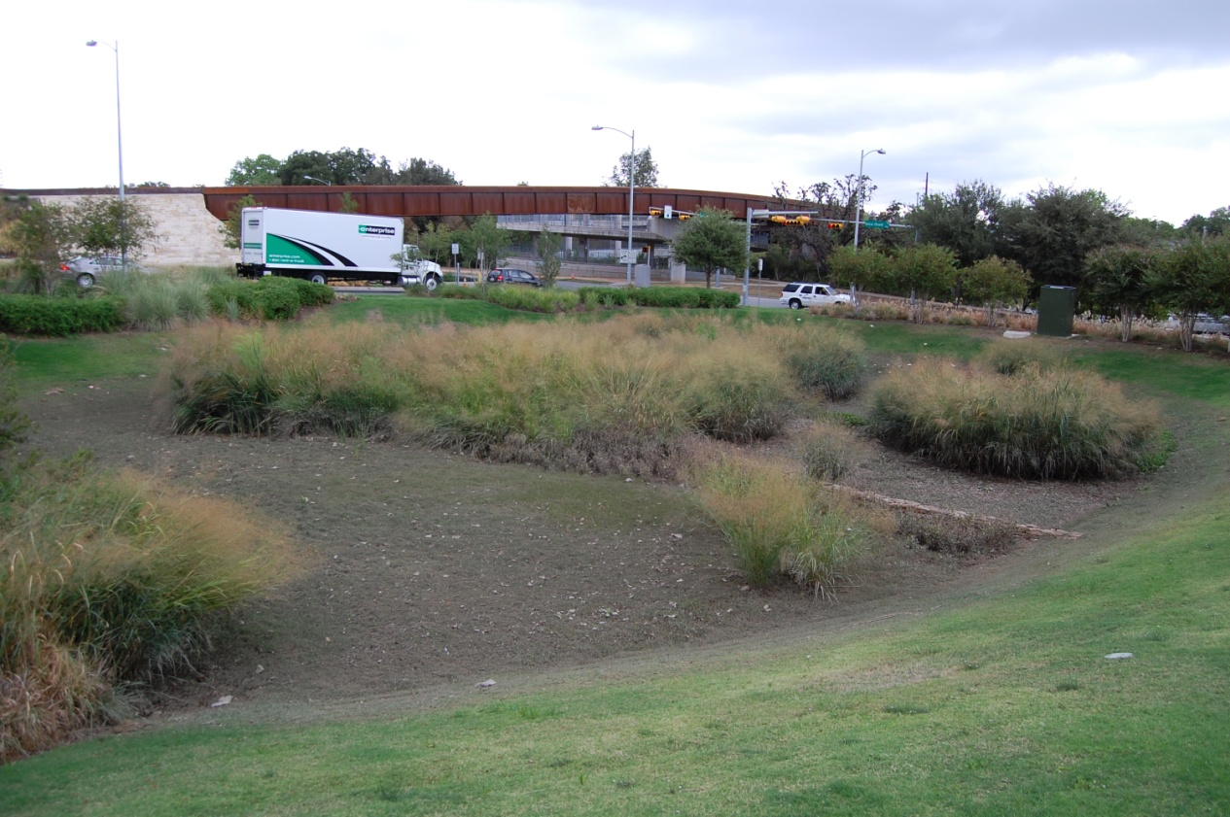
Sand Beach
Biofiltration Pond
March 2009
October 2011

Slide 27
Types of Porous Pavement
Pervious Concrete
Porous Asphalt
Pavers

Slide 28
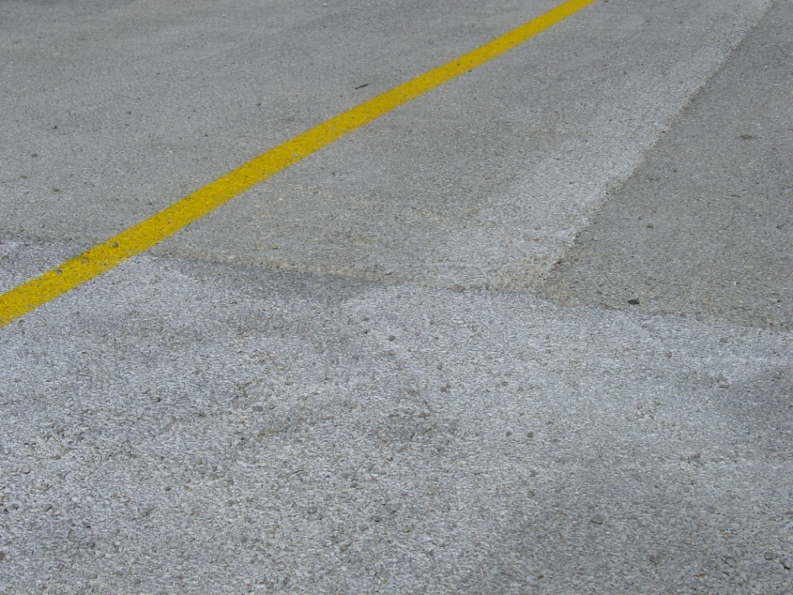
Pervious Concrete
Generally has a lower strength
Water content is critical for proper installation
Requires specialized crew for installation
Each batch tends to have a different color/texture
Tends to ravel in high traffic areas

Slide 29
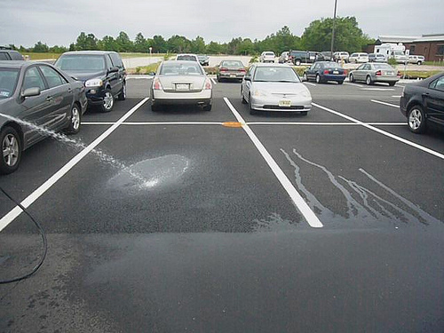
Porous Asphalt
Created by omitting fine material from asphalt
Asphalt is considered flexible pavement, so low strength is not as much an issue.
Less expensive than concrete
No specialized training needed for installation

Slide 30
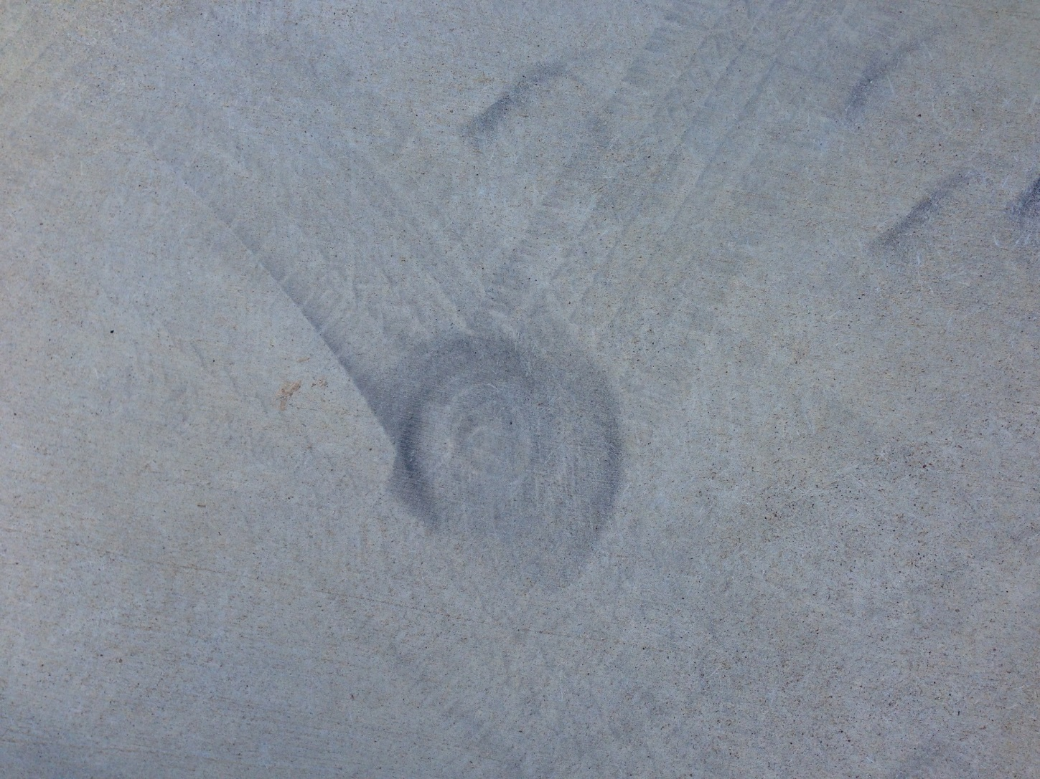
Source of Raveling

Slide 31
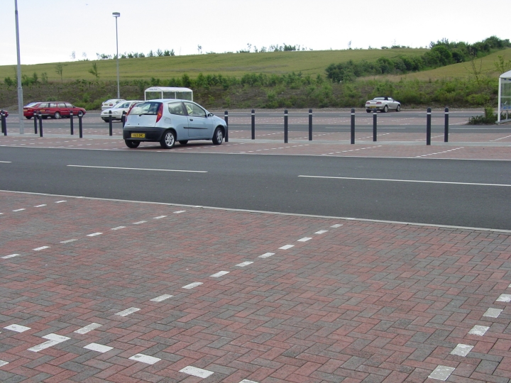
Porous Pavement only in Parking Stalls

Slide 32
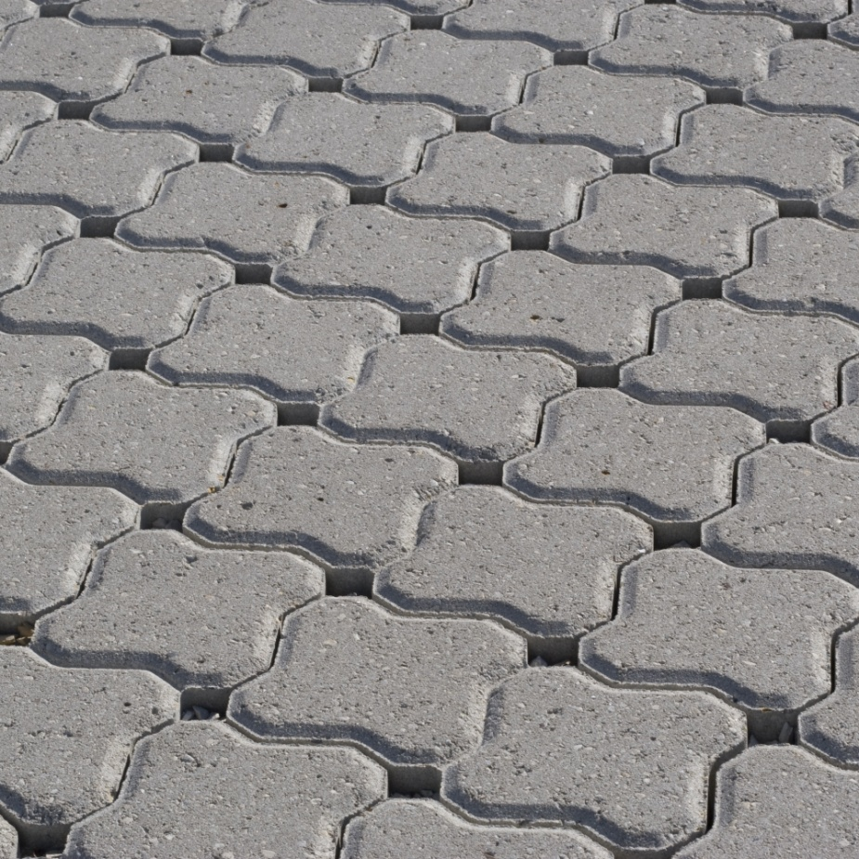
Pavers
Most expensive option
Decorative element
Easily removed and replaced if needed

Slide 33
Permeable Pavers
If 2 inch thick porous overlays gives 90+% pollutant removal, why not permeable pavers?
Most research has focused on volume reduction
Very few studies have quantified the pollutant reduction

Slide 34
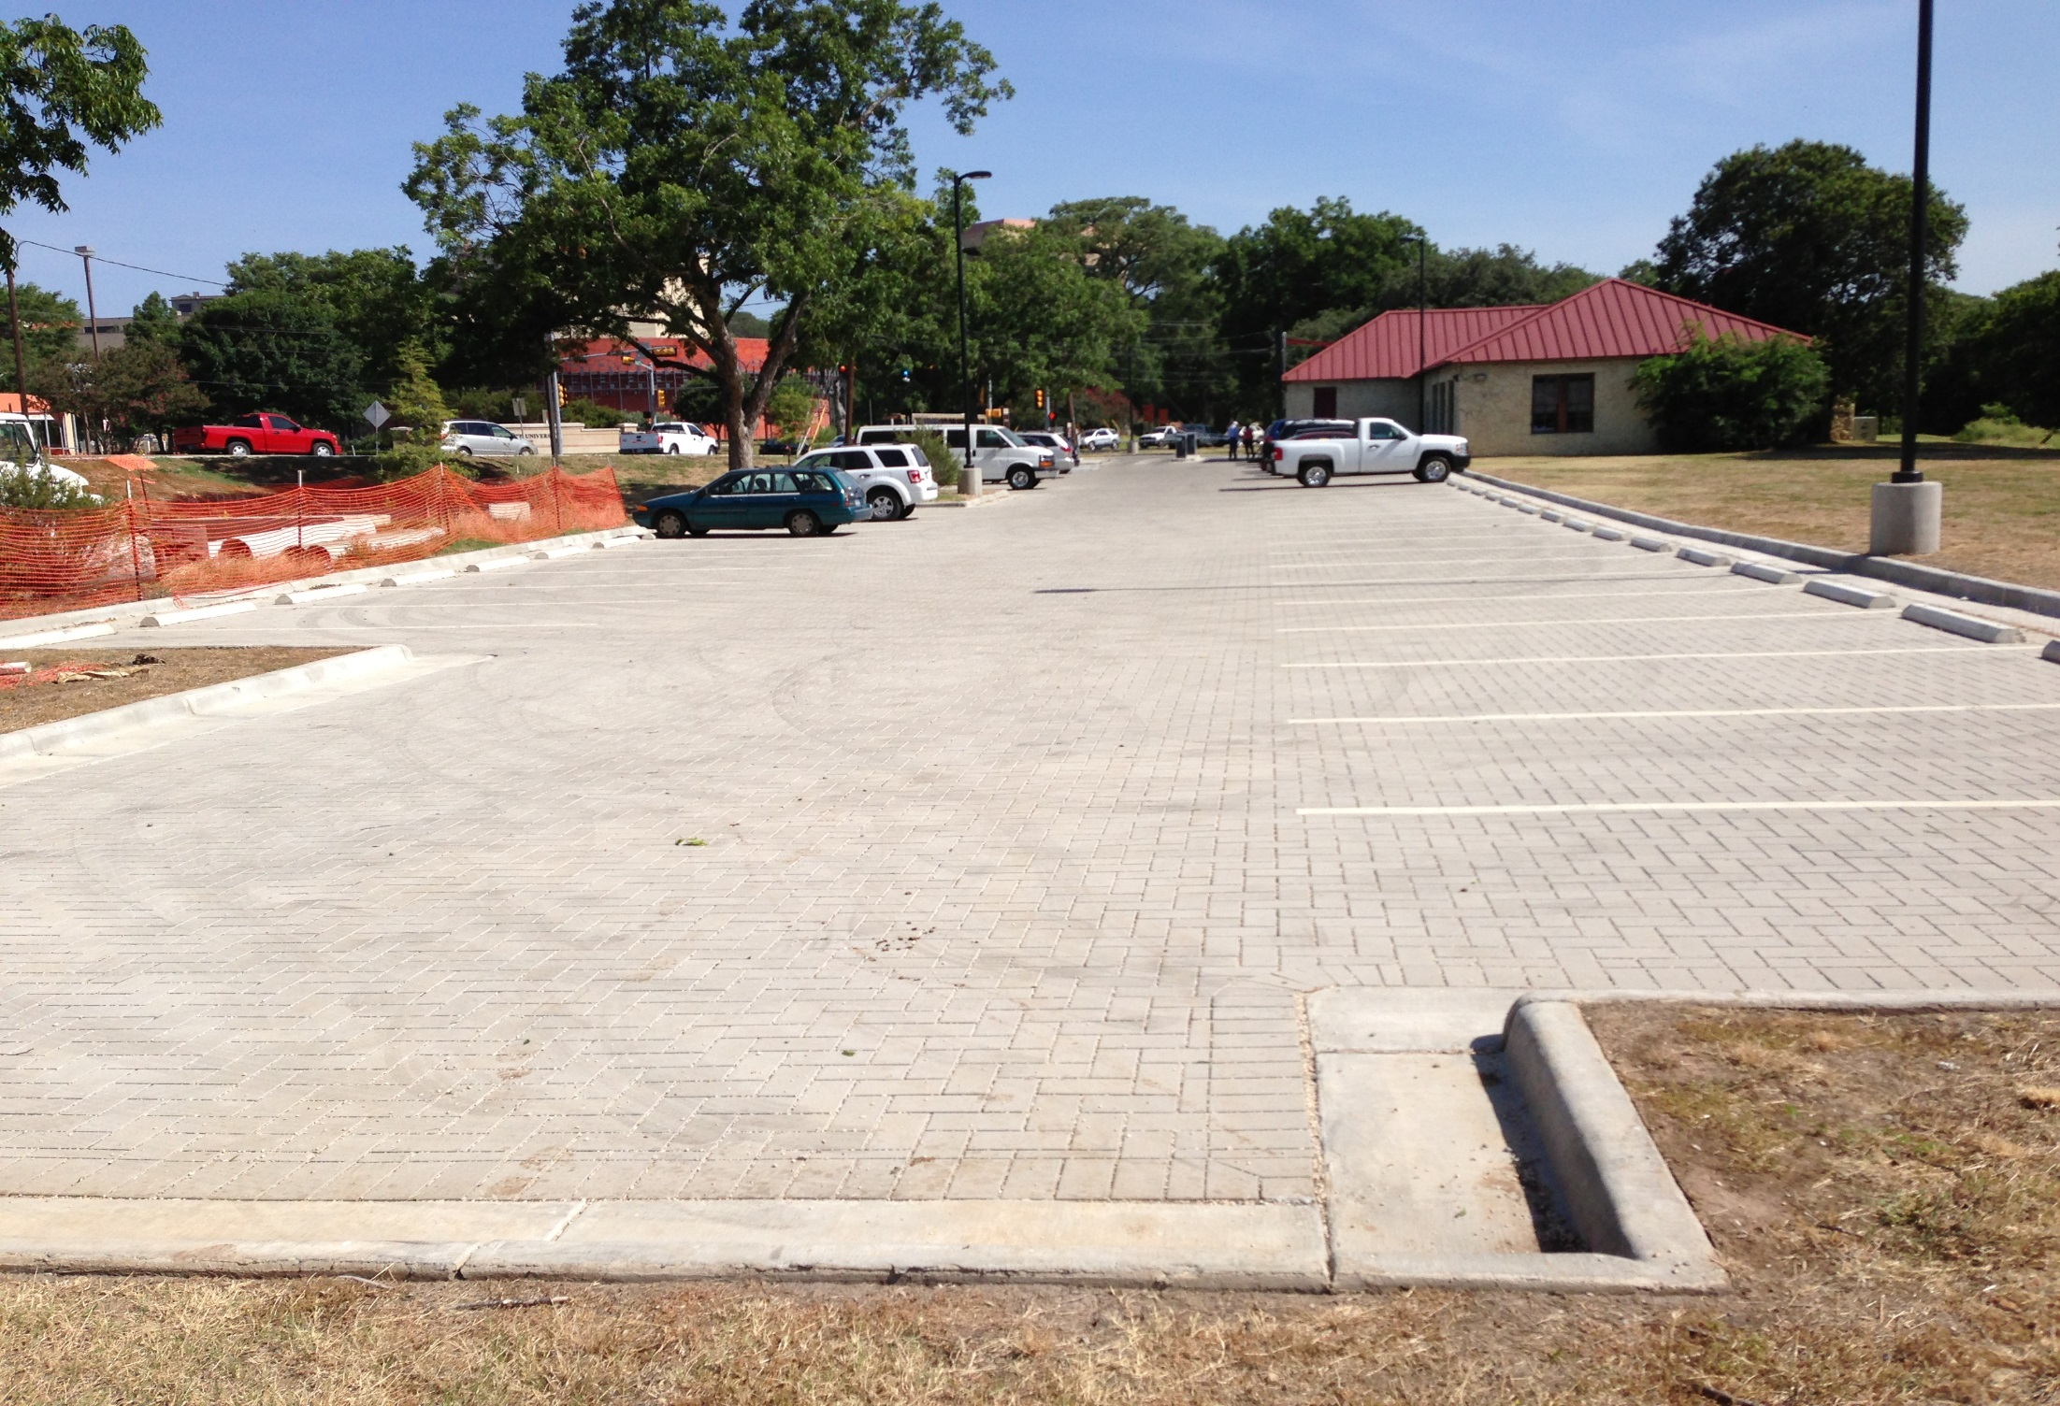

Slide 35
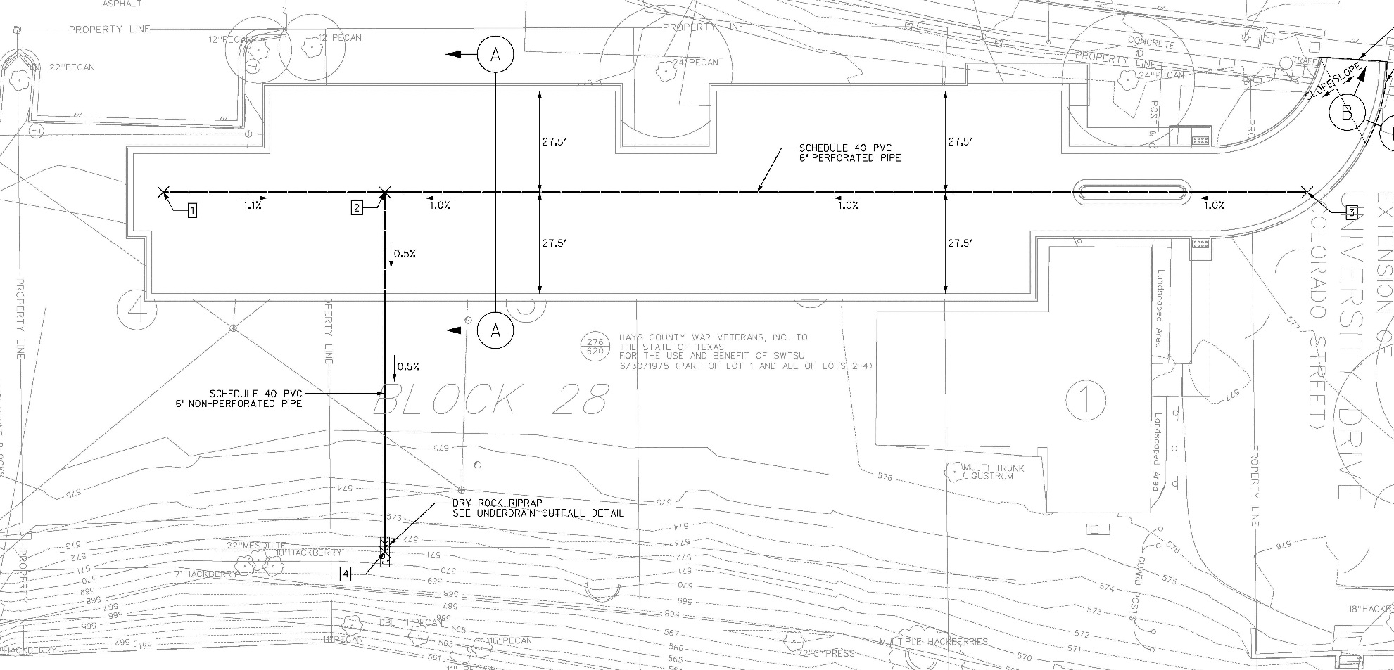
Plan View

Slide 36
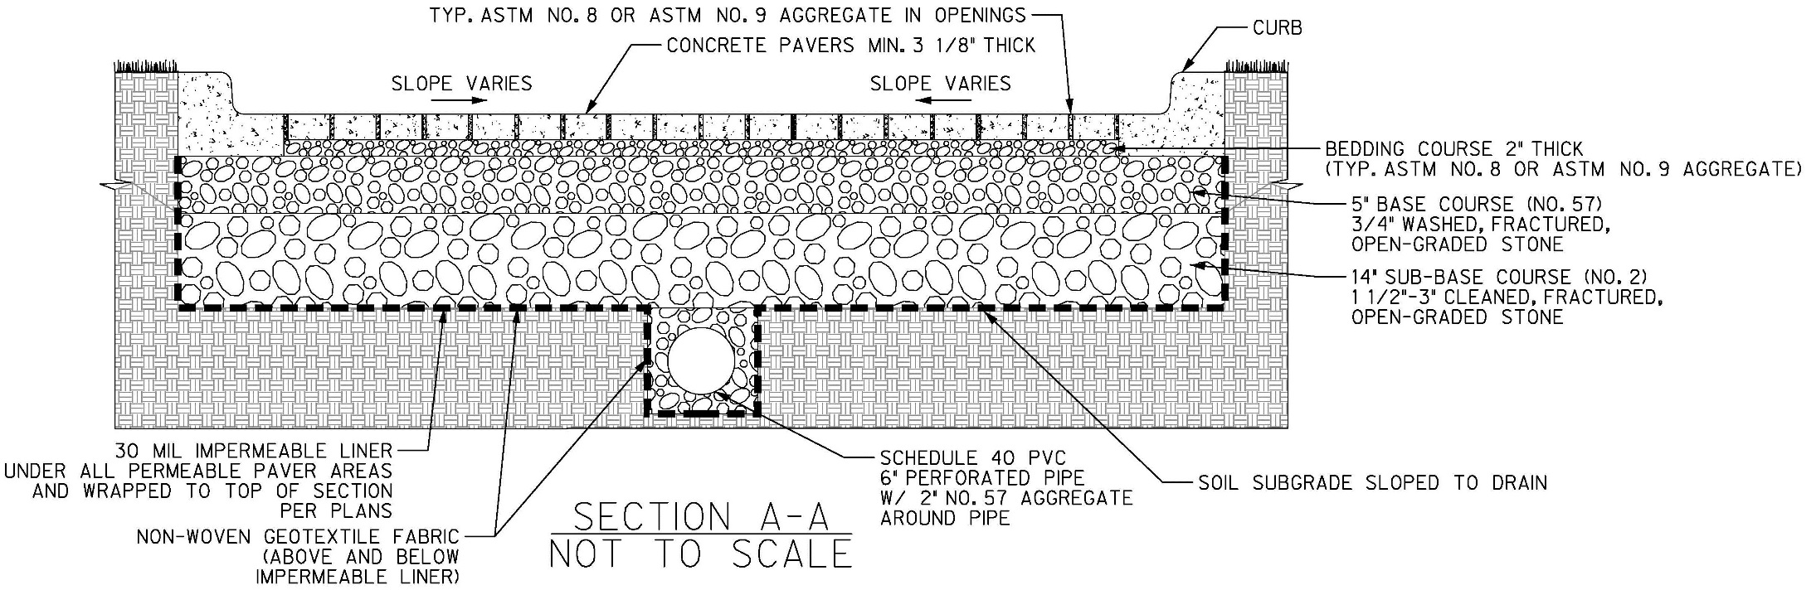
Pavement Section

Slide 37
Comparison of Effluent Quality
Constituent | Paver Underdrain | Sand Filter
TSS (mg/L) | 10.0 | 20.6
Total Phosphorus (mg/L) | 0.02 | 0.099
Total Nitrogen (mg/L) | 0.97 | 1.07
COD (mg/L) | 7.8 | 22
E. Coli (MPN/100mL) | 423 | 4,895
Total Lead (μg/L) | <1 | 5.7
Total Zinc (μg/L) | 5.6 | 22.9
Total Organic Carbon (mg/L) | 2.2 | 7.3

Slide 38
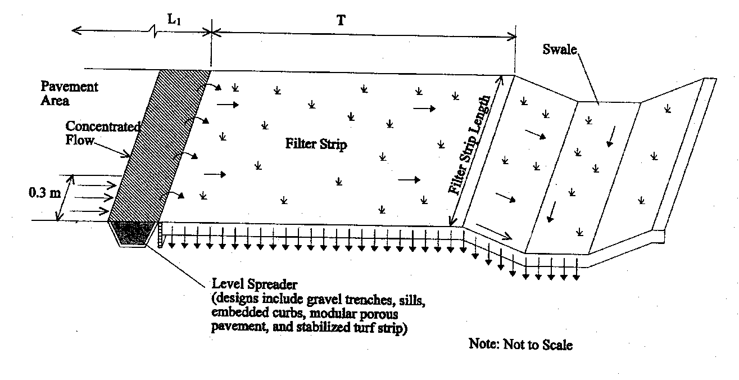
Schematic of Swale and Strip

Slide 39
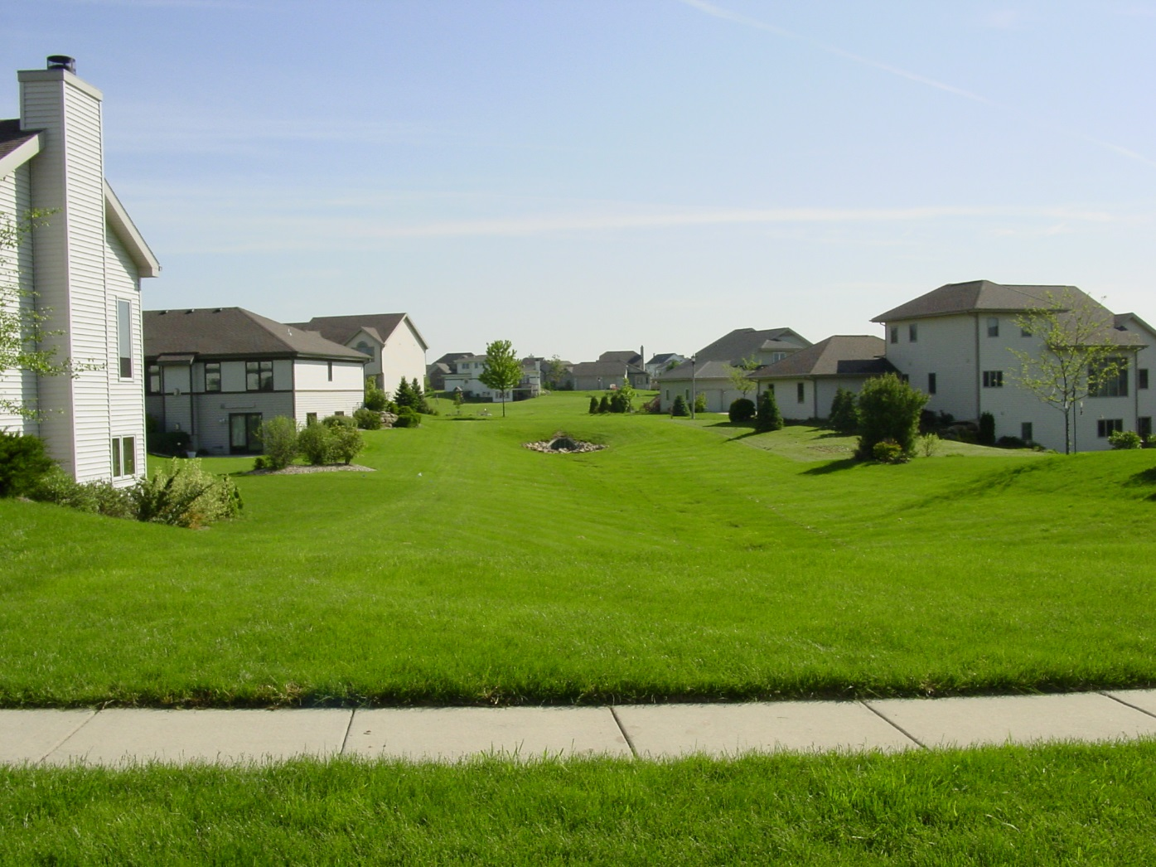

Slide 40
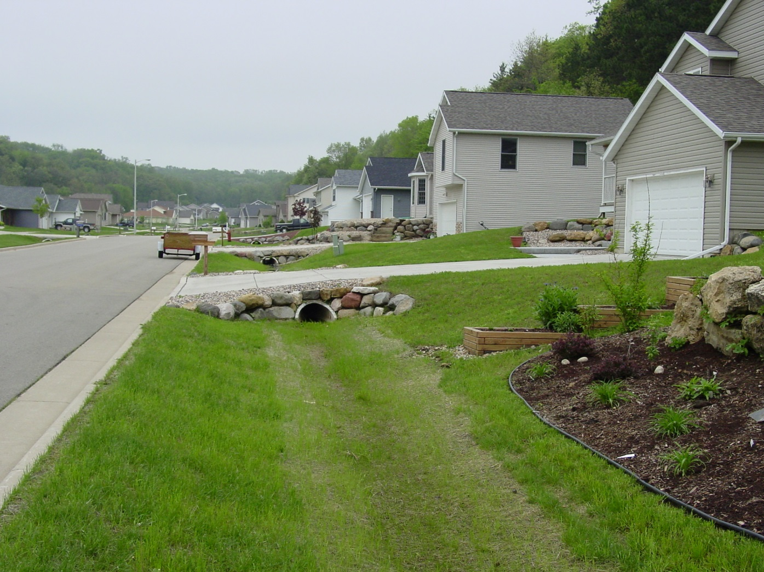

Slide 41
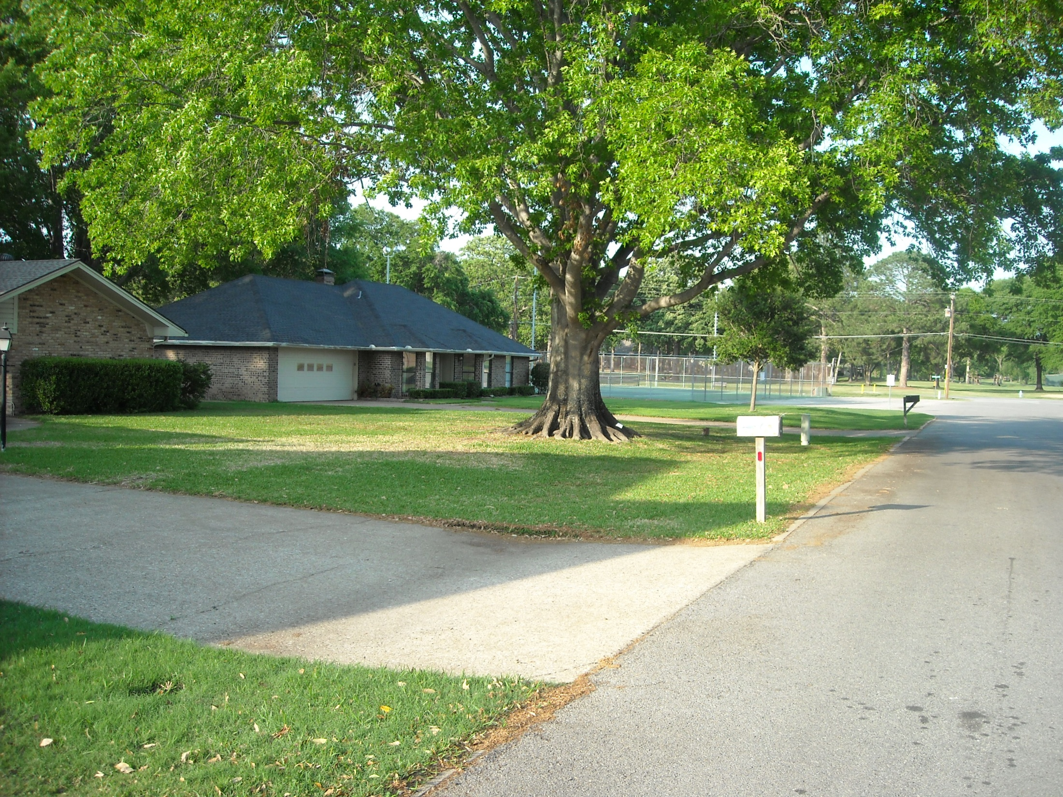

Slide 42
Vegetated Filter Strips

Slide 43
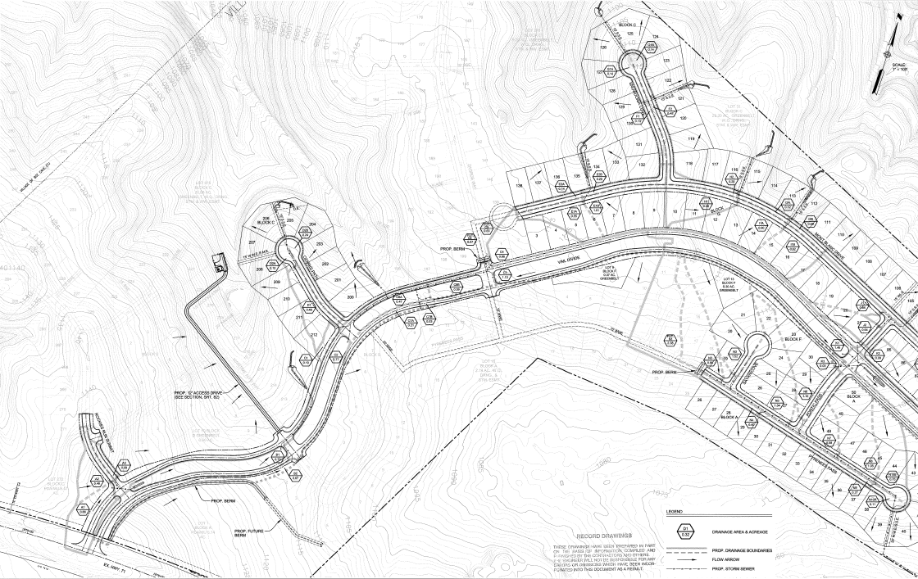
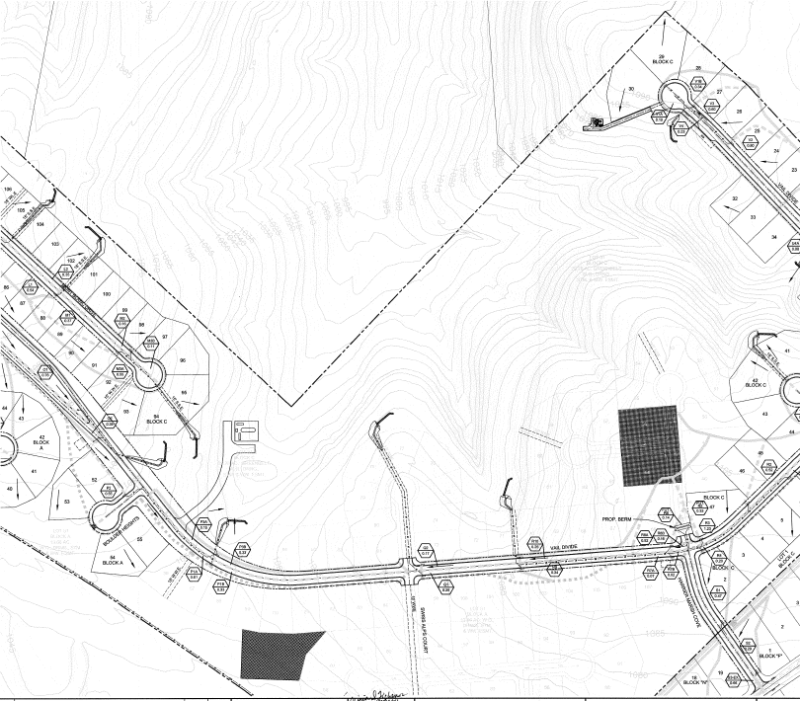
Falconhead West Development
Ozark Path Site
Swiss Alps Site
SH 71

Slide 44
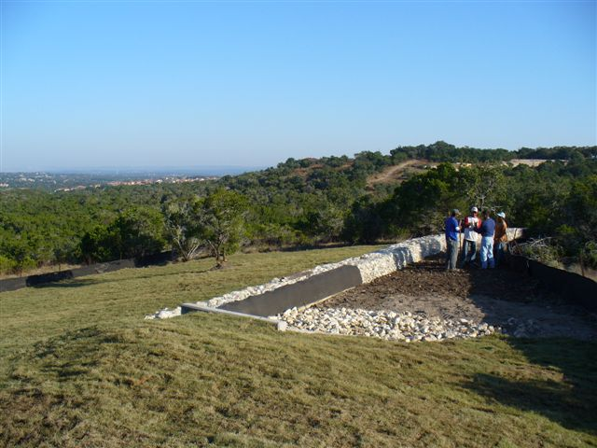

Slide 45
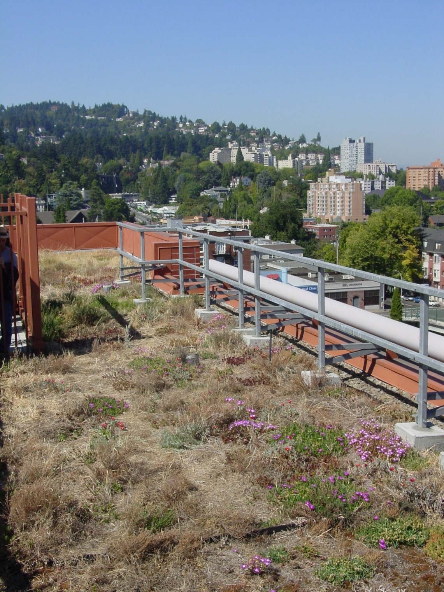
Green Roofs

Slide 46
Summary
Substantial environmental impacts of urbanization
Objectives of BMPs are to reduce concentrations of pollutants and runoff volumes
Move towards LID practices from end-of-pipe
Stormwater treatment is an integral part of urban runoff management

