Slide 1
Climate Change Open Data Initiative
19 March 2014
White House Press Release

Slide 2

Beginning in the Indian Treaty Room

Slide 3
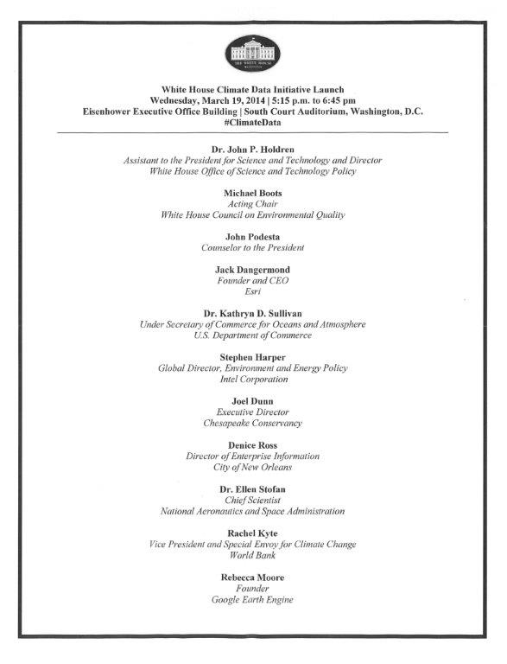

Slide 4
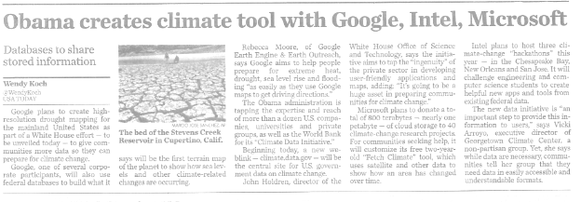
Article in USA Today, 19 March 2014

