Slide 1
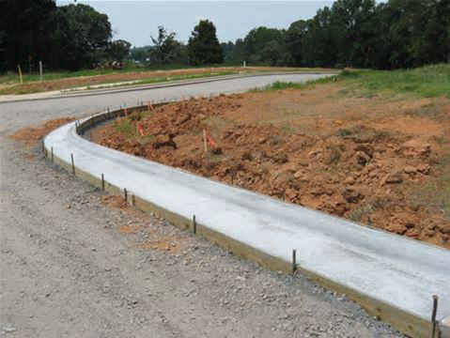
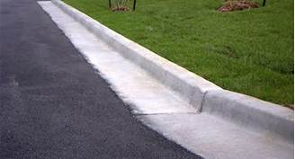
Curb and Gutter
Under Construction
Completed
http://www.ellsworthinc.com/concretework.html
http://www.sscsitework.com/Photo-Gallery.html

Slide 2
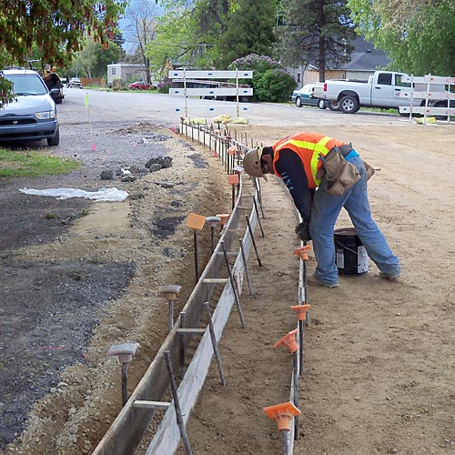
Curb and Gutter Formwork
http://overmanconcrete.com/concrete-services.html

Slide 3
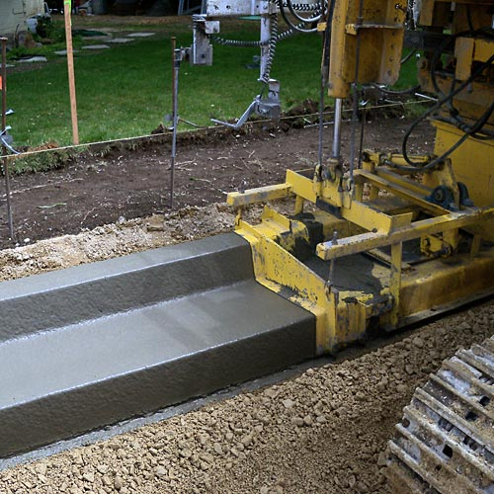
Curb and Gutter Machine
http://overmanconcrete.com/concrete-services.html

Slide 4
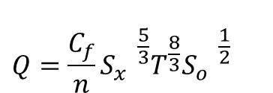
Gutter Flow
$$Q=\frac{C_{f}}{n}{{{S_{x}^{}}^{\frac{5}{3}}T^{\frac{8}{3}}{S_{o}^{}}^{\frac{1}{2}}}_{}^{}}^{}$$
T
d
S_{x}
1
Q = flow in gutter (cfs)
C_{f} = coefficient (0.56 for US units, 0.376 for SI units
S_{o} = longitudinal slope
T = spread (ft)
S_{x} = transverse slope
Ref: SCMD p. 372

Slide 5
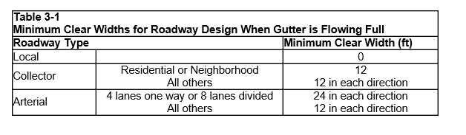
City of Austin Drainage Criteria for Minimum Clear Width
City of Austin, Drainage Criteria Manual, Section 3

Slide 6
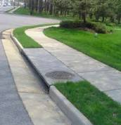
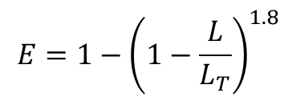
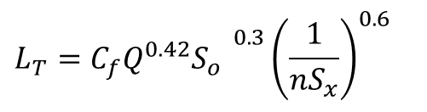
Flow into a Curb Inlet
L_{T}
$$L_{T}={{{C_{f}Q^{0.42}S}_{o}^{}}^{0.3}{\left(\frac{1}{nS_{x}}\right)}^{0.6}}_{}$$
L_{T} = required length to intercept all flow (ft)
Q = flow in gutter (cfs)
C_{f} = coefficient (0.60 for US units, 0.817 for SI units)
S_{o} = longitudinal slope
T = spread (ft)
S_{x} = transverse slope
$$E=1−{\left(1−\frac{L}{L_{T}}\right)}^{1.8}$$
E = efficiency (proportion of flow captured
L = actual length (ft) (for L < L_{T})
Ref: SCMD p. 393

Slide 7
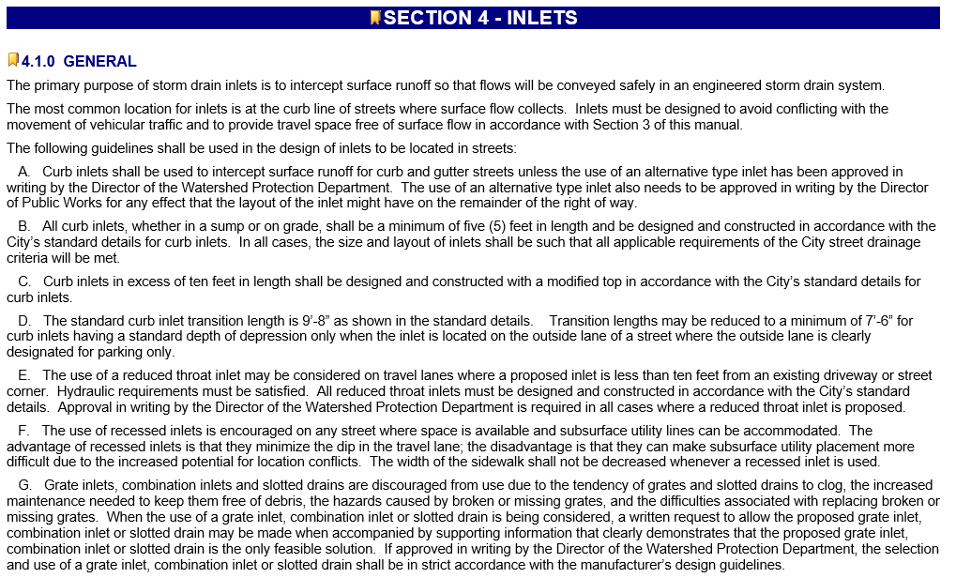
City of Austin Criteria for Inlets

Slide 8
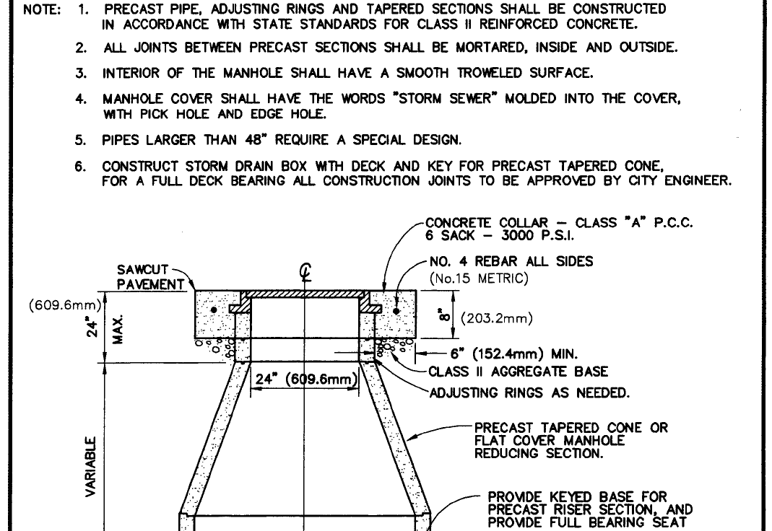
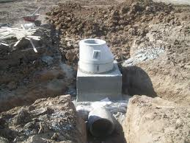
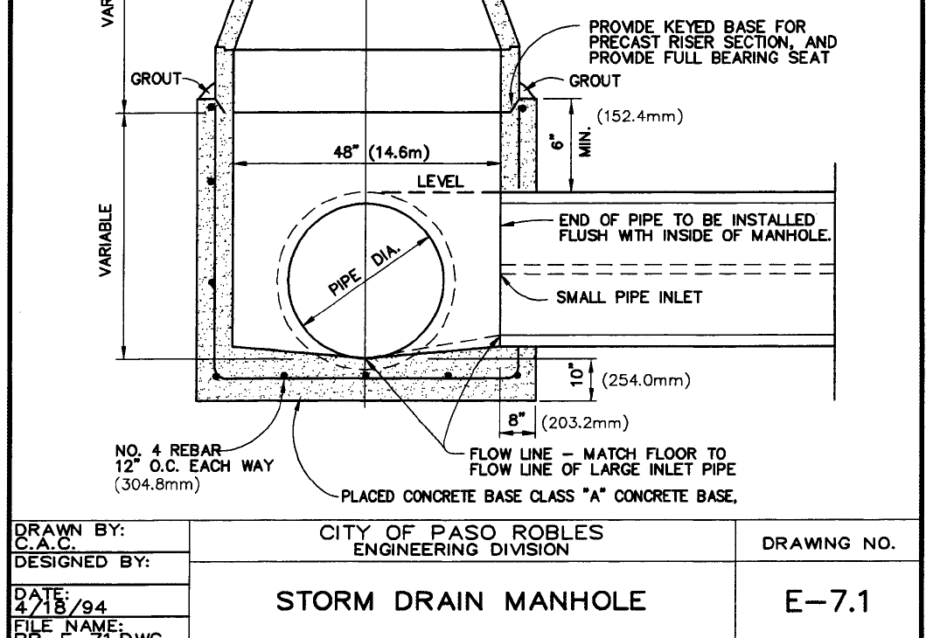
Storm Drain Manhole
http://www.kanapipeline.com/images/manhole-cone.html
http://www.lbiw.com/article/resources/agencystandardplandrawings/agencystandardplandrawings.html?region=CITY%20OF%20PASO%20ROBLES/E-7.1%20-%20STORM%20DRAIN%20MANHOLE.pdf

Slide 9
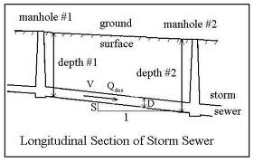
Storm Sewer Flow

