Slide 1
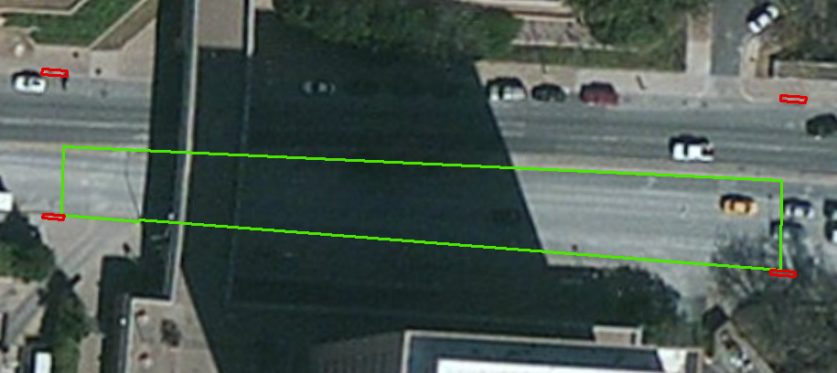
Inlet on Dean Keaton St
32.5ft
548.79 ft
above datum
340.8 ft
534.22 ft
above datum
Catchment Area = 12,736 ft²

Slide 2
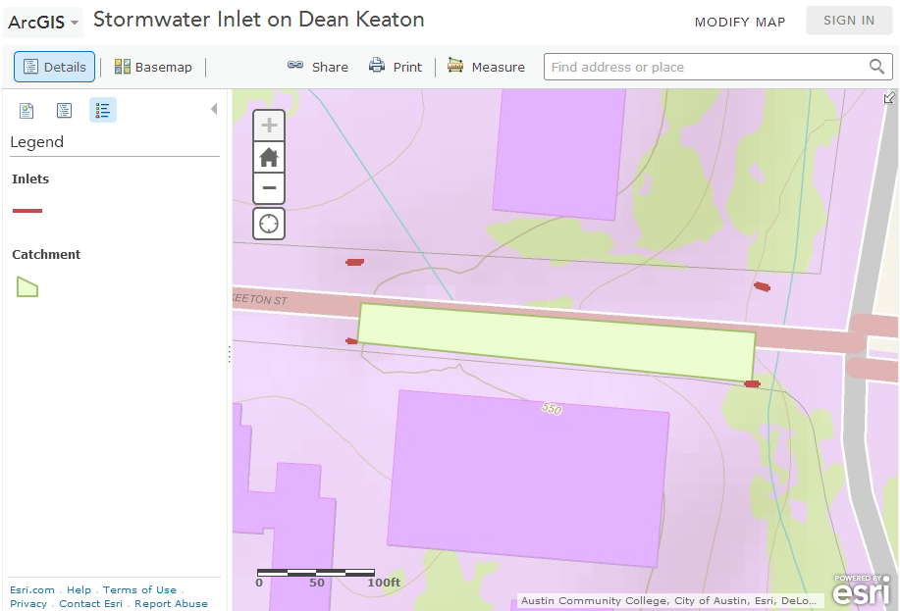
548.79 ft
above datum
534.22 ft
above datum

Slide 3
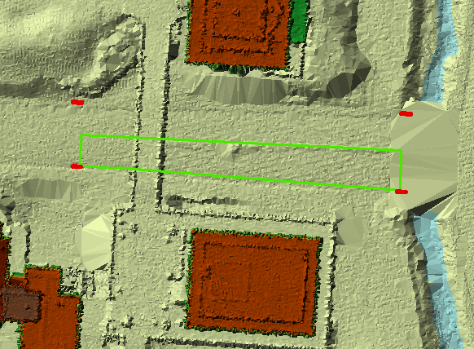
Airborne LIDAR coverage of Dean Keaton St and surroundings

Slide 4
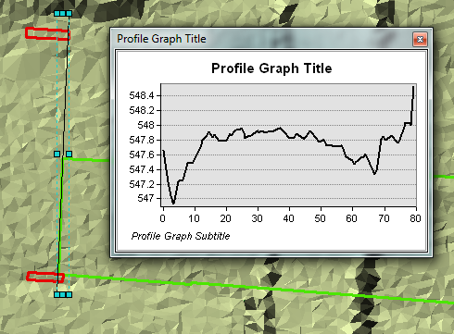
Cross-Section at top end

Slide 5
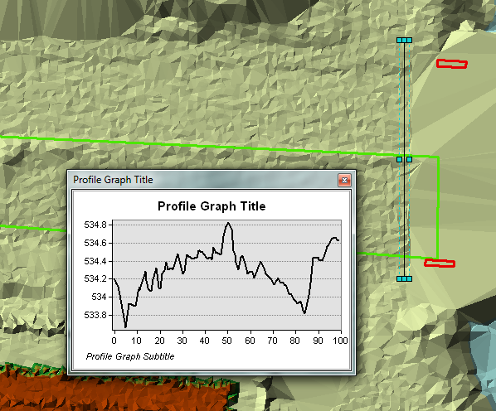
Cross-Section at bottom end

Slide 6
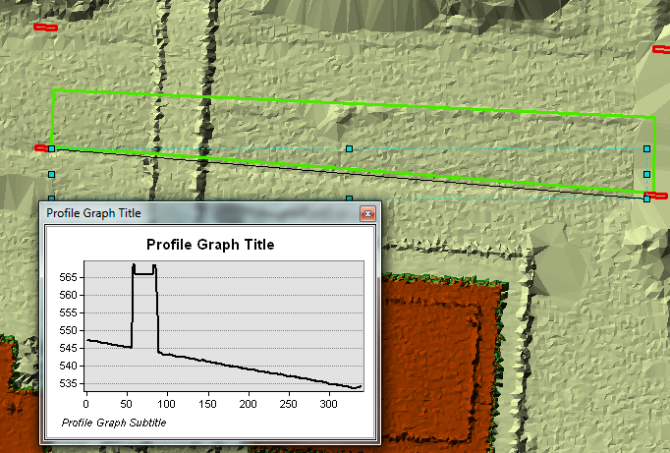
Longitudinal profile in gutter

Slide 7
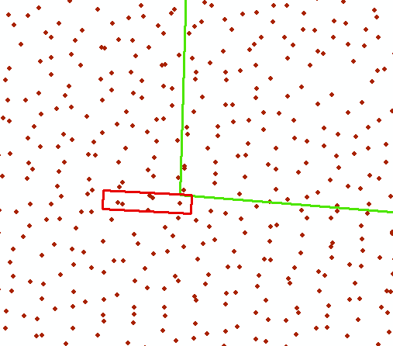
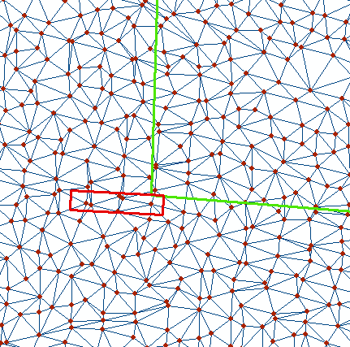
A set of points from LIDAR joined by edges to form triangles
A Triangulated Irregular Network (TIN)

Slide 8
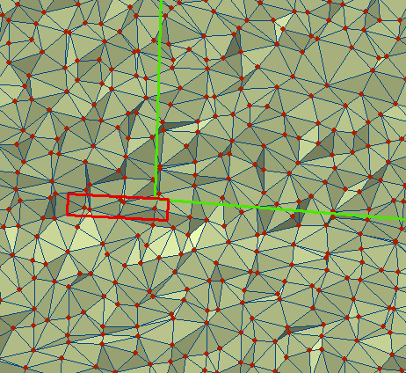
TIN of a portion of Dean Keaton St

Slide 9
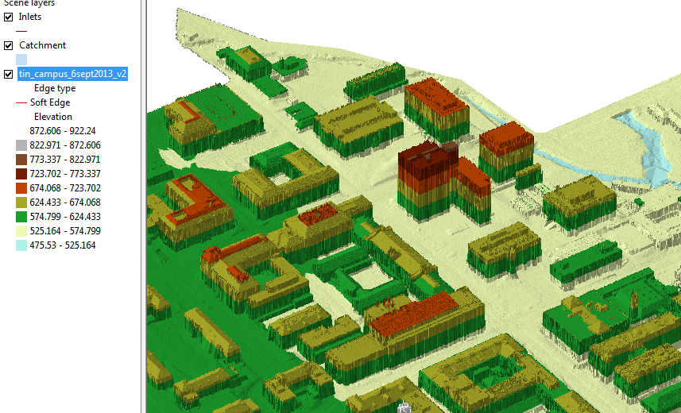
TIN of the North East part of campus
ECJ

Slide 10
Sheet Flow
Rainfall intensity, i
L
A
A
1 ft
s
L
1
v
B
B
q, discharge per unit width
q = iL = vy
y

