Slide 1
CE 365 Consultant Overview
February18, 2014
By: Scott Edelman

Slide 2
AECOM Background

Slide 3
AECOM
AECOM is a global provider of professional technical and management support services to a broad range of markets, including transportation, facilities, environmental and energy. AECOM is a leader in all of the key markets that it serves.
No.1
353
125
45K
$7+bn
Top 500 Design Firm
Ranked No.353 in Fortune 500
Serving 125 countries
45,000 dedicated professionals working globally
US$7.3 billion of revenue
during the 12 months ended March 31, 2011
Disaster – The Way Forward
Introducing AECOM
Page 3

Slide 4
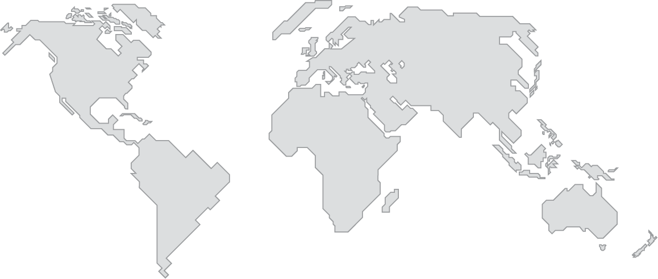
AECOM
5,000
9,000
25,000
6,000
400+ offices serving approximately 125 countries
Americas
UK / Europe
Asia Pacific
Middle East / Africa
Canada
Mexico
Latin America
United States
CIS
France
Germany
Greece
Ireland
Italy
Netherlands
Poland
Romania
Russia
Spain
UK
Australia
China
Hong Kong
India
Indonesia
Japan
Korea
Malaysia
New Zealand
Philippines
Singapore
Thailand
Vietnam
Afghanistan
Algeria
Bahrain
Egypt
Iraq
Jordan
Kuwait
Libya
Nigeria
Oman
Qatar
Saudi Arabia
South Africa
Turkey
Uganda
UAE
Disaster – The Way Forward
Introducing AECOM
Page 4

Slide 5
What important projects have you worked on?

Slide 6
Sun Tzu:
With advance information, costly mistakes can be avoided, destruction averted, and the way to lasting victory made clear.

Slide 7
COST: What is the bottom line?
Proactive Planning
Reactive Emergency Response
Estimated cost $1
Estimated cost $5-7
Notes:
The old saying that “an ounce of prevention is worth a pound of cure” has never been truer.
For every $1 spent on planning and prevention, between $4 and $7 can be saved on the response.

Slide 8
Changing how we fundamentally deal with risk related to disasters
IDENTIFY the risk
ASSESS the risk
COMMUNICATE the risk
MITIGATE the risk

Slide 9
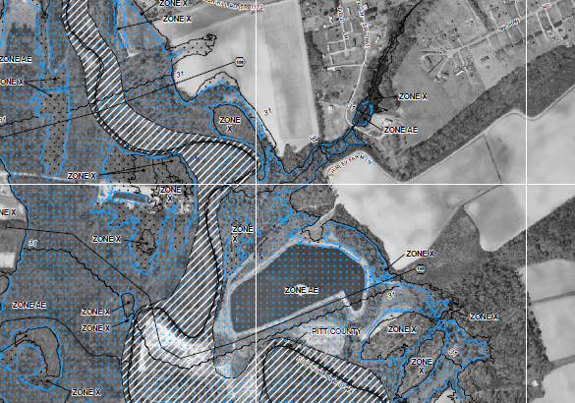
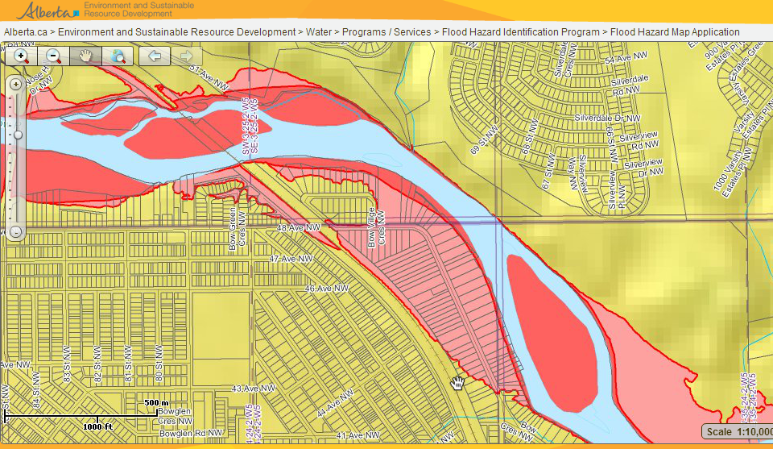
Risk identification and assessment provides basis of decisions

Slide 10
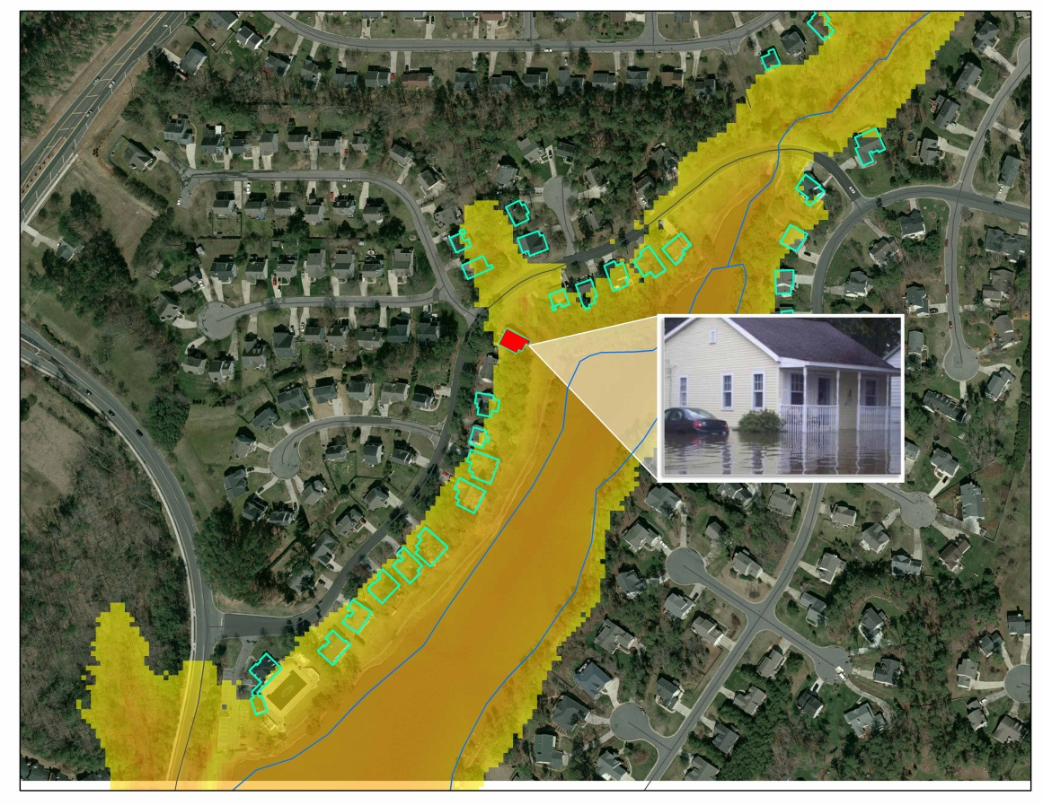
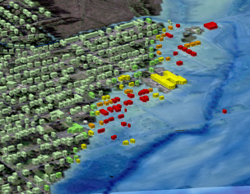
Risk communication needs to be relevant

Slide 11
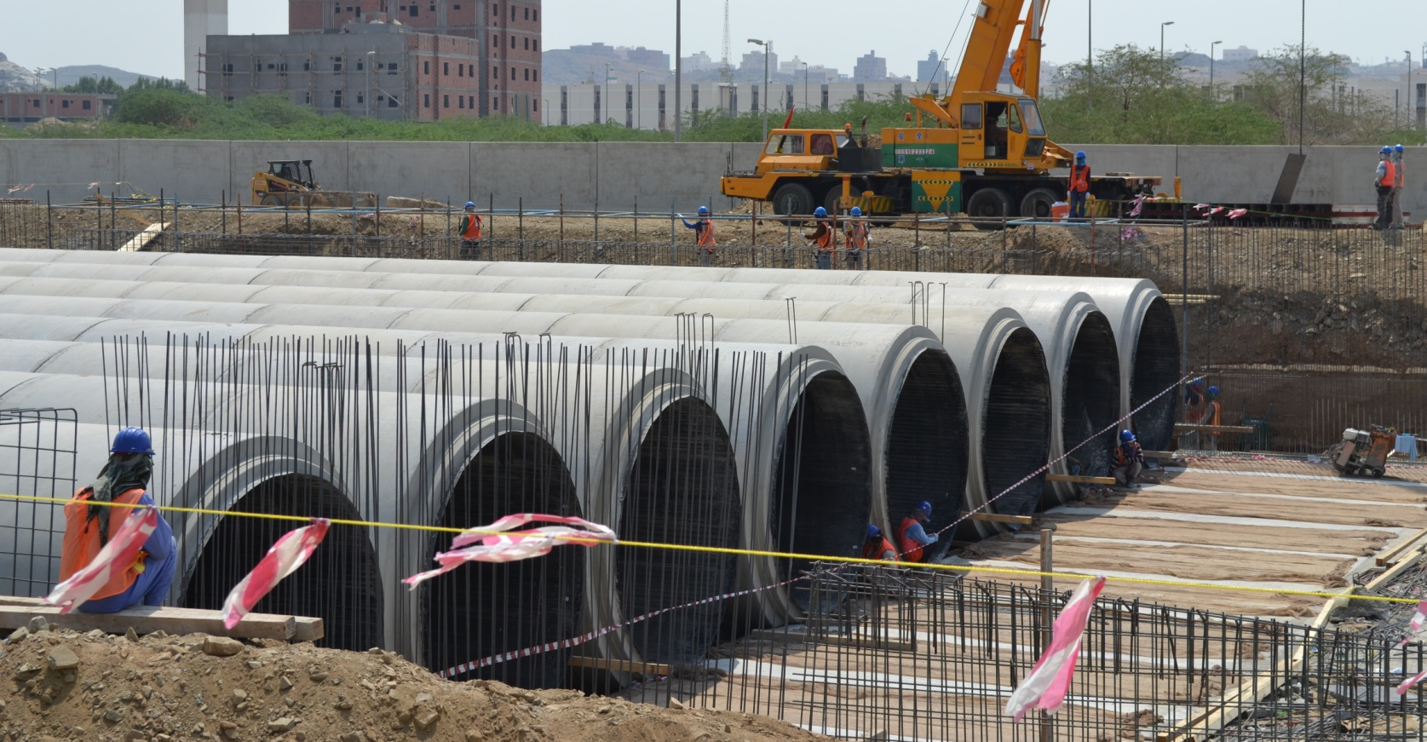
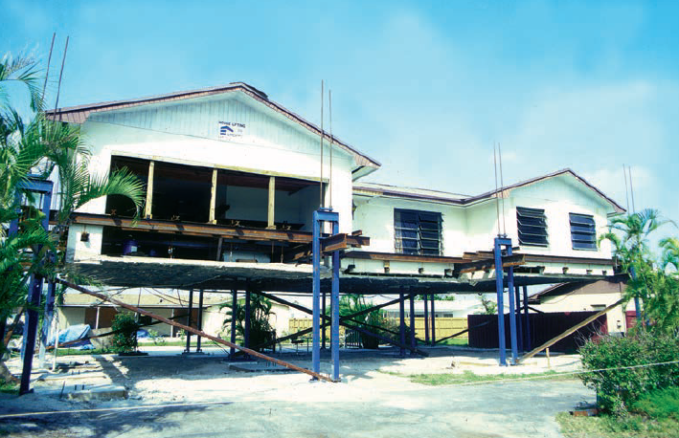
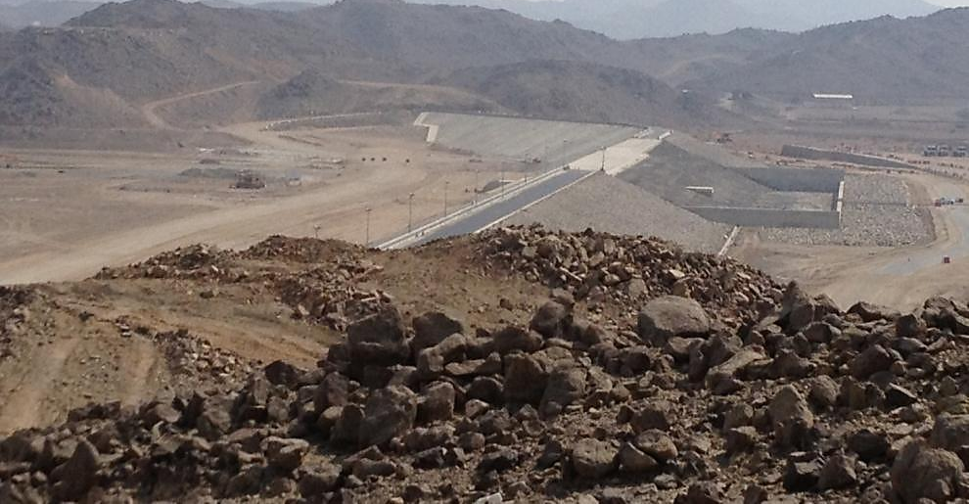
Risk mitigation to change in behavior

Slide 12
The ill-logical hydrologic cycle
Flood
Panic
Plan
Delay
Funding is the typical reason why action is not taken.
Funding needs to take advantage of political good will

Slide 13
What was your favorite project?

Slide 14
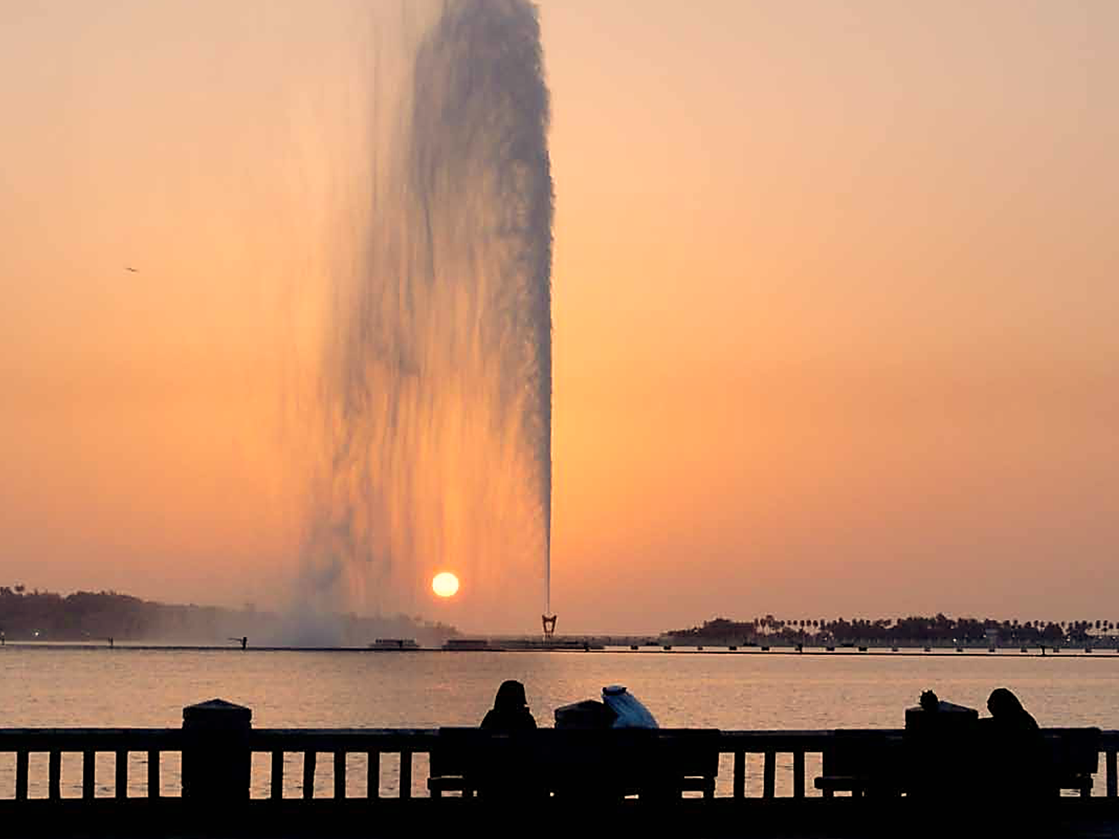
From
Life Threatening
Floods
to
Controlled Stormwater
Flow
6th Global Leadership Forum February 2013
Notes:
Conference website
http://www.cg-la.com/gilf6
From Steve
Scott
I’m about to get on a plane and will look at it and send you comments in detail. But overall, given you have 10 minutes, this outline might work:
The problem (show flooding, result, need)
The competition/AECOM strategy (show what we did to win)
The solution (show what our technical strategy is, the overall plan, and what we had to do to analyze and prevent flooding)
The organization (show how we organized to get it done (with Saudi Aramco, the locals, or own internal AECOM team)
The result (show photos of what we completed – this year, rain and no floods?)
The look forward (next phase, created a platform for NWC in KSA)
Keep slides super high level, all slides should look like AECOM brand, and should have photos that span the whole slide with one message on the top. No bullets, no lists, unless just for impact.

Slide 15
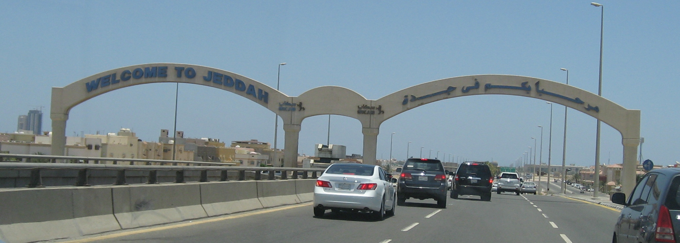
Jeddah is home to 3.5 million people and principle gateway to Mecca
Largest Port on the Red Sea
Comprised of 135 districts
Rainfall 2.1” annually
Except on two days when nearly double the amount fell on each day
Notes:
Entrance to the King’s airport terminal
Jeddah is the entry is to mecca, kings palace

Slide 16
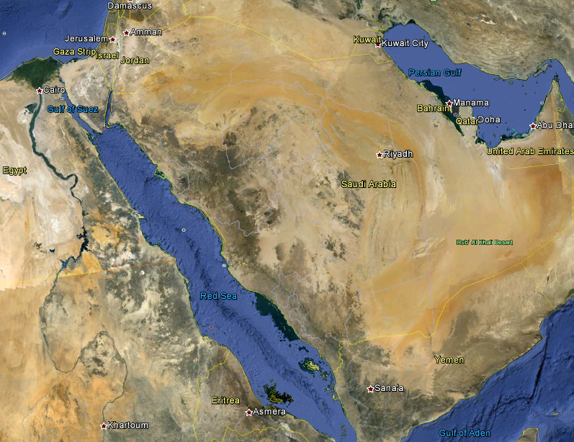
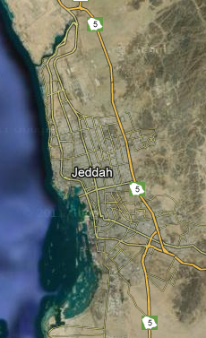
Jeddah is located in the Kingdom of Saudi Arabia
Notes:
New development will be north of the city.
Jeddah is an arid or semi-arid and coastal plain
Topo is like hong kong, flat and steep set of mountains, when it rains run-off goes through the city

Slide 17
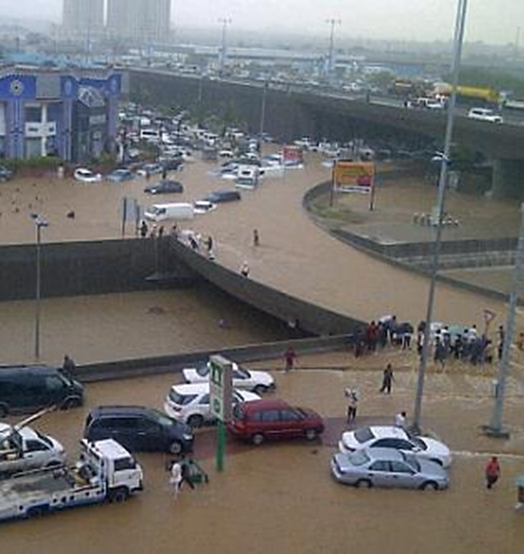
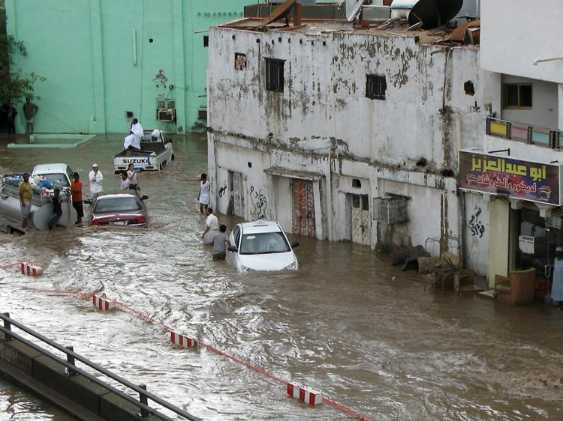
Disastrous flash flooding PROBLEMS devastate Jeddah and cause major damage and loss of life
3.5” of rain in 4 hours on November 25, 2009
4” of rain in 4 hours on January 26, 2011
Notes:
Catalyst for this program after the January 2011 flood, AECOM involved with emergency work Feb – April. April RFQ and May 1st selected contract signed May 14th– super sonic.
Engineering and CM services for Jeddah Stormwater Drainage Program
The norm is intense less than 6 hour storms
Um Al Khair breeched in 2011
Major casualties from flash flooding lead to action
472 people lost on September 11, 2009
160 people lost on January 26, 2011

Slide 18
Program solutions prioritized from urgent to long-term to prepare for the future
The solutions
NORTH
Notes:
Paul, this slide is the proposed stormwater master plan
Protect city from rain from mountains
I – immediate protection of center of the urban area
II – H and G watersheds end protection of the north and south sides of the city
III – implementation of the master plan

Slide 19
The solutions
Phase Solutions | Status | Title
I | Constructed | Al Samer Dam
I | Constructed | UM Al Khair Dam
I | Constructed | Ghaia Dam – GHA-2
I | Constructed | Um Hablian Dam - UHA-2
I | Constructed | Dagbhag Dam - DAG-2
I | Constructed | Braiman Dam - BRA-2
I | Constructed | Ghulail Dam - GHU-3
I | Constructed | Eastern Channel
I | On Going | Airport Outfall
I | Constructed | Northern Channel
I | Constructed | Southern Channel
II | Tender | Misk Lake Dam
II | Tender | Emergency Dam
II | Tender | Quraa & Muraygh Channels
II | Tender | Khumra Channels
II | Tender | Multiple Line Work and PS Repair Projects
II | Tender | Muraygh Dam - Mur-1
Notes:
Multiple Line Work and PS Repair Projects are listed on slide 31: 2013 Urgent Works
Spell out abbreviations: bart

Slide 20
Timeline DETAILS to implement the plan
May 1, 2011
AECOM receives Notice-to-proceed
May 14, 2011
AECOM deployed 147 staff during the first 15 days
End of May 2011
Initiated Design / Build Al Samer and Um Al Khair dams and outlet channels tender
June 1, 2011
AECOM deployed 428 staff during the first 30 days
July 31, 2011
Urgent Works plans and specs complete
Al Samer & Um Al Khair dams and outlet channels construction started
September 2011
Started Phase I Watershed Solutions Plans
November 2011
Al Samer and Um Al Khair Dams and Outlet Channels substantial completion
December 31, 2011
Issued for Bid Phase I plans and specifications
March 31, 2012
Issued for Construction Phase I plans and specifications
September 30, 2012
AECOM crosses over 1 million man-hours
December 2012
Phase I substantial completion on all except the Airport Outfall, complete in September 2013
March 2013
Phase II Watershed Solutions issued for construction plans out to tender
March 2013
CIP is being developed for implementation of the Master Plan for Jeddah Stormwater
Future
Phase III Solutions, Implementation of the Master Plan System
Urgent Works Construction Complete
Notes:
July 2011
Al Samer & UAK Dams and outlet channels
construction started
Nov 2011
Al Samer & UAK Dams and outlet channels
substantial completion
Al Samer & UAK Dams and outlet channels
Initiated Design/Build Tender end of May 2011
Construction started July 2011
Substantial completion Nov 2011
Do you want some pictures of the dams and “final” channels
A few stats – a bit out of order
May 1, 2011 – AECOM receives Notice to Proceed
May 14, 2011 – AECOM dedicated 76 staff
June 1, 2011 – AECOM dedicated 403 staff
July 31, 2011 – Plans and specs for $250 MM complete – Urgent Works
Sept 30, 2011 – Started plans
December 31, 2011 – Issued IFB Plans and specs
March 31 2012 – Issued IFC plans - $900 MM bid price (sure with change orders it is closer to $1B)
Dec 2012 - Construction compete on all but the Airport Outfall (due to complete in Sept 2013)
Sept 30, 2012 – AECOM crosses over 1MM man-hours
March 2013 – Plans are to issue about $1.2 B in new IFC Plans and specs
CIP is being developed for implementation of the Master Plan for Jeddah Stormwater
Also could discuss WER 9 – Environmental, WER 8 Ad Hoc Areas and Middle Ring Road
The MRR is 85 km of new roadway alignment, 30% submitted in Dec 2012, being revised based on new light rail and VE comments, revised 305 due in May 2013
Airport Channel (5 Yr Design Storm) :
Discharge along Baseline A to Red Sea : 21 CMS
Discharge along Baseline B to Red Sea : 17 CMS
Discharge along Baseline C to Red Sea : 25.5 CMS
Southern Channel (100 Yr Design Storm-Future Flows):
Discharge to Red Sea: 1193 CMS
Eastern Channel (100 Yr Design Storm)
Discharge to Obhur Creek: 1170 CMS (The flows shown refers to the flows that are removed from Wadi Murygh and included at Cross-section Station 1609 along with Wadi Qurra)
Northern Channel (10 Yr Design Flows)
Discharge: 86 CMS
Rich Squire, PE
D 713.267.3121 C 832.520.6974
rich.squire@aecom.com
AECOM 5757 Woodway, Suite 101 West Houston, Texas 77057-1599 T 713.780.4100 F 713.267.3283 www.aecom.com

Slide 21
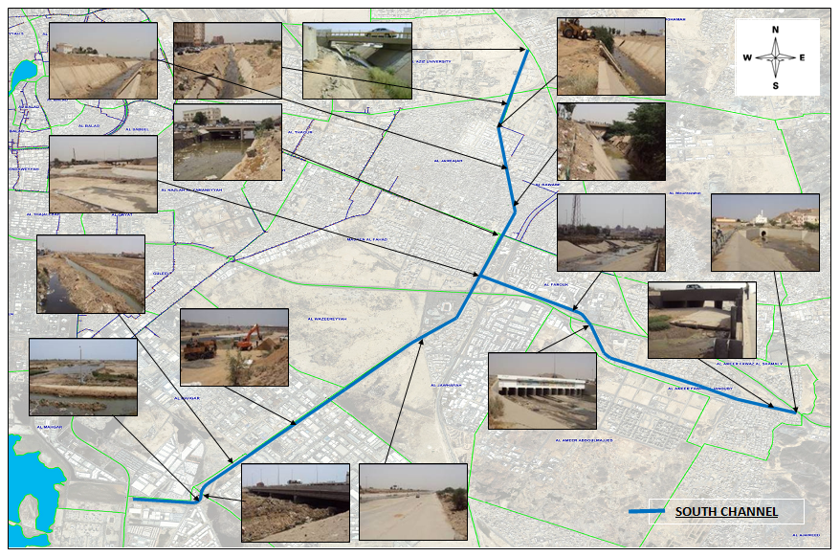
RESULTS prove to bring relief to Jeddah
Assessment of existing infrastructure

Slide 22
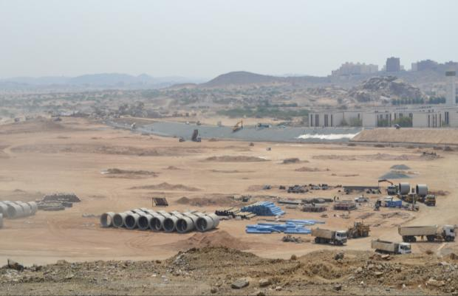
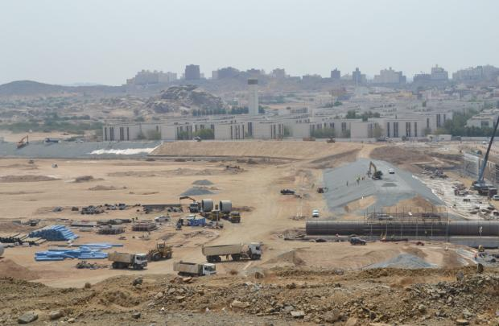
Um Al Khair Dam
The results
Notes:
Design-built plans started 6 weeks after the contract was signed. Construction was substantially completed by November 1.
Um Al Khar means Mother of Optimism (verified by Sam Talje) – and believe this is one of the first dams they construction, interesting factoid.

Slide 23
Um Al Khair Outlet Channel
The results
Notes:
Outlet

Slide 24
Um Al Khair Outlet Channel at Road Crossing
The results

Slide 25
Um Al Khair Outlet Channel
The results
Notes:
Could be eliminated.

Slide 26
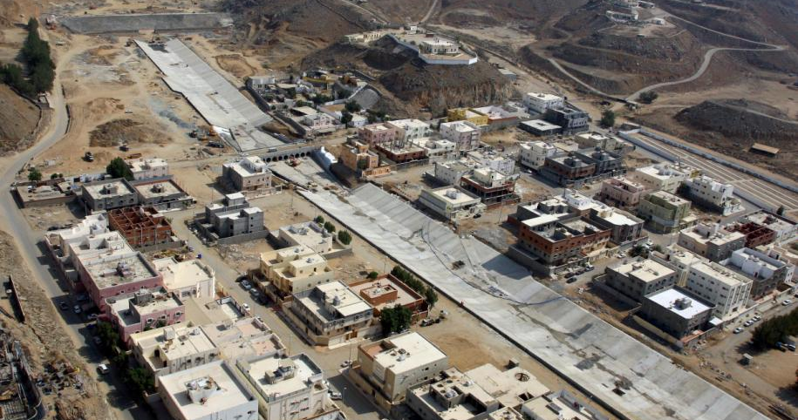
Al Samer Channel and Dam
The results

Slide 27
Al Samer Outlet Channel Waterline Relocation
The results
Notes:
Complex Utility Relocation

Slide 28
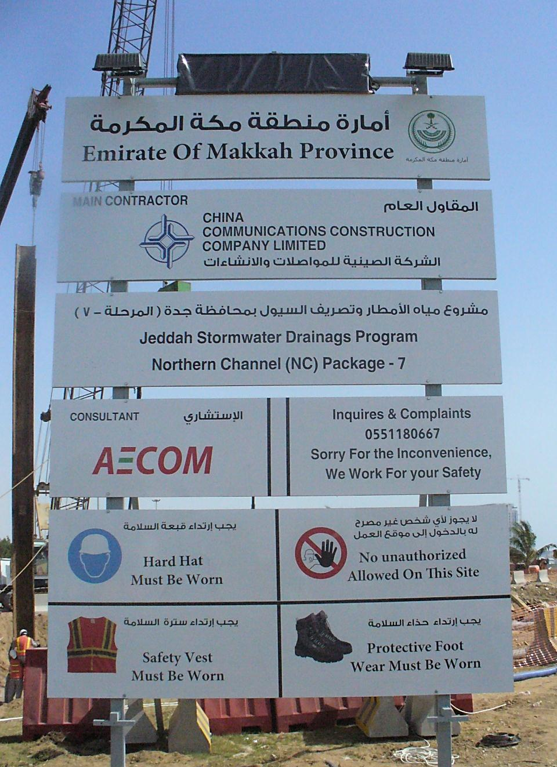
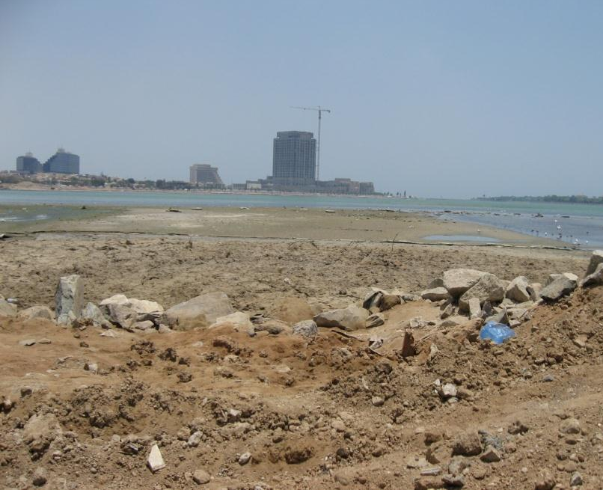
North Channel Red Sea Outfall
The results
Notes:
Photo taken during construction outfall not visible
Runs through center of the city and drain to north channel
North runs east and west from dams to the sea
Red sea outfall

Slide 29
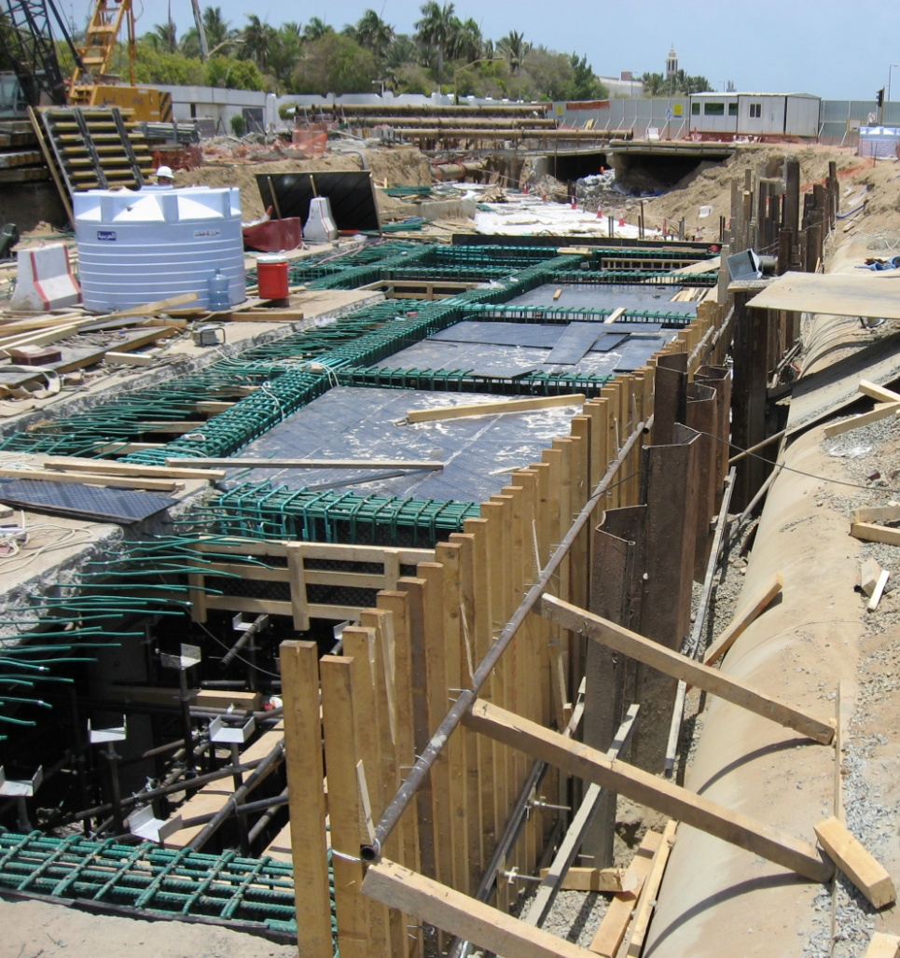
North Channel Box Culvert
The results
Notes:
Dual 3 x 3 meter boxes
Existing box and adding 2 more boxes, so 4 total
East west, 2 – 4 boxes,
Removed two siphons
Left image, pipe hanging over culvert

Slide 30
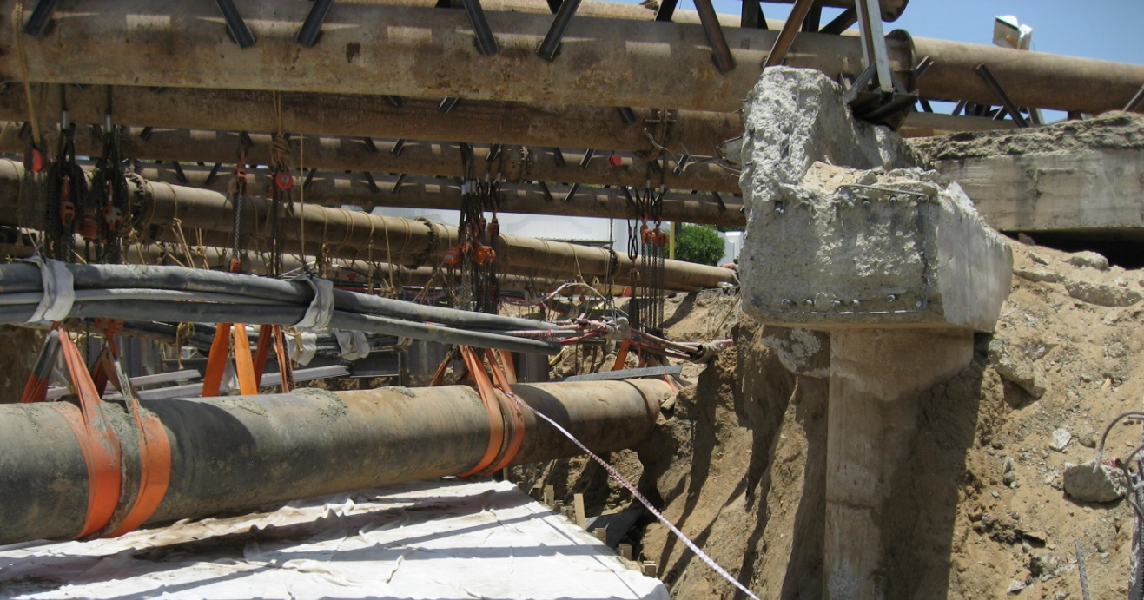
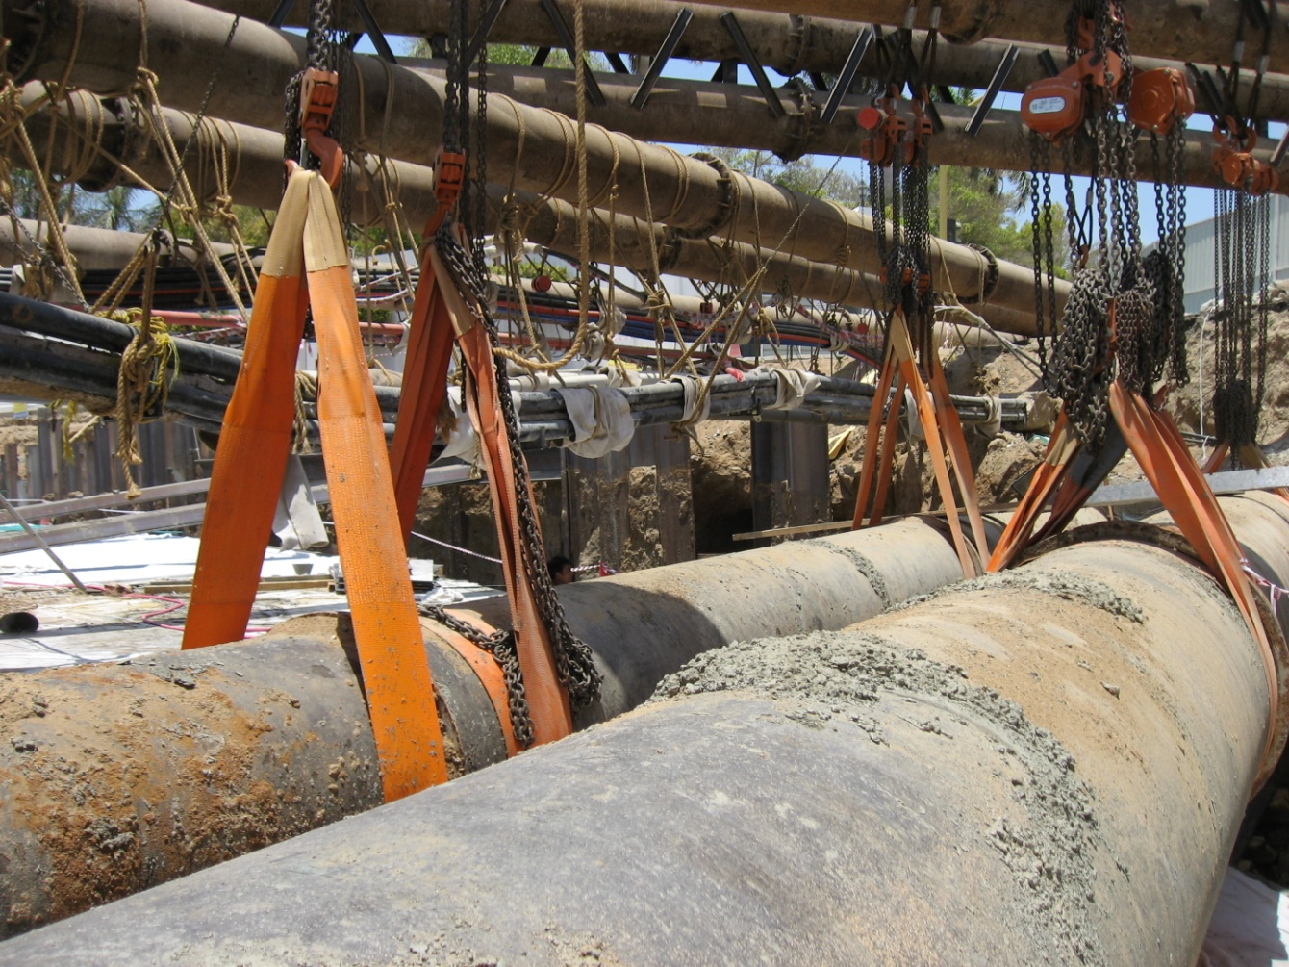
North Channel Utility Crossing
The results
Notes:
Close up of culvert photo
Water, electrical, telcom, all kinds of utilities. All utilities are underground in Jeddah

Slide 31
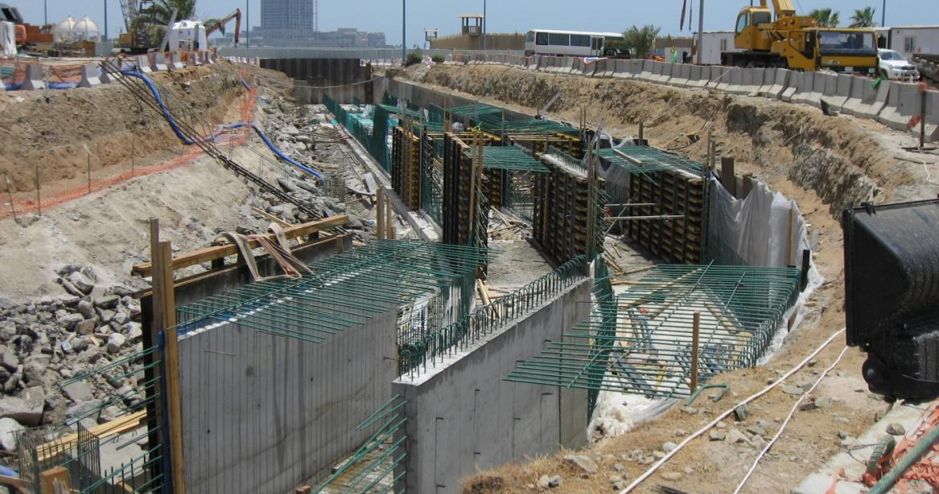
North Channel
The results

Slide 32
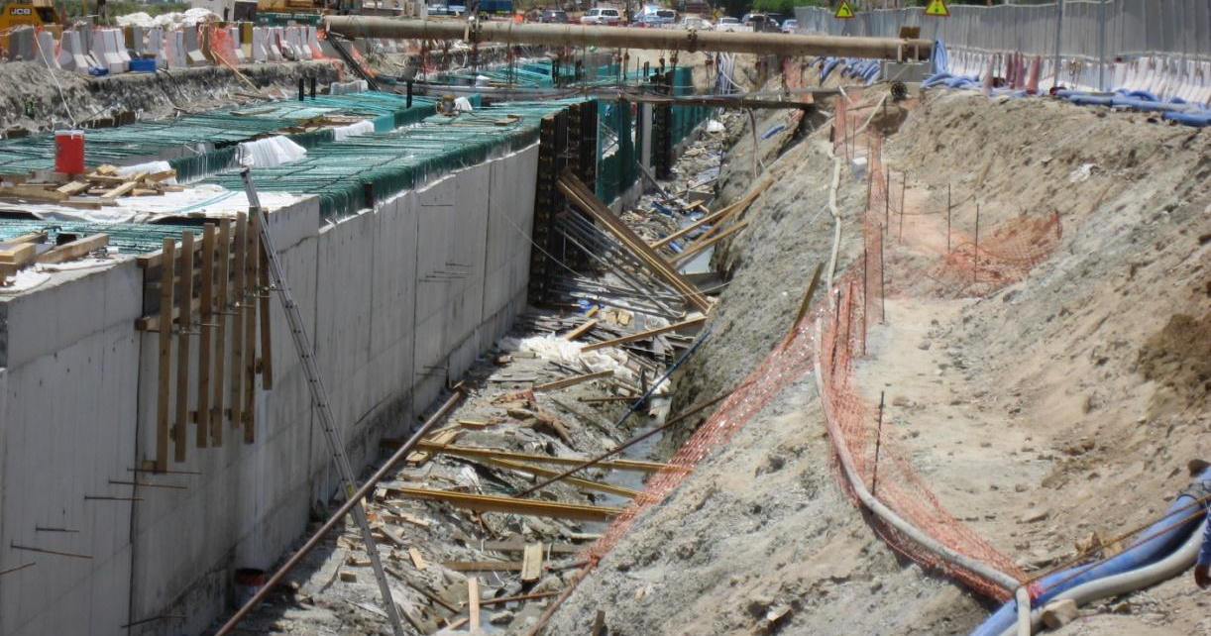
North Channel
The results

Slide 33
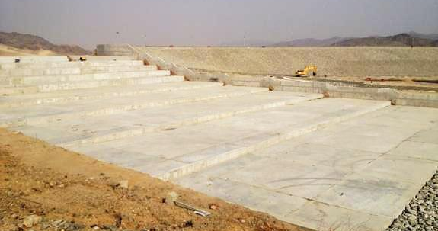
Ghaia Dam
The results
Notes:
One of five new additional dams construction
Further east at the foothills of the mountains
Outfall structure-controlled outlet
15-18 meters tall
Spillway is a used for excess/emergencies for probably maximum flood.
We did all the h&h analysis, collected rainfall gauges

Slide 34
Um Hablain Dam
The results
Notes:
Long dam –
All dams are unique, center spillway before outlet that flows by outlet
Normal conditions no water behind the dam

Slide 35
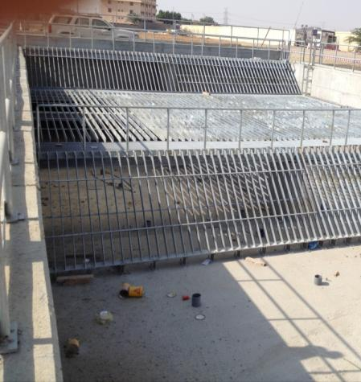
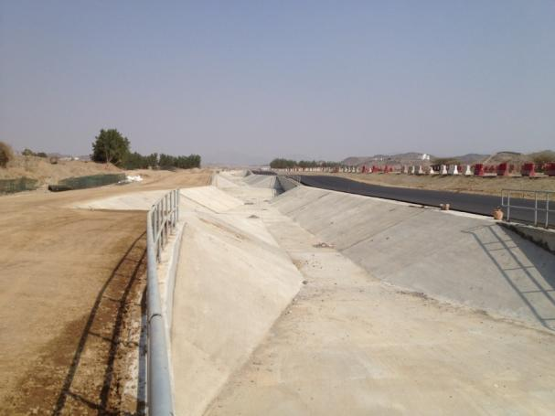
Dam Outlet Channels
The results
Notes:
Right – grates is the entrance into ministry of defense property on the way to the east channel
Channel – conveys the flows from the dams to primarily eastern channel

Slide 36
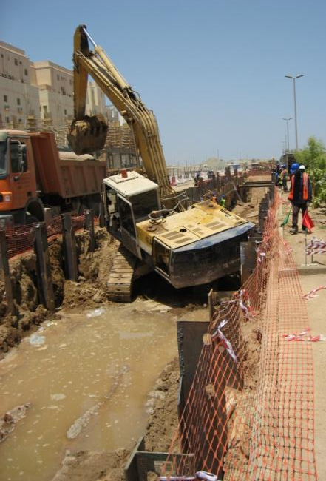
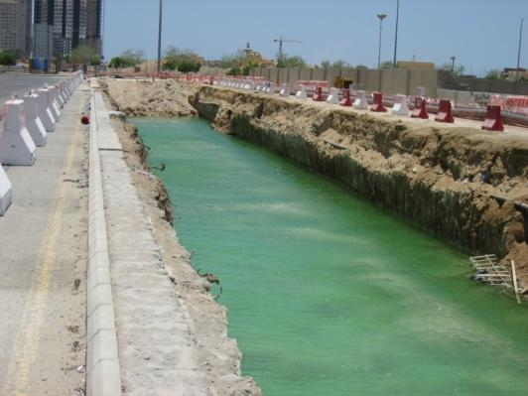
Airport Outfall
The results
Notes:
Left: Airport outfall is 3.5 meters in diameter – 8 meter trench
Angled junction box for the outfalls
Fiberglass reinforced pipe, fabric use to control (?)
Right: red water in trench so dewatering issues

Slide 37
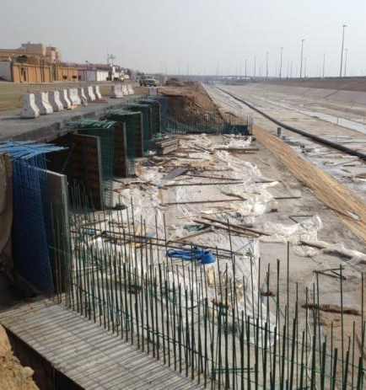
East Channel
The results
Notes:
6 or 8 meters at top end, bottom is paved and 50 – 70 meters at the end of the line
Largest channel
Right side – Ghia outlet into the eastern channel, all big box culvert
3 x 3 box culverts
¼ inch rain, nothing significant

Slide 38
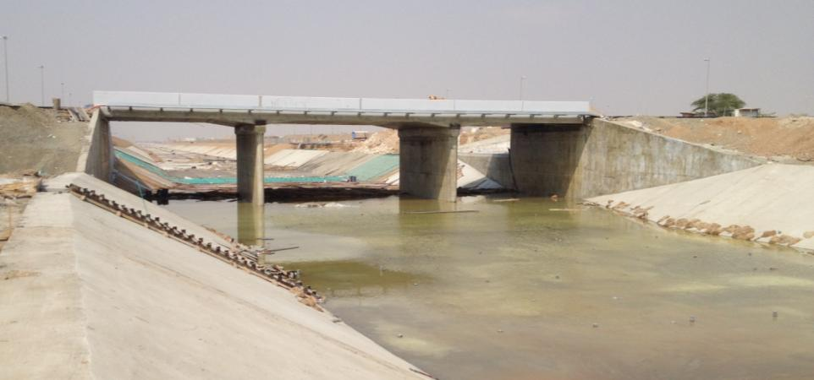
East Channel Bridge
The results
Notes:
Replaced 14 crossing with bridges – 5 – 7 meters tall

Slide 39
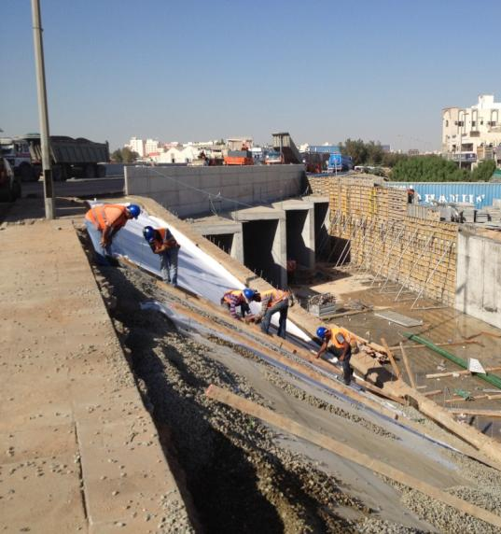
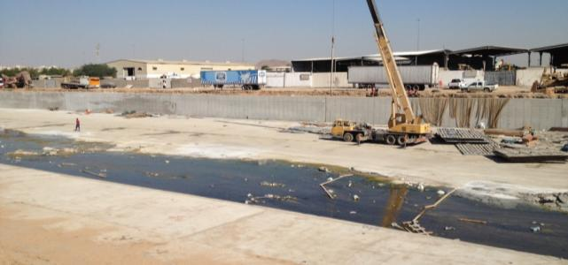
South Channel
The results
Notes:
All but 1 road crossings are box culverts, show in left image
Open channel except by roads
Right side – water lines and had
1 bridge replacement in old mecca and raised to accommodate 100 year flow
to put in 4 meter walls to protect. Urban and industrial area – lots of constraints.

Slide 40
What are the biggest challenges you have faced? What strategies did you use to overcome them?

Slide 41
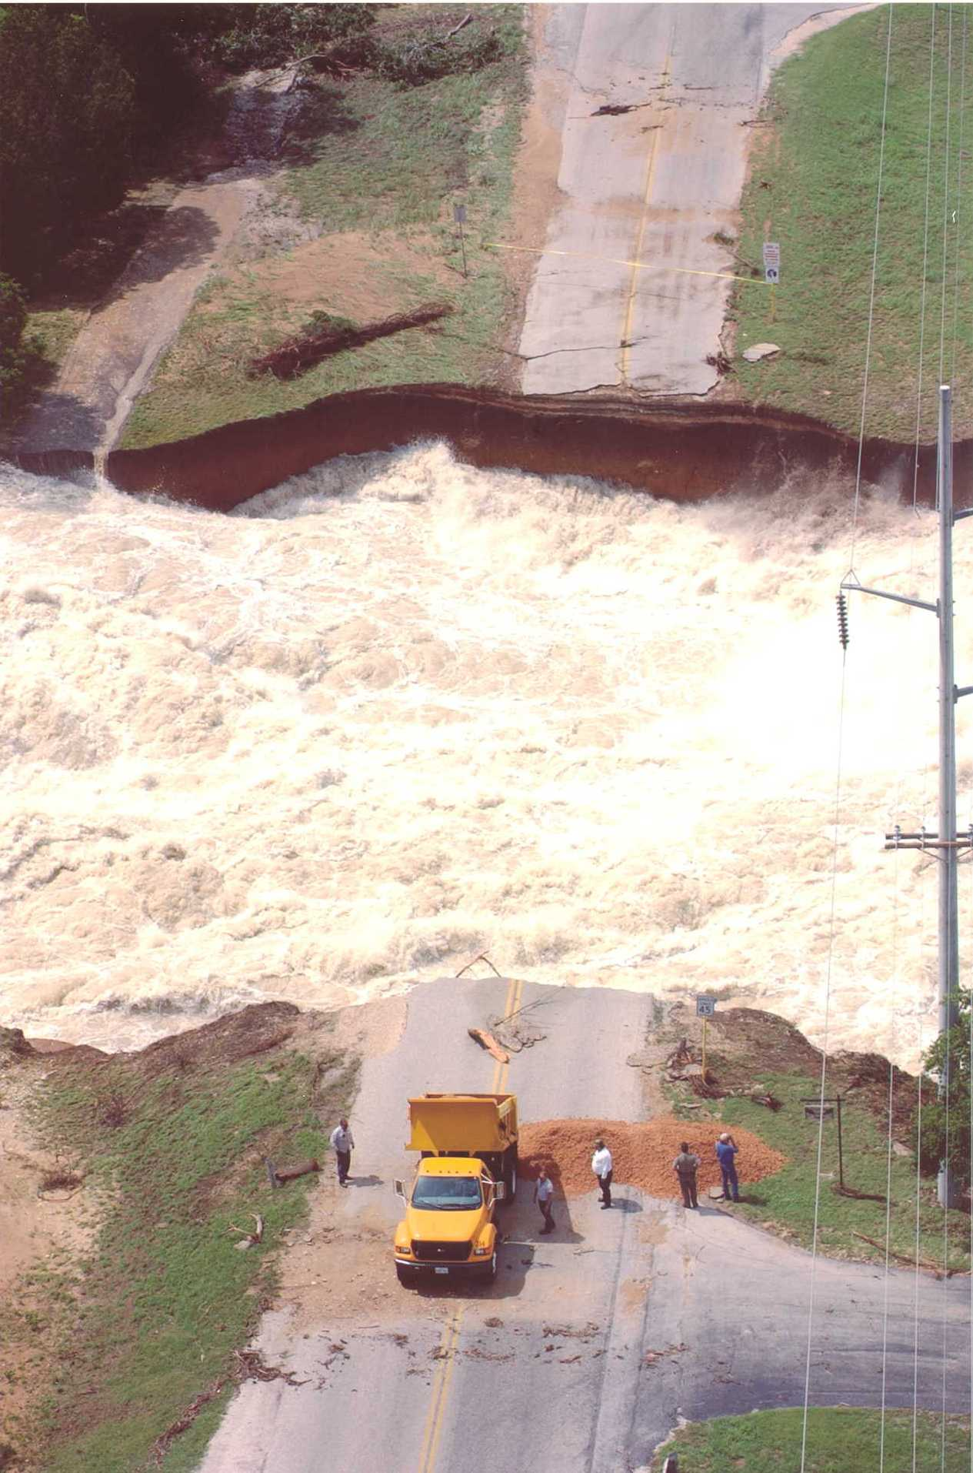
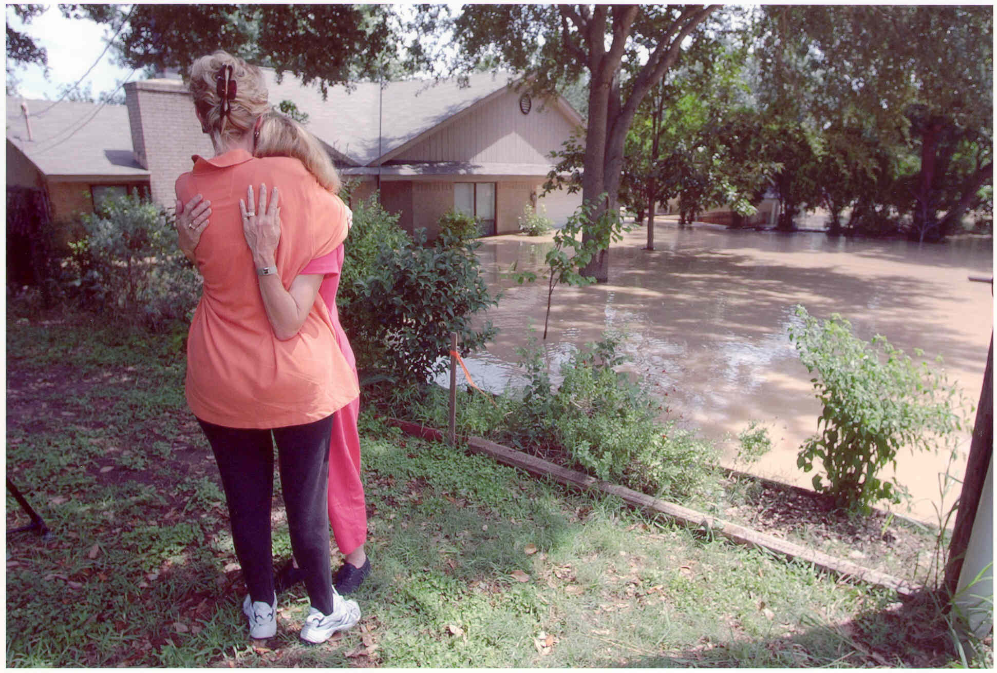
Protection of Life of Property
Financial decisions drive many actions
Need to remain firm on ethics and character

Slide 42
Clarifying Confusing Standards for Public

Slide 43
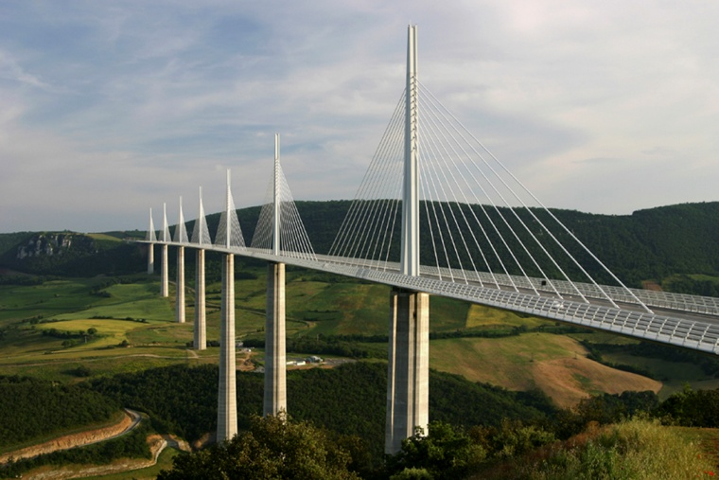
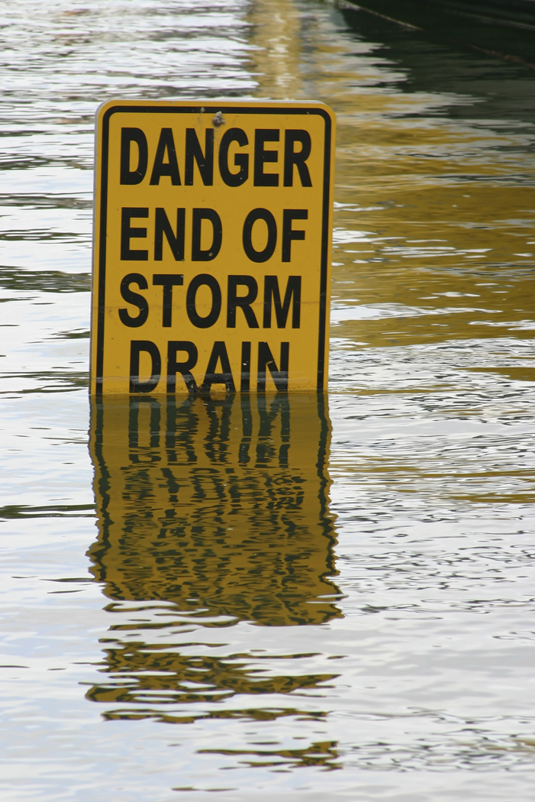
We have confused the public with different definitions
Bridge Standard
AN ABSOLUTE
Flood Plain Elevation
AN AVERAGE

Slide 44
We need to inform the public on the underlying assumptions
All structures operate correctly and will not fail
Structures will not be obstructed with debris
Only existing conditions are considered
Degree of uncertainty of the science

Slide 45
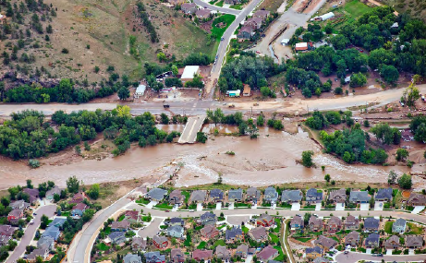
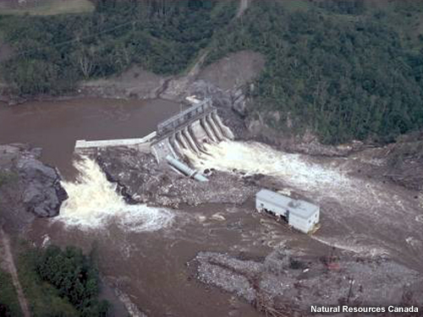
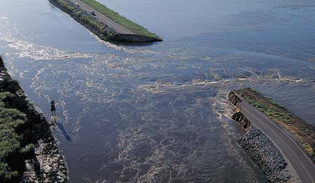
Assumption: Structures will operate properly and will not fail

Slide 46
Assumption: Structures will not be blocked with debris

Slide 47
Assumption: Only existing conditions are reflected on the maps

Slide 48
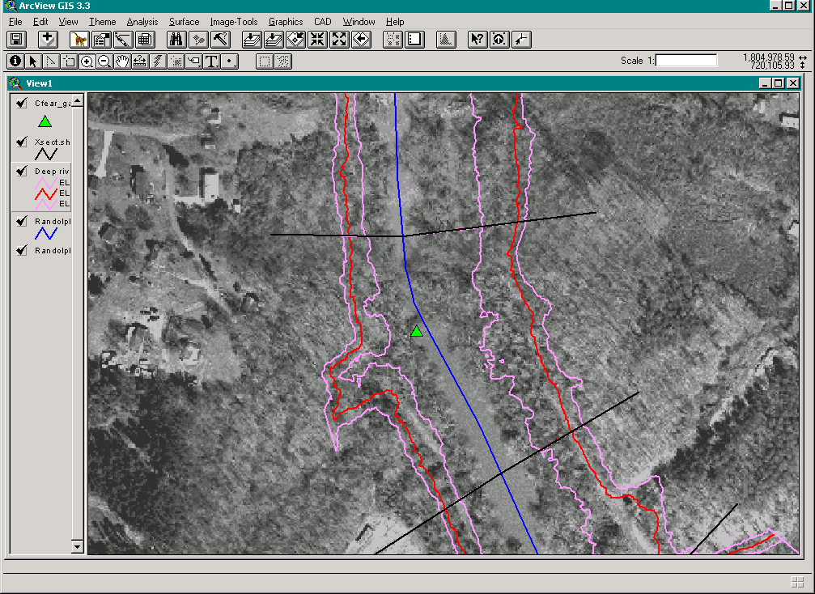
Assumption: The average flood will occur
Regression Estimate Upper & Lower Prediction Limits Water Surface
Average 1% Flood
Notes:
Could be 5 ft vertically higher or 7 ft vertically lower

Slide 49
Statistics are used to predict the future

Slide 50
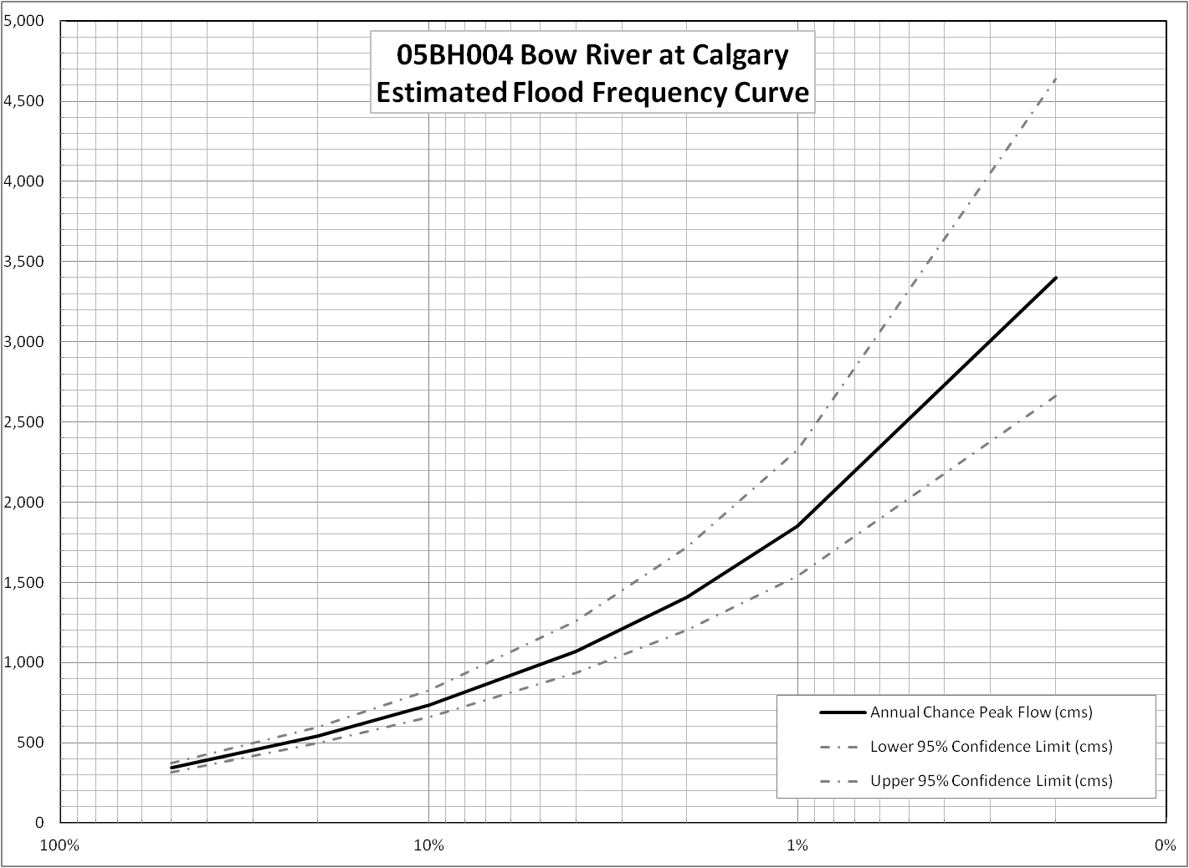
Statistics use confidence limits to show range of likely results

Slide 51
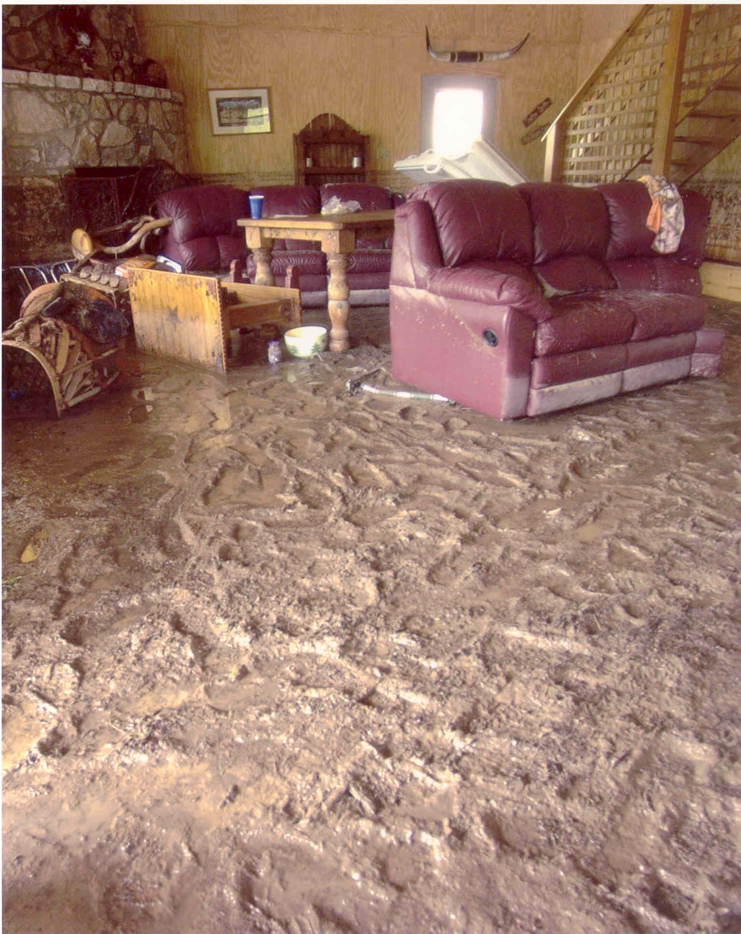
People generally do not associate mud and debris with flooding

Slide 52
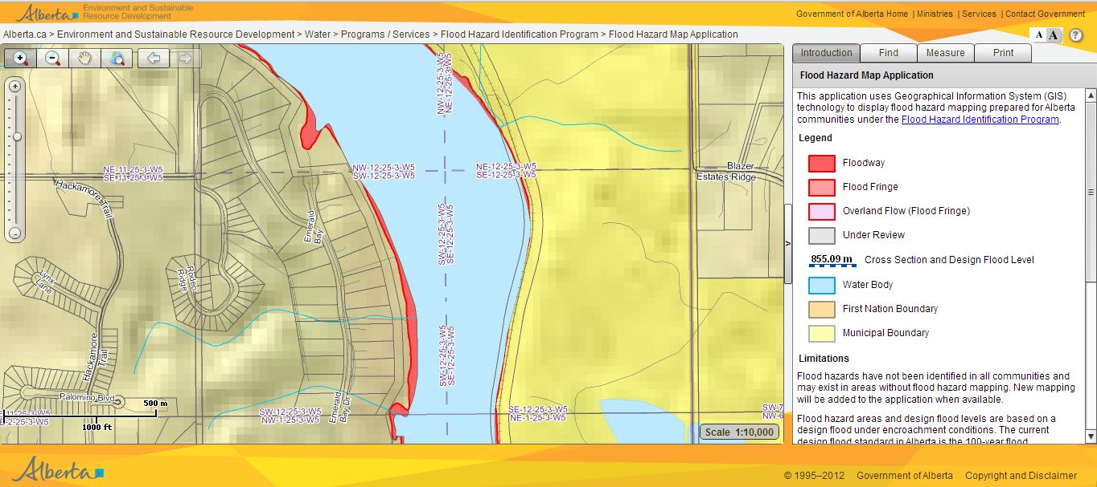
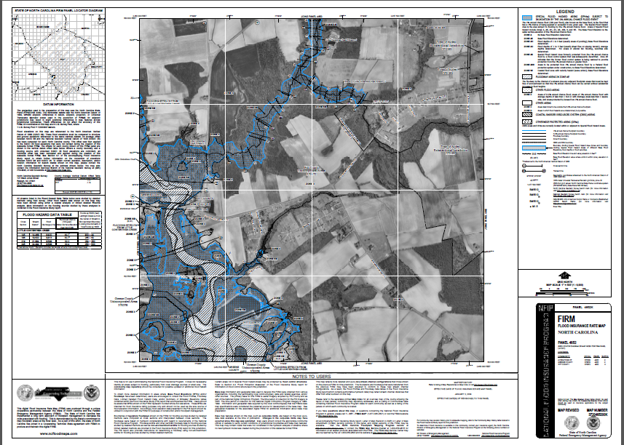
How effective are we today in communicating flood?

Slide 53
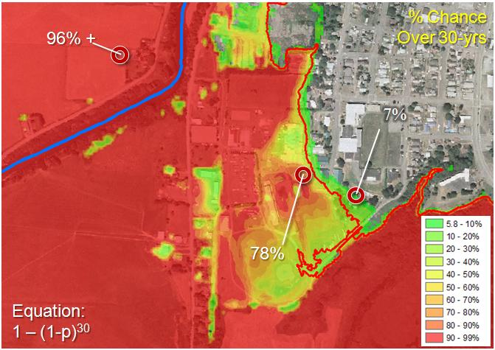
Can products be improved to help guide behavior?
Notes:
The 1% or 100-year has a 26% chance of occurring in a 30 year mortgage
The 2% of 50-year has a 45% chance of occurring
The 10% or 10-year floodplain has a 96% chance of occurring

Slide 54
To what extent does climate change affect AECOM’s approach to hydraulic design?

Slide 55
Why are natural disasters striking with greater impact and more frequently in every corner of the world?
Population growth
Climate change

Slide 56
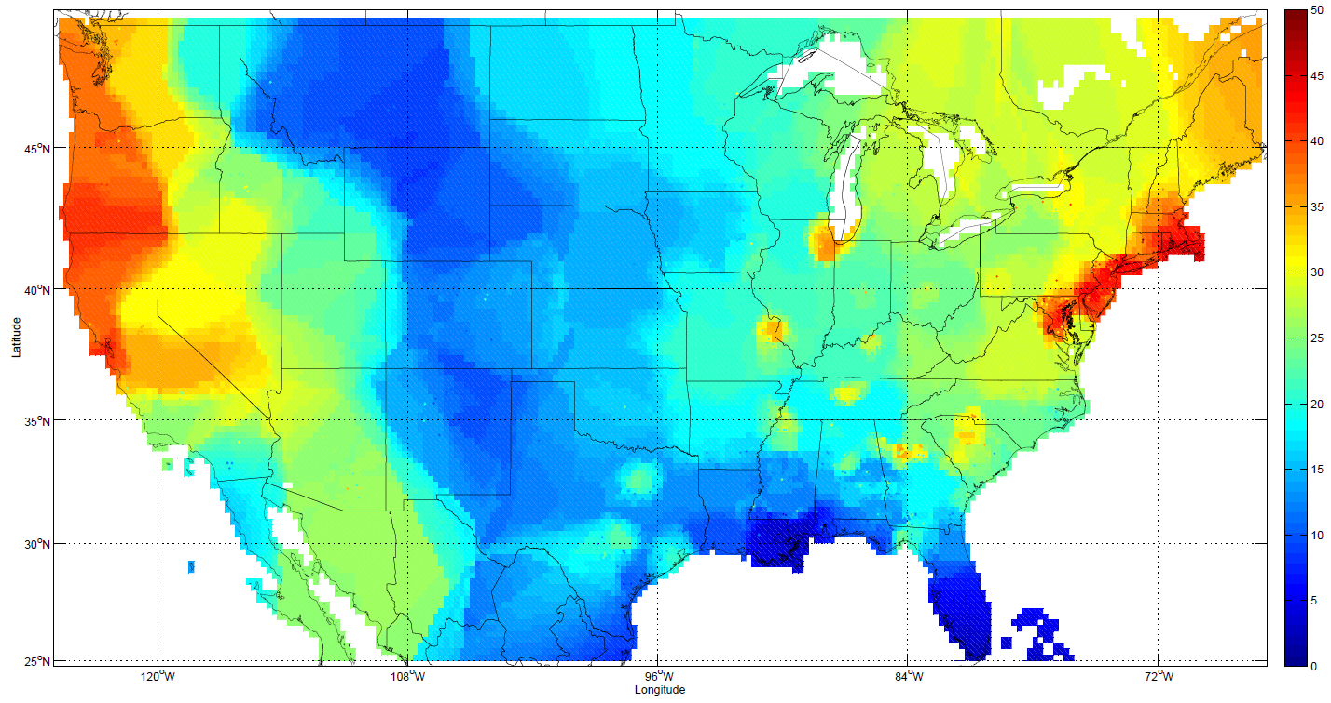
FEMA / AECOM National Climate Change Report
Released by Whitehouse
June 2013
Example Change: Q100
Significant Technical Findings:
By Year 2100 riverine floodplains will double in size,
Coastal areas will double in size
Significant Financial Findings In today’s dollars:
Average loss cost per policy will increase by approximately 90%
Individual premiums will increase 10% to 40%

Slide 57
How do you see Low Impact Development technologies being applied in urban areas around the world?
How is water going to affect terrorism, war and US National Security?
Could water be used as a trading resource between countries?

Slide 58
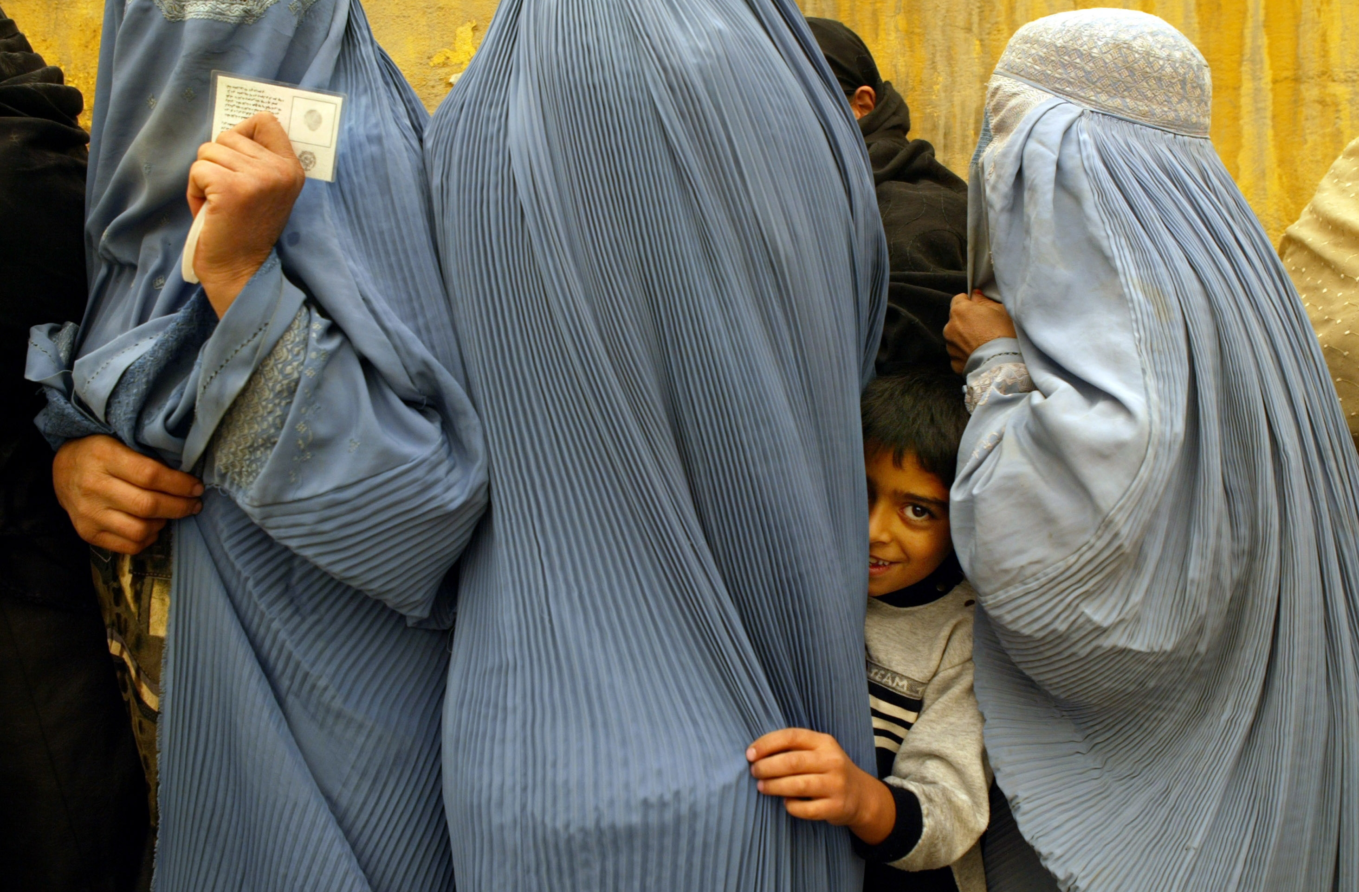
International Development
Afghanistan. Women wait in line to vote.

Slide 59
International Development
Burundi. Youth vocational training.

Slide 60
International Development
India. Delivering reliable water services to communities.

Slide 61
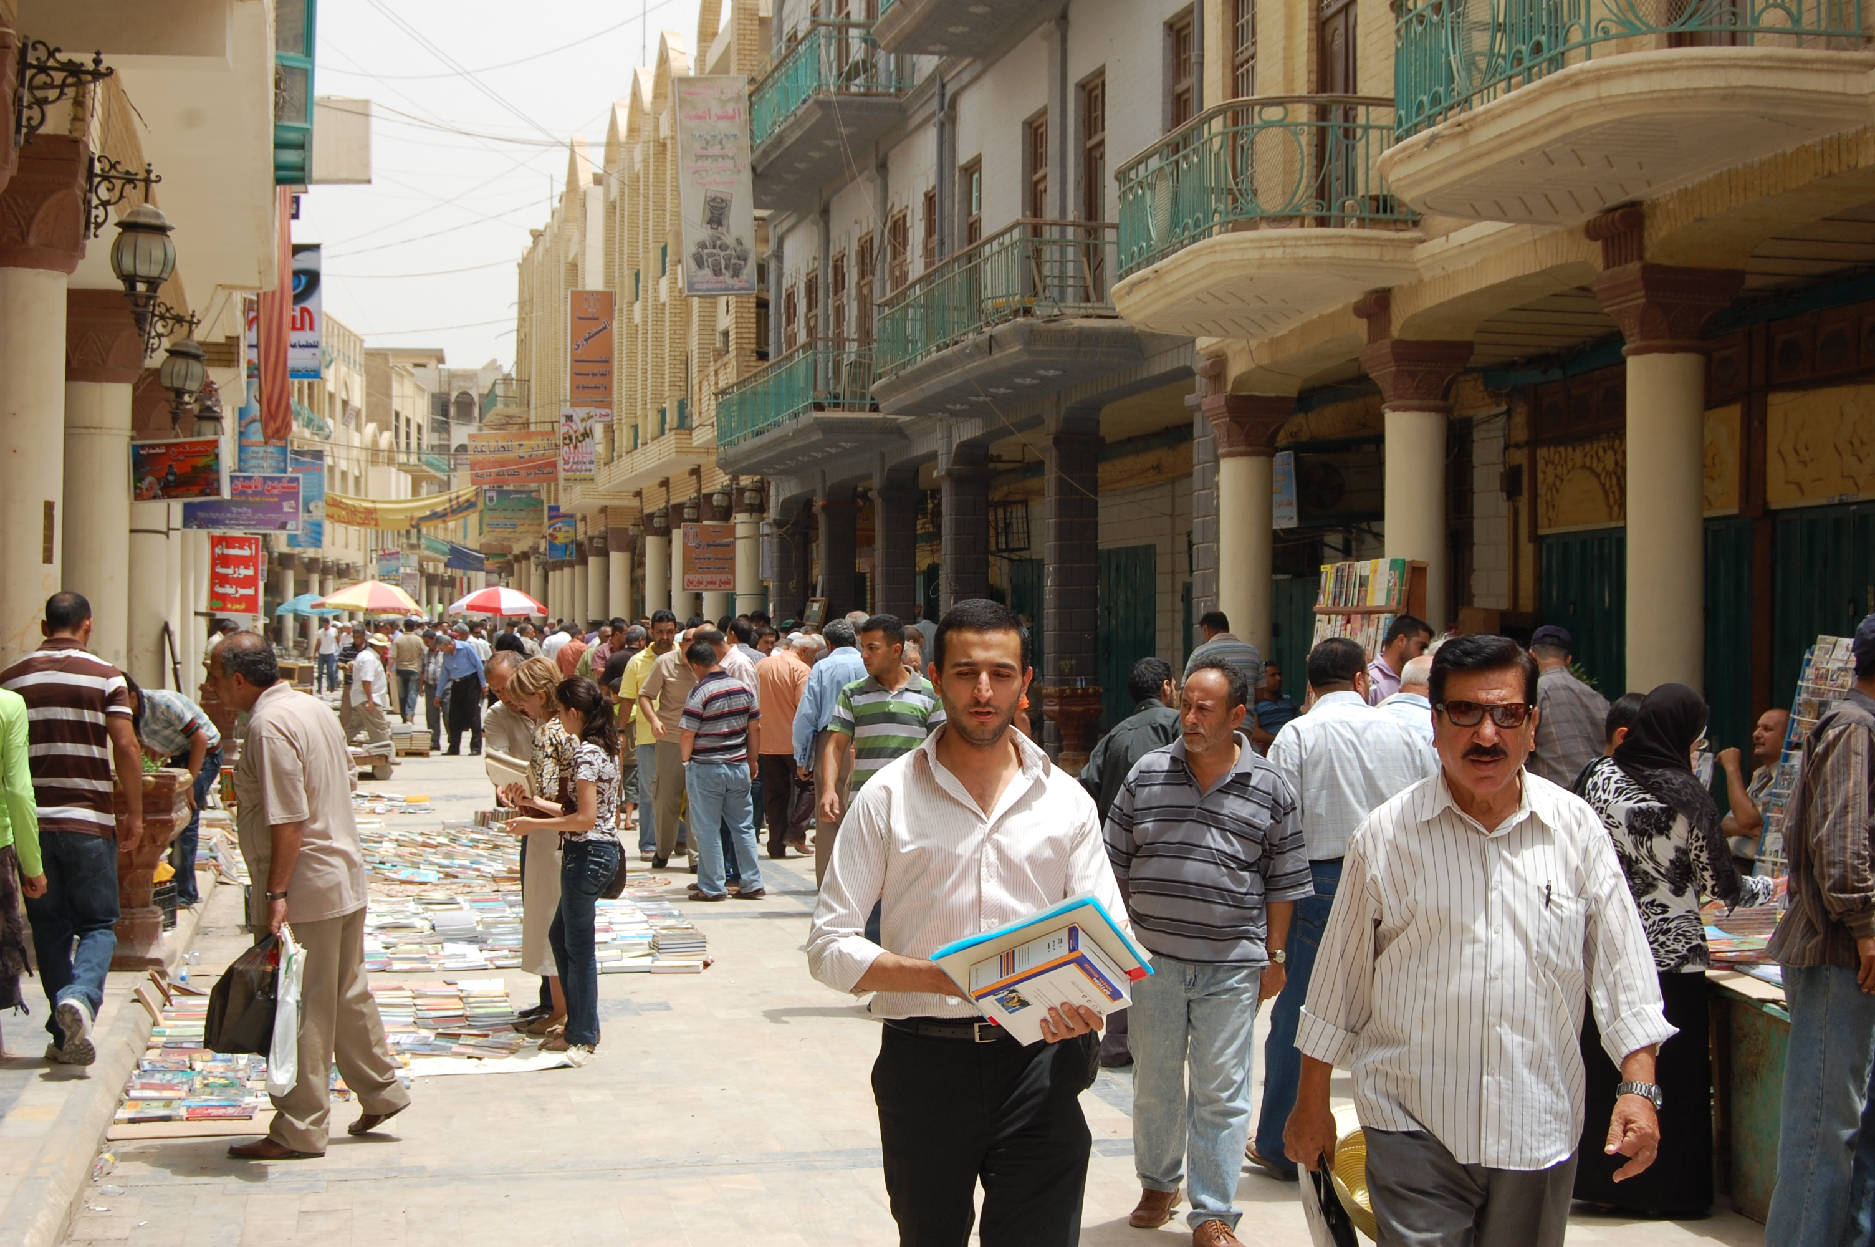
International Development
Iraq. Book market in Baghdad.

Slide 62
International Development
Afghanistan. Livestock trading in Badakhshan.

Slide 63
Origins of the Development Business
Bretton Woods Conference – World Bank, IMF 1944
The African
Development
Bank
1964
Asian Development Bank
1966
United Nations Development Program
1965
Inter-American Development Bank
1959
European Union ACP
1973
4

Slide 64
Structure of the Development Business
Government
of Zambia

Slide 65
Case Study 1: Afghanistan
Stability in Key Conflict Areas (SIKA)
18 months with 18 month option period, $357 M
Southern, Eastern and Western Afghanistan
800 staff
Objective: Supporting the Afghan government by implementing community-led initiatives to build confidence, stability and the provision of basic services.
Success Factor: To help stabilize key areas in Afghanistan as the US military withdrawals.

Slide 66
Personal Security Detail (PSD) with B-6 armored vehicles.

Slide 67
International Development
Sri Lanka. A woman benefits from increased access to piped water.

Slide 68
Are we going to see wastewater to drinking water systems and reuse of gray-water?
How competitive is water resources in business and jobs?

Slide 69
How does your approach to projects vary internationally versus United States?

Slide 70
United Nations The vision of the post-2015 development agenda is to reduce loss of life and economic impact from natural disasters.
And the ultimate goal is to build resilient communities that will mitigate those impacts.
Notes:
Mumbai
Old second sentence:
And the ultimate goal is to build resilient communities that will, by their very nature, mitigate those impacts.

Slide 71
Risk communication and mitigation
ITU 2.27.13 news release
“ICT Facts and Figures report predicts that there will soon be as many mobile-cellular subscriptions as people inhabiting the planet, with the figure set to nudge past the seven billion mark early in 2014.”
Notes:
Third world countries with cell phones
Several flood projects from the jeddah slide show
INTERESTING
http://www.itu.int/en/Pages/default.aspx
Newsroom • Press Release
Share
ITU releases latest global technology development figures
Global mobile penetration now over 100% in four of the world’s six regions
Number of mobile-cellular subscriptions approaching 7 billion
Mobile broadband most dynamic market, with 2.1 billion subscriptions globally
Geneva, 27 February, 2013 – New figures released today by ITU confirm strong sustained demand for information and communication technology (ICT) services, with uptake spurred by a steady fall in the price of broadband Internet.
ITU’s The World in 2013: ICT Facts and Figures report predicts that there will soon be as many mobile-cellular subscriptions as people inhabiting the planet, with the figure set to nudge past the seven billion mark early in 2014. More than half of all mobile subscriptions are now in Asia, which remains the powerhouse of market growth, and by the end of 2013 overall mobile penetration rates will have reached 96% globally, 128% in the developed world, and 89% in developing countries.
With many markets saturated, and penetration at over 100% in four of the six ITU world regions, mobile-cellular uptake is already slowing substantially, with growth rates falling to their lowest levels ever in both the developed and developing worlds.

Slide 72
How has the practice of hydraulic engineering changed over your career?

Slide 73
Fundamentals Have Not Changed
Conservation of Mass /Energy
Matter cannot be created or destroyed
Conservation of Momentum
Newton’s Mass x Velocity

Slide 74
Risk Assessment
Relies heavily on historical data, GIS technology, and probabilistic risk modeling
Better local data = better risk assessments
Better risk assessments do not necessarily lead to higher quality mitigation plans
Have often been the most overemphasized phase of the planning process

Slide 75
HAZUS quantifies the disaster
 | Short Term Shelter | Substantial Damage | Essential Facility Loss of Use | Debris Generated | Truckloads Required to Remove | Economic Loss
Ottawa | 2,695 | 104 | 0 | 46,514 | 1,861 | 180.0M
Rogers | 5,194 | 310 | 0 | 64,385 | 2,575 | 256.2M
Muskogee | 2,023 | 69 | 4 | 26,456 | 1,058 | 111.8M
Pittsburg | 825 | 113 | 0 | 30,235 | 1,209 | 117.6M
Carter | 949 | 23 | 0 | 14.939 | 597 | 71.5M
Logan | 857 | 79 | 2 | 21,461 | 858 | 102.2M

Slide 76
Predicting the risk of flood in financial terms

Slide 77
HAZUS: Based on best data

Slide 78
Risk Assessment: Assessing Vulnerability

Slide 79
Risk Assessment: Assessing Vulnerability
Estimated Potential Losses to Flood Hazards
Return Interval | Capital Stock Losses |  |  | Business Interruption Losses |  |  |  | Total Loss
 | Total Building Damage | Total Contents Damage | Inventory Loss | Relocation Loss | Capital Related Loss | Wage Losses | Rental Income Loss
10-Year | $35,002,000 | $44,332,000 | $1,969,000 | $226,000 | $228,000 | $1,148,000 | $65,000 | $82,970,000
50-Year | $47,887,000 | $60,430,000 | $2,430,000 | $316,000 | $321,000 | $1,255,000 | $100,000 | $112,739,000
100-Year | $56,112,000 | $73,797,000 | $3,309,000 | $390,000 | $542,000 | $1,501,000 | $147,000 | $135,798,000
500-Year | $66,630,000 | $88,974,000 | $3,956,000 | $445,000 | $606,000 | $1,861,000 | $174,000 | $162,646,000
Additional Impacts Caused by Flood Hazards
Return Interval | Debris Generated (tons) | Displaced Households | Temporary Shelter Needs
10-Year | 10,821 | 2,407 | 5,124
50-Year | 14,446 | 3,066 | 6,860
100-Year | 15,368 | 3,164 | 7,194
500-Year | 17,539 | 3,534 | 8,200

Slide 80
Risk Assessment: Assessing Vulnerability

Slide 81
Risk Assessment: Summary Conclusions
Table 6.21 Summary of Results
Hazard | Category/Degree of Risk
 | Probability | Impact | Spatial Extent | Warning Time | Duration | PRI Score
Atmospheric Hazards
Extreme Temperatures | Highly Likely | Minor | Small | More than 24 hours | Less than one week | 2.3
Extreme Wind | Highly Likely | Critical | Large | More than 24 hours | Less than 24 hours | 3.2
Hurricane & Tropical Storm | Likely | Catastrophic | Large | More than 24 hours | Less than 24 hours | 3.2
Lightning | Highly Likely | Minor | Negligible | Less than 6 hours | Less than 6 hours | 2.2
Nor’easter | Highly Likely | Catastrophic | Large | More than 24 hours | Less than one week | 3.6
Tornado | Likely | Limited | Small | Less than 6 hours | Less than 6 hours | 2.4
Winter Storm | Highly Likely | Limited | Large | More than 24 hours | Less than one week | 3.0
Hydrologic Hazards
Coastal Erosion | Highly Likely | Limited | Moderate | More than 24 hours | More than one week | 2.9
Dam Failure | Unlikely | Critical | Small | Less than 6 hours | Less than 6 hours | 2.1
Drought | Possible | Limited | Moderate | More than 24 hours | More than one week | 2.3
Flood | Highly Likely | Critical | Moderate | 6 to 12 hours | More than one week | 3.4
Storm Surge | Possible | Critical | Moderate | More than 24 hours | Less than 24 hours | 2.4
Wave Action | Highly Likely | Limited | Moderate | More than 24 hours | More than one week | 2.9
Geologic Hazards
Earthquake | Unlikely | Minor | Small | Less than 6 hours | Less than 6 hours | 1.5
Landslide | Likely | Critical | Small | Less than 6 hours | Less than 6 hours | 2.7
Other Natural Hazards
Wildfire | Highly Likely | Minor | Moderate | Less than 6 hours | Less than one week | 2.8

Slide 82
Risk Assessment: Summary Conclusions

Slide 83
Risk Assessment: Summary Conclusions
Table 5.22 Conclusions on Hazard Risk
HIGH RISK | Nor’easter Flood Extreme Wind Hurricane and Tropical Storm Winter Storm
MODERATE RISK | Coastal Erosion Wave Action Wildfire Landslide Storm Surge Tornado
LOW RISK | Drought Extreme Temperatures Lightning Dam Failure Earthquake

Slide 84
Transparent and uniform method of comparing projects

Slide 85
Transparent uniform method to rank projects
Uniform Cost Estimate
Pre-construction costs
Construction costs
Ancillary costs (permits, A&E fees …)
Annual maintenance costs
Time value of money
Benefits
Avoided damages and losses
Avoided causalities
Avoided emergency management costs

Slide 86
Transparency in Decisions Triple Bottom Line Tool

Slide 87
The Triple Bottom Line (TBL)

Slide 88
TBL Evaluation Criteria
Financial (LCA)
Capital Costs
Operations and Other* Costs
Environmental
Climate
Habitat
Water Use
Water Quality
Air Quality
Natural Resource Inputs
Social
System Resilience
Ratepayer Affordability
Bicycle and Pedestrian Environment
Odor
Noise
Recreation / Open Space
Employment
Cultural Resources
Construction Impacts
* Includes Operations & Maintenance, Replacement & Renewal, Decommissioning, and Avoided Costs

Slide 89
LCA Components
Operations and maintenance
Sale of bio-fuel energy
Avoided water treatment
Avoided combined sewer discharge
Replacement and renewal
Decommissioning
Design and planning
Capital equipment
Installation and construction
Avoided cost
Operating cost
Capital cost

Slide 90
TBL Model Summary Sheet
E
Doesn’t produce a recommendation or overall score

Slide 91
TBL Model Components Project Alternatives Comparison

Slide 92
As future leaders, protection of life and property is the top priority

