Slide 1
CE 365K Hydraulic Engineering Design
Class 7: Flood Engineering – Local and National
Senator Merkley at 18:00 introduces flood insurance issues
http://www.banking.senate.gov/public/index.cfm?FuseAction=Hearings.LiveStream&Hearing_id=46b52a52-4d45-4c47-8ddc-de2f32cd348e

Slide 2
Profession
A profession is a vocation founded upon specialized educational training, the purpose of which is to supply objective counsel and service to others, for a direct and definite compensation, wholly apart from expectation of other business gain
http://en.wikipedia.org/wiki/Profession

Slide 3
Civil Engineering
Civil engineering is a professional engineering discipline that deals with the design, construction, and maintenance of the physical and naturally built environment, including works like roads, bridges, canals, dams, and buildings. Civil engineering takes place on all levels: in the public sector from municipal through to national governments, and in the private sector from individual homeowners through to international companies.
http://en.wikipedia.org/wiki/Civil_engineering

Slide 4
Hydraulic Engineering
Hydraulic engineering is the application of fluid mechanics principles to problems dealing with the collection, storage, control, transport, regulation, measurement, and use of water
Prasuhn, Alan L. Fundamentals of Hydraulic Engineering. Holt, Rinehart, and Winston: New York, 1987

Slide 5
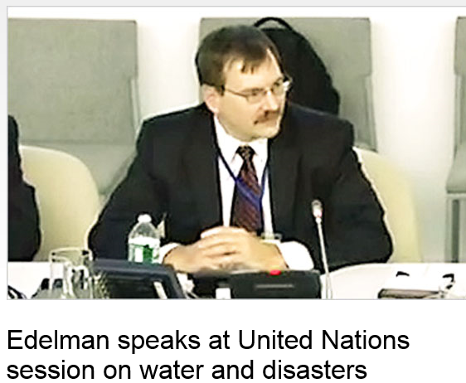
Scott Edelman
Global leader for water resources at AECOM – coming to speak to our CE 365K class on February 18
http://www.aecom.com/News/Where+We+Are/Americas/_news/Edelman+speaks+at+United+Nations+session+on+water+and+disasters

Slide 6

Flood Engineering – a Local Perspective
http://crhphotos.com/2013/10/halloween-2013-flood/

Slide 7
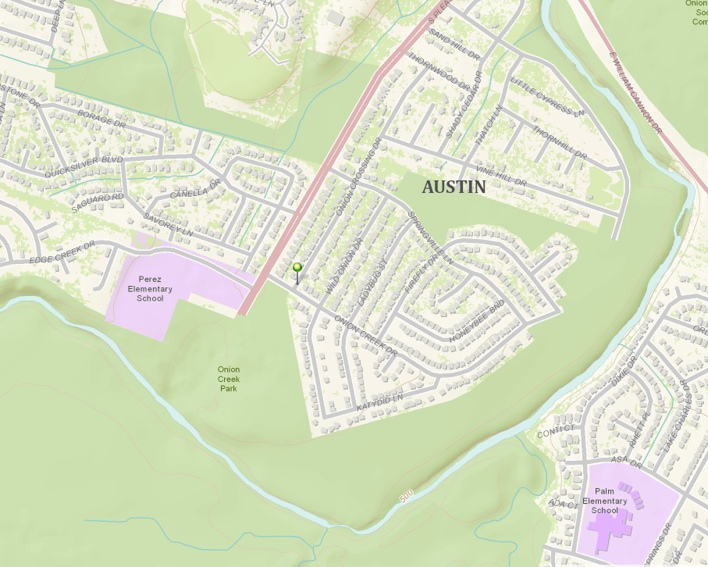
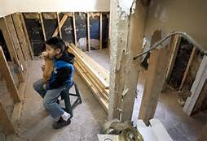
Halloween Flood, Onion Creek
30-31 October 2013
Andres Cerda, 7, with his dog Chica, looks towards his damaged bedroom that is not yet inhabitable as the family works on repairs. Maria Medel and her family lost everything in the Halloween floods as their home at 7408 Onion Crossing was completely destroyed.
Flooded home location
Onion Creek
http://www.statesman.com/photo/news/local/halloween-flood-victims-austin-still-waiting-gas-s/p4Lyg/

Slide 8
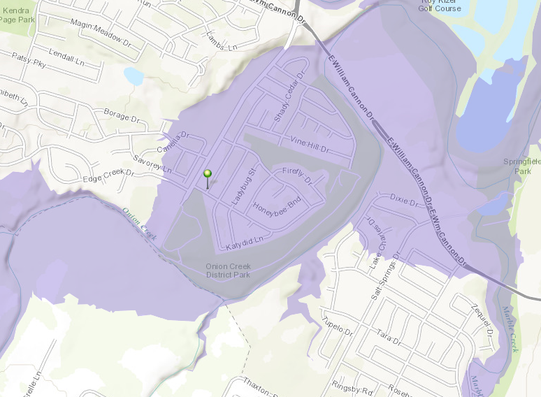
FEMA Flood Hazard Zone

Slide 9
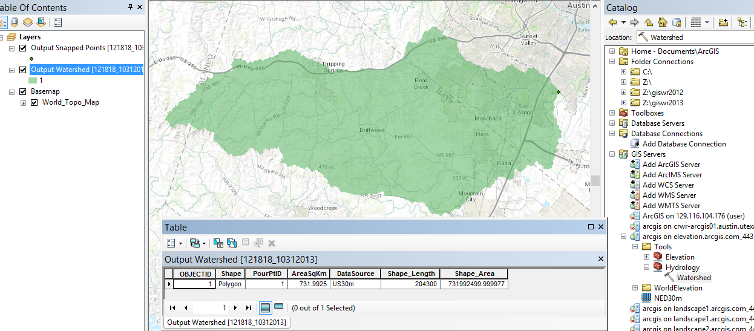
Drainage Area above Home
Drainage area = 732 km², or 282 miles²

Slide 10
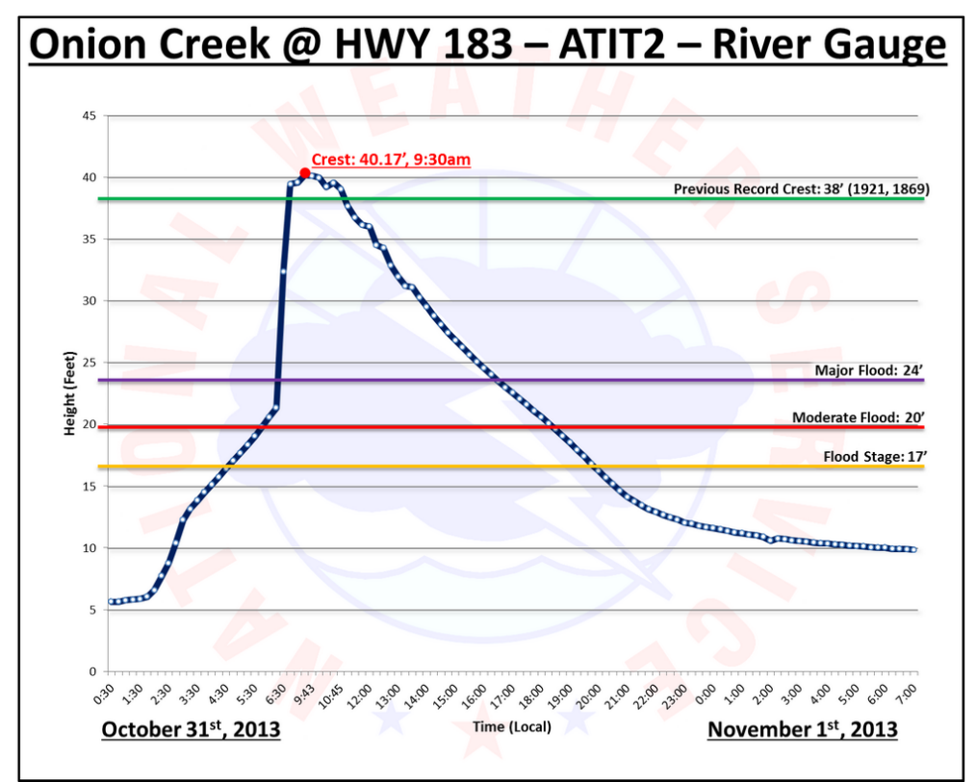
Flood Water Elevations
Halloween Flood on Onion Creek
Expected Hurricane Storm Surge Heights on Gulf Coast

Slide 11
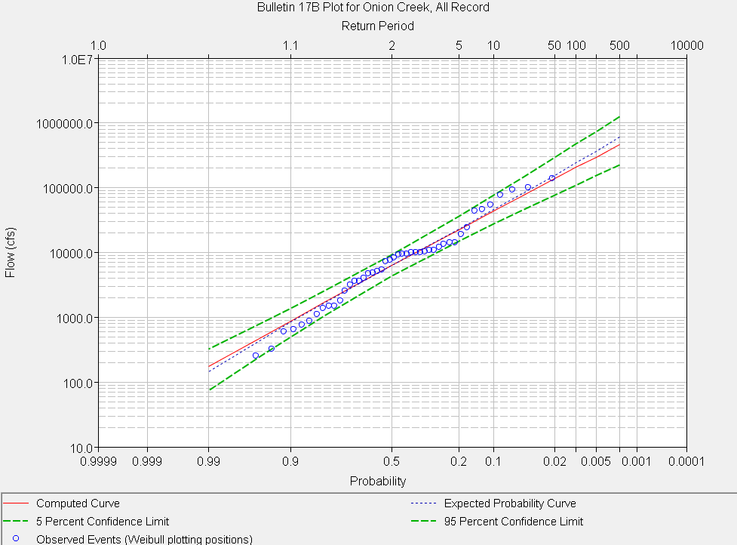
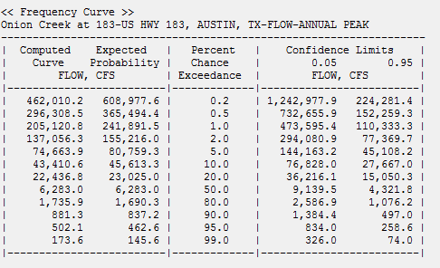
Halloween Flood ~ 120,000 cfs
Somewhere between 20 yr and 100 yr
return period, perhaps 50 yrs
Halloween Flood
HEC-SSP Flood Frequency Analysis
full flood record

Slide 12
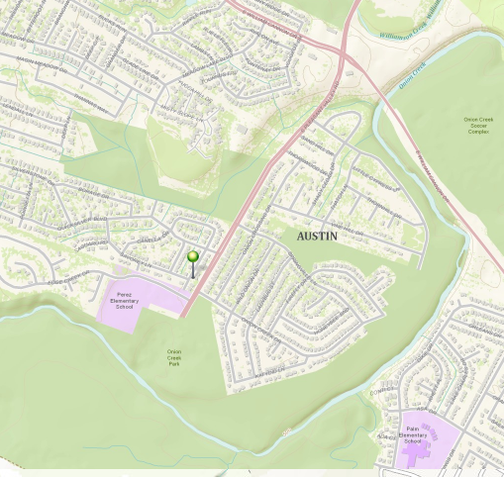
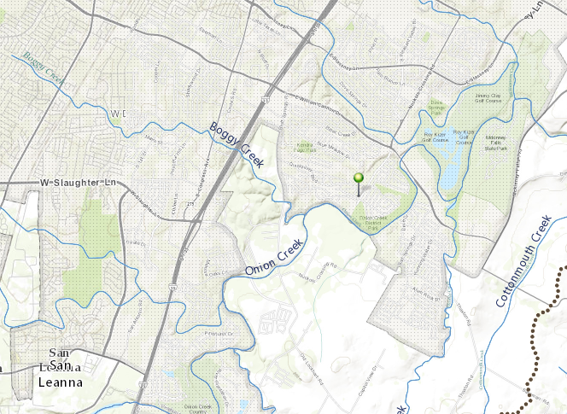
Halloween Flood, Onion Creek
Policy response by the City of Austin – buy out 100 more homes
Number of buyouts already done by the City of Austin in the Onion Creek area – 323 homes
Approximate amount spent on buyouts - $36 million
($8M of this from FEMA grant funding)
A flooded home location
There is a very substantial cost of flood damage to those impacted and to the general community around them

Slide 13
Flood Engineering – A national perspective
National Flood Insurance Program
Begun in 1968
Federal government provides a national flood insurance program
Local communities regulate land development in floodplains
Requires floodplain maps
  Base Flood Elevation for 100 year flood is the key
  Keep building floor elevations above this level
  Keep building out of 100 year inundated area

Slide 14
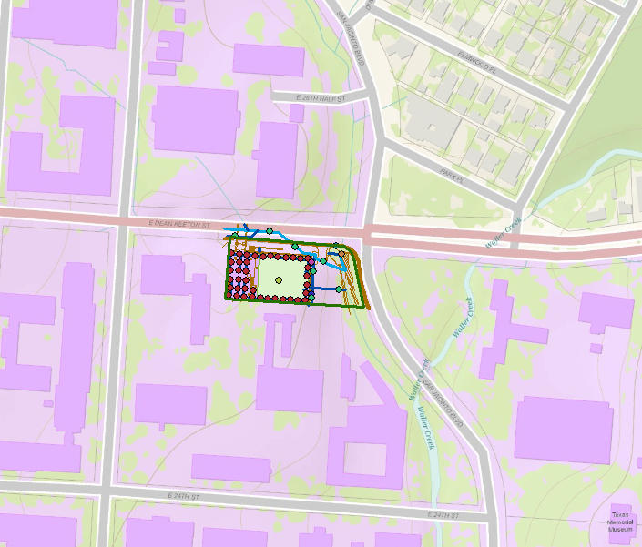
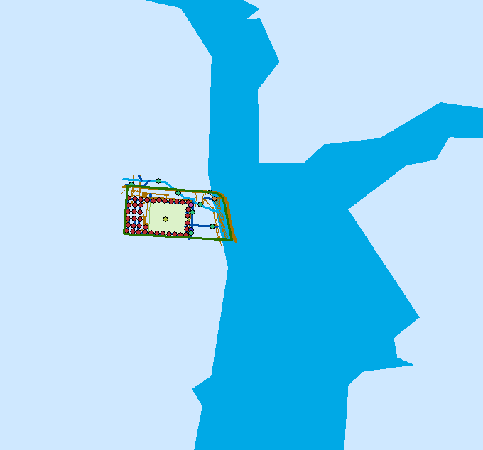
100-year Special Flood Hazard Area (SFHA)
We impact the environment
The environment impacts us

Slide 15
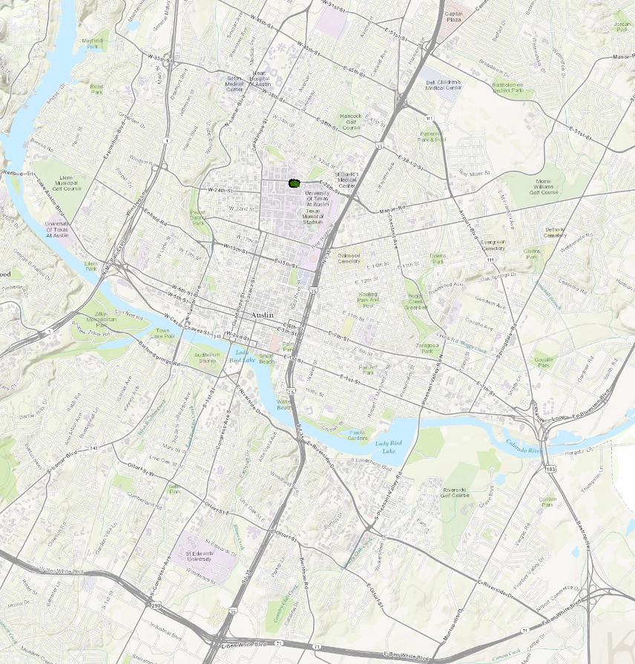
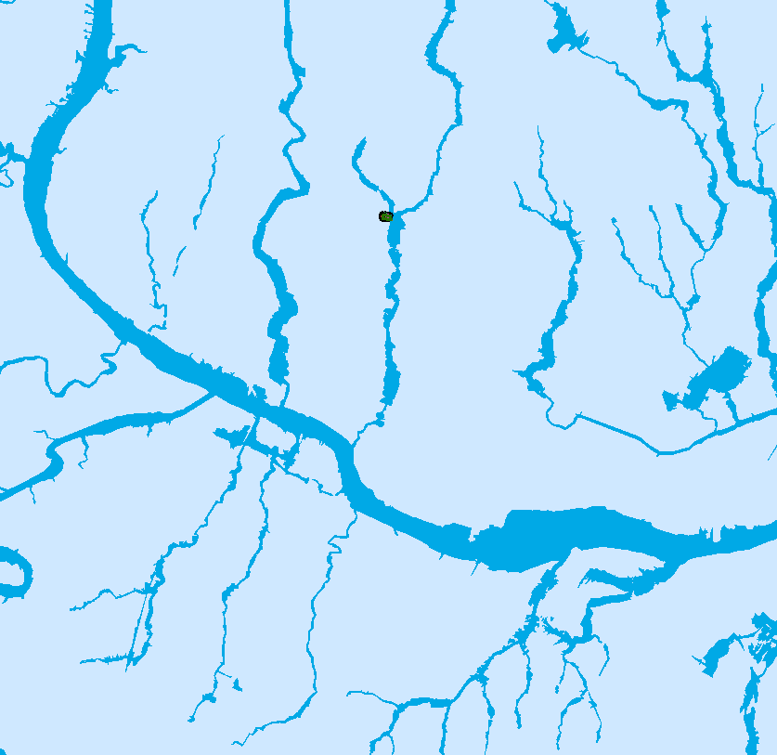
Special Flood Hazard Area for Austin

Slide 16
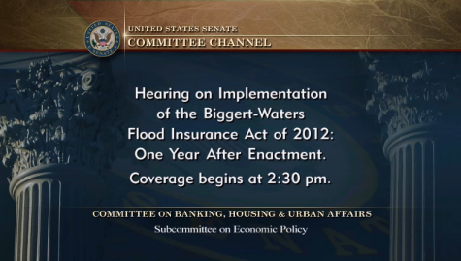
Affordability of Flood Insurance
Senator Merkley at 18:00 introduces flood insurance issues
http://www.banking.senate.gov/public/index.cfm?FuseAction=Hearings.LiveStream&Hearing_id=46b52a52-4d45-4c47-8ddc-de2f32cd348e
September 18, 2013

Slide 17
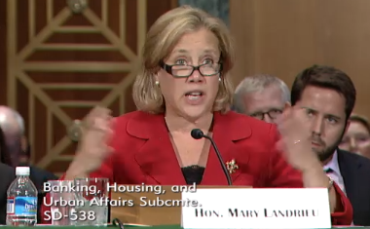
Senator Mary Landrieu
Senator Landrieu at 40:00 talks about impacts in Louisiana and the “affordability study”
http://www.banking.senate.gov/public/index.cfm?FuseAction=Hearings.LiveStream&Hearing_id=46b52a52-4d45-4c47-8ddc-de2f32cd348e

Slide 18
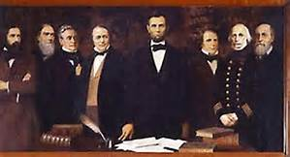

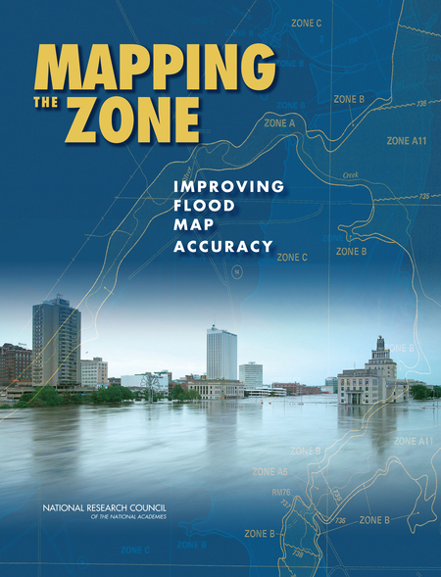
National Academy Reports
National Academy of Sciences chartered by Congress in 1863 to advise the government on matters of science and technology.
Later extended to The National Research Council as the operating arm of the National Academy of Sciences, National Academy of Engineering, and the Institute of Medicine
Produces study reports on matters of national interest
Currently undertaking a study of “affordability of flood insurance”

Slide 19
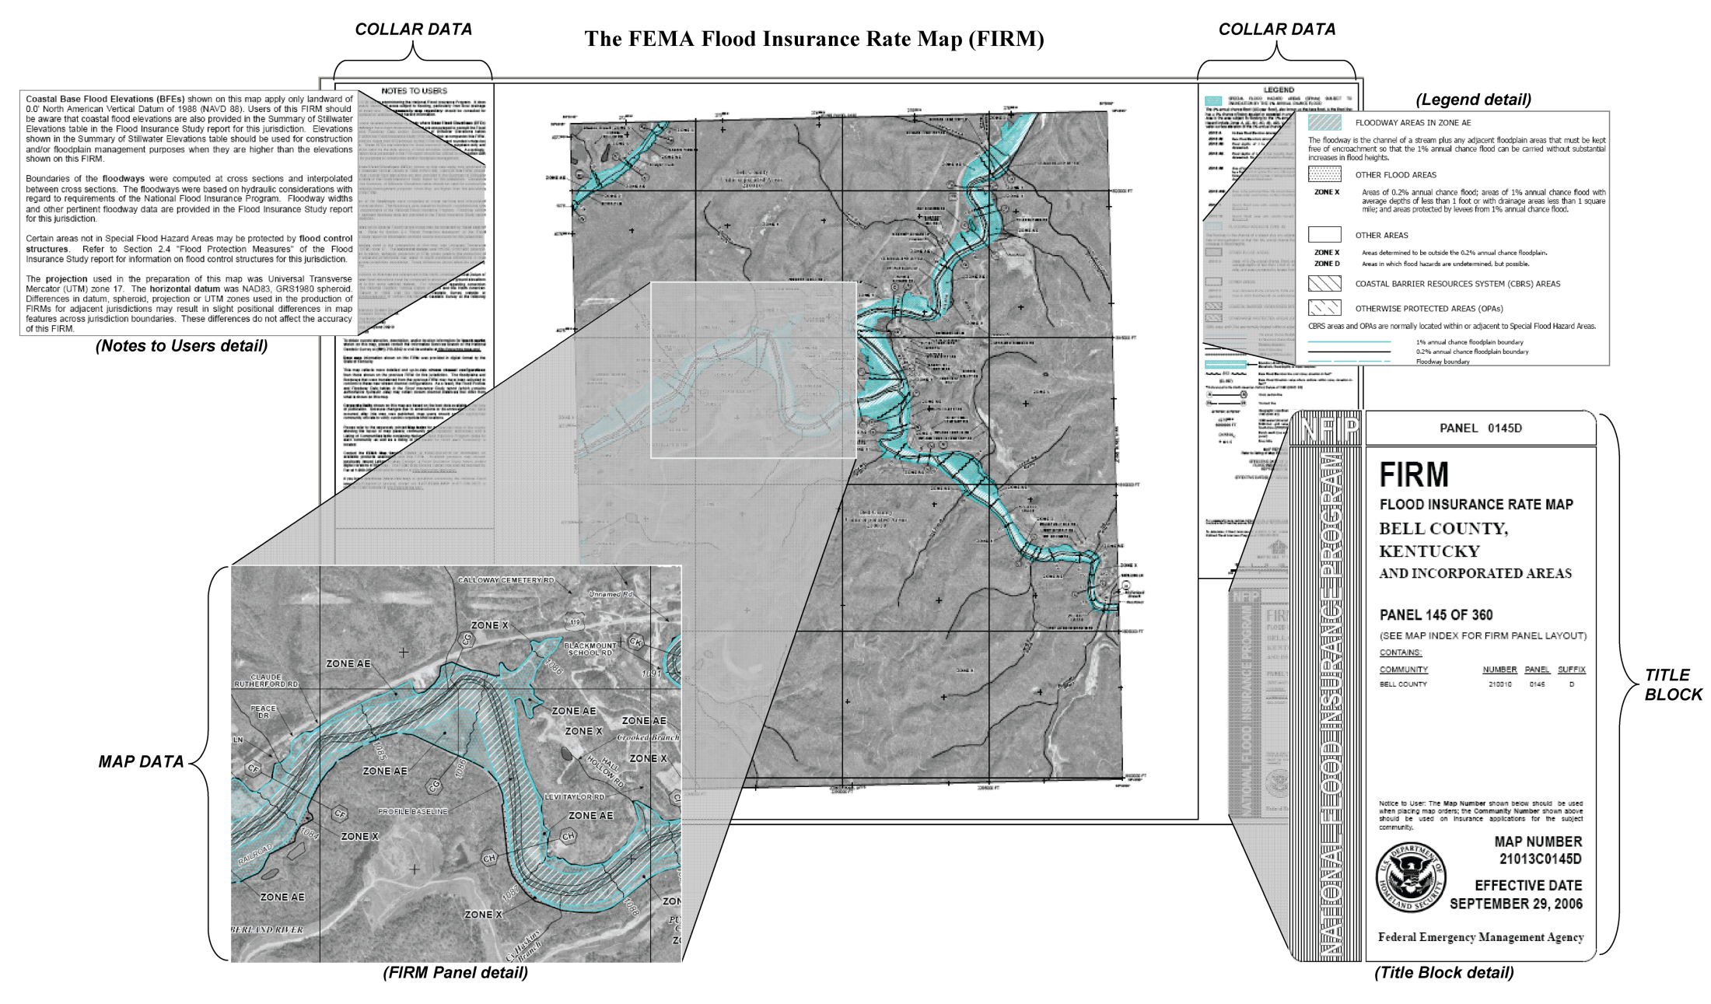
FEMA Floodplain Map

Slide 20
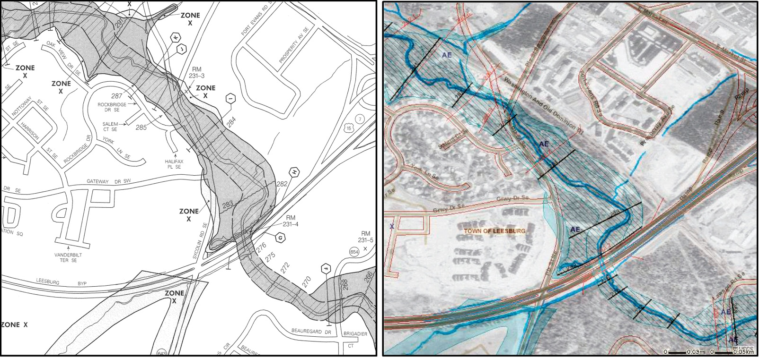
Old, paper FIRM
New, digital (D)FIRM
- The conversion from FIRMs to DFIRMs was intended to create national, digital floodplain map coverage
- The ideal DFIRM: more accurate than paper FIRM, more flexible to use and update, more versatile for community use

Slide 21
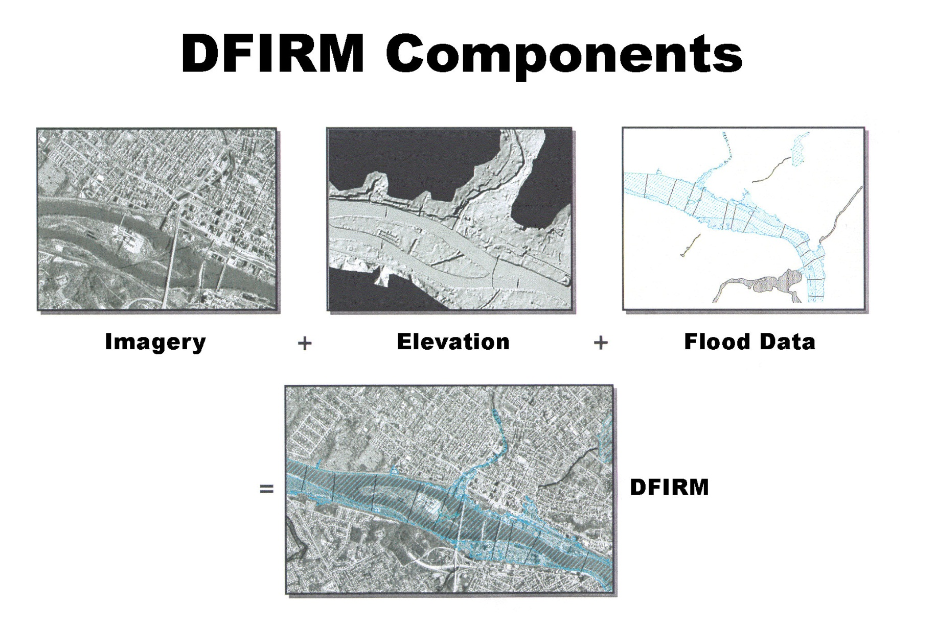
‘Base map information’
*

Slide 22
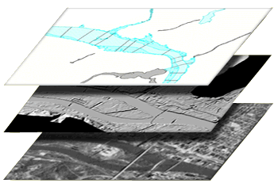
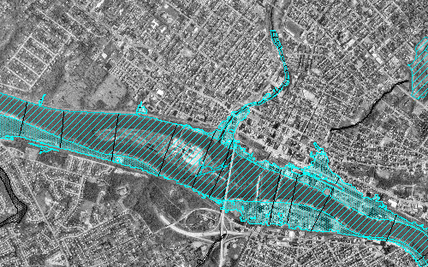
Flood Map Production Process –
Data Development
Flood Data
Topography
Base
Digital Map
Two key inputs:
base map imagery and vector line work
topography – land surface elevation

Slide 23

  Analysis of Costs and Benefits of the
  National Flood Insurance Program
Federal Emergency Management Agency
Affordability
National Flood Insurance Act of 1968 established the requirement.
The Flood Disaster Protection Act of 1973 made it essential.
Biggert Waters 2012 mandates the study of it.
Responsibility to our national community compels us to get it right.
Notes:
There are several reasons for us being here today
The National Flood Insurance Act of 1968 established the requirement for “affordable” flood insurance
The Flood Disaster Protection Act of 1973 made the purchase of flood insurance mandatory which made affordability essential
The Biggert Waters Flood Insurance Reform Act of 2012 significantly impacted affordability and mandates the study of it
Lastly, as caretakers of this process, our responsibility to our national community compels us to get it right

Slide 24
The Problem
National Flood Insurance Program brings in about $3 Billion per year in flood insurance premiums, primarily from home-owners (97% of all policies)
Hurricane Katrina ($17 Billion) and Superstorm Sandy ($7 Billion) drew large amounts of money out of the National Flood Insurance Fund and put it into serious debt to the US government
Biggert-Waters 2012 bill attempted to put this right by upgrading insurance cost to “full risk-based premium”
This premium level is higher than many people can afford (hundreds of $$ per year became thousands of $$ per year)

Slide 25
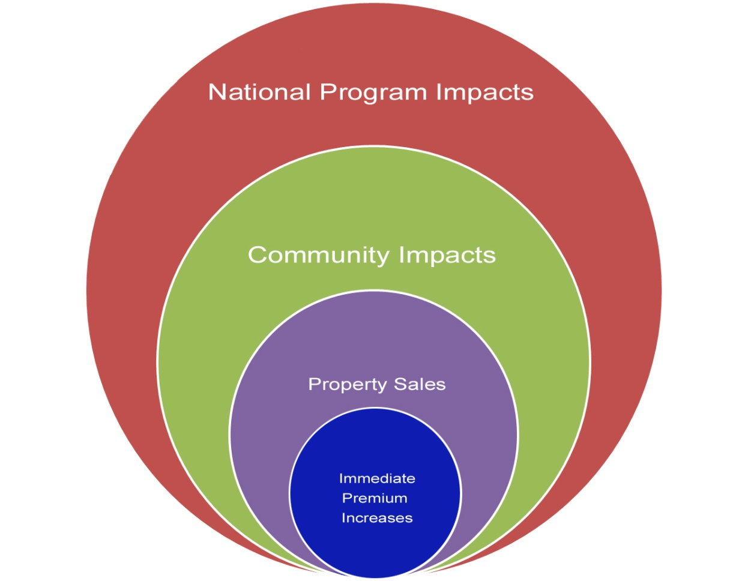
  Analysis of Costs and Benefits of the
  National Flood Insurance Program
Federal Emergency Management Agency
The expanding sphere of Concern
The conversation started with individual property owners but now includes voices from business, local communities and Federal agencies
Notes:
Immediate Premium Increases
The evolution of the conversation on affordability began with the introduction of Premium increases: We started hearing concerns about the property owners' ability to afford premium increases called for in BW-12
Property sales
The conversation expanded with Individual and Business concerns that premium increases would result in lower resale values or inability to sell properties, resulting in a shrinking Real Estate market.
Community Impact
Communities began to voice their concerns about community viability: concerns about property sales led to concerns about neighborhoods and communities being abandoned.
Local tax base: Also led to concerns about reduced tax base for communities
Federal Impact
Ultimately it became a “national” conversation about the impact of affordability on NFIP participation: concerns about the NFIP losing policyholders so that we don't actually have more revenue
FEMA IA and OFA: if NFIP is not insuring, losses may result in greater reliance on other federal programs. This of course was one of the main reasons Congress created the NFIP in the first place.

Slide 26

  Analysis of Costs and Benefits of the
  National Flood Insurance Program
Federal Emergency Management Agency
Perception versus Reality
A sampling of Pluses and Minuses
Individuals
  - Many policy holders economically distressed
  + Encourages Mitigation for those few most effected
Communities
  Potential for unraveling communities
  + Risk affordability equilibrium
National
  NFIP Participation declines, Disaster Aid increases
  + NFIP more fiscally sound
Notes:
In recent months we’ve heard a lot of stories about the perceived pluses and minuses of BW12.
This is a great opportunity to reconcile those perceptions with the realities (as we now know them) of implementing BW12, and of course, identify research-based affordability issues.
Here are just some of the pluses and minuses (by stakeholder group) that we need to address:
Individuals:
- economically distressed homeowners: how many property owners will face large premiums? Where will the problem areas be?
+BW-12 encourages owners to undertake mitigation before the flood
Communities:
- Increased premiums unravels communities as people who can't afford insurance walk away.
+ People who can afford risk move into desirable areas near water and local economies improve
National
- NFIP participation declines making the program even less likely to afford disasters/debt, and govt left supporting more uninsured losses
+ NFIP maintains most policyholders and riskiest properties are mitigated/replaced

Slide 27
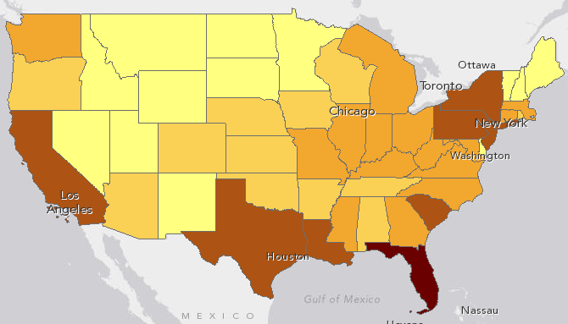
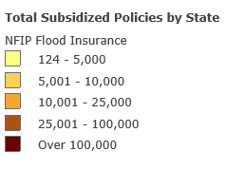
Number of Policy Holders Affected
(about 1.1 million in total)
http://www.arcgis.com/home/webmap/viewer.html?webmap=e0208985e8e64d44bca999325254ff5b&extent=-106.6909,33.1708,-76.9399,43.9898

