Slide 1
Hydraulic Routing in Rivers
Reading: HEC-RAS Manual pp. 2-1 to 2-15
Stormwater Conveyance Modeling and Design, Sec 7.4 on Specific Energy and Critical Flow
http://www.hec.usace.army.mil/software/hec-ras/documentation/HEC-RAS_4.1_Reference_Manual.pdf

Slide 2
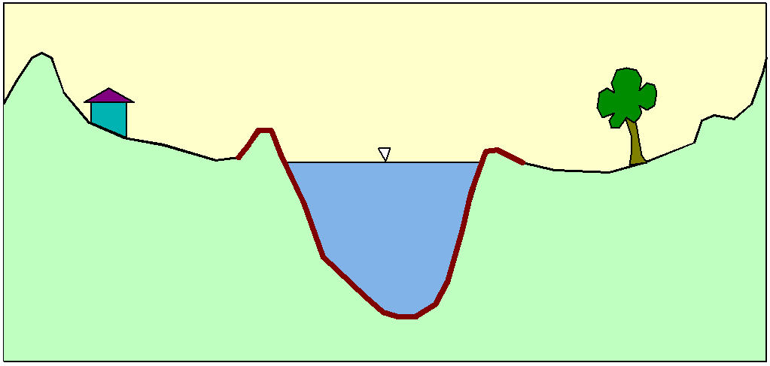
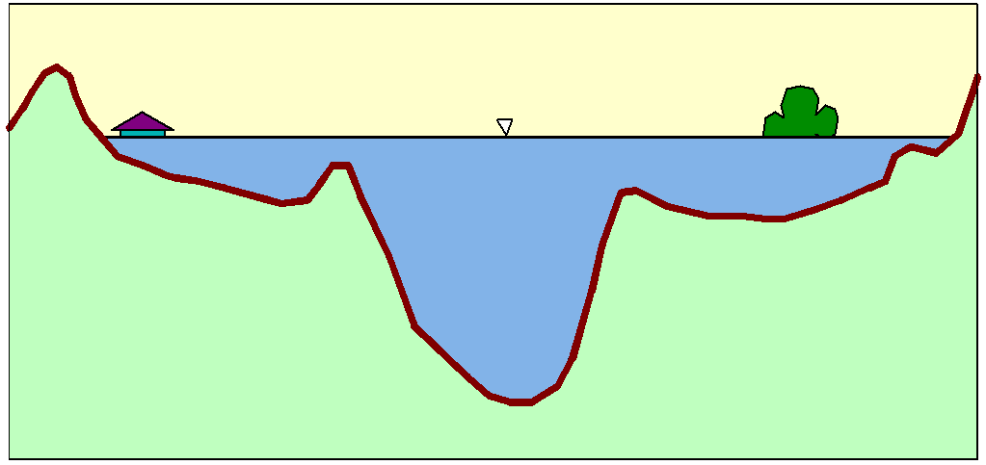
Flood Inundation

Slide 3
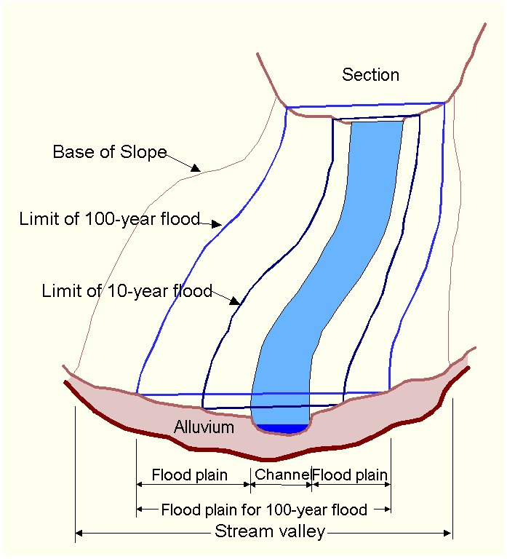
Floodplain Delineation
Notes:
The channel and floodplain are both integral parts of the natural conveyance of a stream. The floodplain carries flow in excess of the channel capacity. The greater the discharge, the greater the extent of inundation. …. Because of its devastating nature, flooding poses serious hazards to human populations in many parts of the world. “The Flood Disaster Protection Act of 1973” required the identification of all floodplain areas in the United States and the establishments of flood-risk zones within those areas.

Slide 4
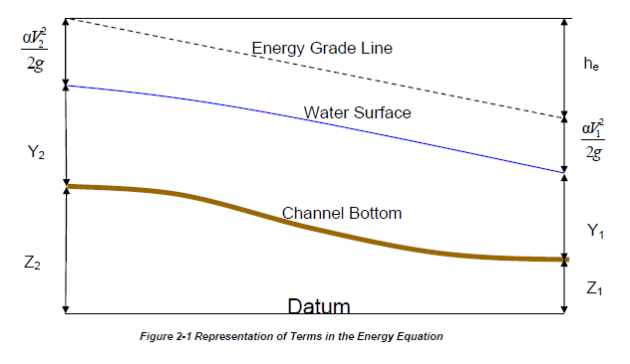
Steady Flow Solution

Slide 5
One-Dimensional Flow Computations
Cross-section
Channel centerline
and banklines
Right Overbank
Left Overbank

Slide 6
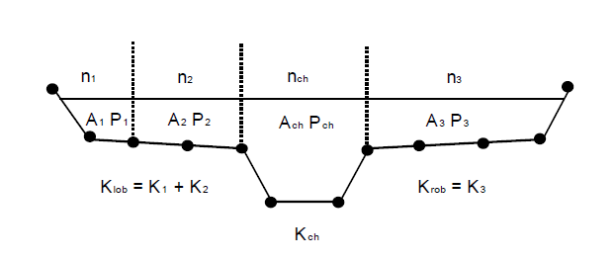
Flow Conveyance, K
Left Overbank
Channel
Right Overbank
$$Q=\frac{1.49}{n}AR^{2/3}S_{f}^{1/2}$$
$$or Q=KS_{f}^{1/2}$$
$$K=\frac{1.49}{n}AR^{2/3}$$
$$or K=\frac{1.49}{n}{\frac{A^{5/3}}{P^{2/3}} }^{}$$

Slide 7
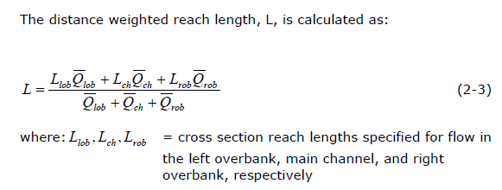
Reach Lengths
(1)
Floodplain
L_{ch}
R_{ob}
L_{ob}
Floodplain
(2)
Left to Right looking downstream

Slide 8
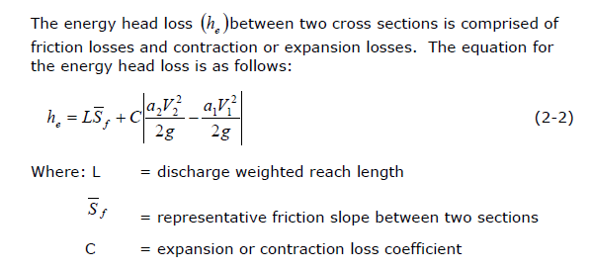
Energy Head Loss

Slide 9
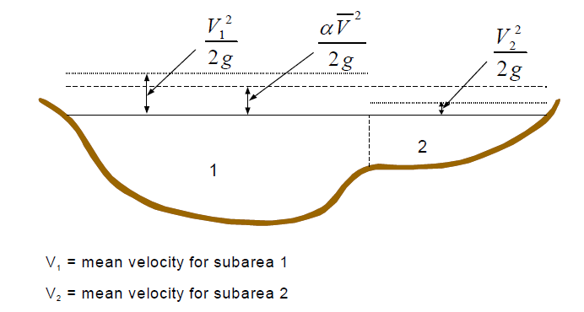
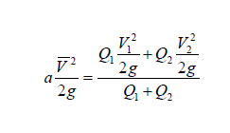
Velocity Coefficient, α

Slide 10
Solving Steady Flow Equations
Q is known throughout reach
All conditions at (1) are known, Q is known
Select h₂
compute Y₂, V₂, K₂, S_{f}, h_{e}
Using energy equation (A), compute h₂
Compare new h₂ with the value assumed in Step 2, and repeat until convergence occurs
(A)
h₂
h₁
(2)
(1)
$$S_{f}={\left(\frac{Q}{K}\right)}^{2}$$

Slide 11
Flow Computations
Reach 3
Reach 2
Start at the downstream end (for subcritical flow)
Treat each reach separately
Compute h upstream, one cross-section at a time
Use computed h values to delineate the floodplain
Reach 1

Slide 12
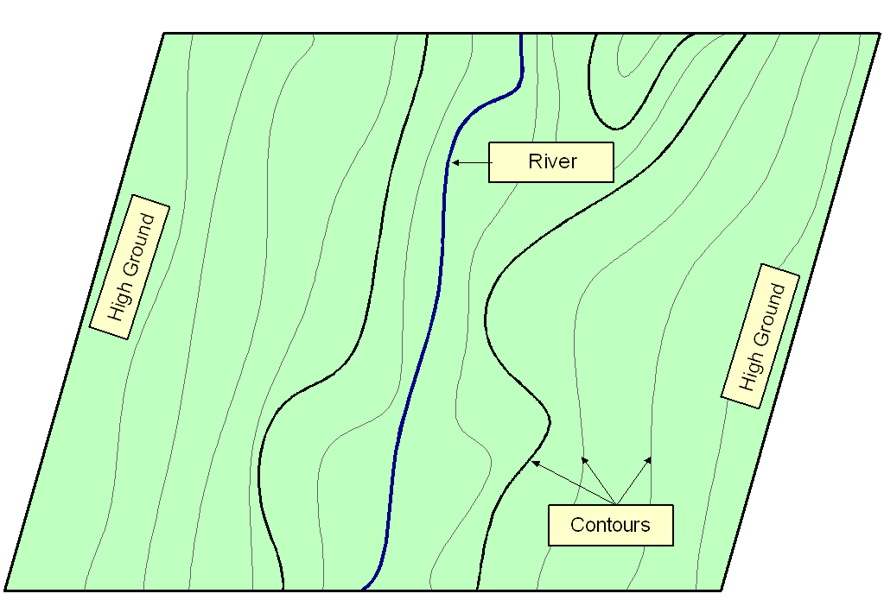
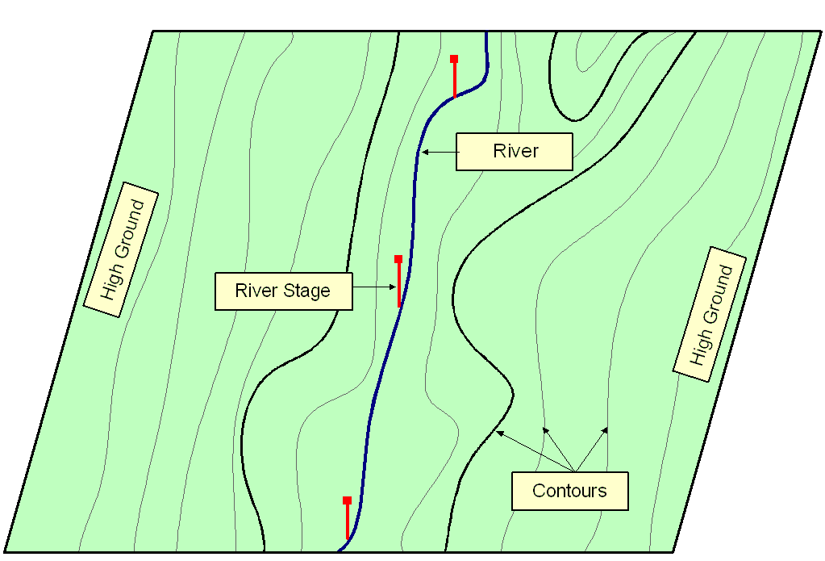
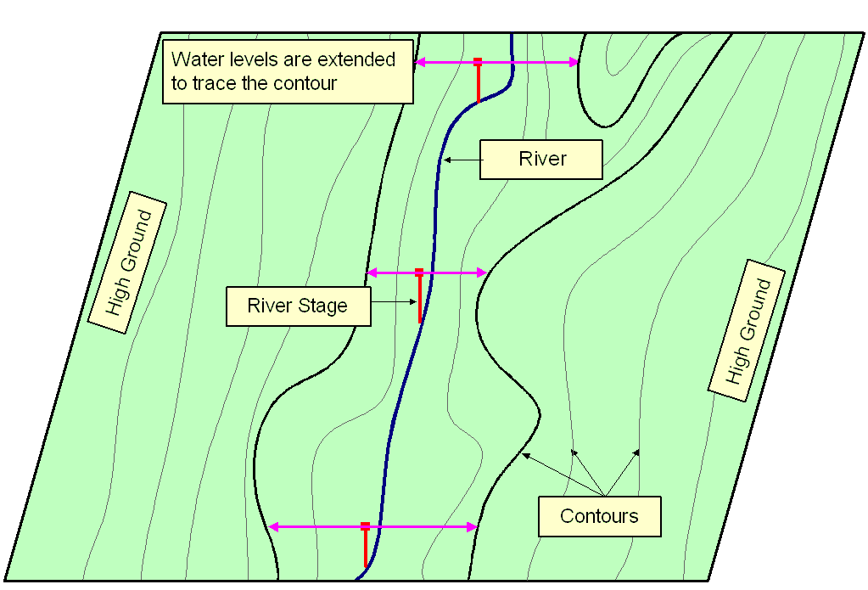
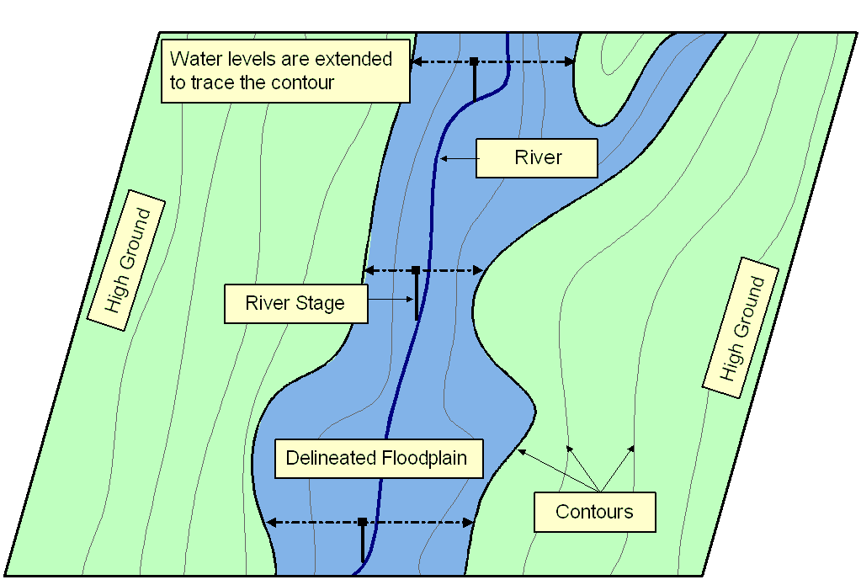
Floodplain Delineation
Notes:
Ideally should have Two D Models…... A floodplain delineation process determines inundation extent by comparing water levels with ground surface elevations. We start with a DTM or topomap. > Water levels are computed based on cross-sections. During normal condition, flow remains within the main channel, but > during flood, water spill over the bank. In these cases it’s important to extent cross-section over the floodplain. > We then bring back water levels on the topomap. > Extent water levels until hit contour of higher elevations. > Finally delineate floodplain following the contours. The accuracy largely depends on water levels and in turns on the cross-section used for computation.

