Slide 1
Lecture 4: Hydrodesign
David R. Maidment
CE 365K Hydraulic Engineering Design
Spring 2014

Slide 2

Definitions from Miriam-Webster Dictionary (10th Edition)
Design (Verb)
  To mark, to conceive and plan out; to have a purpose; to devise for a function
Design (Noun)
  A deliberate, purposeful plan; the arrangement of elements that go into human production; the underlying scheme
Design as a verb
  How to design something
Design as a noun
  What to design
How is more important than what

Slide 3

Geodesign
Design – Everyone designs who devises courses of action aimed at changing existing situations into better ones (Herbert Simon)
Geodesign – understanding the impact of our decisions on the planet and using this information to make the world a better place (Jack Dangermond)
http://esripress.esri.com/display/index.cfm?fuseaction=display&moduleID=0&websiteID=218

Slide 4

Jack Dangermond and Geodesign
http://video.esri.com/watch/125/jack-dangermond-talks-about-geodesign-at-ted2010

Slide 5
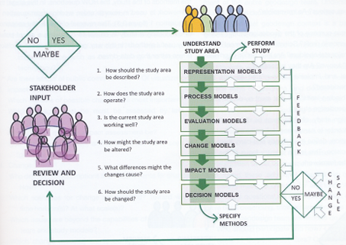
Geodesign Process

Slide 6
Questions
How should the study area be described?
How does the study area operate?
Is the current study area working well?
How might the study area be altered?
What differences would the changes cause?
How should the study area be changed?
Representation
Process
Evaluation
Change
Impact
Decision

Slide 7
Hydrodesign
Hydrodesign is an analogous process to Geodesign for design with water in the constructed and in the natural environment
  Flooding
  Water use
  Water quality
  Environmental integrity
People of the Place
Design Professionals:
Civil Engineers Architects
Earth and Natural Sciences: Geology, Biology
Information Technology

Slide 8
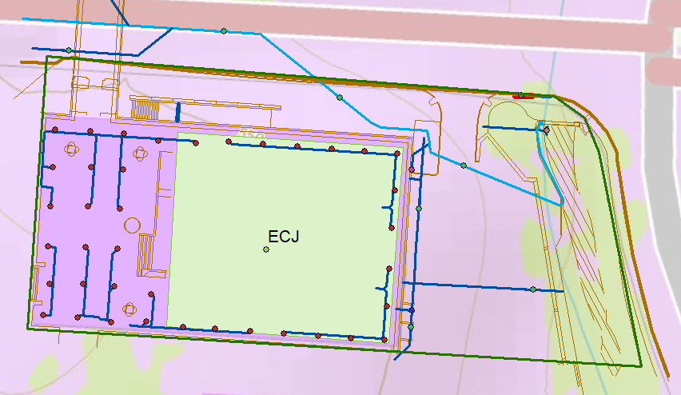
Study Area: Cockrell Hall(ECJ)

Slide 9
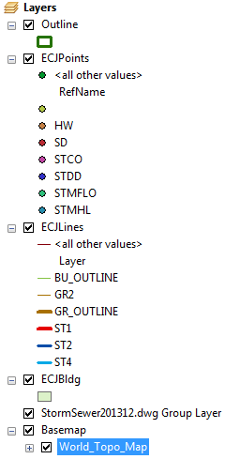
Legend for Map

Slide 10
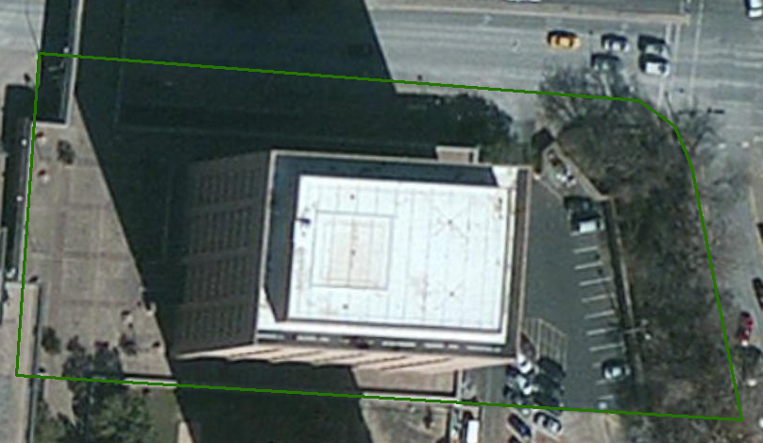
Study Area in Imagery

Slide 11
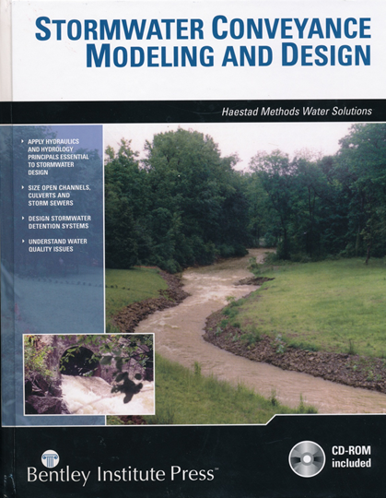
Hydraulic Design
P.11: “The “art” of design involves defining the objectives, and determining from a number of feasible options, the one that best meets those objectives. The design engineer optimizes the use of resources (materials, construction labor, operation and maintenance costs, and so on) to meet the objectives while satisfying certain constraints (such as project budgets, right-of-way limitations, and design storm criteria)

Slide 12
Key Players
Owner
Architect
Permits
City
Regulatory
Process
Engineers

Slide 13
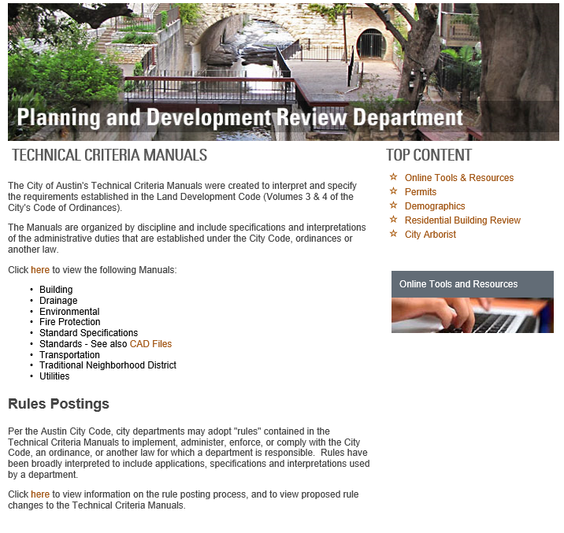
http://www.austintexas.gov/department/technical-criteria-manuals-0

Slide 14
Evolution of Hydraulic Design
Stormwater runoff disposal
  Get the water off the site as quickly and efficiently possible
Stormwater detention
  Slow down the stormwater so that peak flow after development is not more than before
Water Quality Control
  Retain and filter water on site so that bacteria are reduced and water quality improves
Low Impact Development
  Dispersed onsite infiltration, filtration and retention schemes

Slide 15
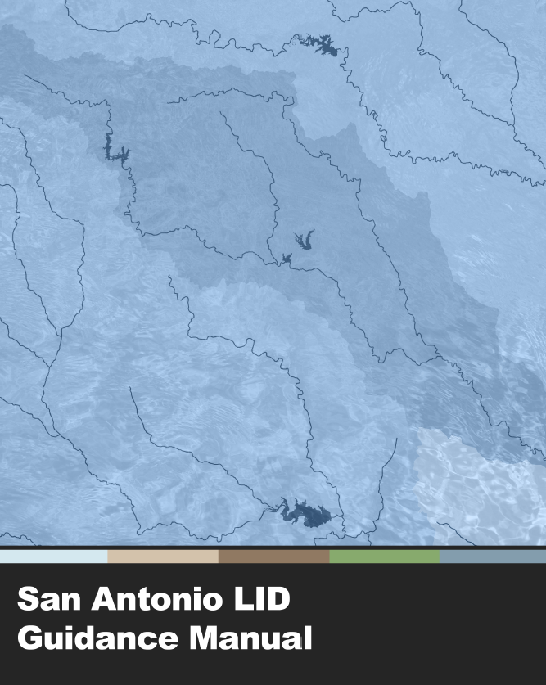
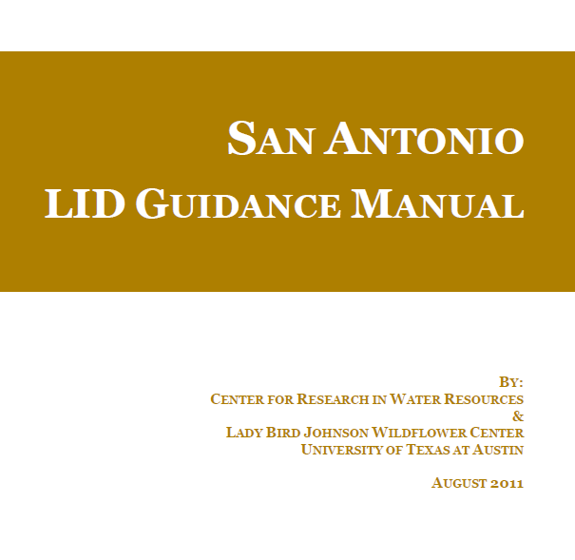
Low Impact Development
Dr Michael Barrett

Slide 16
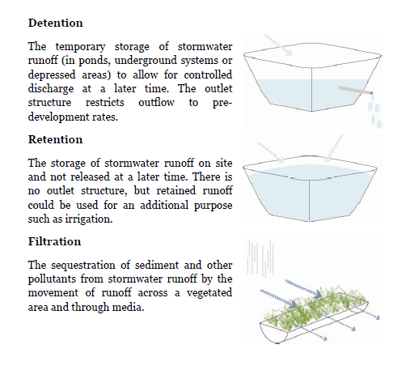
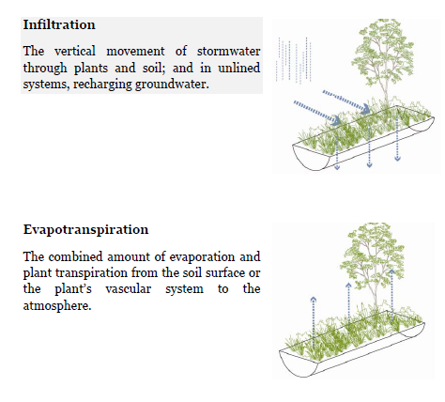
Definitions

Slide 17
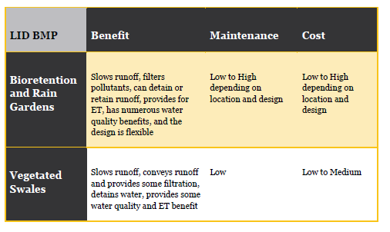
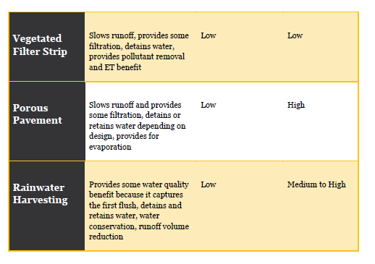
Low Impact Development
Strategies

