Slide 1
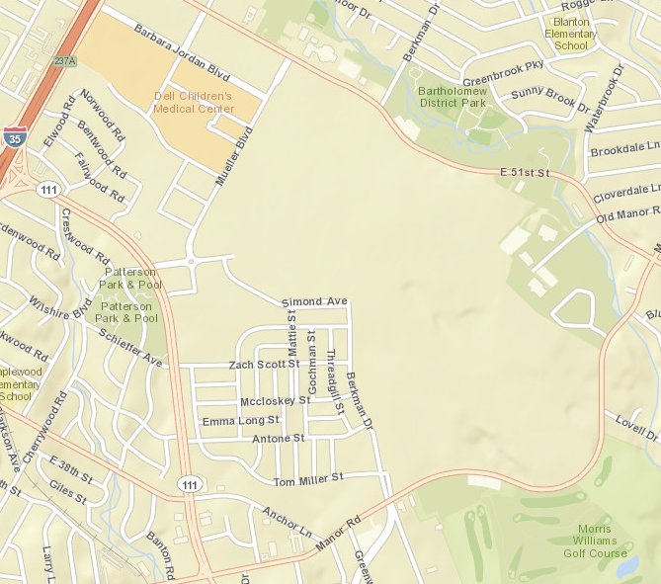
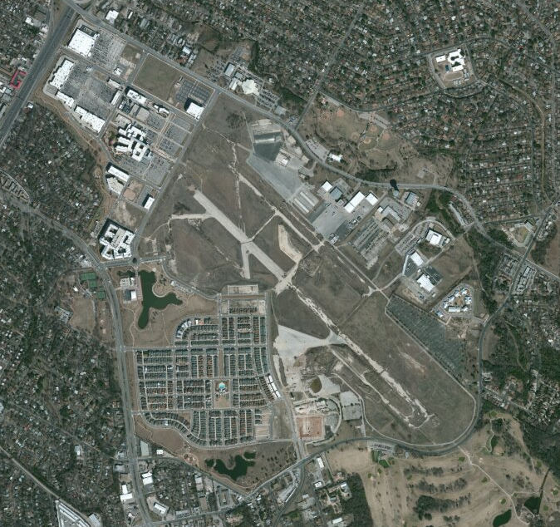
Redevelopment of Mueller Airport

Slide 2
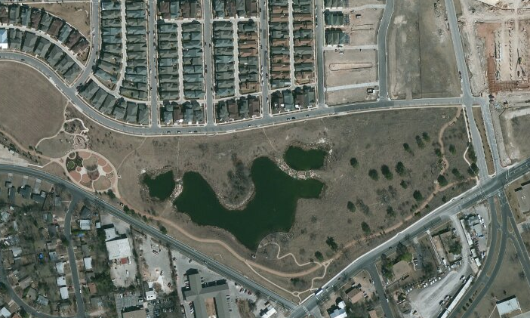
Flood Detention and Water Quality Pond

Slide 3
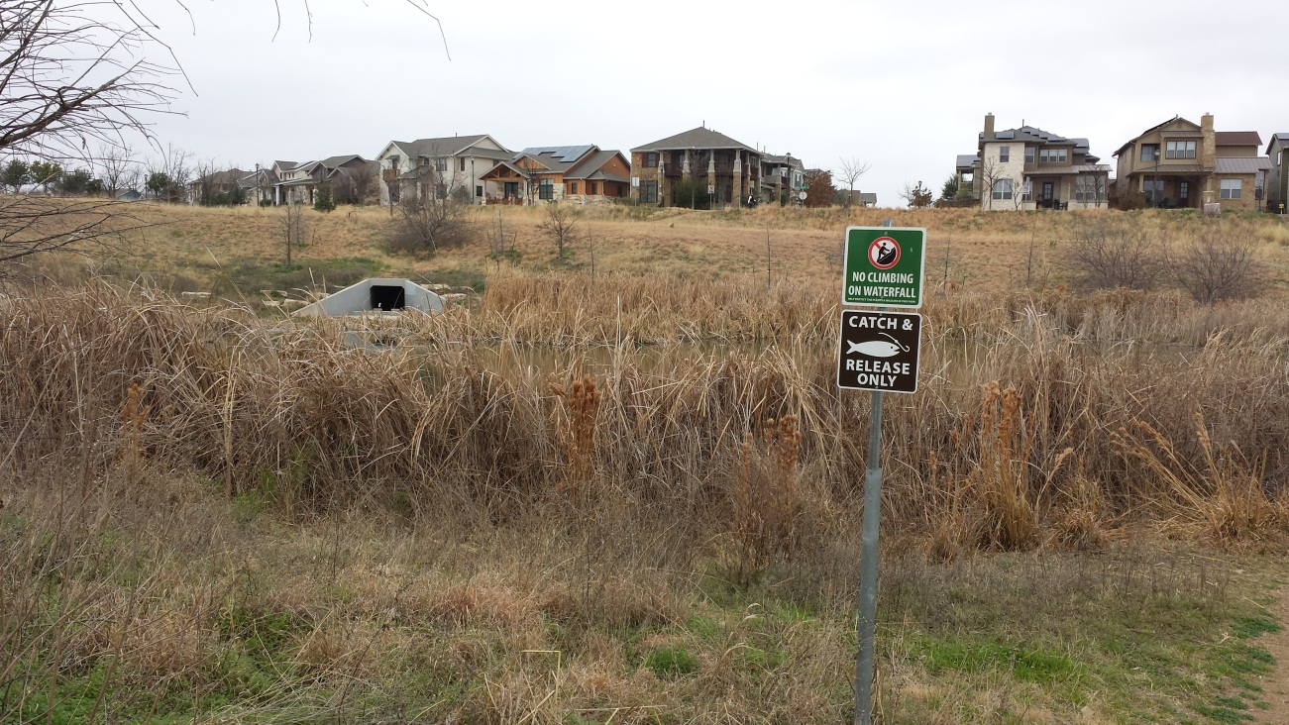
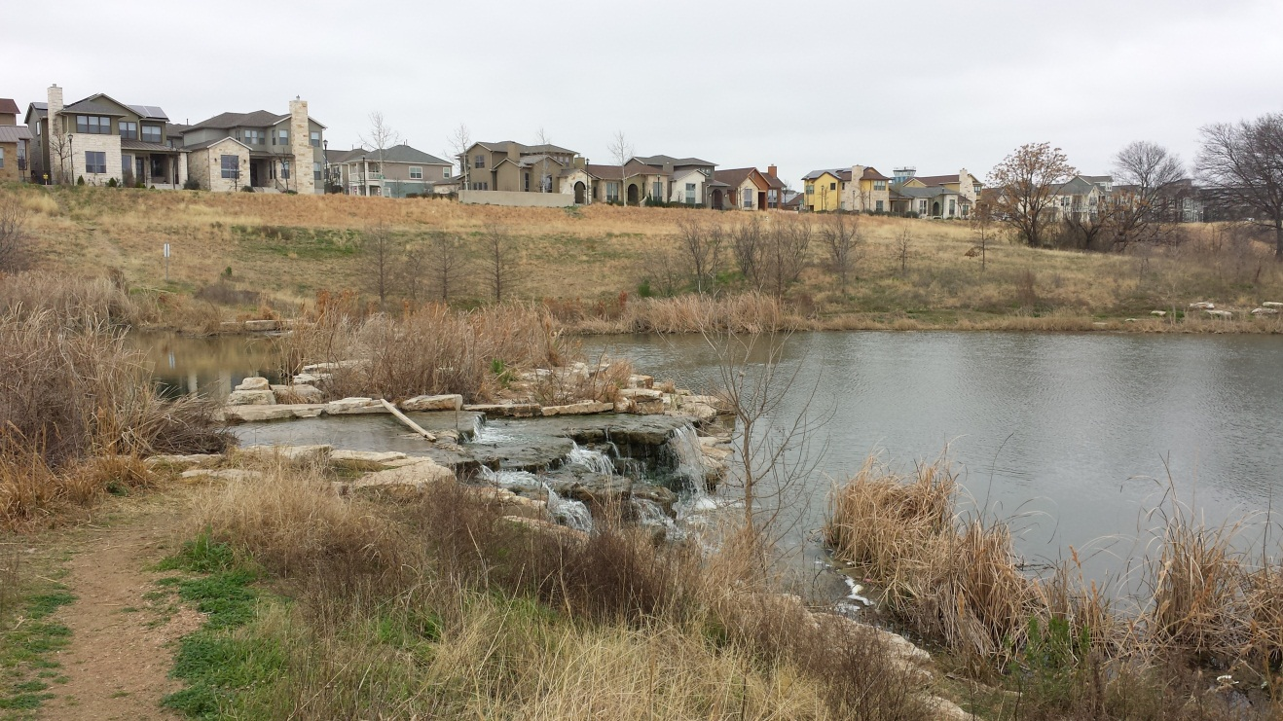
Mueller Wet Pond
Stormwater Outlet and
Upper Pond
Back pumping
Aeration System and
Lower Pond

Slide 4
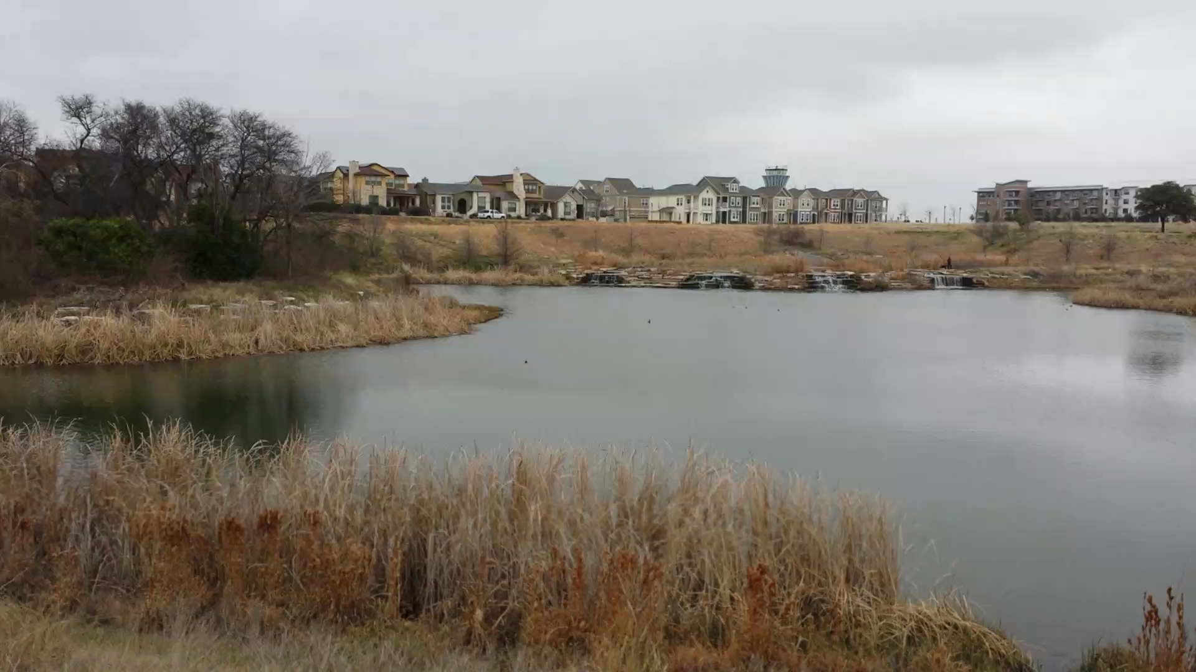
Pond, Outfall and Overflow
Stormater Detention (Flooding)
Wet Pond (Water Quality)

Slide 5
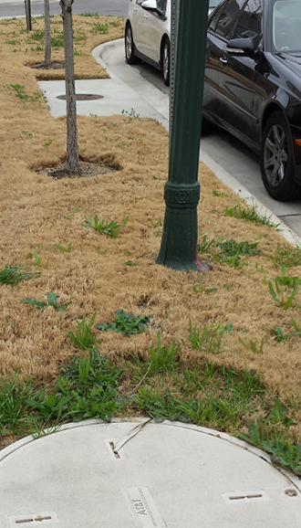
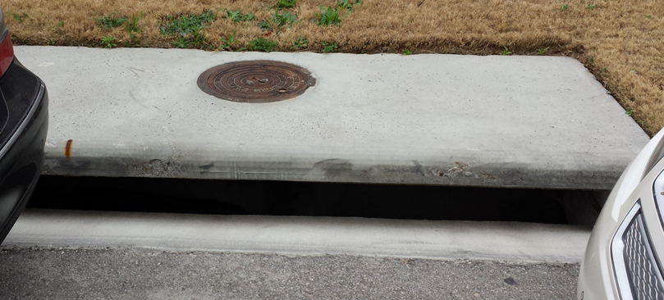
Normal Sidewalk and Stormwater Inlet

Slide 6
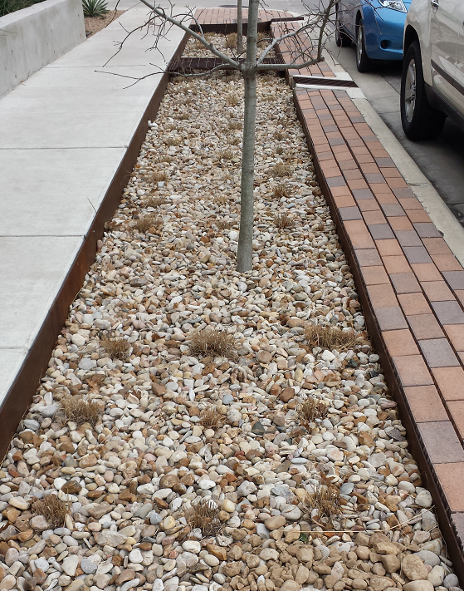
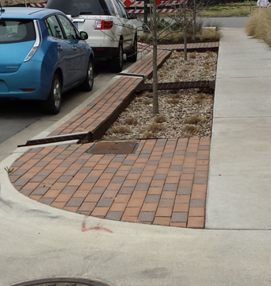
An Alternative: Infiltration Trench
Water flows in from gutter, and along the gravel bed, infiltrating as it goes,
and the remainder goes back out into the gutter again
Pike Powers Laboratory, 3924 Berkman Drive, Austin Texas

Slide 7
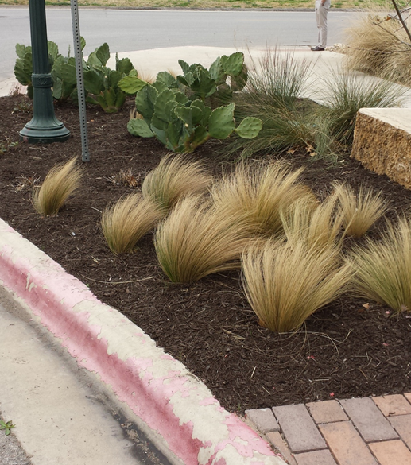
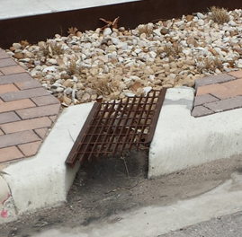
Low Impact Development Elements
Infiltration trench outfall
Alternative Plant Materials

