Slide 1
CE 365K Hydraulic Engineering Design
Review for First Quiz
27 February 2014

Slide 2

CAEE Strategic Plan
https://www.caee.utexas.edu/about/strategic

Slide 3
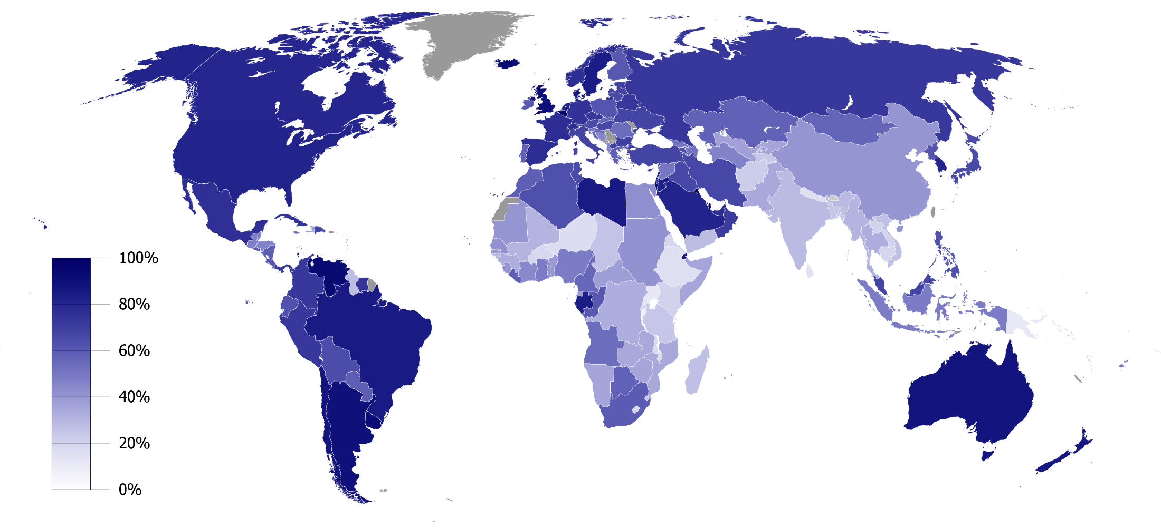
Percent Urbanization by Country
http://en.wikipedia.org/wiki/Urbanization_by_country

Slide 4
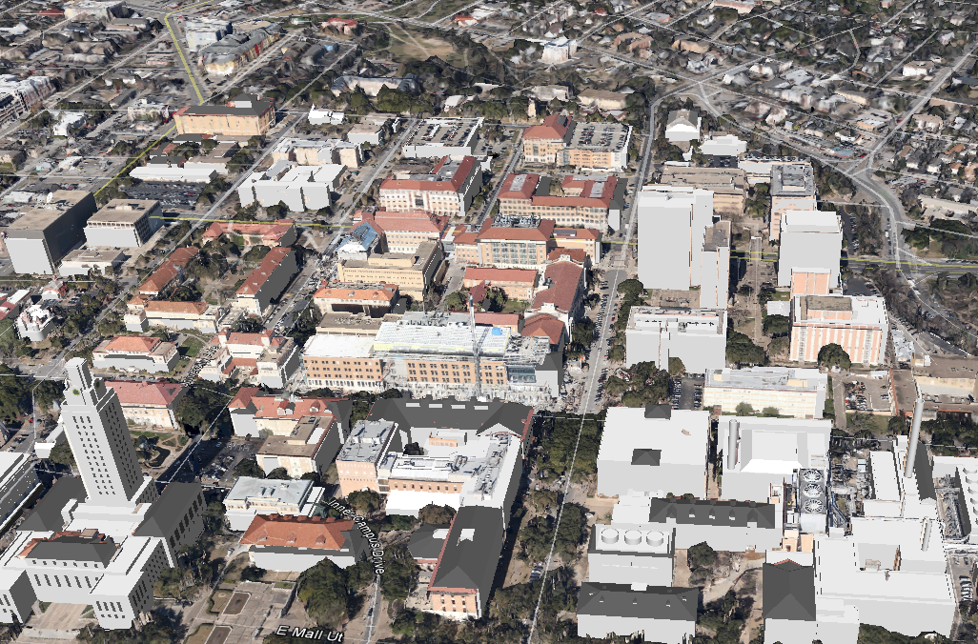
Digital Campus
Digital model of UT-Austin Campus to support research and education

Slide 5
Profession
A profession is a vocation founded upon specialized educational training, the purpose of which is to supply objective counsel and service to others, for a direct and definite compensation, wholly apart from expectation of other business gain
http://en.wikipedia.org/wiki/Profession

Slide 6
Civil Engineering
Civil engineering is a professional engineering discipline that deals with the design, construction, and maintenance of the physical and naturally built environment, including works like roads, bridges, canals, dams, and buildings. Civil engineering takes place on all levels: in the public sector from municipal through to national governments, and in the private sector from individual homeowners through to international companies.
http://en.wikipedia.org/wiki/Civil_engineering

Slide 7
Hydraulic Engineering
Hydraulic engineering is the application of fluid mechanics principles to problems dealing with the collection, storage, control, transport, regulation, measurement, and use of water
Prasuhn, Alan L. Fundamentals of Hydraulic Engineering. Holt, Rinehart, and Winston: New York, 1987

Slide 8

Definitions from Miriam-Webster Dictionary (10th Edition)
Design (Verb)
  To mark, to conceive and plan out; to have a purpose; to devise for a function
Design (Noun)
  A deliberate, purposeful plan; the arrangement of elements that go into human production; the underlying scheme
Design as a verb
  How to design something
Design as a noun
  What to design
How is more important than what

Slide 9
Questions
How should the study area be described?
How does the study area operate?
Is the current study area working well?
How might the study area be altered?
What differences would the changes cause?
How should the study area be changed?
Representation
Process
Evaluation
Change
Impact
Decision

Slide 10
Hydrodesign
Hydrodesign is an analogous process to Geodesign for design with water in the constructed and in the natural environment
  Flooding
  Water use
  Water quality
  Environmental integrity
People of the Place
Design Professionals:
Civil Engineers Architects
Earth and Natural Sciences: Geology, Biology
Information Technology

Slide 11
Evolution of Hydraulic Design
Stormwater runoff disposal
  Get the water off the site as quickly and efficiently possible
Stormwater detention
  Slow down the stormwater so that peak flow after development is not more than before
Water Quality Control
  Retain and filter water on site so that bacteria are reduced and water quality improves
Low Impact Development
  Dispersed onsite infiltration, filtration and retention schemes

Slide 12
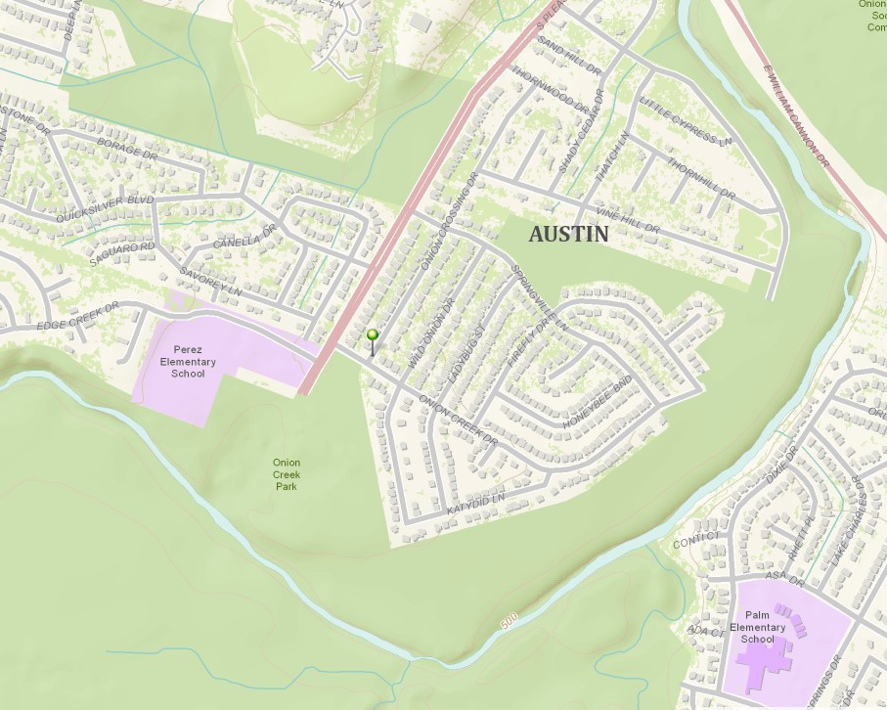
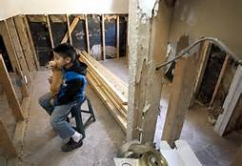
Halloween Flood, Onion Creek
30-31 October 2013
Andres Cerda, 7, with his dog Chica, looks towards his damaged bedroom that is not yet inhabitable as the family works on repairs. Maria Medel and her family lost everything in the Halloween floods as their home at 7408 Onion Crossing was completely destroyed.
Flooded home location
Onion Creek
http://www.statesman.com/photo/news/local/halloween-flood-victims-austin-still-waiting-gas-s/p4Lyg/

Slide 13
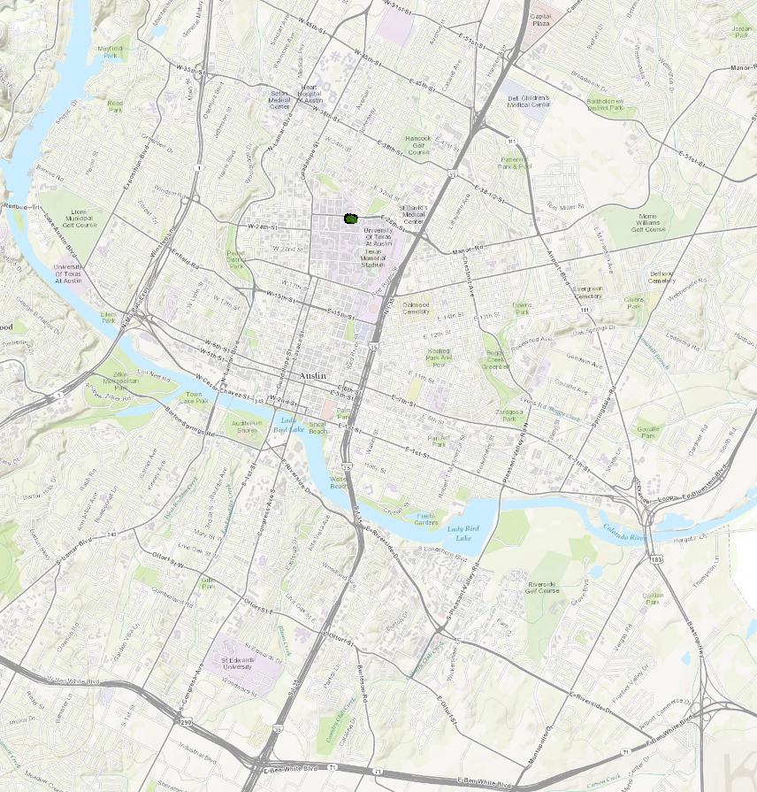
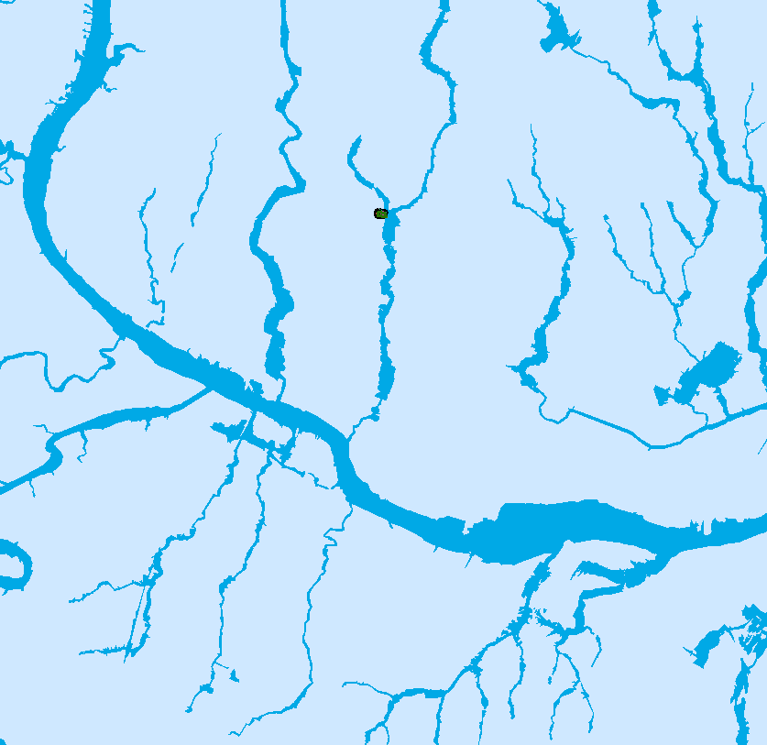
Special Flood Hazard Area for Austin

Slide 14
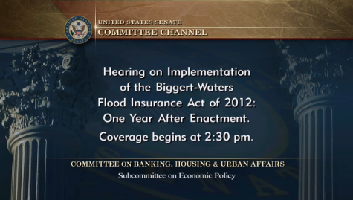
Affordability of Flood Insurance
Senator Merkley at 18:00 introduces flood insurance issues
http://www.banking.senate.gov/public/index.cfm?FuseAction=Hearings.LiveStream&Hearing_id=46b52a52-4d45-4c47-8ddc-de2f32cd348e
September 18, 2013

Slide 15
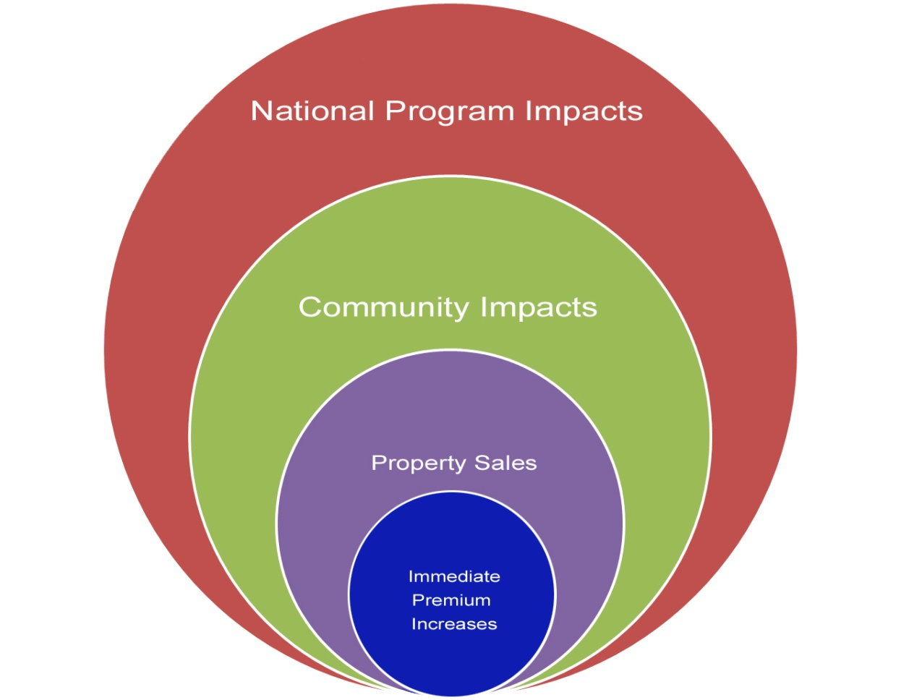
  Analysis of Costs and Benefits of the
  National Flood Insurance Program
Federal Emergency Management Agency
The expanding sphere of Concern
The conversation started with individual property owners but now includes voices from business, local communities and Federal agencies
Notes:
Immediate Premium Increases
The evolution of the conversation on affordability began with the introduction of Premium increases: We started hearing concerns about the property owners' ability to afford premium increases called for in BW-12
Property sales
The conversation expanded with Individual and Business concerns that premium increases would result in lower resale values or inability to sell properties, resulting in a shrinking Real Estate market.
Community Impact
Communities began to voice their concerns about community viability: concerns about property sales led to concerns about neighborhoods and communities being abandoned.
Local tax base: Also led to concerns about reduced tax base for communities
Federal Impact
Ultimately it became a “national” conversation about the impact of affordability on NFIP participation: concerns about the NFIP losing policyholders so that we don't actually have more revenue
FEMA IA and OFA: if NFIP is not insuring, losses may result in greater reliance on other federal programs. This of course was one of the main reasons Congress created the NFIP in the first place.

Slide 16
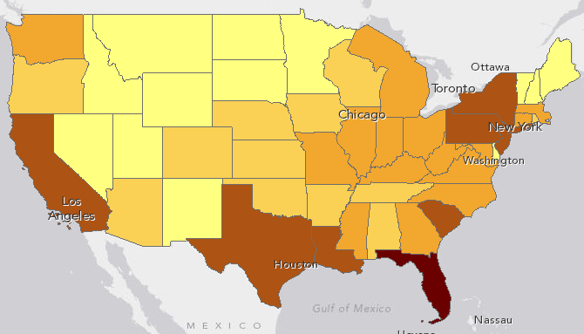
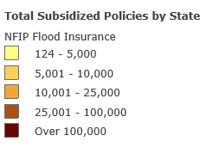
Number of Policy Holders Affected
(about 1.1 million in total)
http://www.arcgis.com/home/webmap/viewer.html?webmap=e0208985e8e64d44bca999325254ff5b&extent=-106.6909,33.1708,-76.9399,43.9898

Slide 17
COST: What is the bottom line?
Proactive Planning
Reactive Emergency Response
Estimated cost $1
Estimated cost $5-7
Notes:
The old saying that “an ounce of prevention is worth a pound of cure” has never been truer.
For every $1 spent on planning and prevention, between $4 and $7 can be saved on the response.

Slide 18
Changing how we fundamentally deal with risk related to disasters
IDENTIFY the risk
ASSESS the risk
COMMUNICATE the risk
MITIGATE the risk

Slide 19
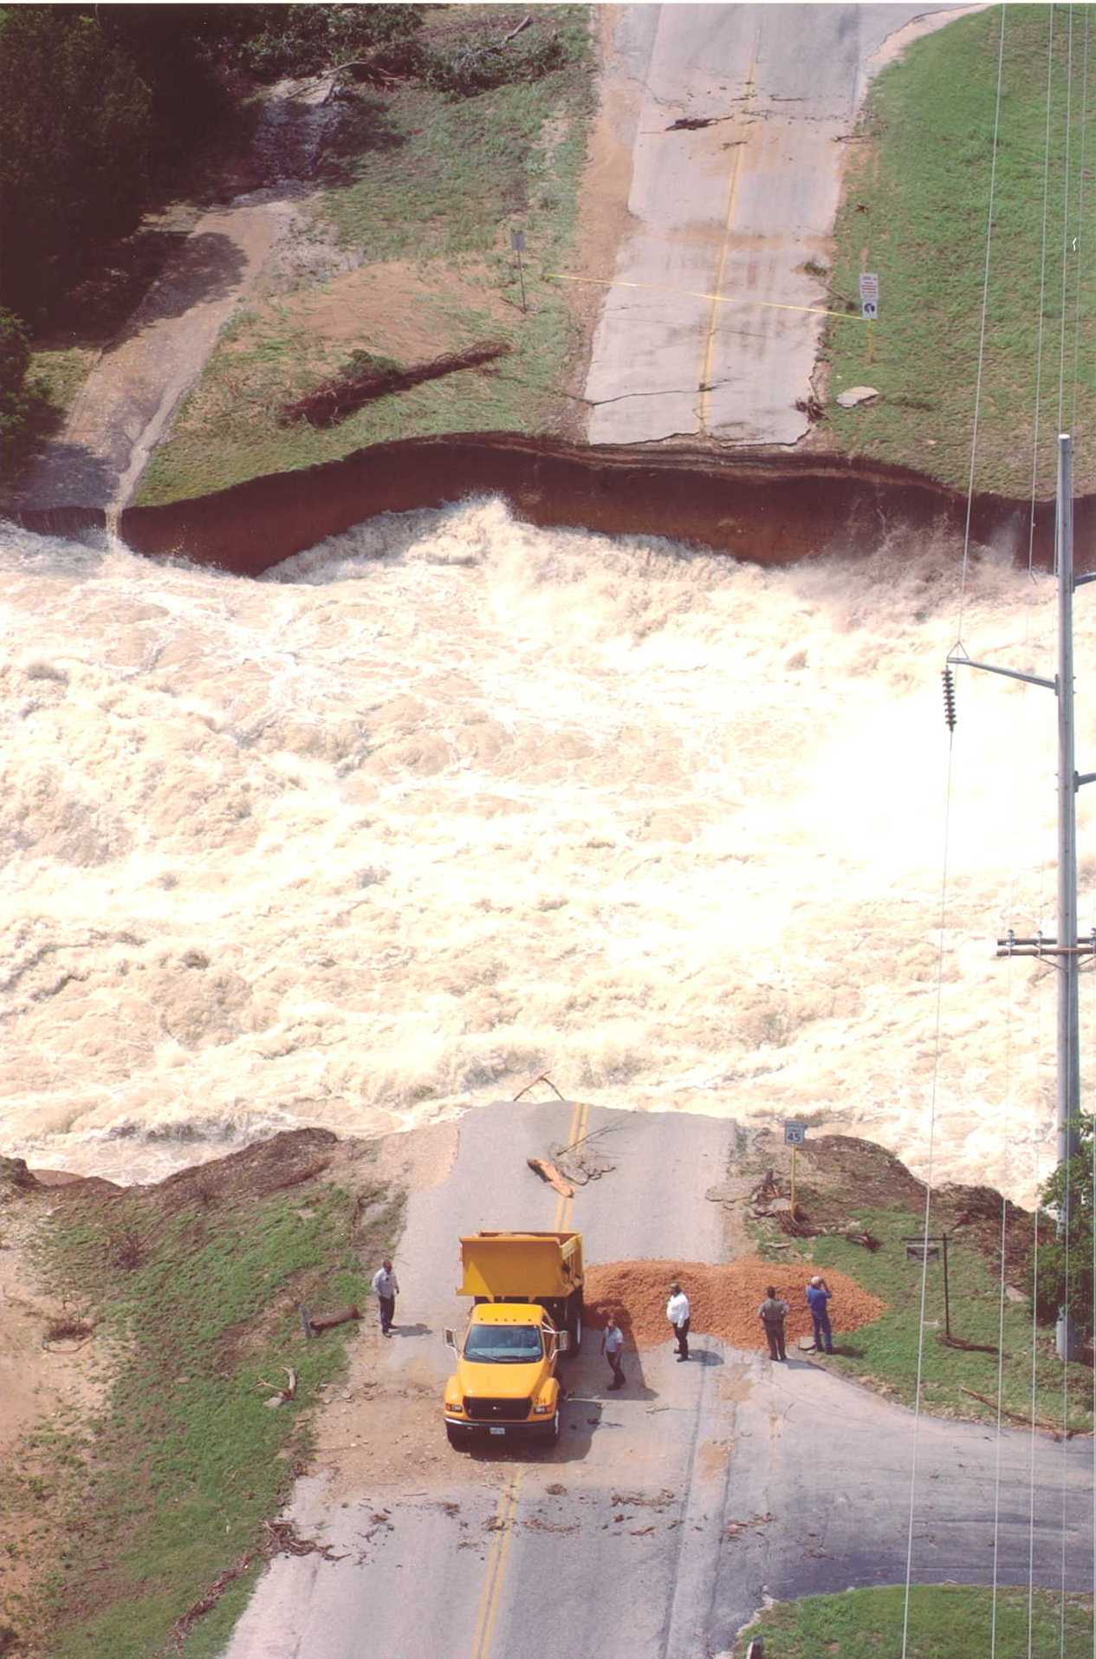
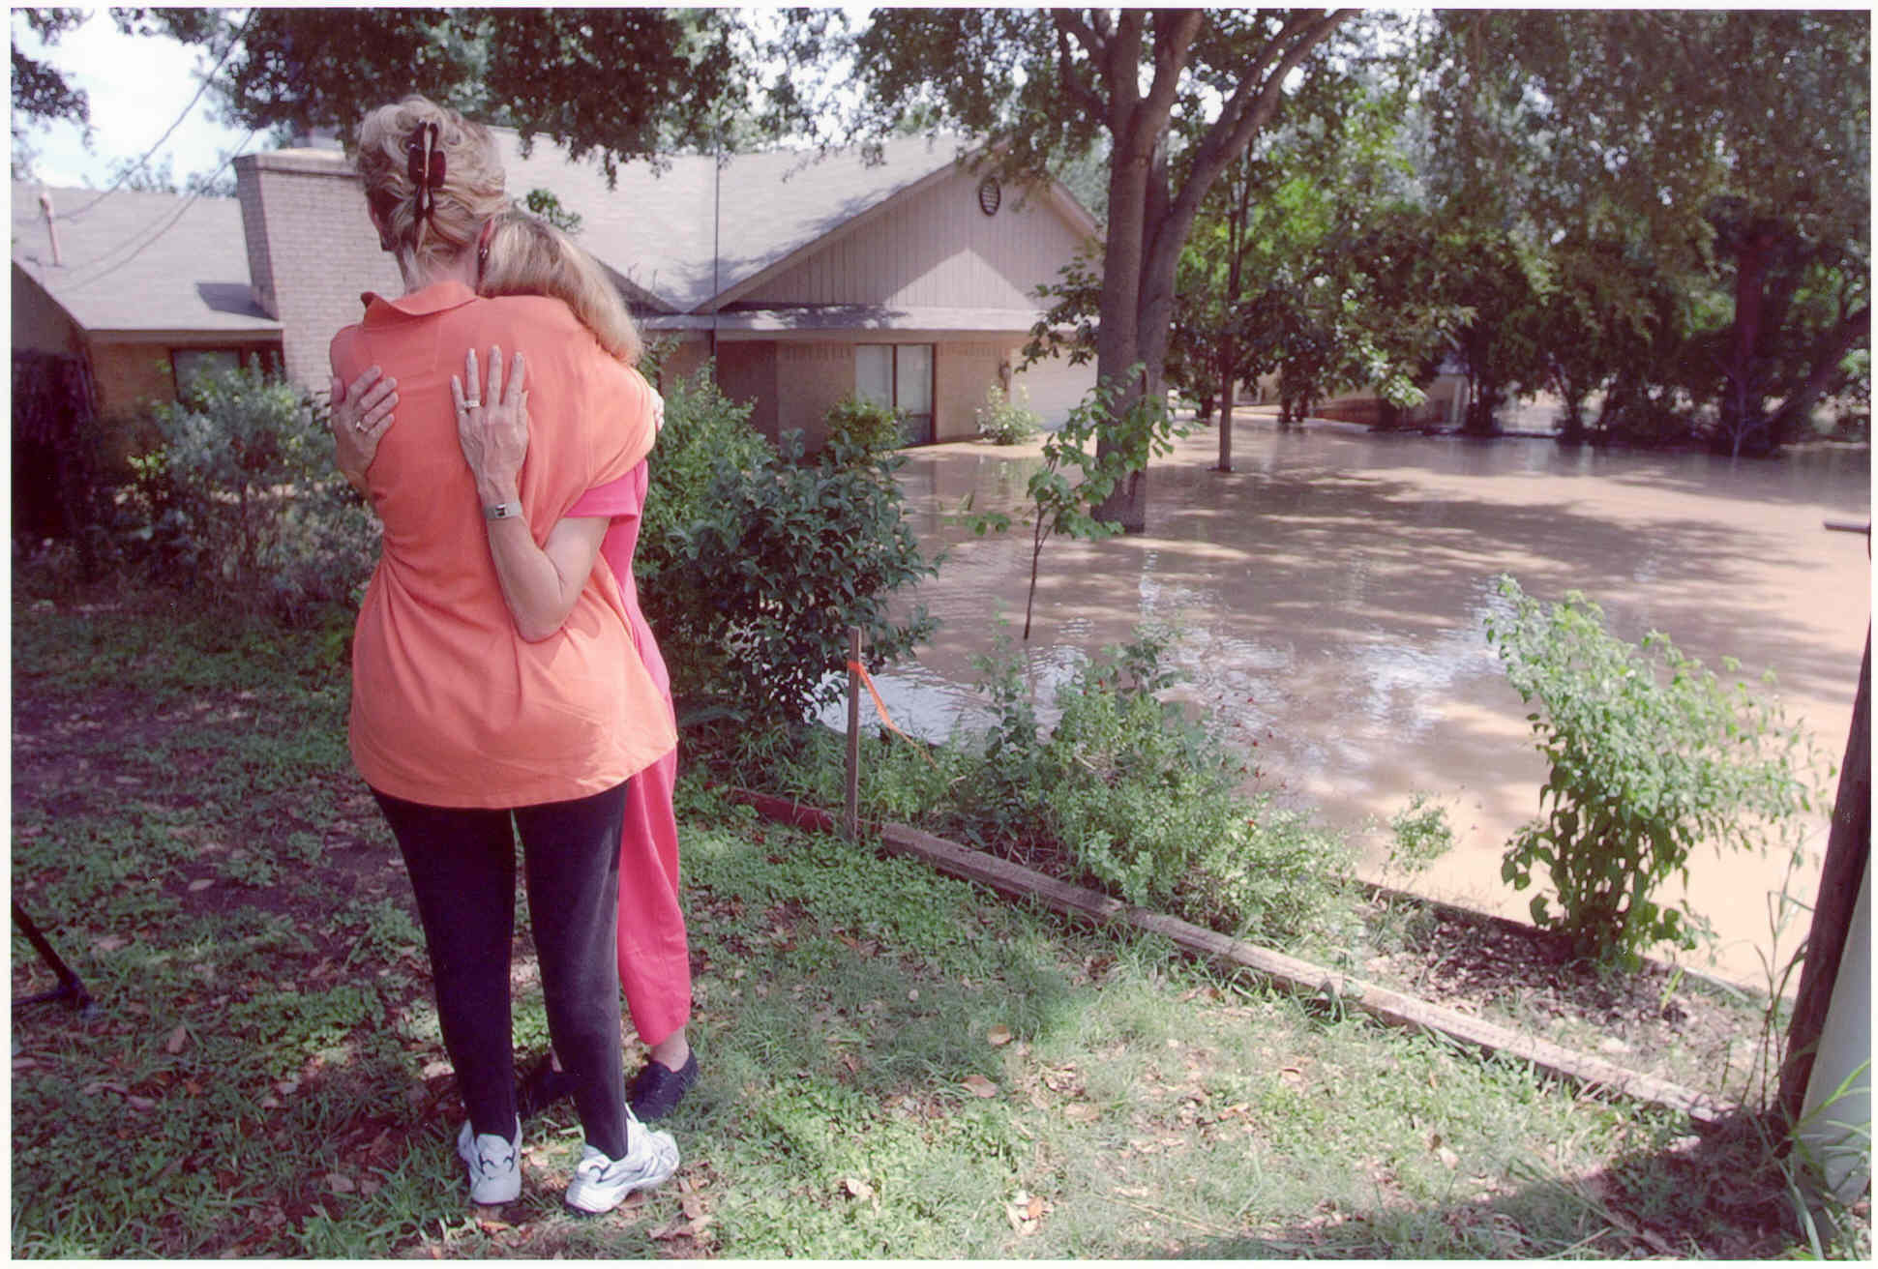
Protection of Life and Property
Financial decisions drive many actions
Need to remain firm on ethics and character

Slide 20
We need to inform the public on the underlying assumptions
All structures operate correctly and will not fail
Structures will not be obstructed with debris
Only existing conditions are considered
Degree of uncertainty of the science

Slide 21
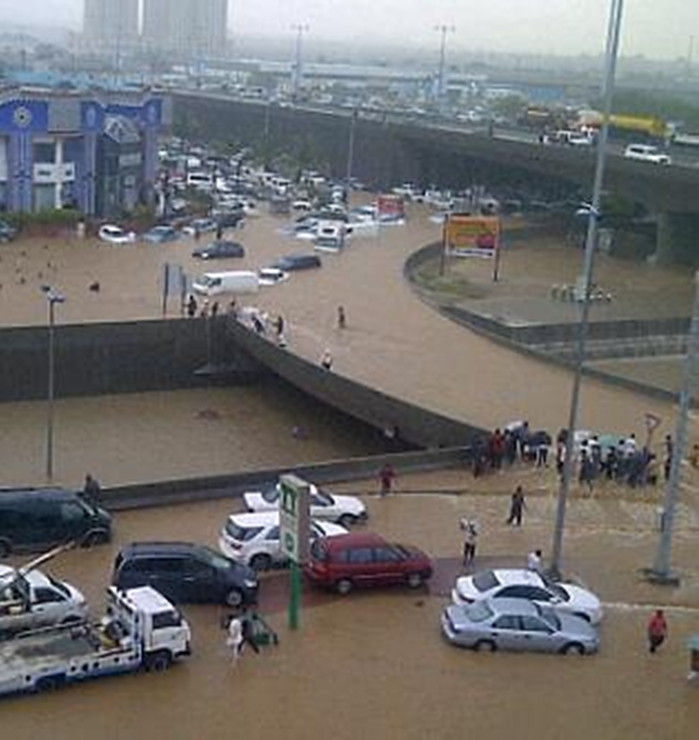
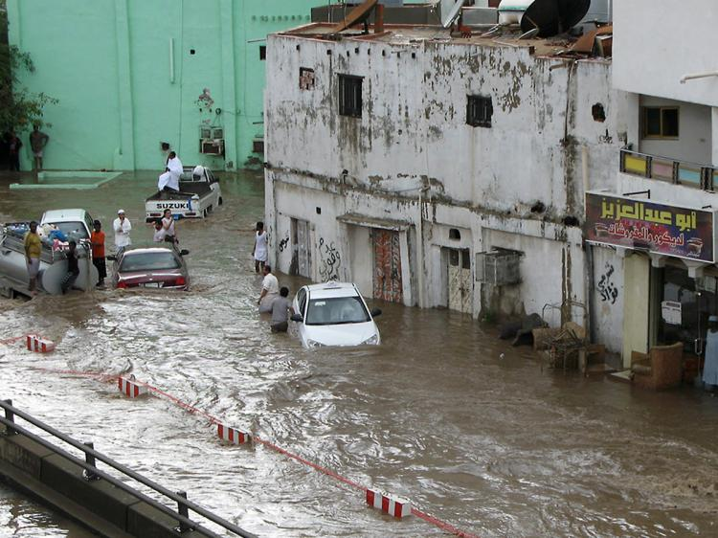
Disastrous flash flooding PROBLEMS devastate Jeddah and cause major damage and loss of life
3.5” of rain in 4 hours on
November 25, 2009
4” of rain in 4 hours on
January 26, 2011
Notes:
Catalyst for this program after the January 2011 flood, AECOM involved with emergency work Feb – April. April RFQ and May 1st selected contract signed May 14th– super sonic.
Engineering and CM services for Jeddah Stormwater Drainage Program
The norm is intense less than 6 hour storms
Um Al Khair breeched in 2011
Major casualties from flash flooding lead to action
472 people lost on September 11, 2009
160 people lost on January 26, 2011

Slide 22
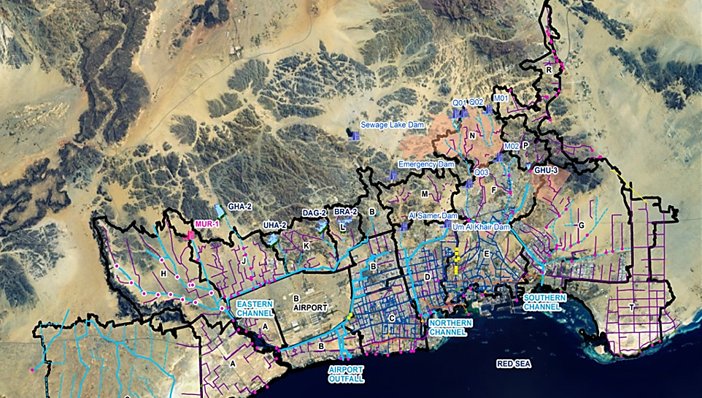
Program solutions prioritized from urgent to long-term to prepare for the future
The solutions
NORTH
Notes:
Paul, this slide is the proposed stormwater master plan
Protect city from rain from mountains
I – immediate protection of center of the urban area
II – H and G watersheds end protection of the north and south sides of the city
III – implementation of the master plan

Slide 23
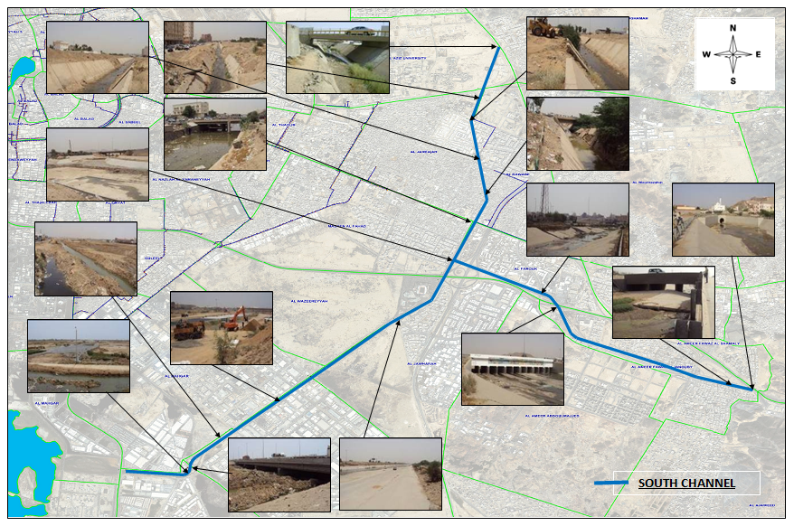
RESULTS prove to bring relief to Jeddah
Assessment of existing infrastructure

Slide 24
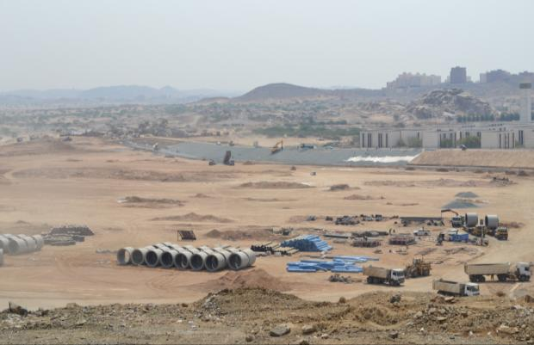
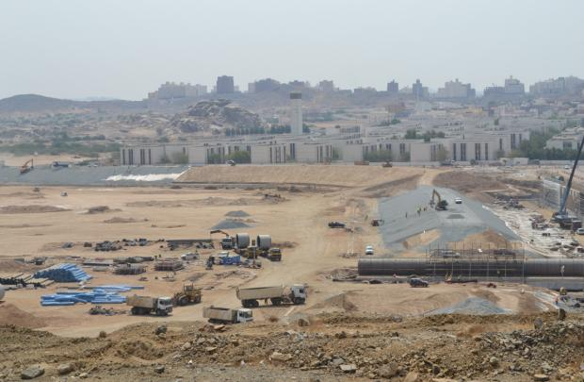
Um Al Khair Dam
The results
Notes:
Design-built plans started 6 weeks after the contract was signed. Construction was substantially completed by November 1.
Um Al Khar means Mother of Optimism (verified by Sam Talje) – and believe this is one of the first dams they construction, interesting factoid.

Slide 25
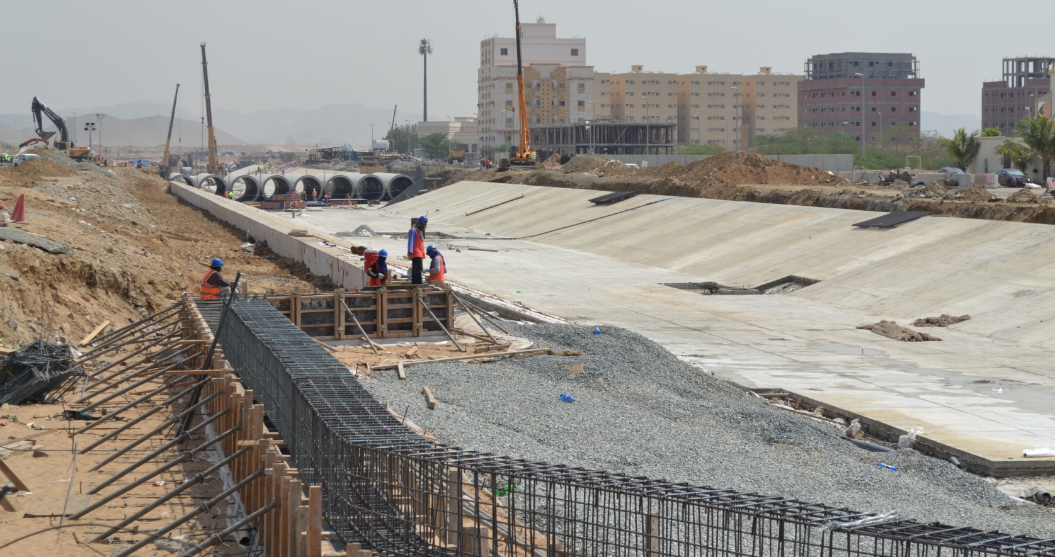
Um Al Khair Outlet Channel
The results
Notes:
Outlet

Slide 26
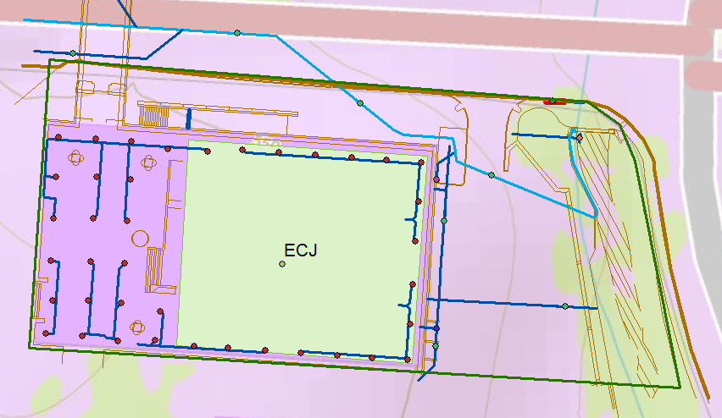
Study Area: Cockrell Hall(ECJ)

Slide 27
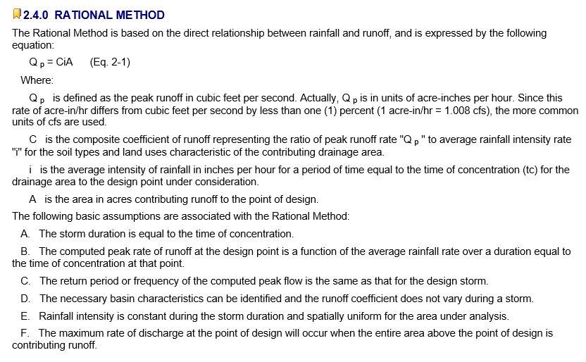
Rational Method
Source: Austin Drainage Criteria Manual, Chapter 2

Slide 28
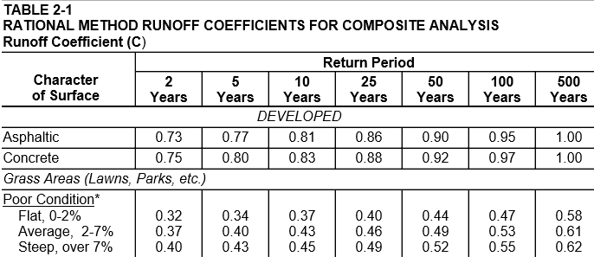
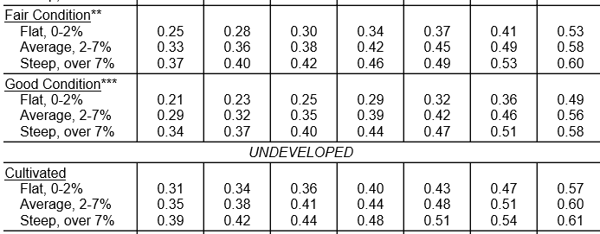
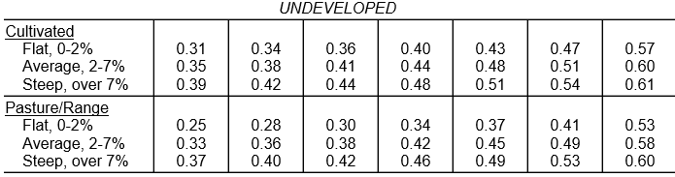

Source: Austin Drainage Criteria Manual, Chapter 2

Slide 29
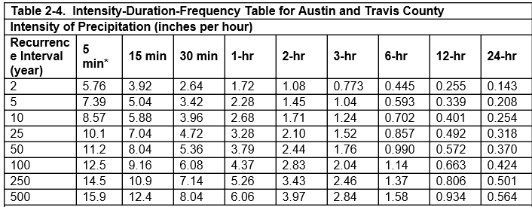
Intensity-Duration-Frequency Curves

Slide 30
Sheet Flow
Rainfall intensity, i
L
A
A
1 ft
s
L
1
v
B
B
q, discharge per unit width
q = iL = vy
y

Slide 31
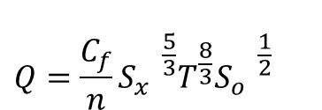
Gutter Flow
$$Q=\frac{C_{f}}{n}{{{S_{x}^{}}^{\frac{5}{3}}T^{\frac{8}{3}}{S_{o}^{}}^{\frac{1}{2}}}_{}^{}}^{}$$
T
d
S_{x}
1
Q = flow in gutter (cfs)
C_{f} = coefficient (0.56 for US units, 0.376 for SI units
S_{o} = longitudinal slope
T = spread (ft)
S_{x} = transverse slope
Ref: SCMD p. 372

Slide 32
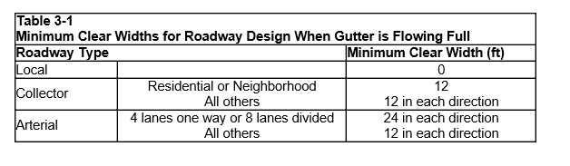
City of Austin Drainage Criteria for Minimum Clear Width
City of Austin, Drainage Criteria Manual, Section 3

Slide 33
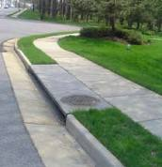
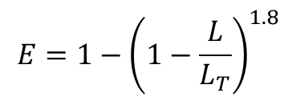
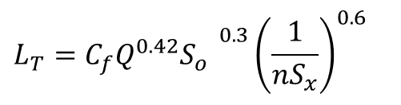
Flow into a Curb Inlet
L_{T}
$$L_{T}={{{C_{f}Q^{0.42}S}_{o}^{}}^{0.3}{\left(\frac{1}{nS_{x}}\right)}^{0.6}}_{}$$
L_{T} = required length to intercept all flow (ft)
Q = flow in gutter (cfs)
C_{f} = coefficient (0.60 for US units, 0.817 for SI units)
S_{o} = longitudinal slope
T = spread (ft)
S_{x} = transverse slope
$$E=1−{\left(1−\frac{L}{L_{T}}\right)}^{1.8}$$
E = efficiency (proportion of flow captured
L = actual length (ft) (for L < L_{T})
Ref: SCMD p. 393

Slide 34
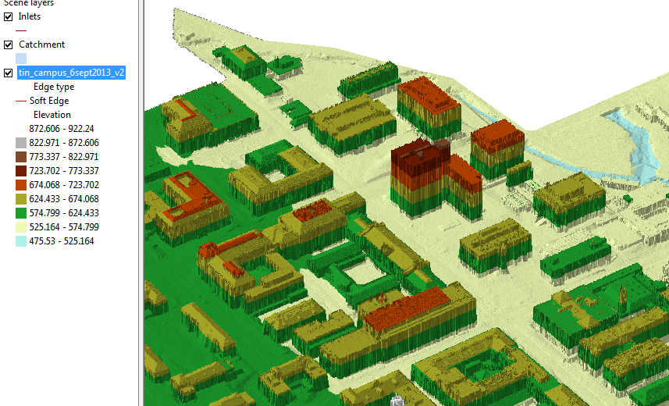
TIN of the North East part of campus
ECJ

Slide 35
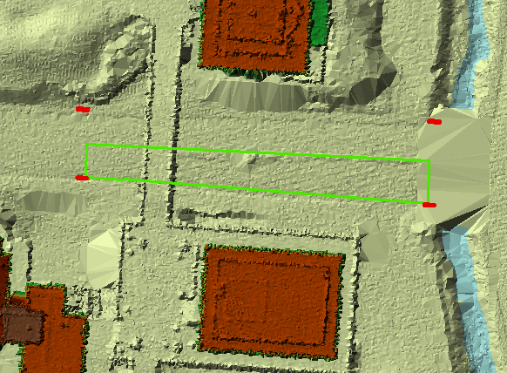
Airborne LIDAR coverage of Dean Keaton St and surroundings
CrossSection 56
Location

Slide 36
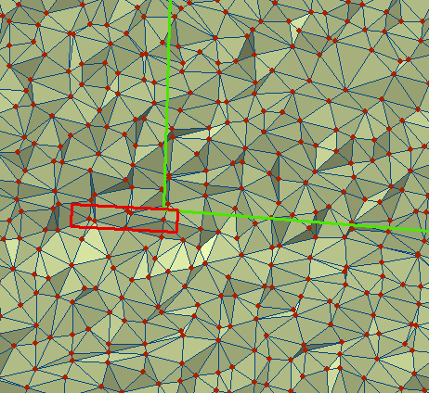
TIN of a portion of Dean Keaton St

Slide 37
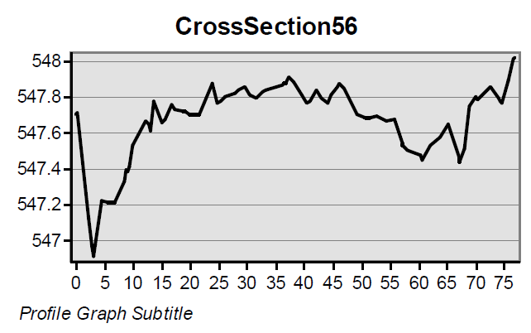
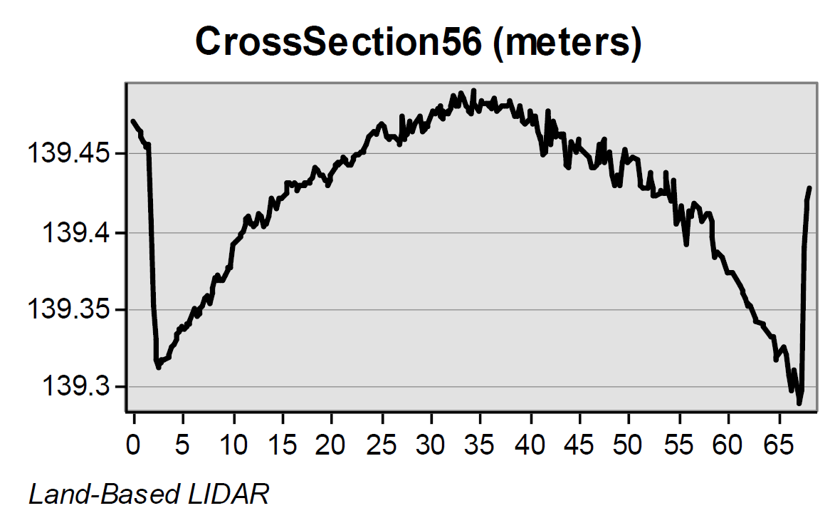
Road CrossSections from LIDAR
Location 5-6 is shown
in previous slides
Airborne LIDAR (ft)
(City of Austin data)
Its clear that the vehicle-based
LIDAR gives a better definition
of the road Cross-Section
Vehicle LIDAR (m) (Mandli Communications)

Slide 38
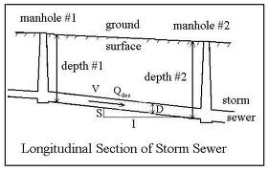
Storm Sewer Flow

Slide 39
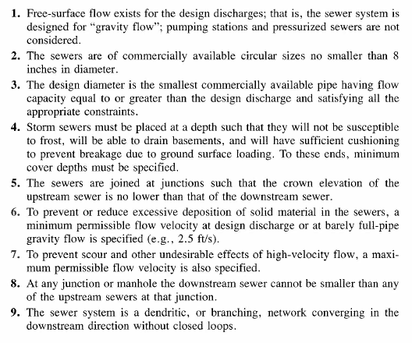
Storm Sewer Design Principles

Slide 40
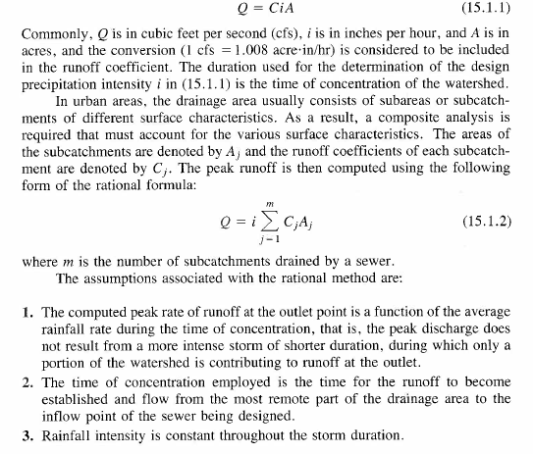
Rational Method for Composite Areas

Slide 41
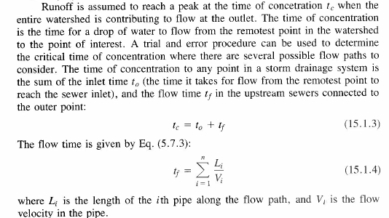
Inlet Time and Flow Time

Slide 42
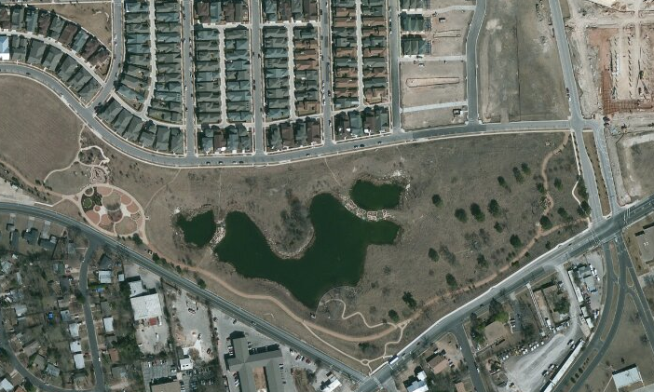
Flood Detention and Water Quality Pond

Slide 43
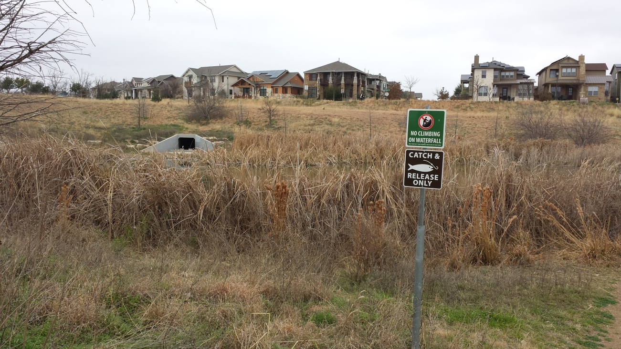
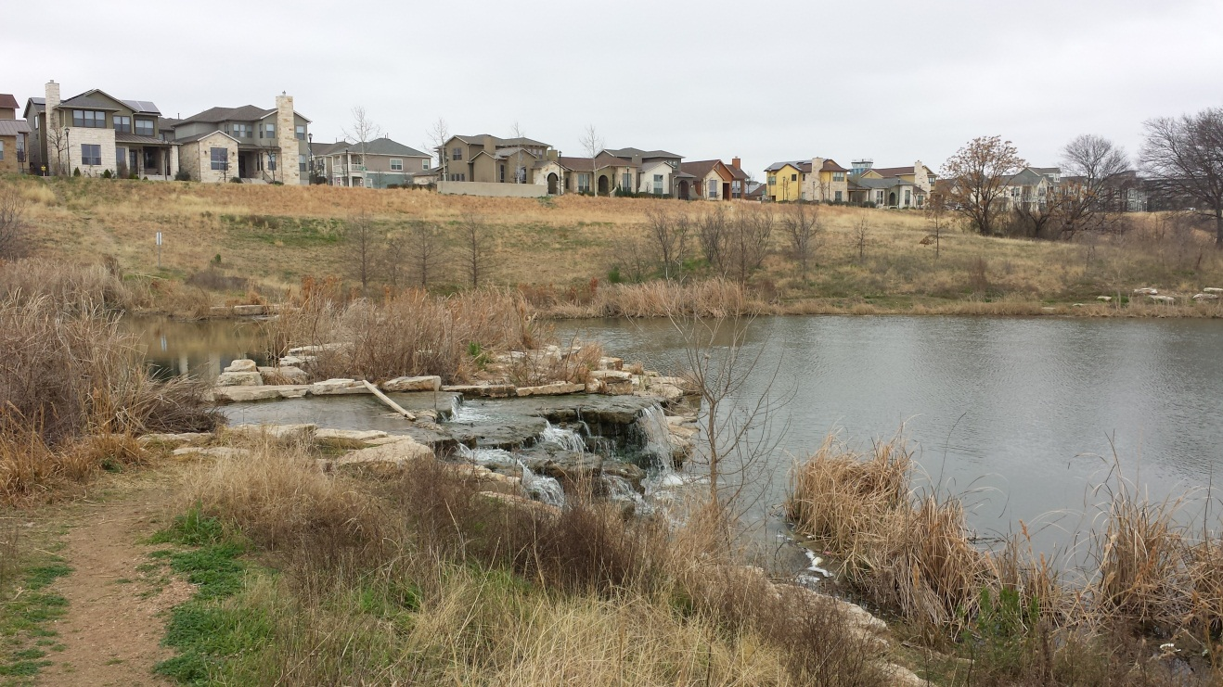
Mueller Wet Pond
Stormwater Outlet and
Upper Pond
Back pumping
Aeration System and
Lower Pond

Slide 44
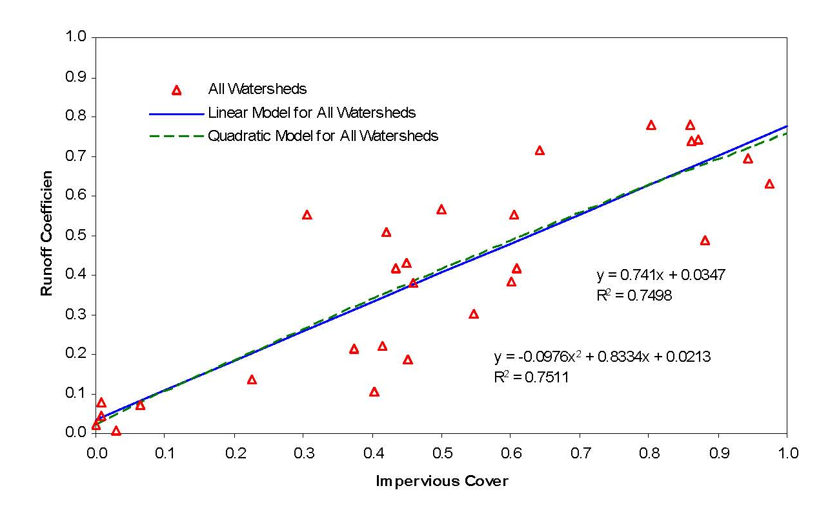
Impervious Cover and Runoff

Slide 45
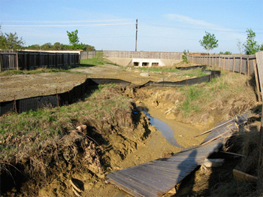
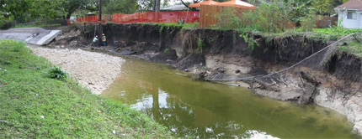
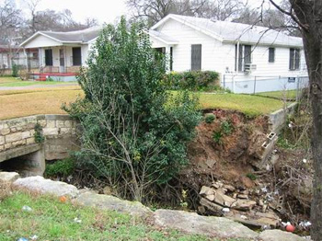
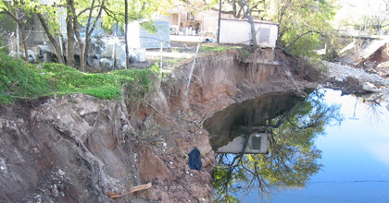
Channel Degradation
Bear Creek
Fort Branch
ShoalCreek
Boggy Creek

Slide 46
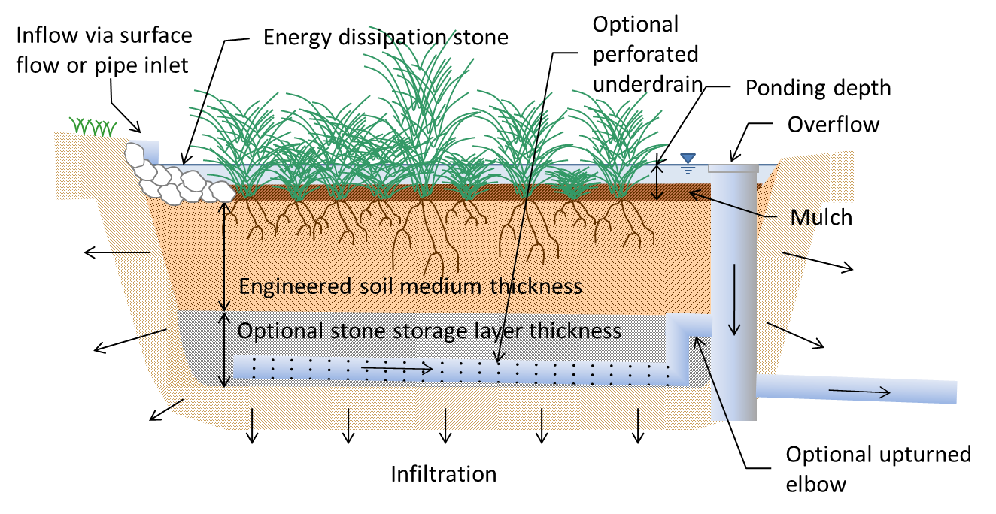
Bioretention

Slide 47
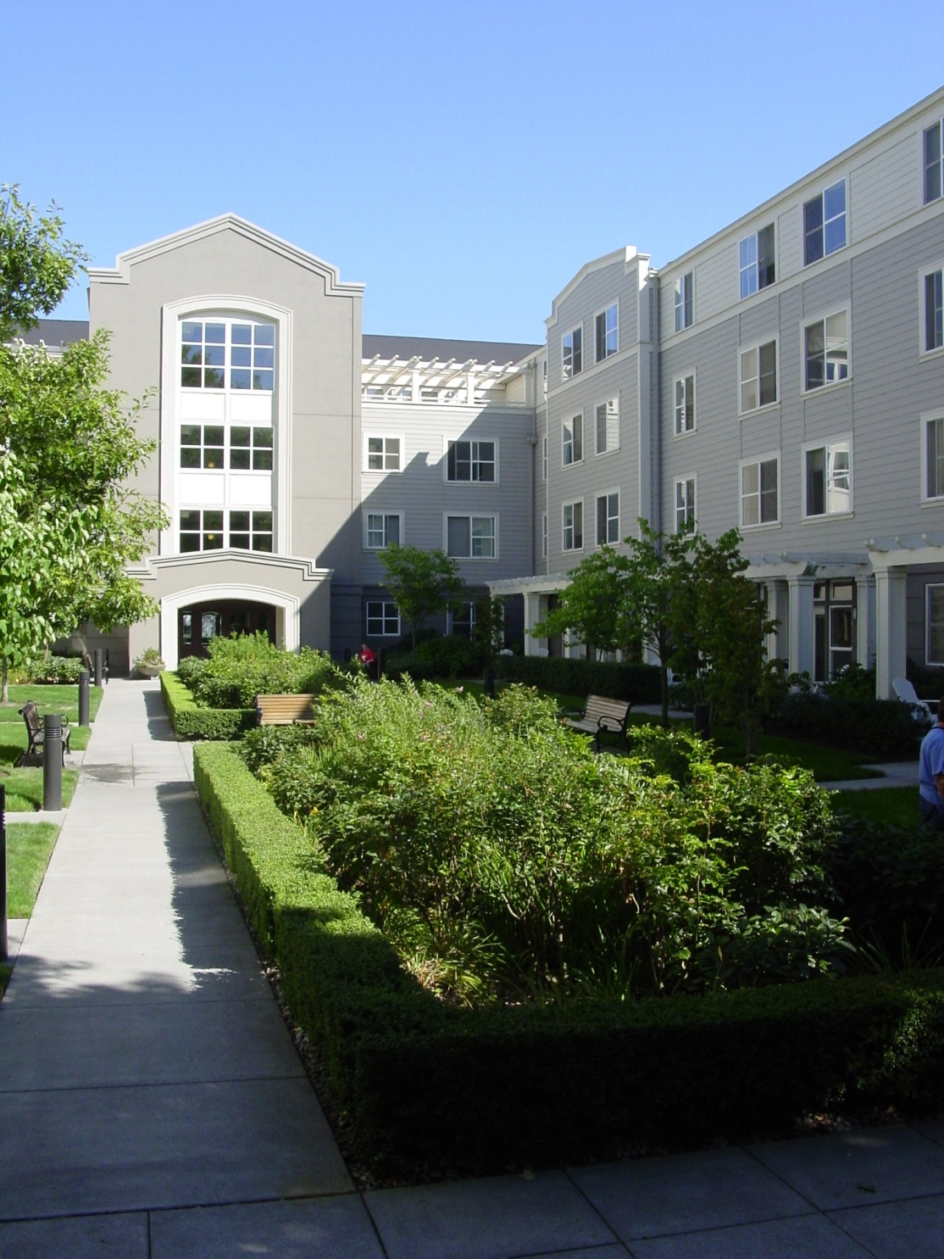
Bioretention

Slide 48
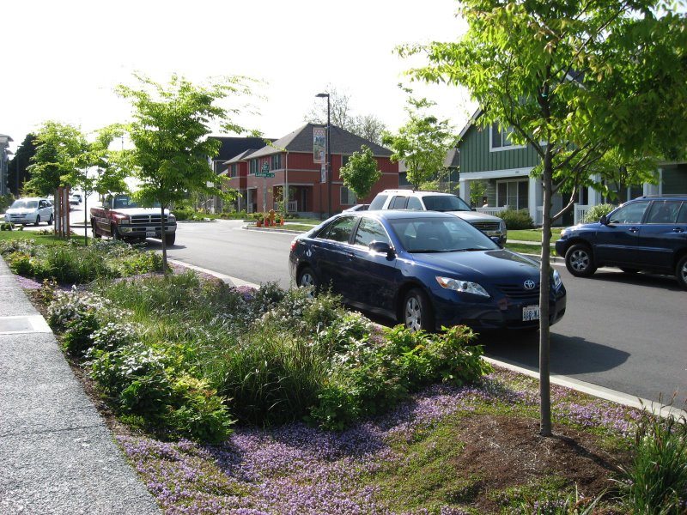
Curbside Bioretention

Slide 49

Porous Pavement only in Parking Stalls

Slide 50
Vegetated Filter Strips

Slide 51

Green Roofs

