Slide 1
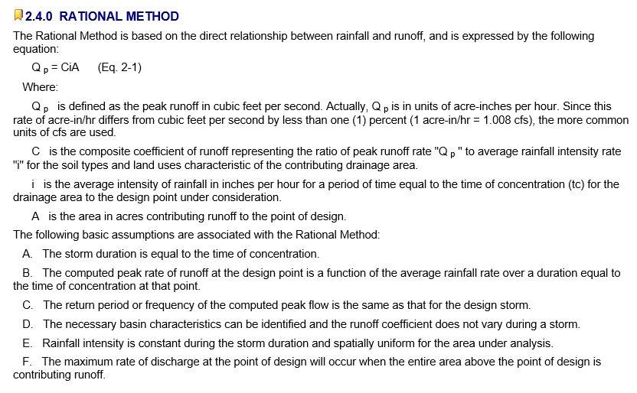
Rational Method
Source: Austin Drainage Criteria Manual, Chapter 2

Slide 2
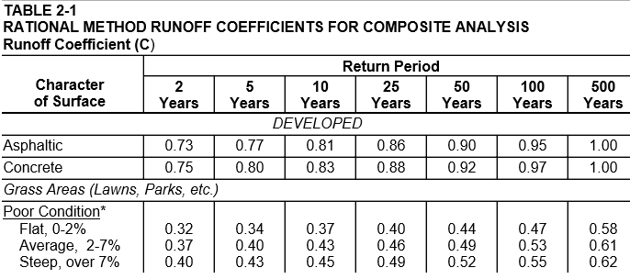
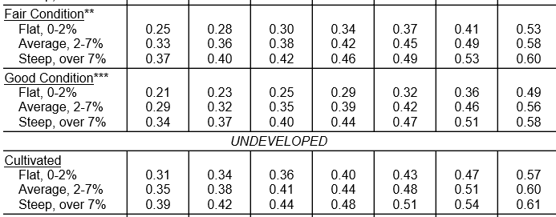
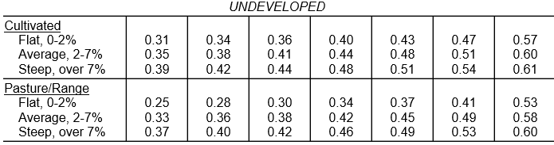

Source: Austin Drainage Criteria Manual, Chapter 2

Slide 3
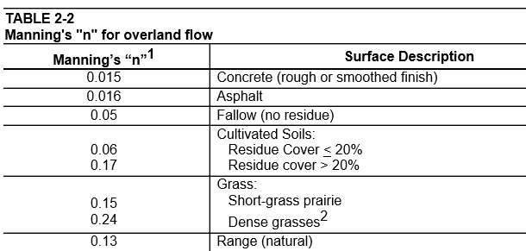
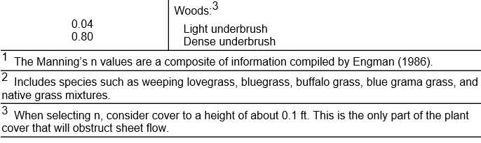
Manning’s N values

Slide 4
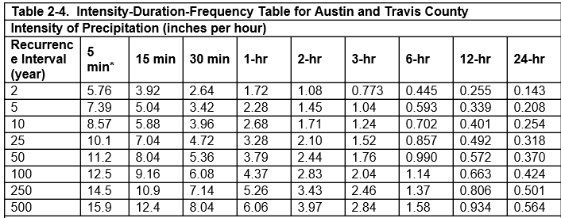
Intensity-Duration-Frequency Curves

