Slide 1
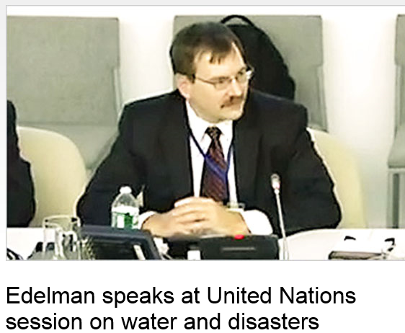
Scott Edelman Global leader for water resources at AECOM – coming to visit EWRE on February 18
http://www.aecom.com/News/Where+We+Are/Americas/_news/Edelman+speaks+at+United+Nations+session+on+water+and+disasters

