Slide 1
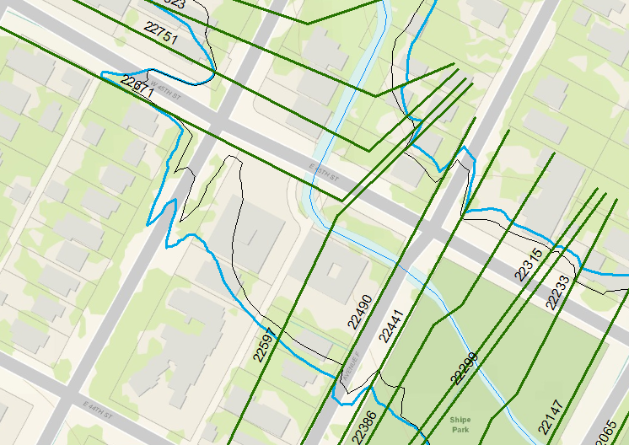
Stations on Waller Creek (STN_T_)

Slide 2
Waller Creek HEC-RAS model

Slide 3
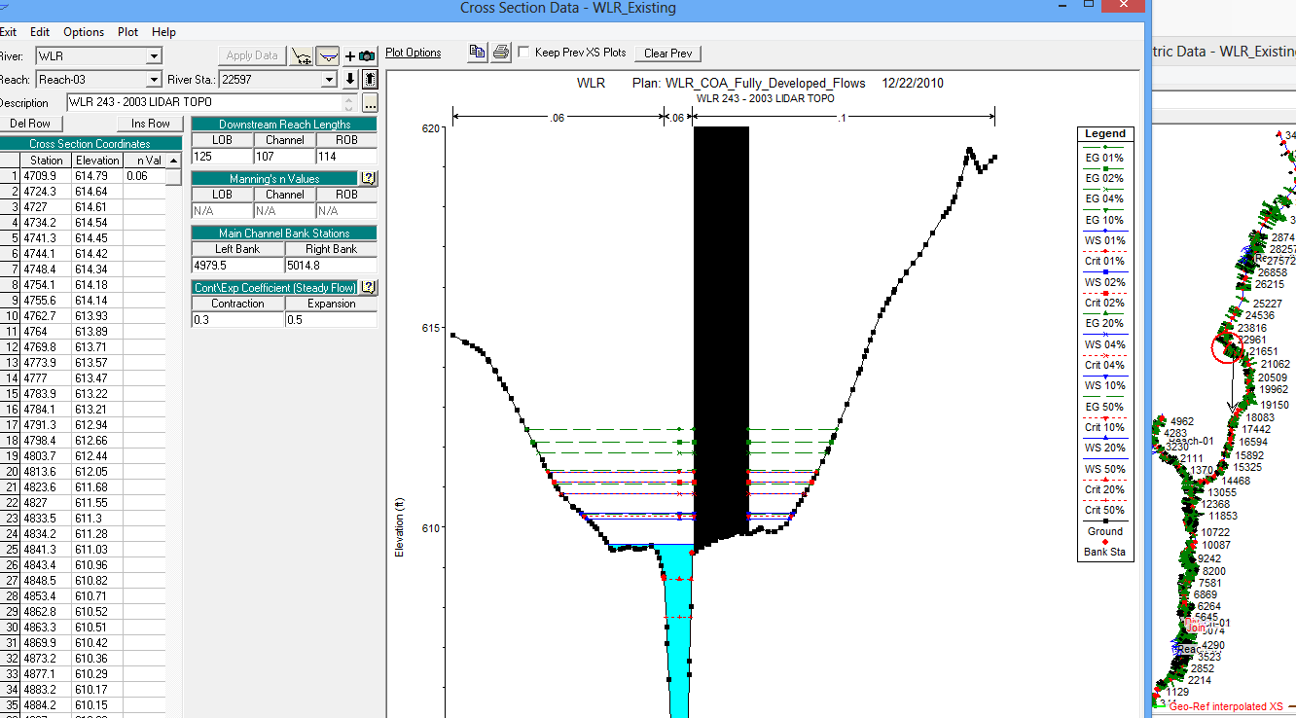
HEC-RAS Model – Waller Creek at 45th St (Station 22597)

Slide 4
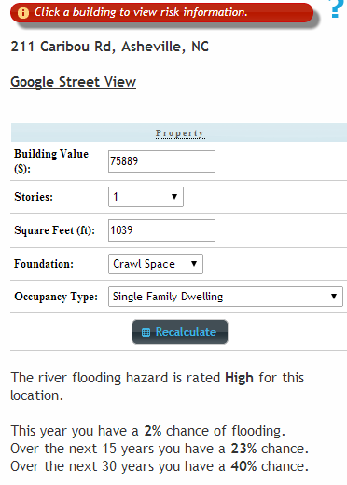
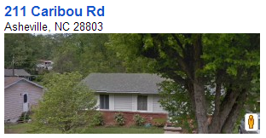
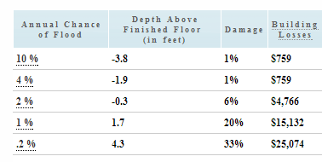
Annual Flood Damage

Slide 5
Return Periods of Floods
Exceedance % | Exceedance Prob | Return Period (Yr)
1 | 0.01 | 100
2 | 0.02 | 50
4 | 0.04 | 25
10 | 0.10 | 10
20 | 0.20 | 5
50 | 0.50 | 2

Slide 6
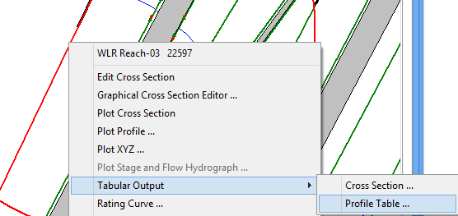
Water Surface Elevations

Slide 7
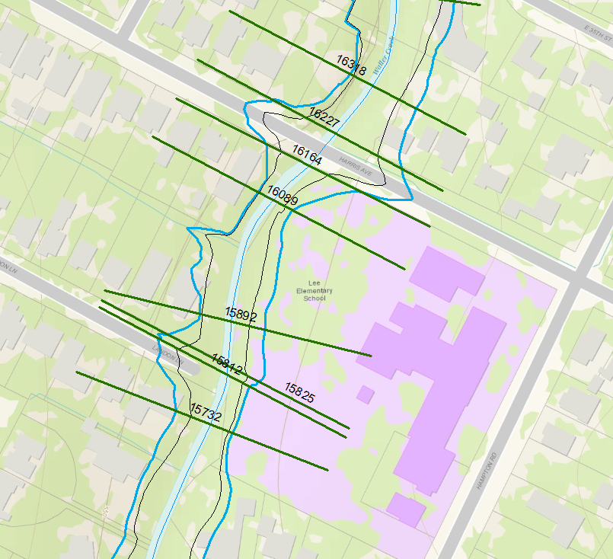
Cross-Sections at Lee Elementary School

Slide 8
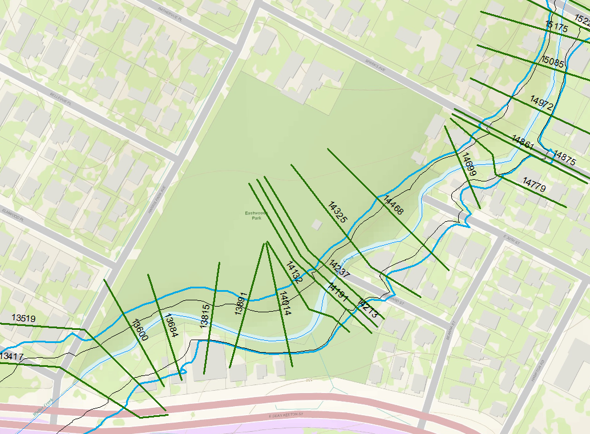
Cross-Sections at Eastwoods Park

Slide 9
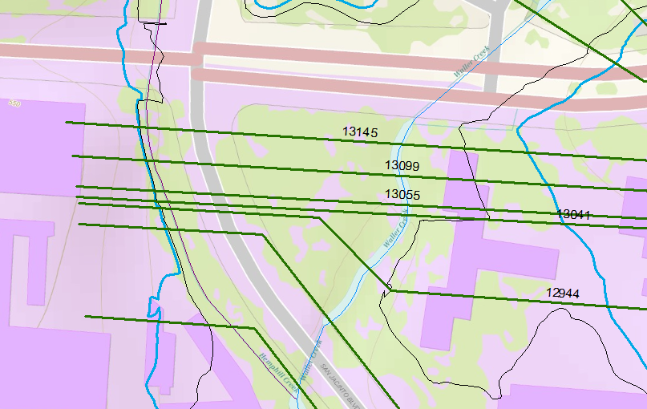
Cross-Sections at ECJ

Slide 10
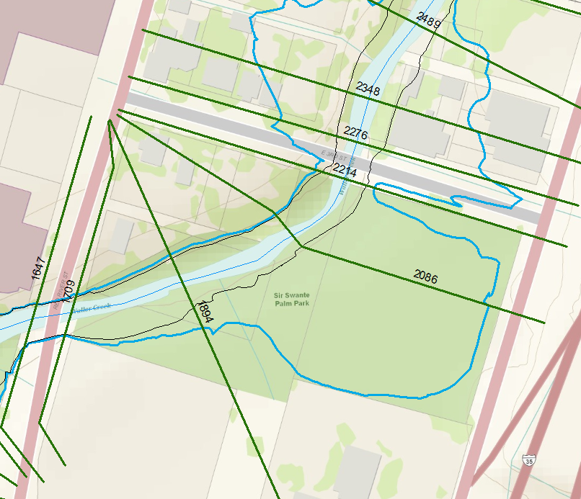
Cross-Sections at Palm Park

