Slide 1
Bob Bullock Museum Parking Lot Rain Gardens
Melody Quach
Gregory Latimer
Dillon Armas
Isabella Albino

Slide 2
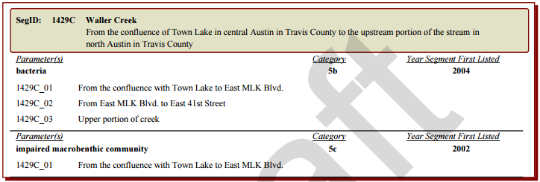
Hydraulic Design Problem
Impervious cover leads to:
Pollution
Flooding
Erosion
Reduced biological diversity
https://www.tceq.texas.gov/assets/public/waterquality/swqm/assess/14txir/2014_303d.pdf
Source: http://www.dem.ri.gov/programs/bpoladm/suswshed/pdfs/imperv.pdf

Slide 3
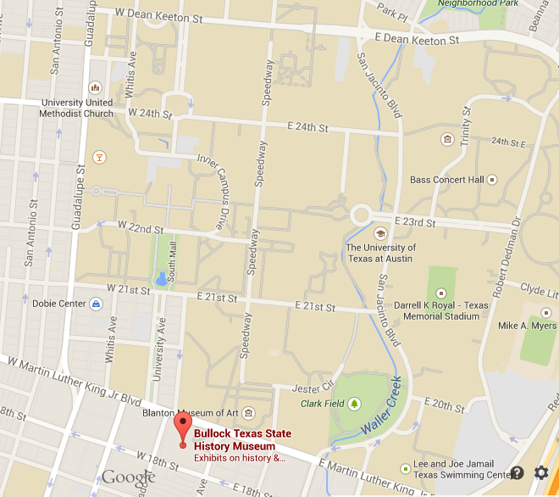
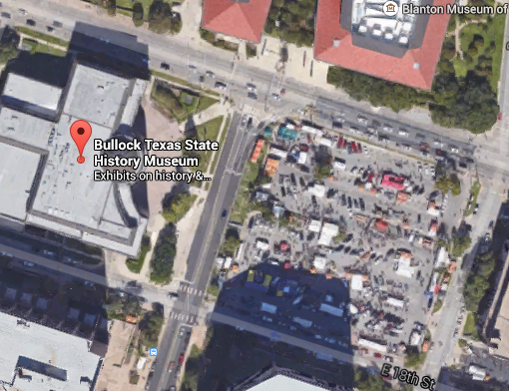
Location
N

Slide 4
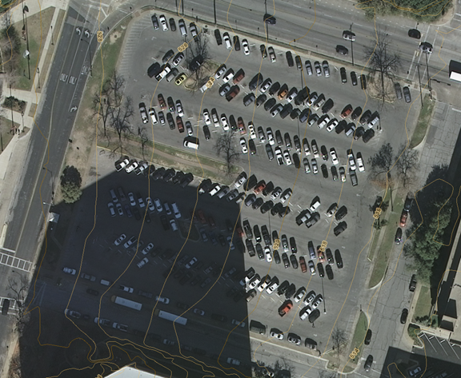
Location
On-Site Drainage Patterns
Waller Creek

Slide 5
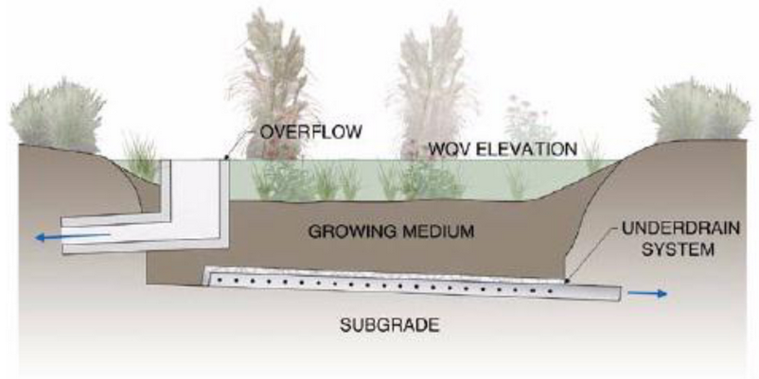
Hydraulic Design
Objectives
Develop full filtration rain gardens
Improve parking lot appearance
Reduce overall runoff and pollution
Constraints
Parking space number and ease of parking
Onsite trees and curbs

Slide 6
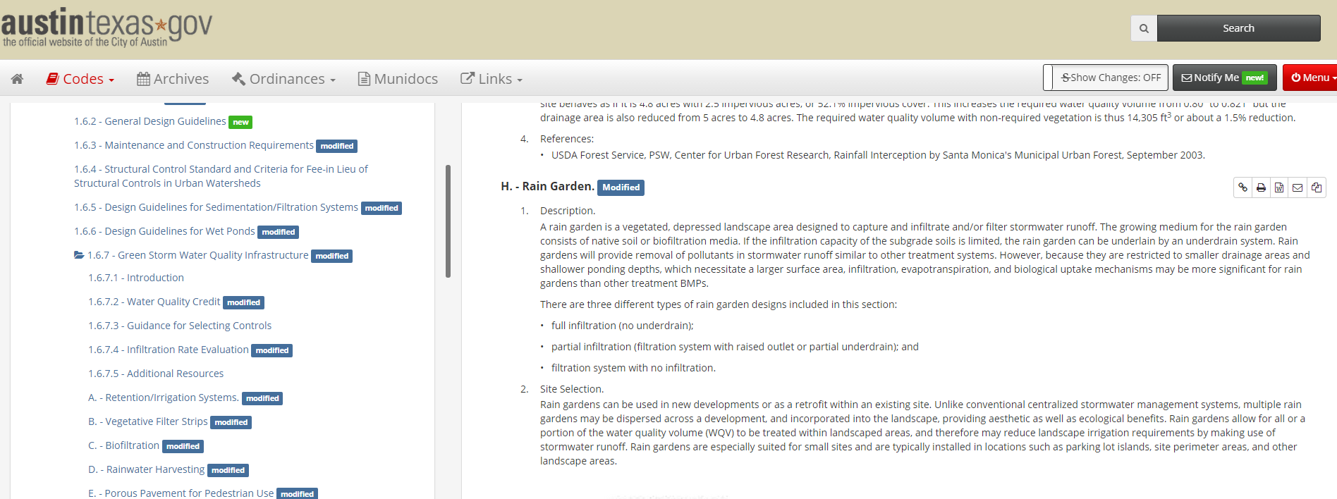
Hydraulic Design
Research resources:
Dr. Barrett
BIG RED DOG Engineering
City of Austin Environmental Criteria Manual

Slide 7
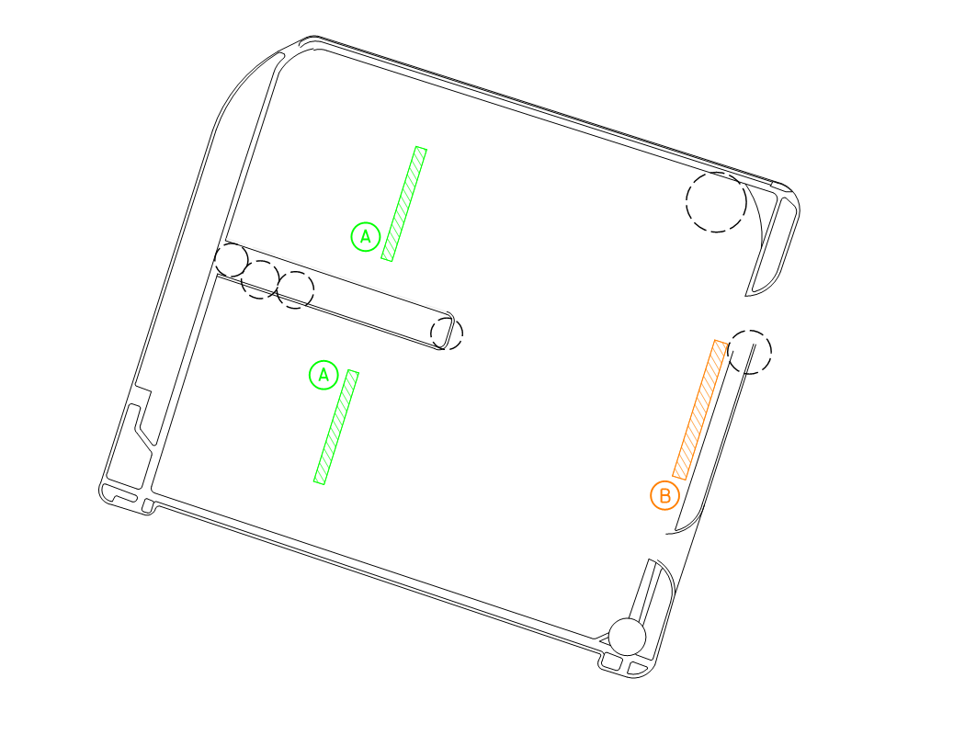
Hydraulic Design
Rain Garden
Drainage Areas
DA 2
DA 3
N
DA 2

Slide 8
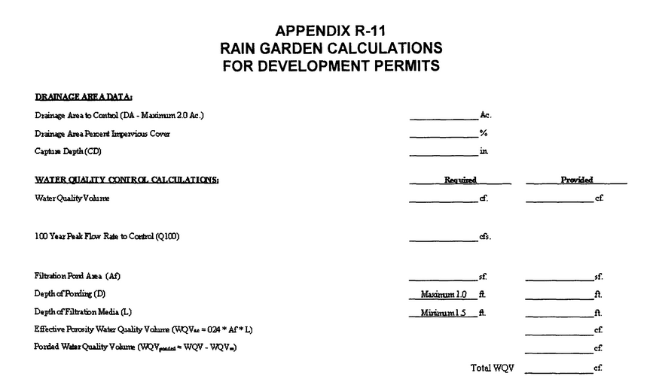
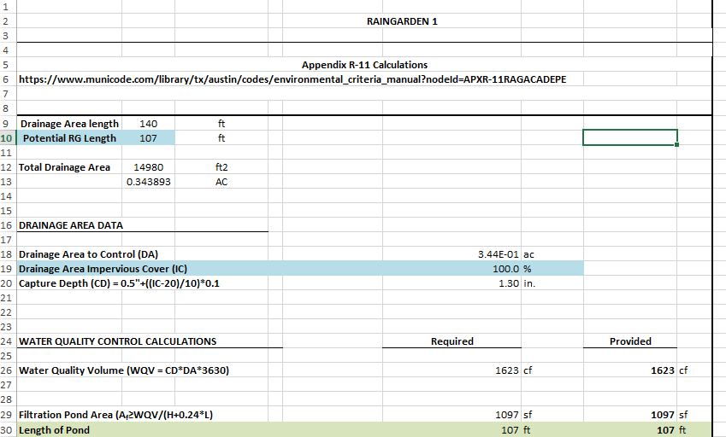
Hydraulic Design
Rain Garden Calculations
Source: City of Austin ECM

Slide 9
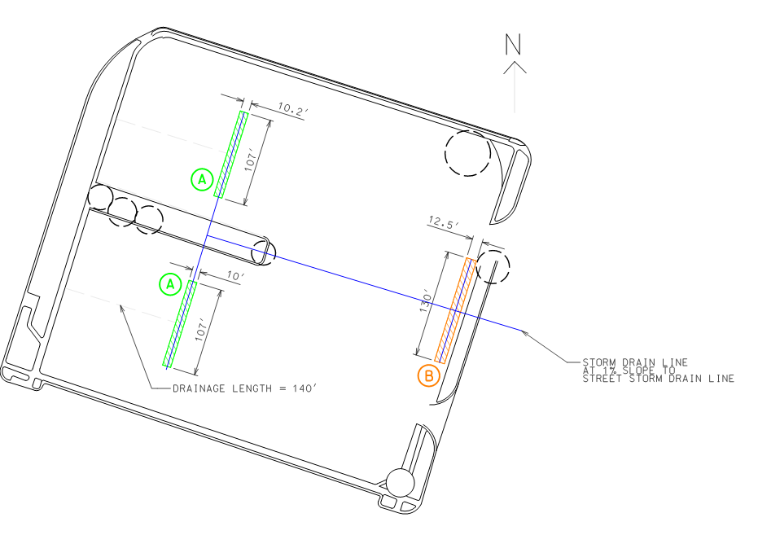
Construction Details
Plan View

Slide 10
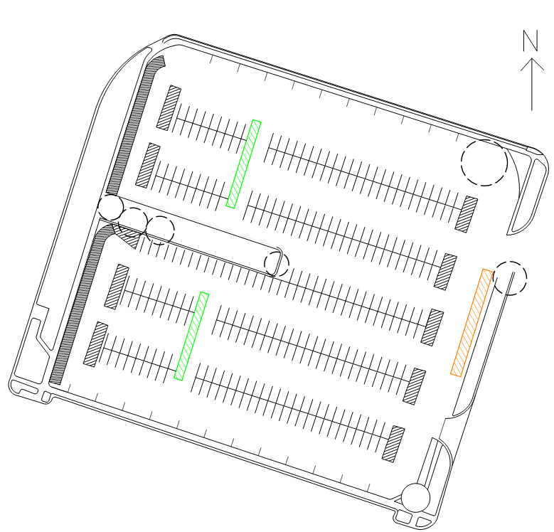
Construction Details
Plan View

Slide 11
Construction Details
Note: Rain Garden “B” will not have curb cuts on the eastern side and will have an overflow pipe instead

Slide 12
Construction Details
Detail Profile View
Note: Underdrain pipes are perforated

Slide 13
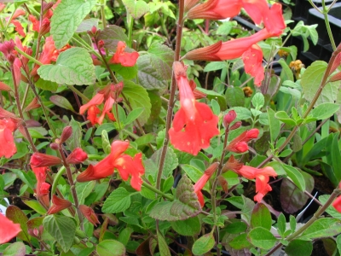
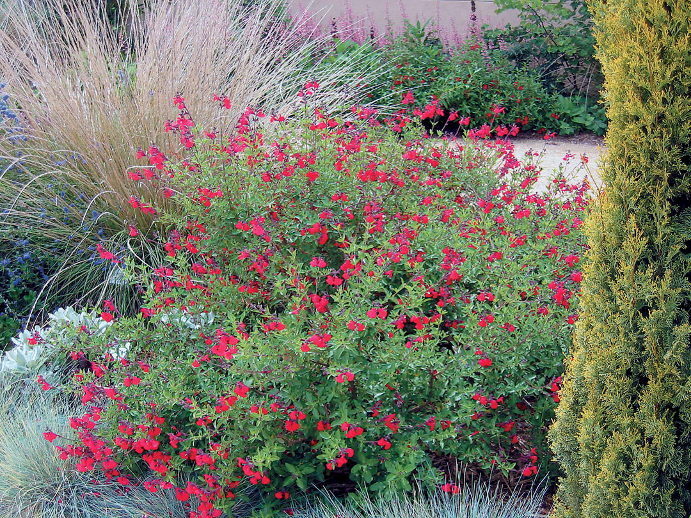
Construction Details
Possible Plants
Cherry Sage
Native Plant
Full Sun and Dry Soil
Attracts Butterflies and Hummingbirds
Blooms Heavily in Spring and Fall
Notes:
http://www.wildflower.org/plants/result.php?id_plant=SAGR4

Slide 14
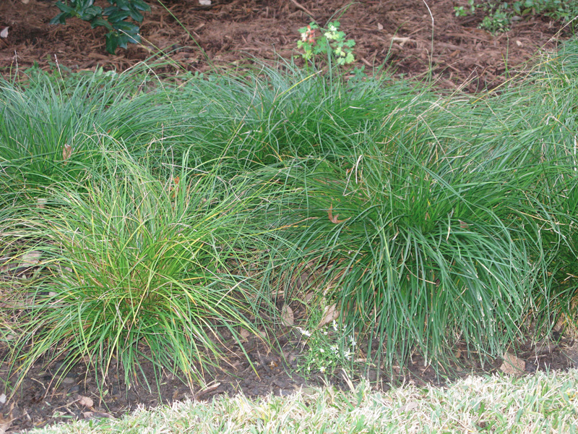
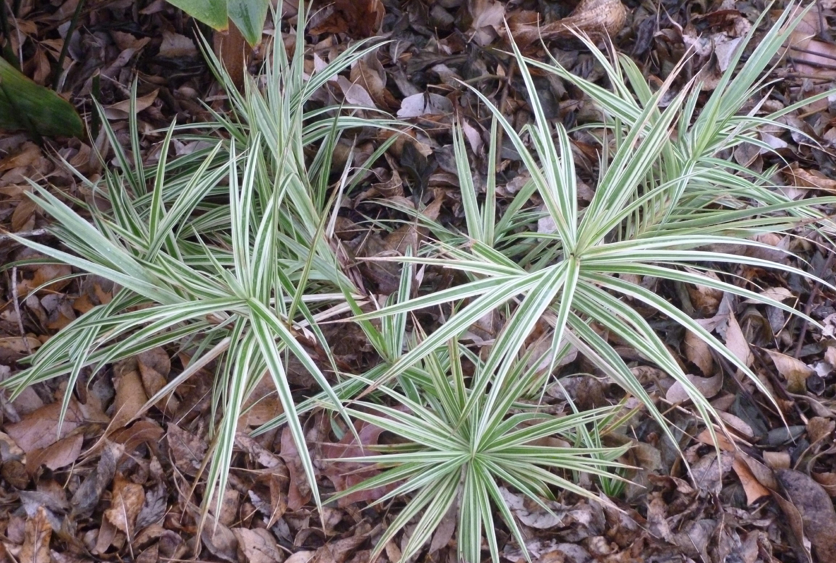
Construction Details
Possible Plants
Sedge
Native Plant
Sun/Partial Shade and Dry to Moist Soil
Attracts birds
Good Groundcover
Notes:
http://www.wildflower.org/plants/result.php?id_plant=CAPE6

Slide 15
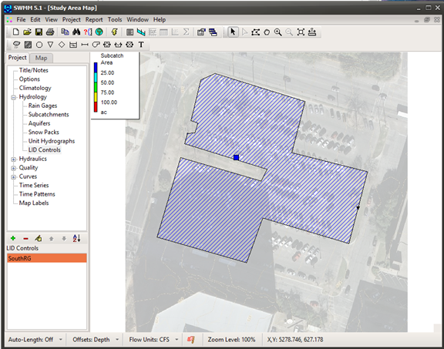
Impact Analysis
StormWater Management Model (SWMM)
Utilize SWMM to analyze the effectiveness of the proposed rain gardens

Slide 16
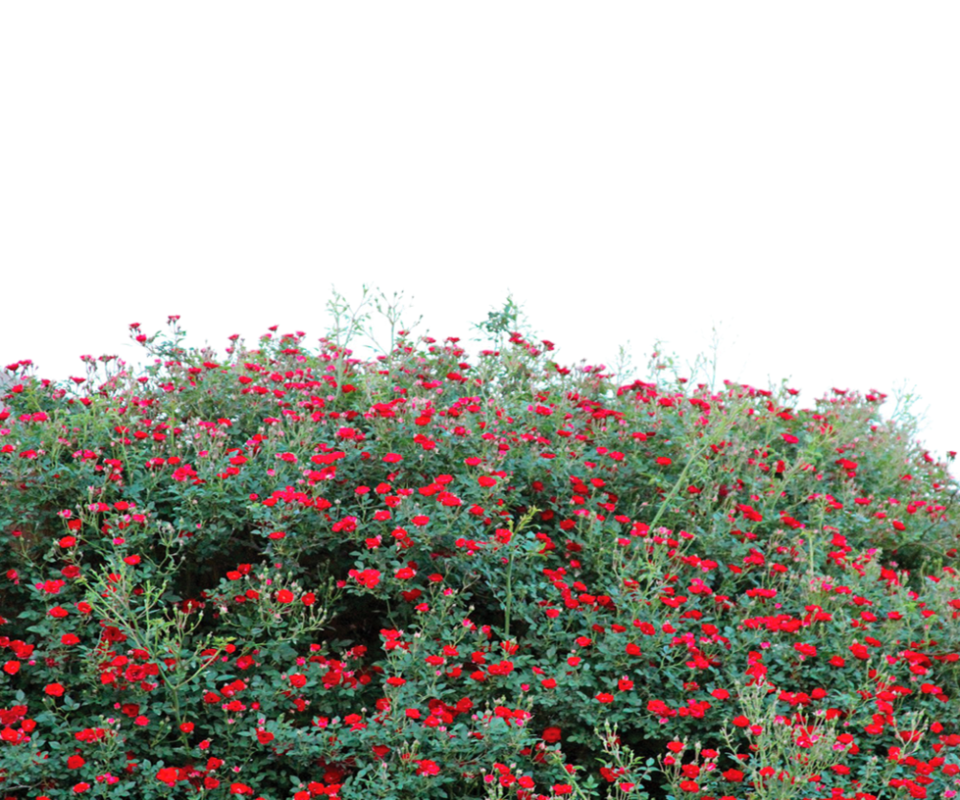
Thank you!

