Slide 1
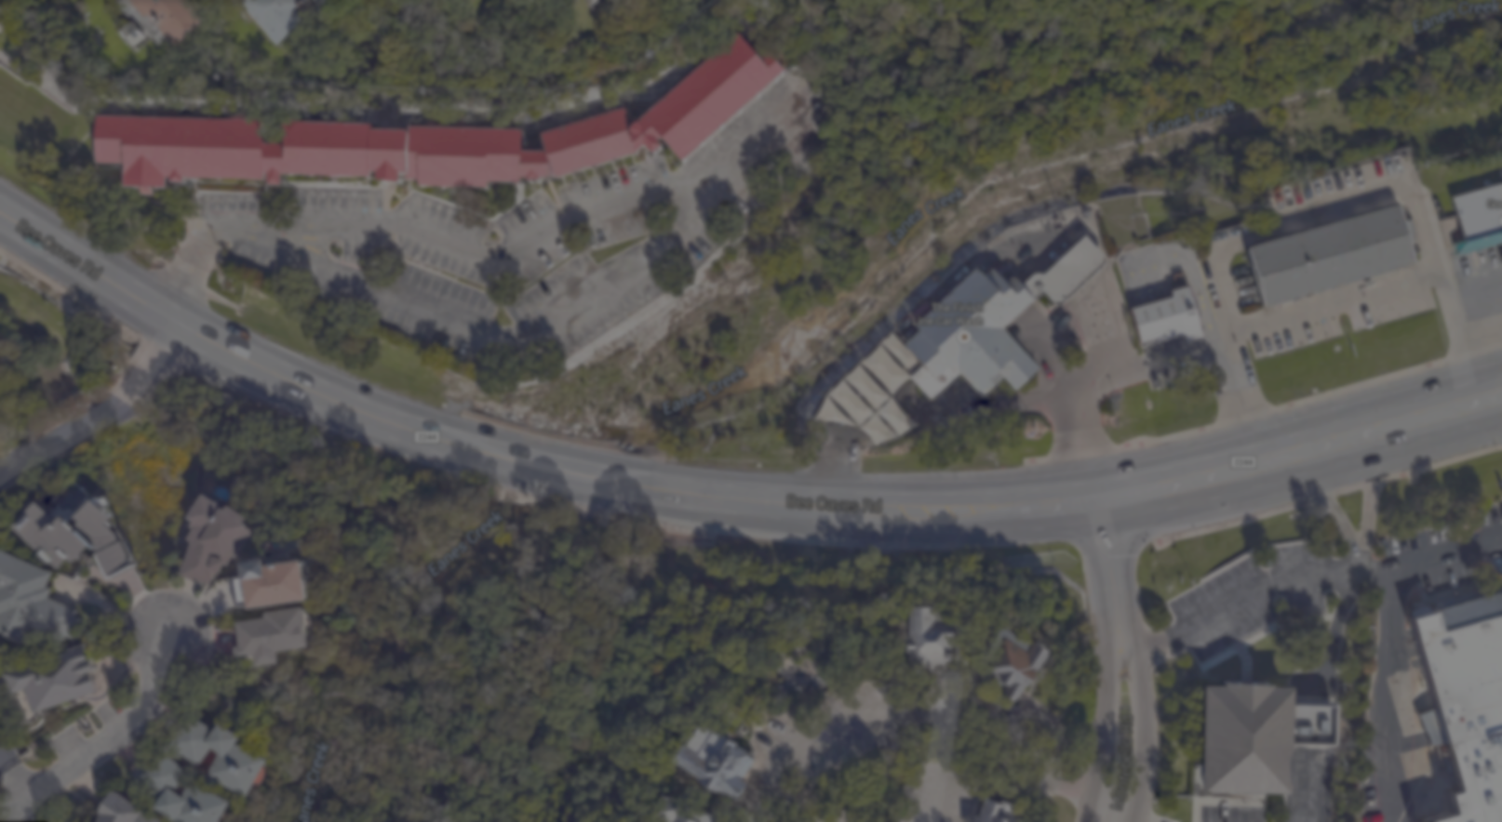
Eanes Creek
Hydraulic Redesign
TEAM 11:
AMYRIZ GARCIA, DAVID VARGAS,
CHRISTIN LEEM, PETER HARTLEY

Slide 2
Overview
Hydrodesign Process
Representation
Process
Evaluation
Change
Impact
Decision
Possible Solutions

Slide 3
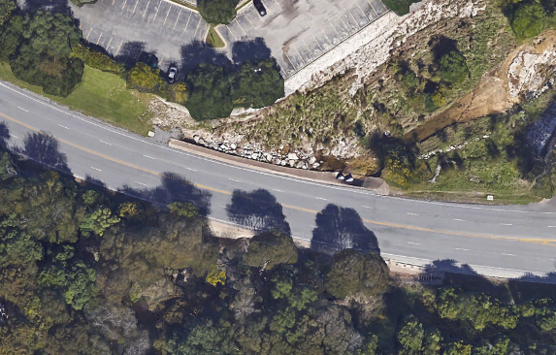
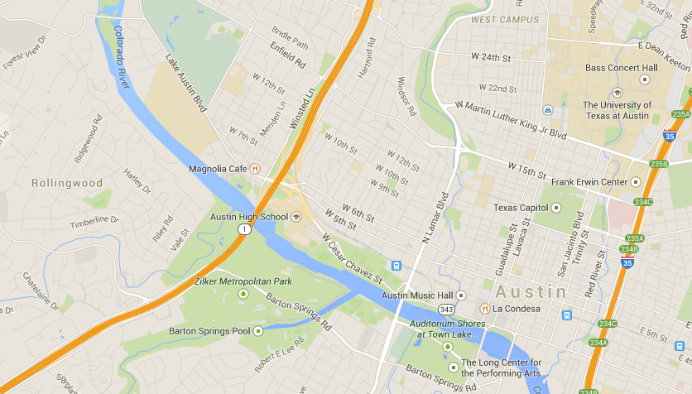
Representation Location
Source: Google Maps
Notes:
Talk about the geographical location about the problem area.
In Rollingwood
Residential area with some small business offices/complexes

Slide 4
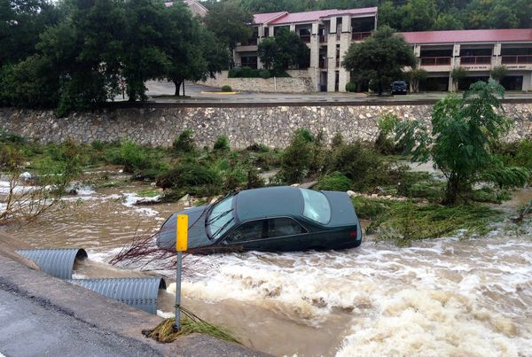
Representation Description
Dry Creek
  Flooding due to storms
Safety issue for motorists
  Floods sweep vehicles off Bee Caves Rd.
  No protection provided
Attempts of temporary reliefs made by locals
Source: Rollingwood Police Department
Notes:
Describe the area in more detail

Slide 5
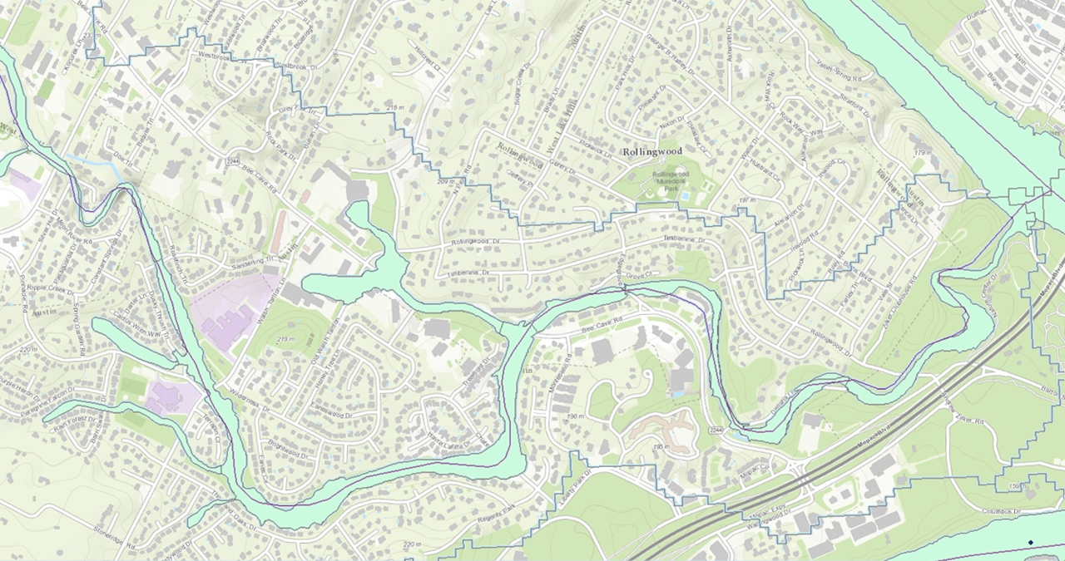
ArcGIS
Key:
Mean Flow Line
Warning Zone
Catchment Boundaries
Problem Area on . Bee Cave Road

Slide 6
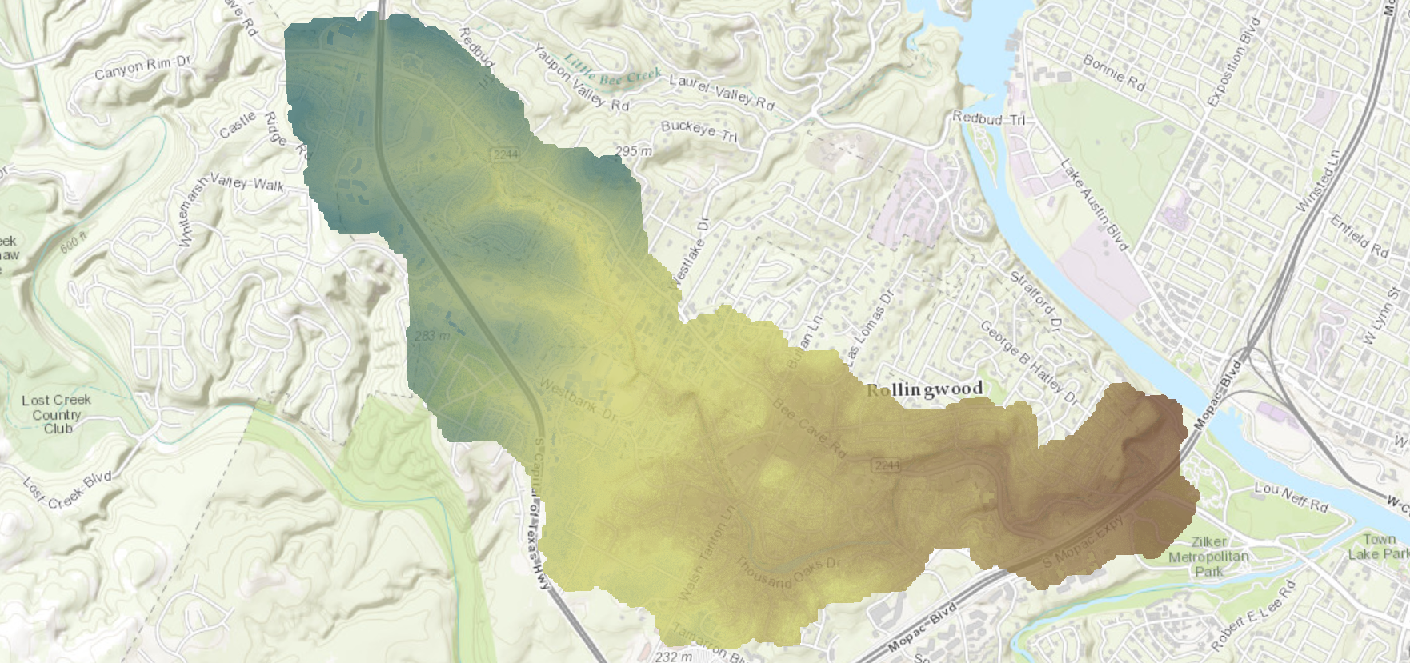
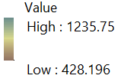
ArcGIS
ArcGIS - DEM
Problem Area on . Bee Cave Road

Slide 7
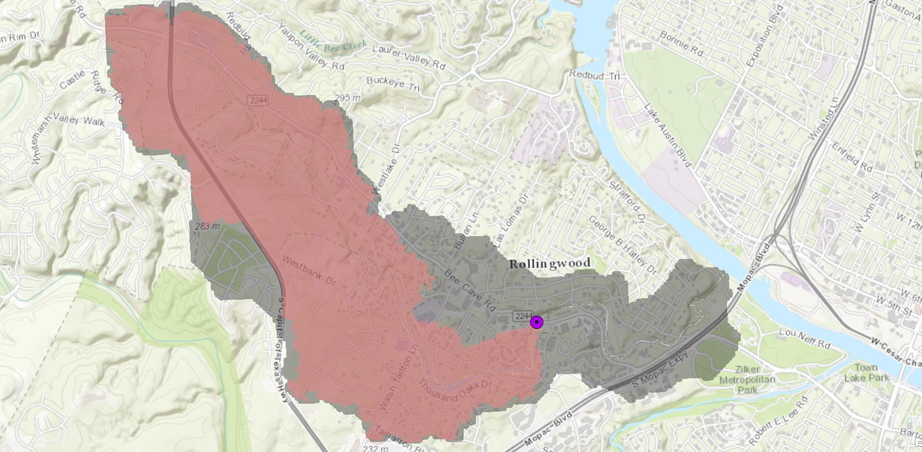

ArcGIS - Watershed Delineation
Cell Count: 700,791
Cell Size: 10’ x 10’ = 100 sq. ft.
DA = 70,079,100 sq. ft.
= 2.5 sq. mi.
Key:
Outlet Point
Drainage Area

Slide 8
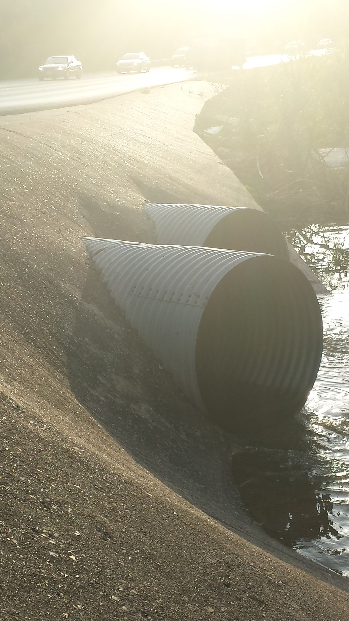
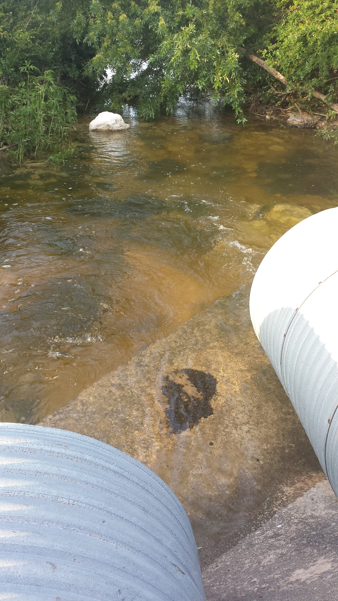
Process Current Status
Two culverts
  Shape: Circular
  Size: 42 in.
  Material: Aluminum
  Inlet Type: Projecting
Source: Photographs taken on 5.6.2015

Slide 9
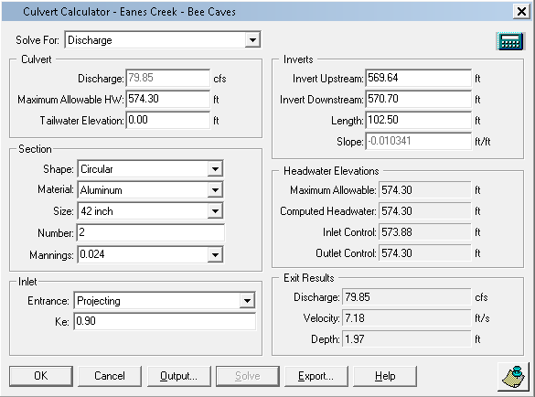
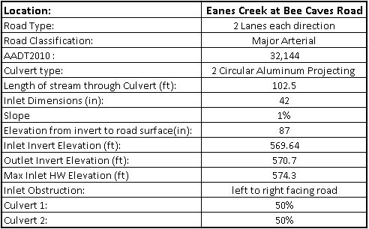
Evaluation Current Status

Slide 10
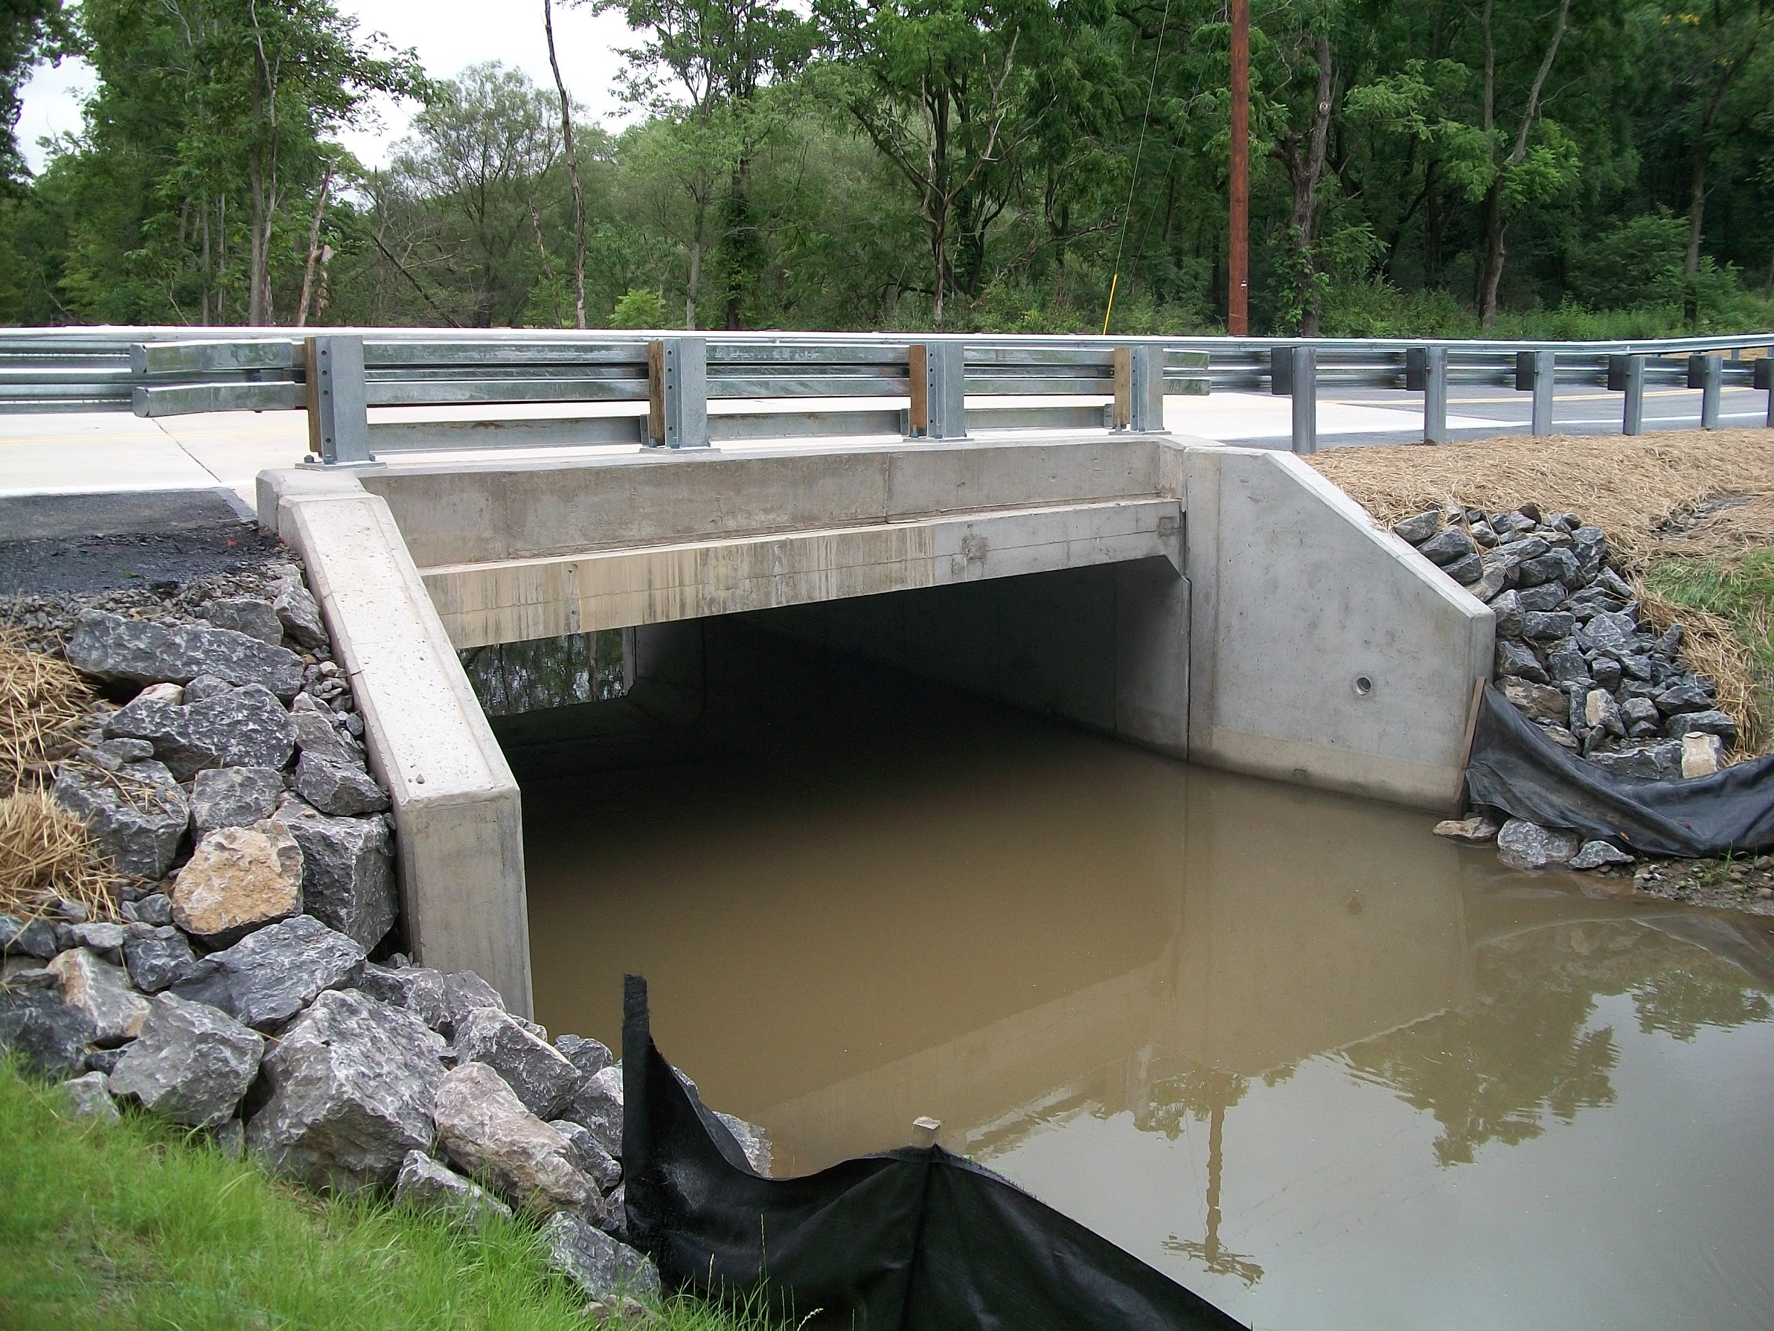
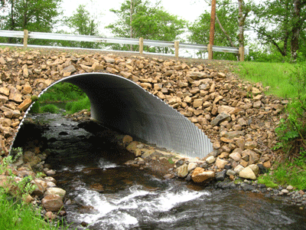
Change Possible Solutions
Redesign culvert
  Concrete box culvert
  Concrete arch culvert
  Aluminum arch culvert
Source: SR 168 Precast Concrete Box Culvert
Source: Wolfe Creek Aluminum Arch Culvert

Slide 11
Option 1 - Concrete Box Culvert Layout
Dimensions for 125% discharge
Size: 4 x 2 ft
Inlet entrance: 90 and 15 wingwall flares

Slide 12
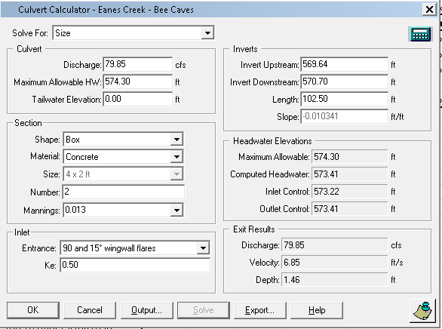
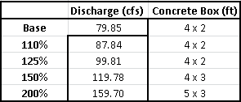
Option 1 - Concrete Box Culvert Analysis

Slide 13
Option 2 - Concrete Arch Culvert Layout
Dimensions for 125% discharge
Size: 51.12 x 31.31 in.
Inlet entrance: Groove end projecting

Slide 14
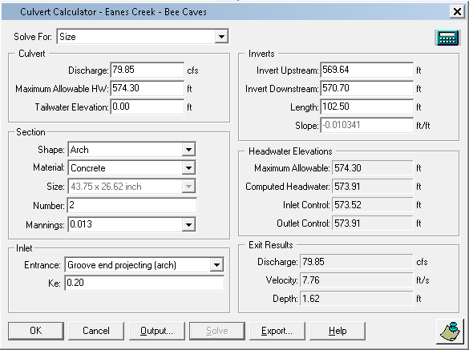
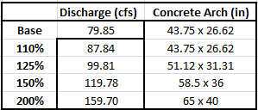
Option 2 - Concrete Arch Culvert Analysis

Slide 15
Option 3 - Aluminum Arch Culvert Layout
Dimensions for 125% discharge
Size: 54 x 41 c in.
Inlet entrance: Thin wall projecting

Slide 16
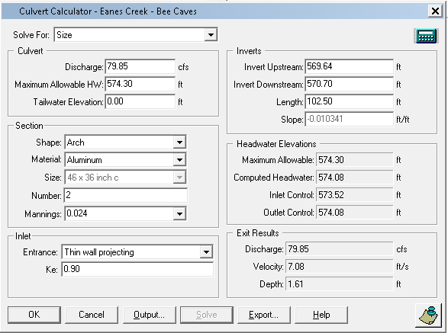
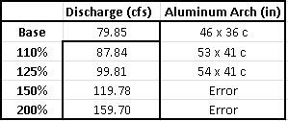
Option 3 - Aluminum Arch Culvert Analysis

Slide 17
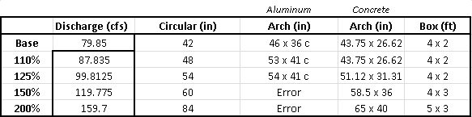
Summary Table

Slide 18
Decision Summary
Current status:
aluminum circular culvert
42 in
Q: 79.85 cfs
Option 1:
concrete
box culvert
4 x 2 ft
Q: 99.81 cfs
Option 2:
concrete
arch culvert
51.12 x 31.31 in
Q: 99.81 cfs
Option 3:
aluminum
arch culvert
54 x 41 c in
Q: 99.81 cfs

Slide 19
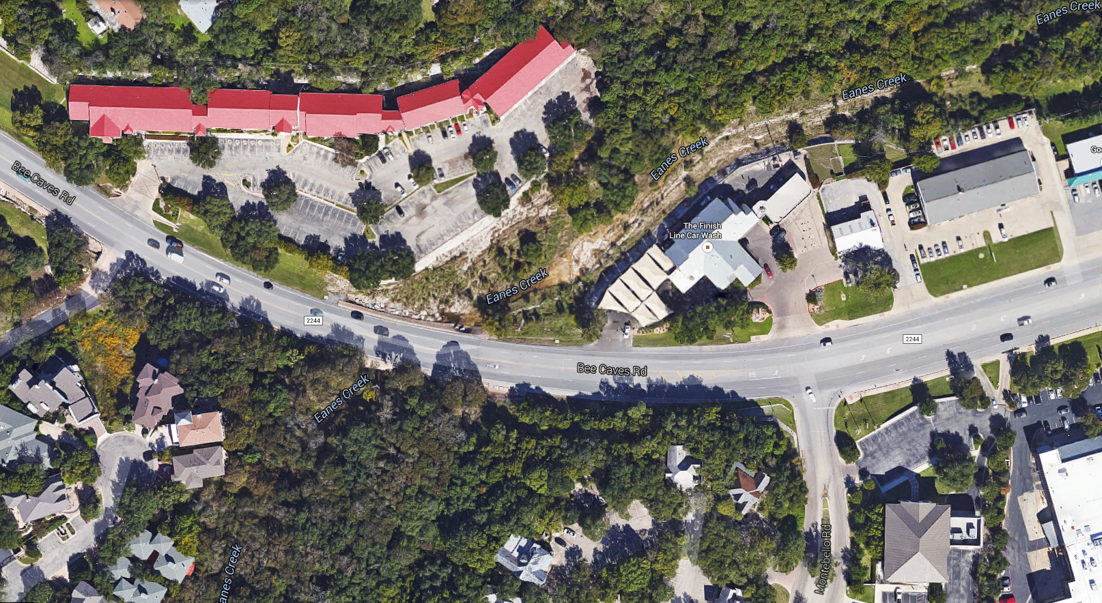
Questions?

