Slide 1

Water Quality
Improvements
Along Waller Creek
By: Molly Coffman, Mona Lotfi, Sandra Nadira & Jeff Nagy
Notes:
Our project is concerning improving the water quality in Waller Creek.

Slide 2
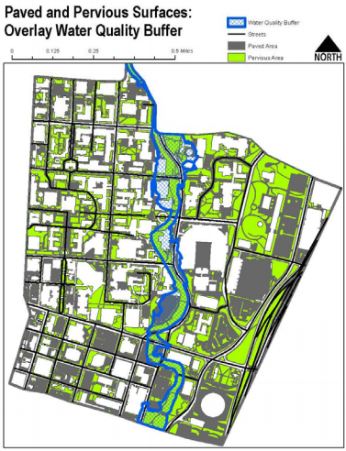
Design Problem
High Amount of Impervious Cover
Waller Creek on EPA 303 (d) List of Impaired Water Bodies
Notes:
Our design problem focuses on 2 main areas:
The UT campus has a high amount of impervious cover, as seen in this picture to the right. This impervious cover is undesirable, as it leads to increased runoff into surrounding areas, including Waller Creek. The runoff from the streets on campus is polluted, which increases pollution levels in the segment of Waller Creek that runs through campus.
This has become such a problem that Waller Creek is on the EPA’s 303 d list of impaired water bodies.
Our proposition for reducing the impervious cover on campus is to install permeable pavement parking stalls along a segment of San Jacinto Blvd, that runs parallel to Waller Creek. This will be discussed in further detail later on in this presentation.

Slide 3
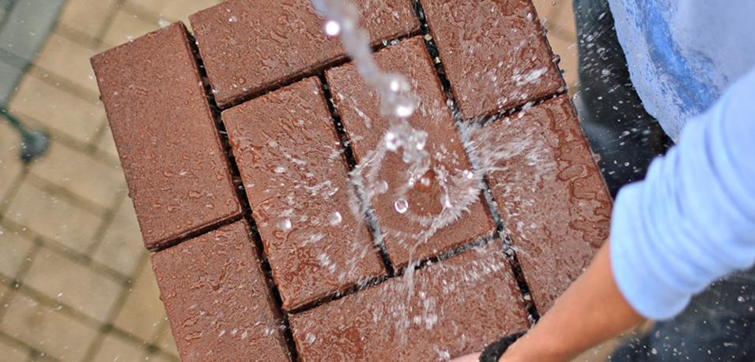
Objectives
Reduce Impervious Cover
  Reduce Total Runoff
Capture “First Flush” Runoff
  Improve Water Quality in Waller Creek
Improve Aesthetics
  Assist in UT’s Master Plan to Transform and Restore Waller Creek Area
Notes:
Our project has three main objectives.
Installing permeable pavement on campus would reduce impervious cover, thereby reducing total runoff into the creek.
The pavement we design would be able to capture the first inch of rainfall. This is known as the “first flush” and is considered to be the most polluted portion of rainfall. Capturing it would reducing the pollution levels in Waller Creek.
These parking stalls are aesthetically pleasing, which would assist in UT’s master plan to not only restore Waller Creek, but do so while keeping aesthetics in mind.

Slide 4
Select location
Research
Existing conditions
Design cross section
Post changes conditions
Compare results
Meet objectives?
N
Done
Y

Slide 5

Design Approach
Select Appropriate Location
  San Jacinto Parking Stalls
Determine Hydraulic Model
  SCS Method vs. Rational Method
  Design Storm: Type III, 25-year, 24-hour
  Measure Area, Length, Slope Using GIS and CAD
Compute Existing and Post Hydrograph
  HEC-HMS, Permeable Design Pro, Arc gis & Microstation
Notes:
“After we established the process we would follow, we had some decisions to make. First, we chose our area of study. We focused our search on areas of campus that not only needed improvement, but also were an obvious source of pollution. We selected San Jacinto as our street of interest, and in a bit I’ll talk about why”
“Next, we needed to consider how we were going to model this area and its performance during rainfall events. We selected HEC-HMS as our preferred program because of its versatility. Since HMS allows us to choose the method used for analysis of a catchment, we chose to use the SCS method so we could have a time distribution of our storm runoff. Since we were advised to model a Type III, 25-yr, 24 hour storm, all that we needed to proceed with our modeling was the geometric characteristics of our area of study which we measured using ArcGIS and AutoCAD.”
“Finally, we needed to decide how we were going to measure the success of our project. We decided that by comparing the hydrograph of the existing conditions to the hydrograph of our recommended post conditions we could effectively quantify the impact of our design. In order to prepare this analysis, we used HEC-HMS, Permeable design Pro, ArcGIS, and Microstation. We will go more in depth on what each of these programs were used for later on.”

Slide 6
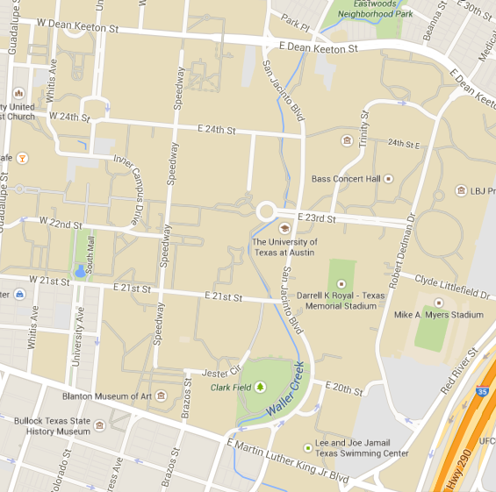
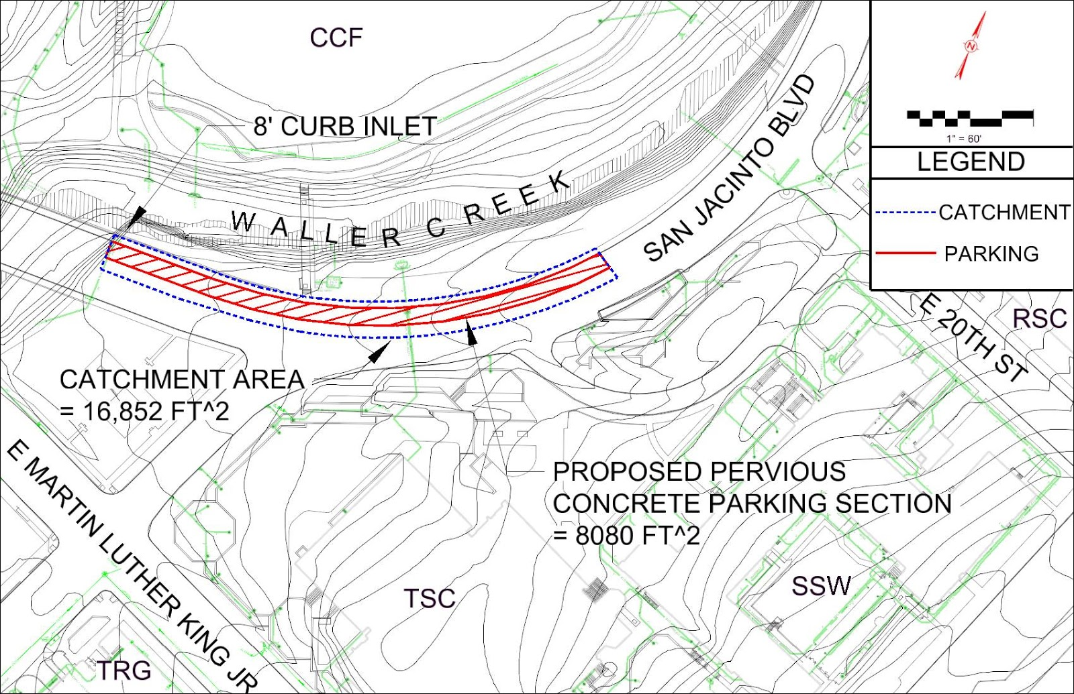

Study Area
Notes:
“We considered various locations on campus and ultimately decided to focus our efforts on this stretch of San Jacinto Boulevard between 20th street and Martin Luther King Jr Boulevard because of its proximity to Waller Creek and because of the parking spots that line the street in this area”
“Here is a closer look at our area of study. As I stated earlier, the proximity of our area of study to Waller Creek was a major motivator for our selection of this part of campus. This is a microstation map of our area which includes elevation contours, street labels, and identifies the curb inlet where our area drains to. We measured our catchment area and our pavement area at this point to determine the possible impact of our study”

Slide 7
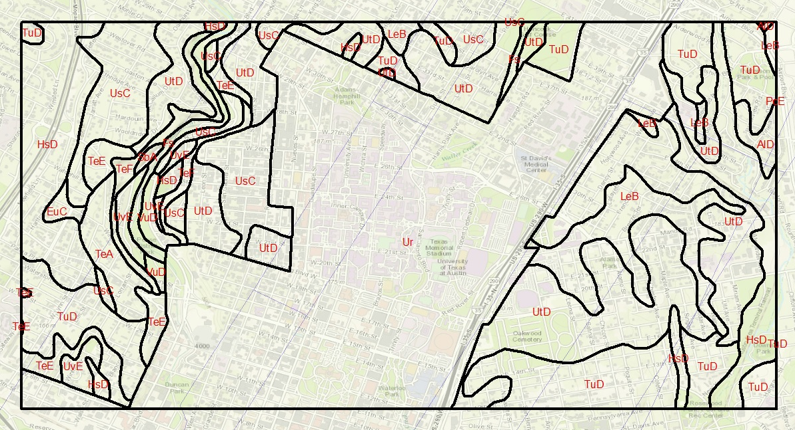
research
Data Gathering
TNRIS
USGS
Web Soil Service
Findings
Soil Type: D
Land Cover: Urban
Notes:
“This is a map that was developed using ArcGIS. We downloaded shapefiles from USGS, Web Soil Survey, and TNRIS containing soil type and land use data. We intersected the two shapefiles and calculated the weighted curve number of our existing area of study. The curve number was used for input to HMS for our existing condition analysis and then later into Design Pro as the subgrade layer. We found that our area of study’s land cover was calssified as “Urban Land” and that our soil type was D”

Slide 8
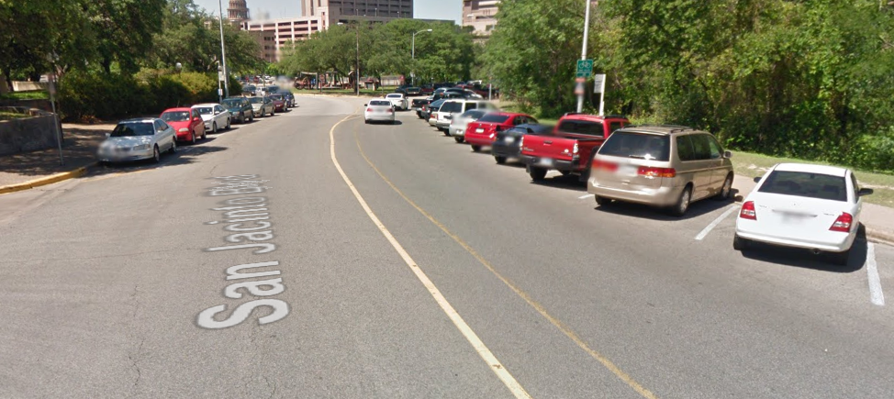
Existing Conditions
CN=98 For Paved Surfaces
High amount of Rainfall Runoff into Creek

Slide 9
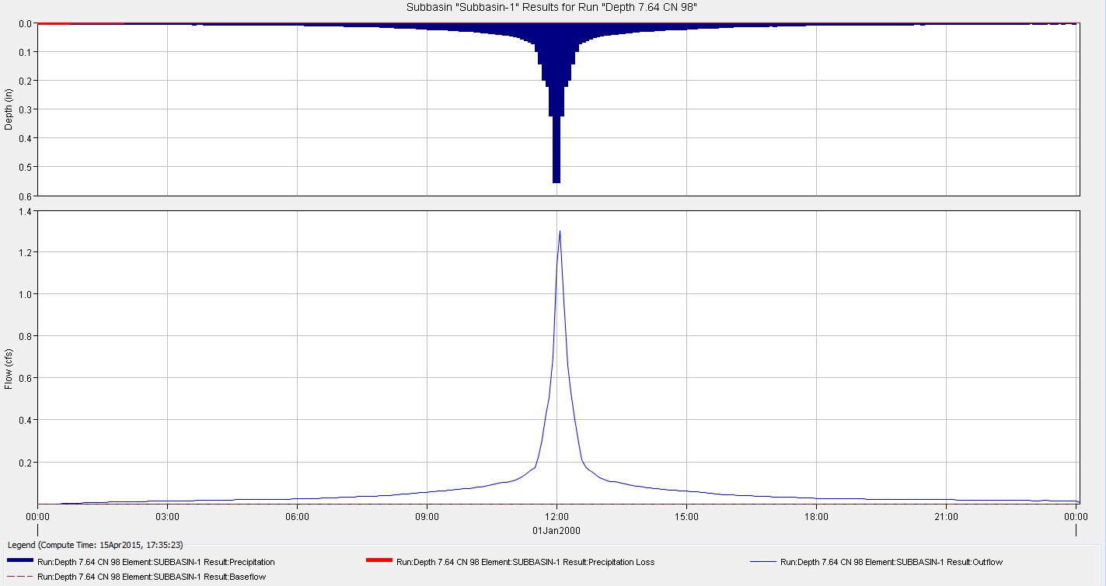
HEC-HMS Results - Existing
CN=98 P=7.64”
Notes:
In this slide, the flow and depth are shown for the base case (prior to adjusting the pavement type along. As you can see, the peak flow is 1.3 cfs and the depth is roughly 0.55 inches.

Slide 10
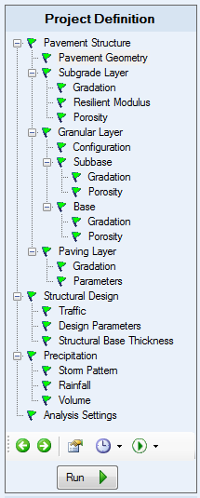
Permeable Pavement Software
Design inputs:
Pavement Geometry
Subgrade Layer
Base Layer and Subbase Layer Thickness
Traffic Category
Rainfall Pattern
Storm Return Period
Notes:
Molly: The software that we used to model the permeable pavement is called Permeable Design Pro, and is a product of the Interlocking Concrete Pavement Institute. The software required the input of the pavement geometry, the type of subgrade, and the depths of the base and subbase layers. In addition, we input the traffic category for the project, which was cars and light vehicles, and well as the rainfall pattern and the storm return period.

Slide 11
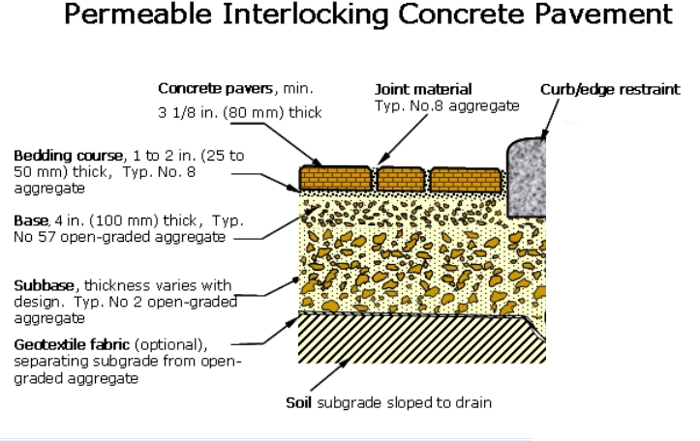
Software Input - Cross Section
(12 in.)
Notes:
The software produced a resulting average curve number of 82

Slide 12
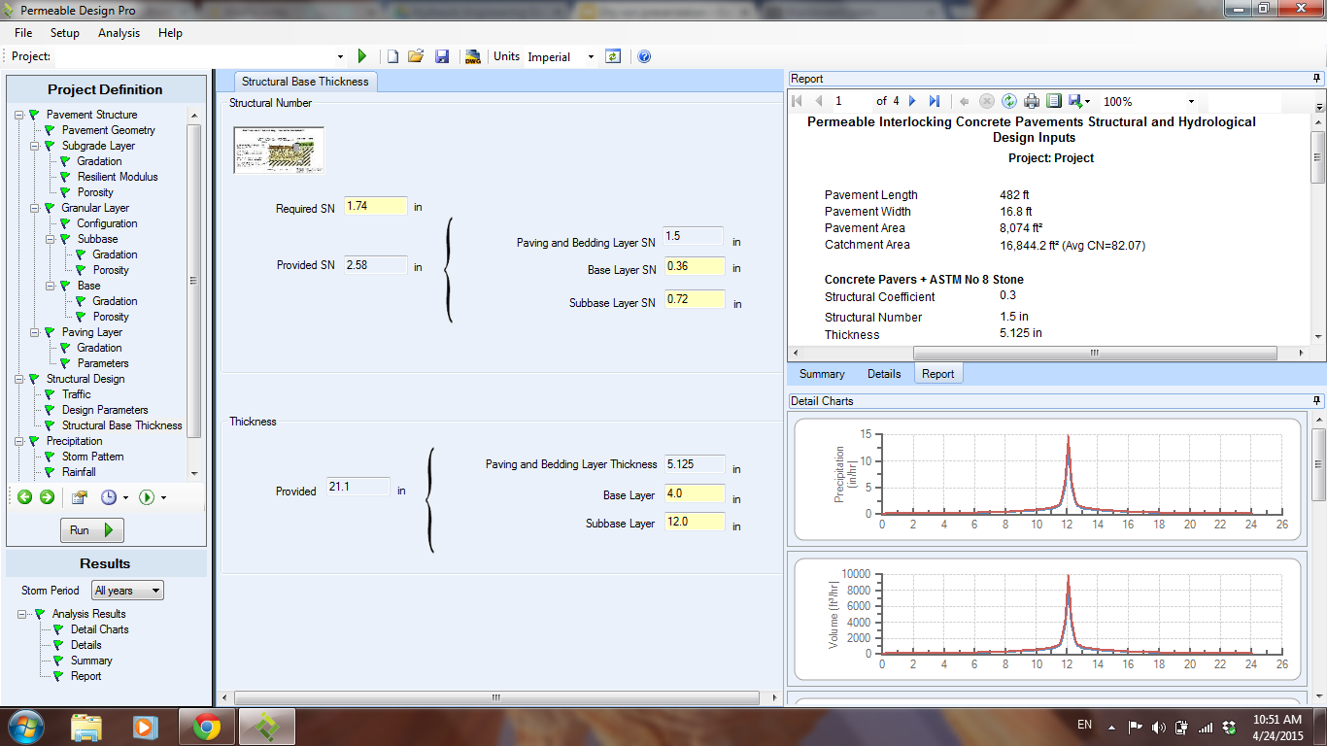
Software output
CN = 82

Slide 13
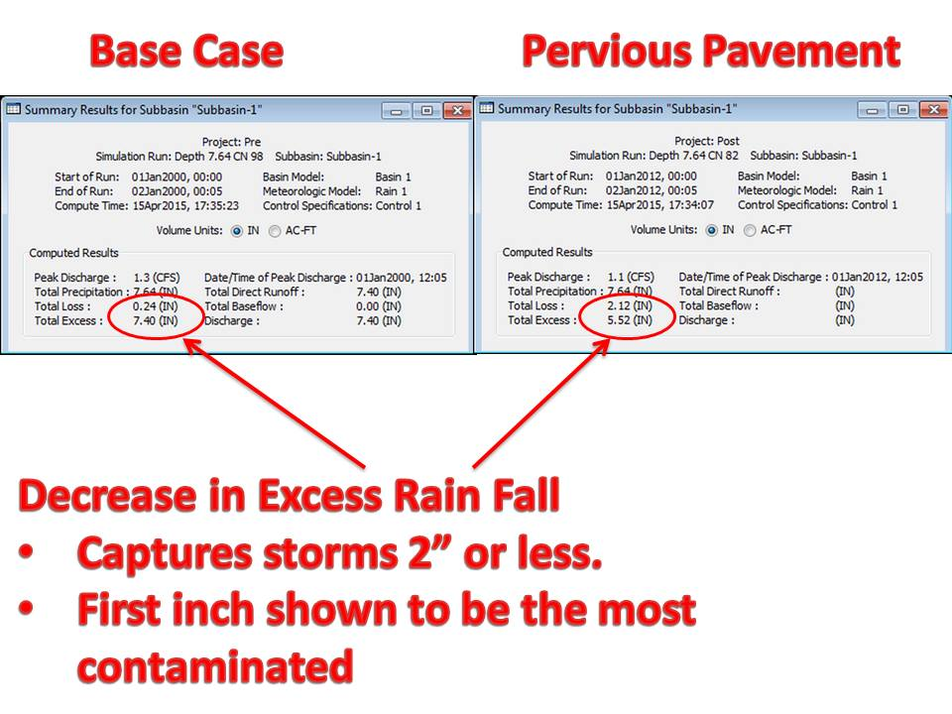
HEC-HMS Results
Notes:
For consistency, the graph and table again have their own slides, as in the “pre” slides.

Slide 14
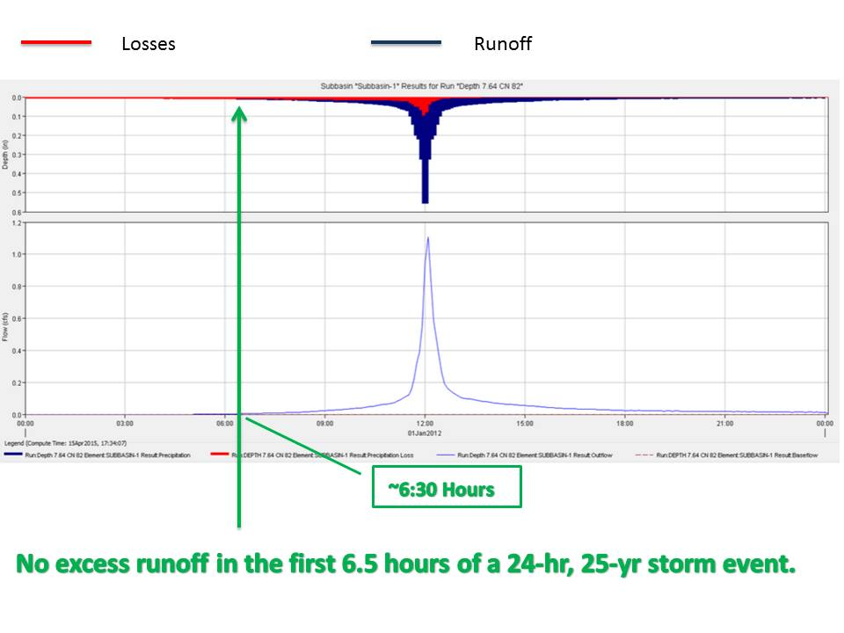
HEC-HMS Model - Proposed
Notes:
Again, here we can just say that after changing the parking spaces to pervious pavement, the max flow is 1.1 cfs and the depth is roughly .55 inches.

Slide 15
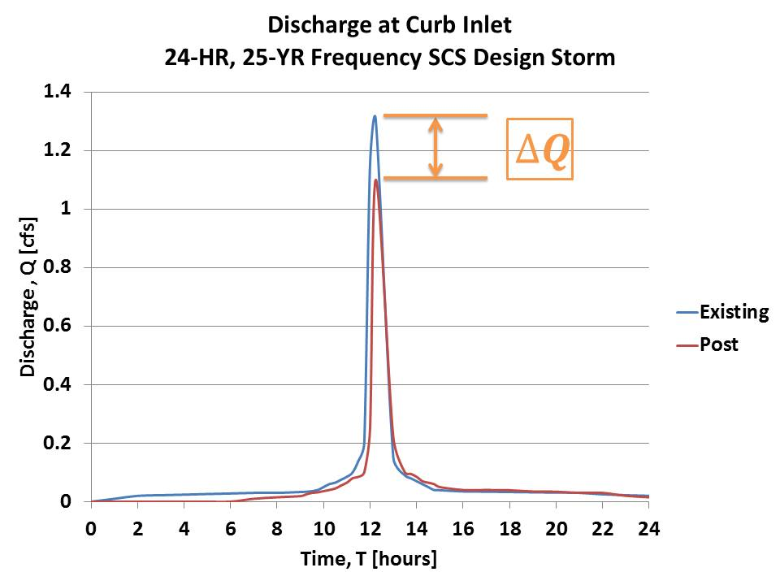
Discharge Hydrograph

Slide 16
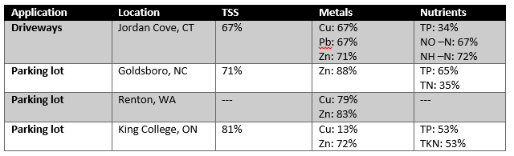
Case study of Pollutant Removal
*Source: EPA Interlocking concrete pavers result
Could Expect Similar Results With Proposed System
Notes:
The table above comes from the EPA Interlocking concrete pavers case study, which was done to determine improvements in pollution levels of water bodies surrounding permeable pavement surfaces. As can be seen, the percent reductions are significant. Though this case study was not performed on the segment we have examined here, we could expect similar results with the proposed system.
From the EPA-Water quality

Slide 17
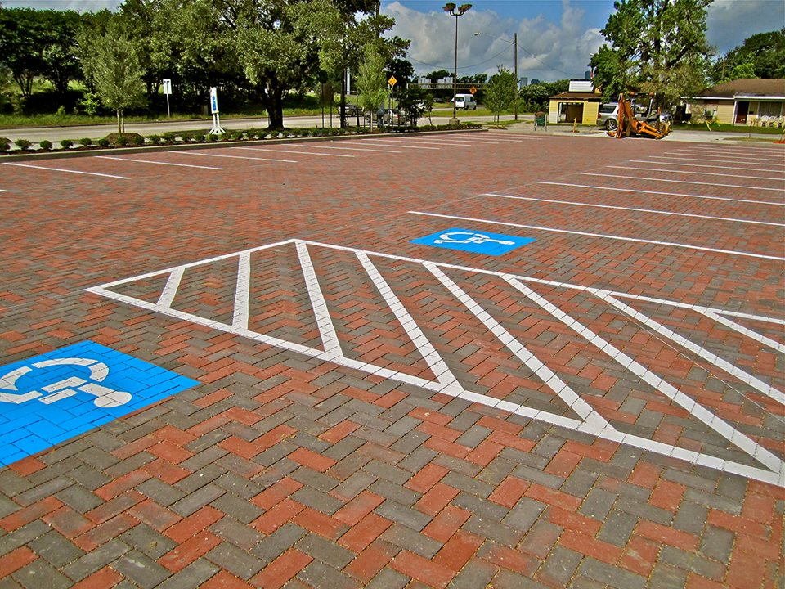
Significance
Proposed System Will:
  Reduce Impervious Cover
  Reduce Runoff
  Reduce Contamination
  Improve Aesthetics
Storm water “collection, detention and infiltration can be integrated as a design feature…If employed across the campus, this strategy would significantly reduce storm water runoff volume entering Waller Creek during storm events.” - UT Landscape Master plan and Design Guidelines 2014
Notes:
As mentioned before, the significance of this proposed system is that it will:
-reduce impervious cover
-reduce runoff
-reduce contamination due to runoff
-improve aesthetics.
The quote at the bottom of this slide comes directly from the UT Landscape Master plan. Our proposed system would serve not only to collect storm water and reduce pollution, but do so in a way that would enhance the UT campus. Although the study area examined here is a small portion of all the impervious parking spaces on campus, the success of this project would suggest that it would be beneficial to carry this throughout the rest of campus as well.

