Slide 1
AQUAPONIC GREENHOUSE
Robert Beckett, Lisa Ho, Zachary Irby, Peter Klayman
CE 365K – Spring 2015

Slide 2
Outline
Problem statement
Aquaponics
Design overview
Rainfall analysis
Pump schematics
Conclusion

Slide 3
Problem Statement
Increasing demand for water & food due to population growth
Diminishing arable soil & clean water
Diminishing supply of oil & mined mineral
FOOD SHORTAGES & RISING FOOD PRICES
=
Notes:
http://www.aquagardensfarm.com/sustainable-produce/

Slide 4
Aquaponics
Hydroponics [Soil-less growing of plants]
Aquaculture [Raising fish]
Notes:
http://theaquaponicsource.com/what-is-aquaponics/

Slide 5
Design Overview

Slide 6
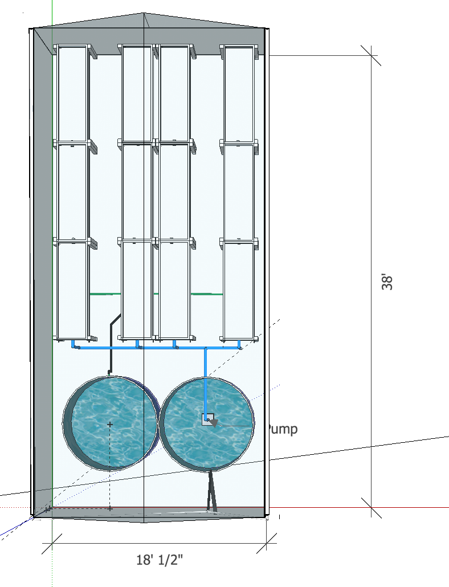
Plan View

Slide 7
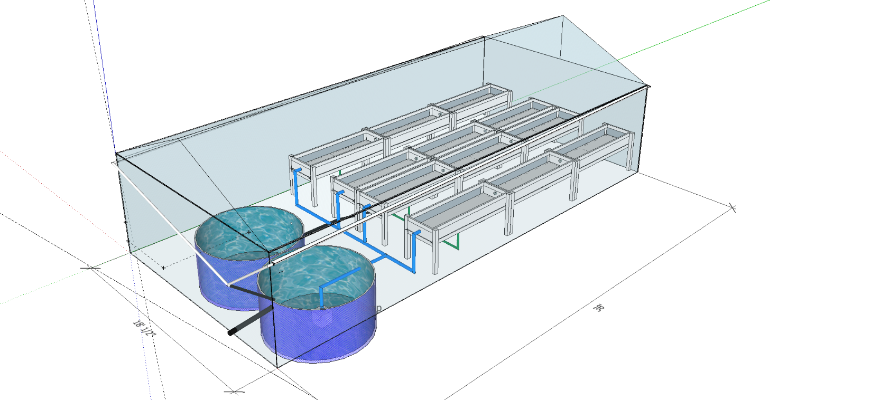
Side View

Slide 8
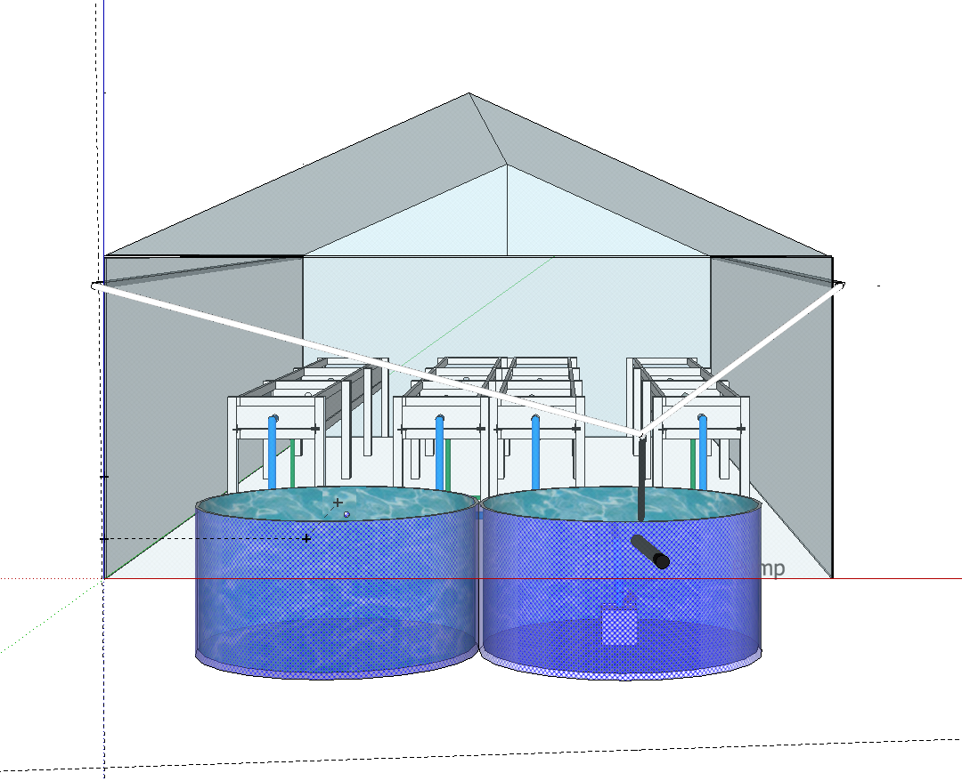
Tank Side View

Slide 9
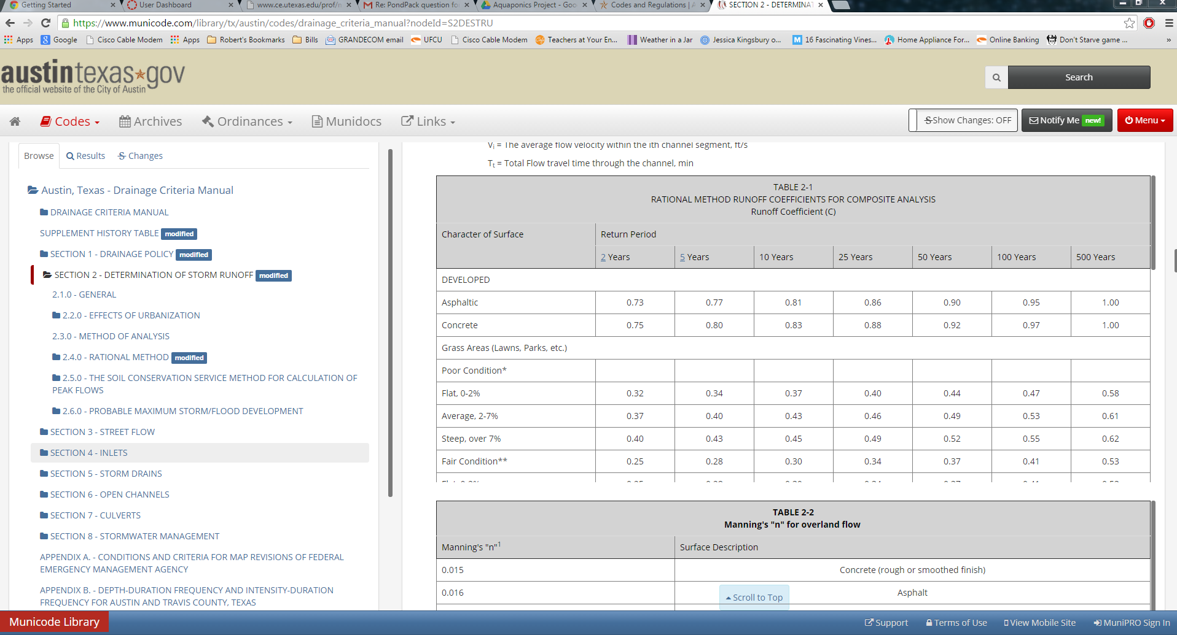
Rainfall Analysis
COA Drainage Criteria Manual – 50 Year Storm

Slide 10
Rainfall Analysis
COA Drainage Criteria Manual: IDF Table IDF Curve Equation

Slide 11
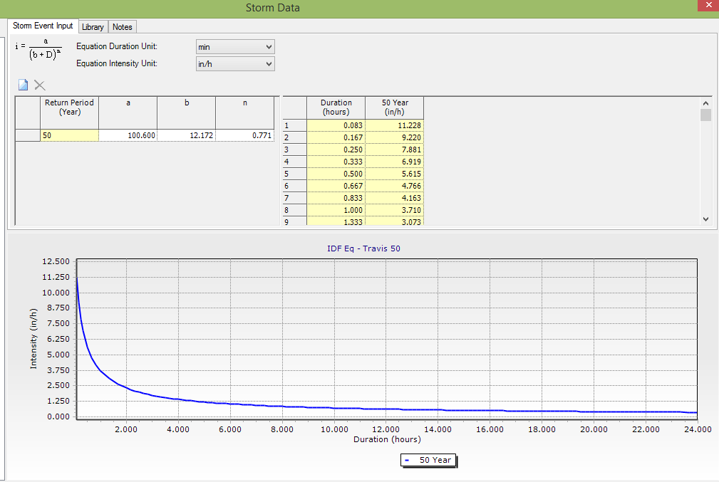
Rainfall Analysis
COA Drainage Criteria Manual:
Time-Depth Table

Slide 12
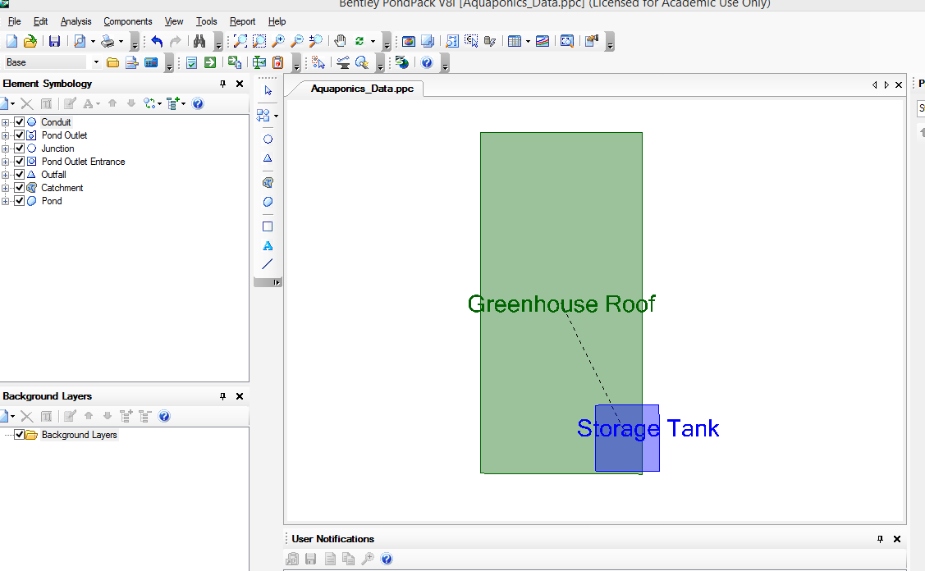
Rainfall Analysis
Roof Area = “Catchment”
Storage Tank = “Pond”

Slide 13
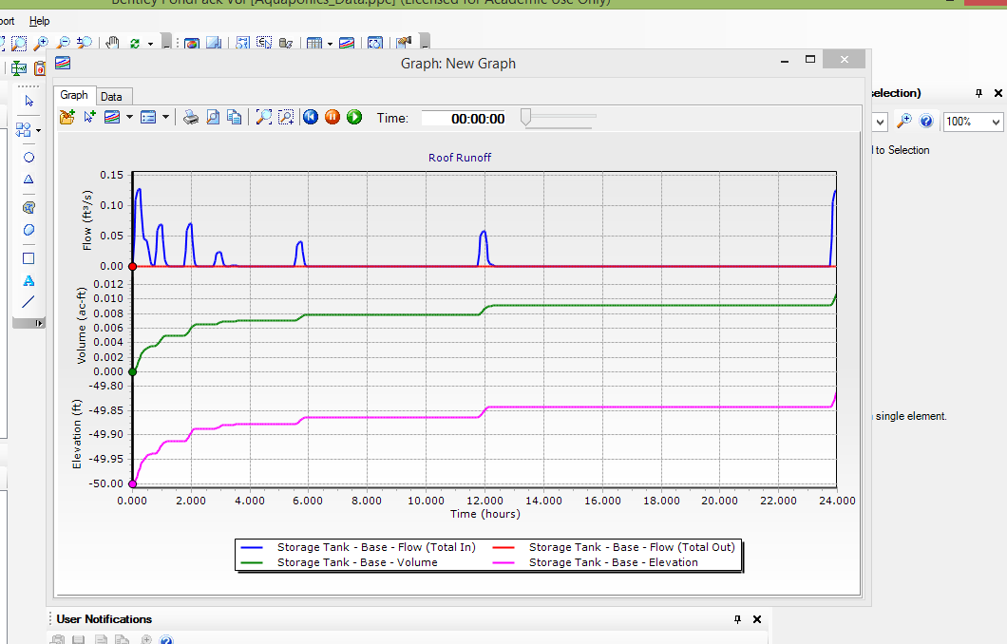
Rainfall Analysis

Slide 14
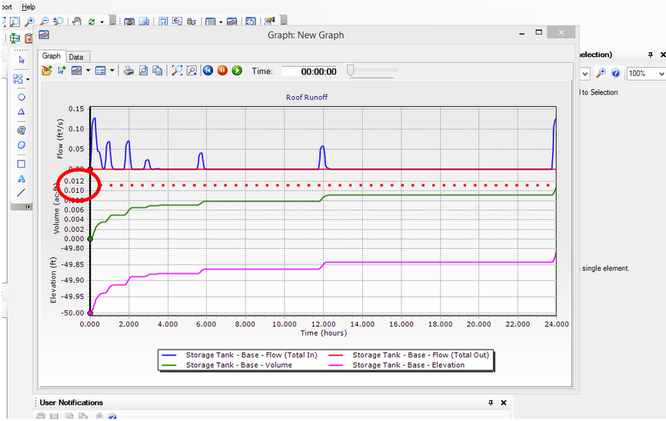
Rainfall Analysis
0.0116 acre-ft = 3793 gal

Slide 15
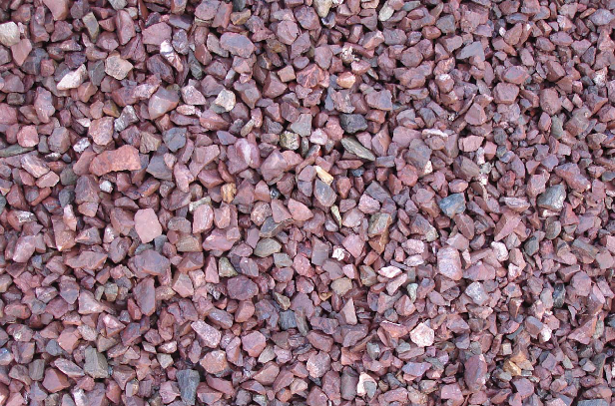
Design Pumpflow
Media filter bed
Max inflow velocity = 2 gal/min
9” water height (3/4 of bed height)
Media used: Pink granite
Porosity = 0.3
Beds flooded once an hour
Due to fish tank (1 lb. per 2 gal.)
Media-filled system
Crushed pink granite

Slide 16
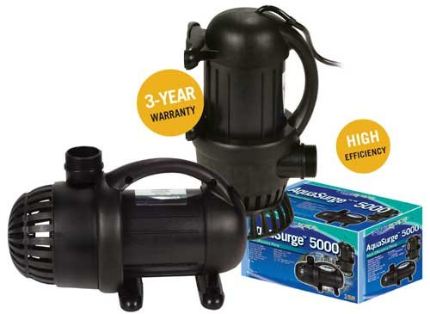
Pump Schematics
400 gallon system (w/ media)
Vertical pump height needed: 8’
Works with fish tank
Decision: Aquascape model 98125
Uses no oil
Can be ran 24/7
27’ max head with 2,500 gph

Slide 17
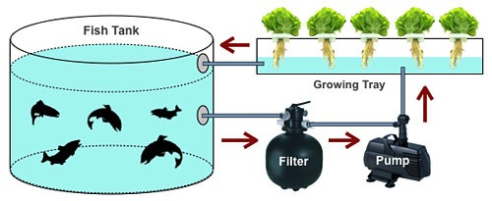
Pump Analysis
Model 98125 Specs
35 gal/min with 7.5’ vertical pump height
Our 400 gallon system
11.5 minutes to fully drain system
Simplified System

Slide 18
Advantages
Compared to conventional agriculture:
Produces 4 to 10 times more vegetables
Uses 90% less water
No need for soil or regular farmland
Only inputs are fish food & electricity
Naturally organic
Notes:
http://www.aquagardensfarm.com/aquaponic-advantages/

Slide 19
Conclusion
Decision:
Aquascape model 98125
400 gallon system

Slide 20
Questions?

